Slide 1

FEA REPORT
Static Structural Analysis Of Guillotine Gate & Frame
Report No.: MWI/FEA/ACK-6179/01
Date: 4th Sept 2026
Client: SILVERTONE

Slide 2
1. Material Properties
Material | Item | Young's Modulus (MPa) | Poisson's Ratio | Density (t/mm³) | Yield Stress (MPa) | Allowable Von-Mises Stress (MPa)
IS 2062 | Duct | 191400 | 0.3 | 7.8E-9 | 213 | 163
Units: Length = mm, Mass = tonnes, Time = second, Force = Newton
Allowable Von-Mises Stress:
σall = Syt / FOS
FOS = 1.3

Slide 3
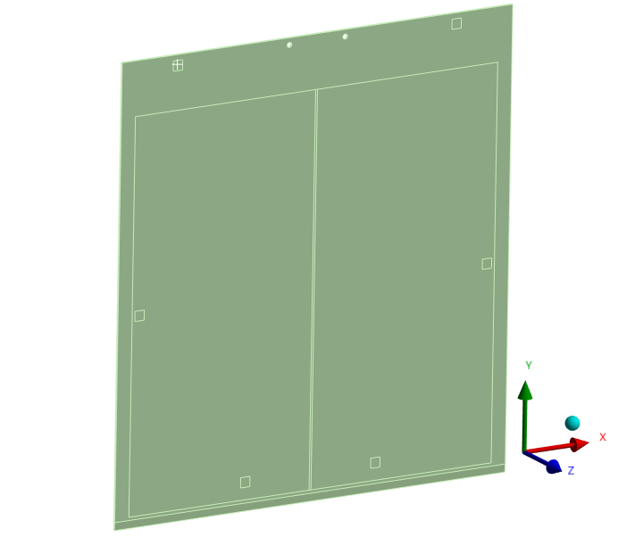
2. GG Geometry

Slide 4
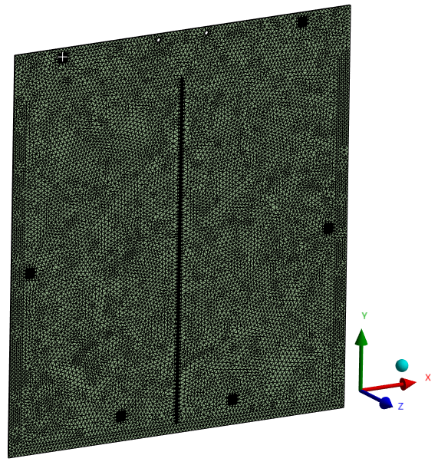
3. GG Mesh

Slide 5
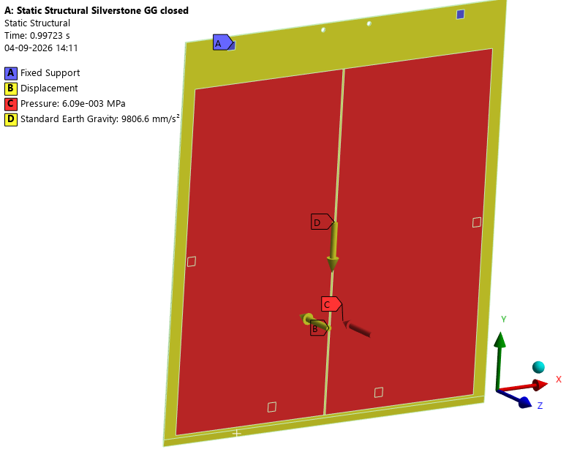
Case 1: Guillotine Gate Fully Closed (Self Weight + Pressure)
Boundary Conditions
Roller contact area is been Fixed.
Free Displacements of 2 mm in Z Direction.
Design pressure 621.47mmWC applied which is 0.00609 MPa.
self weight considered.
Note:
This load case is at the working temperature of 210°C.
Boundary conditions were applied to match the physical constraints of the geometry.

Slide 6
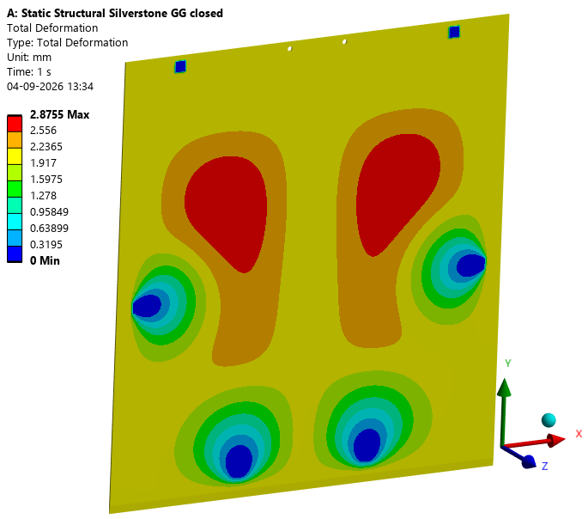
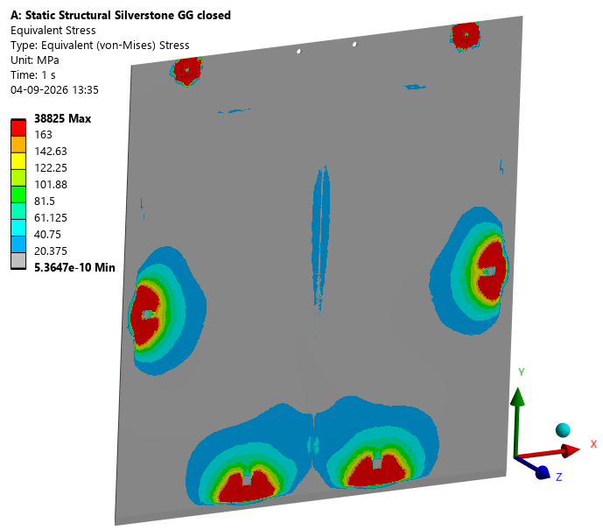
Total Deformation
Total deformation
Von-mises stress
Maximum Total Deformation 3 mm
The stress exceeds the materials allowable limit of 163 MPa.

Slide 7
Observation & Summary
• Total deformation in the GG is 3 mm.
• Von-Mises stress in the GG exceeds the materials allowable stress limit of 163 MPa.
• Therefore, the GG is structurally inadequate to withstand the applied load under this load case. Need to take corrective actions.

Slide 8
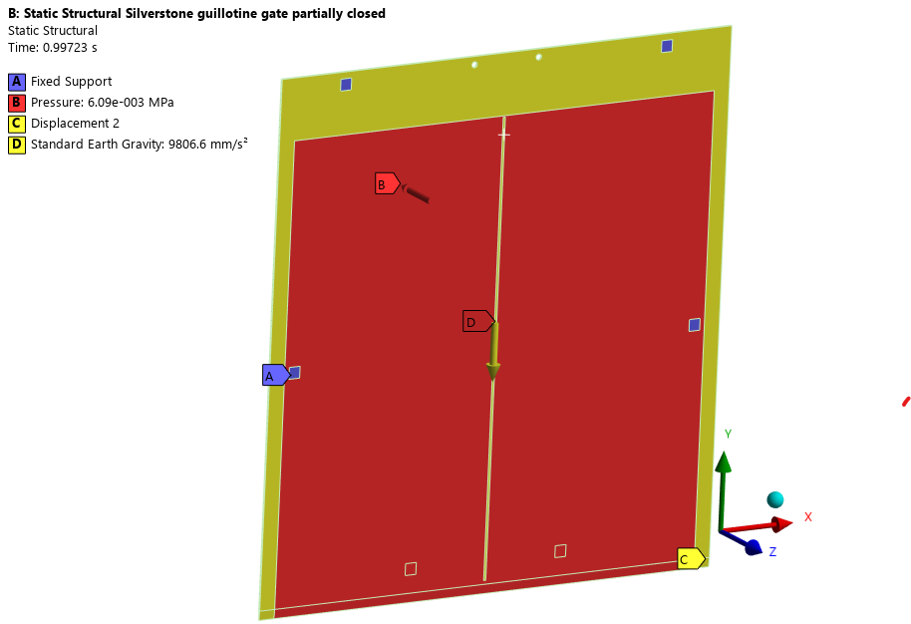
Case 2: Guillotine Gate Partially Closed (Self Weight + Pressure)
Boundary Conditions
Roller contact area is been Fixed.
Design pressure 621.47mmWC applied which is 0.00609 MPa.
Free Displacements of 2 mm in Z Direction.
Self weight considered

Slide 9
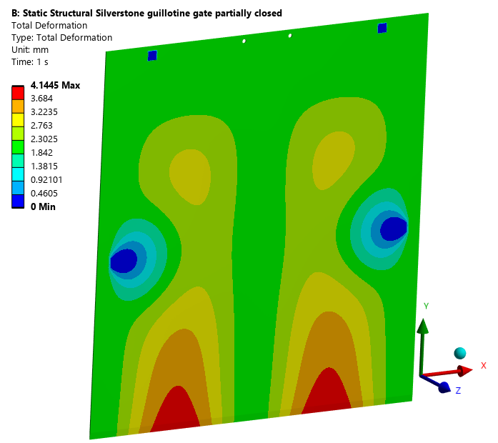
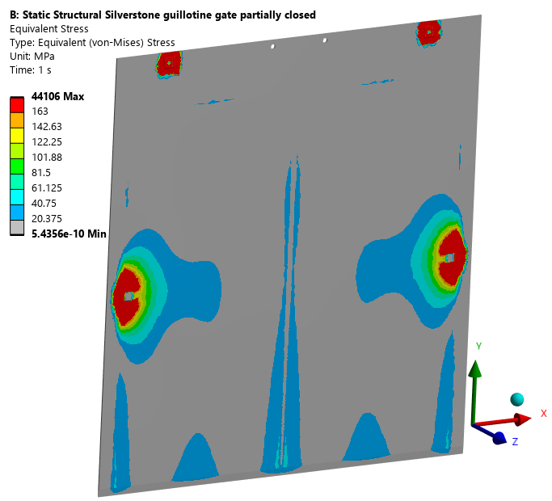
Results
Total deformation
Von-mises stress
Maximum Total Deformation – 4 mm
The stress exceeds the materials allowable limit of 163 MPa.

Slide 10
Case 2: Observation & Summary
• Total deformation in the GG is 4 mm.
• Von-Mises stress in the GG exceeds the materials allowable stress limit of 163 MPa.
• Therefore, the GG is structurally inadequate to withstand the applied load under this load case. Need to take corrective actions.

Slide 11
Final Summary
Load Case | Max. Deformation | Max. Von-Mises Stress | Allowable Stress
Case – GG Fully closed | 3 mm | Exceeding Limit | 163 MPa
Case – GG Partially closed | 4 mm | Exceeding Limit | 163 MPa

