Slide 1
Team Dreamers (Department of CSE, BUET)
Team Members: Hasanur Rahman Hasan Md. Mirajul Islam Rifat Rubaytul Islam Samiul Mushfik Yasin Islam Mentor: Seyed Mosayeb Alam

Slide 2

iDoc
Target users: Anyone who wants to keep a healthier life

Slide 3

Problems
Unavailability of doctors
Fees of doctors and disease diagnosis
Need for immediate treatment
Distance to the medical or doctor chamber
Time constraint
Lack of follow up information for chronic diseases
For example: asthma, diabetes, cardiac failure etc.

Slide 4
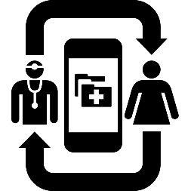










Our Solution
Chronic Disease Follow Up
Disease Prediction
(training AI bot)
Screens
iDoc
Maternity Tips
Android App
USSD App
Reference for Doctor
First Aid Tips
Screens

Slide 5
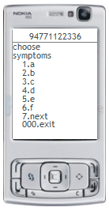
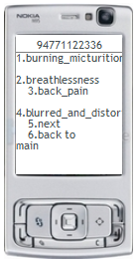
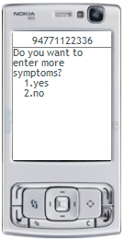
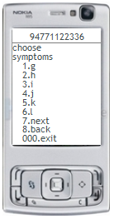
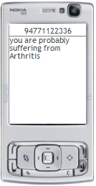
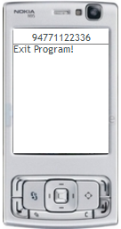
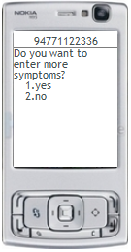
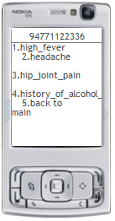
Disease Prediction via USSD
1
2
3
4
8
7
6
5
You can consult Dr. Md, Sharif @
BIRDEM ,
Tel: 020264329746

Slide 6
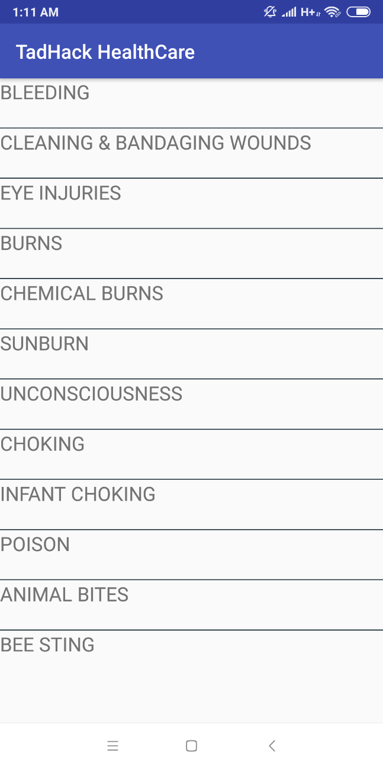
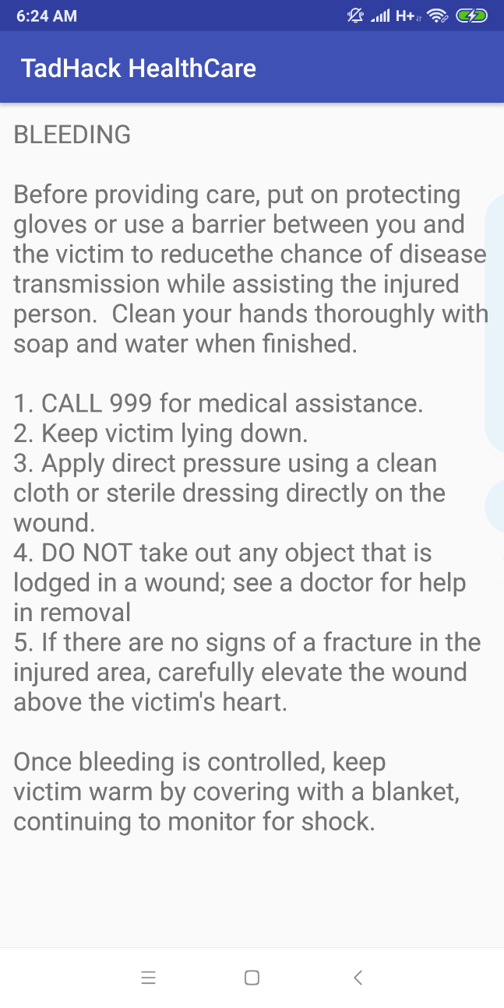
First Aid Tips via Android
1
2

Slide 7
Pregnancy Tips
Your Pregnancy Clinic is due on 20-10-2018.
Please schedule with Doctor.
Your Rubella Vaccination is due on 25-10-2018.
Please schedule with Doctor.
This is your 8th week in pregnancy. You have to start take more foods now.
Get 20% discount for all infants products from wallstreet supermarkets.
Your Promo Code : RTIBS

Slide 8
Chronic Disease Follow Up
Check your sugar level on the morning at 10:00 am.
Take your insulin at 2:00 pm.
You can take sugar free biscuits at your afternoon breakfast.
Go for a walk on 5:00 pm today.

Slide 9

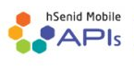

Our Technologies
Machine Learning
Telco API
AI bot for disease prediction
A dataset of University of Columbia containing the mapping of symptoms to diseases was used to train the bot
USSD API (for cellular phone users)
SMS API (for sending message from server to customer)
CAAS API (for subscription charges)

Slide 10
Our Roadmap
Chronic disease follow up
Maternity Tips
Doctor References
Disease Prediction & First Aid Tips
Oct ‘18 Dec ‘18 Feb ‘19 April ’19

Slide 11
Financial Plan
 | Nov 2018 | Dec 2018 | Jan 2019 | Feb 2019 | Mar 2019
Expected User Base from Disease Prediction ( 20 BDT for each req. ) | 200 | 500 | 1000 | 2000 | 4000
Expected User Base from First Aid Tips Consumers (50 BDT/per month ) | 300 | 750 | 2500 | 5000 | 10000
Expected Doctors to be on boarded (1000 BDT/per month ) |  | 20 | 100 | 250 | 500
Expected User Base from Maternity Tips (50 BDT/per month ) |  |  |  | 500 | 2500
Revenue | 19000 | 67500 | 245000 | 565000 | 1205000
Marketing Budget | 20000 | 25000 | 25000 | 25000 | 30000
Operational Budget | 20000 | 20000 | 20000 | 20000 | 30000
Expected Profit | (-) 21000 | 22500 | 200000 | 520000 | 1145000

Slide 12
Thank You!

