Slide 1

Vel Tech Rangarajan Dr. Sagunthala R&D Institute of Science and Technology
School of Computing
Department of Computer Science and Engineering
10211CS224 / FULL STACK APPLICATION DEVELOPMENT (JAVA)
PROJECT REVIEW : 02
Date: 17-04-2026
Smart Campus Event Management System
Presented By:
KESARA YASWANTH REDDY – VTU26049 – 23UECS0274
Courses Handling Faculty:
Dr.Hafizur Rahman -Assistant Professor

Slide 2
INTRODUCTION
In today’s fast-paced college environment, students often miss important updates due to scattered communication channels like notice boards, WhatsApp groups, and emails.
“Information delayed is information denied.” This quote reflects the challenge many institutions face in keeping students informed in real time.
The lack of a unified communication system leads to confusion, missed events, and reduced participation in academic and extracurricular activities.
To solve this issue, our project introduces a Smart Campus Event Management System a centralized platform that streamlines all campus-related updates.
The portal allows administrators to post news, event details, and announcements efficiently, while students can easily access, search, and filter the information they need.
For example, instead of checking multiple sources, a student can simply log in to the portal and view all recent updates from their department, clubs, or college administration.
This project aims to bridge the communication gap and enhance engagement, transparency, and connectivity within the college community.
1
2
3
4
5
6
7
8
9

Slide 3
PROBLEM STATEMENT
Modern educational institutions host numerous events such as seminars, workshops, cultural programs, hackathons, and sports activities. Managing these events manually often leads to inefficiencies, miscommunication, and poor participation. Students and staff face challenges in discovering relevant events, registering seamlessly, and receiving timely updates. Organizers struggle with resource allocation, attendance tracking, and feedback collection.
The absence of a centralized, intelligent system results in:
Fragmented communication across multiple platforms (emails, notice boards, social media).
Difficulty in scheduling events without clashes.
Limited visibility of upcoming events for students and faculty.
Manual registration and attendance processes that are time-consuming and error-prone.
Lack of data-driven insights for improving future events.
1
2
3
4
5
6
7
8
9

Slide 4
OBJECTIVE(S)
1
2
Aim of the Project:
To design and develop a centralized and secure Smart Campus Event Management System that simplifies campus communication by providing students and faculty with a single platform for accessing and managing news, events, and announcements in real time.Scope of the Project:Provides an accessible and responsive digital portal for students and staff to view college updates anytime, anywhere.Allows administrators to post, edit, and manage content securely through an authenticated system.Supports features like search, filters, and categorization to enhance user experience.Encourages transparency, faster communication, and improved engagement within the college community.
3
4
5
6
7
8
9

Slide 5
PROPOSED SYSTEM
1
Centralized Event Portal A single platform accessible via web and mobile apps where students, faculty, and organizers can view, register, and manage events.
Smart Scheduling & Resource Management Automated scheduling to avoid clashes, with resource allocation (venues, equipment, staff) optimized through the system.
Digital Registration & Attendance Online registration with QR codes, RFID, or biometric integration for seamless check‑in and attendance tracking.
Real‑Time Notifications Push notifications, emails, and SMS alerts for event updates, reminders, and last‑minute changes.
Role‑Based Access Control Different interfaces for students, faculty, and administrators to ensure secure and relevant access.
Integration with Campus Systems Links with existing student information systems, calendars, and communication platforms for smooth interoperability.
2
3
4
5
6
7
8
9

Slide 6
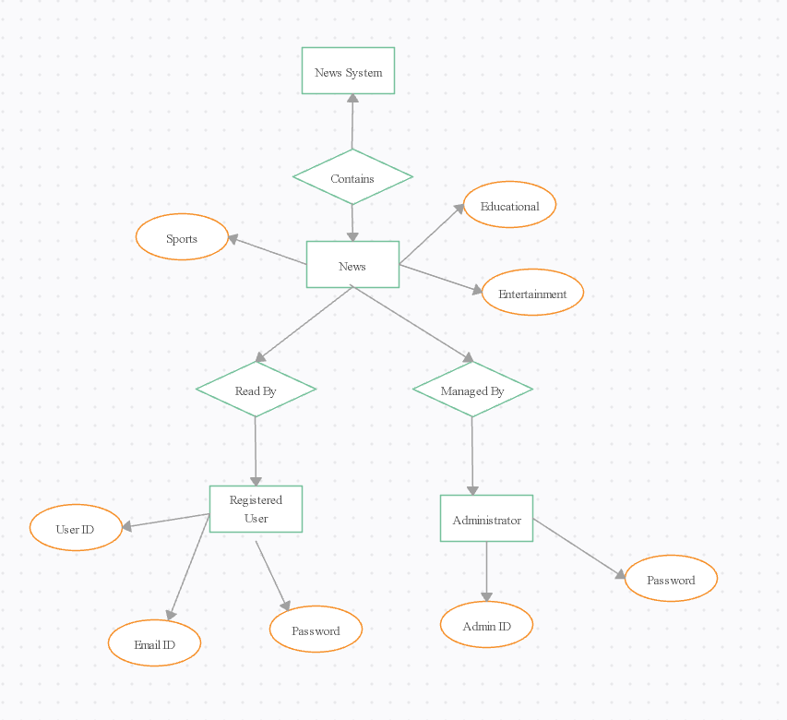
PROPOSED SYSTEM ARCHITECTURE
The system is centered around the "News" entity, which contains different categories of news such as Sports, Educational, and Entertainment, as shown by the oval nodes connected to "News".image.jpg​
The "News" entity relates to users in two main roles: "Registered User" (who reads news) and "Administrator" (who manages news),
depicted by connecting lines and diamond-shaped relationship
nodes.image.jpg​
Each "Registered User" is defined by several attributes:
User ID, Email ID, and Password, while the
"Administrator" has attributes Admin ID and Password,
indicating the need for authentication and user management
in the system.image.jpg​
1
2
3
4
5
6
7
8
9

Slide 7
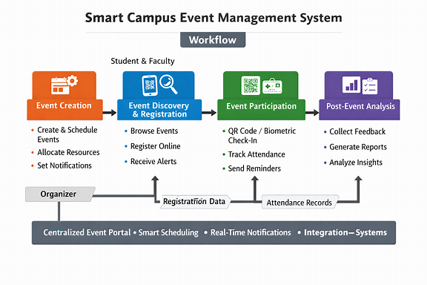
WORKFLOW
1
2
3
4
5
6
7
8
9

Slide 8
TECHNOLOGIES USED
1
Frontend: HTML5, CSS3, JavaScript for responsive UI and dashboards.
Backend: PHP 8 (core PHP) for business logic, authentication, and role-based access.
Database: MySQL for storing users, courses, lessons, enrollments, progress, and reviews.
Tools: XAMPP (Apache, PHP, MySQL), phpMyAdmin for DB management, VS Code for coding, browser dev tools for testing UI.
Hardware Requirements: Standard PC or laptop with at least 4 GB RAM, modern web browser, and local server environment.
Software Requirements: Windows OS, XAMPP stack installed, modern browser (Chrome/Edge), and code editor (VS Code/ Sublime)
2
3
4
5
6
7
8
9

Slide 9
MODULE DESCRIPTION
MODULE 1: Student Interface Design Displays campus news, events, and announcements in a clean, responsive layout accessible to all students.
MODULE 2: Admin Panel & Authentication Secure login system for authorized administrators to manage posts, categories, and event details.
MODULE 3: Search and Filter System Enables students to quickly find news using keywords, dates, or categories for efficient browsing.
MODULE 4: Secure Authentication & Session Management Protects admin accounts with password hashing, validation, and role-based access control.
MODULE 5: Database Management System Stores and retrieves all posts, user details, and categories using MySQL for data consistency and reliability.
MODULE 6: Responsive Frontend Development Implements adaptive UI/UX using HTML, CSS, and JavaScript, ensuring compatibility across mobile, tablet, and desktop devices.
MODULE 7: Testing and Deployment Involves functional, security, and usability testing; followed by hosting on a local or cloud server for deployment.
1
2
3
4
5
6
7
8
9

Slide 10
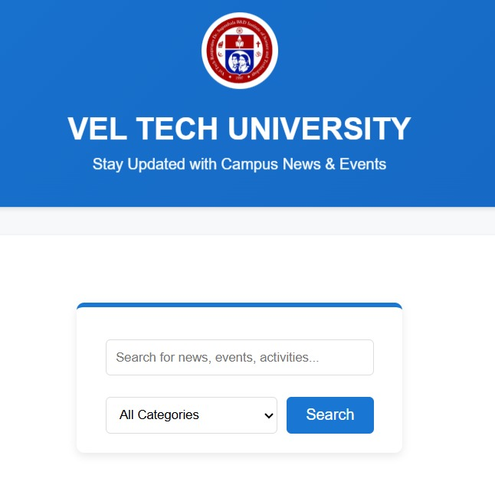
IMPLEMENTATION SCREENSHOTS
Home Page:
Displays featured courses, trending categories, and a modern hero section that introduces the Skill Learning Academy platform to users.
1
2
3
4
5
6
7
8(A)
9

Slide 11
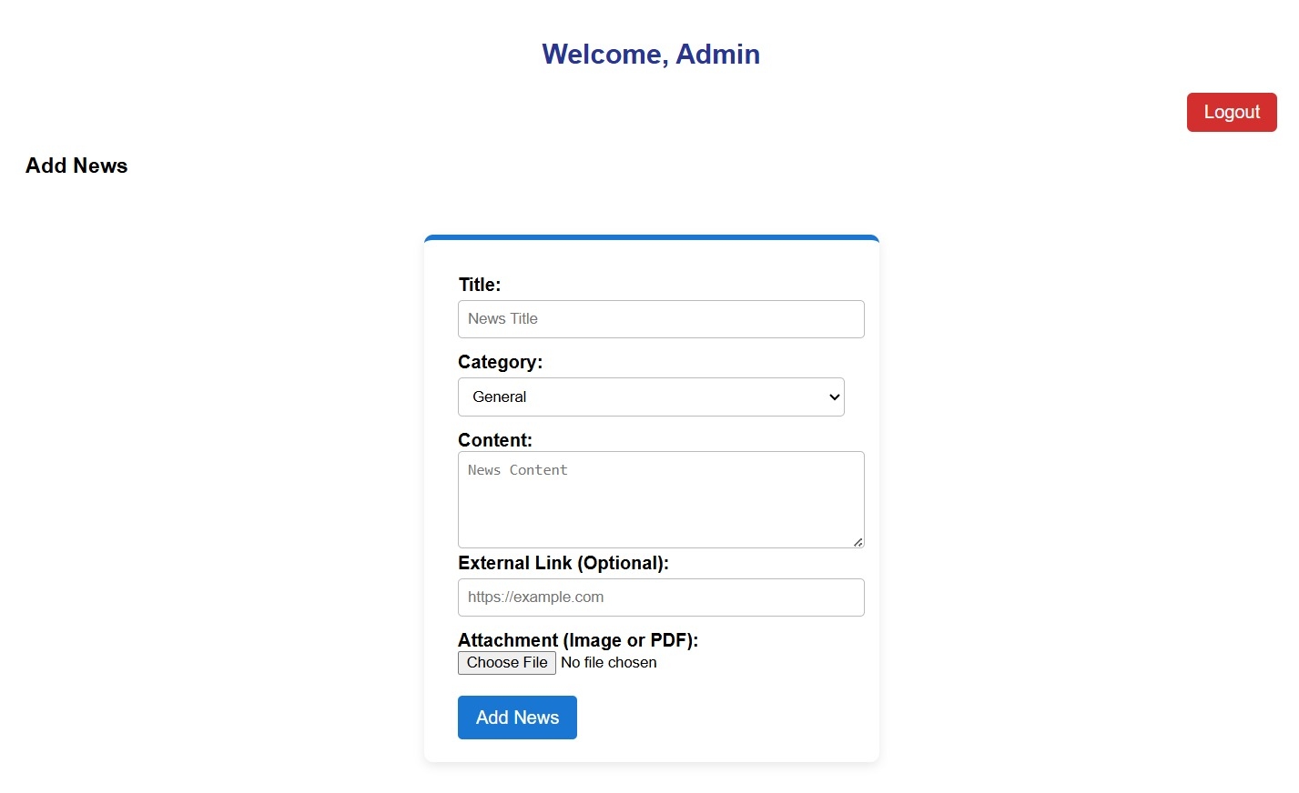
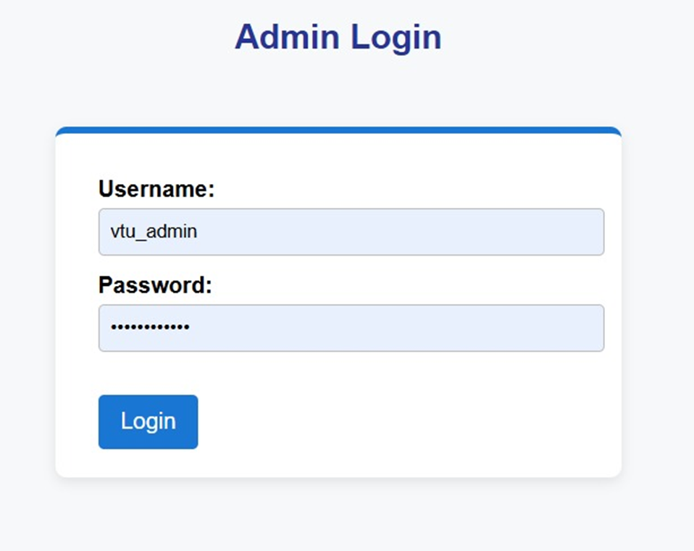
IMPLEMENTATION SCREENSHOTS
Login Page:
Provides secure login for and admins with clean input forms and role-based redirection after successful authentication
1
2
3
4
5
6
7
8(B)
9

Slide 12
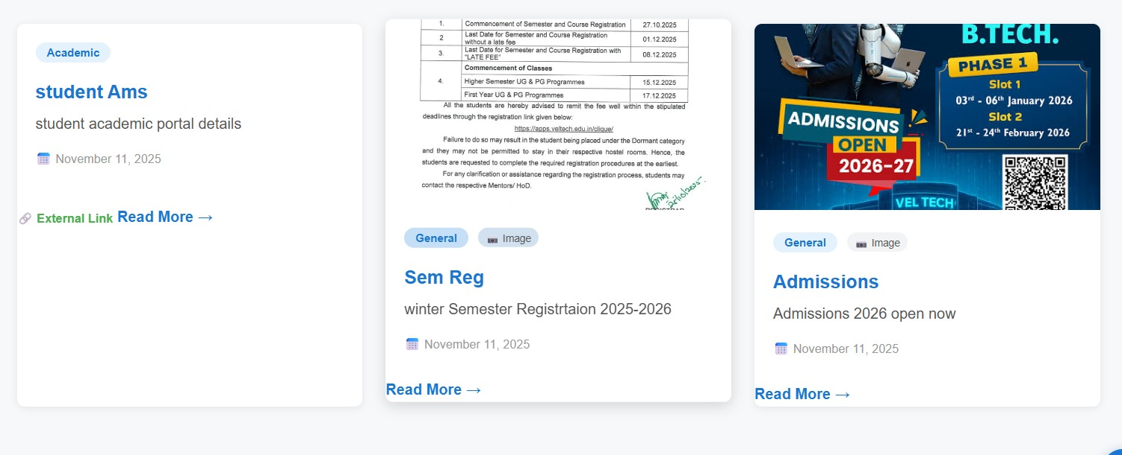
IMPLEMENTATION SCREENSHOTS
Main Module – Student Dashboard:
Shows enrolled events, basic stats and quick links to continue lessons in a structured layout.
1
2
3
4
5
6
7
8(C)
9

Slide 13
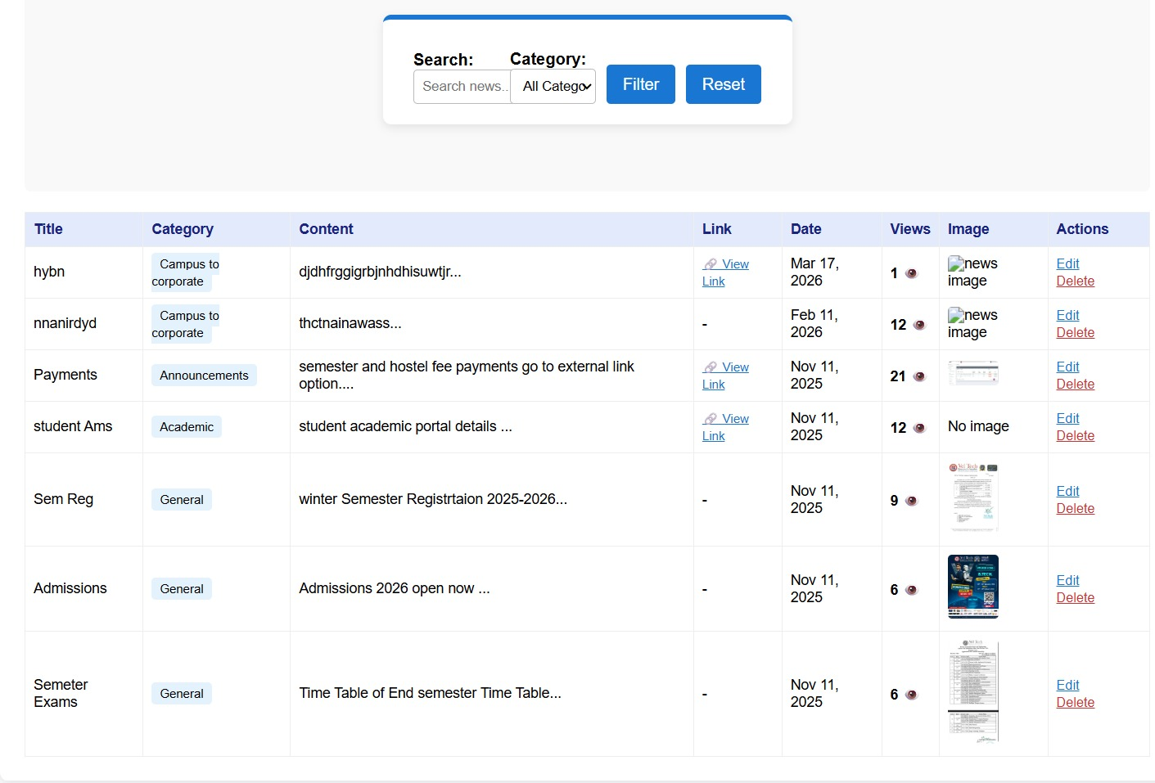
1
2
3
4
5
6
7
8
9

Slide 14
ADVANTAGES & LIMITATIONS
Advantages:
Centralized Management: All campus events are organized and tracked through a single platform, reducing confusion and duplication.Automation.
Registration, scheduling, and attendance are automated, saving time and minimizing manual errors.Smart Scheduling.
Prevents event clashes by intelligently managing dates, venues, and resources.Enhanced Communication.
Real-time notifications and updates keep students and staff informed instantly.Data Analytics: Provides insights into participation trends, feedback, and resource utilization for better decision-making.
Limitations:
. Data Security Risks: Sensitive student and event data must be protected against unauthorized access.Maintenance Needs.
Regular updates and technical support are essential to ensure smooth operation.User Adaptation.
Some users may face challenges adapting to the new digital system initially.
1
2
3
4
5
6
7
8
9

Slide 15
Thank you

