Slide 1
Deep CNN with Self-Attention Network for Speaker Identification
By Yile Bai, Jiayi Liu, and Ethan Swistak

Slide 2

Goals
Infer the identity of a speaker from an input utterance given a closed set of known voice models.
Secondary:
Allow appending additional unknown speakers.

Slide 3
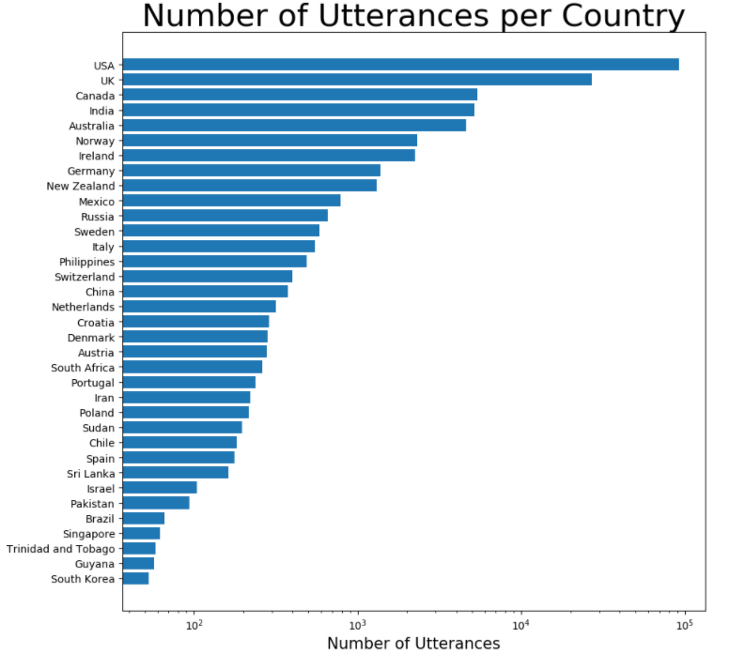
Dataset - VoxCelebA
File containing 148,642 utterances(.wav files) from 1,251 celebrities extracted from videos uploaded to YouTube.
Meta-data contains speaker ID, name, Gender, and Nationality.
Mostly from English speaking countries.

Slide 4
Approach
Divide utterances into 3-second clips and convert to Log-mel feature vector using pre-emphasis and hamming window for denoising.
Train ResNet CNN to comprehend sound features and output a high level feature vector.
Train self-attention layer to focus on most relevant aspects of utterance for speaker identification
Output embedded encoding of predicted speaker ID.

Slide 5
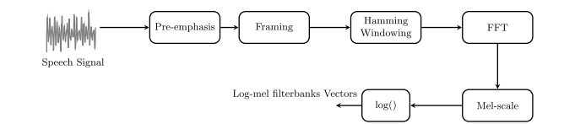
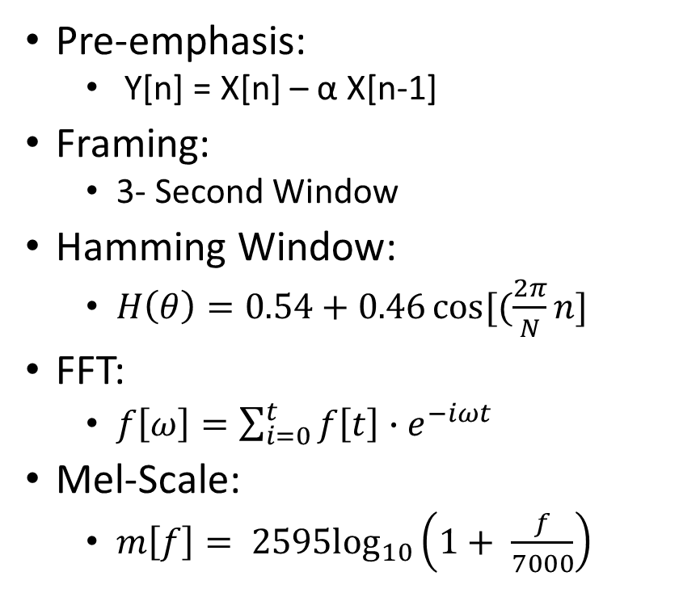
Pre-Processing Layer
Pre-emphasis:
Y[n] = X[n] – α X[n-1]
Framing:
3- Second Window
Hamming Window:
$H\left(θ\right)=0.54+0.46\cos{[(\frac{2π}{N}n]}$
FFT:
$f\left[ω\right]=\sum_{i=0}^{t}{f\left[t\right]{∙e}^{−iωt}}$
Mel-Scale:
$m\left[f\right]= {2595log}_{10}\left(1+ \frac{f}{7000}\right)$

Slide 6
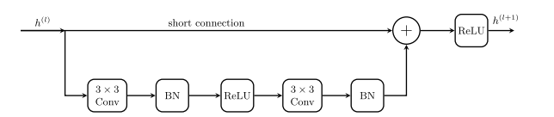
ResNet Architecture
Resnet Block
Explanation
Input enters standard convolution
Second convolution performed on first convolution
Results of both convolutions combined
Additional activation passes to next block

Slide 7
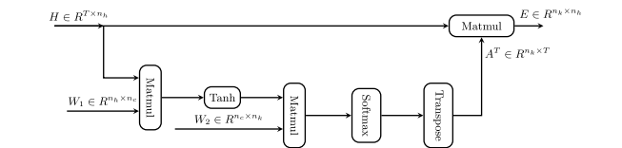
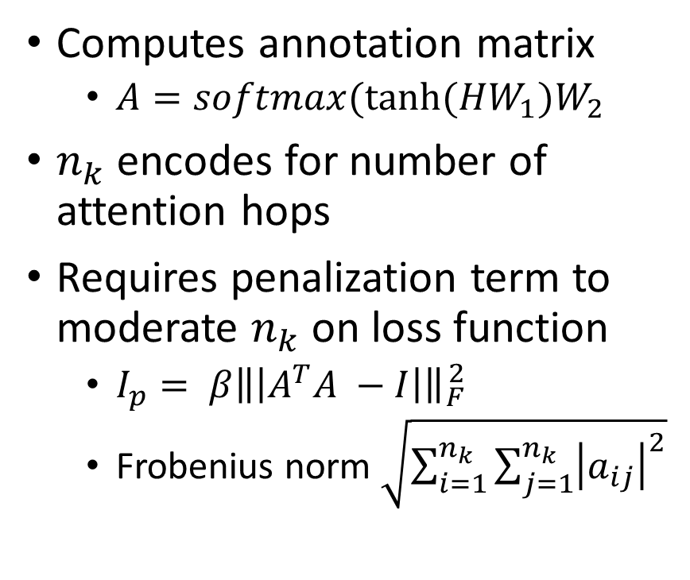
Self-Attention Layer
Computes annotation matrix
$A=softmax(tanh⁡(HW_{1})W_{2}$
$n_{k}$ encodes for number of attention hops
Requires penalization term to moderate $n_{k}$ on loss function
$I_{p}= β\left\|\left|A^{T}A −I\right|\right\|{}_{F}^{2}$
Frobenius norm $\sqrt{\sum_{i=1}^{n_{k}}{\sum_{j=1}^{n_{k}}{{\left|a_{ij}\right|}^{2}}}}$

Slide 8

Training and Tuning
Loss Function – Multi-Class Cross Entropy Objective Function
$I=− \sum_{n=1}^{N}{\sum_{k=1}^{K}{d_{nk}\log\left(P\left(y_{k} | x_{1:T}^{\left(n\right)}\right)\right)}}+ I_{p}$
Adam Optimizer
Other Hyperparameters set via grid search

Slide 9
Loss Function
backpropagation algorithm
until the network model Converges
Goal: to achieve the purpose of training the model
classification task: objective variable is discrete
regression task: objective variable is continuous

Slide 10
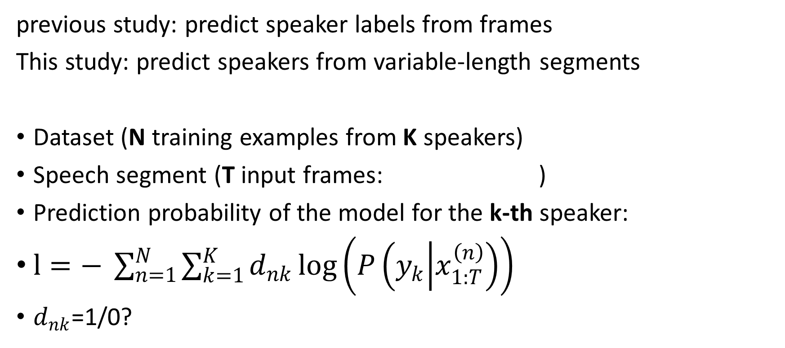
Multi-Class Cross Entropy Objective Function
previous study: predict speaker labels from frames
This study: predict speakers from variable-length segments
Dataset (N training examples from K speakers)
Speech segment (T input frames: )
Prediction probability of the model for the k-th speaker:
$l=− \sum_{n=1}^{N}{\sum_{k=1}^{K}{d_{nk}\log\left(P\left(y_{k} | x_{1:T}^{\left(n\right)}\right)\right)}}$
$d_{nk}$=1/0?
$$x_{1}^{\left(n\right)},x_{2}^{\left(n\right)},...,x_{T}^{\left(n\right)}$$

Slide 11
Training and Tuning
The Neural Network Training Optimization Algorithm
Learning rate
Sample m examples from the training set with target labels .
Compute the loss l
Initial parameters θ
Apply update with the gradient estimate for the parameters θ.
Compute the gradient estimate

Slide 12
Grid search & Adam optimization
Grid search:
a model hyperparameter optimization technology
uses each group of hyperparameters to train
best hyperparameter: with smallest validation set error
used to determine a suite of hyper-parameters (weight decay, the size of the embedding layer, the dropout probability, and the maximum gradient norm)
Adam optimization:
an extension to stochastic gradient descent

Slide 13
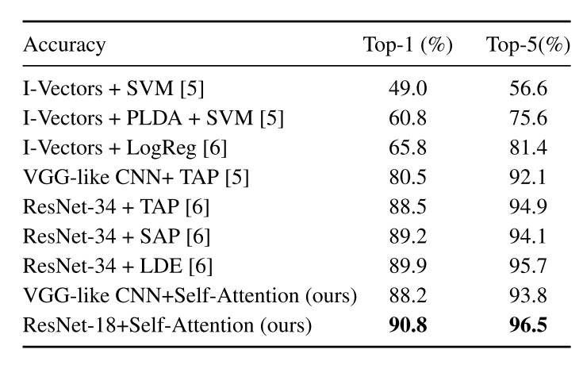
Results for speaker identification
Accuracy:
ResNet > VGG
CNN with self-attention > CNN baseline > I-vectors

Slide 14
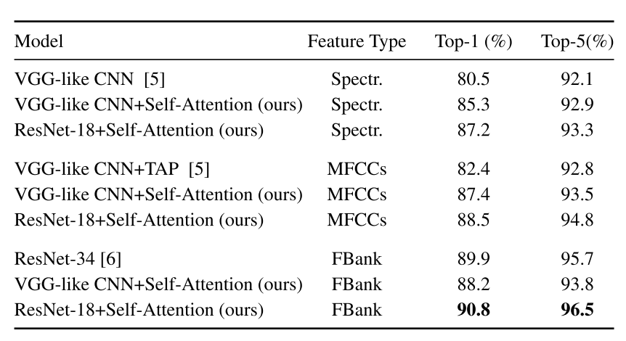
Results for different acoustic features
Accuracy:
FBank> MFCCs> Spectr.
Self-attention mechanism helps
FBank features can be generated after the pre-processing stage

Slide 15
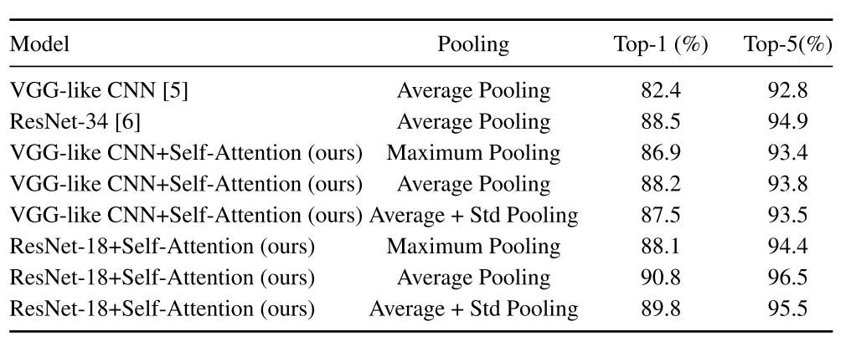
Results for temporal pooling layers
Accuracy:
Average pooling > Average + Std pooling > Maximum pooling

Slide 16
Research question
adding new speakers to the trained network for identification
adjusting parameters accordingly to achieve the lowest loss and highest identification accuracy
quantify the loss incurred by the newly added data and the effect on final result
compare the performance of the proposed CNN variants with other CNN baselines and traditional i-vector-based methods.

