Slide 1
Deep CNN with Self-Attention Network for Speaker Identification
By Yile Bai, Jiayi Liu, and Ethan Swistak

Slide 2

Goals
Infer the identity of a speaker from an input utterance given a closed set of known voice models.
Secondary:
Allow clustering of unknown speakers

Slide 3
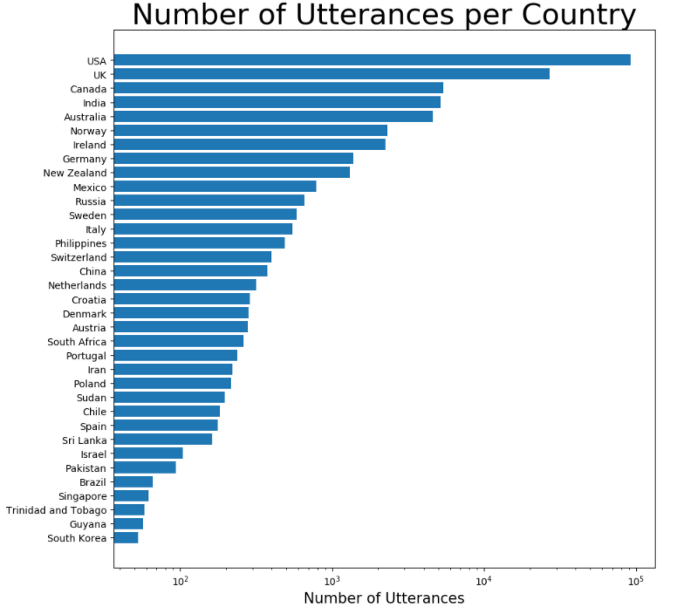
Dataset - VoxCelebA
File containing 148,642 utterances(.wav files) from 1,251 celebrities extracted from videos uploaded to YouTube.
Meta-data contains speaker ID, name, Gender, and Nationality.
Mostly from English speaking countries.

Slide 4
Approach
Divide utterances into 3-second clips and convert to Log-mel feature vector using pre-emphasis and hamming window for denoising.
Train ResNet CNN to comprehend sound features and output a high level feature vector.
Train self-attention layer to focus on most relevant aspects of utterance for speaker identification
Output embedded encoding of predicted speaker ID.

Slide 5
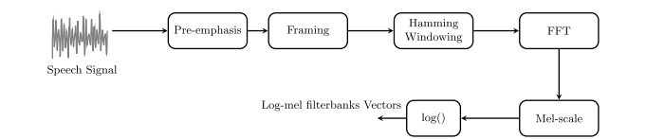
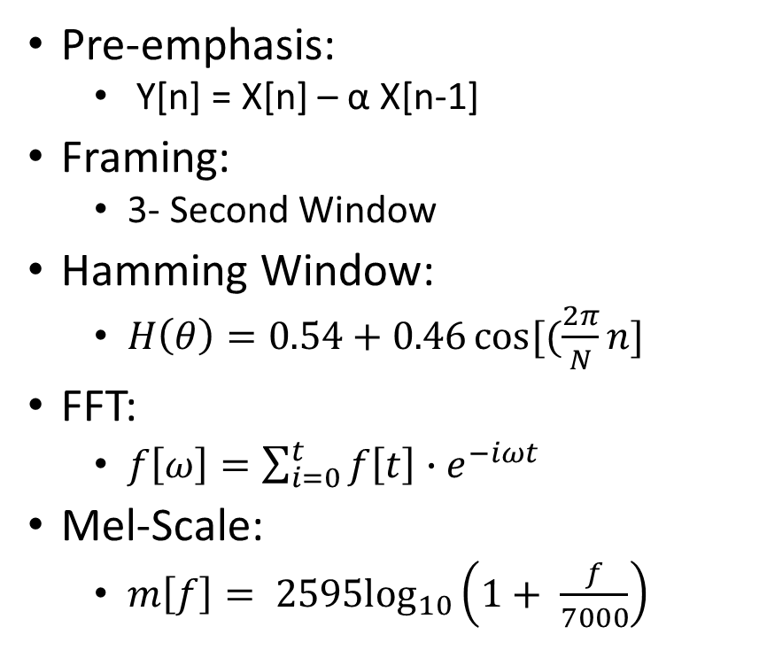
Pre-Processing Layer
Pre-emphasis:
Y[n] = X[n] – α X[n-1]
Framing:
3- Second Window
Hamming Window:
$H\left(θ\right)=0.54+0.46\cos{[(\frac{2π}{N}n]}$
FFT:
$f\left[ω\right]=\sum_{i=0}^{t}{f\left[t\right]{∙e}^{−iωt}}$
Mel-Scale:
$m\left[f\right]= {2595log}_{10}\left(1+ \frac{f}{7000}\right)$

Slide 6
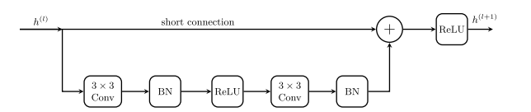
ResNet Architecture
Resnet Block
Explanation
Input enters standard convolution
Second convolution performed on first convolution
Results of both convolutions combined
Additional activation passes to next block

Slide 7
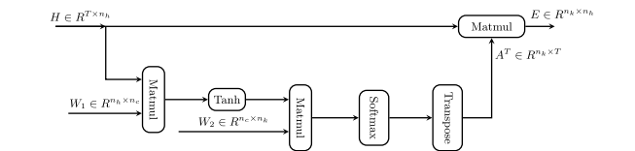
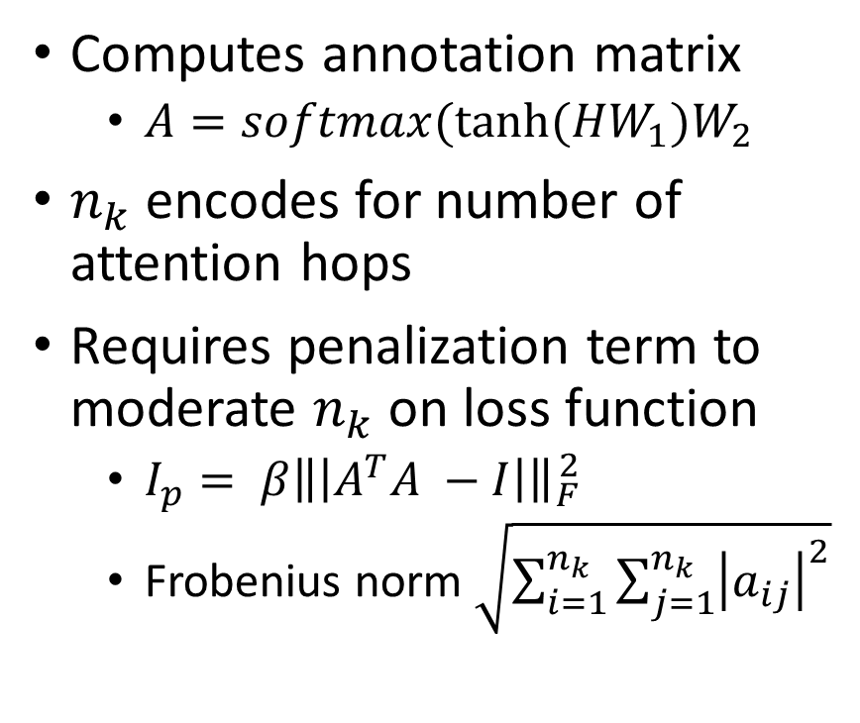
Self-Attention Layer
Computes annotation matrix
$A=softmax(tanh⁡(HW_{1})W_{2}$
$n_{k}$ encodes for number of attention hops
Requires penalization term to moderate $n_{k}$ on loss function
$I_{p}= β\left\|\left|A^{T}A −I\right|\right\|{}_{F}^{2}$
Frobenius norm $\sqrt{\sum_{i=1}^{n_{k}}{\sum_{j=1}^{n_{k}}{{\left|a_{ij}\right|}^{2}}}}$

Slide 8

Training and Tuning
Loss Function – Multi-Class Cross Entropy Objective Function
$I=− \sum_{n=1}^{N}{\sum_{k=1}^{K}{d_{nk}\log\left(P\left(y_{k} | x_{1:T}^{\left(n\right)}\right)\right)}}+ I_{p}$
Adam Optimizer
Other Hyperparameters set via grid search

