Slide 1
Deep CNN with Self-Attention Network for Speaker Identification
By Yile Bai, Jiayi Liu, and Ethan Swistak

Slide 2

Goals
Infer the identity of a speaker from an input utterance given a closed set of known voice models.
Secondary:
Allow clustering of unknown speakers

Slide 3
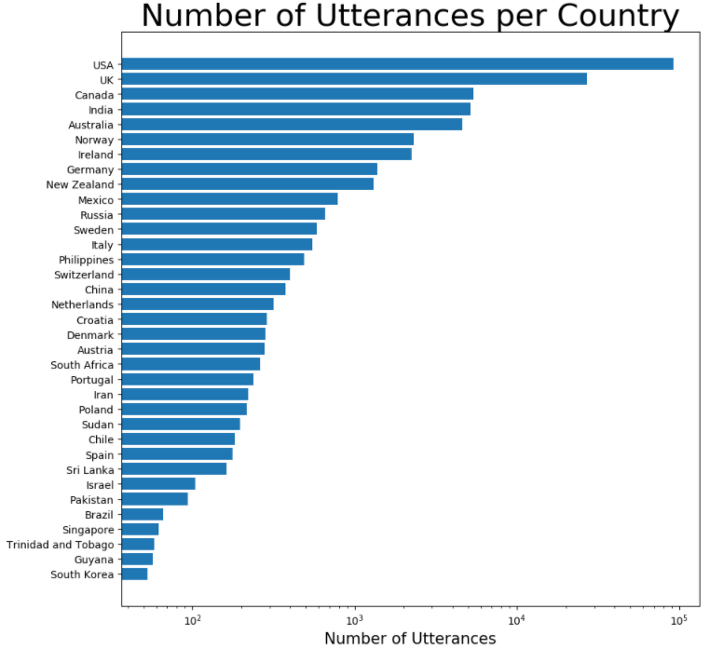
Dataset - VoxCelebA
File containing 148,642 utterances(.wav files) from 1,251 celebrities extracted from videos uploaded to YouTube.
Meta-data contains speaker ID, name, Gender, and Nationality.
Mostly from English speaking countries.

Slide 4
Approach
Divide utterances into 3-second clips and convert to Log-mel feature vector using pre-emphasis and hamming window for denoising.
Train ResNet CNN to comprehend sound features and output a high level feature vector.
Train self-attention layer to focus on most relevant aspects of utterance for speaker identification
Output embedded encoding of predicted speaker ID.

