Slide 1

Presented By:
Mohammad Tamkeen
Yash Vardhan
NETFLIX
Content, Viewership & Profitability Analysis
SQL • Business Intelligence • Data Analytics
N
N

Slide 2

Project Overview
Goal: Analyze Netflix content, viewership & profitability using SQL
Focus on content mix, regional trends, engagement & revenue drivers
Business-oriented, insight-first analytics project
N

Slide 3
Dataset Overview
Netflix content metadata
Viewership & watch-time data
Production & marketing cost data
Cleaned & SQL-ready relational tables
N

Slide 4
Key Business Questions
Movies vs TV Shows distribution
Top countries & genres
Content trends over time
Profitability & engagement analysis
N

Slide 5
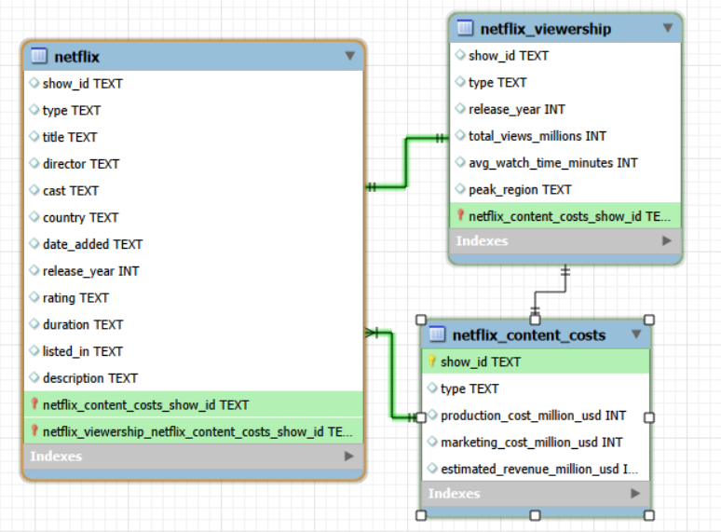
ER Diagram
N

Slide 6
Content Analysis
Most common ratings identified
Documentaries form a niche segment
Long-running TV shows improve engagement
Genre distribution reveals audience preferences
N

Slide 7
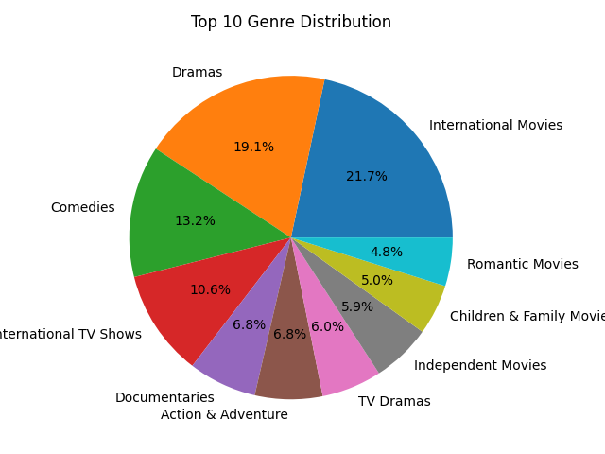
Top 10 Genre Distribution
Business Insight:
  Drama and International Movies
  genres dominate audience
  preferences.
N

Slide 8
Geographical Insights
India shows rising average content release
Certain countries contribute disproportionate views
Regional storytelling boosts engagement
N

Slide 9
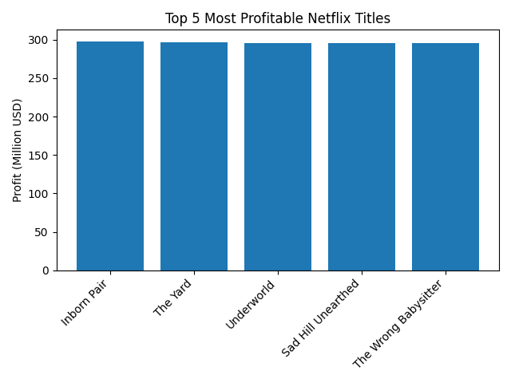
Top 5 Most Profitable Titles
Business Insight:
  High profitability is driven by cost efficiency,
  not just high budgets.
N

Slide 10
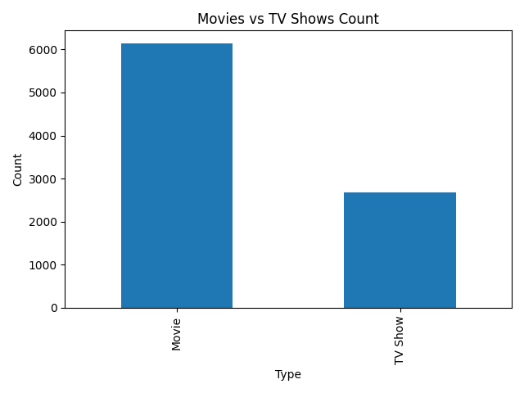
Movies vs TV Shows Distribution
Business Insight:
  Movies dominate volume, while
  TV Shows are stronger retention drivers.
N

Slide 11
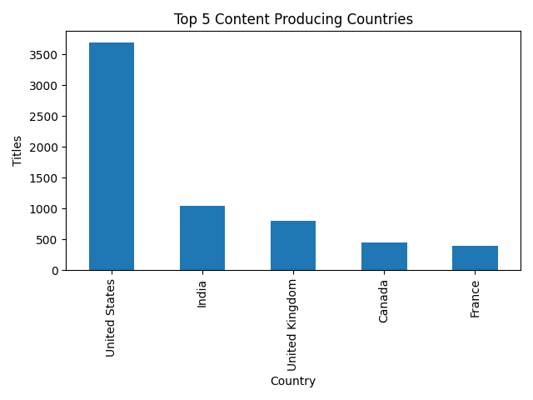
Top 5 Content Producing Countries
Business Insight:
  Netflix balances global scale with
  strong local content investments.
N

Slide 12
Profitability Analysis
Profit = Revenue – (Production + Marketing Cost)
Top 3 profitable titles identified by content type
High-budget content does not guarantee profit
N

Slide 13
Viewership Analysis
Above-average watch time titles drive platform views
Viewer engagement is highly skewed
Few titles retain majority of users
N

Slide 14
Risk Categorization
Content tagged with 'kill' & 'violence' analyzed
Risk vs non-risk content classification
Helps in content moderation & recommendations
N

Slide 15
Business Conclusions
Netflix follows high-volume, low-hit-rate model
Data-driven content selection is critical
Retention-focused content outperforms volume
N

Slide 16
Strategic Recommendations
Invest more in high-retention TV formats
Optimize marketing spend on low-ROI titles
Expand localized content in high-growth regions
Balance creative freedom with brand safety
N

Slide 17
Tools & Skills Used
SQL: Joins, CTEs, Window Functions
Business Metrics & Trend Analysis
Analytical storytelling & presentation
N

Slide 18
SQL Approach & Methodology
Used show_id as primary key to join content, viewership, and cost tables
Applied aggregations (COUNT, SUM, AVG) for trends
Used window functions for ranking and profitability analysis
Focused on business questions before writing queries
N

Slide 19
Key SQL Results – Content & Region
Movies dominate content volume; TV Shows drive retention
USA and India are top content-producing countries
Drama and International genres have highest presence
Post-2018 releases show strong growth
N

Slide 20
Key SQL Results – Profit & Engagement
Profit calculated as Revenue – (Production + Marketing Cost)
Few titles generate majority of total profit
High budget does not guarantee high profitability
Above-average watch time titles drive most views
N

Slide 21
Final Business Impact
Supports data-driven content investment decisions
Helps optimize marketing and production budgets
Improves regional and genre-level strategy
N

Slide 22
THANK YOU
N

