Slide 1
NETFLIX
Netflix Content & Viewership Analysis
Presented By:
Mohammad Tamkeen
Yash Vardhan

Slide 2
Project Overview
Goal: Analyze Netflix content, viewership & profitability using SQL
Focus on content mix, regional trends, engagement & revenue drivers
Business-oriented, insight-first analytics project

Slide 3
Dataset Overview
Netflix content metadata
Viewership & watch-time data
Production & marketing cost data
Cleaned & SQL-ready relational tables

Slide 4
Key Business Questions
Movies vs TV Shows distribution
Top countries & genres
Content trends over time
Profitability & engagement analysis

Slide 5
Headline Insights
Movies dominate catalog, TV Shows drive retention
USA & India are top content producers
Post-2018 content shows stronger performance
Few titles generate majority of profit

Slide 6
Content Analysis
Most common ratings identified
Documentaries form a niche segment
Long-running TV shows improve engagement
Genre distribution reveals audience preferences

Slide 7
Geographical Insights
India shows rising average content release
Certain countries contribute disproportionate views
Regional storytelling boosts engagement

Slide 8
Profitability Analysis
Profit = Revenue – (Production + Marketing Cost)
Top 3 profitable titles identified by content type
High-budget content does not guarantee profit

Slide 9
Viewership Analysis
Above-average watch time titles drive platform views
Viewer engagement is highly skewed
Few titles retain majority of users

Slide 10
Risk Categorization
Content tagged with 'kill' & 'violence' analyzed
Risk vs non-risk content classification
Helps in content moderation & recommendations

Slide 11
Business Conclusions
Netflix follows high-volume, low-hit-rate model
Data-driven content selection is critical
Retention-focused content outperforms volume

Slide 12
Strategic Recommendations
Invest more in high-retention TV formats
Optimize marketing spend on low-ROI titles
Expand localized content in high-growth regions
Balance creative freedom with brand safety

Slide 13
Tools & Skills Used
SQL: Joins, CTEs, Window Functions
Business Metrics & Trend Analysis
Analytical storytelling & presentation

Slide 14
Thank You
Netflix Content Analytics Project
SQL • Business Intelligence • Data Analysis

Slide 15
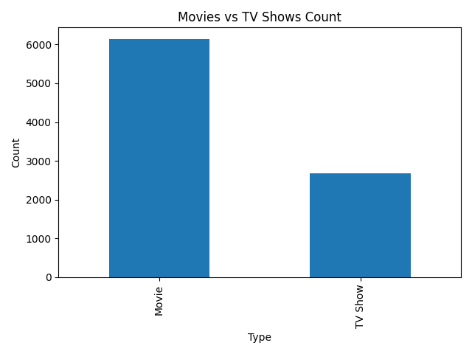
Movies vs TV Shows Distribution
Business Insight:
  Movies dominate volume, while TV Shows are stronger retention drivers.

Slide 16
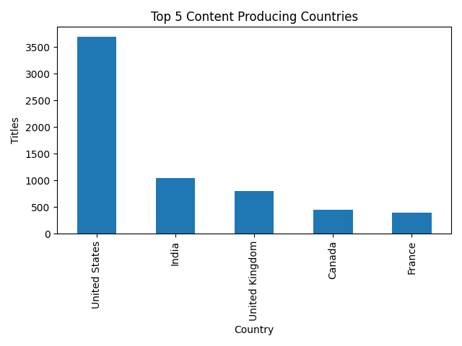
Top 5 Content Producing Countries
Business Insight:
  Netflix balances global scale with strong local content investments.

Slide 17
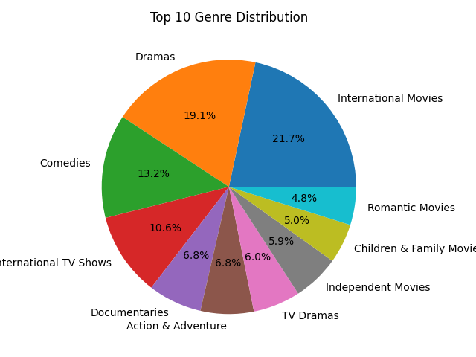
Top 10 Genre Distribution
Business Insight:
  Drama and International genres dominate audience preferences.

Slide 18
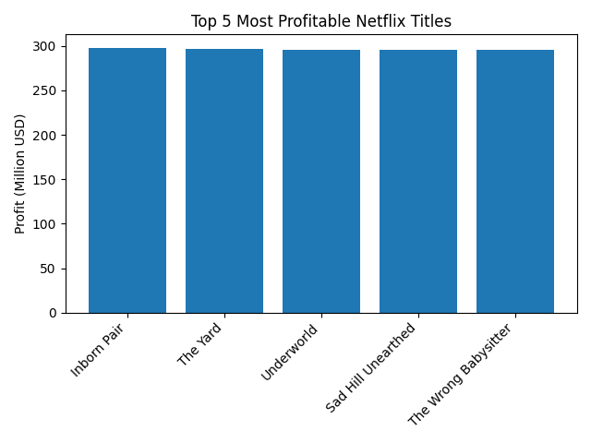
Top 5 Most Profitable Titles
Business Insight:
  High profitability is driven by cost efficiency, not just high budgets.

Slide 19
SQL Approach & Methodology
Used show_id as primary key to join content, viewership, and cost tables
Applied aggregations (COUNT, SUM, AVG) for trends
Used window functions for ranking and profitability analysis
Focused on business questions before writing queries

Slide 20
Key SQL Results – Content & Region
Movies dominate content volume; TV Shows drive retention
USA and India are top content-producing countries
Drama and International genres have highest presence
Post-2018 releases show strong growth

Slide 21
Key SQL Results – Profit & Engagement
Profit calculated as Revenue – (Production + Marketing Cost)
Few titles generate majority of total profit
High budget does not guarantee high profitability
Above-average watch time titles drive most views

Slide 22
Final Business Impact
Supports data-driven content investment decisions
Helps optimize marketing and production budgets
Improves regional and genre-level strategy
Demonstrates real-world SQL + business analytics skills

