Slide 1
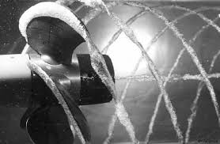
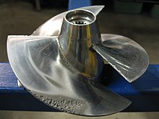
Backgroud
Cavitation bubble is formed when the static pressure of liquid is reduced to below vapor pressure
Magnitude of shock wave generated from the collapse of cavitation bubble can reach ~ GPa
Cavitation can lead to severe damage on underwater machinery
Thus, It is important to understand the behavior of cavitation bubble

Slide 2
Gilmore model
Python script in this article solves Gilmore model, which describes dynamics of spherical bubble
Assumptions: - bubble is spherical in shape - temperature effect is ignored (isothermal) - gas inside bubble is ideal gas with uniform pressure - energy dissipation from viscosity and acoustic radiation is considered

Slide 3
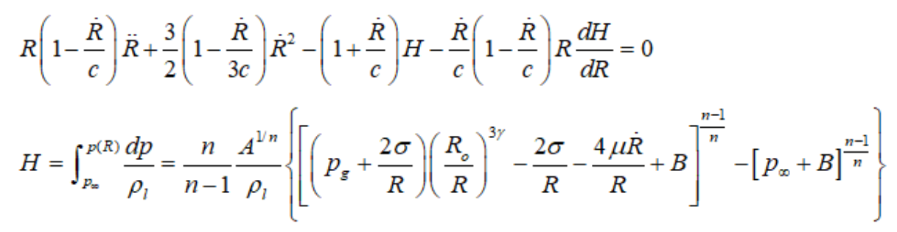
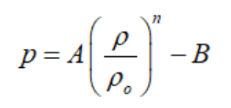

Gilmore model
R : bubble radius with time
H : enthalpy
ρ_{l} : density of liquid
c : speed of sound
p : pressure, p_{g} : gas pressure inside bubble, p∞ : ambient pressure
σ : surface tension , μ : viscosity
A, B, n : Constants for Tait equation of state

Slide 4
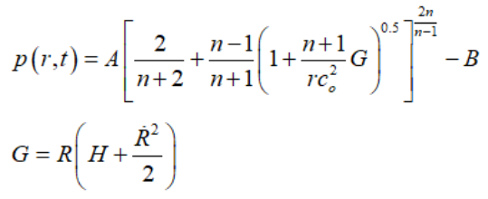
Gilmore model
Pressure can be calculated as a function of time and space, once we have R(t) (Akilichev., 1968)

Slide 5
Benchmark
Comparison with Direct Numerical Simulation (DNS) result from Nagrath et al., 2006
present work (Gilmore model)
DNS (Nagrath et al., 2006)
Pressure contour
Bubble radius with time

Slide 6
Benchmark
Comparison with Direct Numerical Simulation (DNS) result from Nagrath et al., 2006
present work (Gilmore model)
DNS (Nagrath et al., 2006)
Pressure contour
Pressure at bubble wall with time

Slide 7
Thanks

