Slide 1
Intelligent financial planning hub
TEAM - 5
Presented By
Y. Baby Ramya
P. Venkata Sai Meghana

Slide 2
INTRODUCTION
The intelligent Financial Planning Hub is an advanced, technology-powered platform designed to streamline personal finance management. By equipping users with tools to monitor expenses, evaluate spending habits, and establish financial objectives, the system delivers an organized approach to managing finances effortlessly. This easy-to-use and efficient application helps individuals make well-informed financial decisions, promoting better financial habits and awareness while supporting effective future planning.

Slide 3

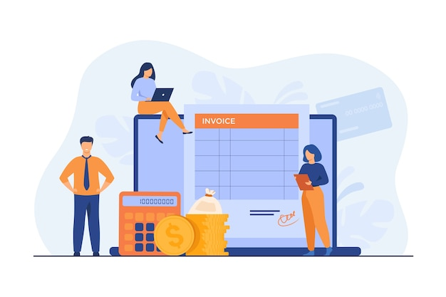

KEY FEATURES
User Authentication
Expense Management
Financial Reporting

Slide 4
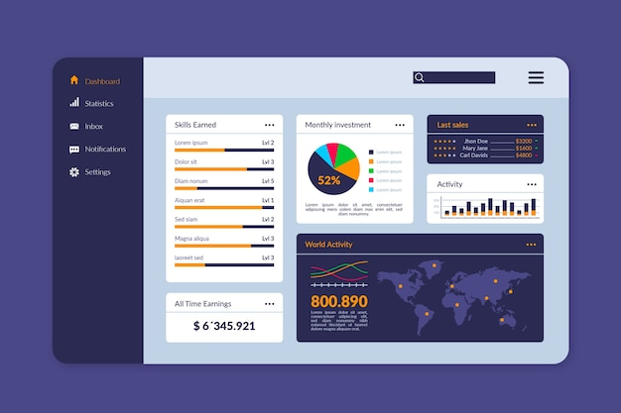
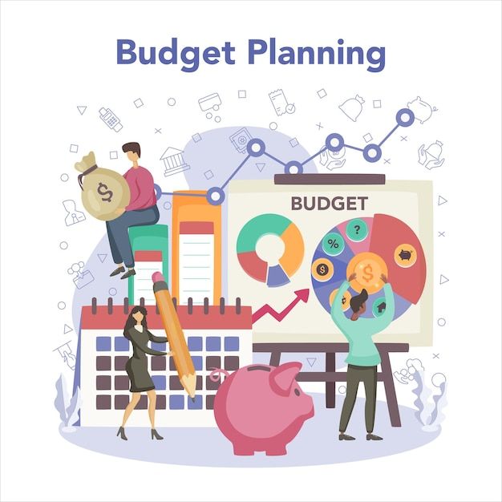
KEY FEATURES
Financial Dashboard
Budget Planning And Alerts

Slide 5


Technologies used
Django is a free, open-source Python-based web framework that
helps developers build web applications quickly and efficiently
HTML provides the structure of a webpage, CSS styles the
appearance of that structure, and Bootstrap acts as a front-end
development framework that offers pre-designed HTML and CSS
components, like buttons, forms, and grids, to quickly build
responsive and visually appealing websites

Slide 6

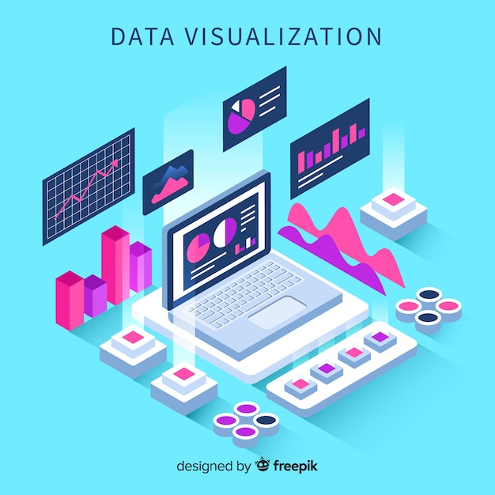
Technologies used
MySQL is open source, meaning anyone can use, modify, publish,
and expand on it. It's known for being reliable, fast, scalable, and
easy to use.
Data visualization is the representation of data through use of
common graphics, such as charts, plots, infographics and even
animations

Slide 7
project METHODOLOGY
Frontend Development:
The user interface is developed using HTML, CSS, and JavaScript, offering a responsive design for various devices. Dynamic elements and interactive components enhance the user experience.
Key Focus Areas:
Security: Protecting sensitive financial data through robust authentication and validations.
Scalability: Supporting a growing number of users and expense data.
User Experience: Ensuring an intuitive interface with clear navigation and functionality.

Slide 8
project METHODOLOGY
Backend Technology:
The project employs the Django framework, ensuring secure and efficient handling of user authentication, expense management, and financial reporting. Django's scalability supports real-time updates and robust database interactions.
Programming Language:
Python serves as the primary programming language, enabling seamless data processing, financial calculations, and integration with visualization tools.

Slide 9
CLASS DIAGRAM
Logout
Add Expenses
View Expense
Update Expense
Financial Reports
Login
Dashboard
Export as PDF
Budget Notification And Alerts

Slide 10
MILESTONE - 1
USER AUTHENTICATION
EXPENSE MANAGEMENT
Developed User Registration, Login, and Logout Functionalities
Implemented Secure Session management and validation
Designed the Database for Expense
Tracking
Created Interfaces to add, update,
view and delete expenses

Slide 11
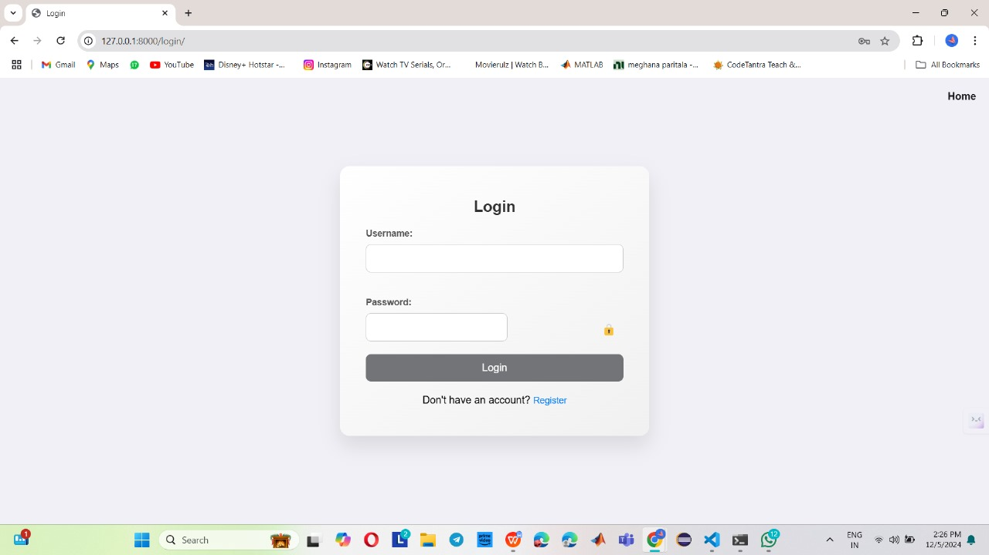
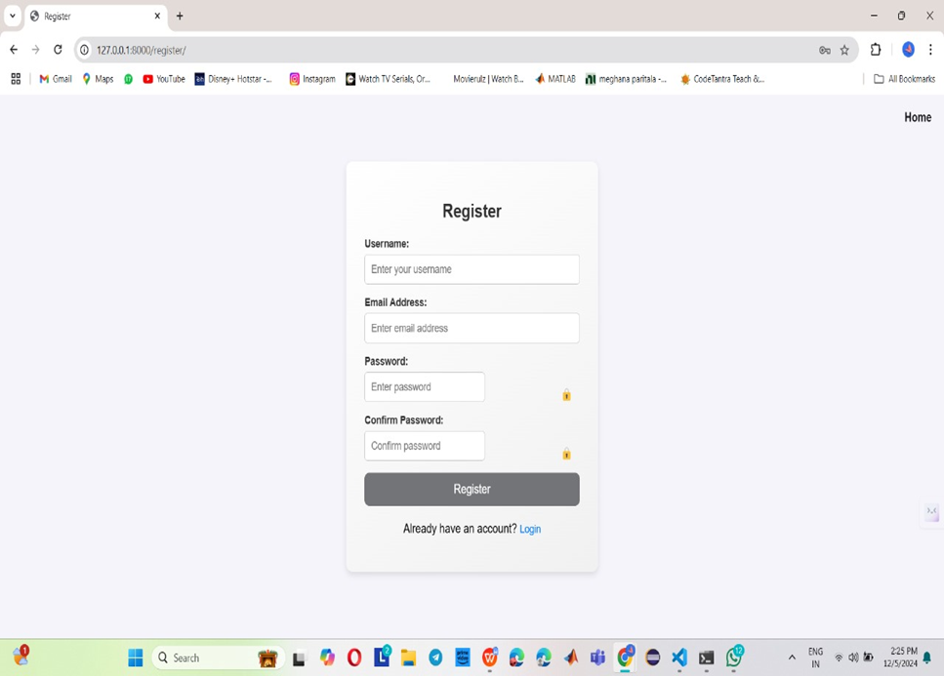
Login
Register

Slide 12


HOME
PROFILE

Slide 13

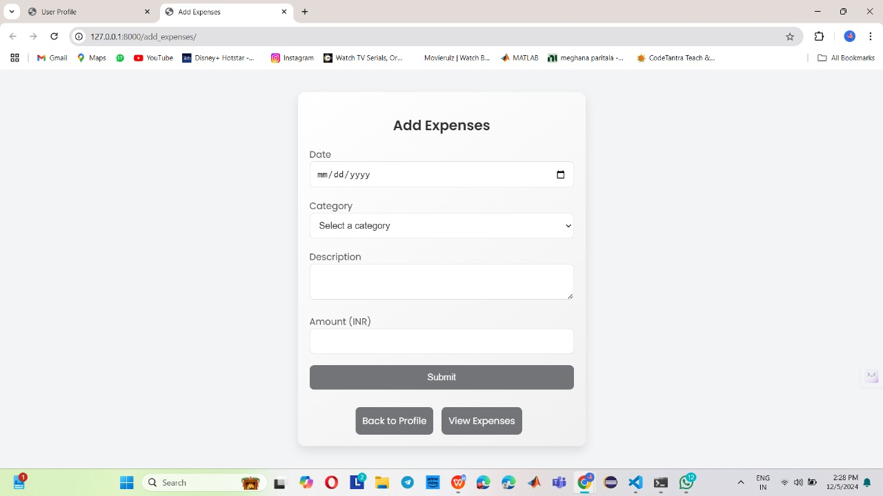
MENU
ADD EXPENSE

Slide 14
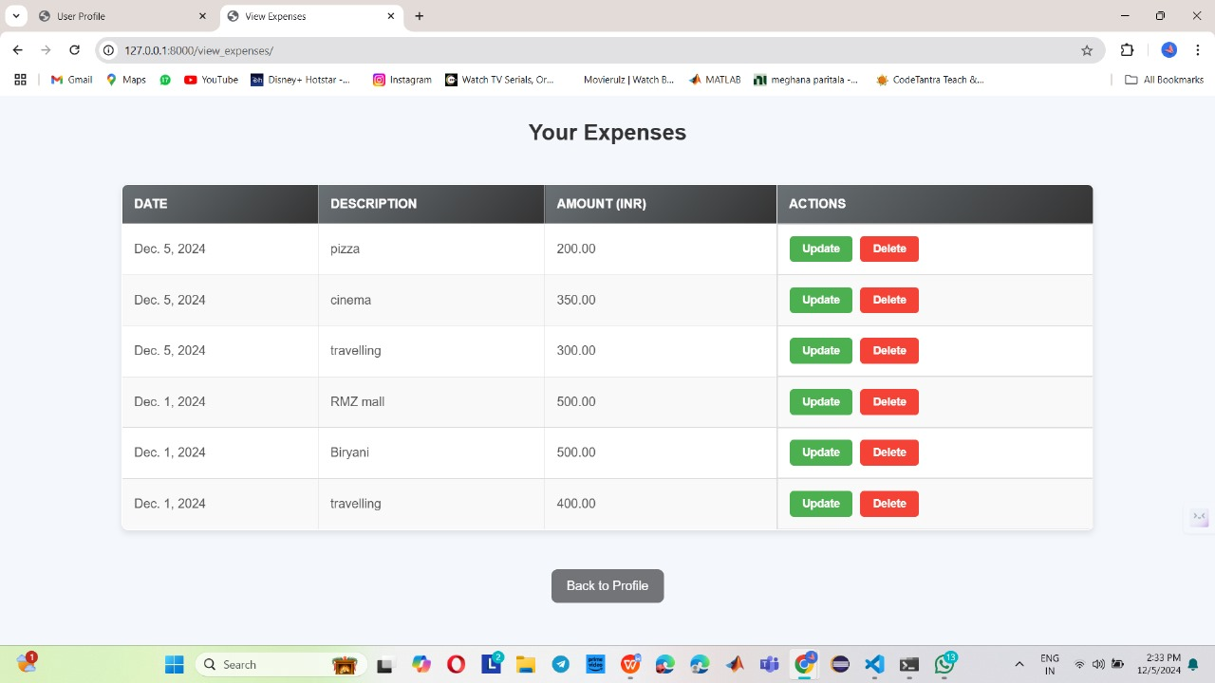
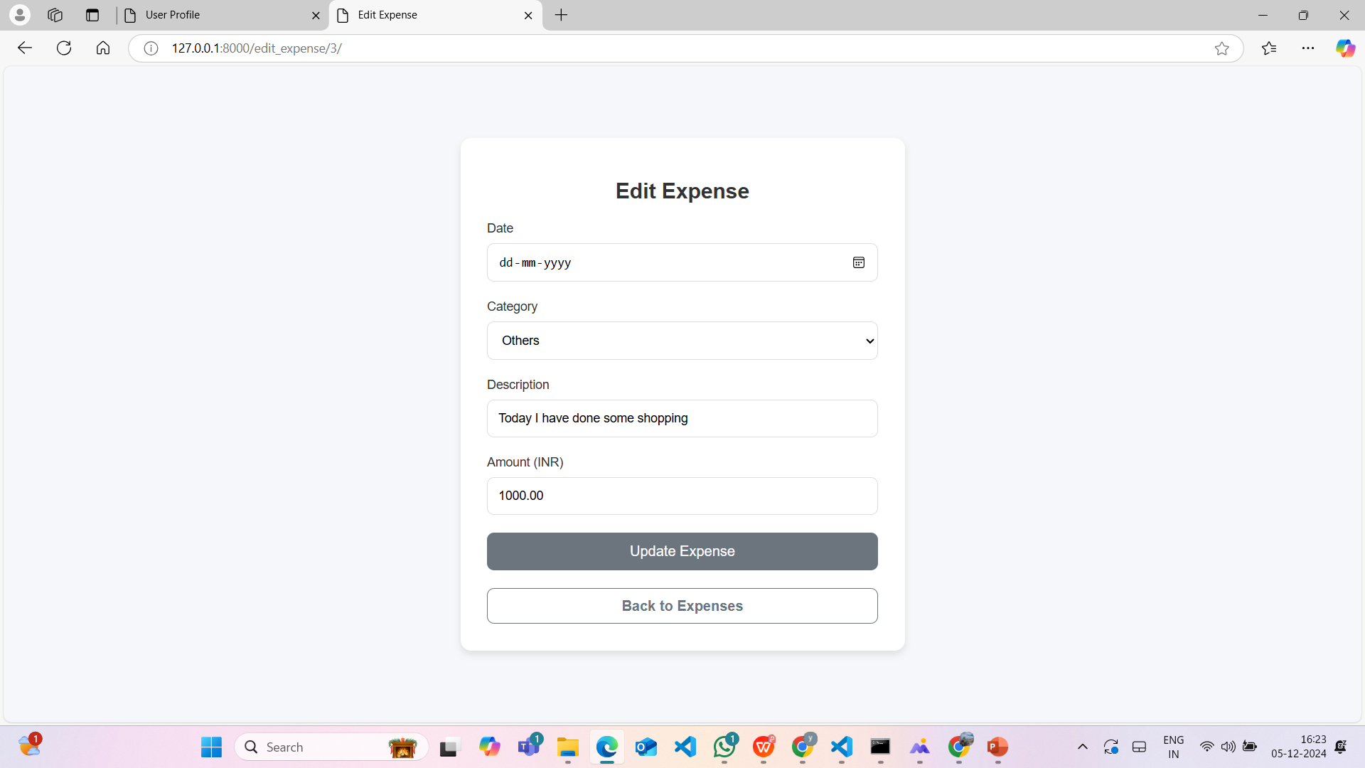
VIEW EXPENSE
UPDATE EXPENSE

Slide 15
MILESTONE - 2
Financial reporting features are successfully implemented, including the ability to export reports in PDF format. The system provides accurate calculation and display of financial summaries and visualizations.

Slide 16
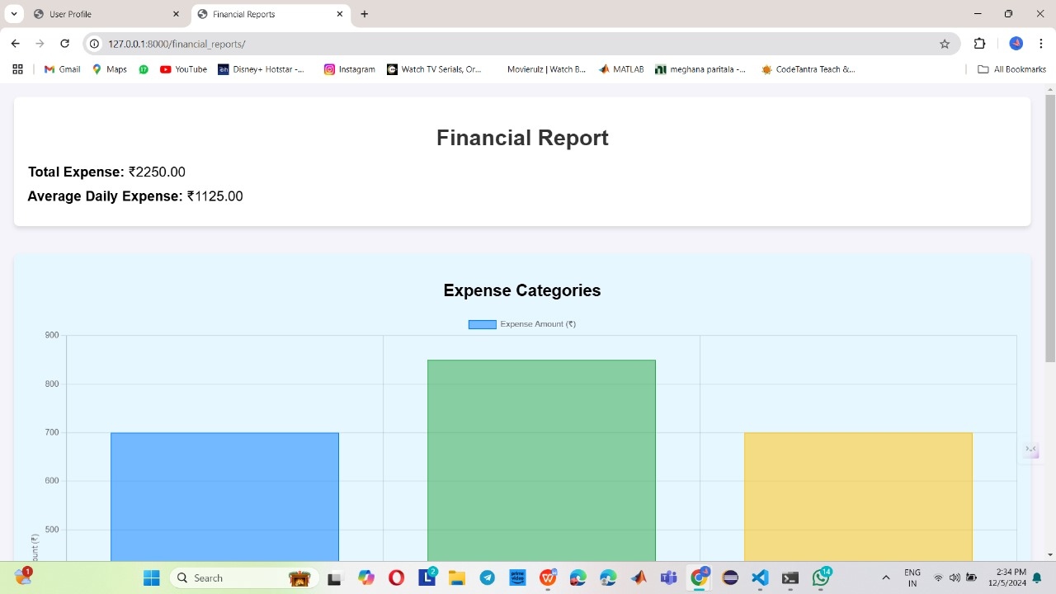
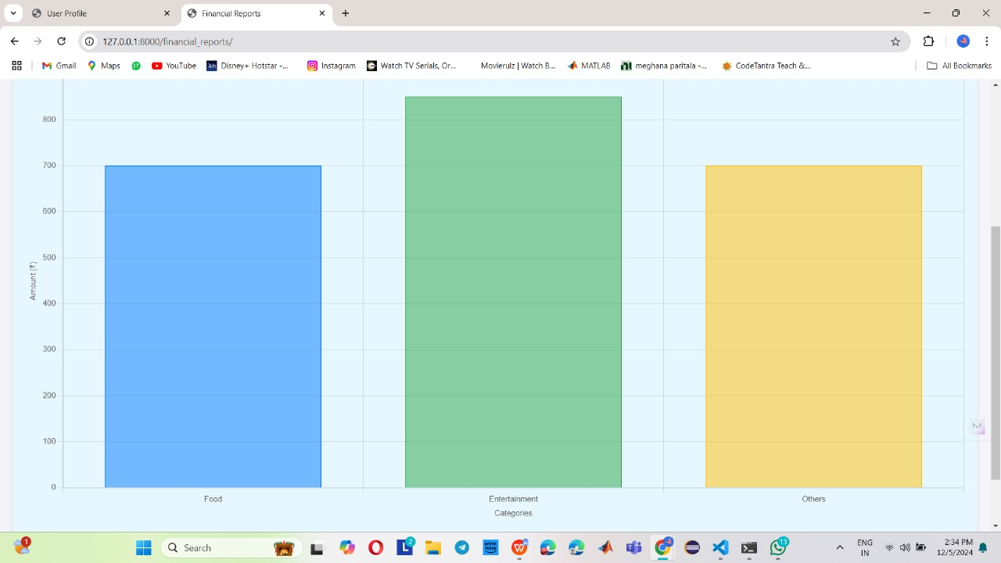
FINANCIAL REPORTS

Slide 17
MILESTONE - 3
A financial dashboard visually represents financial data, providing insights into budgets, expenses, and transactions using charts and tables. The update budget feature allows users to adjust their spending limits, ensuring better financial planning and control. Together, they enhance decision-making and promote effective management of personal or organizational finances.

Slide 18
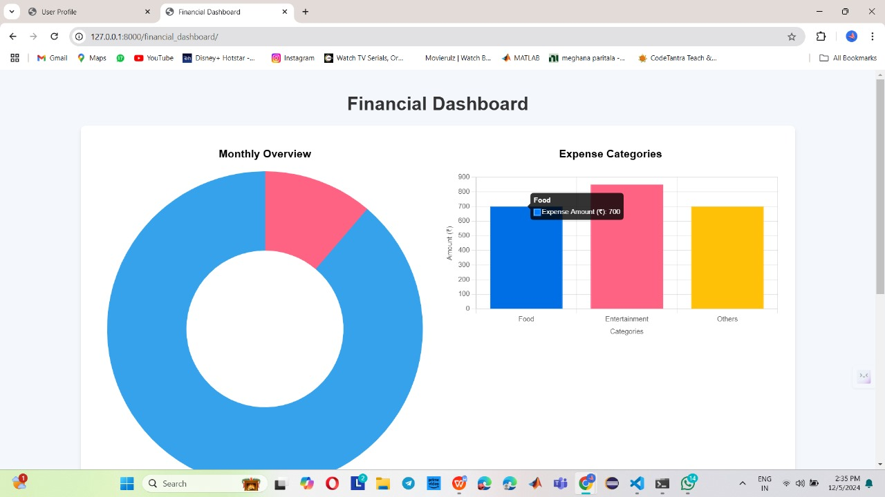
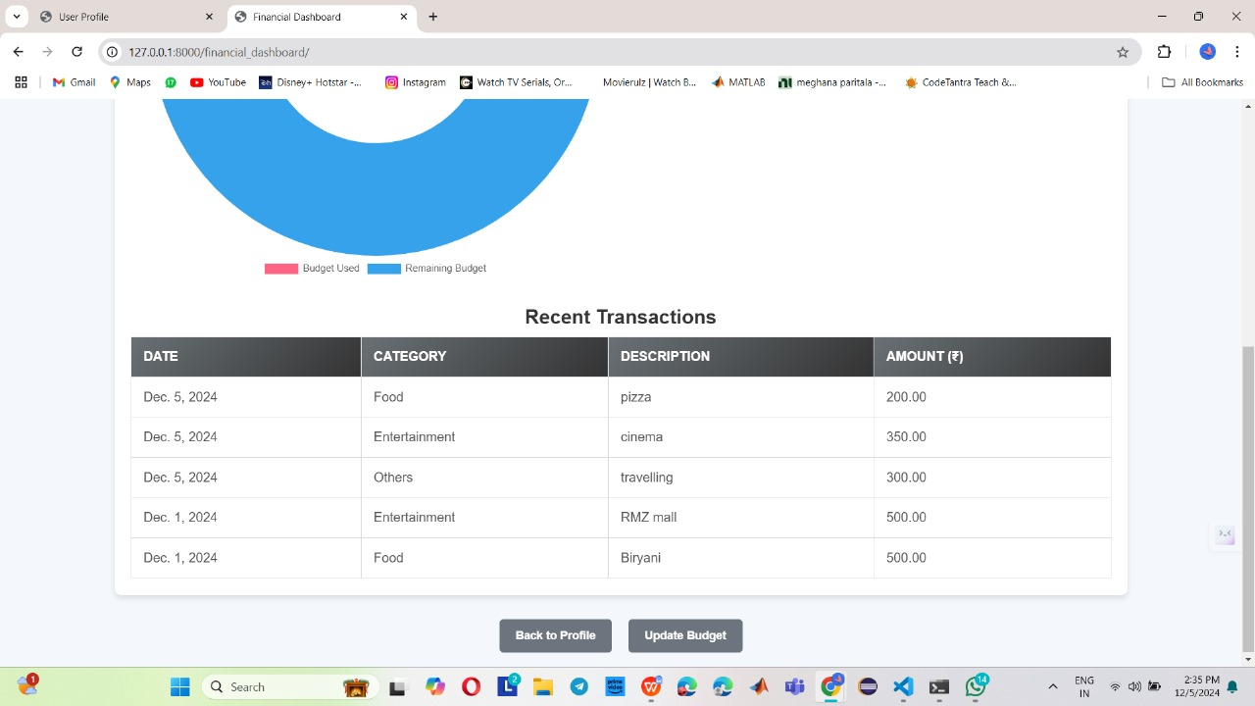
FINANCIAL DASHBOARDS

Slide 19
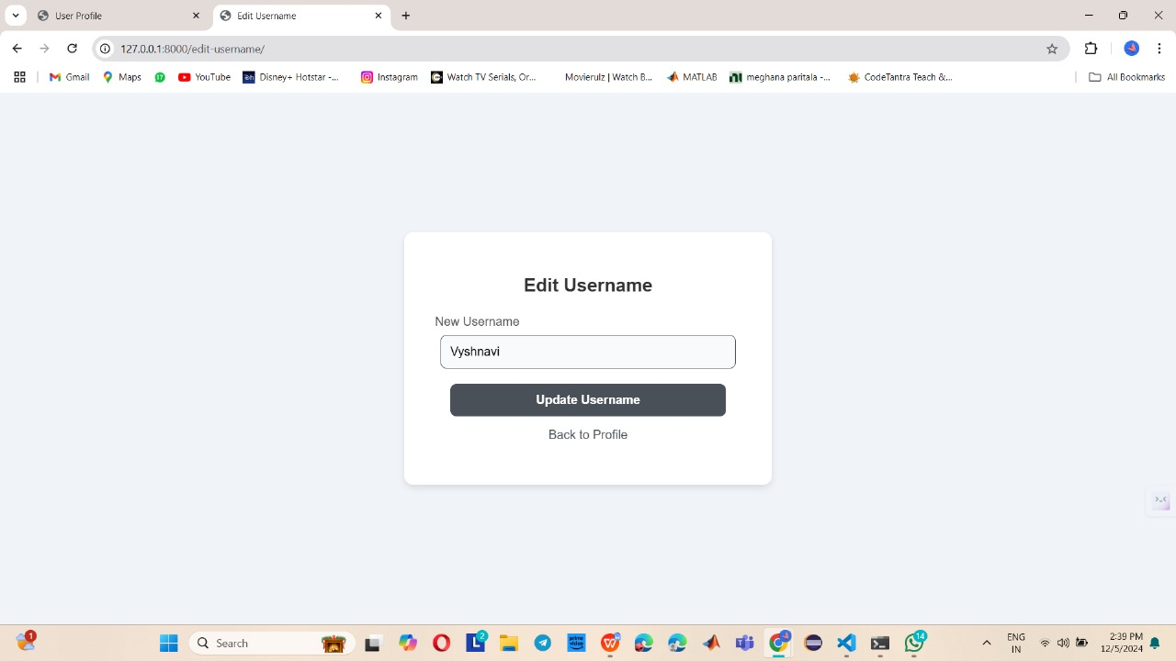
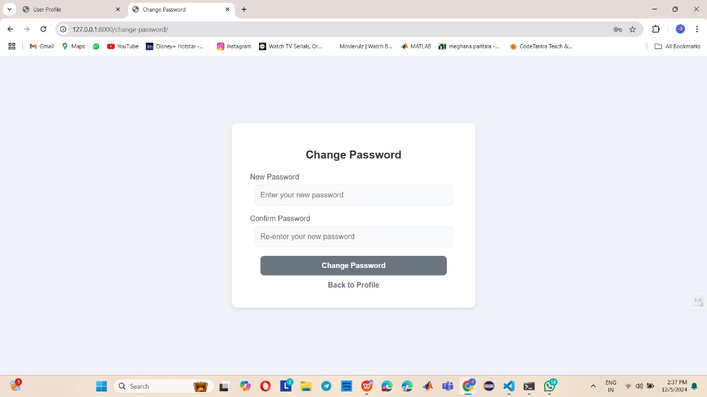
UPDATE USERNAME
CHANGE PASSWORD

Slide 20
MILESTONE - 4
The Budget Planning and Alerts feature enables users to set budget limits for expense
categories, receive alerts when nearing or exceeding limits, and compare budgets with
actual spending. It includes goal-setting and progress tracking, comprehensive error ha
-ndling, and user-friendly feedback, ensuring financial control. Test cases validate func
-tionality and reliability.

Slide 21
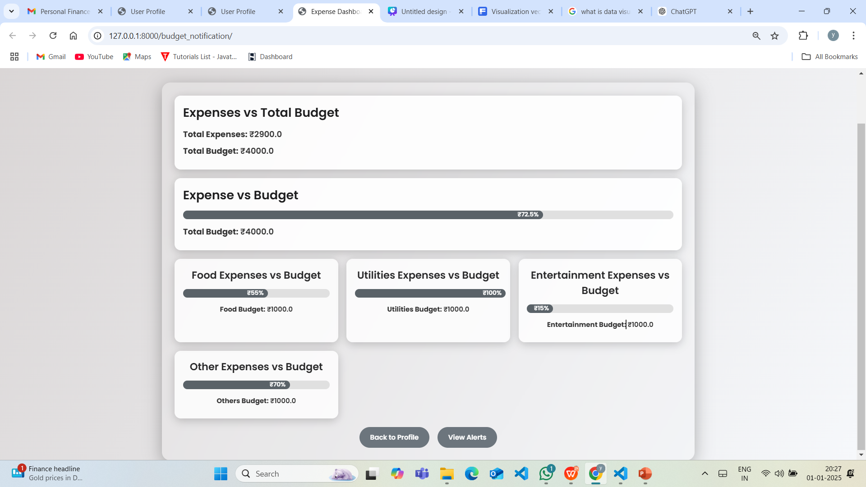
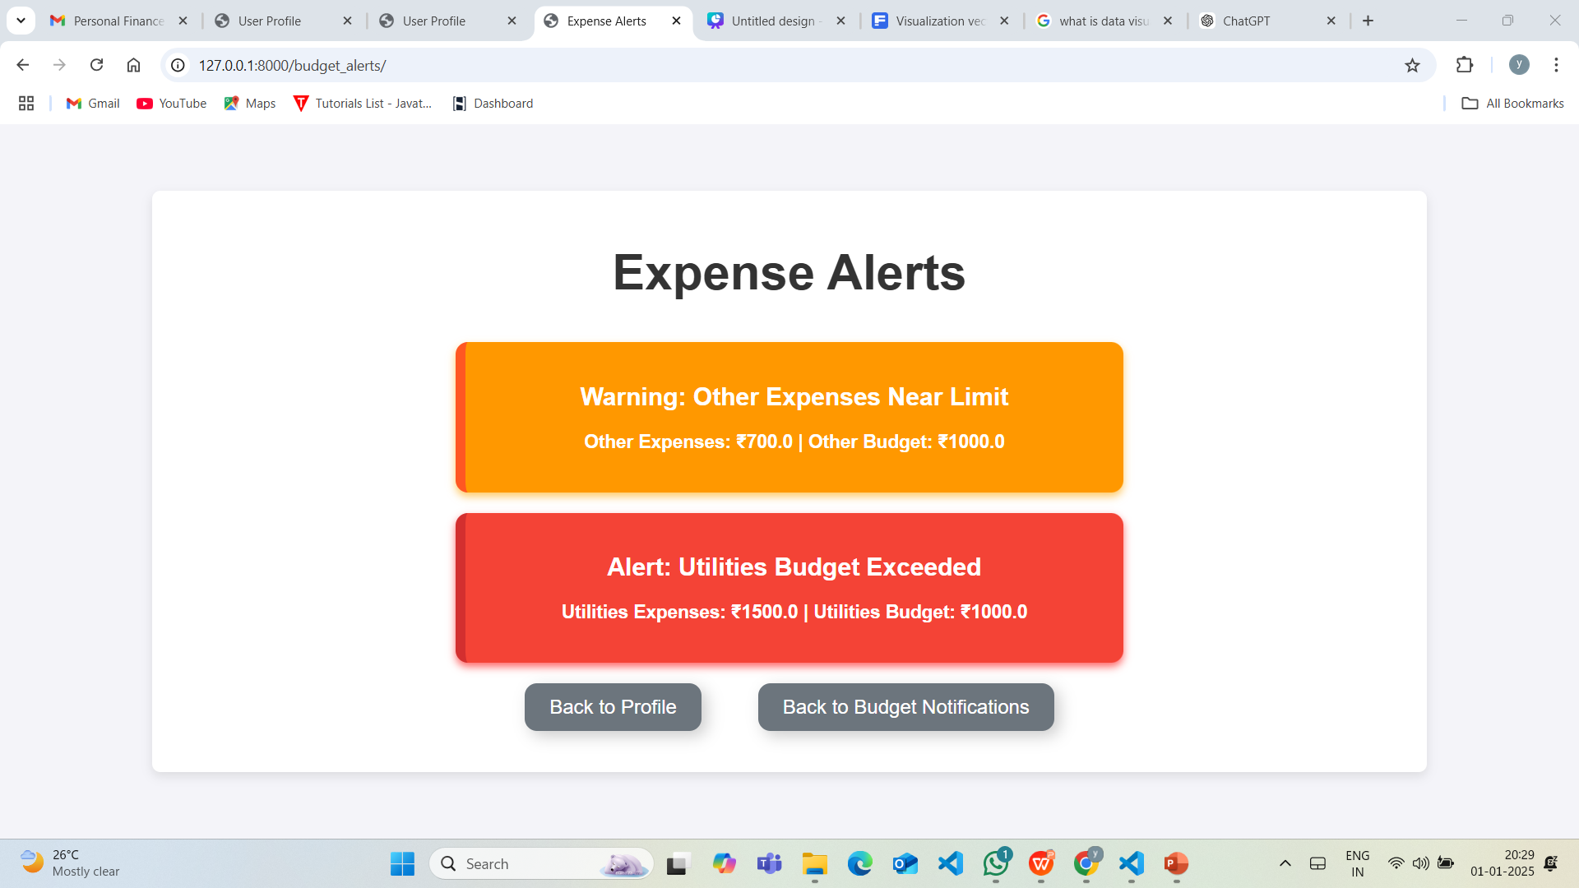
EXPENSE DASHBOARD
Expense alerts

Slide 22
CONCLUSION
The Intelligent Financial Planning Hub aims to redefine personal finance management by offering a blend of simplicity and intelligence. By integrating key functionalities like expense management, reporting, dashboard visualization, and budget planning, the hub equips users with the tools to gain complete control over their finances. The system’s ability to generate insights, visualize trends, and send alerts ensures that users remain informed and proactive about their financial health. With a focus on usability, accuracy, and efficiency, this hub aspires to be a trusted companion in achieving financial well-being for individuals in an ever-evolving economic landscape.

Slide 23
TEAM MEMBERS
Y. Baby Ramya
P. Venkata Sai Meghana

Slide 24
THANK YOU

