Slide 1
EXTENSION · RQ5
A second selection problem: the replan step
A chunking policy predicts H = 50 actions from one observation but executes only the first h of them before re-observing and re-planning. At time t₀ + k the executed action is
a_exec(t₀+k) = P[ t₀ + h·⌊k/h⌋ , k mod h ] h = n_action_steps ∈ {1 … H}
h is a deployment knob, not a learned one
…and it is tuned by a sim sweep
Nothing is retrained. The same weights span 34 → 51 % pooled success, and 36 → 68 % on the best checkpoint.
Exactly the cost offline metrics were introduced to remove for the checkpoint index k. One sweep here = 59 rollouts ≈ 8 GPU-hours.
Same question as early stopping, one level down: can a validation-set functional m̄(h) put its optimum where Q(h) puts its maximum?
Notation follows wenyan_experiment_instruction.tex: Q(·) is closed-loop LIBERO success, m̄(·) an aggregated offline metric, regret = Q(best) − Q(selected).
Yibo Zhang · Offline Trajectory Metrics for Early Stopping in VLA Fine-Tuning
17

Slide 2
METHOD
What an offline predictor can — and cannot — see
Offline, observations are always the recorded ones, so always on the expert state distribution. Online, a long horizon also hurts because execution error carries the robot off that distribution — and no metric on recorded observations can see that. These are proxies, not rollout simulations.
(i) accuracy decays with lookahead
(ii) every replan costs a discontinuity
e_k = E_t ‖ P[t,k] − a_{t+k} ‖²
A larger h forces execution of later chunk positions. If e_k rises monotonically, every accuracy-only predictor is minimised at h = 1.
‖ P_fresh[0] − P_stale[h−1] ‖² once per h steps
Each replan re-samples the flow-matching noise and re-conditions, so the executed sequence jumps. Smaller h ⇒ more jumps. Minimised at h = H.
The two effects pull in opposite directions, so the families below are built to be separable — pure-(i), pure-(ii), and λ-free combinations.
This is what makes the comparison diagnostic rather than a leaderboard: it identifies WHICH effect the offline data must model to reproduce the online ranking.
Yibo Zhang · Offline Trajectory Metrics for Early Stopping in VLA Fine-Tuning
18

Slide 3
METHOD
Four predictor families, 27 candidates
prefix_* (i) only
stitch* (i)+(ii)
smoothness (ii) only
composites & GT-free
m̄(h) = (1/h) Σ_{k<h} e_k
The existing AC-Chunk protocol with the chunk truncated to h steps. Needs no new machinery.
Risk: compares different-LENGTH sequences across h.
window fixed at H; replan every h inside it
The executed sequence is the concatenation of h-step prefixes of chunks re-predicted at t₀, t₀+h, … scored against the same GT window.
Only the replan schedule varies with h.
tv_ratio, jerk_ratio, switch_excess
Roughness of the executed sequence relative to ground truth; and the position-matched discontinuity at replan boundaries.
By construction minimised by never switching.
stitchE_l2(h) + switch(h)/h
λ-FREE: both terms are mean-squared normalised-action units, so they add with no tuned weight.
GT-free variants replace the label a_{t+k} with the policy's own fresh prediction — no action labels at all.
Distances throughout: DTW, entropic OT, cosine, L1, L2 — the same five the checkpoint-selection study ranks.
Scored with that study's conventions: ρ on the negated metric, regret in success points, and an h-independent metric charged the regret of a uniform random pick.
Yibo Zhang · Offline Trajectory Metrics for Early Stopping in VLA Fine-Tuning
19

Slide 4
EXPERIMENTAL SETUP
Five checkpoints, up to eleven horizons, 59 rollouts
SmolVLA LoRA r=32 on libero_goal, chunk H = 50. Checkpoints span the run's whole quality range so that “the metric picks h well” can be told apart from “h happened to be good at one θ_k”.
checkpoint
peak Q
grid
role
Why pooling is legitimate here
θ₃₀₀₀
30 %
core (7)
weak / early
Core grid h ∈ {1,3,5,10,15,25,50} at every checkpoint; dense adds {2,8,20,35}.
Task set, seed and episode count are identical in every cell, so episodes are paired — trial i of task j starts from the same state at every h and every θ_k.
Pooling ⇒ n = 500 per horizon, SE 2.2 instead of 5.0.
θ₈₀₀₀
48 %
core (7)
—
θ₂₂₀₀₀
58 %
dense (11)
DTW-selected
θ₄₀₅₀₀
61 %
core (7)
—
θ₇₅₅₀₀
68 %
dense (11)
online peak
Offline cost: 6.5 min GPU per checkpoint — the predicted chunk is cached at every one of the 5 016 validation frames, with two independent sampler draws. Everything after that is CPU-only.
Sanity check: re-deriving the published AC-Chunk metric from the cache at h = H reproduces metrics_history.json to within 0.7–1.7 % (flow-matching sampling noise).
Yibo Zhang · Offline Trajectory Metrics for Early Stopping in VLA Fine-Tuning
20

Slide 5
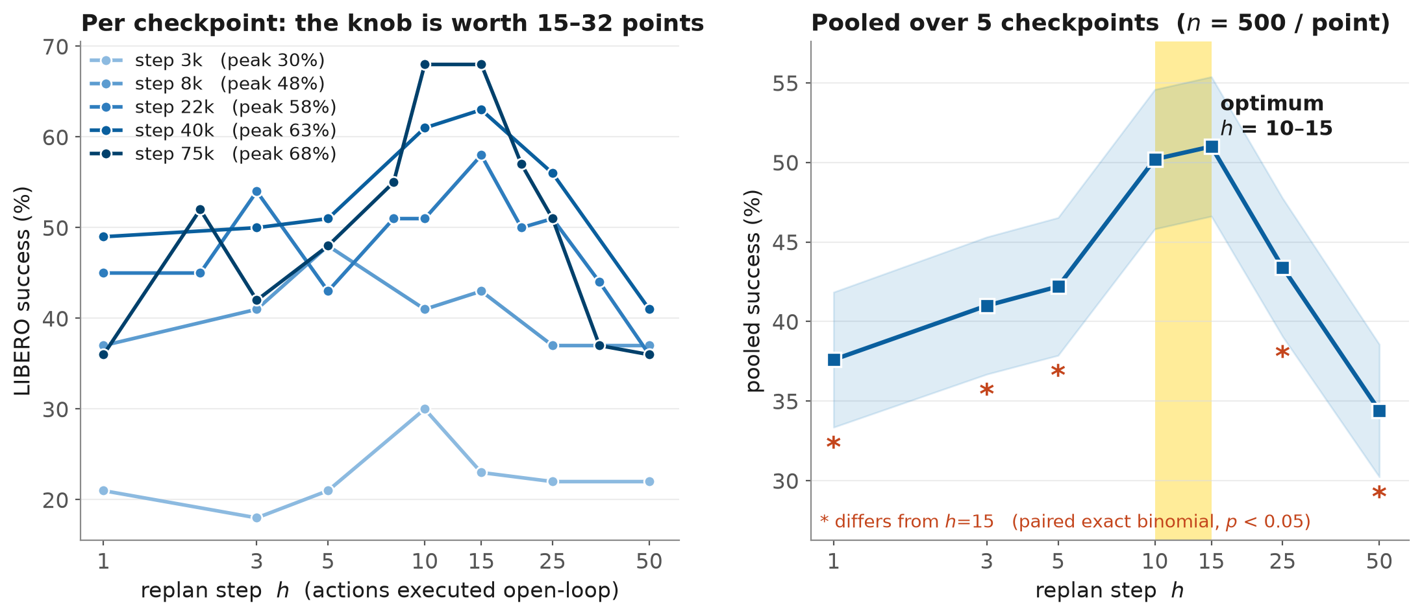
RESULT · RQ5
The knob is worth 15–32 points, and the optimum is h = 10–15
Pooled over 5 checkpoints, every horizon except h = 10 is significantly worse than h = 15 (paired exact binomial, p ≤ 0.005).
The first pass used 5 horizons at ONE checkpoint and could show only that h = 50 was bad — 14 of 25 predictors tied at zero regret. Densifying and pooling turned that unrankable tie into a resolved curve.
Yibo Zhang · Offline Trajectory Metrics for Early Stopping in VLA Fine-Tuning
21

Slide 6
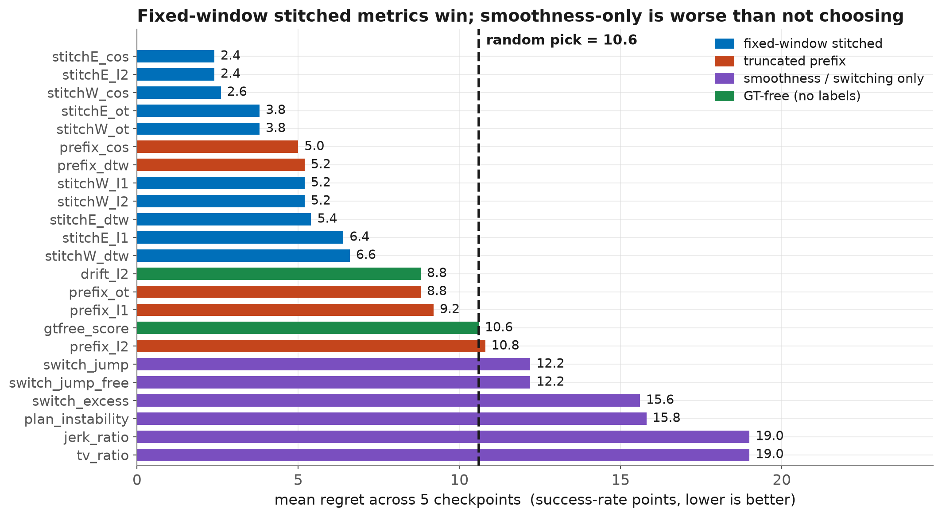
RESULT · RQ5
Which offline predictor finds it?
stitchE_cos and stitchE_l2 pick h = 15 at all five checkpoints — regret 2.4 vs 10.6 for a random pick.
All five favour them over the null ⇒ Wilcoxon p = 0.062 — the smallest attainable two-sided p at n = 5 (2/2⁵): maximal consistency, not a near-miss. More checkpoints, not more episodes, would be needed for significance.
Yibo Zhang · Offline Trajectory Metrics for Early Stopping in VLA Fine-Tuning
22

Slide 7
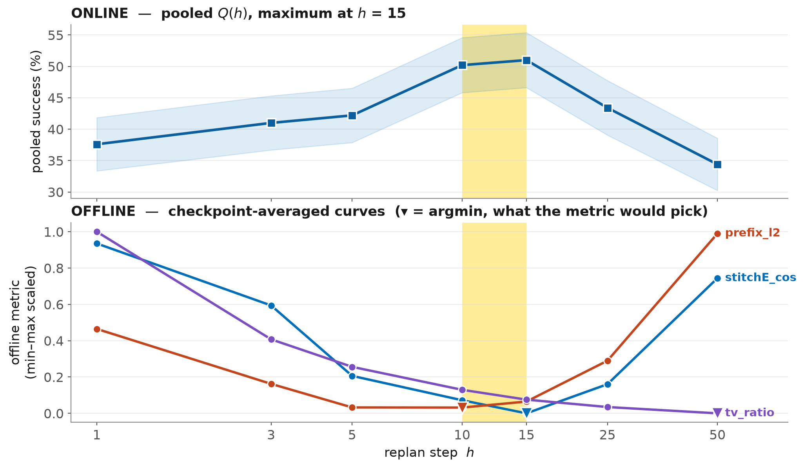
RESULT · RQ5
The offline minimum sits at the online maximum
Two quantities, one shared x-axis — never a twin y-axis. The claim is about the POSITION of the extremum in h, so that is what the reader compares.
Stitched metrics bottom out inside the online plateau; the truncated prefix bottoms out too early; smoothness-only runs the wrong way and selects the worst horizon.
Yibo Zhang · Offline Trajectory Metrics for Early Stopping in VLA Fine-Tuning
23

Slide 8
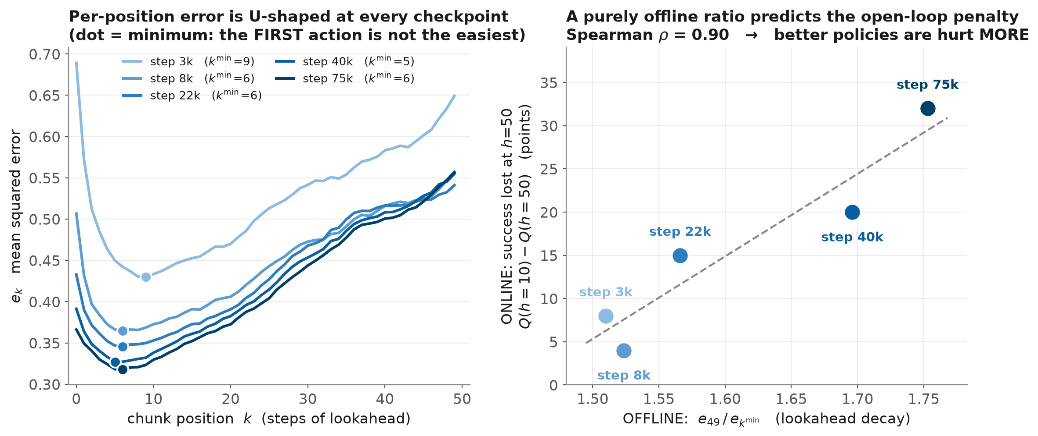
MECHANISM
Why an offline metric has an interior optimum at all
The design assumed e_k rises monotonically. It does not — e_k is U-shaped at every checkpoint, so accuracy alone already yields an interior optimum.
The sampler noise floor collapses with training (0.596 → 0.135). At θ₃₀₀₀ it is 86 % of e₀ — that plan is mostly noise, so its Q(h) is nearly flat. As the noise clears, lookahead decay is exposed and the open-loop penalty grows.
Yibo Zhang · Offline Trajectory Metrics for Early Stopping in VLA Fine-Tuning
24

Slide 9
SYNTHESIS
What the experiment establishes
▸ Yes — h is selectable offline.
A fixed-window stitched cosine or L2 metric picks h = 15 at all five checkpoints: mean regret 2.4 vs 10.6 points for a random pick, worst case 7.0 vs 18.0.
▸ The construction matters more than the distance.
Same metric, same data: stitchE_l2 = 2.4, prefix_l2 = 10.8 — no better than chance. Truncating the chunk to h compares different-length sequences, so m̄(h) is not on a common scale.
▸ DTW is the wrong distance here — and that dissociates from checkpoint selection.
Every DTW variant lands mid-pack (5.2–6.6) though DTW is the BEST metric for choosing k (ρ = 0.72). DTW is invariant to time warping, and choosing h is precisely about WHEN actions are issued.
▸ Smoothness-only criteria are actively harmful.
tv_ratio and jerk_ratio select h = 50 — the worst horizon — at every checkpoint, for 19.0 points: nearly twice the null. The switching effect belongs inside a composite, never used alone.
▸ The optimum does not measurably move with policy quality.
Per-checkpoint argmaxima are 10, 5, 15, 15, 10 — scatter inside binomial noise. One horizon serves the whole run, and the metric's job is to find that single value with zero rollouts.
Counterintuitive corollary: better policies are hurt MORE by a long horizon, not less.
At h = 50 the 68 % and 58 % checkpoints both collapse to 36 % — full open-loop execution erases the entire quality advantage.
Yibo Zhang · Offline Trajectory Metrics for Early Stopping in VLA Fine-Tuning
25

Slide 10
TAKEAWAYS & LIMITATIONS
Practical guidance, and what this cannot yet claim
Use this
Not yet claimed
1 Compute a fixed-window stitched cosine/L2 over a replan schedule and take its argmin. Do NOT truncate the chunk.
2 Do not use DTW, smoothness/jerk alone, or GT-free surrogates for this decision.
3 Rank by regret, not ρ: Q(h) is non-monotone, so ρ over ~7 points is uninformative.
4 Never tune h on an early checkpoint. It mis-sets the value AND understates how much the knob matters.
— One model, one task suite. π₀.₅ puts its optimum lower (h ≈ 6–12), so the VALUE of h does not transfer even if the method does.
— Five checkpoints caps the significance test at p = 0.062. The binding constraint is checkpoints, not episodes.
— Off-distribution drift stays invisible offline. The predictors work because e_k rises for the same reason open-loop degrades — empirical, not guaranteed.
— Two earlier readings of this experiment were sparse-data artifacts; only the five-checkpoint aggregate separates the families.
Next step, already cheap: π₀.₅ has eight online Q(h) points at step_48499 / step_73499.
Two 6.5-minute caches would test whether the METHOD transfers across architectures against ground truth that already exists.
Yibo Zhang · Offline Trajectory Metrics for Early Stopping in VLA Fine-Tuning
26

