Slide 1
MASTER'S THESIS DEFENCE · AALTO UNIVERSITY
Offline Trajectory Metrics for Early Stopping
in Vision-Language-Action Model Fine-Tuning
When should you stop fine-tuning a robot policy — without running it?
Yibo Zhang
Supervisor: Prof. Joni Pajarinen Advisor: Dr. Wenyan Yang
Department of Electrical Engineering and Automation · Aalto Robot Learning Lab
Espoo, 21 July 2026
Notes:
Good morning. My thesis asks a very practical question in robot learning: when fine-tuning a vision-language-action model, when do we stop? The honest answer today is 'after a fixed number of steps' — and I'll show why that's wrong, and what cheap offline signal we can use instead. [~40s] Target: finish by slide 17 in 20 minutes, leaving time for questions.

Slide 2
MOTIVATION
Fine-tuning a VLA: powerful, but when do we stop?
— VLAs are the foundation-model recipe for robots. One model maps camera + language instruction to robot actions.
— Deployment means fine-tuning. A pretrained VLA is adapted with LoRA to a new task, robot, or scene.
— Training is stopped by a fixed budget. State-of-the-art VLAs train for a preset number of steps — no validation-based stopping rule.
— But the optimum is not fixed. It shifts with dataset size, learning rate, and batch size: too long overfits, too short underfits.
The core tension
— Online success = truth, but a rollout per checkpoint is slow, high-variance, and can damage hardware.
— Training loss = cheap, but a poor proxy for closed-loop task success.
— We need a middle ground: an offline signal, computed every checkpoint, that predicts success.
Yibo Zhang · Offline Trajectory Metrics for Early Stopping in VLA Fine-Tuning
1
Notes:
VLAs are the robot version of foundation models. In practice we don't train from scratch — we fine-tune with LoRA. The problem: everyone trains for a fixed number of steps, with no principled stopping criterion. The optimum isn't fixed — it depends on data size, LR, batch size. The tension on the right frames the whole thesis: online success is the truth but too expensive to measure every checkpoint; training loss is cheap but a bad proxy. We want something in between. [~1:15]

Slide 3
THE PROBLEM
Why training loss is the wrong stopping signal
Teacher-forced, per-step
Not aligned with success
Averaging hides structure
Loss is computed on ground-truth context, one timestep at a time. It never sees a rolled-out trajectory, so it is blind to compounding error.
In behaviour cloning, validation loss correlates only weakly with closed-loop success. The loss-minimising checkpoint is not the success-maximising one.
A scalar mean of per-step errors cannot separate a smooth-but-lagged motion from a jittery-but-timed one — errors of shape vs. phase.
Consequence — early stopping on loss can pick a checkpoint that is worse in the only sense that matters at deployment. This thesis measures that cost directly as selection regret.
Yibo Zhang · Offline Trajectory Metrics for Early Stopping in VLA Fine-Tuning
2
Notes:
Three structural reasons loss fails. One: it's teacher-forced and per-step — never a rollout, so blind to compounding error. Two: empirically it correlates weakly with success in BC. Three: it's an average, so it can't tell a lagged-but-smooth motion from a jittery one. The consequence, bottom, is that stopping on loss forgoes real success — I quantify that as selection regret. [~1:10]

Slide 4
PROPOSED IDEA
Compare whole trajectories, not single steps
Chunking VLAs predict a short sequence of future actions. That makes the unit of comparison a trajectory segment — so geometric, sequence-level similarity to the expert becomes measurable.
DTW
OT
COS
NLL
Dynamic Time Warping
Optimal Transport
Cosine distance
Likelihood surrogate
Aligns two sequences in time. Tolerant of pace / phase lag — forgives a correct shape run slightly fast or slow.
Matches sequences as distributions of waypoints (entropic Sinkhorn). Geometry-aware and a true metric.
Per-step direction agreement, magnitude-blind. Cheap; used alongside, never alone.
Token NLL for discrete policies; the flow-matching / L1–L2 loss stands in for continuous ones.
All metrics normalised per action dimension, lower = better. L1 / L2 per-step distances serve as the baseline the geometric metrics must beat.
Yibo Zhang · Offline Trajectory Metrics for Early Stopping in VLA Fine-Tuning
3
Notes:
The key idea: chunking VLAs output a sequence, so we can compare trajectory segments, not steps. Four candidate metrics. DTW aligns in time — forgives pace. OT matches waypoint distributions, a true metric. Cosine is cheap directional agreement, magnitude-blind, so only ever a companion. NLL is the probabilistic one, but the surrogate is architecture-dependent — remember that, it comes back in the results. L1/L2 are the baseline the geometric metrics must beat. [~1:20]

Slide 5
METHOD
The pipeline: score → select → judge
1
Score every checkpoint
On held-out expert data, compute the trajectory metric m̄(k) for each saved checkpoint.
2
Select one checkpoint
Early-stopping rule: earliest checkpoint within 1% of the metric's best value → k*_m.
3
Judge the metric
Against true success Q(k): Spearman ρ (ranking) and selection regret (success forgone).
Selection rule: k*_m = min { k : m̄(k) ≤ min m̄ + η }, η = 0.01 · |m̄(0) − min m̄| Regret(m) = max_k Q(k) − Q(k*_m)
Yibo Zhang · Offline Trajectory Metrics for Early Stopping in VLA Fine-Tuning
4
Notes:
The method is three steps applied identically to every checkpoint. One: score each checkpoint with the metric on held-out data. Two: the early-stopping rule turns that curve into a single choice — the earliest checkpoint within 1% of the best value, so we don't chase one noisy minimum. Three: judge each metric against true success by two numbers — Spearman rho for ranking and regret for the success we gave up. High rho, low regret is a good metric. [~1:10]

Slide 6
RESEARCH QUESTIONS
Four questions, each a check on the last
RQ1 Do the metrics carry any information at all?
RQ2 Do they correlate with closed-loop success?
Model-independent precondition: can a metric tell same-task from different-task expert trajectories? If not, it is disqualified.
The central question — across 3 architectures and 2 data sizes, does the offline signal predict online success Q(k)?
RQ3 Is metric-based early stopping effective?
RQ4 Which differences are statistically real?
Does the signal survive the hard, converged plateau — and can it catch genuine overtraining when it happens?
With as few as 11 evaluations per run, which rankings survive bootstrap resampling rather than sampling noise?
Yibo Zhang · Offline Trajectory Metrics for Early Stopping in VLA Fine-Tuning
5
Notes:
I organised the study as four research questions, each a precondition for the next. RQ1: do the metrics carry any task information at all — a sanity check before anything else. RQ2, the heart: do they predict success, across architectures and data sizes. RQ3: do they still work in the hard converged regime, and can they catch overtraining. RQ4: with tiny evaluation budgets, which differences are statistically real. I'll answer them in order. [~1:00]

Slide 7
EXPERIMENTAL SETUP
Three architectures, five LoRA runs, one benchmark
— OpenVLA (7B) — discrete-token, autoregressive. The likelihood is a genuine token NLL.
— SmolVLA (450M) — flow-matching, edge-scale.
— π₀.₅ (4B) — flow-matching, Physical Intelligence.
— Benchmark: LIBERO-Goal — 10 tasks, shared scene, varying instruction: the suite with the most action-sequence diversity.
— Ground truth Q(k) — 100-episode simulated success, ±5% noise; sparse by design (11–33 evals per run).
The five fine-tuning runs
Run
Arch.
Train
Peak Q
SmolVLA-150
FM 450M
150
0.68
OpenVLA-150
tok 7B
150
0.83
OpenVLA-full
tok 7B
342
0.78
π₀.₅-full
FM 4B
342
0.18†
π₀.₅-150
FM 4B
150
0.38†
† π₀.₅ rows use different replan horizons — only relative metric ranking is meaningful.
Yibo Zhang · Offline Trajectory Metrics for Early Stopping in VLA Fine-Tuning
6
Notes:
Setup. Three architectures spanning both paradigms: OpenVLA is discrete-token — importantly its NLL is a real likelihood. SmolVLA and pi-0.5 are flow-matching. Five runs cross architecture with data size, plus a deliberate pi-0.5 overtraining stress run. Benchmark is LIBERO-Goal, chosen because varying only the instruction gives the most action diversity. Truth is 100-episode success, but sparse and noisy — that sparsity drives RQ4. The dagger note: the two pi-0.5 rows use different horizons, so compare rankings within a row, not absolute levels. [~1:20]

Slide 8
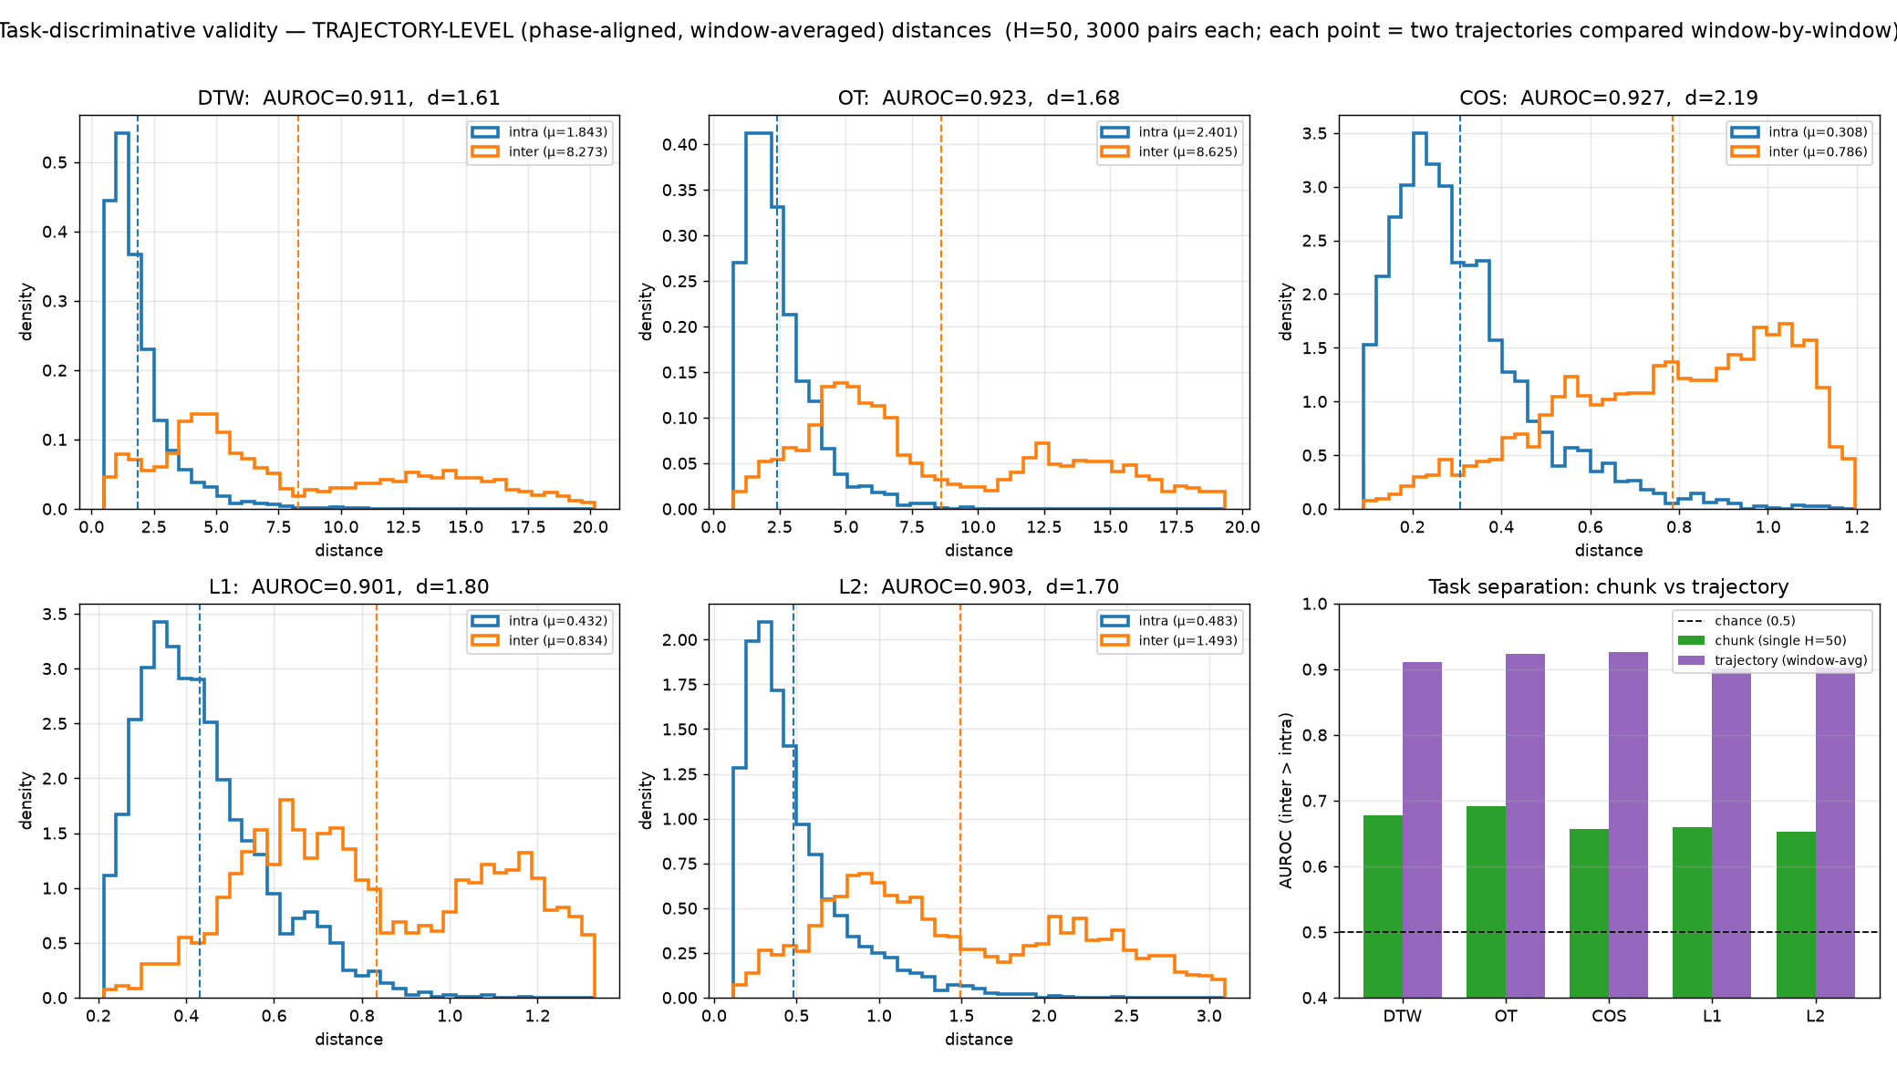
RESULT · RQ1
Do the metrics carry task information? Yes.
Test
Same-task trajectories must score closer than different-task ones — measured by AUROC.
— Single chunk: AUROC 0.65–0.69 — tasks share a common motion vocabulary.
— Trajectory-level: AUROC ≥ 0.90 for every metric — Cohen's d roughly triples.
— Phase alignment, not averaging, drives the gain (DTW intra-distance 7.06 → 1.84).
Verdict: all five metrics pass the precondition — none is disqualified.
Yibo Zhang · Offline Trajectory Metrics for Early Stopping in VLA Fine-Tuning
7
Notes:
RQ1, the sanity check. Can a metric tell two demos of the same task from different tasks, on ground truth alone? On a single 50-step chunk, barely — AUROC 0.65-0.69, because all LIBERO tasks reach, grasp, transport. But aggregate a whole trajectory phase-aligned, and every metric jumps above 0.90. Crucially it's the phase alignment, not just averaging away noise — DTW's within-task distance collapses while across-task barely moves. All five pass. This is why I use the trajectory-level estimator everywhere after. [~1:10]

Slide 9
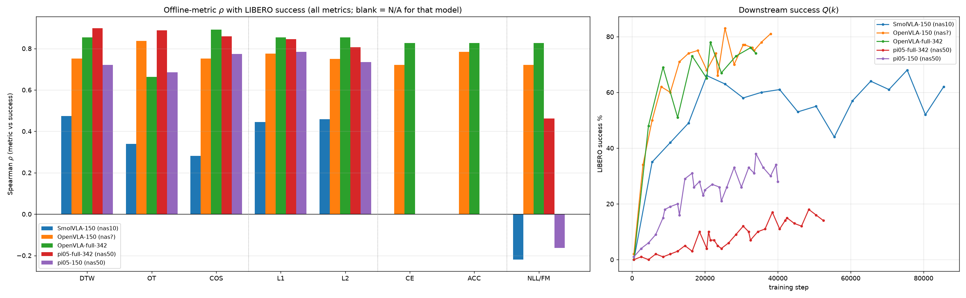
RESULT · RQ2
Trajectory metrics track success in every run
DTW is positive in all five runs — ρ = 0.47 / 0.75 / 0.85 / 0.90 / 0.72 — and its selection regret never exceeds 0.17.
Trajectory (DTW/OT/cosine) and regression (L1/L2) metrics are positive across both architectures and both data sizes. The likelihood family (right-hand bars) is the one that splits by architecture.
Yibo Zhang · Offline Trajectory Metrics for Early Stopping in VLA Fine-Tuning
8
Notes:
RQ2, the headline. Left: Spearman rho of every metric with success, per run. Right: the success curves. The trajectory metrics — DTW, OT, cosine — and the L1/L2 baselines are positive in every single run, across discrete-token and flow-matching, across 150 and full data. DTW specifically: 0.47 to 0.90, never negative, regret never above 0.17 — the most consistent default. The one family that behaves differently is likelihood — hold that thought for RQ4. [~1:05]

Slide 10
RESULT · RQ2
Per-run rankings: a family of comparable metrics
OpenVLA-full (discrete-token)
π₀.₅-full (flow-matching)
SmolVLA-150 (flow-matching)
Metric
ρ
Regret
Metric
ρ
Regret
Metric
ρ
Regret
Cosine
+0.89
0.05
DTW
+0.90
0.04
DTW
+0.47
0.02
DTW
+0.85
0.00
OT
+0.89
0.04
L₂
+0.46
0.05
L₂
+0.85
0.00
Cosine
+0.86
0.04
L₁
+0.44
0.24
L₁
+0.85
0.05
L₁
+0.84
0.04
OT
+0.34
0.26
CE / Acc / NLL
+0.83
0.04
L₂
+0.81
0.04
Cosine
+0.28
0.08
OT
+0.66
0.04
NLL / FM
+0.46
0.08
NLL / FM
−0.22
0.19
Two patterns: (1) on OpenVLA-full, DTW and L₂ pick the identical checkpoint (21499) with identical ρ and zero regret; (2) the NLL/FM surrogate collapses on flow-matching runs (green, purple) while staying strong on discrete-token (blue).
Yibo Zhang · Offline Trajectory Metrics for Early Stopping in VLA Fine-Tuning
9
Notes:
Zooming in per run. Two things to see. First, the trajectory and regression metrics are interchangeable — on OpenVLA-full, DTW and L2 literally select the same checkpoint, 21499, same rho, zero regret. So this is a family of comparable choices, not a strict winner. Second, look at the highlighted NLL/FM row: strong on the blue discrete-token table, but collapses to 0.46 and even negative on the flow-matching tables. That architecture split is the RQ4 story. [~1:15]

Slide 11
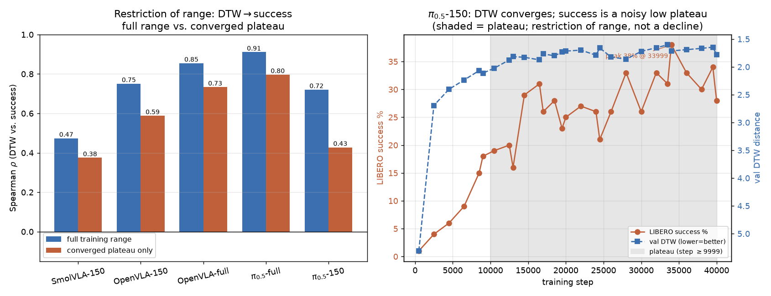
RESULT · RQ3
Effective for the coarse decision; harder on the plateau
Full range vs. converged plateau
Run
ρ full
ρ plat
SmolVLA-150
+0.47
+0.38
OpenVLA-150
+0.75
+0.59
OpenVLA-full
+0.86
+0.73
π₀.₅-full
+0.91
+0.80
π₀.₅-150
+0.72
+0.43
— Coarse decision is robust: “do not stop before the knee” holds at ρ ≈ 0.8–0.9 over the full descent, every run.
— Fine-ranking the plateau is harder but stays usable (ρ ≥ 0.59) for four of five runs.
— π₀.₅-150 is the exception — and it is an artifact: the apparent 31%→23% dip recovers to 38% once training is extended. A noisy low ceiling, not real overtraining.
Yibo Zhang · Offline Trajectory Metrics for Early Stopping in VLA Fine-Tuning
10
Notes:
RQ3: is it actually usable for stopping? Split each run at the knee — where DTW has done 90% of its descent — and recompute rho before vs after. Full-range rho is 0.8-0.9 everywhere, so the coarse decision 'don't stop before the knee' is rock-solid. Inside the plateau it weakens but stays usable, 0.59+, for four of five. The exception, pi-0.5-150 in red, looked like overtraining — success fell 31 to 23% — but extending training recovered it to 38%. So it was restriction of range on a noisy low ceiling, not a real decline. [~1:15]

Slide 12
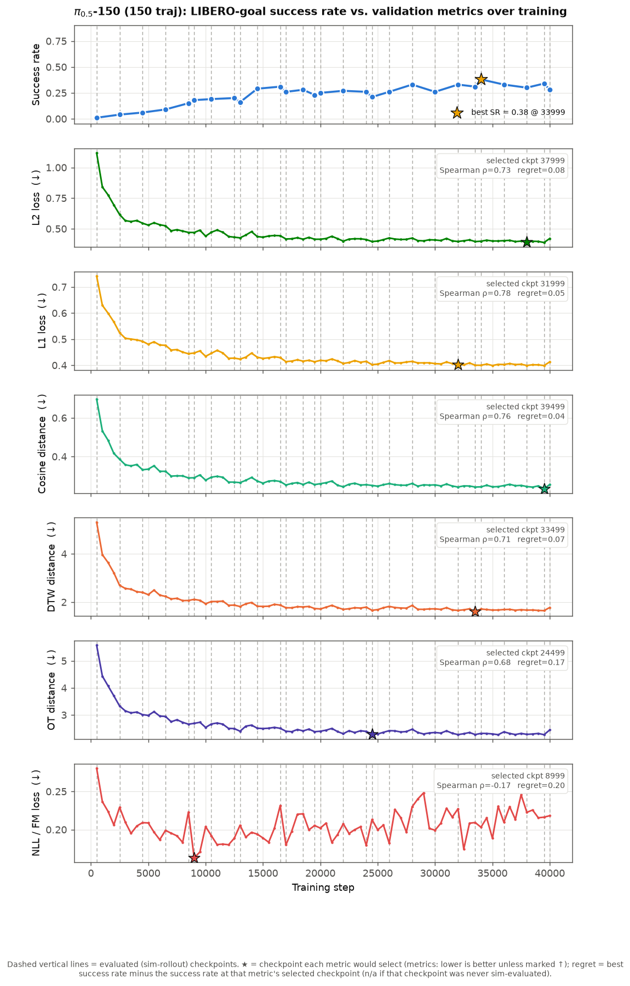
RESULT · RQ3
The overtraining we tried to induce never came
Three runs were designed to overtrain
— SmolVLA-150 & OpenVLA-150 — small data, pushed well past convergence.
— π₀.₅-150 — aggressive LR (6×), a non-decaying schedule, 40k steps.
— Outcome: every run settled into a noisy plateau in both the offline metrics and Q(k) — no monotone late decline.
Honest limitation. Because no run genuinely overtrained, I cannot show the metrics catching a real decline — only that they reliably track the rise and plateau. Proving the preventive value of early stopping needs a run that actually degrades.
Yibo Zhang · Offline Trajectory Metrics for Early Stopping in VLA Fine-Tuning
11
Notes:
A point of intellectual honesty. Three runs were built to force overtraining — tiny data, and for pi-0.5-150 an aggressive 6x learning rate held near peak for 40k steps. It still didn't overtrain: everything settled into a noisy plateau. So I can show the metrics track the rise and plateau, but I cannot show them catching a genuine late decline, because I never produced one. That's a real limitation and I'll return to it. [~1:00]

Slide 13
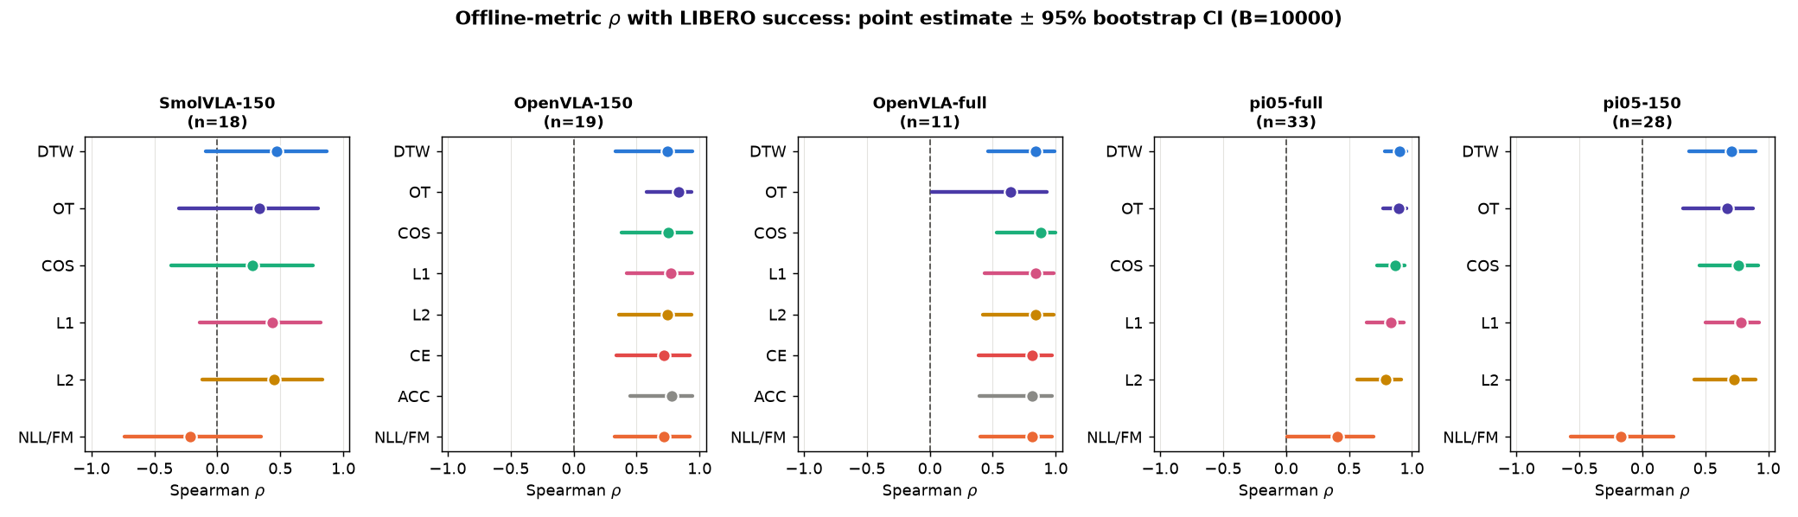
RESULT · RQ4
How much of the ranking is real? Power is the limit
What is statistically resolved
What is NOT resolved
— Architecture split of NLL — significant: real token likelihood works, the FM surrogate does not.
— π₀.₅-full (n=33) — well-powered; DTW’s CI spans < 0.20.
— DTW vs. L1/L2/OT/cosine — intervals overlap; on OpenVLA-full DTW ≡ L₂ exactly.
— SmolVLA-150 (n=18) — no metric clears zero at 95%: too few, too converged.
Yibo Zhang · Offline Trajectory Metrics for Early Stopping in VLA Fine-Tuning
12
Notes:
RQ4 keeps me honest about what the numbers support. Point estimates come from as few as 11 evaluations, so I bootstrap a 95% CI on every rho and on paired differences. What survives, left: the architecture split of NLL is real, and the well-powered pi-0.5-full resolves fine structure. What doesn't, right: DTW is not statistically separable from L1, L2, OT or cosine — they're one family. And underpowered SmolVLA-150 can't clear zero at all. The binding constraint is usually statistical power, not the choice of metric. [~1:10]

Slide 14
SYNTHESIS
The four questions, answered
RQ1
Yes — every metric is task-discriminative (AUROC ≥ 0.90) at the trajectory level.
RQ2
Yes — DTW/OT/cosine (and L1/L2) correlate positively with success in all five runs.
RQ3
Partly — robust for the coarse “don’t stop early” call; genuine overtraining never occurred.
RQ4
Qualified — the architecture split is real; finer metric orderings need more evaluations.
Yibo Zhang · Offline Trajectory Metrics for Early Stopping in VLA Fine-Tuning
13
Notes:
So, the four answers. RQ1 yes, cleanly. RQ2 yes — the core positive result, architecture-general. RQ3 a qualified yes: excellent for the coarse decision, but I couldn't test the overtraining case. RQ4 qualified: the one hard, significant claim is the NLL architecture split; the rest is a family of comparable metrics limited by evaluation budget. Two green, two amber — I think that's an honest scorecard. [~1:00]

Slide 15
TAKEAWAYS
Practical guidance for VLA practitioners
1 Use a trajectory-similarity metric.
2 Trust the coarse decision.
DTW is the safest default: positive in every run, regret ≤ 0.17, never negative.
“Do not stop before the knee” is reliable; fine-ranking a converged plateau is not.
3 Match the surrogate to the architecture.
4 Report uncertainty, not point ranks.
Token NLL is fine for discrete-token policies; for flow-matching, use a trajectory metric, not the FM loss.
With 10–30 rollouts, bootstrap CIs — most single-metric orderings are noise.
Yibo Zhang · Offline Trajectory Metrics for Early Stopping in VLA Fine-Tuning
14
Notes:
If you take four things away as a practitioner. One: use a trajectory metric — DTW is the safe default. Two: trust the coarse call, don't stop before the knee, but don't over-trust fine ranking on the plateau. Three: match the surrogate to the architecture — token NLL for discrete, a trajectory metric for flow-matching. Four: with tiny rollout budgets, report confidence intervals, because most single-metric orderings are noise. [~1:00]

Slide 16
LIMITATIONS & FUTURE WORK
What this study cannot yet claim
Open-loop only
No overtraining regime
Sparse, confounded Q(k)
Metrics score teacher-forced action chunks, not rollouts. A learned world model would test whether they also predict compounding closed-loop error.
No run genuinely degraded, so the preventive value of early stopping is untested. Longer runs at higher LR are needed to force a decline.
11–33 evals per run, and two π₀.₅ runs at mismatched horizons. Denser, horizon-matched evaluation would resolve DTW vs. L1/L2.
None of these overturns the central claim — they mark where the evidence stops and the next study begins.
Yibo Zhang · Offline Trajectory Metrics for Early Stopping in VLA Fine-Tuning
15
Notes:
Three limitations, stated plainly. One: everything here is open-loop, teacher-forced chunks — a world-model rollout would test compounding error directly. Two, the big one: no run overtrained, so I can't claim early stopping prevents degradation, only that it tracks the plateau. Three: success was measured sparsely and, for pi-0.5, at mismatched horizons — denser matched evaluation would finally separate DTW from L1/L2. None of these breaks the main result; they mark where the next study starts. [~1:05]

Slide 17
CONCLUSION
An offline trajectory-similarity metric, computed once
per checkpoint, is a practical, architecture-agnostic
signal for when to stop fine-tuning a VLA.
— Validated across 3 architectures, 5 runs, and a 10-task benchmark — DTW the safest default.
— Honest about scope — coarse stopping proven; overtraining and closed-loop rollout remain open.
Thank you — I welcome your questions.
Yibo Zhang · zjack0127@gmail.com
Supervisor: Prof. Joni Pajarinen · Advisor: Dr. Wenyan Yang · Aalto Robot Learning Lab
Notes:
To conclude: a single offline trajectory metric, computed once per checkpoint, is a practical, architecture-agnostic answer to when to stop fine-tuning a VLA. Validated across three architectures and five runs, with DTW as the safe default — and honest about what's still open: the overtraining case and true closed-loop rollout. Thank you, I'm happy to take questions. [Total ~19 min, leaving buffer.] Backup slides / thesis tables ready for detail questions.

