Slide 1
MSc THESIS SEMINAR · AALTO UNIVERSITY
Offline Trajectory Metrics for Early Stopping in Vision-Language-Action Model Fine-Tuning
When should the robot policy fine-tuning stop — without really running it?
Yibo Zhang
Supervisor: Prof. Joni Pajarinen Advisor: Dr. Wenyan Yang
Department of Electrical Engineering and Automation · Aalto Robot Learning Lab
Espoo, 21 July 2026
Notes:
Good morning. My thesis asks a very practical question in robot learning: when fine-tuning a vision-language-action model, when do we stop? The honest answer today is 'after a fixed number of steps' — and I'll show why that is often suboptimal, and what cheap offline signal we can use instead. [~40s] Target: ~22 minutes of talk within the 30-minute slot, leaving time for questions.

Slide 2
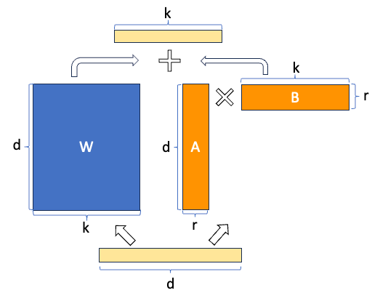
BACKGROUND
A glance of the workflow
Robot policy (VLA)
Fine-tuning (LoRA)
A neural network that takes a camera image plus a plain-language instruction (“put the carrot on the plate”) and outputs the robot’s next movements.
Adapting a large pretrained model to a new domain with a small dataset by adding an adapter multiped by two low rank matrics. (LoRA).
Checkpoint
Early stopping
A snapshot of the model saved periodically during training. LoRA adapter is saved instead of the entire parameter.
Choosing which snapshot to keep requires an efficient signal that predicts real performance.
Research problem: can we predict how well the robot will perform — without the cost of actually running it?
Yibo Zhang · Offline Trajectory Metrics for Early Stopping in VLA Fine-Tuning
1
Notes:
A quick primer, since this room spans several fields. A VLA is one network that maps a camera image and a language instruction to robot actions. We do not train it from scratch — we fine-tune a pretrained model with LoRA, which is cheap. During training we periodically save checkpoints, and the practical question is simply which checkpoint to keep. Choosing the best one is early stopping, and doing it well needs a signal that predicts real robot performance — ideally without running the robot every time. That is what the rest of the talk is about. [~55s]

Slide 3
MOTIVATION
Why to design an early-stopping signal
The core tension
— Training is stopped by a fixed budget. Many current VLAs are trained for a preset number of steps, with no validation-based stopping rule.
— But the optimum is not fixed. It shifts with dataset size, learning rate, and batch size: too long overfits, too short underfits.
— Closed-loop success rate = ground truth, but a rollout per checkpoint is slow, high-variance, expensive, even damage hardware.
— Training loss = cheap, but cannot guarantee general performance, nor avoid over-fitting
-> We need a middle ground: an offline signal, computed every checkpoint on validation dataset to predicts success
Yibo Zhang · Offline Trajectory Metrics for Early Stopping in VLA Fine-Tuning
2
Notes:
VLAs are the robot version of foundation models. In practice we don't train from scratch — we fine-tune with LoRA. The problem: everyone trains for a fixed number of steps, with no principled stopping criterion. The optimum isn't fixed — it depends on data size, LR, batch size. The tension on the right frames the whole thesis: online success is the truth but too expensive to measure every checkpoint; training loss is cheap but a bad proxy. We want something in between. [~1:15]

Slide 4
THE PROBLEM
Limitation of offline loss in validation
Teacher-forcing causes Exposure Bias and Error Accumulation
Weakly aligned with success
Averaging hides structure
Loss is computed on ground-truth context instead of the prediction
In behaviour cloning, a minimum validation loss doesn’t guarantee a best success rate.
A scalar mean of per-step errors does not distinguish a smooth-but-lagged motion from a jittery-but-timed one — lose trajectory spacial-temperal structure.
Consequence — early stopping on loss can pick a checkpoint with a success-rate gap with the global-optimal. This thesis measures that cost directly as selection regret.
Yibo Zhang · Offline Trajectory Metrics for Early Stopping in VLA Fine-Tuning
3
Notes:
Three structural reasons loss fails. One: it's teacher-forced and per-step — never a rollout, so blind to compounding error. Two: empirically it correlates weakly with success in BC. Three: it's an average, so it can't tell a lagged-but-smooth motion from a jittery one. The consequence, bottom, is that stopping on loss forgoes real success — I quantify that as selection regret. [~1:10]

Slide 5
PROPOSED IDEA
Compare trajectory chunks, not single steps
Make geometric, sequence-level similarity to the expert becomes measurable.
DTW
OT
COS
Dynamic Time Warping
Optimal Transport
Cosine distance
Aligns two sequences in time. Tolerant of pace / phase lag — forgives a correct shape run slightly fast or slow.
Matches sequences as distributions of waypoints (entropic Sinkhorn). Geometry-aware and a true metric.
Per-step direction agreement, magnitude-blind. Cheap; used alongside, never alone.
All metrics normalised per action dimension, lower = better.
L1 / L2 per-step distances, NLL (discrete) / flow-matching loss (continuous) serve as the baseline comparation.
Yibo Zhang · Offline Trajectory Metrics for Early Stopping in VLA Fine-Tuning
4
Notes:
The key idea: chunking VLAs output a sequence, so we can compare trajectory segments, not steps. Four candidate metrics. DTW aligns in time — forgives pace. OT matches waypoint distributions, a true metric. Cosine is cheap directional agreement, magnitude-blind, so only ever a companion. NLL is the probabilistic one, but the surrogate is architecture-dependent — remember that, it comes back in the results. L1/L2 are the baseline the geometric metrics must beat. [~1:20]

Slide 6
METHOD
The pipeline: score → select → judge
1
Score every checkpoint
On held-out expert data, compute the trajectory metric m̄(k) for each saved checkpoint.
2
Select one checkpoint
Early-stopping rule: earliest checkpoint within 1% of the metric's best value → k*_m.
3
Judge the metric
Against true success Q(k): Spearman ρ (rank agreement, +1 to −1) and selection regret (success forgone).
Selection rule: k*_m = min { k : m̄(k) ≤ min m̄ + η }, η = 0.01 · |m̄(0) − min m̄| Regret(m) = max_k Q(k) − Q(k*_m)
Yibo Zhang · Offline Trajectory Metrics for Early Stopping in VLA Fine-Tuning
5
Notes:
The method is three steps applied identically to every checkpoint. One: score each checkpoint with the metric on held-out data. Two: the early-stopping rule turns that curve into a single choice — the earliest checkpoint within 1% of the best value, so we don't chase one noisy minimum. Three: judge each metric against true success by two numbers — Spearman rho for ranking and regret for the success we gave up. High rho, low regret is a good metric. [~1:10]

Slide 7
RESEARCH QUESTIONS
Four questions, each a check on the last
RQ1 Do the metrics show a trajectory’s similarity to expert demonstrations?
RQ2 Do they correlate with closed-loop success?
Can a metric show (a) high similarity among same-task trajectories, and (b) low similarity among different-task trajectories? If not, it is disqualified.
The central question — across 3 architectures and 2 data sizes, does the offline signal predict online success Q(k)?
RQ3 Is metric-based early stopping effective?
RQ4 Which differences are statistically real?
Does the signal survive the hard, converged plateau — and can it catch genuine overtraining when it happens?
Which rankings survive bootstrap resampling rather than sampling noise?
Yibo Zhang · Offline Trajectory Metrics for Early Stopping in VLA Fine-Tuning
6
Notes:
I organised the study as four research questions, each a precondition for the next. RQ1: do the metrics carry any task information at all — a sanity check before anything else. RQ2, the heart: do they predict success, across architectures and data sizes. RQ3: do they still work in the hard converged regime, and can they catch overtraining. RQ4: with tiny evaluation budgets, which differences are statistically real. I'll answer them in order. [~1:00]

Slide 8
EXPERIMENTAL SETUP
Three architectures, five LoRA runs, one benchmark
Experiment VLA Models
— OpenVLA (7B) — single-step action, discrete action space based on token. The likelihood is a genuine token NLL.
— SmolVLA (450M) — chunk action, continous action space based on flow-matching.
— π₀.₅ (4B) — chunk action, continous action space based on flow-matching.
Benchmark: LIBERO-Goal — 10 tasks, shared scene, varying instruction: the LIBERO suite with the most instruction-driven action diversity.
Ground truth Q(k) — 100-episode simulated success, ±5% noise; sparse by design (11–33 evals per run).
The five fine-tuning runs
Run
Arch.
Train
Peak Q
SmolVLA-150
FM 450M
150
0.68
OpenVLA-150
tok 7B
150
0.83
OpenVLA-full
tok 7B
342
0.78
π₀.₅-full
FM 4B
342
0.18†
π₀.₅-150
FM 4B
150
0.38†
† π₀.₅ rows use different replan horizons — only relative metric ranking is meaningful.
Yibo Zhang · Offline Trajectory Metrics for Early Stopping in VLA Fine-Tuning
7
Notes:
Setup. Three architectures spanning both paradigms: OpenVLA is discrete-token — importantly its NLL is a real likelihood. SmolVLA and pi-0.5 are flow-matching. Five runs cross architecture with data size, plus a deliberate pi-0.5 overtraining stress run. Benchmark is LIBERO-Goal, chosen because varying only the instruction gives the most action diversity. Truth is 100-episode success, but sparse and noisy — that sparsity drives RQ4. The dagger note: the two pi-0.5 rows use different horizons, so compare rankings within a row, not absolute levels. [~1:20]

Slide 9
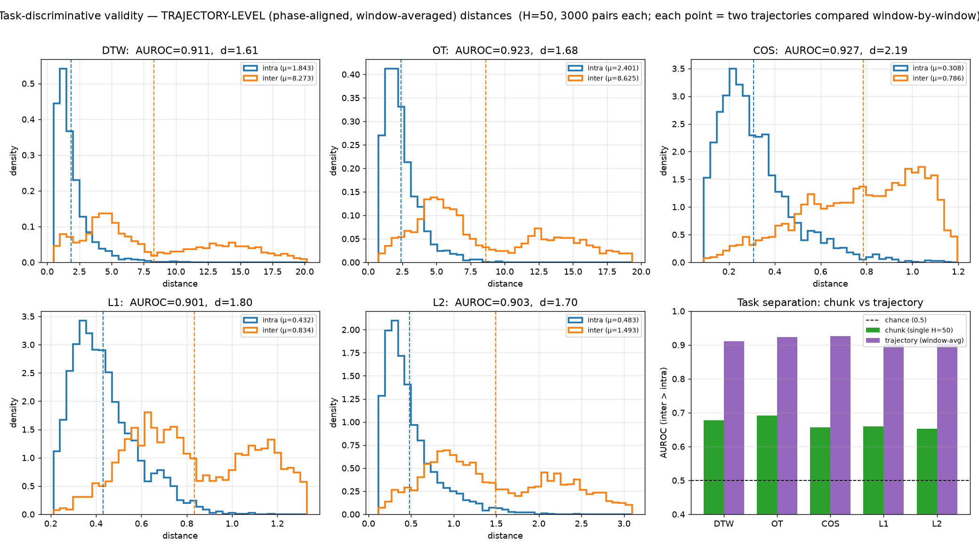
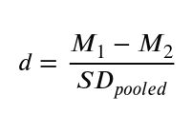
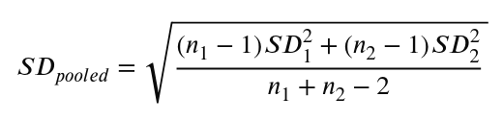
RESULT · RQ1
Do the metrics carry task information? Yes.
Test
Same-task trajectories should score closer than different-task ones — measured by
(a) AUROC (0.5 = Random guessing, 1.0 = perfect separation)
(b) Cohen’s d (standardized difference between two means).
— Trajectory-level: AUROC ≥ 0.90 for every metric.
— Phase alignment, not averaging, drives the gain (DTW average intra-distance 7.06 → 1.84).
Verdict: all five metrics pass the precondition — none is disqualified.
Yibo Zhang · Offline Trajectory Metrics for Early Stopping in VLA Fine-Tuning
8
Notes:
RQ1, the sanity check. Can a metric tell two demos of the same task from different tasks, on ground truth alone? On a single 50-step chunk, barely — AUROC 0.65-0.69, because all LIBERO tasks reach, grasp, transport. But aggregate a whole trajectory phase-aligned, and every metric jumps above 0.90. Crucially it's the phase alignment, not just averaging away noise — DTW's within-task distance collapses while across-task barely moves. All five pass. This is why I use the trajectory-level estimator everywhere after. [~1:10]

Slide 10
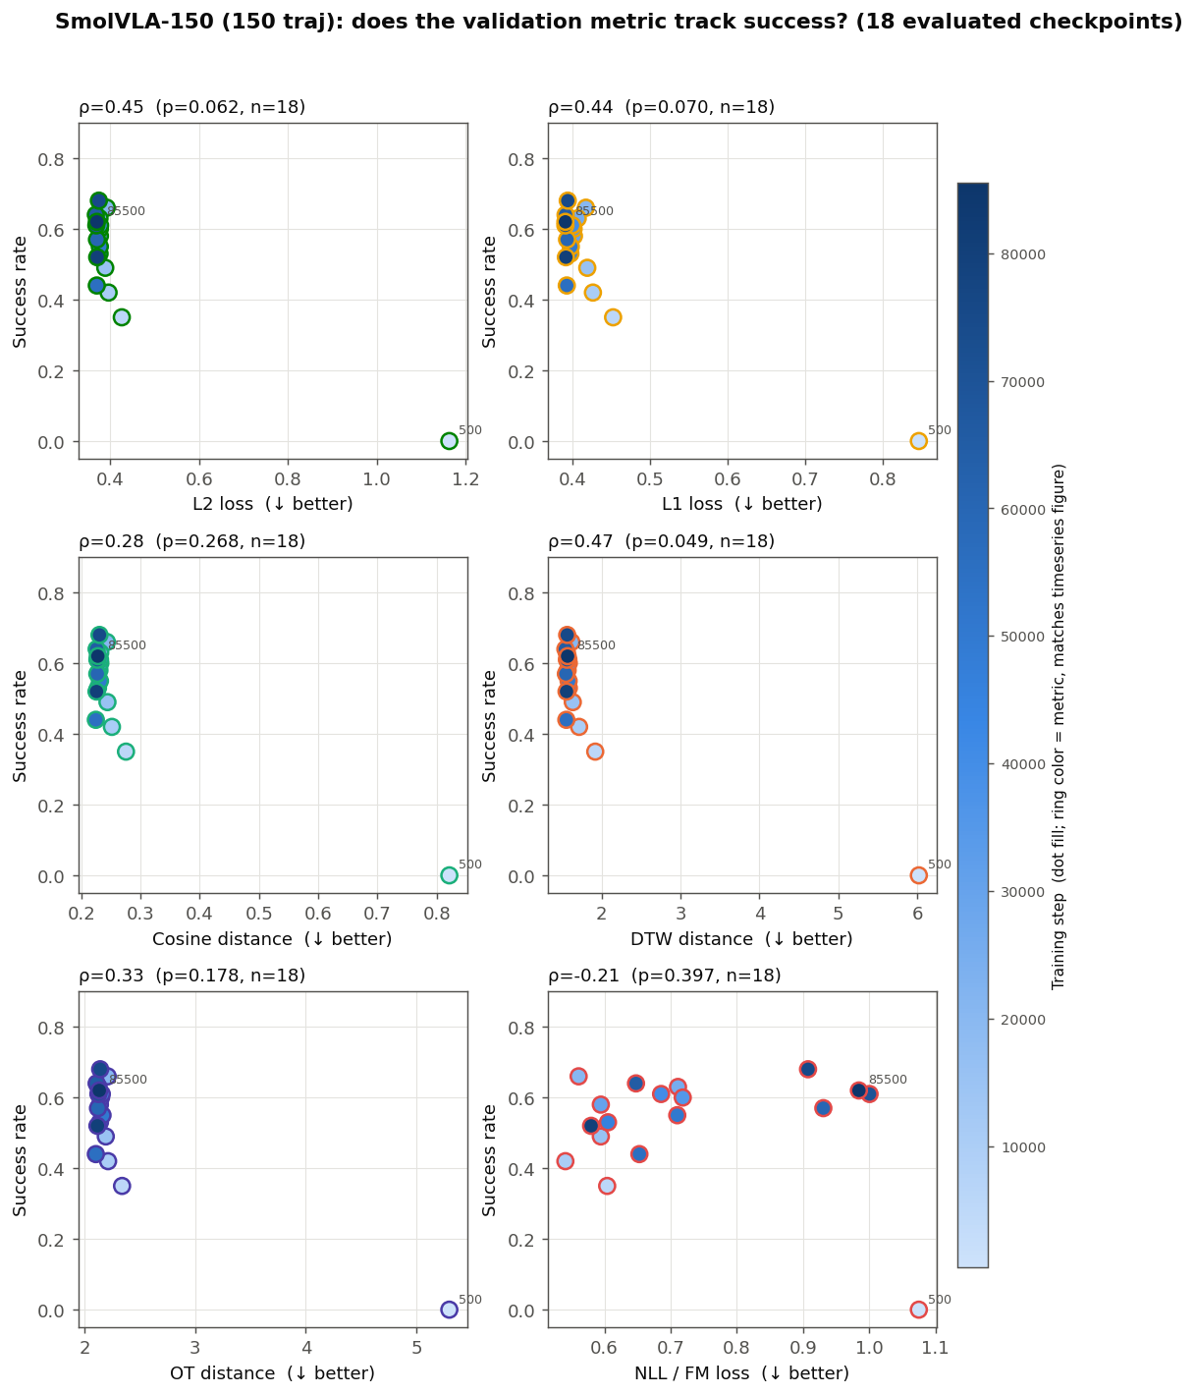
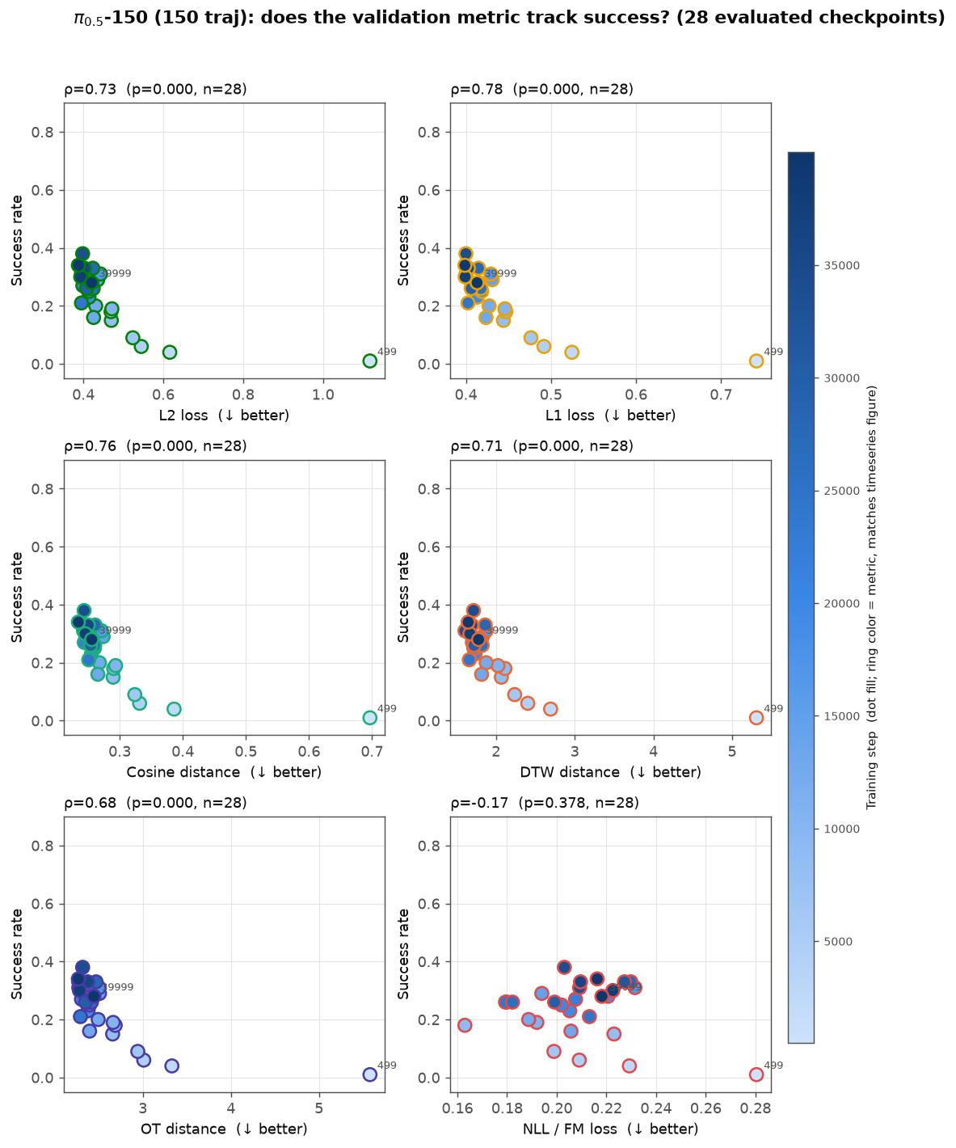
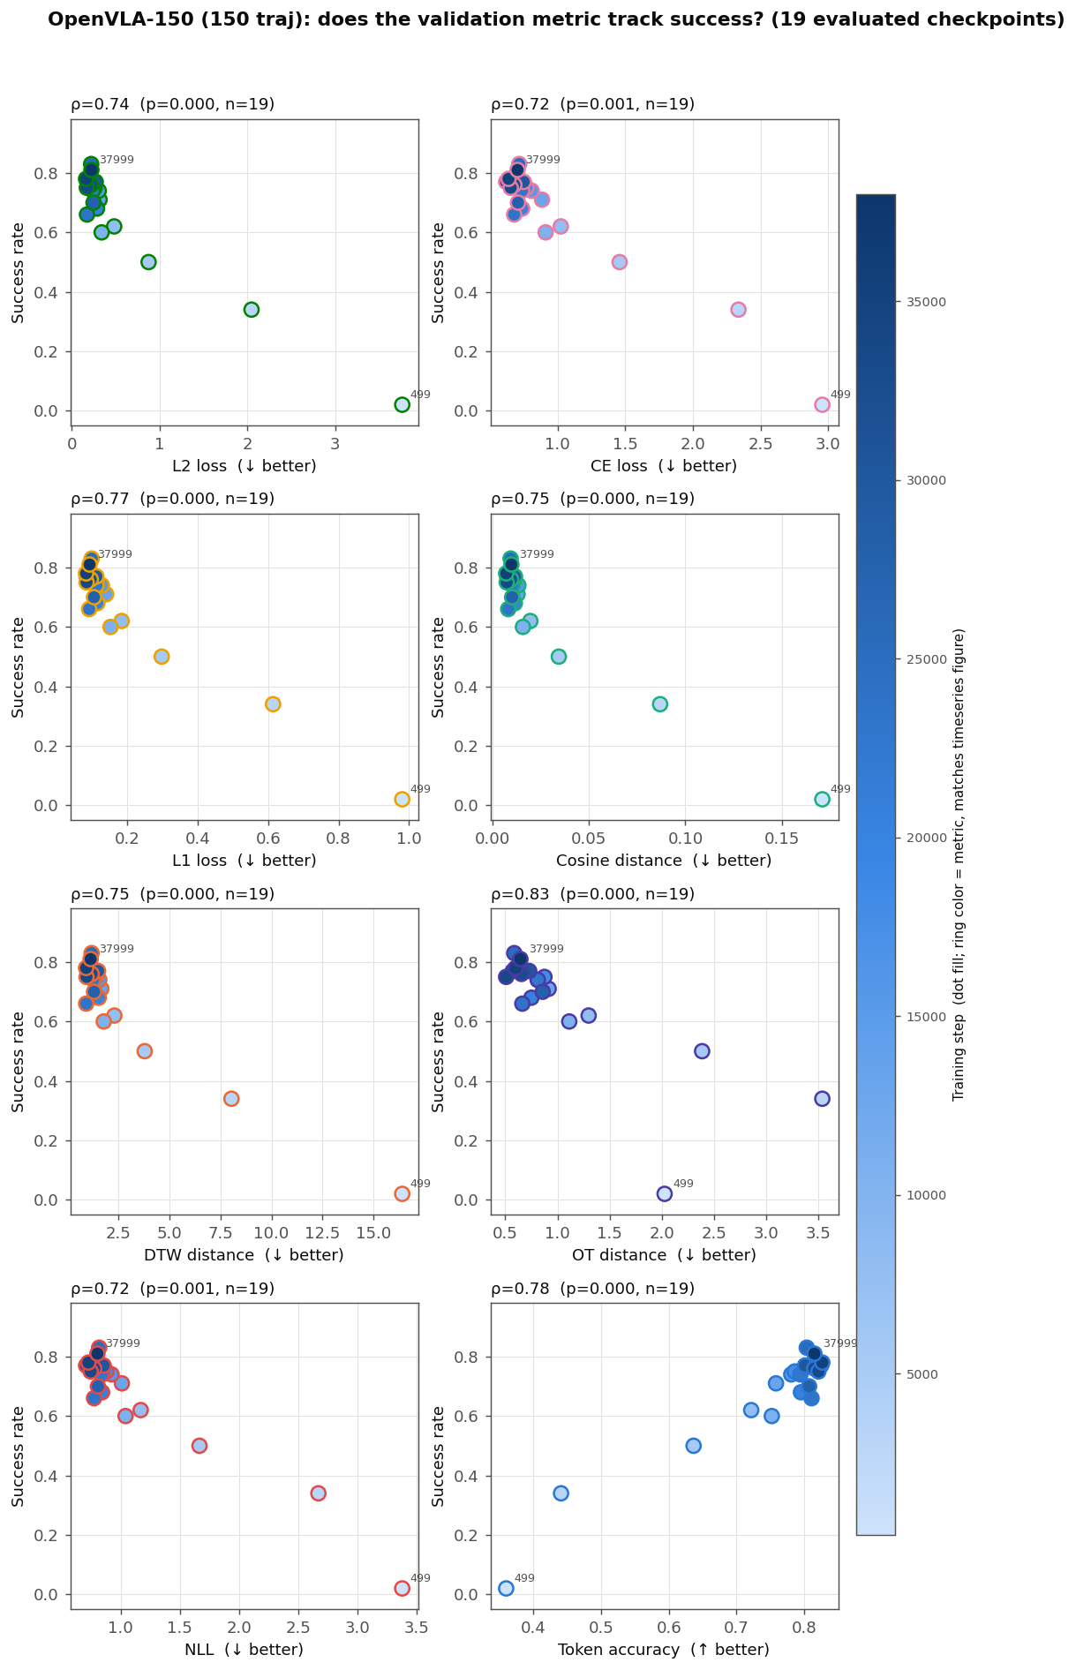
RESULT · RQ2
Per-run rankings: a family of comparable metrics
Yibo Zhang · Offline Trajectory Metrics for Early Stopping in VLA Fine-Tuning
10
Notes:
Zooming in per run. Two things to see. First, the trajectory and regression metrics are interchangeable — on OpenVLA-full, DTW and L2 literally select the same checkpoint, 21499, same rho, zero regret. So this is a family of comparable choices, not a strict winner. Second, look at the highlighted NLL/FM row: strong on the blue discrete-token table, but drops to 0.46 and even negative on the flow-matching tables. That architecture split is the RQ4 story. [~1:15]

Slide 11
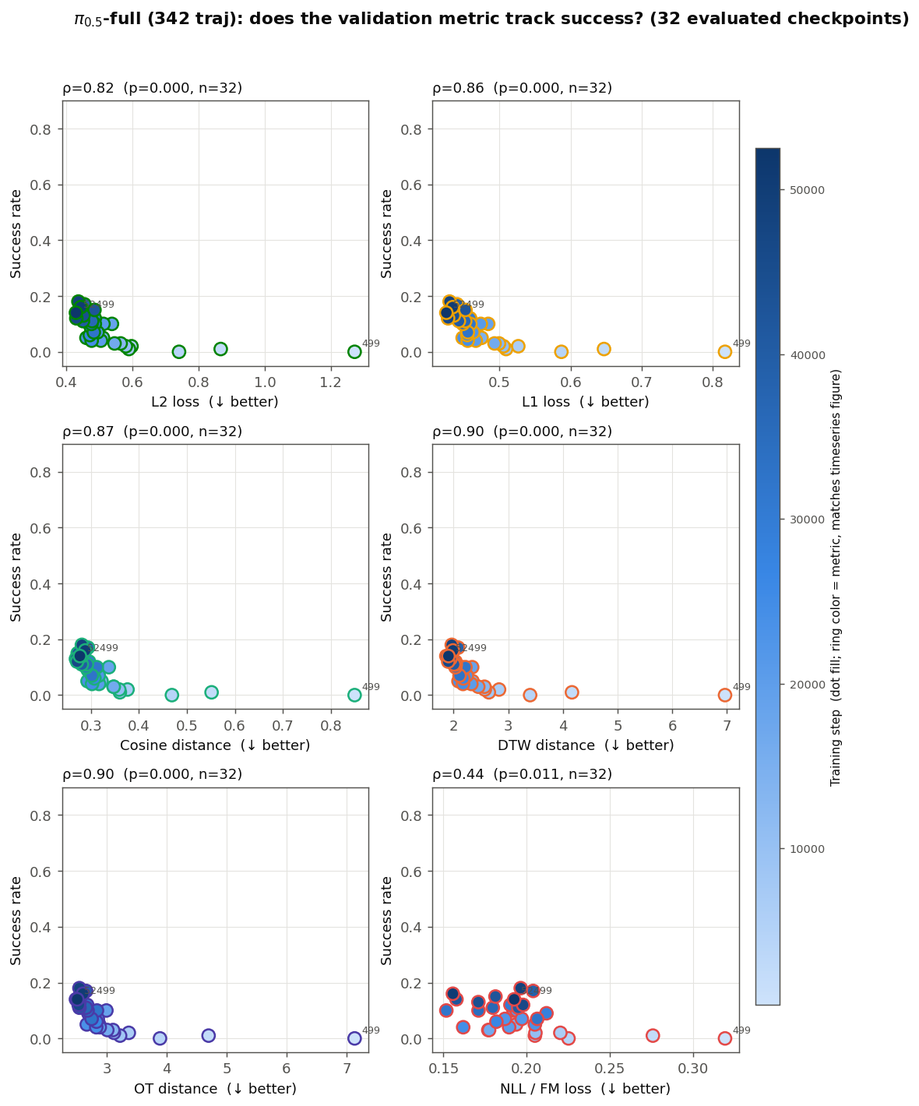
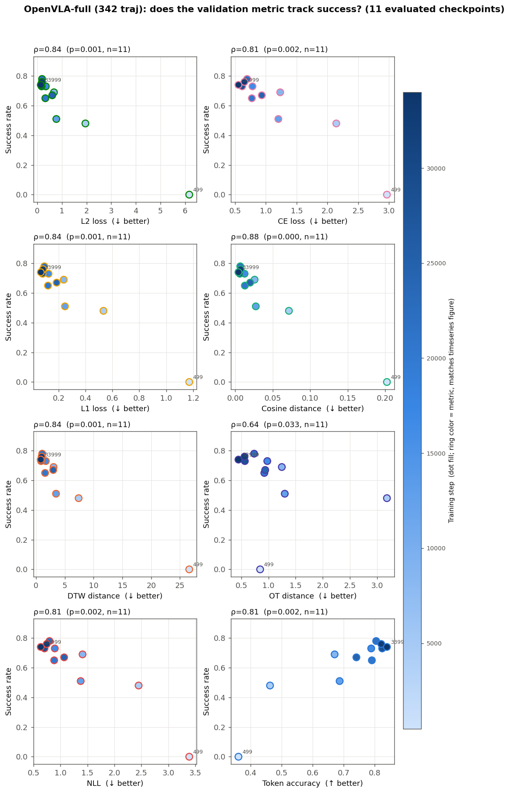
RESULT · RQ2
Per-run rankings: a family of comparable metrics
Yibo Zhang · Offline Trajectory Metrics for Early Stopping in VLA Fine-Tuning
10
Notes:
Zooming in per run. Two things to see. First, the trajectory and regression metrics are interchangeable — on OpenVLA-full, DTW and L2 literally select the same checkpoint, 21499, same rho, zero regret. So this is a family of comparable choices, not a strict winner. Second, look at the highlighted NLL/FM row: strong on the blue discrete-token table, but drops to 0.46 and even negative on the flow-matching tables. That architecture split is the RQ4 story. [~1:15]

Slide 12
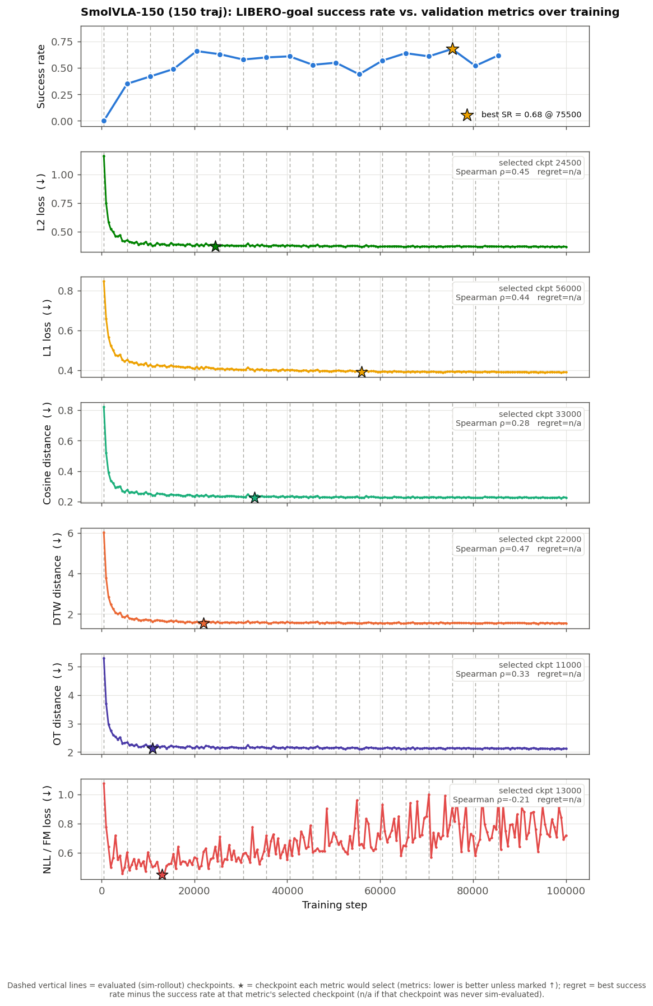
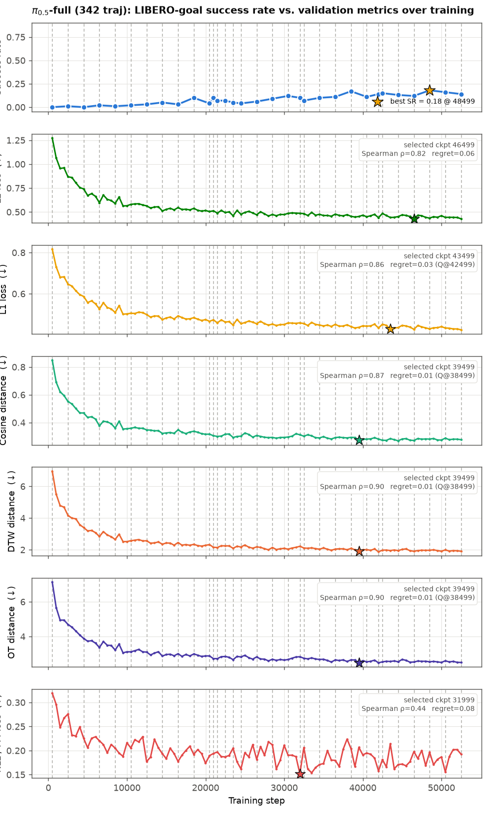
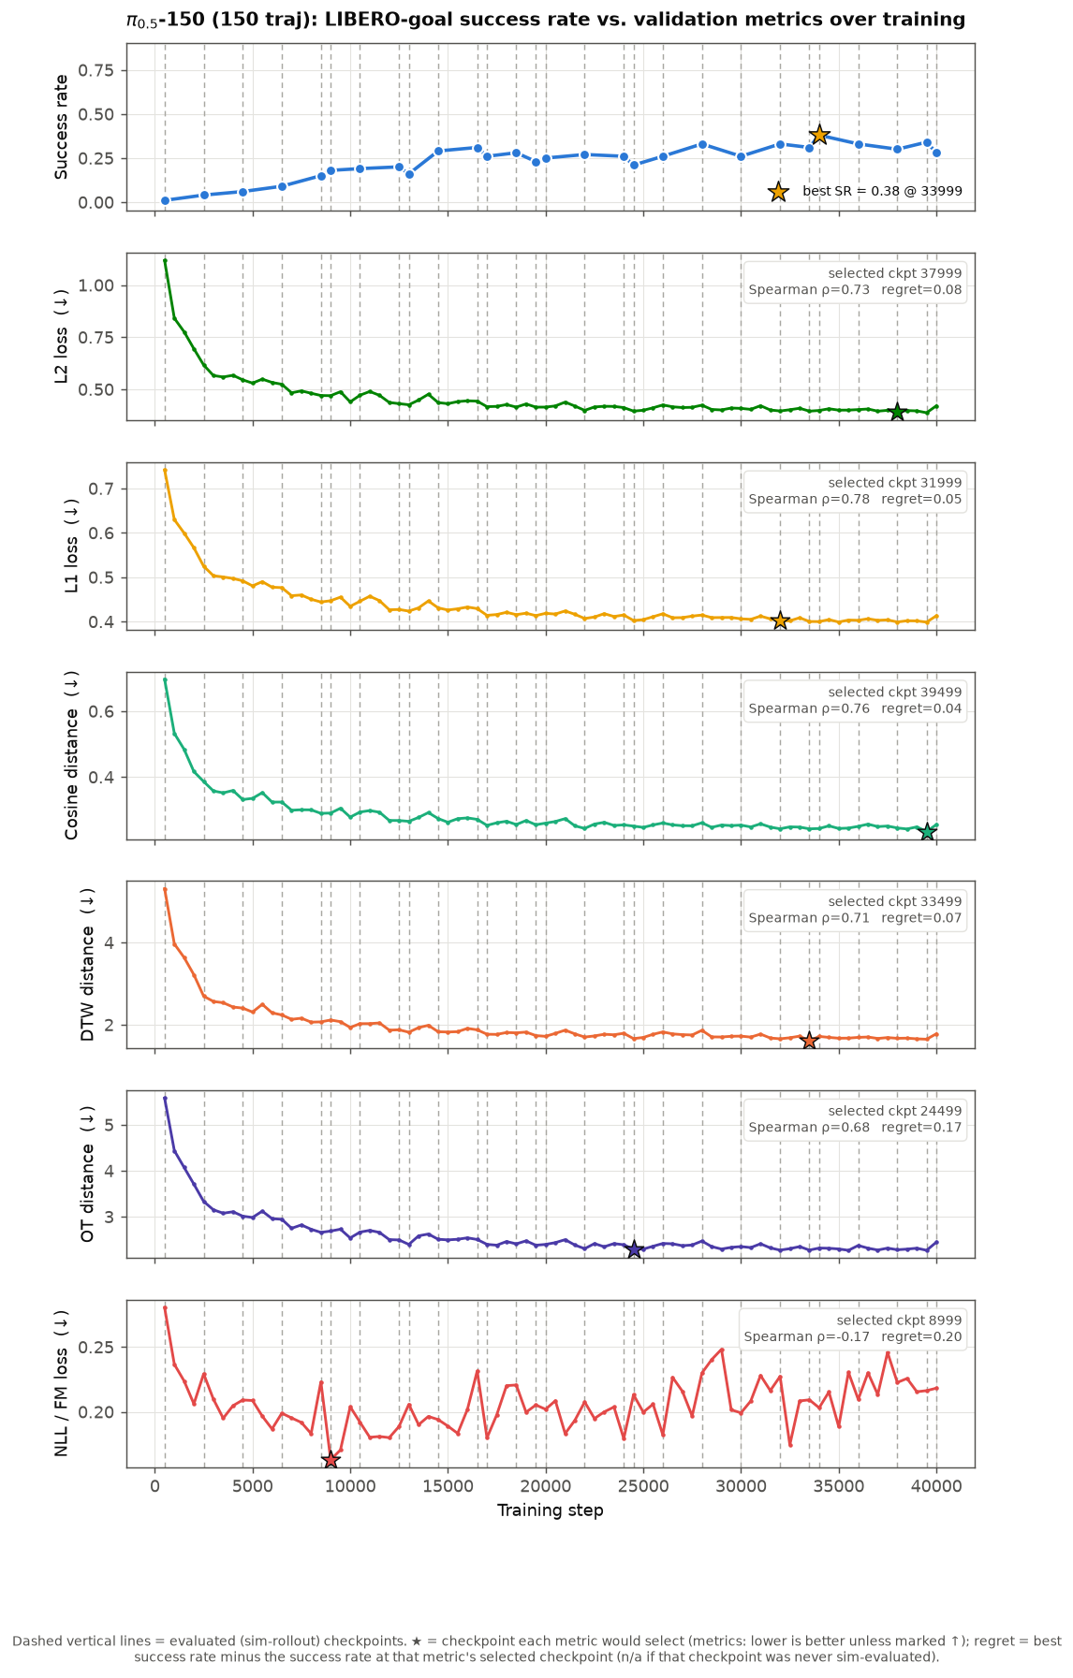
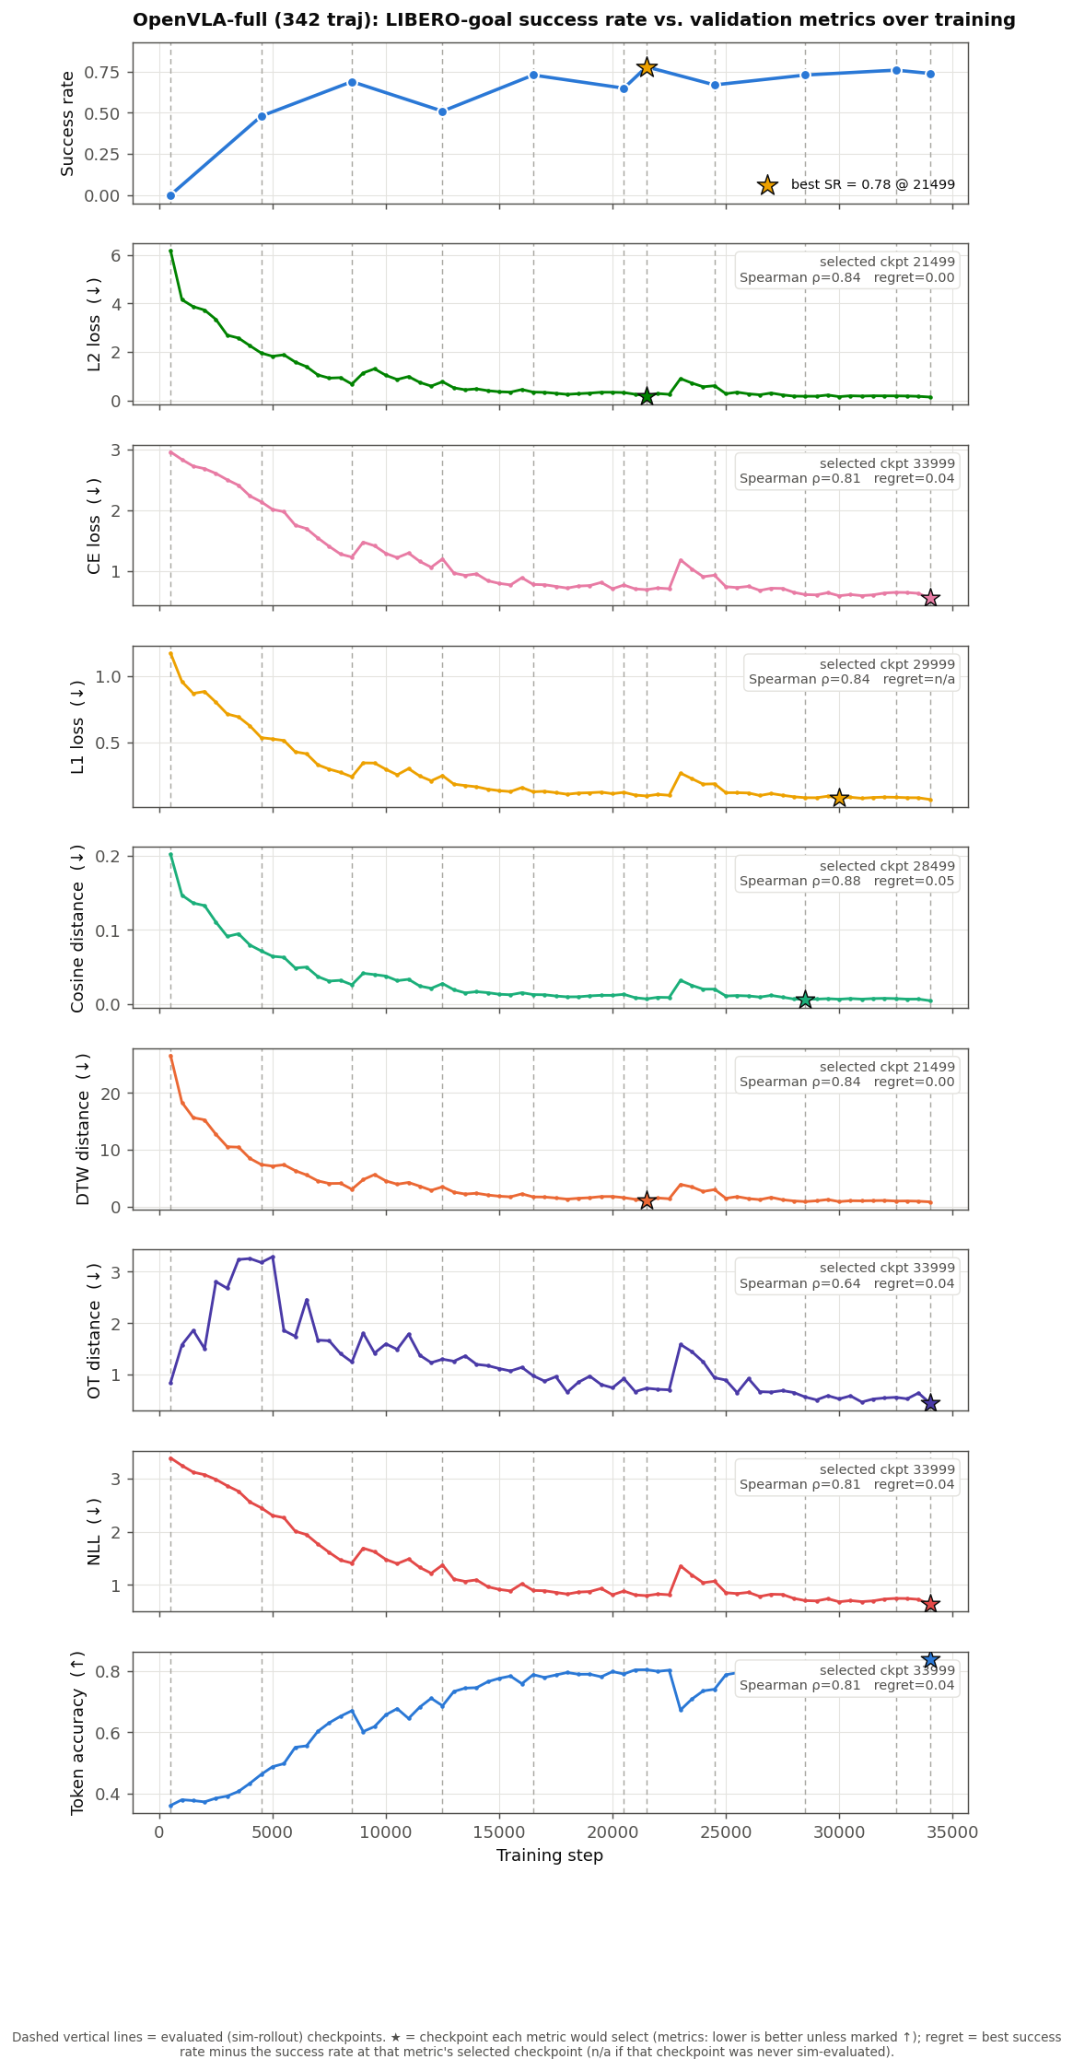
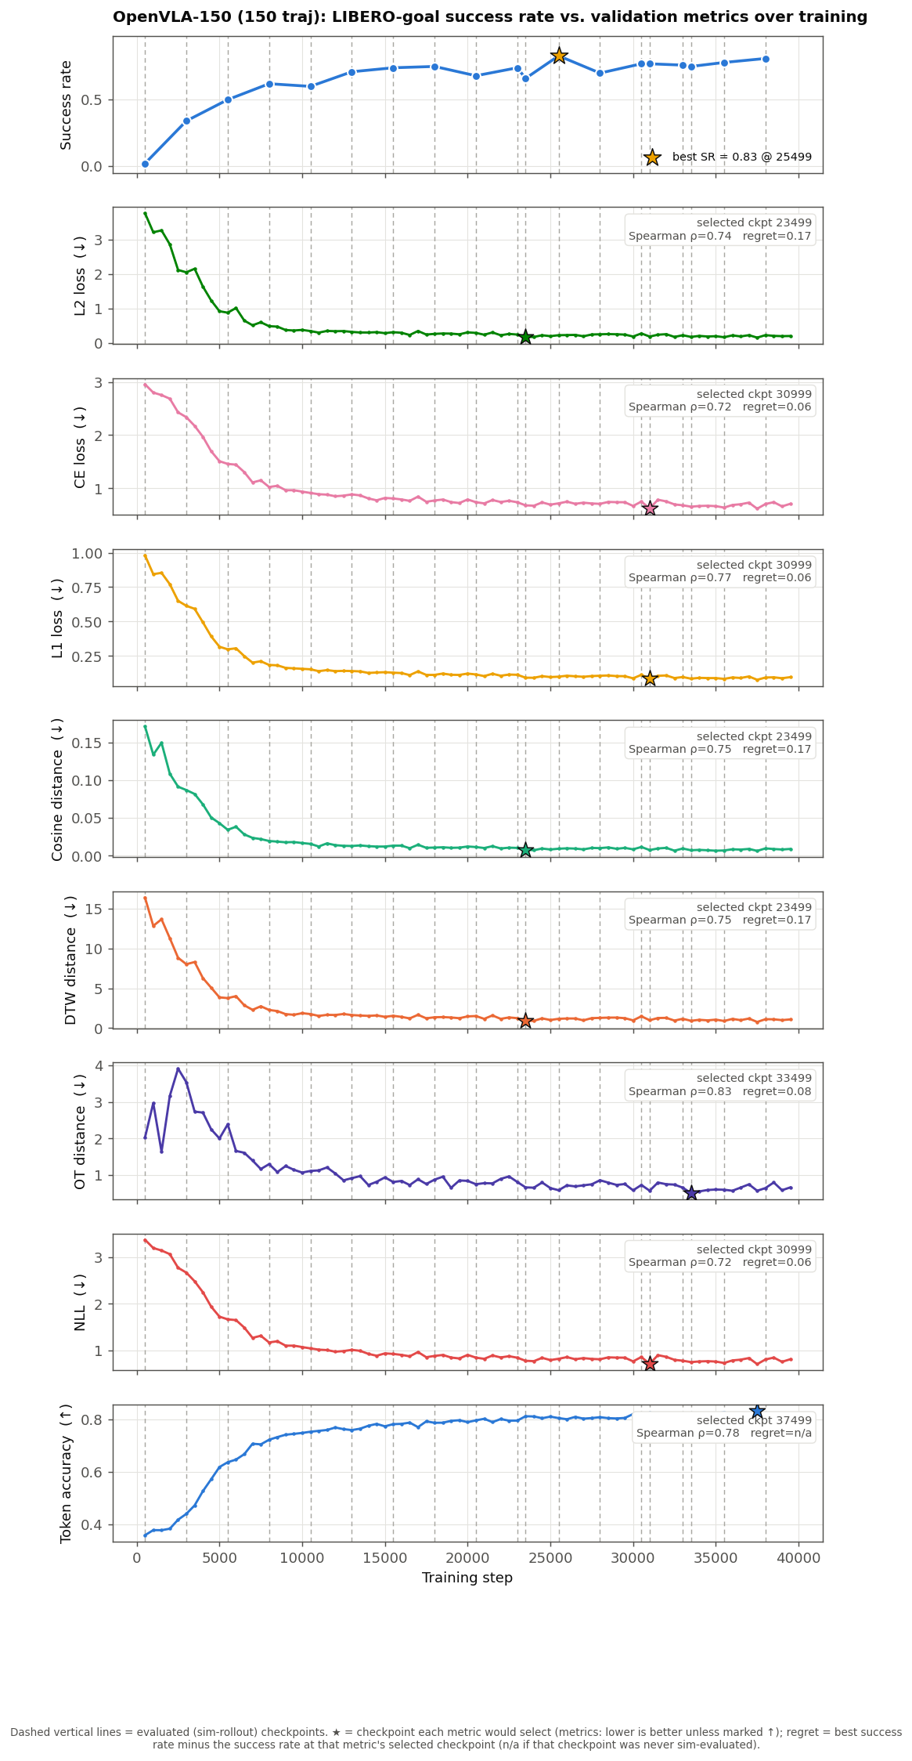
RESULT · RQ2
Per-run rankings: a family of comparable metrics
Yibo Zhang · Offline Trajectory Metrics for Early Stopping in VLA Fine-Tuning
10
Notes:
Zooming in per run. Two things to see. First, the trajectory and regression metrics are interchangeable — on OpenVLA-full, DTW and L2 literally select the same checkpoint, 21499, same rho, zero regret. So this is a family of comparable choices, not a strict winner. Second, look at the highlighted NLL/FM row: strong on the blue discrete-token table, but drops to 0.46 and even negative on the flow-matching tables. That architecture split is the RQ4 story. [~1:15]

Slide 13
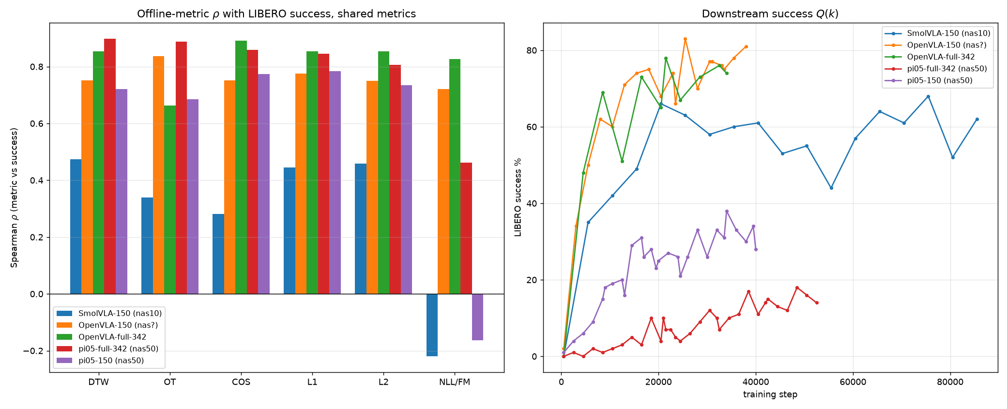
RESULT · RQ2
Trajectory metrics track success across all five runs
DTW is positive in all five runs — ρ = 0.47 / 0.75 / 0.85 / 0.90 / 0.72 — and its selection regret never exceeds 0.17.
Trajectory (DTW/OT/cosine) and regression (L1/L2) metrics are positive across both architecture families (discrete-token and flow-matching) and both data sizes. The likelihood / flow-matching loss failed to match Q(k) all the time.
Yibo Zhang · Offline Trajectory Metrics for Early Stopping in VLA Fine-Tuning
9
Notes:
RQ2, the headline. Left: Spearman rho of every metric with success, per run. Right: the success curves. The trajectory metrics — DTW, OT, cosine — and the L1/L2 baselines are positive in every single run, across discrete-token and flow-matching, across 150 and full data. DTW specifically: 0.47 to 0.90, never negative, regret never above 0.17 — the most consistent default. The one family that behaves differently is likelihood — hold that thought for RQ4. [~1:05]

Slide 14
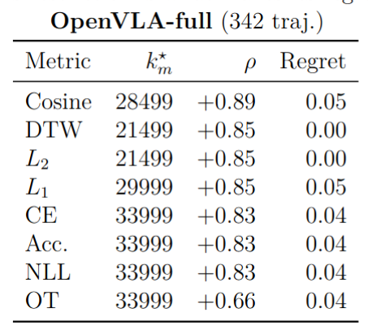
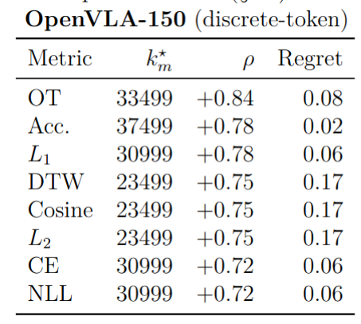
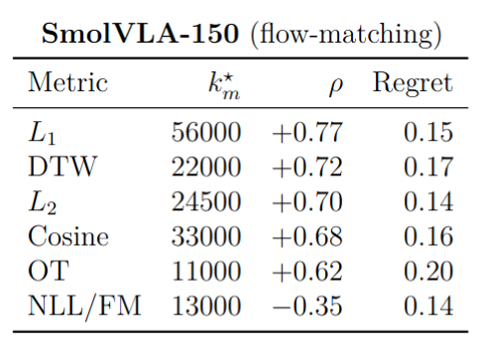
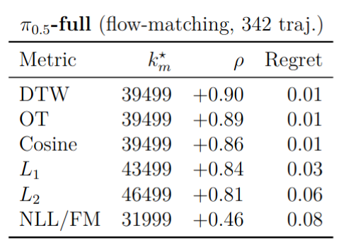
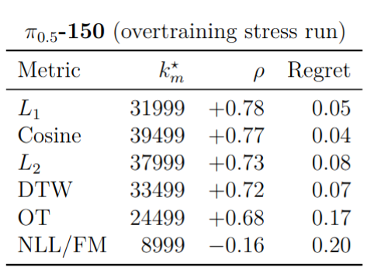
RESULT · RQ2
Per-run rankings: a family of comparable metrics
(1) for OpenVLA, DTW, Cosine and L₂ earlier step with similar regrets.
(2) the Flow-matching surrogate drops sharply runs while NLL staying strong on discrete-token.
Yibo Zhang · Offline Trajectory Metrics for Early Stopping in VLA Fine-Tuning
10
Notes:
Zooming in per run. Two things to see. First, the trajectory and regression metrics are interchangeable — on OpenVLA-full, DTW and L2 literally select the same checkpoint, 21499, same rho, zero regret. So this is a family of comparable choices, not a strict winner. Second, look at the highlighted NLL/FM row: strong on the blue discrete-token table, but drops to 0.46 and even negative on the flow-matching tables. That architecture split is the RQ4 story. [~1:15]

Slide 15
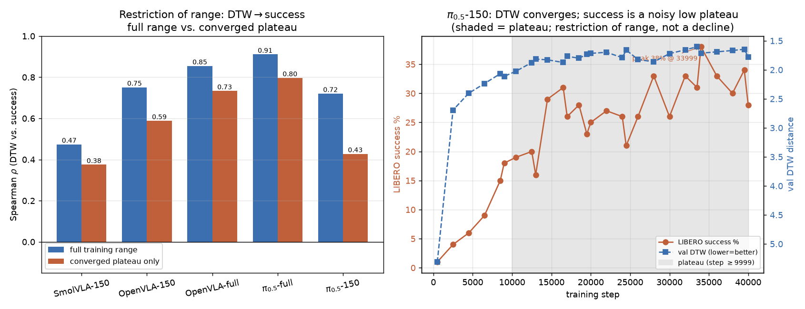
RESULT · RQ3
Effective for the coarse decision; harder on the plateau
Full range vs. converged plateau
Run
ρ full
ρ plat
SmolVLA-150
+0.47
+0.38
OpenVLA-150
+0.75
+0.59
OpenVLA-full
+0.86
+0.73
π₀.₅-full
+0.91
+0.80
π₀.₅-150
+0.72
+0.43
— Coarse decision is robust: “do not stop before the knee” holds at ρ ≈ 0.7–0.9 over the full descent in all five runs.
— Fine-ranking the plateau is harder but stays usable (ρ ≥ 0.59) for four of the five runs.
— π₀.₅-150 is the exception, and it appears to be an artifact: the apparent 31%→23% dip recovers to 38% once training is extended — consistent with a noisy low ceiling rather than genuine overtraining.
Yibo Zhang · Offline Trajectory Metrics for Early Stopping in VLA Fine-Tuning
11
Notes:
RQ3: is it actually usable for stopping? Split each run at the knee — where DTW has done 90% of its descent — and recompute rho before vs after. Full-range rho is 0.8-0.9 everywhere, so the coarse decision 'don't stop before the knee' is robust. Inside the plateau it weakens but stays usable, 0.59+, for four of five. The exception, pi-0.5-150 in red, looked like overtraining — success fell 31 to 23% — but extending training recovered it to 38%. So it was restriction of range on a noisy low ceiling, not a real decline. [~1:15]

Slide 16
RESULT · RQ3
The overtraining we aimed to induce did not appear
Three runs were designed to overtrain
— SmolVLA-150 & OpenVLA-150 — small data, pushed well past convergence.
— π₀.₅-150 — aggressive LR (6×), a non-decaying schedule, 40k steps.
— Outcome: every run settled into a noisy plateau in both the offline metrics and Q(k) — no monotone late decline.
Honest limitation. Because no run genuinely overtrained, I cannot show the metrics catching a real decline — only that they reliably track the rise and plateau. Proving the preventive value of early stopping needs a run that actually degrades.
Yibo Zhang · Offline Trajectory Metrics for Early Stopping in VLA Fine-Tuning
12
Notes:
A point of intellectual honesty. Three runs were built to force overtraining — tiny data, and for pi-0.5-150 an aggressive 6x learning rate held near peak for 40k steps. It still didn't overtrain: everything settled into a noisy plateau. So I can show the metrics track the rise and plateau, but I cannot show them catching a genuine late decline, because I never produced one. That's a real limitation and I'll return to it. [~1:00]

Slide 17
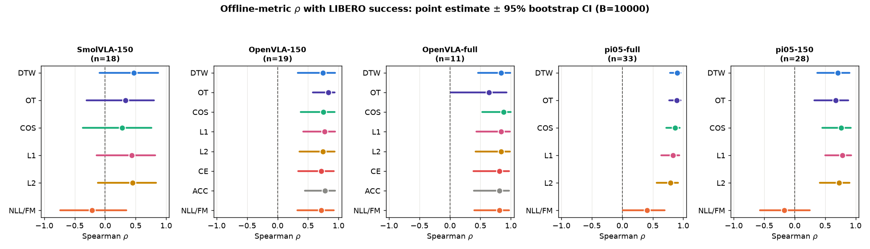
RESULT · RQ4
How much of the ranking is real? Power is the limit
What is statistically resolved
What is NOT resolved
— Architecture split of NLL — significant: the true token likelihood tracks success, the FM surrogate does not.
— π₀.₅-full (n=33) — well-powered; DTW’s CI spans < 0.20.
— DTW vs. L1/L2/OT/cosine — intervals overlap; on OpenVLA-full DTW ≡ L₂ exactly.
— SmolVLA-150 (n=18) — no metric clears zero at 95%: too few, too converged.
Yibo Zhang · Offline Trajectory Metrics for Early Stopping in VLA Fine-Tuning
13
Notes:
RQ4 keeps me honest about what the numbers support. Point estimates come from as few as 11 evaluations, so I bootstrap a 95% CI on every rho and on paired differences. What survives, left: the architecture split of NLL is real, and the well-powered pi-0.5-full resolves fine structure. What doesn't, right: DTW is not statistically separable from L1, L2, OT or cosine — they're one family. And underpowered SmolVLA-150 can't clear zero at all. The binding constraint is usually statistical power, not the choice of metric. [~1:10]

Slide 18
SYNTHESIS
The four questions, answered
RQ1
Yes — every metric is task-discriminative (AUROC ≥ 0.90) at the trajectory level.
RQ2
Yes — DTW/OT/cosine (and L1/L2) correlate positively with success in all five runs.
RQ3
Partly — robust for the coarse “don’t stop early” call; genuine overtraining never occurred.
RQ4
Qualified — the architecture split is real; finer metric orderings need more evaluations.
Yibo Zhang · Offline Trajectory Metrics for Early Stopping in VLA Fine-Tuning
14
Notes:
So, the four answers. RQ1 yes, cleanly. RQ2 yes — the core positive result, architecture-general. RQ3 a qualified yes: excellent for the coarse decision, but I couldn't test the overtraining case. RQ4 qualified: the one hard, significant claim is the NLL architecture split; the rest is a family of comparable metrics limited by evaluation budget. Two green, two amber — I think that's an honest scorecard. [~1:00]

Slide 19
TAKEAWAYS
Practical guidance for VLA practitioners
1 Use a trajectory-similarity metric.
2 Trust the coarse decision.
DTW is a reliable default: positive in all five runs, regret ≤ 0.17.
“Do not stop before the knee” is reliable; fine-ranking a converged plateau is much less so.
3 Match the surrogate to the architecture.
4 Report uncertainty, not point ranks.
Token NLL is fine for discrete-token policies; for flow-matching, prefer a trajectory metric over the FM loss.
With 10–30 rollouts, report bootstrap CIs — many single-metric orderings may be noise.
Yibo Zhang · Offline Trajectory Metrics for Early Stopping in VLA Fine-Tuning
15
Notes:
If you take four things away as a practitioner. One: use a trajectory metric — DTW is the safe default. Two: trust the coarse call, don't stop before the knee, but don't over-trust fine ranking on the plateau. Three: match the surrogate to the architecture — token NLL for discrete, a trajectory metric for flow-matching. Four: with tiny rollout budgets, report confidence intervals, because most single-metric orderings are noise. [~1:00]

Slide 20
LIMITATIONS & FUTURE WORK
What this study cannot yet claim
Open-loop only
No overtraining regime
Sparse, confounded Q(k)
Metrics score teacher-forced action chunks, not rollouts. A learned world model would test whether they also predict compounding closed-loop error.
No run genuinely degraded, so the preventive value of early stopping is untested. Longer runs at higher LR are needed to force a decline.
11–33 evals per run, and two π₀.₅ runs at mismatched horizons. Denser, horizon-matched evaluation would resolve DTW vs. L1/L2.
None of these overturns the central finding — they mark where the current evidence stops and the next study begins.
Yibo Zhang · Offline Trajectory Metrics for Early Stopping in VLA Fine-Tuning
16
Notes:
Three limitations, stated plainly. One: everything here is open-loop, teacher-forced chunks — a world-model rollout would test compounding error directly. Two, the big one: no run overtrained, so I can't claim early stopping prevents degradation, only that it tracks the plateau. Three: success was measured sparsely and, for pi-0.5, at mismatched horizons — denser matched evaluation would finally separate DTW from L1/L2. None of these breaks the main result; they mark where the next study starts. [~1:05]

Slide 21
CONCLUSION
An offline trajectory-similarity metric, computed once per checkpoint, can serve as a practical, largely architecture-agnostic signal for when to stop fine-tuning a VLA.
— Evaluated across 3 architectures, 5 runs, and a 10-task benchmark — DTW a reliable default.
— Honest about scope — coarse stopping is well-supported; overtraining and closed-loop rollout remain open.
Thank you — I welcome your questions.
Yibo Zhang · yibo.zhang@aalto.fi
Supervisor: Prof. Joni Pajarinen · Advisor: Dr. Wenyan Yang · Aalto Robot Learning Lab
Notes:
To conclude: a single offline trajectory metric, computed once per checkpoint, can be a practical, largely architecture-agnostic answer to when to stop fine-tuning a VLA. Evaluated across three architectures and five runs, with DTW as a reliable default — and honest about what's still open: the overtraining case and true closed-loop rollout. Thank you, I'm happy to take questions. [Total ~22 min in the 30-min slot, leaving time for Q&A.] Backup slides / thesis tables ready for detail questions.

