Slide 1
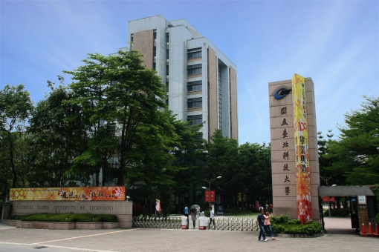
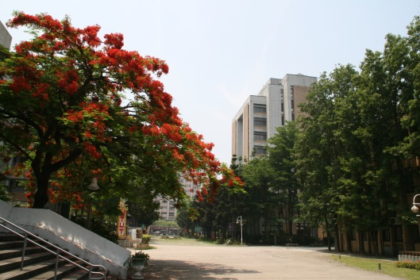
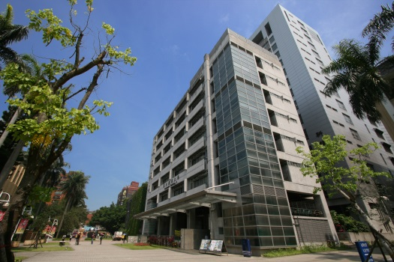
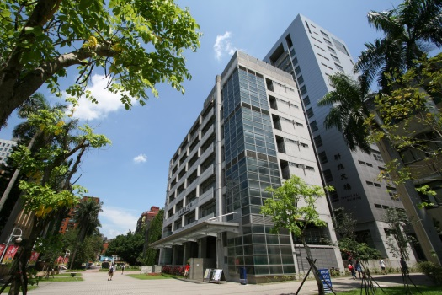
Introduction and Recursion
Chuan-Ming Liu
Computer Science & Information Engineering
National Taipei University of Technology
Taiwan

Slide 2
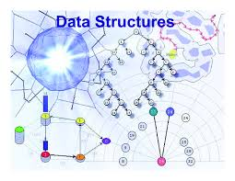
Outline
Data Structures and Algorithms
Pseudo-code
Recursion
Courtesy of google pictures

Slide 3
Data Structures
A data structure* is a data organization, management, and storage format that enables efficient access and modification.
An organization of mathematical and logical concepts of data
Implementation using a programming language
A proper data structure can make the algorithm or solution more efficient in terms of time and space
*Wikipedia: http://en.wikipedia.org/wiki/Data_structure

Slide 4
Why Learning Data Structures
Knowing data structures well can make our programs or algorithms more efficient
In this course, we will learn
Some basic data structures
How to tell if the data structures are good or bad
The ability to create some new and advanced data structures

Slide 5
Where is “Data Structures”
Big Data
Processing
Management
Data
Science
Linear Algebra
Databases
Processing
Management
Architectures
Processing
Management
Statistics
Data Analysis
Probability
Data Engineering
Data Mining
Data Structures
Algorithms

Slide 6

Algorithms (1)
Definition
An algorithm is a finite set of instructions that, if followed, accomplishes a particular task. All the algorithms must satisfy the following criteria:
Input
Output
Definiteness
Effectiveness
Finiteness

Slide 7
Algorithms (2)
Definiteness: each instruction is clear and unambiguous
Effectiveness: each instruction is executable; in other words, feasibility
Finiteness: the algorithm terminates after a finite number of steps.

Slide 8
Algorithms (3)
Definiteness
Input
Output
Effectiveness
Finiteness
Computational Procedures

Slide 9


Procedures vs. Algorithms
Terminate or not
One example for procedure is OS
Program, a way to express an algorithm

Slide 10
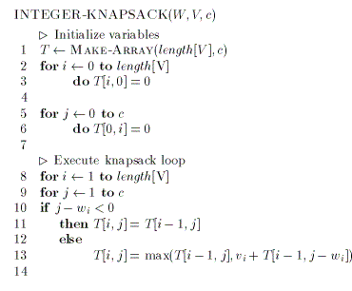

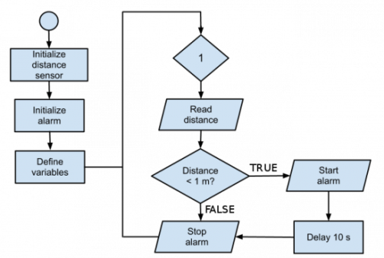
Expressing Algorithms
Ways to express an algorithm
Natural languages
Graphic (flow chart)
Programming languages
Real programming languages, like C/C++
Pseudo-code representation

Slide 11
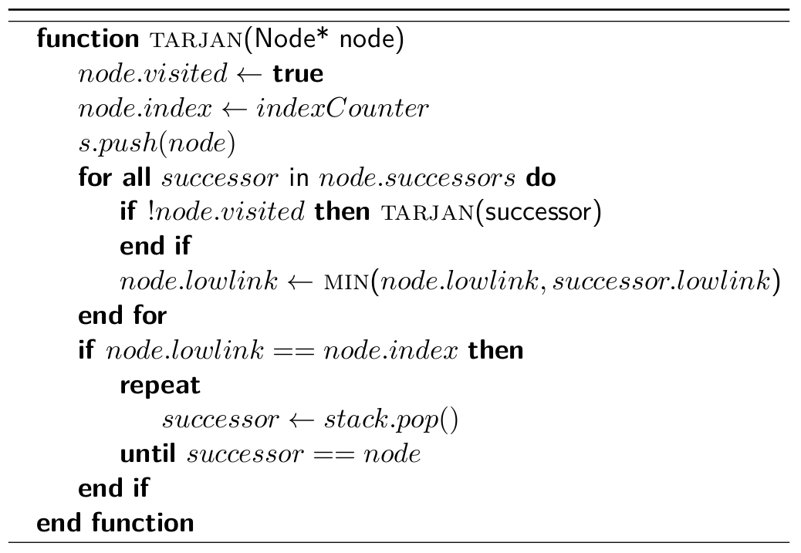
Outline
Data Structures and Algorithms
Pseudo-code
Recursion

Slide 12
Maximum of Three Numbers
Problem:
Find the largest of the numbers a, b, and c.
Instance:
Input: 45, 30, and 55
Output: 55

Slide 13
Idea
Using English:
Select the first element as the largest one to compare the other two elements contiguously and replace the largest if the current largest one is smaller than the compared element
Expressing the idea in a programming-like way
Input Parameters: a, b, c
Output Parameter: x
max(a, b, c) {
x = a
if (b > x) // if b is larger than x, update x
x = b
if (c > x) // if c is larger than x, update x
x = c
return x
}

Slide 14
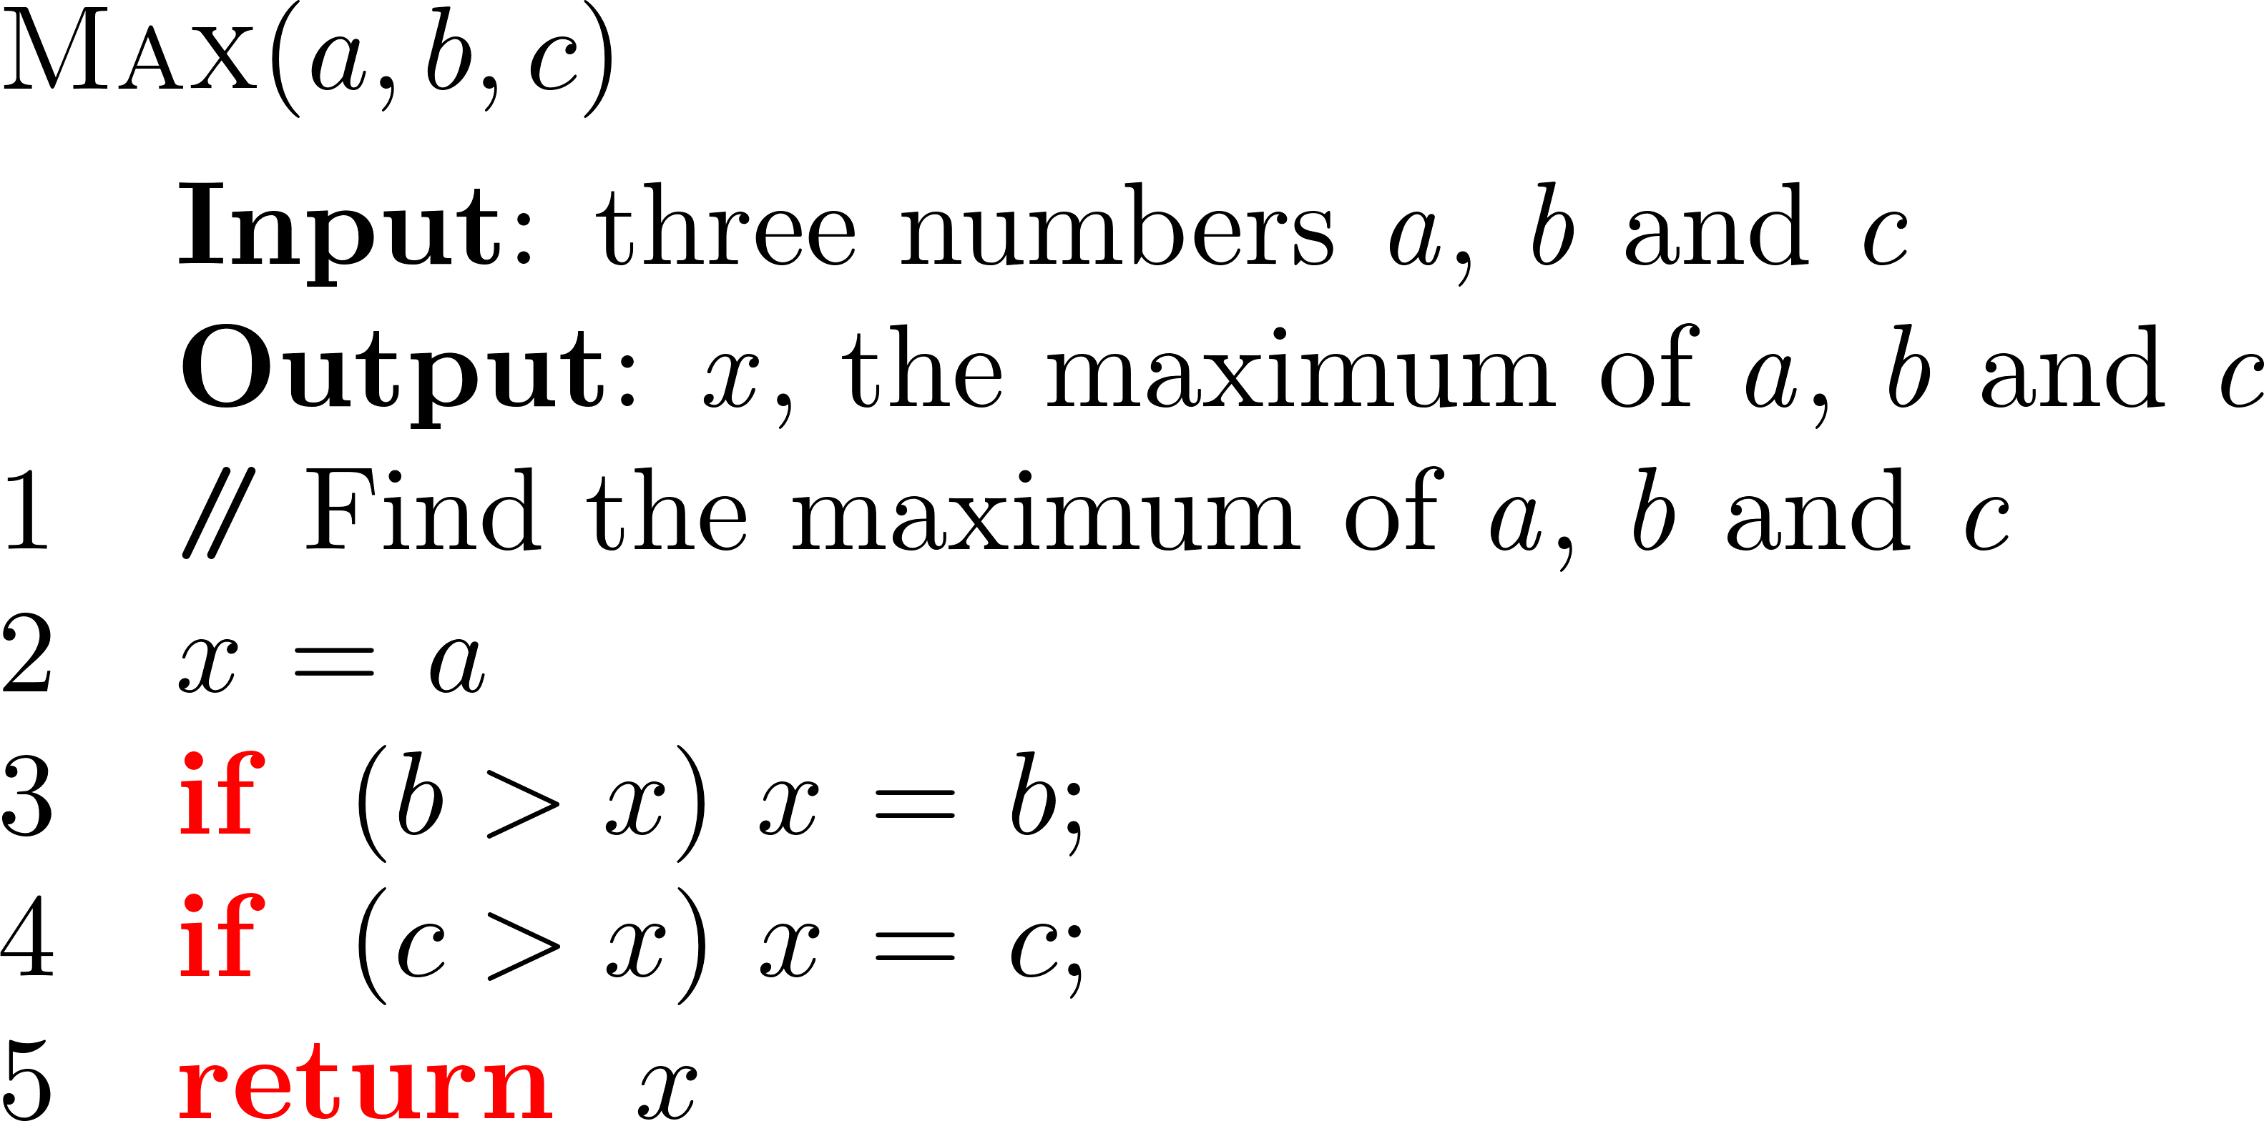
Pseudo-code

Slide 15
Minimum of Numbers
Problem:
Find the smallest number among n numbers a₁, a₂, …, and a_{n}.
Instance:
Input: 16, 24, 33, 8, 2, 45, 30, and 55
Output: 2

Slide 16
Idea
Using English:
Select the first element as the smallest one to compare the rest of numbers contiguously and replace the smallest if the current smallest one is larger than the compared number
Expressing the idea in a programming-like way
Input Parameters: an array A of n numbers
Output Parameter: the smallest one, x
min(A, n) {
x = A[0];
for (i=1;i<n;i++){
if (A[i] < x)
x = A[i];
}
}

Slide 17
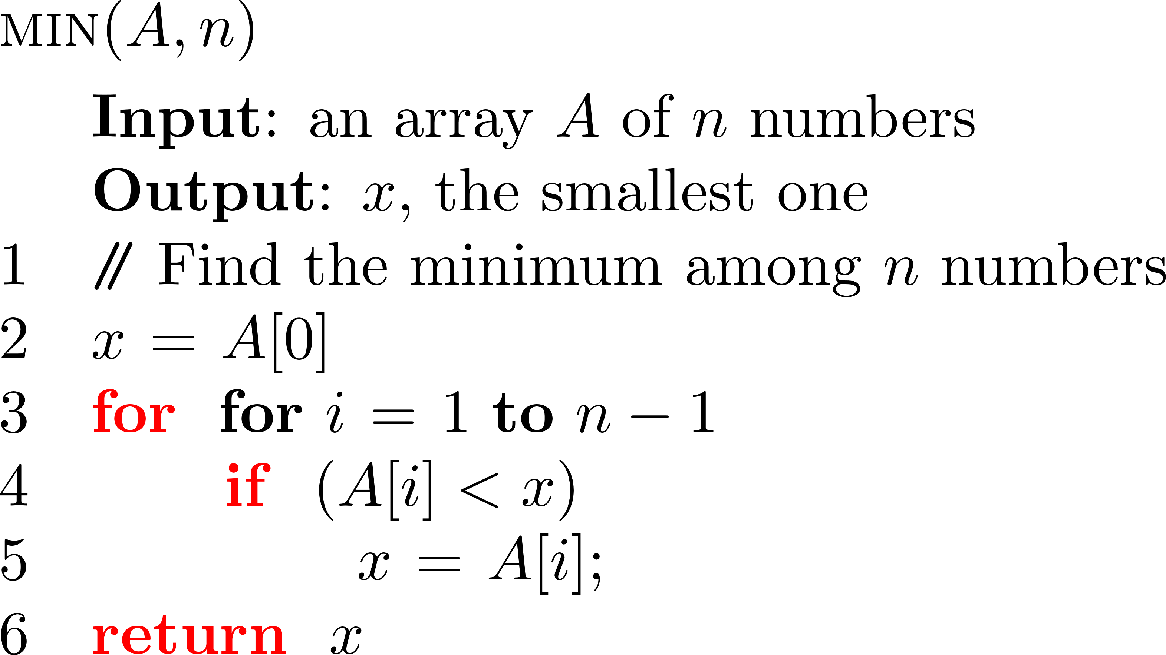
Pseudo-code

Slide 18
Example – Selection Sort
Problem:
Suppose we must devise a program that sorts a collection of n≥1 elements.
Instance:
Input: 34, 26, 4, 67, 15, 44, 53
Output: 4, 15, 26, 34, 44, 53, 67

Slide 19
Idea about Selection Sort
Idea: Using a natural language – English
Among the unsorted elements, select the smallest one and place it next in the sorted list.
4
15
26
34
44
53
67
34, 26, 67, 15, 44, 53
34, 67, 44, 53
67
34, 26, 4, 67, 15, 44, 53
67, 53
34, 26, 67, 44, 53
67, 44, 53

Slide 20
Expressing the Idea
Using natural language – English
Among the unsorted elements
select the smallest one
place it next in the sorted list
Expressing the idea in a programming-like way
for (int i=1; i<=n; i++) {
select the minimum from a[i] to a[n] and suppose the minimum element is at a[j];
interchange a[i] and a[j];
}

Slide 21
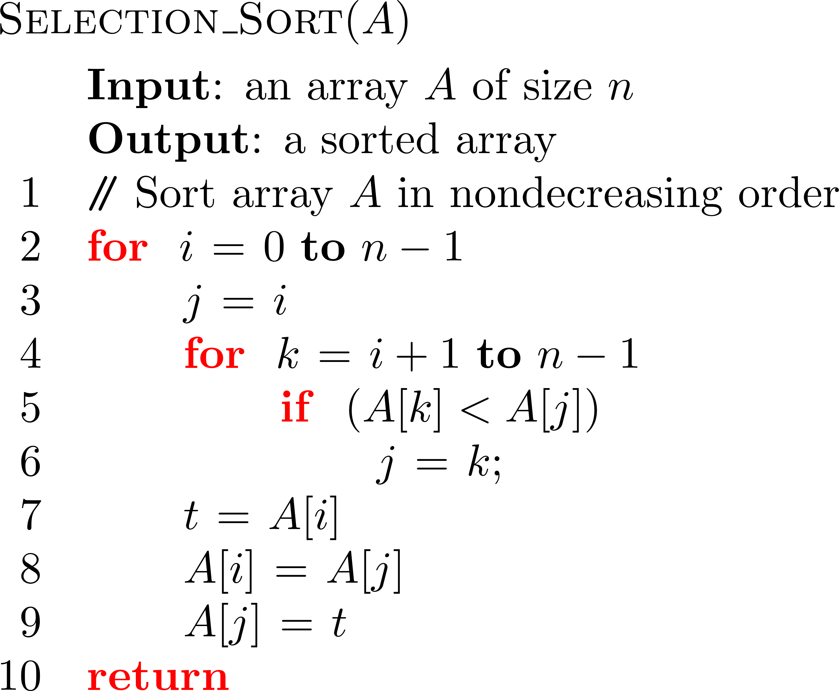
Pseudo-code for Selection Sort

Slide 22
Pseudo-Code Conventions
Indentation as block structure
Loop and conditional constructs similar to those in PASCAL, such as while, for, repeat( do – while) , if-then-else
// as the comment in a line
Using ← for the assignment operator
Variables local to the given procedure
Relational operators: ==, != , ≥, ≤
Logical operators: &&, ||, !
Array element accessed by A[i] and A[1..j] as the subarray of A

Slide 23

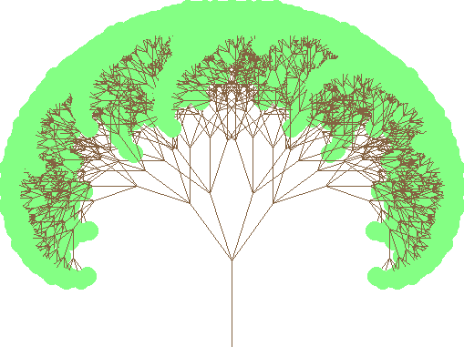

Outline
Data Structures and Algorithms
Pseudo-code
Recursion

Slide 24
Recursion
Recursion is the concept of defining a method that makes a call to itself
A method calling itself is making a recursive call
A method M is recursive if it calls itself (direct recursion) or another method that ultimately leads to a call back to M (indirect recursion)

Slide 25
Repetition
Repetition can be achieved by
Loops (iterative) : for loops and while loops
Recursion (recursive) : a function calls itself
Factorial function
General definition: n! = 1· 2· 3· ··· · (n-1)· n
Recursive definition

Slide 26
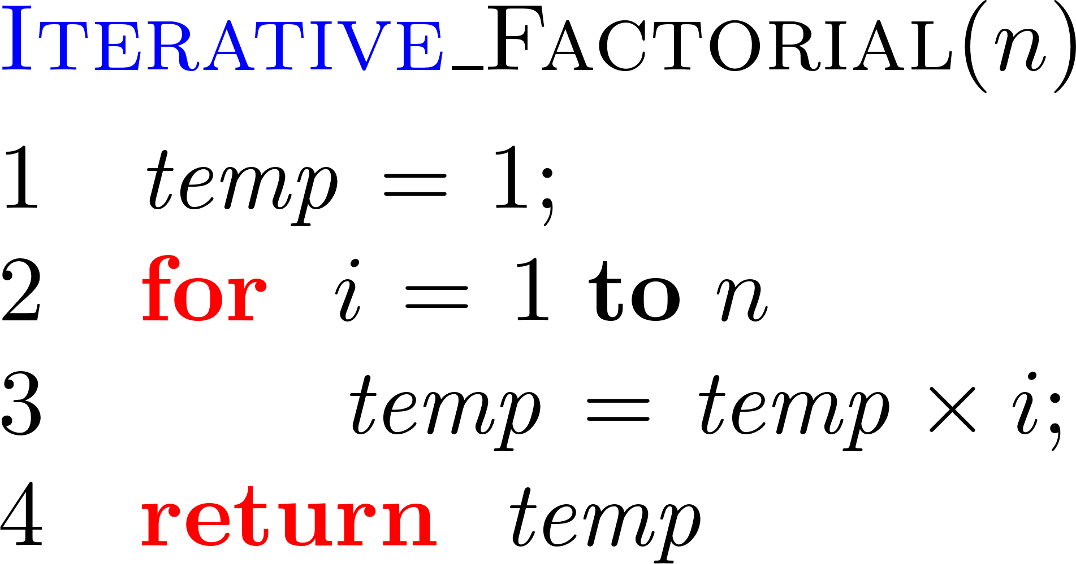
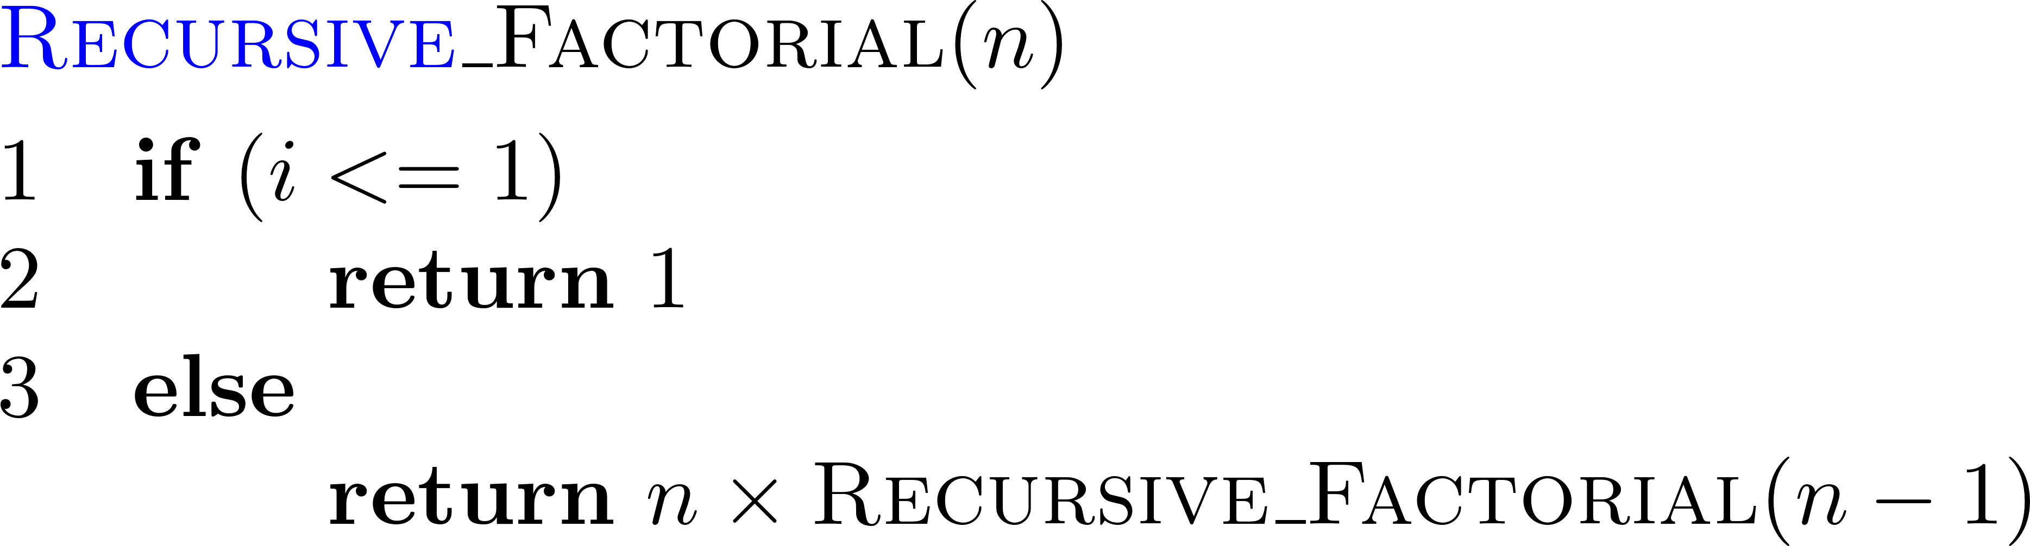
Functions for Factorials

Slide 27
Content of a Recursive Method
Base case(s)
Values of the input variables for which we perform no recursive calls are called base cases (there should be at least one base case).
Every possible chain of recursive calls must eventually reach a base case.
Recursive calls
Calls to the current method
Each recursive call should be defined so that it makes progress towards a base case.

Slide 28
Visualizing Recursion
Example recursion trace:
Recursion trace
A box for each recursive call
An arrow from each caller to callee
An arrow from each callee to caller showing return value
return 4*6
recursiveFactorial(4)
return 3*2
recursiveFactorial(3)
return 2*1
recursiveFactorial(2)
return 1*1
recursiveFactorial(1)
return 1
recursiveFactorial(0)

Slide 29
About Recursion
Advantages
Avoiding complex case analysis
Avoiding nested loops
Leading to a readable algorithm description
Efficiency in time complexity
Examples
File-system directories
Syntax in modern programming languages
http://www.cs.man.ac.uk/~pjj/bnf/c_syntax.bnf

Slide 30
Linear Recursion
The simplest form of recursion
A method M is defined as linear recursion if it makes at most one recursive call
Example: Summing the Elements of an Array
Problem: Given an integer array A of size m and an integer n, where m ≧n≧1, calculate the sum of the first n integers in A.
Instance:
Input: A[]={4, 13, 21, 3, 6, 14} and n=5
Output: 47

Slide 31
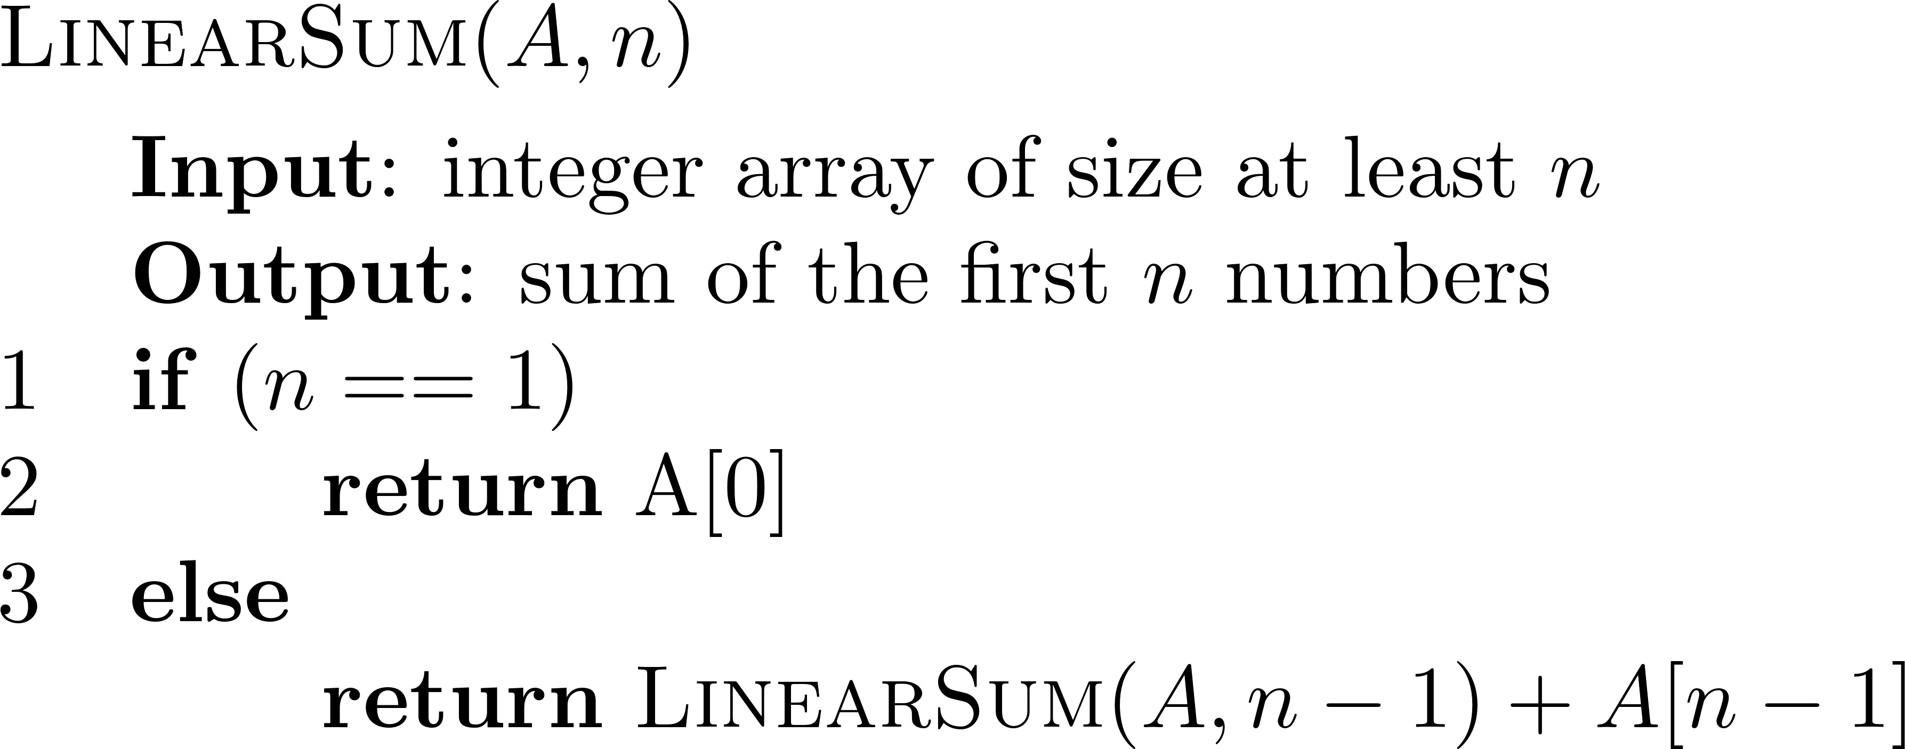
Summing the Elements of an Array
Solutions:
using (for) loop
using recursion
Note: the index starts from 0.

Slide 32
Recursive Method
An important property of a recursive method – the method terminates
An algorithm using linear recursion has the following form:
Test for base cases
Recur
Analyzing using Recursion trace
Box for each instance of the method
Label the box with parameters
Arrows for calls and returns
call
return
15
+
A
[
4
] =
15
+
5
=
20
LinearSum
(
A
,
5
)
call
return
13
+
A
[
3
] =
13
+
2
=
15
LinearSum
(
A
,
4
)
call
return
7
+
A
[
2
] =
7
+
6
=
13
LinearSum
(
A
,
3
)
call
return
4
+
A
[
1
] =
4
+
3
=
7
LinearSum
(
A
,
2
)
call
return
A
[
0
] =
4
LinearSum
(
A
,
1
)

Slide 33
Example
Reversing an Array by Recursion
Problem: Given an array A of size n, reverse the elements of A (the first element becomes the last one, …)
Instance:
Input: A[]={w, x, y, z, h}
Output: A[]={h, z, y, x, w}
Solutions
Nested loop ?
Recursion

Slide 34
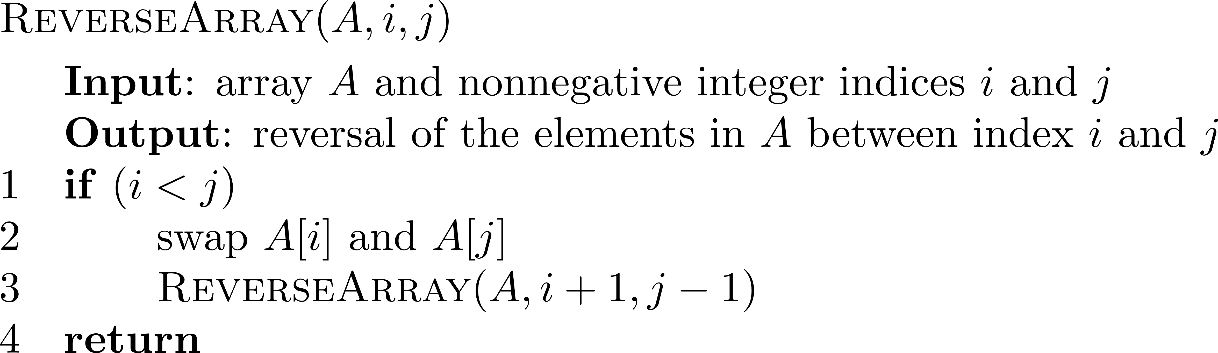
Reversing an Array

Slide 35
Facilitating Recursion
In creating recursive methods, it is important to define the methods in ways that facilitate recursion.
This sometimes requires we define additional parameters that are passed to the function.
For example, we defined the array reversal function as ReverseArray(A, i, j), not ReverseArray(A).

Slide 36
Example – Computing Powers
The power function, p(x, n)=x^{n}, can be defined recursively:
Following the definition leads to an O(n) time recursive algorithm (for we make n recursive calls).
We can do better than this, however.

Slide 37
Example – Computing Powers
We can derive a more efficient linearly recursive algorithm by using repeated squaring:
For example,
2⁴ = 2^{(4/2)2} = (2^{4/2})² = (2²)² = 4² = 16
2⁵ = 2^{1+(4/2)2} = 2(2^{4/2})² = 2(2²)² = 2(4²) = 32
2⁶ = 2^{(6/2)2} = (2^{6/2})² = (2³)² = 8² = 64
2⁷ = 2^{1+(6/2)2} = 2(2^{6/2})² = 2(2³)² = 2(8²) = 128

Slide 38
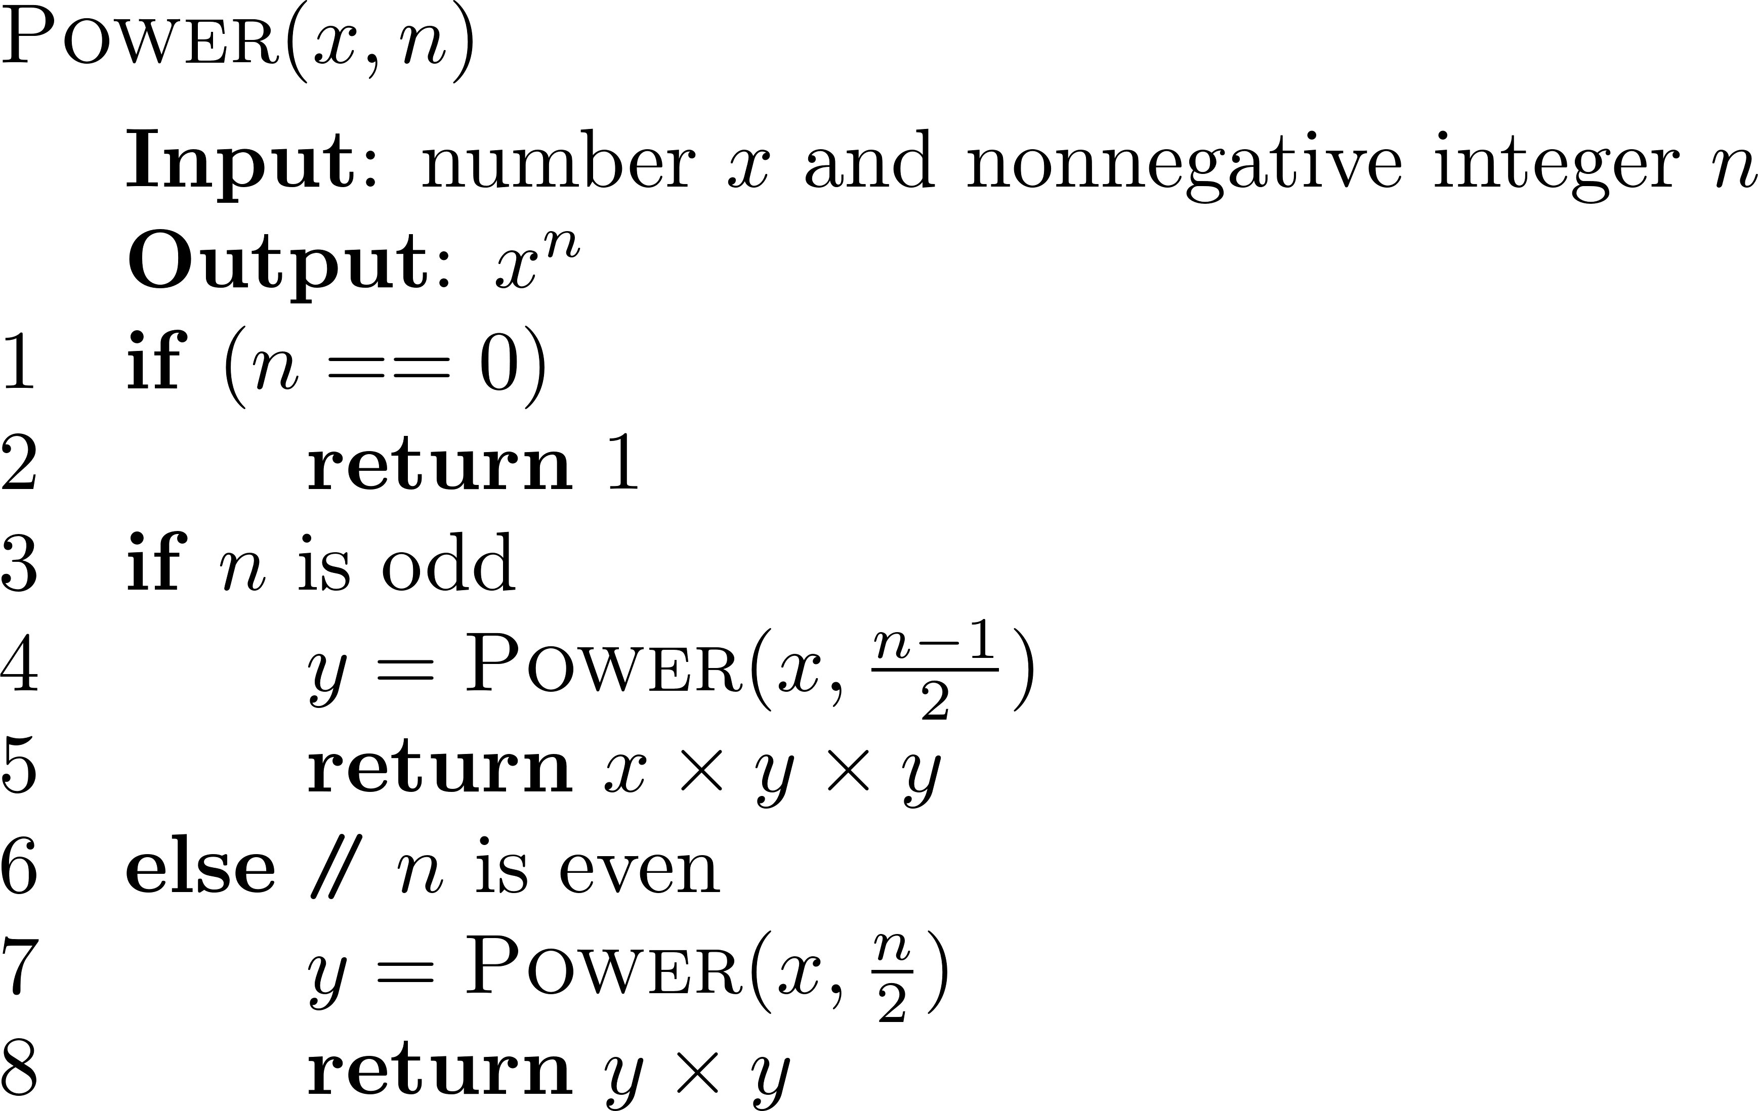
A Recursive Squaring Function

Slide 39
Analyzing Recursive Squaring Function
It is important that we used a variable twice here rather than calling the method twice.
Each time we make a recursive call we halve the value of n; hence, we make log n recursive calls. That is, this method runs in O(log n) time.

Slide 40
Tail Recursion
Tail recursion occurs when a linearly recursive method makes its recursive call as its last step.
Such methods can be easily converted to non-recursive methods (which saves on some resources).
The array reversal method is an example.

Slide 41
Example – Using Iteration
Algorithm IterativeReverseArray(A, i, j ):
Input: Array A and nonnegative integer indices i and j
Output: The reversal of the elements in A starting at index i and ending at j
while i < j do
Swap A[i ] and A[ j ];
i ← i + 1;
j ← j – 1;
return

Slide 42
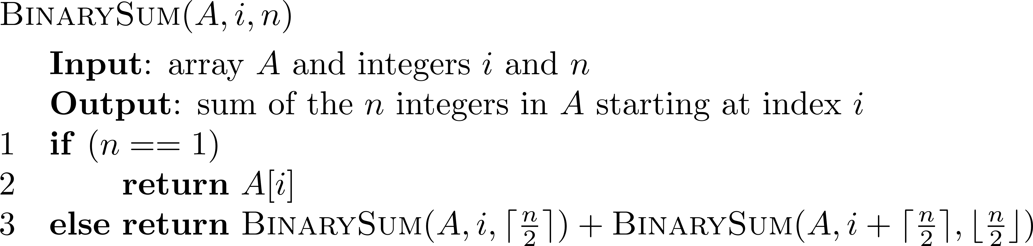
Binary Recursion
Binary recursion occurs whenever there are two recursive calls for each non-base case.
Example: BinaySum
Recall that this problem has been solved using linear recursion
Using binary recursion instead

Slide 43
Recursion Trace
Note the floor and ceiling used in the method
0
,
8
0
,
4
4
,
4
0
,
2
2
,
2
4
,
2
6
,
2
0
,
1
1
,
1
2
,
1
3
,
1
4
,
1
5
,
1
6
,
1
7
,
1

Slide 44
Fibonacci Numbers
Fibonacci numbers are defined recursively:
F₀ = 0
F₁ = 1
F_{i} = F_{i-1} ⁺ F_{i-2} for i > 1.
Example: 0, 1, 1, 2, 3, 5, 8, …

Slide 45
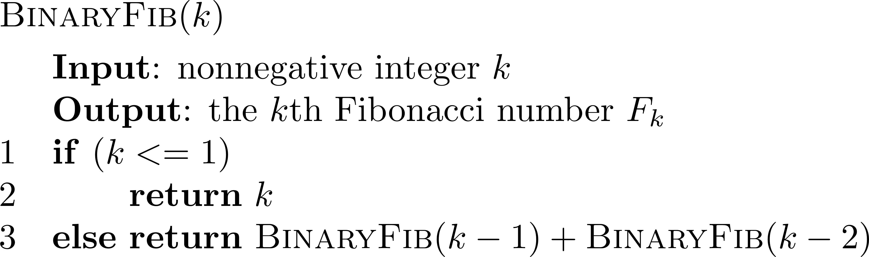
Fibonacci Numbers – Binary Recursion

Slide 46
Analyzing the Binary Recursion
Algorithm BinaryFib makes the number of calls exponential in k
By observation, there are many redundant computations:
F₀ = 0; F₁ = 1; F₂ = F₁ ⁺ F₀;
F₃ = F₂ ⁺ F₁ = (F₁ ⁺ F₀) + F₁; …
The above two results show the inefficiency of the method using binary recursion

Slide 47
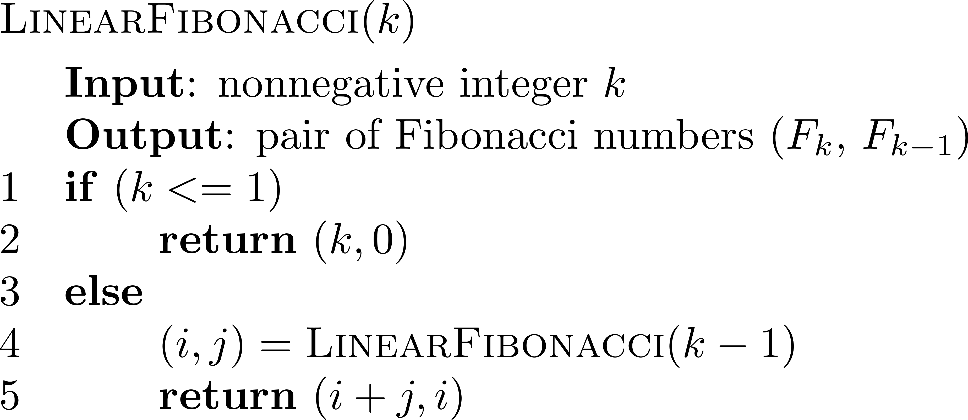
A Better Fibonacci Algorithm
Using linear recursion instead
avoid the redundant computation
Runs in O(k) time.

Slide 48
Multiple Recursion
Motivating example: summation puzzles
pot + pan = bib
dog + cat = pig
boy + girl = baby
Multiple recursion: makes potentially many recursive calls (not just one or two).

Slide 49
Algorithm for Multiple Recursion
Algorithm PuzzleSolve(k,S,U):
Input: An integer k, sequence S, and set U (the universe of elements to test)
Output: An enumeration of all k-length extensions to S using elements in U
without repetitions
for all e in U do
Remove e from U {e is now being used}
Add e to the end of S
if k = 1 then
Test whether S is a configuration that solves the puzzle
if S solves the puzzle then
return “Solution found: ” S
else
PuzzleSolve(k - 1, S,U)
Add e back to U {e is now unused}
Remove e from the end of S

Slide 50
Visualizing PuzzleSolve()
Initial call
PuzzleSolve
(
3
,
()
,{
a
,
b
,
c
}
)
PuzzleSolve
(
2
,
a
,{
b
,
c
}
)
PuzzleSolve
(
2
,
b
,{
a
,
c
}
)
PuzzleSolve
(
2
,
c
,{
a
,
b
}
)
PuzzleSolve
(
1
,
ab
,{
c
}
)
PuzzleSolve
(
1
,
ba
,{
c
}
)
PuzzleSolve
(
1
,
ca
,{
b
}
)
abc
bac
cab
PuzzleSolve
(
1
,
ac
,{
b
}
)
PuzzleSolve
(
1
,
bc
,{
a
}
)
PuzzleSolve
(
1
,
cb
,{
a
}
)
acb
bca
cba

