Slide 1
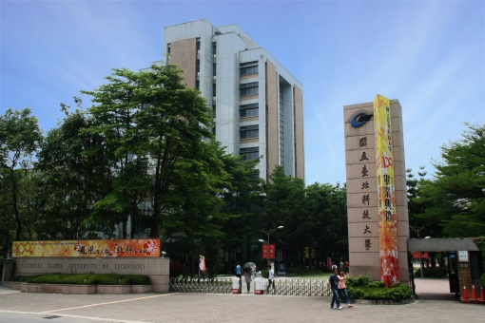
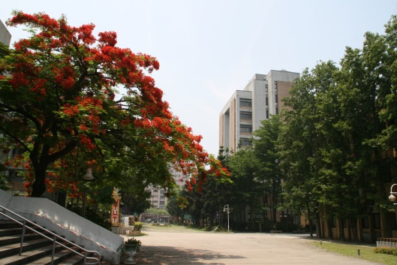
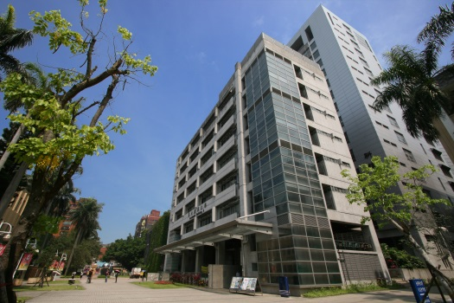
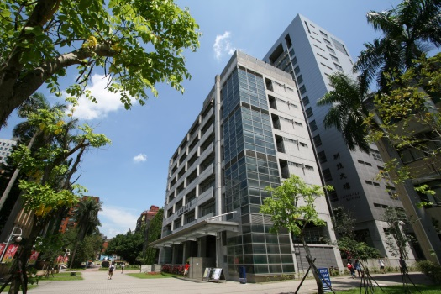
Analysis Tools
Chuan-Ming Liu
Computer Science & Information Engineering
National Taipei University of Technology
Taiwan

Slide 2
Contents
The Abstract Data Type (ADT)
Functions Usually Used
Analysis of Algorithms
Simple Justification Techniques

Slide 3
Abstract Data Types (ADTs)
An abstract data type (ADT) is collection of data items together with the operations on the data.
The word abstract presents that the operations and data are defined independently of how they are implemented.
An ADT specifies:
Data stored
Operations on the data
Error conditions associated with operations

Slide 4
Example – Stock Trading System
ADT modeling a simple stock trading system
The data stored are buy/sell orders
The operations supported are
order buy(stock, shares, price)
order sell(stock, shares, price)
void cancel(order)
Error conditions:
Buy/sell a nonexistent stock
Cancel a nonexistent order

Slide 5
Example – Sets
ADT modeling a set data structure
The data stored are homogeneous objects
The operations supported can be
Create()
Insert()
Delete()
Union
Intersection()
Difference
isIn()

Slide 6
Contents
The Abstract Data Type (ADT)
Functions Usually Used
Analysis of Algorithms
Simple Justification Techniques

Slide 7
Important Functions
To analyze the running time of an algorithm, we associate the algorithm with a function f(n) that characterizes the running time of the algorithm as a function of the input size n.
In this course, some basic functions will be usually used.

Slide 8
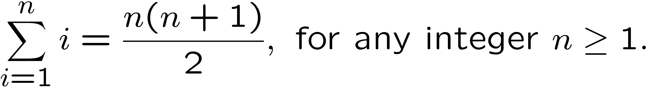
Some Common Functions (1)
Constant function: f(n) ≈ c, c is a constant.
Linear function: f(n) ≈ cn, c is a constant.
Quadratic function: f(n) ≈ cn², c is a constant.
Nested loops

Slide 9
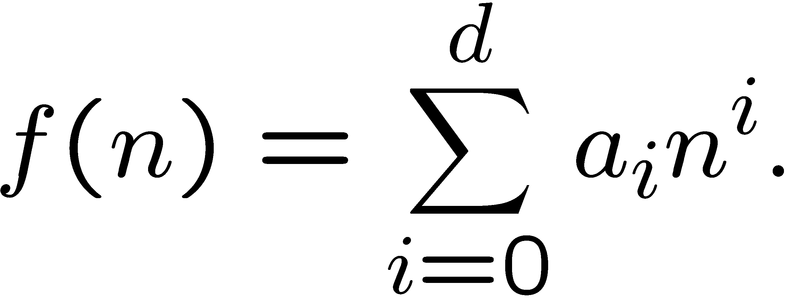
Some Common Functions (2)
Cubic function and other polynomials:
Cubic function, f(n) ≈ n³.
Polynomial of degree d, f(n) = a₀+a₁n+a₂n²+ … +a_{d}n^{d}, where a₀,a₁,a₂, …, a_{d} are coefficients and a_{d}≠0.
using the notation of summation Σ, a polynomial of degree d is

Slide 10
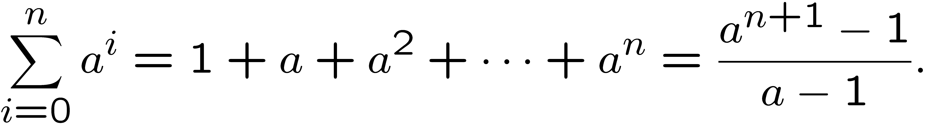
Some Common Functions (3)
Exponential function, f(n)=b^{n}, where b is the base and n is the exponent respectively.
Given positive integers a, b, and c:
(bª)^{c}=b^{ac}
bªb^{c}=b^{a+c}
bª/b^{c}=b^{a-c}
For real number x, f(x)=b^{x} still holds.
Geometric Sums: For integer n ≧ 0 and any real number a > 0 but ≠1,

Slide 11
Some Common Functions (4)
Logarithm function, f(n)=log_{b} n, for some b>1.
x=log_{b}n ≡ b^{x}=n
log_{b} 1= 0
in computer science, the base is 2, so log n = log₂ n
real numbers, a>0, b>1, c>0, and d>1
log_{b}ac = log_{b}a+log_{b}c (log_{b}a/c=log_{b}a-log_{b}c)
log_{b}a^{c}=clog_{b}a
log_{b}a=log_{d}a/log_{d}b
b^{log a}=a^{log} ^{b}
log^{c}n = (log n)^{c}

Slide 12
Some Common Functions (5)
N-log-N function: f(n)=n log n
Note: x is a real number
floor function of x: f(x)=⎣x⎦, largest integer ≦ x
ceiling function of x: f(x)=⎡x⎤, smallest integer ≧ x
Growth rates of the seven functions
1 < log n < n < nlogn < n² < n³ < a^{n}

Slide 13
Contents
The Abstract Data Type (ADT)
The Seven Functions Usually Used
Analysis of Algorithms
Simple Justification Techniques

Slide 14
Data Structures vs. Algorithms
Data Structures
Systematic way of organizing and accessing data
Algorithms
Step by step procedure for performing some task in a finite amount of time

Slide 15
Are They Good?
How to tell some data structures and algorithms as “good”?
running time
space usage
p.s. both increases with the input size
Need to learn some tools and concepts for the analysis

Slide 16
Running Time
Running time
varies for different inputs of the same size
is affected by the hardware and software environment
increases with the input size
can be studied by experiments
We are interested in characterizing the running time of an algorithm as a function of the input size.

Slide 17
Limitations on Experiments
Three major limitations on experimental study
Results only for a limited set of test inputs
Difficult comparisons due to the experiment environments
Full implementation and execution of an algorithm
We prefer having an analysis tool which allows to avoid performing experiments

Slide 18
Analysis Methodology
General methodology for analyzing the running time
Consider all possible inputs
Evaluate algorithms in a way that is independent from the hardware and software environments
Analyze an algorithm without implementing it
Associate each algorithm with a function f(n) that characterizes the running time of the algorithm as a function of the input size n.

Slide 19
Analysis of Algorithms
too much work
Experimental analysis
Need to implement and code the algorithms
Low-level executable language
Determine the time to execute the instruction
Count the number of times that an instruction is executed
Analysis on the high-level pseudo-code
Use an abstract view for the instructions
too complicated
easier

Slide 20
Primitive Operations
Basic computations performed by an algorithm
Each corresponding to a low-level instruction with an constant execution time
Largely independent from the programming language
Examples:
Evaluating an expression
Assigning a value to a variable
Comparing two numbers
Indexing into an array
Calling a method
Returning from a method

Slide 21
Counting Primitive Operations
Total number of primitive operations executed
is the running time of an algorithms
is a function of the input size
Example
Algorithm arrayMax(A, n) # operations
currentMax ← A[0] 2
for i ← 1 to n − 1 do 2n+1
if A[i] > currentMax then 2(n − 1)
currentMax ← A[i] 2(n − 1)
{ increment counter i } 2(n − 1)
return currentMax 1
Total 8n − 2

Slide 22
Best-case vs. Worst-case
Recall the if statement in the above example
condition is true: 6(n − 1) units in the loop
condition is false: 4(n − 1) units in the loop
So, the number of primitive operations t(n) is
6n≦t(n) ≦8n-2
when t(n)=6n, we refer to this case as the best-case
when t(n)=8n-2, we refer to this case as the worst-case

Slide 23
Average- vs. Worst-case Analysis
Average-case analysis measures the average running time of an algorithm (on all the possible inputs)
Needs heavy mathematics and probability theory
Poses challenging work
Worst-case analysis measures the maximum number of primitive operations executed

Slide 24
Estimating Running Time
Algorithm arrayMax executes 8n − 2 primitive operations in the worst case. Define:
a = Time taken by the fastest primitive operation
b = Time taken by the slowest primitive operation
Let T(n) be worst-case time of arrayMax. Then a (8n − 2) ≤ T(n) ≤ b(8n − 2)
Hence, the running time T(n) is bounded by two linear functions

Slide 25
Growth Rate of Running Time
Changing the hardware/ software environment
Affects the running time T(n) of algorithm arrayMax by a constant factor, but
Does NOT alter the growth rate of T(n)
The linear growth rate of the running time T(n) is an intrinsic property of algorithm arrayMax

Slide 26
Simplified Analysis
Recall the example, the number of primitive operations is between 6n and 8n-2 steps
In algorithm analysis, the growth rate of the running time as a function of the input size is considered
It is enough to know that the running time of an algorithm grows proportionally to some function of n, the input size.
Approaches can be applied to the space usage
Time Complexity

Slide 27
Big-Oh Notation
Given functions f(n) and g(n), we say that f(n) is O(g(n)) if there are positive constants c and n₀ such that f(n) ≤ c．g(n) for n ≥ n₀.
We will say “ f(n) is order of g(n)” or “f(n) is big-oh of g(n)”.
Example:
2n + 10 is O(n)
n² is not O(n)

Slide 28
Figure – Big “oh”
c • g(n)
y
f(n)
n
n₀

Slide 29
More Big-Oh Examples
3n³ + 20n² + 5
O(n³)
need c > 0 and n₀ ≥ 1 such that 3n³ + 20n² + 5 ≤ c•n³ for n ≥ n₀
is true for c = 4 and n₀ = 21
3 log n + 5
O(log n)
need c > 0 and n₀ ≥ 1 such that 3 log n + 5 ≤ c•log n for n ≥ n₀
is true for c = 8 and n₀ = 2

Slide 30
Interpreting Big-Oh
f(n) is less than or equal to g(n) up to a constant factor and in the asymptotic sense as n approaching infinity (n→∞).
The big-Oh notation allows us to
ignore constant factors and lower order terms
focus on the main components of a function that effect the growth

Slide 31
Big-Oh and Growth Rate
The big-Oh notation gives an upper bound on the growth rate of a function
The statement “f(n) is O(g(n))” means that the growth rate of f(n) is no more than the growth rate of g(n)
We can use the big-Oh notation to rank functions according to their growth rate
 | f(n) is O(g(n)) | g(n) is O(f(n))
g(n) grows more | Yes | No
f(n) grows more | No | Yes
Same growth | Yes | Yes

Slide 32
Properties of Big-Oh Notation
If f(n) = a₀+a₁n+a₂n²+ … +a_{d}n^{d,} a_{d}>0, then f(n) is O(n^{d}).
note that, for n≧1, 1≦n ≦… ≦n^{d}; hence,
a₀+a₁n+a₂n²+ … +a_{d}n^{d} ≦ (a₀+a₁+a₂+ … +a_{d})n^{d} .
We will use f(n) ≡ O(n^{d}) to present “f(n) is O(n^{d})” i.e. f(n) is in the class of O(n^{d}).

Slide 33
Big-Oh Rules
If is f(n) a polynomial of degree d, then f(n) is O(n^{d}), i.e.,
Drop lower-order terms
Drop constant factors
Use the smallest possible class of functions
Say “2n is O(n)” instead of “2n is O(n²)”
Use the simplest expression of the class
Say “3n + 5 is O(n)” instead of “3n + 5 is O(3n)”

Slide 34
Asymptotic Analysis
Determines the running time in big-Oh notation
Asymptotic analysis
find the worst-case number of primitive operations executed as a function of the input size
express this function with big-Oh notation
Example:
algorithm arrayMax executes at most 8n − 2 primitive operations
algorithm arrayMax runs in O(n) time
Time Complexity

Slide 35
Asymptotic Running Time
If algorithm A has O(n) running time and algorithm B has O(n²) running time, algorithm A is asymptotically better than algorithm B.
The asymptotic notations can be ordered in classes of functions by asymptotic growth rate
1 < log n < n < nlogn < n² < n³ < a^{n}
Improving an algorithm is better than improving hardware

Slide 36
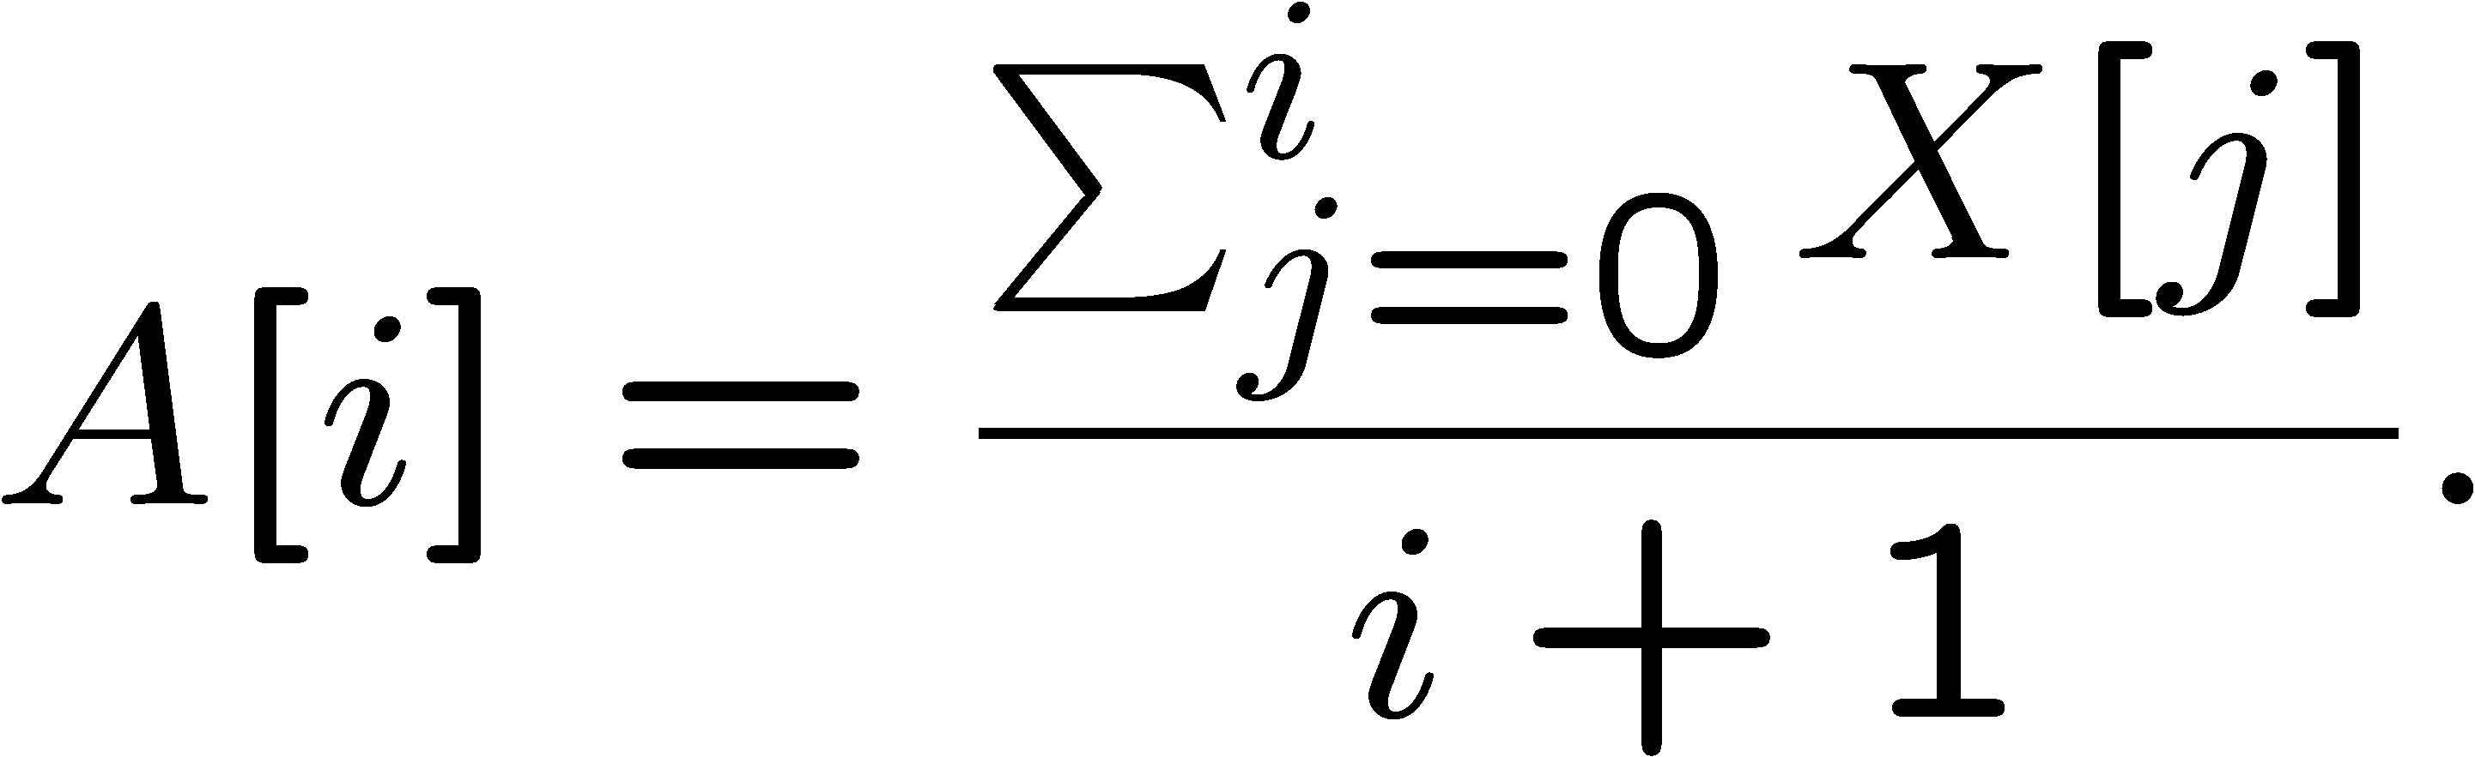
Using the Big-Oh Notation
It is better to say “f(n) is O(g(n))”
Mathematically, “f(n) ∈ O(g(n))”
Example: prefix averages
Problem: given an array X storing n numbers, we want to compute an array A such that A[i] is the average of element X[0],…,X[i], for i=0,…, n-1, that is,

Slide 37
Prefix Averages – Algorithm 1
Algorithm prefixAverages1(X, n)
Input: array X of n integers
Output: array A of prefix averages of X
A ← new array of n integers
for i ← 0 to n − 1 do
s ← X[0]
for j ← 1 to i do
s ← s + X[j]
A[i] ← s / (i + 1)
return A

Slide 38
Analysis of Algorithm 1
Algorithm prefixAverages1(X, n)
Input: array X of n integers
Output: array A of prefix averages of X #operations
A ← new array of n integers n
for i ← 0 to n − 1 do n
s ← X[0] n
for j ← 1 to i do 1 + 2 + …+ (n − 1)
s ← s + X[j] 1 + 2 + …+ (n − 1)
A[i] ← s / (i + 1) n
return A 1
The running time is therefore O(n²) –
quadratic-time algorithm.

Slide 39
Prefix Averages – Algorithm 2
Algorithm prefixAverages2(X, n)
Input array X of n integers
Output array A of prefix averages of X
A ← new array of n integers
s ← 0
for i ← 0 to n − 1 do
s ← s + X[i]
A[i] ← s / (i + 1)
return A

Slide 40
Analysis of Algorithm 2
Algorithm prefixAverages2(X, n)
Input: array X of n integers
Output: array A of prefix averages of X #operations
A ← new array of n integers n
s ← 0 1
for i ← 0 to n − 1 do n
s ← s + X[i] n
A[i] ← s / (i + 1) n
return A 1
The running time is therefore O(n) –
linear-time algorithm.

Slide 41
Relatives of Big-Oh
big-Omega
f(n) is Ω(g(n)) if there is a constant c > 0 and an integer constant n₀ ≥ 1 such that f(n) ≥ c• g(n) for n ≥ n₀
big-Theta
f(n) is Θ(g(n)) if there are constants c’ > 0 and c’’ > 0 and an integer constant n₀ ≥ 1 such that c’• g(n) ≤ f(n) ≤ c’’• g(n) for n ≥ n₀

Slide 42
Figure – Big Omega
f(n)
y
c • g(n)
n
n₀

Slide 43
Figure – Big Theta
c₁ • g(n)
y
f(n)
c₂ • g(n)
n
n₀

Slide 44
Intuition for Asymptotic Notation
big-Oh
f(n) is O(g(n)) if f(n) is asymptotically less than or equal to g(n))
big-Omega
f(n) is Ω(g(n)) if f(n) is asymptotically greater than or equal to g(n)
big-Theta
f(n) is Θ(g(n)) if f(n) is asymptotically equal to g(n)

Slide 45
Example – Relatives of Big-Oh
5n² is Ω(n²)
let c = 5 and n₀ = 1
5n² is Ω(n)
let c = 1 and n₀ = 1
5n² is Θ(n²)
f(n) is Θ(g(n)) if it is Ω(n²) and O(n²)
already seen the former
for the latter, let c = 5 and n₀ = 1

Slide 46
Math you need to review
properties of logarithms:
log_{b}(xy) = log_{b}x + log_{b}y
log_{b} (x/y) = log_{b}x - log_{b}y
log_{b}xª = alog_{b}x
log_{b}a = log_{x}a/log_{x}b
properties of exponentials:
a^{(b+c)} = a^{b}a^{c}
a^{bc} = (a^{b})^{c}
a^{b} /a^{c} = a^{(b-c)}
b = a ^{log}_{a}^{b}
b^{c} = a ^{c*log}_{a}^{b}
Summations
Logarithms
Exponents
Proof techniques
Basic probability

Slide 47
Contents
The Abstract Data Type (ADT)
The Seven Functions Usually Used
Analysis of Algorithms
Simple Justification Techniques

Slide 48
Simple Justification Techniques
How do we justify that our algorithms or data structures are correct or fast?
By example – an counterexample
The “contra” attack – a contradiction
Induction and loop invariants
Induction
Loop invariant

