Slide 1
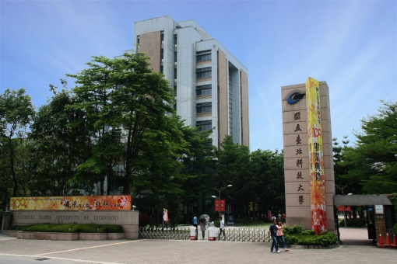
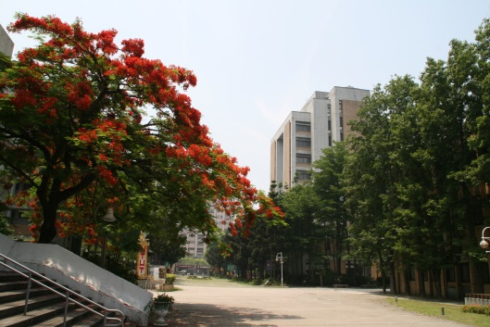
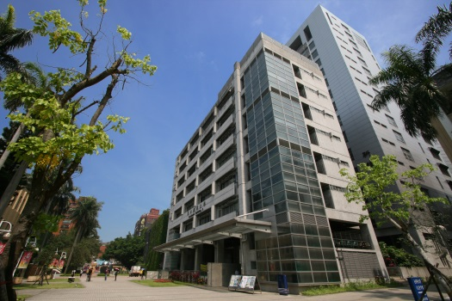

Linked Lists
Chuan-Ming Liu
Computer Science & Information Engineering
National Taipei University of Technology
Taiwan

Slide 2
Contents
Singly Linked Lists and Chains
Linked Stacks and Queues
Circularly Linked Lists
Doubly Linked Lists

Slide 3
Linked Lists
A linked list in its simplest form is a collection of nodes that together form a linear ordering
Examples
Each node in a linked list is a compound object that stores
a reference to an element (data) and,
a reference, called next (link), to another node

Slide 4
Singly Linked Lists
A singly linked list (Chain) is a concrete data structure consisting of a sequence of nodes
Each node stores
element (data)
link to the next node
next
data
node
head
tail
∅
A
B
C
D

Slide 5
Node
class Node:
def __init__(self,initdata):
self.data = initdata
self.next = None
def getData(self):
return self.data
def getNext(self):
return self.next
def setData(self,newdata):
self.data = newdata
def setNext(self,newnext):
self.next = newnext
next
data
node
Note: A self-reference structure

Slide 7
Comparing with Arrays
Unlike an array, a singly linked list
has no predetermined fixed size
uses space proportional to the number of its elements

Slide 8
Example –Linked List
class LinkedList:
def __init__(self):
self.head = None
self.tail = None
def insert(self,item):
temp = Node(item)
temp.setNext(self.head)
if self.tail == None:
self.tail = temp
self.head = temp
def isEmpty(self):
return self.head == None
head
tail
∅
head
tail
temp
∅
D

Slide 9
Insertion at the Head
Allocate a new node
Insert new element
Have new node point to old head
Update head to point to new node
head
tail
∅
A
B
C
D

Slide 10
Removing at the Head
Update head to point to next node in the list
Allow garbage collector to reclaim the former first node
head
tail
∅
A
B
C
D

Slide 11
Inserting at the Tail
Allocate a new node
Insert new element
Have new node point to null
Have old last node point to new node
Update tail to point to new node
head
tail
∅
∅
A
B
C
D

Slide 12
Removing at the Tail
Removing at the tail of a singly linked list is not efficient!
There is no constant-time way to update the tail to point to the previous node
head
tail
∅
A
B
C
D

Slide 13
Contents
Singly Linked Lists and Chains
Linked Stacks and Queues
Circularly Linked Lists
Doubly Linked Lists

Slide 14
Stack with a Singly Linked List
We can implement a stack with a singly linked list
The top element is stored at the first node of the list
The space used is O(n) and each operation of the Stack ADT takes O(1) time
nodes
t
∅
elements

Slide 15
Stack Operations
When using a chain to implement a stack, the operations push and pop are executed at the head of the chain and keep the tail as the bottom.
Pop ()
Push(pig)
Push(dog)
Push(fox)
tail
Push(cat)
cat
head
fox
dog
cat
fox
dog
pig
∅
pig
Stack
top
Underlying chain

Slide 16
Queue with a Singly Linked List
We can implement a queue with a singly linked list
The front element is stored at the head of the list; the rear element is stored at the tail
The space used is O(n) and each operation of the Stack ADT takes O(1) time
nodes
tail
head
∅
front
rear
elements

Slide 17
Queue Operations
When using a chain to implement a queue, the operations enqueue and dequque are executed at the tail and the head of the chain respectively
enqueue(pig)
enqueue(dog)
enqueue(fox)
dequeue()
tail
fox
head
dog
pig
rear
∅
∅
∅
∅
pig
dog
fox
Queue
front
Underlying chain

Slide 18
Contents
Singly Linked Lists and Chains
Linked Stacks and Queues
Circularly Linked Lists
Doubly Linked Lists

Slide 19
Circularly Linked Lists
A variation on the singly linked list.
A circularly linked list has the same kind of nodes as a single linked list but no head or tail (i.e. the tail points back to the head instead of null.)
We will use a cursor to traverse a circularly linked list
cursor
A
B
C
D
∅

Slide 20
Some Update Methods
We can define some simple update methods for a circularly linked list:
insert(v): insert a new node v right after the cursor; if the list is empty, then v become the cursor and its next pointer points to itself
delete(): remove and return the node v immediate after the cursor, unless it is the only node
advance(): advance the cursor to the next node in the list

Slide 21
Contents
Singly Linked Lists and Chains
Linked Stacks and Queues
Circularly Linked Lists
Doubly Linked Lists

Slide 22
Doubly Linked Lists
A doubly linked list is a linked list where each node has two references
next link: points to the next node
prev link: points to the previous node
prev
next
data
node
A
B
C
A

Slide 23
Example – Doubly Linked List
prev
next
data
node
header
nodes/positions
trailer
elements

Slide 24
Node in a Doubly Linked List
class Node:
def __init__(self,initdata):
self.prev = None
self.data = initdata
self.next = None
prev
next
data
node

Slide 25
Dummy (Sentinel) nodes
In a doubly linked list, two dummy (or sentinel) nodes are added at the head and the tail, respectively:
Header (at the head): has a valid next link but null prev link
Trailer (at the tail): has a valid prev link but null next link
header
trailer
A
B
C

Slide 26
Insertion at the Beginning
Allocate a new node
Insert new element
Have new node point to the old beginning node and the header respectively
Update the header and the old beginning node to point to the new node
header
trailer
A
B
C
X

Slide 27
Removing at the End
Update trailer to point to the node second to the last
Update the node second to the last to point to the trailer
Allow garbage collector to reclaim the former last node
header
trailer
A
B
C

Slide 28
Inserting After an Element
insetAfter(p, X): returns position q
p
A
B
C
p
A
B
q
C
X
p
q
A
B
X
C

Slide 29
Deleting an Element
delete(p) :
p
A
B
C
D
A
B
C
p
D
A
B
C

