Slide 1
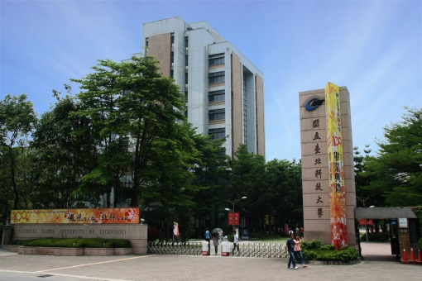
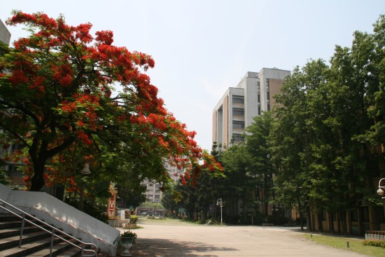
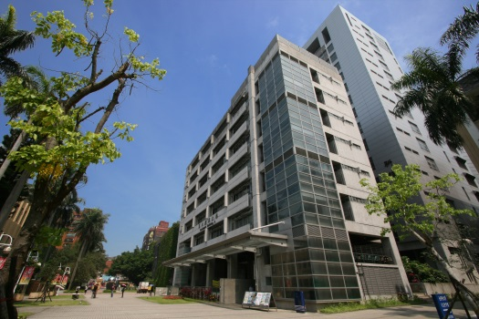

Trees
Chuan-Ming Liu
Computer Science & Information Engineering
National Taipei University of Technology
Taiwan

Slide 2
Contents
General Trees
Representation of Trees
Properties on Trees
Binary Trees
Binary Search Trees

Slide 3
What is a Tree?
In computer science, a tree is an abstract model of a hierarchical structure
A tree consists of nodes with a parent-child relation
Applications:
Organization charts
File systems
Computers”R”Us
Sales
Manufacturing
R&D
US
International
Laptops
Desktops
Europe
Asia
Canada

Slide 4
Terminology (1)
A tree T is a set of nodes with parent-child relation and satisfies the following properties:
If T is nonempty, it has a special node, root, which has no parent
Each node v in T different from the root has a unique parent w and v is a child of w
Nodes having the same parent are siblings.
Node (leaf) having no children is external
Node having child(ren) is internal

Slide 5
Terminology (2)
A node u is an ancestor of a node v if u=v or u is an ancestor of the parent of v.
A node v is a descendant of a node u if u is an ancestor of v.
The subtree of T rooted at a node v is the tree consisting of all the descendants of v in T.
A
subtree
B
C
D
E
F
G
H
I
J
K

Slide 6
Terminology (3)
The number of subtrees of a node is called its degree
Example: The degree of A is 3 and of C is 2.
The degree of a tree is the maximum of the degree of the nodes in the tree.

Slide 7
Edges and Paths
An edge of tree T is a pair of nodes (u,v) such that u is the parent of v
A path of T is a sequence of nodes such that any two consecutive nodes in the sequence form an edge

Slide 8
Example
ancestor of c, d, e, h, i, and a
root
r
g’s parent
siblings
a
leaf
b
subtree rooted at b
c
d
e
f
g
edge (d, h)
b’s child
h
i
j
path

Slide 9
Ordered Trees
Tree T is ordered if there is a linear ordering defined for the children of each internal node.
Ordered trees typically indicate the linear order existing between siblings by listing them in the correct order.

Slide 10
Contents
General Trees
Representation of Trees
Properties on Trees
Binary Trees
Binary Search Trees

Slide 11
Lists Representation
B
B
A
F
0
Child List
A
D
F
D
C
E
0
C
E
Child List
(B(A, D(C, E), F))

Slide 12
Lists Representation – Fixed Size
One can use nodes of a fixed size to represent tree nodes
Data
Child 1
Child 2
…
Child k
Node structure for a tree of degree k
Note: This structure is very wasteful of space

Slide 13
Left Child-Right Sibling Representation
Two pointers for each node
one to the left child
the other to its closest right sibling
Node structure:
data
left child
right sibling

Slide 14
Left Child-Right Sibling Representation – Example
B
∅
B
A
D
F
A
D
F
∅
∅
∅
C
E
C
E
∅
∅
∅

Slide 15
Linked Structure for General Trees
A node is represented by an object storing
Element
Parent node
Sequence of children nodes
∅
B
B
∅
∅
A
D
F
A
D
F
C
E
∅
∅
C
E

Slide 16
Contents
General Trees
Representation of Trees
Properties on Trees
Binary Trees
Binary Search Trees

Slide 17
Depth
For a node v in a tree T, the depth of v is the number of ancestors of v, excluding v itself
So, the depth of the root of T is 0
The depth of a node v can also be defined recursively:
If v is the root, the depth of v is 0
The depth of v is one plus the depth of the parent of v

Slide 18
Example – depth and height
Depth
Height
0
r
3
1
2
a
b
2
c
d
e
f
g
1
3
h
i
j
0

Slide 19
Algorithm for the Depth
Algorithm depth(T, v):
If T.isRoot(v) then
return 0
else
return 1+depth(T, T.parent(v))
The running time is O(d_{v}), where d_{v} is the depth of the node v
In the worst case, algorithm depth(T, v) runs in O(n) time, where n is the total number of nodes in T.

Slide 20
Height
The height of a node v in a nonempty tree T defined recursively:
The height of an external node is 0;
The height of a node v is one plus the maximum height of a child of v
The height of a nonempty tree is the height of the root of T.
The height of a nonempty tree is equal to the maximum depth of an external node of T.

Slide 21
Algorithm1 for the Height
Algorithm heigh1(T):
h=0
for each v∈T do
if T.isExternal(v) then
h=max(h, depth (T, v))
return h
The running time is O(n + Σ _{v∈E} (1+d_{v})), where d_{v} is the depth of the node v
In the worst case, algorithm height1(T) runs in O(n²) time, where n is the total number of nodes in T.

Slide 22
Algorithm2 for the Height
Algorithm heigh2(T, v):
if T.isExternal(v) then
return 0
else
h=0
for each w∈T.children(v) do
h=max(h, height2(T, w))
return 1+ h
Recall Σ_{v∈T} c_{v} = n-1, where c_{v} is the number of children of a node v and n is the size of the tree
The running time is linear, O(n).

Slide 23
Preorder Traversal
A traversal of a tree T is a systematic way of accessing, or “visiting”, all the nodes of T
In a preorder, a node is visited before its descendants
The preorder traversal is useful for producing a linear ordering where parents must always come before their children

Slide 24
Algorithm for Preorder Traversal
1
Make Money Fast!
2
9
5
1. Motivations
2. Methods
References
3
4
6
7
8
1.1 Greed
1.2 Avidity
2.1 Stock Fraud
2.2 Ponzi Scheme
2.3 Bank Robbery
Algorithm preOrder(v)
visit(v)
for each child w of v
preorder (w)
The overall running time is O(n)
Application: print a structured document

Slide 25
Postorder Traversal
In a postorder, a node is visited after its descendants
The postorder traversal is useful for solving problems where we wish to compute some property in a bottom-up fashion

Slide 26
Algorithm for Postorder Traversal
9
cs16/
3
7
todo.txt 1K
8
homeworks/
programs/
5
1
2
h1c.doc 3K
h1nc.doc 2K
4
DDR.java 10K
Stocks.java 25K
6
Robot.java 20K
Algorithm postOrder(v)
for each child w of v
postOrder (w)
visit(v)
The overall running time is O(n)
Application: compute space used by files in a directory and its subdirectories

Slide 27
Contents
General Trees
Representation of Trees
Properties on Trees
Binary Trees
Binary Search Trees

Slide 28
Binary Trees
A binary tree is an ordered tree with
Each node has at most two children
Each child is labeled as being either a left child or a right child
The left child precedes the right child in the ordering
The subtree rooted at a left (right) child of an internal node v is a left (right) subtree of v
A binary tree is proper if each node had either zero or two children (full binary tree).

Slide 29
Example – A Binary Tree
A
Right subtree of A
A proper binary tree?
Yes!
不是0就是2個節點
B
C
D
E
F
G
H
I

Slide 30
Example – Decision Tree (Binary)
Binary tree associated with a decision process
internal nodes: questions with yes/no answer
external nodes: decisions
Example: dining decision
Want a fast meal?
Yes
No
How about coffee?
On expense account?
Yes
No
Yes
No
Starbucks
Spike’s
Al Forno
Café Paragon

Slide 31
Example – Arithmetic Expression
Binary tree associated with an arithmetic expression
internal nodes: operators
external nodes: operands
Example: arithmetic expression tree for the expression (2 × (a - 1) + (3 × b))
+
×
×
2
−
3
b
a
1

Slide 32
Binary Trees – Recursive Definition
A binary tree is either
a tree consisting of a single node, or
a tree whose root has an ordered pair of children, each of which is a binary tree

Slide 33
BinaryTree ADT
The Binary Tree ADT extends the Tree ADT
Additional methods:
left(v): return the left child of v;
right(v): return the right child of v;
hasLeft(v): whether v has a left child;
hasRight(v): whether v has a right child
Update methods may be defined by data structures implementing the Binary Tree ADT

Slide 34
Properties of Binary Trees
Suppose T is a binary tree and
n : number of nodes
e : number of external nodes
i : number of internal nodes
h : height of T
Then
h+1≤n≤2^{h+1}-1
1 ≤e ≤2^{h}
h ≤i ≤2^{h}-1
log(n+1)-1 ≤h≤n-1

Slide 35
Relation between h and n (Maximum)
2⁰
2¹
2
3
2²
h
2³
…
…
…
…
2^{h}

Slide 36
Relation between h and n (Minimum)
1
1
1
1
h
…
…
1

Slide 37
Number of Leaves (e)
2⁰
2¹
2²
h
2³
…
…
∴ e≦2^{h}
…
…
2^{h}

Slide 38
Number of Internal Nodes (Maximum)
2⁰
2¹
2²
h
2³
…
…
2^{h-1}
…
…
2^{h}

Slide 39
Taking the Logarithm
Recall that h+1≤n≤2^{h+1}-1
Consider h+1≤n
Consider n≤2^{h+1}-1
Hence, log(n+1)-1 ≤h≤n-1

Slide 40
Properties of Proper Binary Trees
Suppose T is a proper binary tree and let n, e, i and h denote the number of nodes, number of external nodes, number of internal nodes, and height of T, respectively. Then
2h+1≤n≤2^{h+1}-1
h+1 ≤e ≤2^{h}
h ≤i ≤2^{h}-1
log(n+1)-1 ≤h≤(n-1)/2
e=i+1

Slide 41
Linked Structure for Binary Trees
A natural way to realize a binary tree T
A node in T is represented by an object storing
Element
Parent node
Left child node
Right child node
Node objects implement the Position ADT

Slide 42
Binary Tree using Linked Structure
parent
∅
left
right
B
element
∅
∅
B
A
D
A
D
∅
∅
∅
∅
C
E
C
E

Slide 43
Array-based Structure
A simple structure for representing a binary tree T.
For every node v in T, define p(v) as
p(v) =1, if v is the root
p(v) = 2p(u), if v is the left child of node u
p(v) = 2p(u)+1, if v is the right child of node u
The numbering function p is known as a level numbering of the nodes in a binary tree T.

Slide 44
Level Numbering
Level 0: 2⁰
1
2*1=2
2*1+1=3
Level 1: 2¹
3
2
2*2=4
2*2+1=5
Level 2: 2²
4
5
6
7
Level 3: 2³
8
9
10
11
12
13
14
15
1
2
3
4
5
6
7
8
9
10
11
12
13
14
15

Slide 45
Representing General Trees with Binary Trees
One can transform a general tree T (ordered) into a binary tree T’ by the following rules
For each node u in T, there is a node u’ in T’
If u is internal and v is u’s first child, v’ is the left child of u’ in T’
If v has a sibling w next to v, then w’ is the right child of v’ in T’

Slide 46
Illustration for Transformation
A
A
B
B
C
D
E
C
E
F
G
F
D
G
左邊放children，右邊放siblings

Slide 47
Traversals of a Binary Tree
The preorder and postorder traversals for general trees can be applied to any binary tree
For a binary tree, we further discuss the inorder traversal which visits a node v after visiting the right subtree of v and then visits the left subtree of v in the following
preorder: ABC
postorder:BCA
inorder:BAC
A
B
C

Slide 48
Inorder Traversal
In an inorder traversal a node is visited after its left subtree and before its right subtree
6
Algorithm inOrder(v)
if hasLeft (v)
inOrder (left (v))
visit(v)
if hasRight (v)
inOrder (right (v))
8
2
4
7
1
9
3
5

Slide 49
Print Arithmetic Expressions
Specialization of an inorder traversal
print operand or operator when visiting node
print “(“ before traversing left subtree
print “)“ after traversing right subtree
+
×
×
2
−
3
b
Algorithm printExpression(v)
if hasLeft (v) print(“(’’)
printExpression (left(v))
print(v.element ())
if hasRight (v)
printExpression right(v))
print (“)’’)
a
1
((2 × (a − 1)) + (3 × b))

Slide 50
Evaluate Arithmetic Expressions
Specialization of a postorder traversal
recursive method returning the value of a subtree
when visiting an internal node, combine the values of the subtrees
Algorithm evalExpr(v)
if isExternal (v)
return v.element ()
else
x ← evalExpr(leftChild (v))
y ← evalExpr(rightChild (v))
◊ ← operator stored at v
return x ◊ y
+
×
×
2
−
3
2
5
1

Slide 51
Euler Tour Traversal
Generic traversal of a binary tree
Preorder, postorder and inorder traversals become the special cases
Walk around the tree and visit each node three times:
on the left (preorder)
from below (inorder)
on the right (postorder)
+
L
×
R
×
B
2
−
3
2
5
1

Slide 52
Algorithm eulerTour
Algorithm eulerTour(T,v):
perform the action for visiting node v on the left
if T.hasLeft(v) then
eulerTour(T, T.left(v))
perform the action for visiting node v from below
if T.hasRight(v) then
eulerTour(T, T.right(v))
perform the action for visiting node v on the right
overall running time is O(n) for an n-node tree.
The Euler Tour traversal has more applications, including all the applications which the one of the three traversals can be applied.

Slide 53
Algorithm printExpression
Recall the example for printing an arithmetic expression
The Euler Tour can also be used to print a fully parenthesized arithmetic expression
Algorithm printExpression(T, v):
if T.isExternal(v) then
print the value stored at v
else
print “(“
printExpression(T, T.left(v))
print the operator stored at v
printExpression(T, T.left(v))
print “)”

Slide 54
Contents
General Trees
Representation of Trees
Properties on Trees
Binary Trees
Binary Search Trees

Slide 55
Binary Search Trees (BST)
Idea from the binary search
A binary search tree is a binary tree satisfying the following properties:
Each node has a key
keys in the left subtree smaller than the root’s key
keys in the right subtree greater than the root’s key
The left and right subtrees are binary search trees
A binary search tree is the realization of an ordered dictionary (or map).

Slide 56
Example – A Binary Search Tree
20
12
30
10
16
25
35
8
11
15
19
How to search, insert, and remove?

Slide 57
Searching
Recursive search – due to the recursive property of the BST
Start from the root
if key matches item,
then output
else if (key < item)
then search on the right subtree
else search on the left subtree
O(h), if the tree height is h

Slide 58
Example – Searching
Search 19
20
12
30
10
16
25
35
8
11
15
19

Slide 59
Insertion
First, search x on BST to verify x is in or not.
if the search successes, no insertion
else //insert x at the node n where the search stops
if (key <x)
then make x a right child of n
else make x a left child of n
Insertion: O(h), if the tree height is h.

Slide 60
Example – Insertion
Insert 28
20
12
30
10
16
25
35
8
11
15
19
28

Slide 61
Removal
Removal on a BST is little bit tricky
if v is a leaf, then delete v directly
if v is an internal node having only one child u, then
replace v by u and delete original u
if v is an internal node having two children, then
select one subtree, say the right subtree;
find the element y whose key is next to v;
replace v by y and delete y
O(h), if h is the tree height.
need a routine to serve this

Slide 62
Node Next to Removed Node
To find an element y next to an element v in the subtree rooted an v, can be done in O(h), if the tree height is h
We can verify that y has at most one child
Then, to delete y is simple and can be done in O(1)

Slide 63
Example – Deletion
Delete 12
20
Delete 16
12
30
10
16
25
35
8
11
15
19

Slide 64
Height of a BST
Depending on the order of insertions
O(n) in worst case
O(log n) in average by random insertion
Search tree with height O(log n) in worst case is a balanced search tree, e.g.
AVL trees
2-3 trees
Red-Black trees
B-trees

