Slide 1
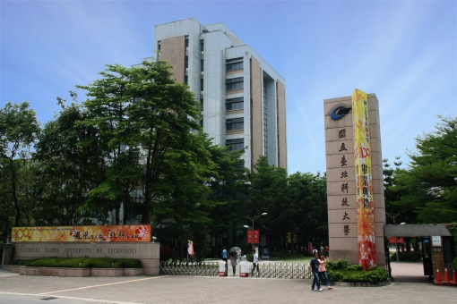
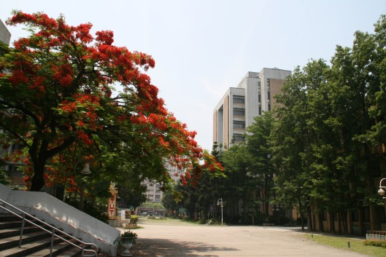
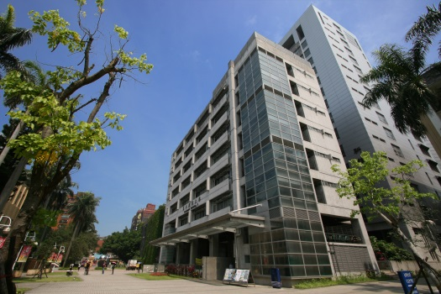

Search Trees
Chuan-Ming Liu
Computer Science & Information Engineering
National Taipei University of Technology
Taiwan

Slide 2
Contents
Binary Search
Trees
AVL Trees
Splay Trees
(2,4) Trees
Red-Black
Trees
B-Trees

Slide 3
Contents
Binary Search
Trees
AVL Trees
Splay Trees
(2,4) Trees
Red-Black
Trees
B-Trees

Slide 4
Height-Balance Property
Height-Balance Property: For every internal node v of a tree T, the heights of the children of v differ by at most 1.
An AVL tree is a binary search tree that satisfies the height-balance property.
An internal node v of T is balanced if the absolute value of the difference between the heights of the children of v is at most 1; otherwise, v is unbalanced.

Slide 5
An AVL Tree
46
4
3
2
24
73
1
2
1
0
e₁
38
58
85
1
1
0
0
0
0
e₂
e₃
51
63
e₈
e₉
0
0
0
0
e₄
e₅
e₆
e₇
An example of an AVL tree where the heights are shown next to the nodes

Slide 6
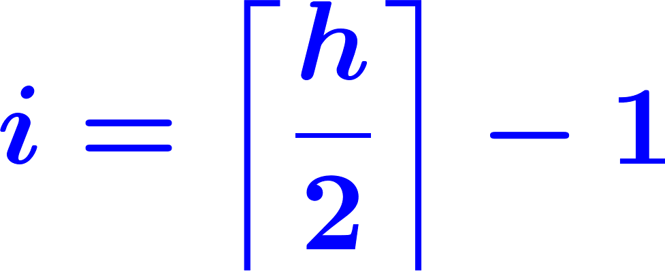
Height of an AVL Tree
The height of an AVL tree storing n keys is O(log n).
Proof:
Let T be an n-ndoe AVL tree of height h
Define n(h) to be the minimum number of internal nodes of an AVL tree of height h.
Note that n(1) = 1 and n(2) = 2.
For h > 2, we can derive
n(h) = 1 + n(h-1) + n(h-2)
since an AVL tree of height h contains the root node, one AVL subtree of height h-1 and another of height h-2.
Knowing n(h-1) > n(h-2), we get n(h) > 2n(h-2).
by induction, n(h) > 2^{i}n(h-2i).
picking i so that h-2i = 1 or 2.
Solving the base case, we get: n(h) > 2 ^{h/2-1}.
Taking logarithms: h < 2log n(h) +2.
Thus the height of AVL tree T is O(log n).
r
n(h-2)
n(h-1)

Slide 7
Insertion
Insertion is as in a binary search tree.
Always done by expanding an external node.
Example:
40
Insert 8
12
72
Insert 65
Height Balanced?
8
20
60
94
Insert 45
50
65
45

Slide 8
Single Rotation
40
12
72
y
8
20
60
94
x
50
65
z
45

Slide 9
Double Rotation – I
z
Insert 48
40
y
12
60
x
8
20
50
72
45
55
65
94
48

Slide 10
Double Rotation – II
z
40
12
x
50
y
8
20
45
60
48
55
72
65
94

Slide 11
Cases for Single Rotations
c = z
single rotation
b = y
b = y
a = x
c = z
a = x
T
3
T
0
T
0
T
2
T
1
T
2
T
3
T
1

Slide 12
Cases for Double Rotations

Slide 13
Trinode Restructuring
let (a,b,c) be an inorder listing of x, y, z
perform the rotations needed to make b the topmost node of the three
(other two cases are symmetrical)
case 2: double rotation
(a right rotation about c, then a left rotation about a)
a=z
a=z
T₀
b=y
T₀
c=y
c=x
b=x
T₁
T₃
b=y
b=x
T₂
T₃
T₁
T₂
a=z
c=x
a=z
c=y
case 1: single rotation
(a left rotation about a)
T₀
T₁
T₂
T₃
T₀
T₁
T₂
T₃

Slide 14
Question
Does one restructuring restore the height-balance property of the tree?

Slide 15
Removal
Removal begins as in a binary search tree.
Resulting at most one unbalanced node (Why?)
Using Trinode restructuring to restore balance in the tree.

Slide 16
Example – Removal
Remove 32
44
w
17
62
32
50
78
Height Balanced?
48
54
88

Slide 17
Example – Locating Nodes
44
z
1. z is the first unbalanced
node encountered from w
y
w
17
62
2. y is the child of z with larger height
x
50
78
3. x is the child of y with larger height
(if height is tied, x is on the same side as y)
48
54
88

Slide 18
Example – Restructuring
44
z
y
17
62
x
50
78
48
54
88

Slide 19
Example – Result
y
62
44
z
x
78
17
50
88
48
54
Can one restructuring store the height-balance property globally?

Slide 20
Performance
A single restructure is O(1)
find is O(log n) – height is O(log n)
insert is O(log n)
initial find is O(log n)
Restructuring tree to maintain heights is O(1)
remove is O(log n)
initial find is O(log n)
Restructuring up the tree needs O(log n)

Slide 21
Contents
Binary Search
Trees
AVL Trees
Splay Trees
(2,4) Trees
Red-Black
Trees
B-Trees

Slide 22
Multi-Way Search Tree
A multi-way search tree is an ordered tree:
Each internal node
has at least two children
stores d −1 key-element items (k_{i}, o_{i}), where d is the number of children
For a node with children v₁ v₂ … v_{d} storing keys k₁ k₂ … k_{d−1}
keys in the subtree of v₁ are less than k₁
keys in the subtree of v_{i} are between k_{i−1} and k_{i} (i = 2, …, d − 1)
keys in the subtree of v_{d} are greater than k_{d−1}
The leaves store no items and serve as placeholders

Slide 23
Example
11 24
2 6 8
15
27 32
30

Slide 24
Multi-Way Inorder Traversal
Extend the notion of inorder traversal from binary trees
visit item (k_{i}, o_{i}) of node v between the recursive traversals of the subtrees of v rooted at children v_{i} and v_{i} ₊ ₁
Visits the keys in increasing order
11 24
8
12
2 6 8
15
27 32
2
4
6
10
14
18
30
1
3
5
7
9
11
13
15
16
17
19

Slide 25
Multi-Way Searching
Similar to search in a binary search tree
Each internal node with children v₁ v₂ … v_{d} and keys k₁ k₂ … k_{d−1}
k = k_{i} (i = 1, …, d − 1): terminates successfully
k < k₁: continues the search in child v₁
k_{i−1} < k < k_{i} (i = 2, …, d − 1): continues the search in child v_{i}
k > k_{d−1}: continues the search in child v_{d}
Reaching an external node terminates the search unsuccessfully

Slide 26
Example: Search for 30
11 24
2 6 8
15
27 32
30

Slide 27
B-trees
A B-tree of order m is an m-way search tree that is empty or satisfies the following properties
The root node has at least two children;
All nodes other than the root and external nodes (leaves) have at least ⎡m/2⎤ children;
All external nodes are at the same level.

Slide 28
Observations about B-trees
When m=3, all internal nodes of a B-tree have a degree that is either 2 or 3
When m=4, the possible degrees of internal nodes are 2, 3, and 4.
When m=5, the possible degrees of internal nodes are 3, 4, and 5.
A B-tree of order 3 is known as a 2-3 tree
A B-tree of order 4 is known as (2,4)-tree

Slide 29
(2,4) Trees
A (2,4) tree (also called 2-4 tree or 2-3-4 tree) is a multi-way search with
Size Property: every internal node has at most four children and
Depth Property: all the external nodes have the same depth
Depending on the number of children, an internal node of a (2,4) tree is called a 2-node, 3-node, or 4-node

Slide 30
Example
4-node
10 15 24
2 8
12
18
27 32
2-node
3-node

Slide 31
Height of a (2,4) Tree
A (2,4) tree storing n items has height O(log n)
Let h be the height of a (2,4) tree with n items
Since there are at least 2^{i} items at depth i = 0, … , h−1 and no items at depth h, we have n ≥ 1 + 2 + 4 + … + 2^{h−1} = 2^{h} − 1
Searching in a (2,4) tree with n items takes O(log n) time
depth
items
0
1
1
2
h−1
2^{h−1}
h
0

Slide 32
Insertion
Inserting a new item (k, o)
searching for k
inserting (k, o) at the parent v of the reached leaf
Preserve the depth property but may cause an overflow (i.e., node v may become a 5-node)

Slide 33
Example – Inserting Key 30
10 15 24
v
2 8
12
18
27 32 35
overflow
10 15 24
v
2 8
12
18
27 30 32 35

Slide 34
Splitting the Overflow Node
Split operation on a 5-node (overflow) v
let v₁ … v₅ be the children of v and k₁ … k₄ be the keys of v
node v is replaced nodes v' and v"
v' is a 3-node with keys k₁ k₂ and children v₁ v₂ v₃
v" is a 2-node with key k₄ and children v₄ v₅
key k₃ is inserted into the parent u of v (a new root may be created)
The overflow may propagate to the parent node u

Slide 35
Example – Split Operation
u
15 24
v
12
18
27 30 32 35
v₁
v₂
v₃
v₄
v₅
u
15 24 32
v'
v"
12
18
27 30
35
v₁
v₂
v₃
v₄
v₅

Slide 36
Analysis of Insertion
Algorithm insert(k, o)
1.Searching for key k to locate the insertion node v
2.Adding the new entry (k, o) at node v
3. while overflow(v)
if isRoot(v)
create a new empty root above v
v ← split(v)
Let T be a (2,4) tree with n items
Tree T has O(log n) height
Step 1 takes O(log n) time because we visit O(log n) nodes
Step 2 takes O(1) time
Step 3 takes O(log n) time because each split takes O(1) time and we perform O(log n) splits
Thus, an insertion in a (2,4) tree takes O(log n) time

Slide 37
Removal
Reducing deletion of an entry to the case where the item is at the node with leaf children
Otherwise, we replace the entry with its inorder successor (or, equivalently, with its inorder predecessor) and delete the latter entry

Slide 38
Example – Removal
10 15 24
2 8
12
18
27 32 35
To delete key 24, we replace it with 27 (inorder successor)
10 15 27
2 8
12
18
32 35

Slide 39
Underflow
Deleting an entry from a node v may cause an underflow – node v becomes a 1-node with one child and no keys
Example: remove 15
Handling an underflow by considering two cases
underflow
9 14
9 14
2 5 7
10
15
2 5 7
10

Slide 40
Fusion for Underflow
Case 1: the adjacent siblings of v are 2-nodes
Fusion operation: merge v with an adjacent sibling w and move an entry from u to the merged node v'
After a fusion, the underflow may propagate to the parent u
u
u
9 14
9
w
v
v'
2 5 7
10
2 5 7
10 14

Slide 41
Transfer for Underflow
Case 2: an adjacent sibling w of v is a 3-node or a 4-node
Transfer operation:
1. move a child of w to v
2. move an item from u to v
3. move an item from w to u
After a transfer, no underflow occurs
u
u
4 9
4 8
w
v
w
v
2
6 8
2
6
9

Slide 42
Analysis of Removal
Let T be a (2,4) tree with n items
Tree T has O(log n) height
In a deletion operation
We visit O(log n) nodes to locate the node from which to delete the entry
We handle an underflow with a series of O(log n) fusions, followed by at most one transfer
Each fusion and transfer takes O(1) time
Thus, deleting an item from a (2,4) tree takes O(log n) time

Slide 43
Implementing a Dictionary
Comparison of efficient dictionary implementations
 | Search | Insert | Delete | Notes
Hash Table | 1 expected | 1 expected | 1 expected | no ordered dictionary methods simple to implement
Skip List | log n high prob. | log n high prob. | log n high prob. | randomized insertion simple to implement
(2,4) Tree | log n worst-case | log n worst-case | log n worst-case | complex to implement

Slide 44
Contents
Binary Search
Trees
AVL Trees
Splay Trees
(2,4) Trees
Red-Black
Trees
B-Trees

Slide 45
Red-Black Trees
A red-black tree is a binary search tree having
Root Property: the root is black
External Property: every leaf is black
Internal Property: the children of a red node are black
Depth Property: all the leaves have the same black depth
9
4
15
2
6
12
21
7

Slide 46
From Red-Black to (2,4) Trees
Convert a red-black tree to a (2, 4) tree by
Merging every red node into its parent
Storing the entry from the red node at its parent
4
5
3
6
OR
3
5
2
7
4
3 5
2 6 7

Slide 47
From (2,4) to Red-Black Trees
Converting by
Color each node black first
Then,
3 5
2 6 7
4
5
3
6
4
OR
3
5
2
7

Slide 48
Height of a Red-Black Tree
Theorem: A red-black tree storing n entries has height O(log n).
The height of a red-black tree is at most twice the height of its associated (2,4) tree, which is O(log n)
The search algorithm for a red-black tree is the same as that for a binary search tree
By the above theorem, searching in a red-black tree takes O(log n) time

Slide 49
Insertion
Execute the insertion algorithm for binary search trees and color red the newly inserted node z unless it is the root
The root, external, and depth properties are preserved.
If the parent v of z is black, we also preserve the internal property and we are done
Else (v is red ) we have a double red (i.e., a violation of the internal property) – restructuring the tree is required.

Slide 50
Inserting a New Node z
The parent v of z is black.
v
Insert 8
v
6
z
6
z
3
8
3
8
The parent v of z is red.
double red
Insert 4
6
6
v
v
z
3
8
3
8
z
4
4

Slide 51
Two Cases of a Double Red
Consider a double red with z and parent v
Let u be the parent of v
For the sibling w of v, there are two cases:
Case 1: w is black sibling是黑的，旋轉
Case 2: w is red sibling是紅的，往上推
u
u
Case 1
Case 2
v
w
v
w
z
z

Slide 52
Restructuring for Case 1
Perform a trinode restructuring about nodes u, v, and z
This is similar to the rotation operation
Rule: keep the order of the inorder traversal among these three nodes
There are four cases
Color the new middle node (as the inorder) black and the other two nodes red

Slide 53
Example – Restructuring
The inorder traversal is v, z, u
u
z
v
w
v
u
z
w
z
Recoloring
v
u
w

Slide 54
Four Configurations for Case 1
There are four restructuring configurations depending on whether the double red nodes are left or right children
2
6
6
2
6
2
4
4
4
4
2
6
4
2
6

Slide 55
Re-coloring for Case 2
Case 2 seems simple initially
Color node u red and v and w black
The problem is that after the re-coloring, the double red problem re-appears.
u
u
v
w
v
w
z
z

Slide 56
Analysis of Insertion
Algorithm insert(k, o)
1. We search for key k to locate the insertion node z
2. We add the new entry (k, o) at node z and color z red
3. while doubleRed(z)
if isBlack(sibling(parent(z)))
z ← restructure(z)
return
else { sibling(parent(z)) is red }
z ← recolor(z)
Recall that a red-black tree has O(log n) height
Step 1 takes O(log n) time because we visit O(log n) nodes
Step 2 takes O(1) time
Step 3 takes O(log n) time because we perform
O(log n) recolorings, each taking O(1) time, and
at most one restructuring taking O(1) time
Thus, an insertion in a red-black tree takes O(log n) time

Slide 57
Removal
Execute the deletion algorithm for binary search trees
Consider node v which is really removed in the binary tree and the child r of v which is a new child of the parent x of v
Color r black
If either v or r was red, ok;
Else (v and r were both black)
r is double black
O(log n) time
u
x
v
w
r

Slide 58
Cases Having no Impact
u
u
u
or
x
x
x
v
v
v
r
r
w
r
w
w
Black depth is still the same

Slide 59
Double Black Problem
u
u
x
x
v
v
w
r
w
r
Double Black:
black depth now becomes less 1 than the original black depth.

Slide 60
Remedying a Double Black
We consider the sibling y of r and there are three cases
y is black
has a red child (Case 1)
its children are both black (Case 2)
y is red (Case 3)

Slide 61
Case 1 – Restructuring
Keep the original color of x
u
u
x
y
b+1
b
b
b
r
y
x
z
b+1
z
r

Slide 62
Case 2 – Recoloring
u
if x is red
b
x
u
b+1
r
y
x
b+1
b
b+1
b+1
r
y
b+1
u
b+1
if x is black
x
b+1
r
y
double black
b+1
b+1
Double black propagation – repeat the remedy at the parent.

Slide 63
Case 3 – Adjustment
u
u
adjustment
b-1
b-1
x
y
b+1
b-1
b
r
y
x
z
b
b+1
t
z
r
t
The double black problem still exists.
- Case 3 will never meet.
- For case 1, use the restructuring.
- For case 2, recoloring is applied and done.

Slide 64
Red-Black Tree Reorganization
Insertion | remedy double red
Red-black tree action | (2,4) tree action | result
restructuring | change of 4-node representation | double red removed
recoloring | split | double red removed or propagated up
Deletion | remedy double black
Red-black tree action | (2,4) tree action | result
restructuring | transfer | double black removed
recoloring | fusion | double black removed or propagated up
adjustment | change of 3-node representation | restructuring or recoloring follows

