Slide 1
明年工作计划
Research Experience
Different Machine Learning Topics
Various Data, Models, and Tasks
Transfer Learning
Data Modalities
Machine
Learning
1D text, 2D images, 3D point cloud, multi-modalities
Pre-Training, Efficient Fine-tuning,
Domain Adaptation, Domain Generalization
Trustworthy AI
Model Structures
Out-of-distribution Detection/Generalization,
Robustness
Convolutional Neural Network, Transformer
Multi-modal Learning
Diverse Tasks
Vision-language models
Classification, Segmentation, Detection, Generation
My early research focused on transfer learning, and now I'm interested in Trustworthy AI, especially with Large Multi-modal Models. I've worked with various data modalities, model architectures, and tasks.

Slide 2
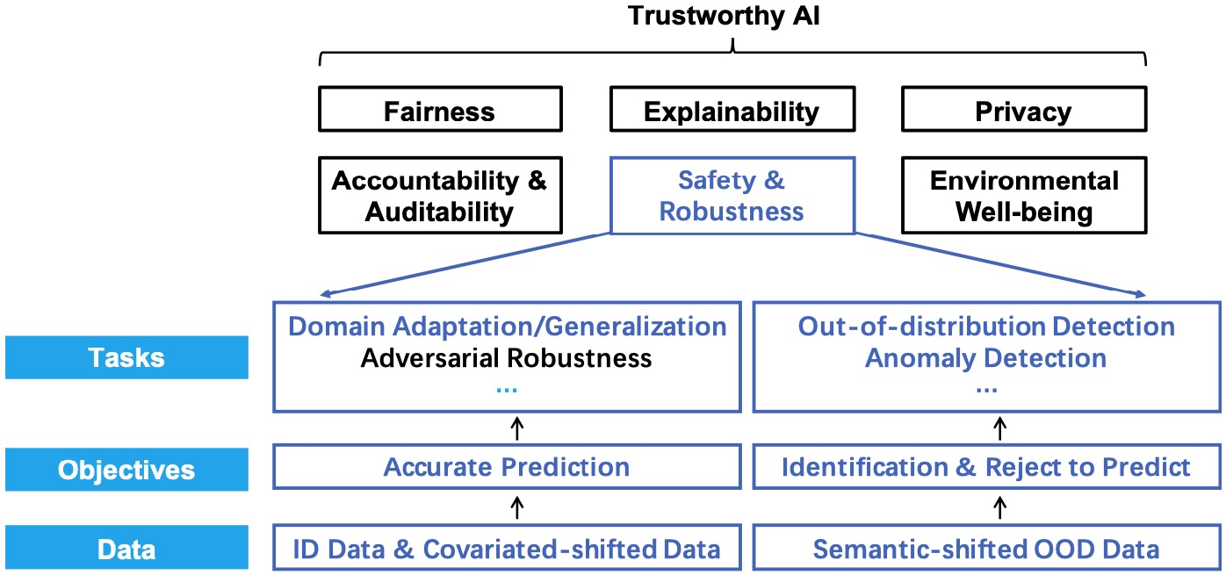
Current Research Interests
I mainly focus on the safety & robustness, especially issues from OOD data. In the future, I plan to explore broader trustworthy issues, particularly with Large (Vision-) Language Models.

Slide 3
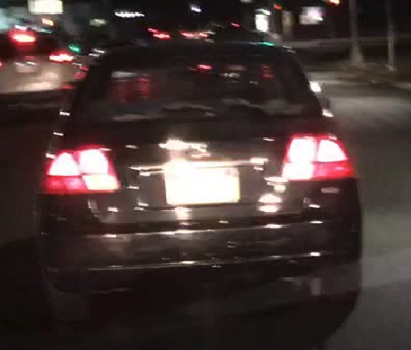
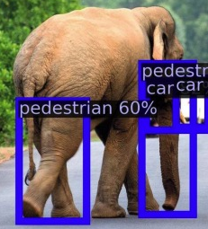
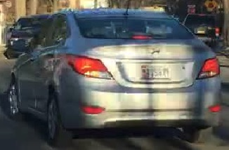
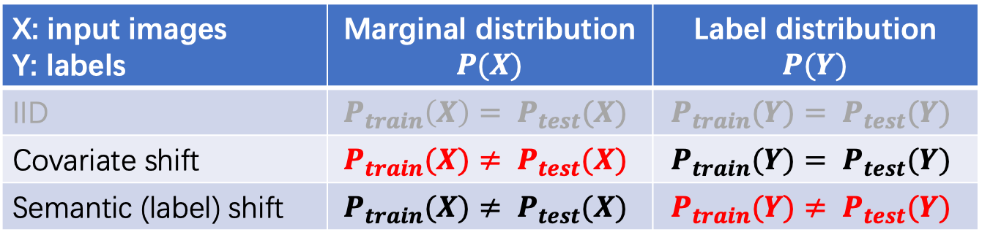
Typical Distribution Shifts
X: input images Y: labels | Marginal distribution $$P(X)$$ | Label distribution $$P(Y)$$
IID | $$P_{train}\left(X\right)= P_{test}(X)$$ | $$P_{train}(Y)= P_{test}(Y)$$
Covariate shift | $$P_{train}(X)≠ P_{test}(X)$$ | $$P_{train}(Y)= P_{test}(Y)$$
Semantic (label) shift | $$P_{train}(X)≠ P_{test}(X)$$ | $$P_{train}(Y)≠ P_{test}(Y)$$
Training data
Covariate Shifts (e.g., at night)
Semantic Shifts (e.g., elephant)
BDD100K: A Diverse Driving Dataset for Heterogeneous Multitask Learning, CVPR2020
VOS: LEARNING WHAT YOU DON’T KNOW BY VIRTUAL OUTLIER SYNTHESIS, ICLR2022

