Slide 1


Nic Jansma
@NicJ
//nicj.net

Slide 2

Who am I?
Nic Jansma
Spent 6 years as a dev at Microsoft - Win 7 & IE 9/10 Perf Teams
Recently founded Wolverine Digital
Developing high-performance websites and apps
nic@nicj.net @NicJ http://nicj.net
http://github.com/nicjansma

Slide 3
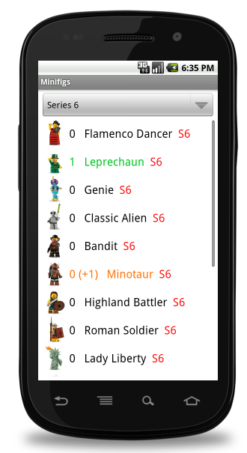
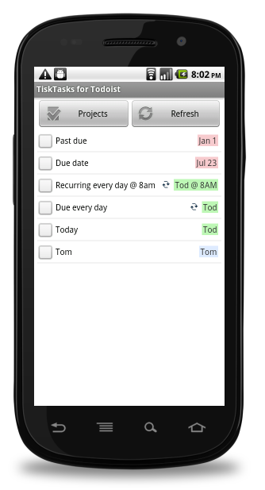
First Two Apps (Native Android)
Minifig Collector (free) TiskTasks for Todoist ($0.99)
http://minifigcollector.com http://tisktasks.com

Slide 4

3rd App
October 2011: Partnered with the author of the Unofficial LEGO Minifigure Catalog to create an interactive version of his book
Wanted to release on iOS and Android
Native? PhoneGap? Appcelerator?

Slide 5


Native Development
Java
Objective-C

Slide 6
Appcelerator Titanium Mobile
Titanium is a JavaScript runtime that gives you native access to the platform’s controls
You are not building a app via html/css/js (i.e. PhoneGap)
JavaScript

Slide 7
How Titanium Mobile Works
You write code in JavaScript
At runtime, your application has 3 major components:
JavaScript source code (minified and inlined, but not compiled, into Java/Obj-C strings)
Titanium API implementation in the native OS
JavaScript interpreter (V8/Rhino for Android, JavaScriptCore for iOS)
The JavaScript interpreter runs your JavaScript code in an environment with proxies for the native objects (windows, controls, etc)

Slide 8
Getting Titanium Mobile
Step 1: Sign up for Appcelerator
https://my.appcelerator.com/auth/signup
“App EXPLORE” plan = Free: Build, test, ship, sell for free
Additional plans available (more analytics, cloud, support): http://www.appcelerator.com/plans-pricing
Step 2: Download Titanium Studio
http://www.appcelerator.com/platform/titanium-studio
Step 3:
Profit ???

Slide 9
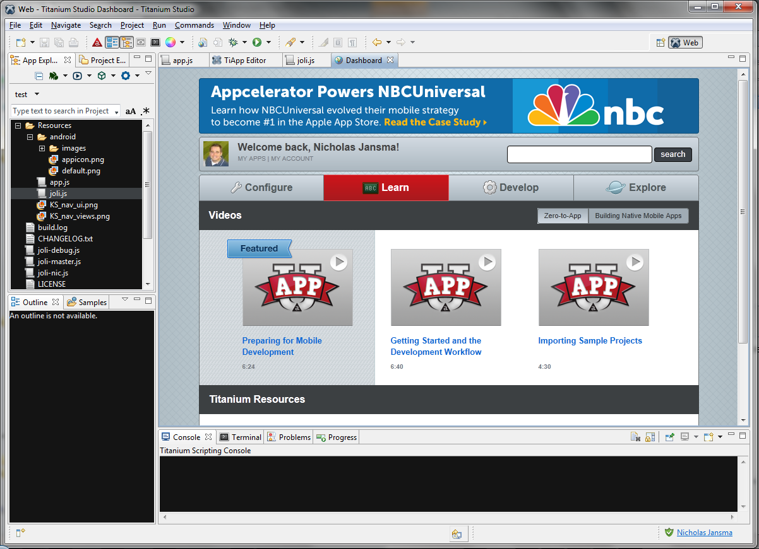
Titanium Studio
Eclipse-- (was Aptana Studio)
Editor
Formatting
Code-completion
Build
Debug
Release

Slide 10
App File Structure
I18n\ - Internationalization files
modules\ - Third-Party (or Appcelerator) native modules
Resources\
app.js – Startup file
images\ - Generic Images
android\ - Android-specific images
images\high / etc – Android density/screen-size dirs
iphone\ - iOS-specific images
@2x files
lib\, ui\, whatever\ - your source file dirs

Slide 11

Hello World
var win = Ti.UI.createWindow({
title: 'Hello, World!',
layout: 'vertical',
backgroundColor: 'white'
});
var helloLabel = Ti.UI.createLabel({
text: 'Hello World',
color: 'black',
font: {
fontSize: '20sp'
},
height: '40dp',
width: '250dp'
});
win.add(helloLabel);
var helloButton = Ti.UI.createButton({
title: 'Click me!',
font: {
fontSize: '20sp'
},
top: '20dp',
height: '40dp',
width: '250dp'
});
helloButton.addEventListener('click', function() {
alert('you clicked me!');
});
win.add(helloButton);
win.open();

Slide 12
Titanium Mobile APIs
AJAX / Web services
In-App Purchases
Geolocation
Camera
Media / Photo Gallery
Accelerometer
Maps
Analytics
Social Sharing (Facebook, etc)
Extensible with your own native iOS/Android packages

Slide 13
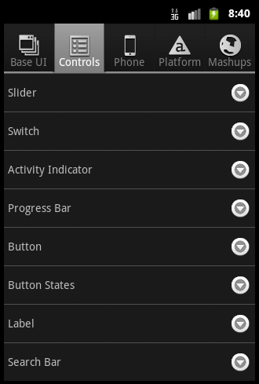
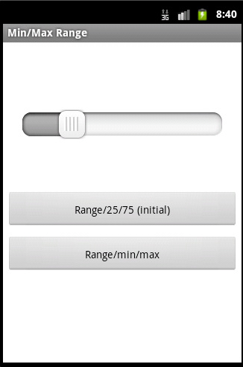
KitchenSink
https://github.com/appcelerator/KitchenSink/

Slide 14
Cloud Services
http://www.appcelerator.com/cloud

Slide 15
Future Platform Support
Blackberry
WinPhone7

Slide 16
Pros
One codebase for two platforms
You’ll (theoretically) spend less time than writing two native apps
Maintenance on one codebase should be easier in the long run
Native interface controls
Your apps can look just like native ones
Might be able to reuse your JavaScript in other parts of your project
eg., Web front-end, Node.js backend
Platform is open-source
https://github.com/appcelerator/titanium_mobile
JavaScript is fun!

Slide 17
Cons
Platform is young and still changing
Need to learn a new platform / SDK / quirks
Knowing the ins & outs of native iOS / Android will help
You’ll still have lots of if(iOS){} and if(android){}
LEGO Minifig Collector has 24 blocks of code that are Android or iOS specific
Performance isn’t 100% of a native app
SDK/API Documentation is weak (but getting better)
Q&A support forum is a mess (use SO instead)

Slide 18
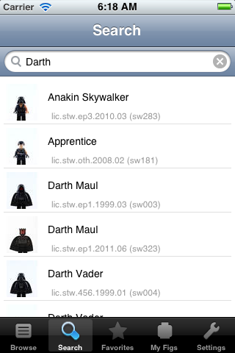

Unofficial LEGO Minifigure Catalog
Took ~1 month to develop
http://minifigure.org/application
Releasing content updates via IAP
Got featured in iTunes Catalogs category for a week
Looking back, Titanium was the right choice for our product’s needs

Slide 19
Lessons Learned
I probably spent as much time learning Titanium and building my first app as I would have spent learning native iOS
Now I can build apps in Titanium quickly, but still need to learn native iOS
2nd+ Titanium app will be a lot easier to build
It takes time to ramp-up on good JavaScript patterns
CommonJS modules, Crockford-isms, http://shichuan.github.com/javascript-patterns/
I like JavaScript
Now I’m developing a game where JavaScript is the whole stack: Node.js websockets and HTTP server, frontend in HTML/CSS/JS, mobile version via Titanium
iOS simulator is a lot faster to test on. Android emulator is slow!
For community support, you’ll need to use a combination of the Appcelerator API Docs, Q&A site, videos and StackOverflow

Slide 20
Lessons Learned, continued
You’ll spend time adapting when they release SDK updates
1.7.x => 1.8.x: Took me 2 days to find and fix bugs from SDK changes
You won’t double your sales just by releasing on both platforms

Slide 21


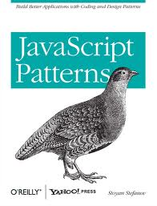
Good Reads

Slide 22
Links
Appcelerator
http://appcelerator.com
http://docs.appcelerator.com/titanium/2.1/index.html
http://developer.appcelerator.com/questions/newest
http://stackoverflow.com/questions/tagged/titanium
http://vimeo.com/appcelerator
Community Projects
Joli https://github.com/xavierlacot/joli.js/

