Slide 1
Using Modern Browser APIs to Improve the Performance of Your Web Applications
Nic Jansma
@NicJ
//nicj.net

Slide 2

Who am I?
Nic Jansma
Microsoft Sr. Developer (2005-2011)
Windows 7 & IE 9/10 Performance Teams
Founding member of W3C WebPerf WG
Founder of Wolverine Digital LLC
Developing high-performance websites, apps and games
nic@nicj.net @NicJ http://nicj.net
http://github.com/nicjansma
http://www.slideshare.net/nicjansma/

Slide 3
Performance Measurement (<=2010)
Server-side
HTTP logs
Server monitoring (cacti / mrtg / nagios)
Profiling hooks
Developer
Browser developer tools (Firebug / Chrome / IE)
Network monitoring (Fiddler / WireShark)
Client-side / Real World
Date.now() !?!?
Client side-hacks (Boomerang)

Slide 4
State of Performance (<=2010)
Measuring performance from the server and developer perspective is not the full story
The only thing that really matters is what your end-user sees
Measuring real-world performance of your end-users is tough
No standardized APIs in the browser that expose performance stats
Other client hacks exist (eg timing via Date.now()), but these are imprecise and not sufficient

Slide 5

WebPerf WG
Founded in 2010 to give developers the ability to assess and understand performance characteristics of their applications
“The mission of the Web Performance Working Group is to provide methods to measure aspects of application performance of user agent features and APIs”
Collaborative effort from Microsoft, Google, Mozilla, Opera, Facebook, Netflix, etc

Slide 6
W3C WebPerf Goals
Expose information that was not previously available
Give developers the tools they need to make their applications more efficient
Little or no overhead
Easy to understand APIs

Slide 7
W3C WebPerf Specs
Navigation Timing (NT): Page load timings
Resource Timing (RT): Resource load times
User Timing (UT): Custom site events and measurements
Performance Timeline: Access NT/RT/UT and future timings from one interface
Page Visibility: Visibility state of document
Timing control for script-based animations: requestAnimationFrame
High Resolution Time: Better Date.now()
Efficient Script Yielding: More efficient than setTimeout(...,0) / setImmediate()

Slide 8
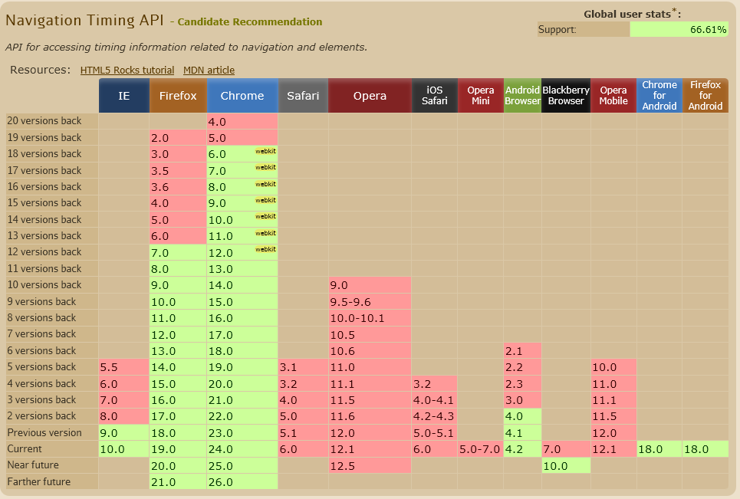
Navigation Timing (NT)
http://www.w3.org/TR/navigation-timing/
Page load and other network phase timings
Great modern browser support

Slide 9
NT: Why You Should Care
How it was done before:
<html><head><script>
var start = new Date().getTime();
function onLoad {
var pageLoadTime = (new Date().getTime()) - start;
}
body.addEventListener(“load”, onLoad, false);
</script>...</html>
That’s all you get: total page load time (kinda)
Technically, you get the time from the start of processing of JS in your HEAD to the time the body’s onLoad event fires
Says nothing of time spent before HEAD is parsed (DNS, TCP, HTTP request)
Date.getTime() has problems (imprecise, not monotonically non-decreasing, user clock changes)

Slide 10
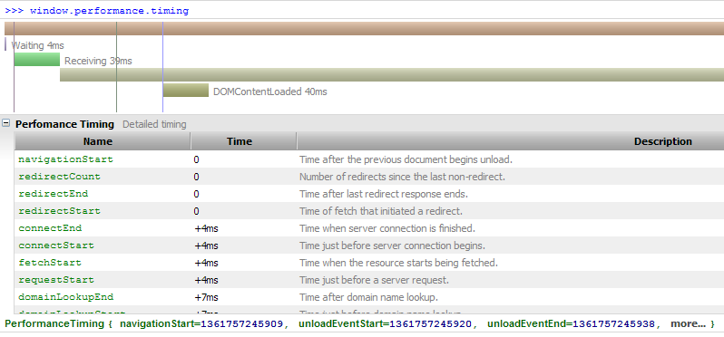
NT: How To Use
DOM: window.performance.timing
Phases of navigation
Redirect (301/302s)
DNS
TCP
SSL
Request
Response
Processing (DOM events)
Load

Slide 11
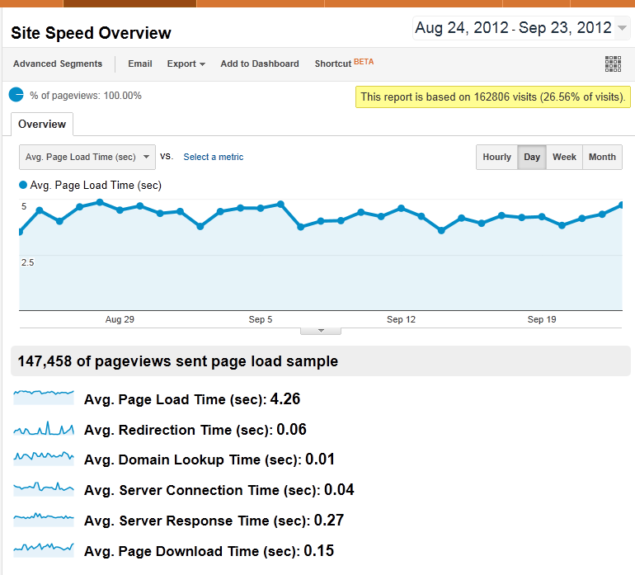
NT: How To Use
How to Use
Sample real-world page load times
XHR back to mothership
JSON.stringify(window.performance):
"{"timing":{"navigationStart":0,"unloadEventStart":0,"unloadEventEnd":0,"redirectStart":0,"redirectEnd":0,"fetchStart":1348506842513,"domainLookupStart":1348506842513,"domainLookupEnd":1348506842513,"connectStart":1348506842513,"connectEnd":1348506842513,"requestStart":1348506842513,"responseStart":1348506842595,"responseEnd":1348506842791,"domLoading":1348506842597,"domInteractive":1348506842616,"domContentLoadedEventStart":1348506842795,"domContentLoadedEventEnd":1348506842795,"domComplete":1348506842795,"loadEventStart":1348506842900,"loadEventEnd":1348506842900,"msFirstPaint":1348506842707},"navigation":{"redirectCount":1,"type":0}}"
Used by:
Google Analytics' Site Speed
Boomerang
Demo
http://ie.microsoft.com/testdrive/Performance/msPerformance/Default.html

Slide 12
Resource Timing (RT)
http://www.w3.org/TR/resource-timing/
Similar to NavigationTiming, but for all of the resources (images, scripts, css, media, etc) on your page
Get most of the data you can see in Net panel in Firebug/etc
Support:
IE10
Chrome 25+ (prefixed)

Slide 13
RT: Why You Should Care
How it was done before:
(it wasn’t)
For dynamically inserted content, you could time how long it took from DOM insertion to the element’s onLoad event, but that’s not practical for all of your resources
You can get this information from Firebug, but that’s not the end-user’s performance

Slide 14
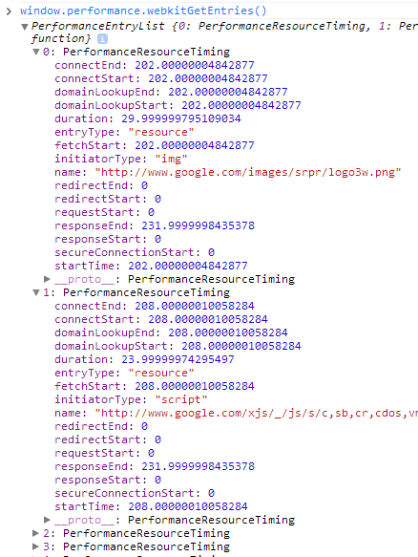
RT: How To Use
DOM: See PerformanceTimeline
Each resource:
URL
Initiator type (SCRIPT/IMG/CSS/XHR)
Timings:
Redirect (301/302s)
DNS
TCP
Request
SSL
Response
Processing (DOM events)
Load

Slide 15
RT: How To Use
Gotchas
Many attributes zero’d out if the resource is cross-domain (redirect, DNS, connect, TCP, SSL, request) UNLESS server sends Timing-Allow-Origin HTTP header
Timing-Allow-Origin: [* | yourserver.com]
This is to protect your privacy (attacker can’t load random URLs to see where you’ve been)
Your own CDNs should send this HTTP header if you want timing data. 3rd-party CDNs/scripts (eg. Google Analytics) should add this too.
Only first 150 resources will be captured unless setResourceTimingBufferSize() is called

Slide 16
Performance Timeline (PT)
http://www.w3.org/TR/performance-timeline/
Interface to access all of the performance metrics that the browser exposes (eg. Navigation Timing, Resource Timing, User Timing, etc)
Support:
IE10
Chrome 25+ (prefixed)

Slide 17
PT: Why You Should Care
Only way to access Resource Timing, User Timing, etc
Gives you a timeline view of performance metrics as they occur
Future interfaces (say, rendering events) can be added as long as they hook into the Performance Timeline interface

Slide 18
PT: How To Use
performance.getEntries()
All entries in one array
performance.getEntriesByType(type)
eg performance.getEntriesByType(“resource”)
performance.getEntriesByName(name)
eg performance.getEntriesByName(“http://myurl.com/foo.js”)
interface PerformanceEntry {
readonly attribute DOMString name;
readonly attribute DOMString entryType;
readonly attribute DOMHighResTimeStamp startTime;
readonly attribute DOMHighResTimeStamp duration;
};

Slide 19
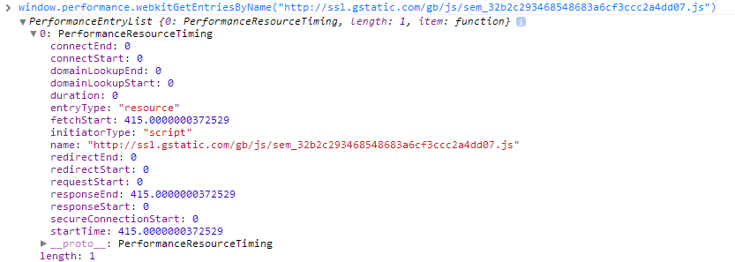
PT: How To USe
Example

Slide 20
User Timing (UT)
http://www.w3.org/TR/user-timing/
Custom site profiling and measurements
Support:
IE10
Chrome 25+ (prefixed)

Slide 21
UT: Why You Should Care
How it was done before:
<script>
var myMeasurements = [];
var startMeasure = new Date().getTime();
...
myMeasurements.push((new Date().getTime()) - start);
</script>
Problems: Date is imprecise, not monotonically non-decreasing, user clock changes

Slide 22
UT: How To Use
Mark a timestamp:
performance.mark(“foo_start”)
performance.mark(“foo_end”)
Log a measure (difference of two marks)
performance.measure(“foo”, “foo_start”, “foo_end”)
Get marks and measures
performance.getEntriesByType(“mark”)
[
{name: “foo_start”, entryType: “mark”, startTime: 1000000.203, duration: 0}
{name: “foo_end”, entryType: “mark”, startTime: 1000010.406, duration: 0}
]
performance.getEntriesByType(“measure”)
[
{name: “foo_end”, entryType: “measure”, startTime: 1000000.203, duration: 10.203}
]

Slide 23
UT: How To Use
Easy way to add profiling events to your application
Uses DOMHighResolutionTimeStamp instead of Date.getTime() for higher precision
Can be used along-side NT and RT timings to get a better understanding of your app’s performance in the real-world

Slide 24
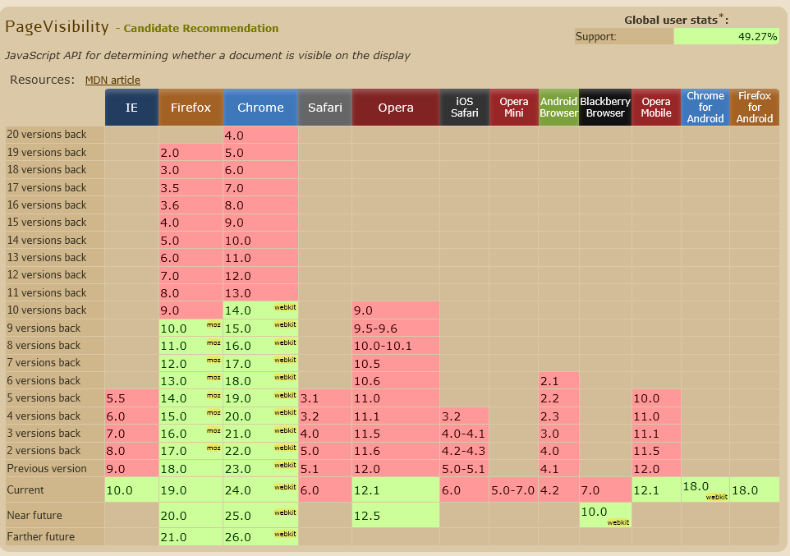
Page Visibility (PV)
http://www.w3.org/TR/2013/PR-page-visibility-20130219/
Know when your application is not visible to the user

Slide 25
PV: Why You Should Care
How it was done before:
(it wasn’t)
or
“Are you still there?” popups
There are times when you may want to know that you can “stop” doing something if the user isn’t actively looking at your app:
Applications that periodically do background work (eg, a mail client checking for new messages)
Games (auto-pause)
Knowing this gives you the option of stopping or scaling back your work
Not doing background work is an efficiency gain -- less resource usage, less network usage, longer battery life

Slide 26
PV: How To Use
document.hidden: True if:
User agent is minimized
Page is on a background tab
User agent is about to unload the page
Operating System lock screen is shown
document.visibilityState:
hidden, visible, prerender, unloaded
visibilitychange event
Fired whenever visibilityState has changed

Slide 27
PV: How To Use
Automatically scale back checking for email if app isn’t visible:
var timer = 0;
var PERIOD_VISIBLE = 1000;
var PERIOD_NOT_VISIBLE = 60000;
function onLoad() {
timer = setInterval(checkEmail, (document.hidden) ? PERIOD_NOT_VISIBLE : PERIOD_VISIBLE);
document.addEventListener("visibilitychange", visibilityChanged);
}
function visibilityChanged() {
clearTimeout(timer);
timer = setInterval(checkEmail, (document.hidden) ? PERIOD_NOT_VISIBLE : PERIOD_VISIBLE);
}
function checkEmail() { // Check server for new messages }

Slide 28
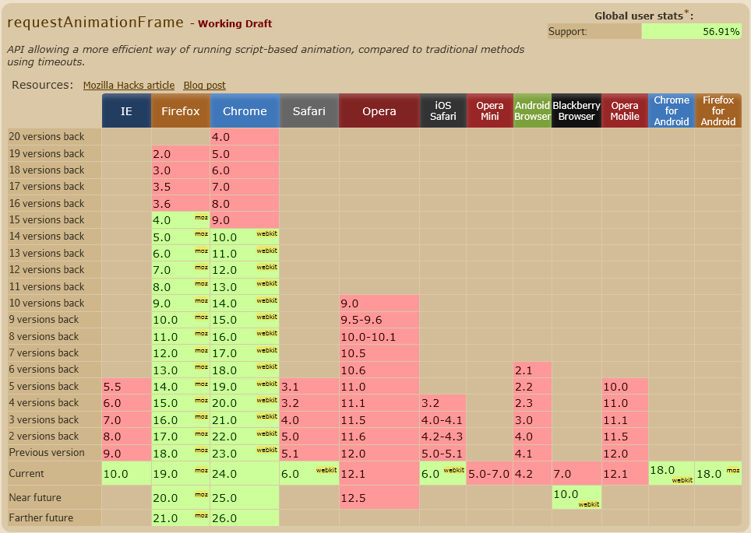
Timing control for script-based animations (requestAnimationFrame)
http://www.w3.org/TR/animation-timing/
Smarter animations

Slide 29
RAF: Why You Should Care
How it was done before:
setTimeout(myAnimation, 10)
Might be throttled in background tabs (Chrome 1fps)
The browser can be smarter:
Coalesce multiple timers (frame animations) so they all draw (and thus reflow/repaint) at the same time instead of odd intervals, along with CSS transitions and SVG SMIL
Can sync with the device’s frame rate

Slide 30
RAF: How To Use
Instead of:
function render() { ... stuff ... }
setInterval(render, 16);
Do:
// Find a good polyfill for requestAnimationFrame
(function animate() {
requestAnimationFrame(animate);
render();
})();

Slide 31
High Resolution Time (HRT)
http://www.w3.org/TR/hr-time/
A better Date.now
IE10+, Chrome 23(?)+, Firefox 18(?)+

Slide 32
HRT: Why You Should Care
Date.now() / Date().getTime() is the number of milliseconds since January 1, 1970 UTC.
To be backwards compatible, modern browsers can only get as precise as 1ms
Resolution of 15+ms in older browsers
Is not monotonically non-decreasing: it does not guarantee that subsequent queries will not be negative. For example, this could happen due to a client system clock change.

Slide 33

HRT: How To Use
window.performance.now()
Monotonically non-decreasing
Allows higher than 1ms precision
Is defined as time since performance.timing.navigationStart
NOTE: Is NOT milliseconds since UTC 1970

Slide 34
Efficient Script Yielding (setImmediate)
http://www.w3.org/TR/animation-timing/
Smarter than setTimeout(..., 0)
Great demo @ http://ie.microsoft.com/testdrive/Performance/setImmediateSorting/Default.html

Slide 35
ESY: Why You Should Care
How it was done before:
setTimeout(longTask, 0);
Done to breakup long tasks and to avoid Long Running Script dialogs
At max, setTimeout() in this manner will callback every 15.6ms (HTML4) or 4ms (HTML5) or 1s (modern browsers in background tabs) because callback depends on OS interrupts
Setting a 0ms timeout still takes 4-15.6ms to callback
Not efficient! Keeps CPU from entering low-power states (40% decrease in battery life)
setImmediate yields if there is UI work to be done, but doesn’t need to wait for the next processor interrupt

Slide 36
ESY: How To Use
setImmediate(longTask);
Waits for the UI queue to empty
If nothing in the queue, runs immediately (eg without setTimeout() 4ms/15.6ms/1s delay)

Slide 37
Questions?
@NicJ
nic@nicj.net
Slides @ http://www.slideshare.net/nicjansma/

