Slide 1
Debugging IE Performance Issues
xperf, ETW & NavigationTiming
Nic Jansma
@NicJ
//nicj.net

Slide 2

Who am I?
Nic Jansma
Microsoft Sr. Developer (2005-2011)
Windows 7 & IE 9/10 Performance Teams
Founding member of W3C WebPerf WG
Back to GR / founded Wolverine Digital
Developing high-performance websites and apps
nic@nicj.net @NicJ http://nicj.net
http://github.com/nicjansma

Slide 3
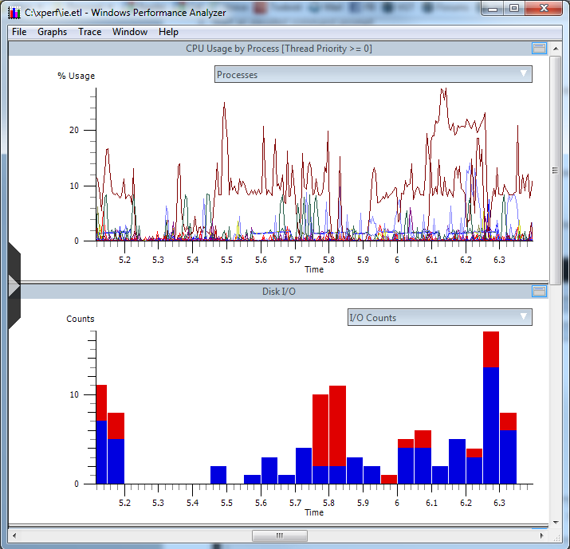
What is ETW/xperf?
Event Tracing for Windows (ETW) enables the OS/apps to efficiently generate runtime tracing events
Windows XP+
CPU usage
Disk usage
Hard faults
DPCs/ISRs
TCP
Profiling
Custom app events (incl IE7+)
Stacks on most of the above
xperf is a toolset used to trace/view ETW events
Use ETW/xperf to trace page loads of browsers
IE9 load of cnn.com

Slide 4
Getting WPT (xperf)
Windows Performance Toolkit (WPT)
Free!
From the Windows SDK
WPT home
http://msdn.microsoft.com/en-us/performance/cc825801.aspx
Windows 7 SDK
http://www.microsoft.com/en-us/download/details.aspx?id=8279
Windows 8 SDK
http://msdn.microsoft.com/en-us/windows/hardware/hh852363

Slide 5
Getting a Trace
From an elevated command prompt:
Simple trace of system events
xperf.exe -on latency
[run scenario]
xperf.exe -stop -d myscenario.etl
(latency = PROC_THREAD+LOADER+DISK_IO+HARD_FAULTS+DPC+INTERRUPT+CSWITCH+PROFILE)
Stack-Walking on sample profiling events
xperf.exe -on latency -stackwalk profile -setprofint 1224
[run scenario]
xperf.exe -stop -d myscenario.etl
IE events
xperf.exe -on latency -start ie -on Microsoft-IE+Microsoft-IEFRAME+Microsoft-Windows-WinINet+PerfTrack
[run scenario]
xperf.exe -stop -stop ie -d myscenario.etl

Slide 6
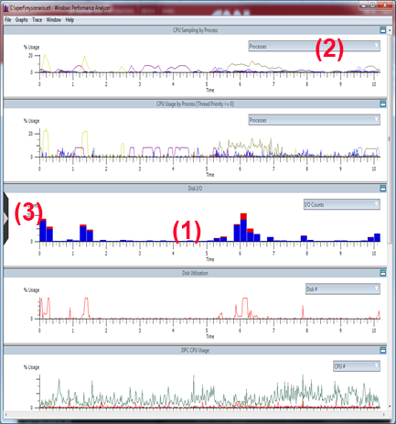
xperfview
xperfview gives you a timeline view of the events in the .etl (1)
Use the drop-downs to filter out specific processes (2)
Use the left fly-out to see different graphs (3)

Slide 7
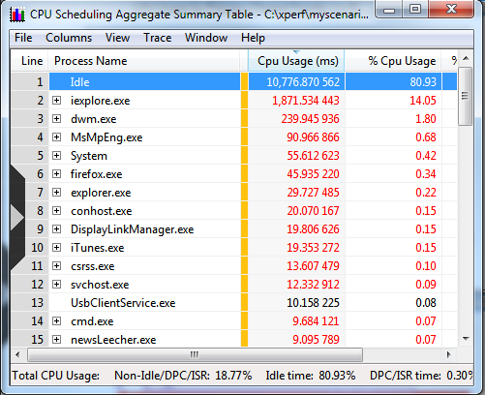
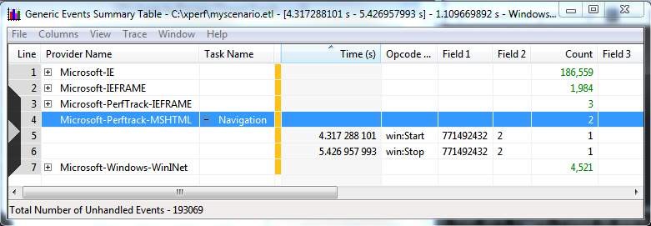
xperfview - Summary Tables
All of the graphs can be interacted with - zoom, popups, right-clicked
Summary Tables show data in tabular form

Slide 8
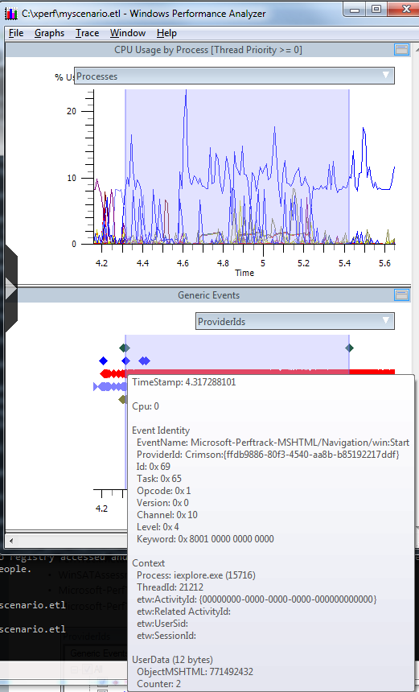
xperfview - Generic Events
Events without associated graphs show up in Generic Events
Look for Microsoft-IE* and Microsoft-PerfTrack* events

Slide 9
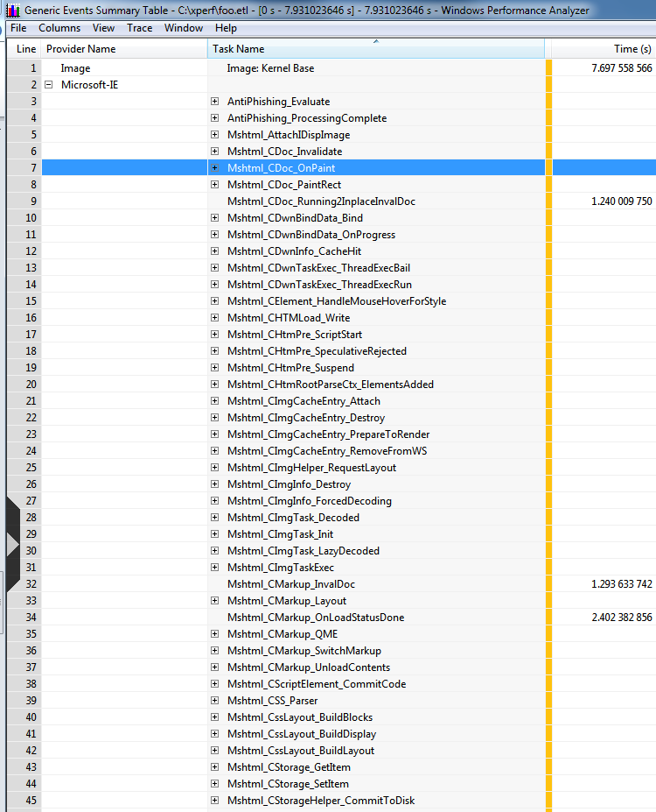
xperfview - IE events
Microsoft-IE events
CMarkup_OnLoadStatusDone: Page load is complete
CDoc_OnPaint: Paints
CDwnBindData_Bind: Downloads
+ 100s more
Microsoft-IEFRAME
Frame events such as tab creation, navigation start, history queries, extension loading
Microsoft-PerfTrack-*
-MSHTML-Navigation - End-to-end page load time

Slide 10
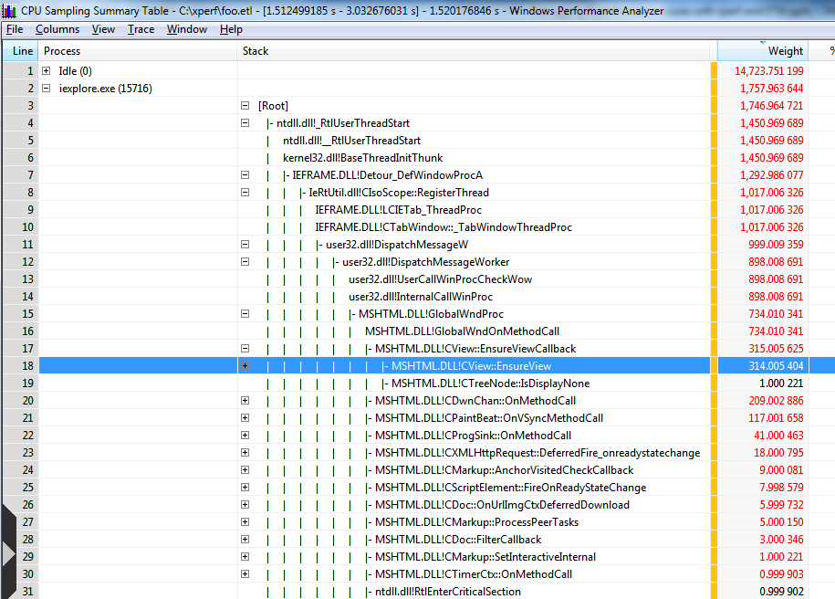
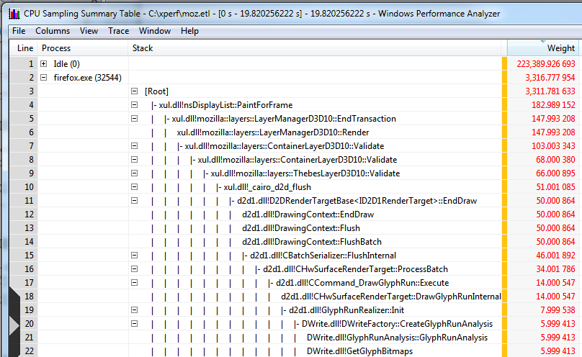
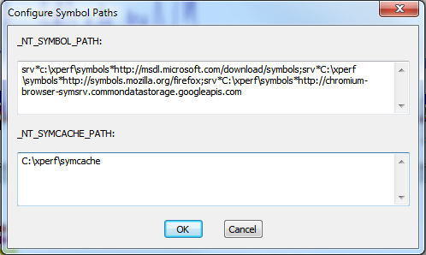
xperfview - Stacks
By using the -StackWalk tag, you can enable stacks on many events
Public symbol servers:
http://msdl.microsoft.com/download/symbols
http://symbols.mozilla.org/firefox
http://chromium-browser-symsrv.commondatastorage.googleapis.com

Slide 11
Custom Web Events
JavaScript ETW events
<SCRIPT type="text/javascript">
if (msWriteProfilerMark) {
msWriteProfilerMark("Mark1");
}
</SCRIPT>
Comes in as:
Microsoft-IE\Mshtml_DOM_CustomSiteEvent

Slide 12
What Can You Do?
Slow page load performance? Take a trace!
See page load from a system-wide perspective
Isolate page-load from interference due to other CPU/disk/network activity
Compare IE/FF/Chrome browser page-load times and resource usage
Examine browser CPU usage hot-spots from sampled profile stacks
Automated page-load regression testing of browsers via command-line tools
Integrate page load time / cpu usage metrics into your build system

Slide 13
ETW/xperf is great, but...
Your development machine isn’t your customer’s machine
How does your website behave in the real world?
Enter...
W3C WebPerf WG
Navigation Timing, User Timing, Resource Timing
Performance Timeline, Page Visibility, High Resolution Time

Slide 14
W3C WebPerf
Founded in 2010 to give developers the ability to assess and understand performance characteristics of their applications
Specs:
Navigation Timing: Page load timings
User Timing: Custom site events and measurements
Resource Timing: Resource / download times
Page Visibility: Get visibility state
High Resolution Time: Better than Date.now() - sub-millisecond resolution, monotonically non-decreasing timestamps

Slide 15
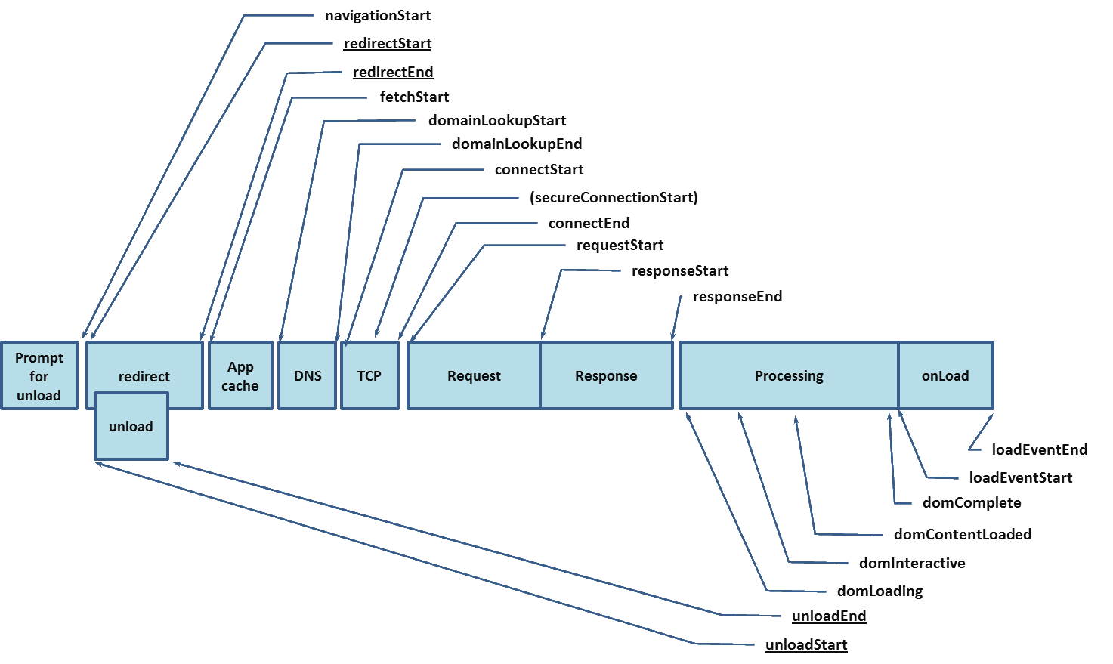
Navigation Timing
http://www.w3.org/TR/navigation-timing/
Page load timings
Implemented in IE9+, FF7+, C6+, Android 4+

Slide 16
Navigation Timing
API available from the DOM (window.performance.timing)
Get real-world page-load timings from your users via JavaScript
<script type="text/javascript">
window.addEventListener("load", loadTime, false);
function loadTime() {
var now = new Date().getTime();
var pageLoadTime = now - performance.timing.navigationStart;
}
</script>
Many other sub-timings (DNS, connect, request, response, redirects, DOM events, load event)
Demo
http://ie.microsoft.com/testdrive/Performance/msPerformance/Default.html

Slide 17
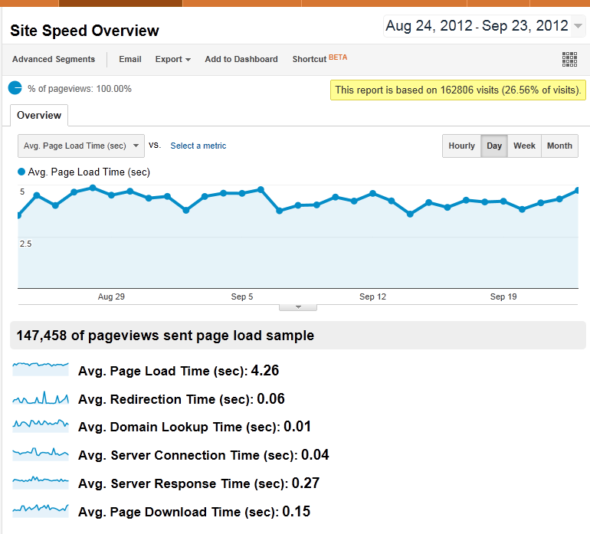
Navigation Timing
How to Use
Sample real-world page load times
XHR back to mothership
JSON.stringify(window.performance):
"{"timing":{"navigationStart":0,"unloadEventStart":0,"unloadEventEnd":0,"redirectStart":0,"redirectEnd":0,"fetchStart":1348506842513,"domainLookupStart":1348506842513,"domainLookupEnd":1348506842513,"connectStart":1348506842513,"connectEnd":1348506842513,"requestStart":1348506842513,"responseStart":1348506842595,"responseEnd":1348506842791,"domLoading":1348506842597,"domInteractive":1348506842616,"domContentLoadedEventStart":1348506842795,"domContentLoadedEventEnd":1348506842795,"domComplete":1348506842795,"loadEventStart":1348506842900,"loadEventEnd":1348506842900,"msFirstPaint":1348506842707},"navigation":{"redirectCount":1,"type":0}}"
Used by:
Google Analytics' Site Speed
Boomerang

Slide 18
Links
Xperf/ETW
http://msdn.microsoft.com/en-us/performance/cc825801.aspx
http://blogs.msdn.com/b/ie/archive/2010/06/21/measuring-browser-performance-with-the-windows-performance-tools.aspx
W3C WebPerf
http://www.w3.org/2010/webperf/
http://www.w3.org/wiki/Web_Performance/Publications
http://w3c-test.org/webperf/specs/NavigationTiming/

Slide 19
Questions?
@NicJ
nic@nicj.net

