Slide 1

Robotics Project
Dylan Bruz

Slide 2
Contents
Introduction
Calibration
Lane Following
Challenges
Experiments for Improving the Performance
Conclusion
Resources

Slide 3
Objectives
To understand AutoRace 2020 package with ROS
Lane following using Turtlebot3

Slide 4
Hardware and Software Used for the Project
Software:
ROS version : Melodic Linux version : 18.04.6
Hardware:
TurtleBot3 Burger version

Slide 5
Camera calibration
Camera Imaging calibration
Intrinsic calibration
Extrinsic calibration
Lane detection calibration

Slide 6
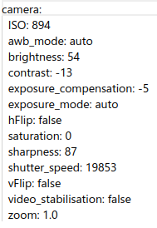
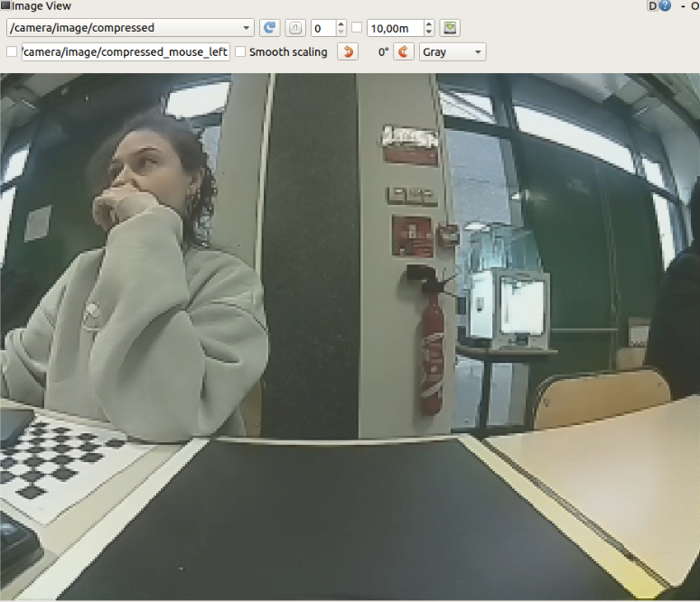
Camera Imaging Calibration
Determining basic image view parameters like contrast, sharp- ness, brightness

Slide 7
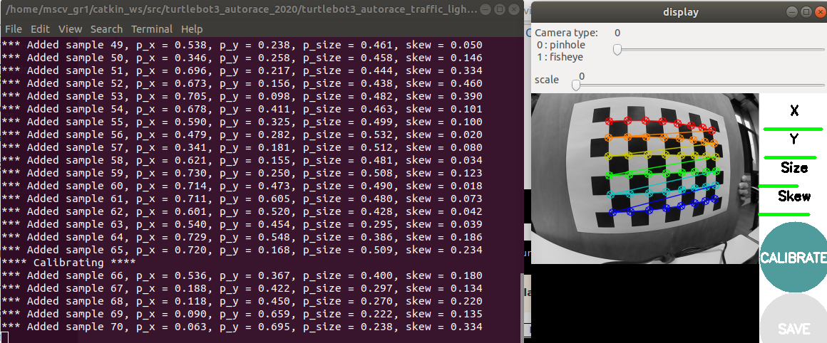
Intrinsic Calibration
Determining intrinsic camera parameters of Turtlebot3's camera like focal lengths, principal points, distortion coefficients using a chessboard.

Slide 8
Extrinsic calibration
Image Compensation
Image Projection

Slide 9
Image Compensation
Scales the image according to the clip_hist_percent parameter
The higher the clip_hist_percent parameter, the brighter output image we obtain

Slide 10
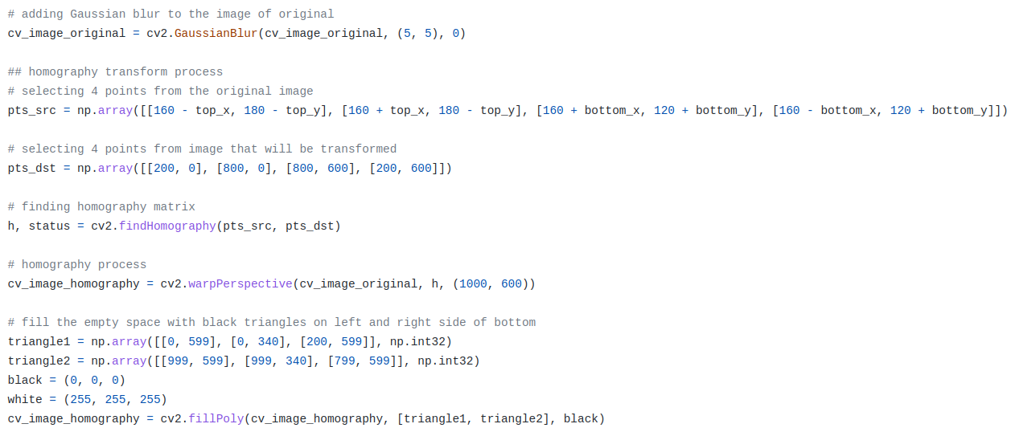
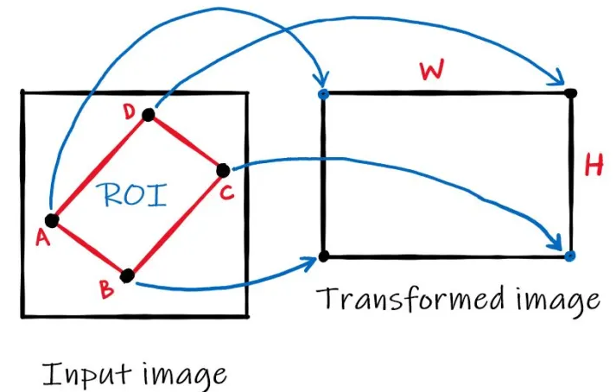
Image Projection
Projection of the image to obtain a better view for lanes
Using the Homography Matrix calculated by our top_x, top_y, bottom_x, bottom_y parameters, we try to extract the optimal ROI containing white and yellow lanes

Slide 11
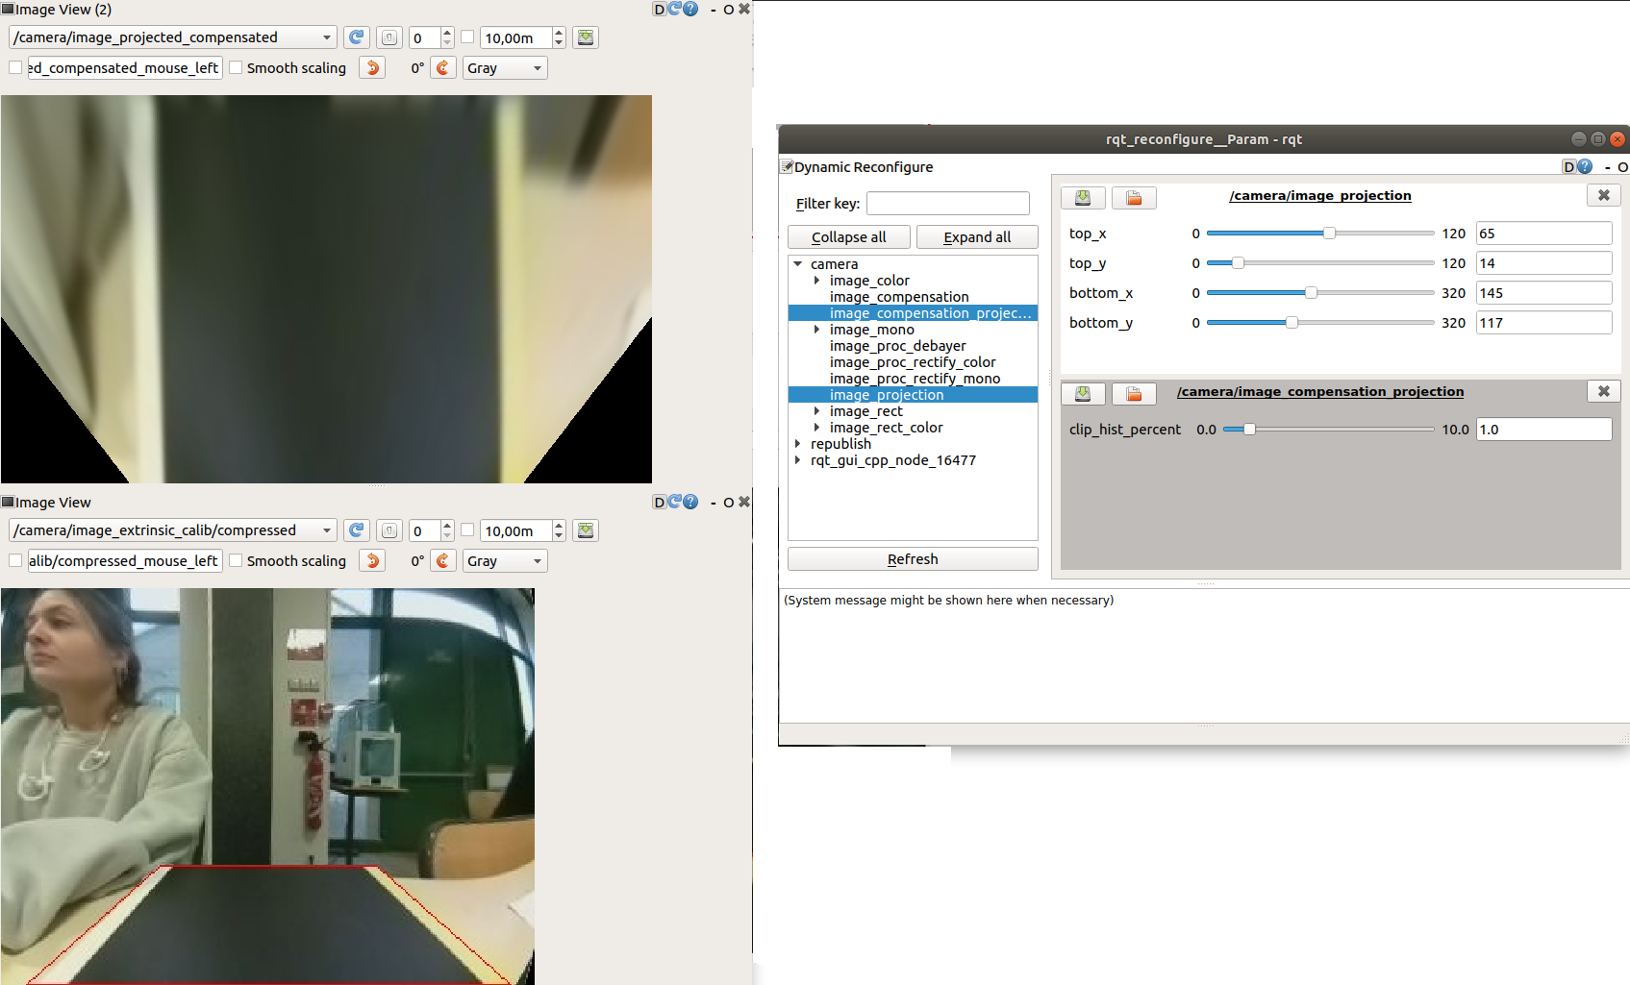

Slide 12
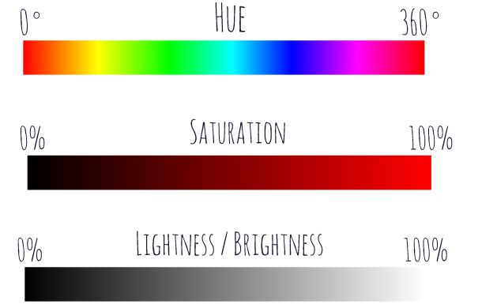
Lane Detection Calibration
Determining lowes and highest thresholds for HSV values of yellow and white lane masks
Hue: Dominant wavelength of the visible spectrum
Saturation: The amount of white light mixed with a hue. High- saturation colors contain little or no white light.
Lightness: The amount of white pixels mixed in with the color color.

Slide 13
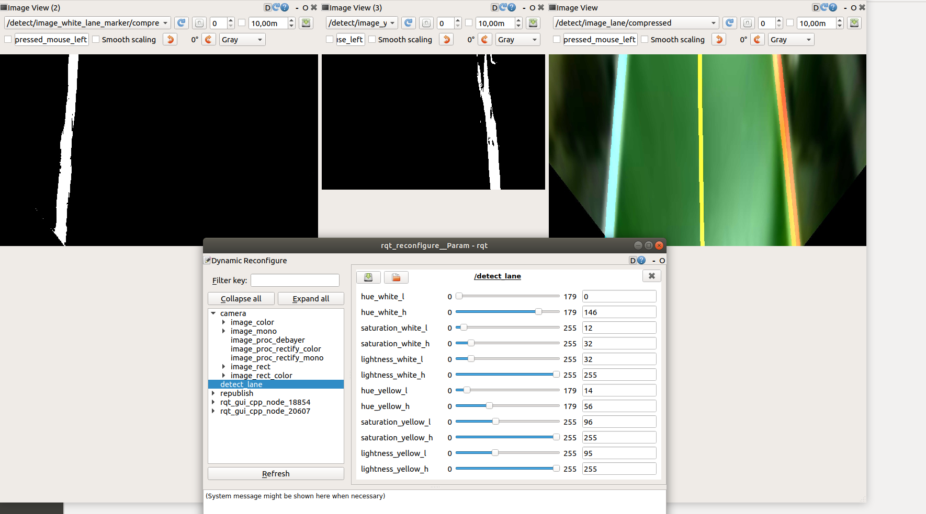
Dark Mode Calibration

Slide 14
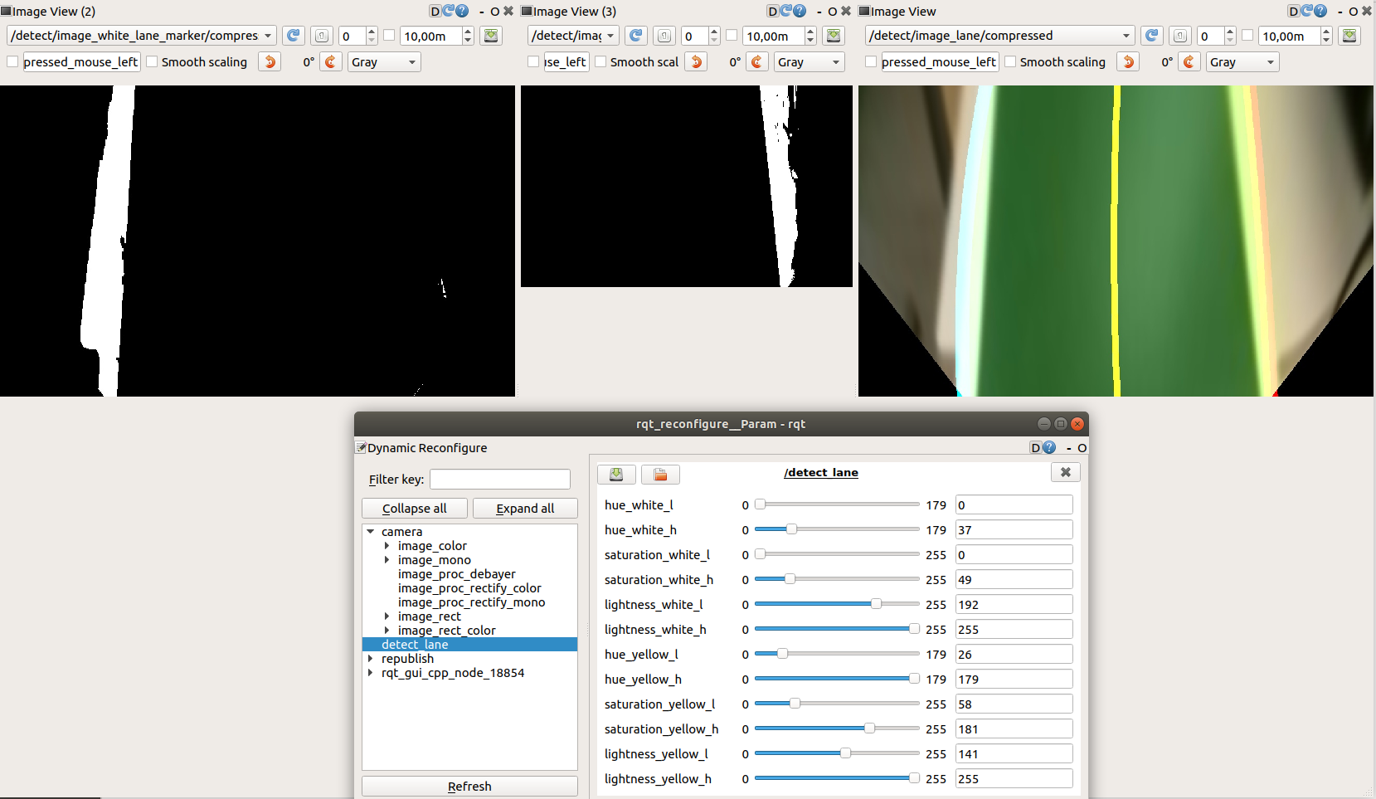
Normal Light Calibration

Slide 15
Challenges with Lane Detection
Dark mode calibration parameters doesn't work in normal light and normal light mode calibration parameters doesn't work in dark light as in tunnel
Dark Mode Calibrated Video
Normal Mode Calibrated Video

Slide 16
Challenges with Lane Detection
Sometimes the same parameters doesn’t work after 2-3 days due to the small change of light intensity in the room

Slide 17
Challenges with Lane Detection
White lane is detected in the same place as the correctly detected yellow line.
This is the main reason which breaks the detection most of the time, even with the compatible parameters for related mode
White Line Sensitivity 1 White Line Sensitivity 2

Slide 18
Experiments for Improving the Performance
1) Automatic Change between Dark Mode – Light Mode
2) Normalization
3) Adding Constraints on White Line Detection

Slide 19
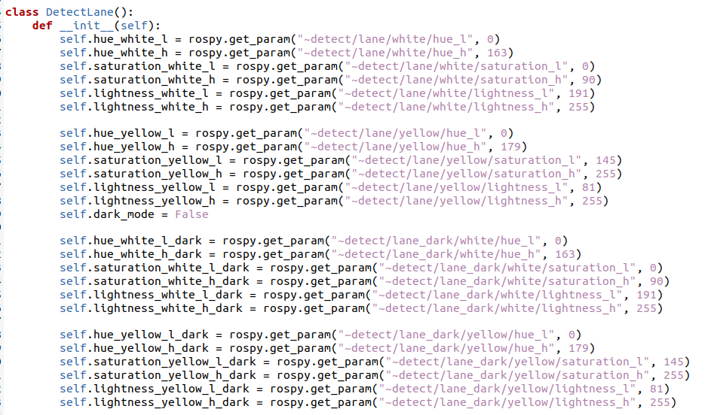
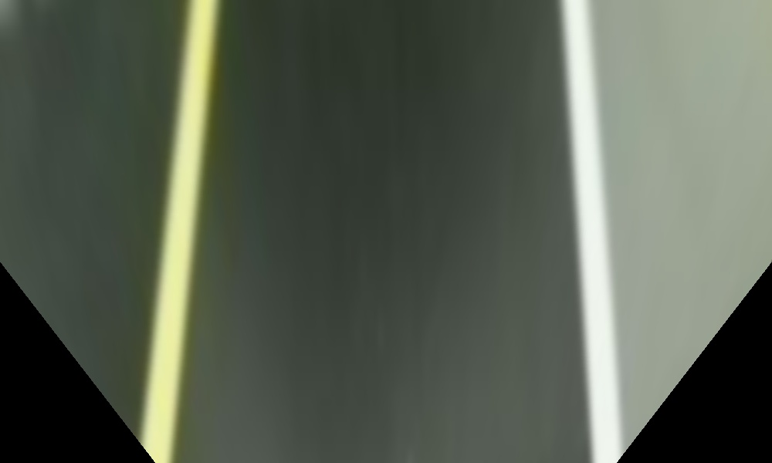
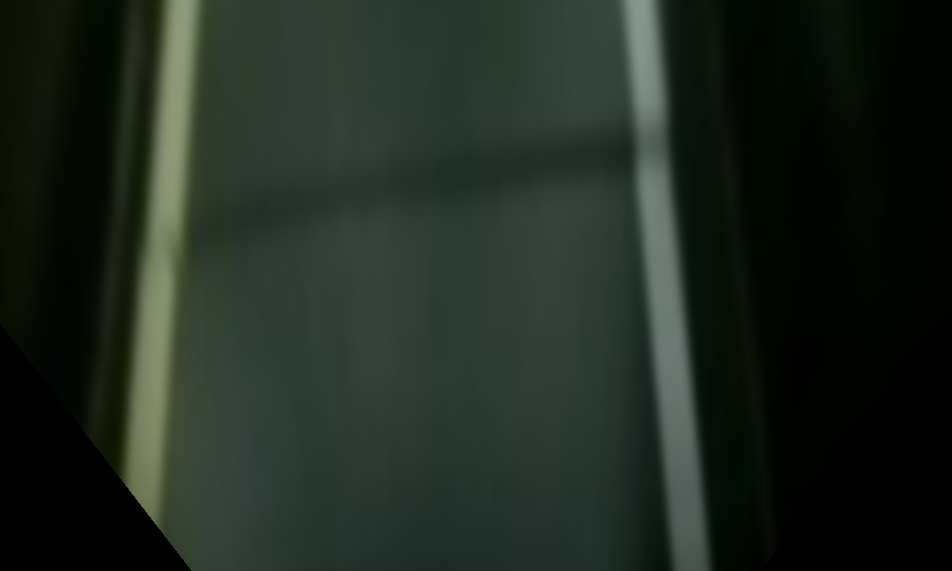
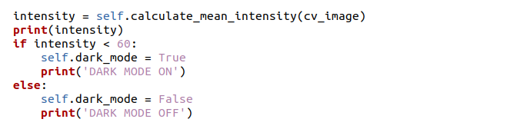
Automatic Change between Dark Mode – Light Mode
*
Mean Intensity > 80 Mean Intensity < 25

Slide 20
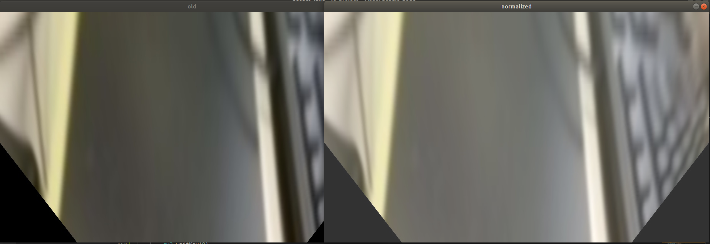
Normalization

Slide 21
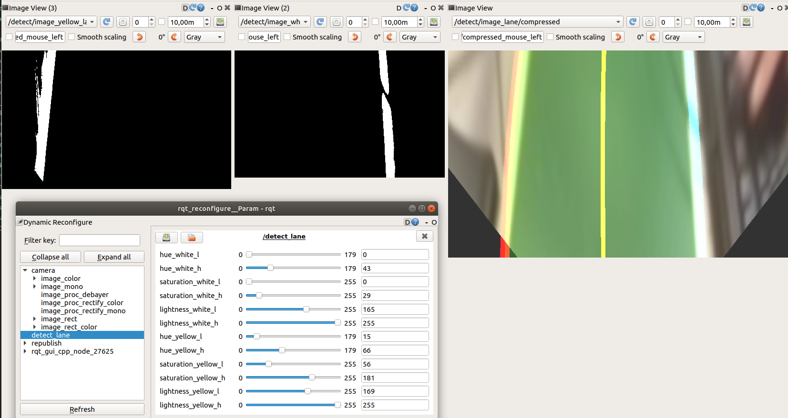
Normalization
Calibration Parameters for all the modes with normalized images

Slide 22
Adding Constraints on White Line Detection
* If left line's center point is bigger than a threshold, don't use this line to create main line to follow
* If right line's center point is lower than a threshold, don't use this line to create main line to follow

Slide 23
Conclusion
* Dark Mode – Light Mode Implementation created new challenge as it causes noise where the robot enters to the Dark Mode while it's under the Normal Light due to the light reflection
* Normalization increased the performance very well where the robot can follow the line both in dark or light conditions. It also improved yellow line - white line conflict
* Additional constrants was not enough to solve "big corner" problem since the base problem is that the robot sees only white lane and detecs it as yellow lane. Where we should use left lane as right lane position. But implementing this manually breaks the already working parts.
Demo

Slide 24
Resources
https://emanual.robotis.com/docs/en/platform/turtlebot3/autonomous_driving/#autonomous-driving
OUR GITHUB LINK HERE

Slide 25
THANK YOU!

