Slide 1
HOUSING: PRICE PREDICTION
Submitted by:
Yogesh.C.Mudliar

Slide 2
Problem Statement
Houses are one of the necessary need of each and every person around the globe
Therefore housing and real estate market is one of the markets which is one of the major contributors in the world’s economy.
It is a very large market and there are various companies working in the domain.
Data science comes as a very important tool to solve problems in the domain to help the companies increase their overall revenue, profits, improving their marketing strategies.

Slide 3
Exploratory data analysis
Defining the question
First I define the problem statmente
Collecting the data
Cleaning the data
-Removing major errors, duplicates, and outliers
-Removing unwanted data points
-Bringing structure to your data
-Filling in major gaps
Analyzing the data
Sharing your results

Slide 4
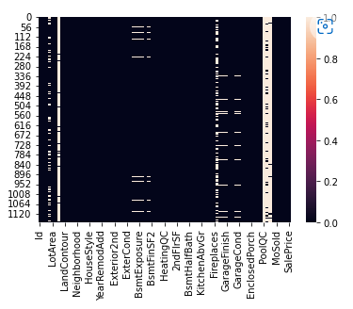
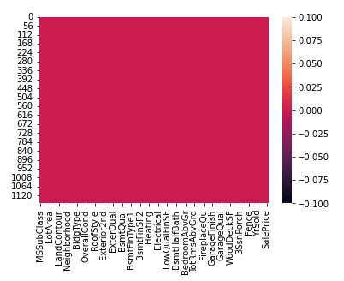
Removed all null values
Before removing null values
After removing null values

Slide 5
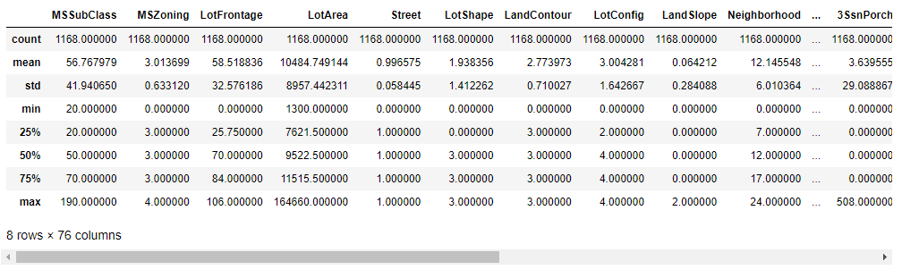
Described dataset
The mean is more than median.
There is a large difference in 75% percentile and max.
These observations suggest that there are outliers in these columns.
The mean value is higher that 50% it shows there is littel skwness present.

Slide 6
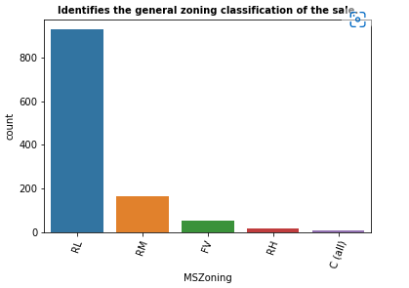
Identifies the general zoning classification of the sale
Most of the general zoning classification of the sale is RL-Residential Low Density(RL).

Slide 7
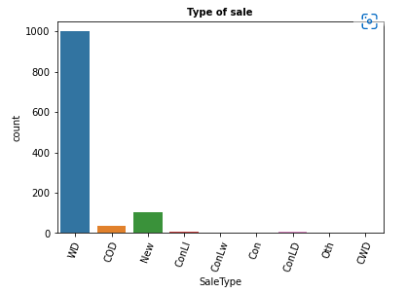
Type of sale
WD (Warranty Deed – Conventional) is high sale type

Slide 8
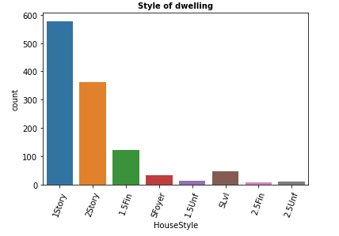
Style of dwelling
Most of the dwelling1Story-One story
And another are 2Story Two story dwelling.

Slide 9
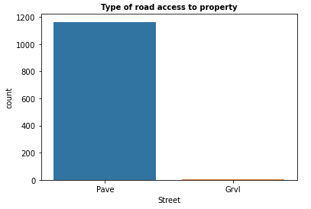
Type of road access to property
We can observe that all the roads are Pave.

Slide 10
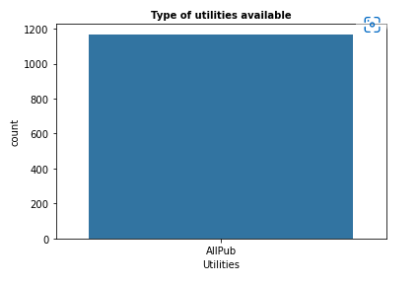
Type of utilities available
All public Utilities (Electricity, Gas, Water, and Septic Tank)

Slide 11
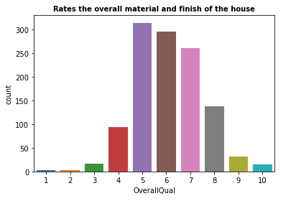
Rates the overall material and finish of the house
8-Very Good
7-Good
6-Above Average
5-Average
4-Below Average

Slide 12
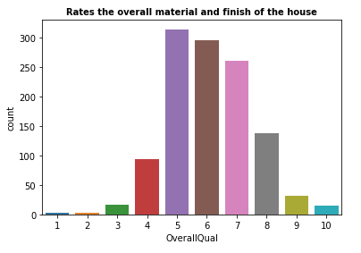
Rates the overall material and finish of the house
8-Very Good
7-Good
6-Above Average
5-Average
4-Below Average

Slide 13
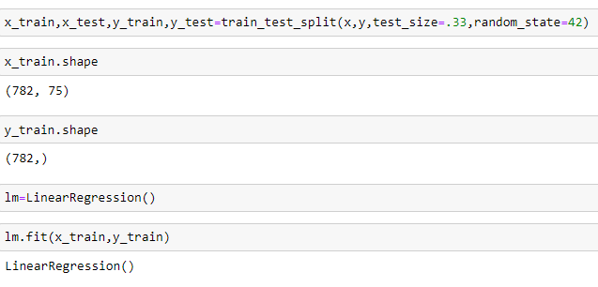
Applying machine learning and finding the results
Putting the model for training and testing

Slide 14
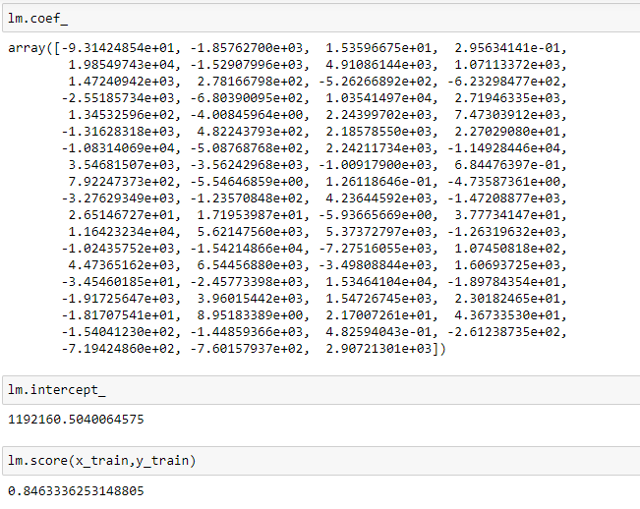
Finding coefficient and score

Slide 15
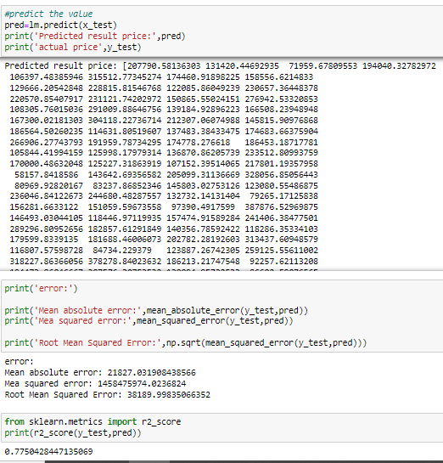
Predictions

Slide 16
CONCLUSION
I find out the price of houses with the available independent variables.
I find out which variables are important to predict the price of variable by ploting countplot
I fined how these variables describe the price of the house
This model will then be used by the management to understand how exactly the prices vary with the variables.
They can accordingly manipulate the strategy of the firm and concentrate on areas that will yield high returns.

Slide 17


