Slide 1
Impact of COVID-19 crisis and
each countries’ policies to economy

Slide 2
contents
01
Project Overview
02
Related Work & Data Sets
03
Data Analysis
04
Policy Analysis
05
Conclusion & Limitation

Slide 3
Project Overview

Slide 4
Background
The spread of COVID-19 has led to rapid and big changes in all areas, including living, consumption patterns, and the economy
According to "Impact of COVID-19 crisis on service industry (EU)", a remarkable decline and recovery in service production is shown
Various policies such as masks, lockdown, and inspecting COVID-19 were decided to prevent the spread of COVID-19

Slide 5
Objective
To find out the relationship and influence of COVID-19 and each countries’ different policies to the economy
To figure out how individuals responded to COVID-19 situation by analyzing policies that are effective for the economy

Slide 6
Related Work & Data Sets

Slide 7
Related Work
The relationship between each countries’ different policies and number of patients & deaths
LSHTM
Oxford
CSH Vienna
WHO

Slide 8
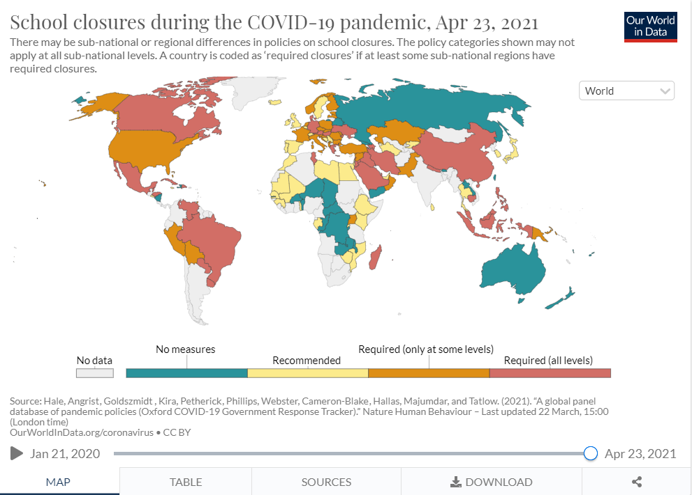
Data Sets
OxCGRT(https://ourworldindata.org/coronavirus)

Slide 9
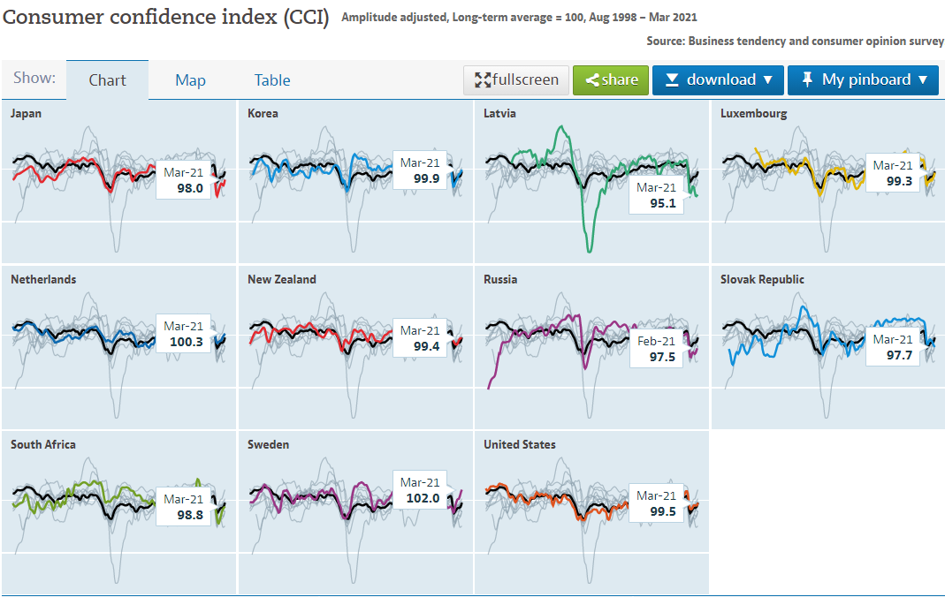
Data Sets
OECD Economy(https://data.oecd.org/leadind/consumer-confidence-index-cci.htm#indicator-chart)

Slide 10
Data Sets
CCI = Consumer Confidence Index
Consumer Confidence Index is an indicator that shows the consumer's optimism on the economy which is represented by the consumer’s activities of saving and spending.
CLI = Composite Leading Indicator
Composite Leading Indicator shows the economic trends and the flow of the economic activities by interpreting multiple indices.
  Ex) stock index, orders index, new building permits, new order of capital goods, number of unemployment, the spread between long and short interest rates, average consumer expectations for business conditions, etc.

Slide 11
Pre-processing
Monthly average COVID-19 data
- economy data is monthly and COVID-19 data is daily
Convert year value to month value
- xxxx(year) xx(month)->xxxx*12+xx(month)
Inner Join

Slide 12
Data analysis
Case, death, vaccination

Slide 13
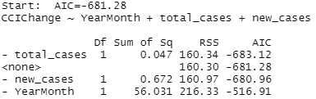
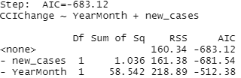
Code
Backward elimination
selectNames <- names(Data)[c(2:32)] formula = as.formula(paste('CCIChange~',paste(selectNames,collapse = '+'))) full.model <- lm(formula, data = Data) step.model <- step(direction = "backward", object = full.model) summary(step.model)

Slide 14
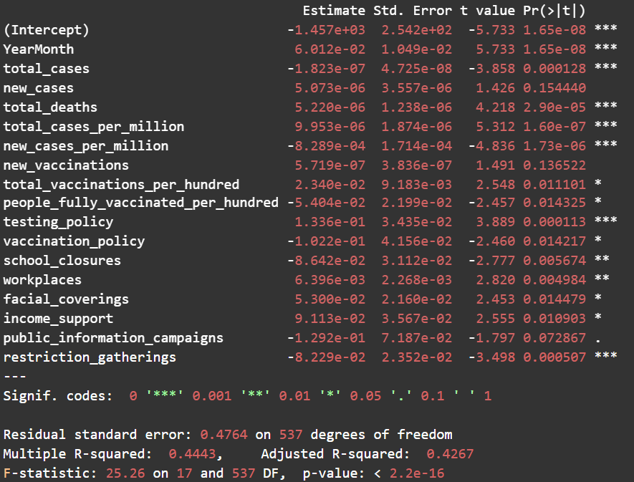
CCI Result
Sign Interpretation
Divided to 4 parts
Time
Case & Death
Vaccination
Policy

Slide 15
Time
YearMonth > 0
As months passed, even if the other values were the same, CCI increased more than before
Adaptation of situation – became optimistic

Slide 16
Case & Death
- total_cases + new_cases + total_deaths
New cases and total deaths increase CCIChange?
Think these as correction term of total cases
total_cases( -1 + new_case_rate + death_rate)
Plot new case rate, death rate

Slide 17
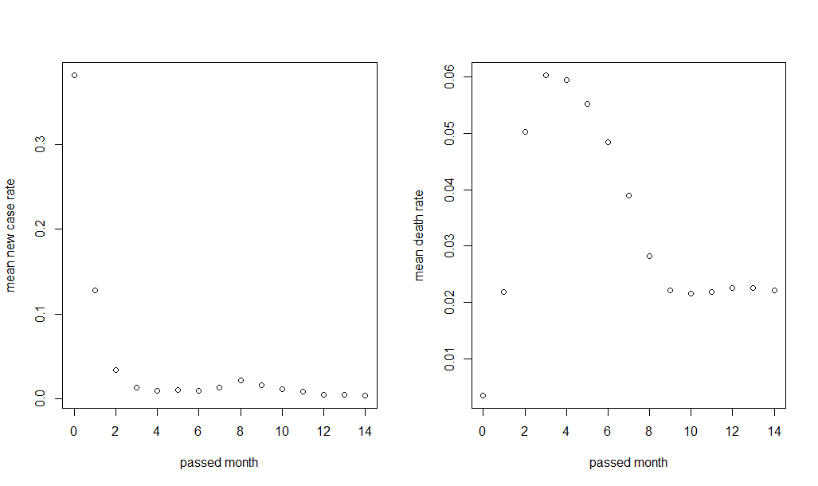
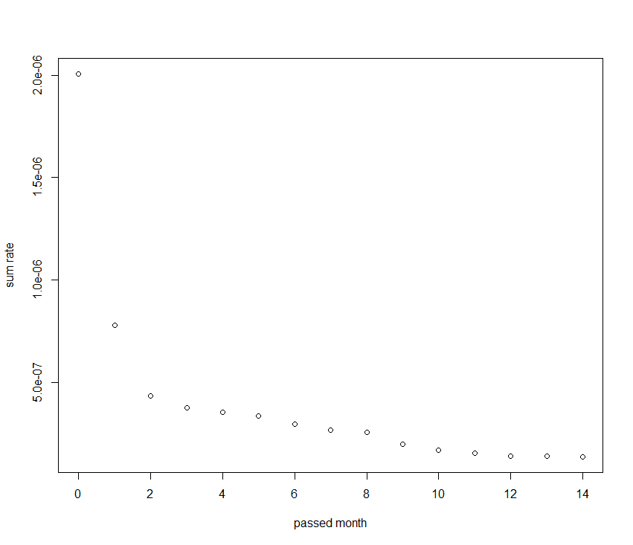
Case & Death
new case rate death rate coeff multiplied sum
At month 0 and 1, there was not enough time for total cases to affect the economy or optimism of people

Slide 18
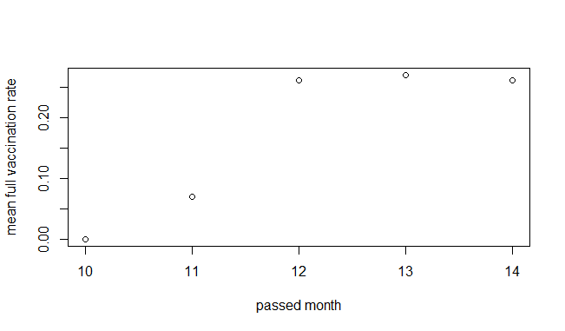
Vaccination
new_vaccinations > 0
total_vaccinations_per_hundred - people_fully_vaccinated_per_hundred
total_vaccinations_per_hundred ( 1 - full_vaccination_rate)
Think as correction term
Effect of vaccination rate high at
beginning because of expectation
of economy recovery.

Slide 19
Format of Data
Case & Death & Vaccination : total cases, new cases, new vaccine
Total vaccination : per hundred terms
Because CCI focuses on only consumer optimism, COVID-19’s effect to people mind is reflected.
Therefore, format of data on news affects
Total vaccination: shown as rate 50%, 60%
Case, new vaccination : 10k, 20k case, 1k vaccination

Slide 20
CLI vs CCI
CCIChange - Multiple R-squared: 0.4443
CLIChange - Multiple R-squared: 0.1501
CCI focuses on only consumer optimism
→ COVID-19’s effect to people mind reflected
CLI shows economic trends though various indices
→ Without those indices, low correlation

Slide 21
CLI vs CCI
Case & Death part
CCI : total cases, new cases, total deaths
CLI : total cases per million, total deaths per million
CCI shows people’s optimism, so the format (exact value) shown in news is important
However, Because CLI is showing the overall economy, we can say the ratio is important

Slide 22
Policy Analysis
Each policies’ effect on the economy

Slide 23
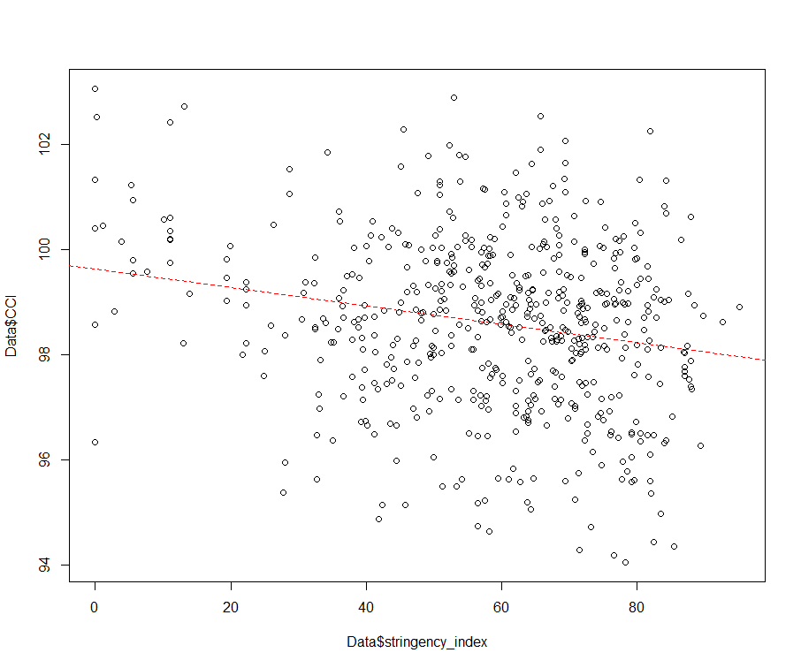
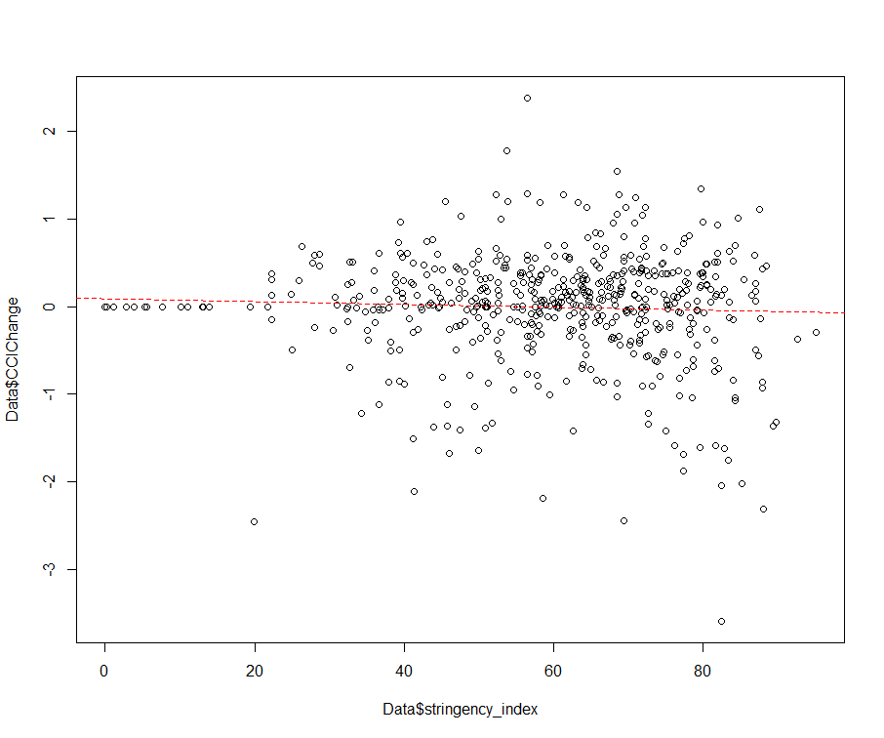
Policy analysis
Direct compare of the stringency index and CCI, CCI change
  When stringency index is high, CCI is low
  Stringency index doesn’t affect much on the CCI change
Which policy has the most significant effect?

Slide 24
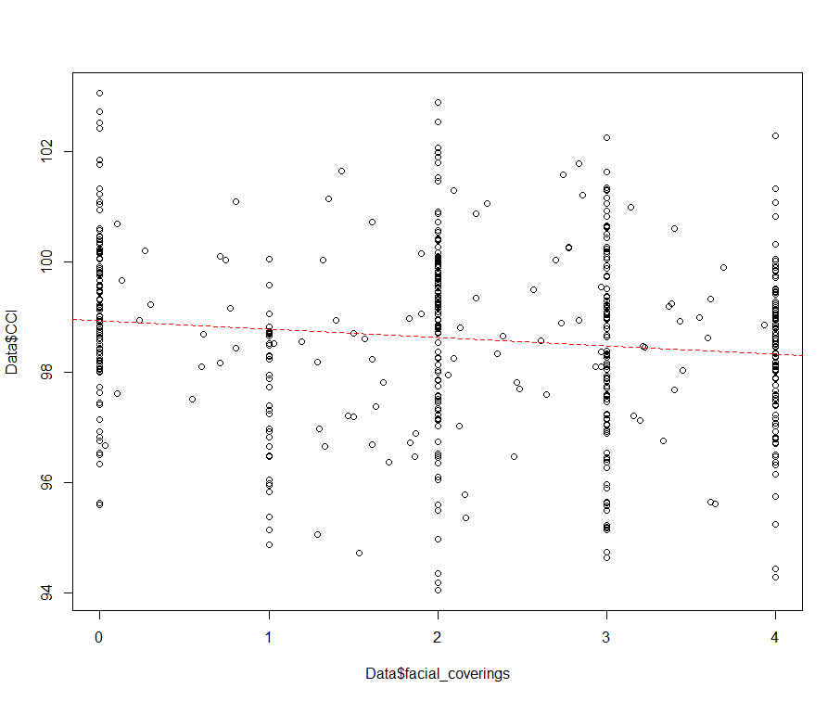
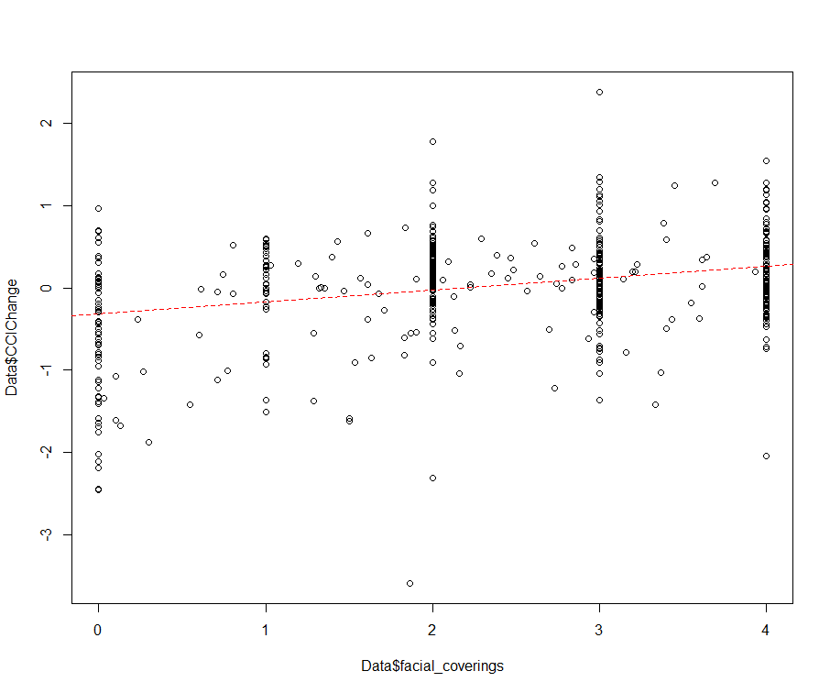
Facial covering
Effect of Facial covering
  If the policy’s stringency is high, CCI is low
  Policy’s stringency is high, CCI change is poistive
Seems effective to encourage economy

Slide 25
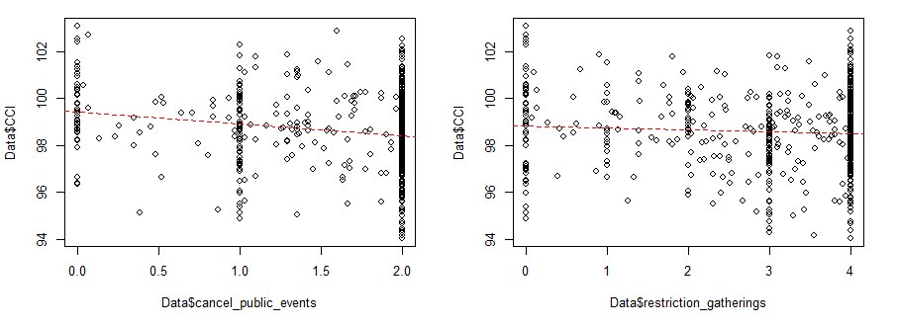
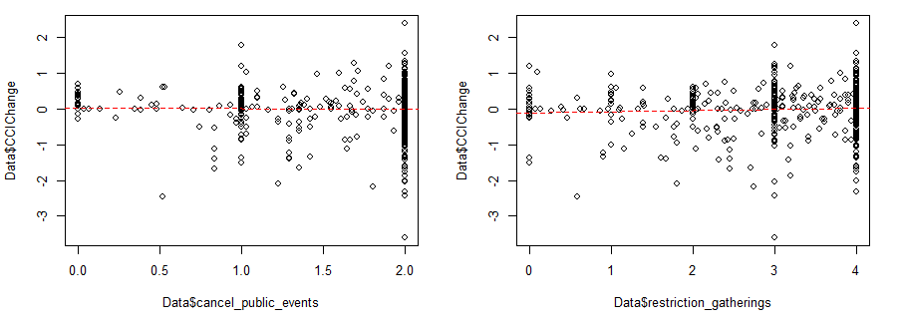
Public events and gathering
Effect of restricting public events and gathering
  When the policy’s stringency is strong, CCI is low.
  These policies doesn’t affect much on the CCI changes.
Seems not effective to the economy.

Slide 26
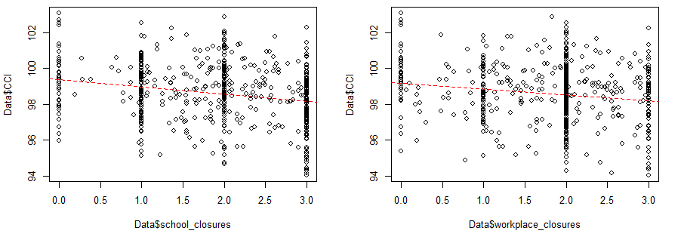
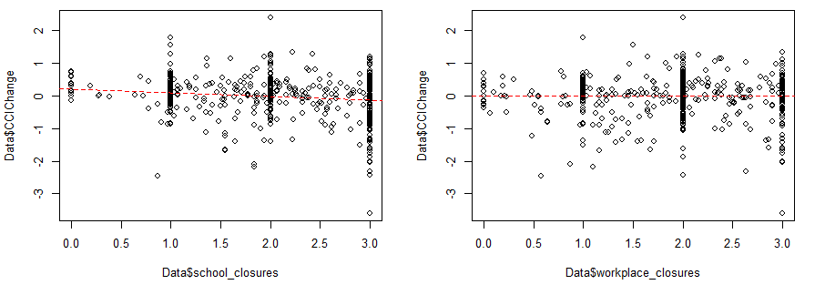
School and workplace closure
Effect of School closure and workplace closure
  When the policy’s stringency is strong, CCI is low.
  These policies doesn’t affect much on the CCI changes.
Seems not effective to the economy.

Slide 27
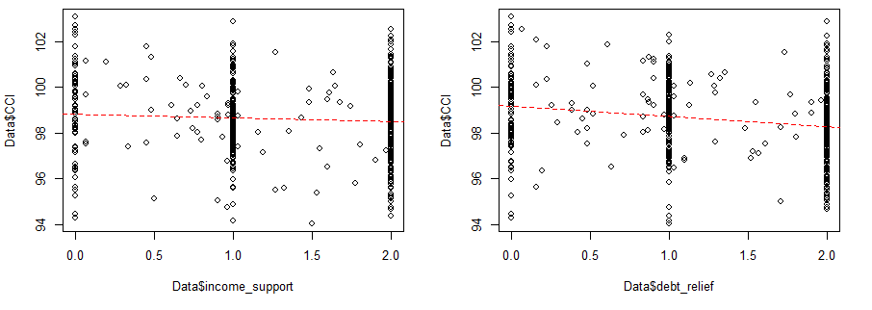
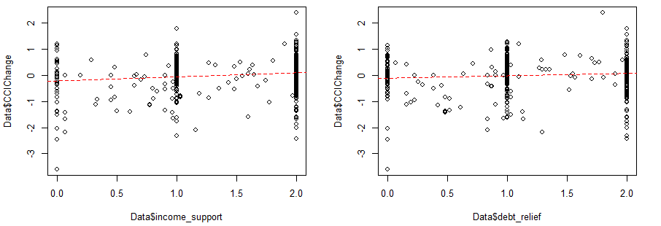
Financial Support
Effect of income support and debt relief
  When the policy’s stringency is strong, CCI is lower, but not that significantly.
  These policies makes CCI changes positive, but slightly.
Seems less effective to the economy.

Slide 28
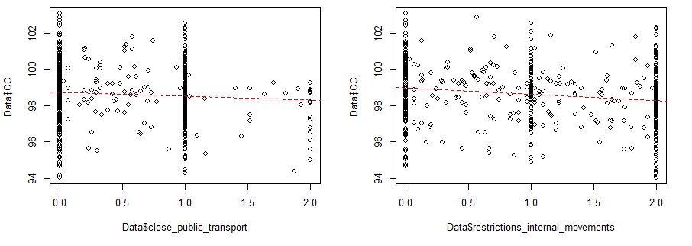
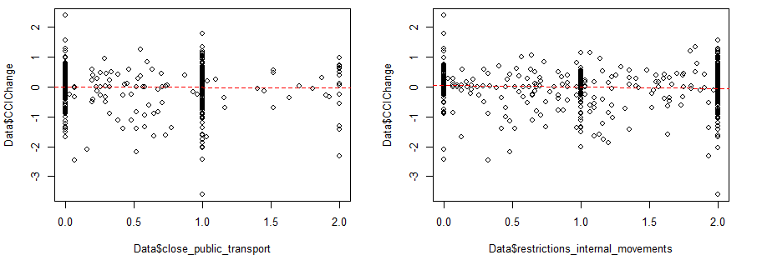
Transport and Internal movement
Effect of travel and internal movement restriction
  When the policy’s stringency is strong, CCI is low.
  These policies doesn’t affect much on the CCI changes.
Seems not effective to the economy.

Slide 29
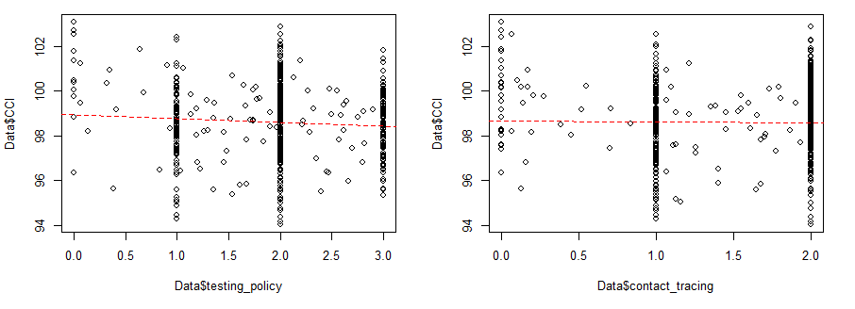
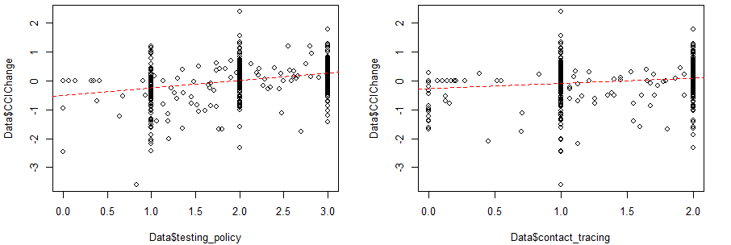
Testing and Contact tracing
Effect of testing and contact tracing
  Policy’s stringency and CCI value’s relation is weak.
  If the policy’s stringency is strong, CCI change become positive.
Seems effective to the economy.

Slide 30
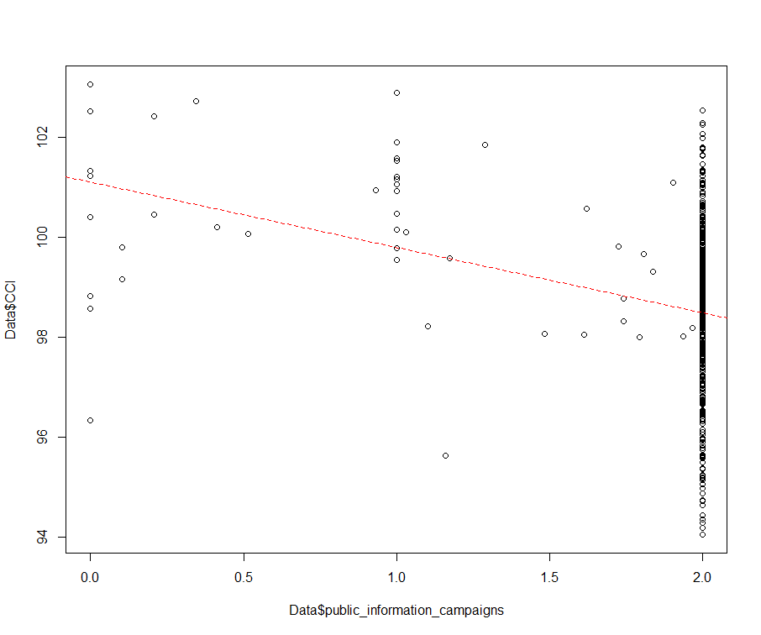
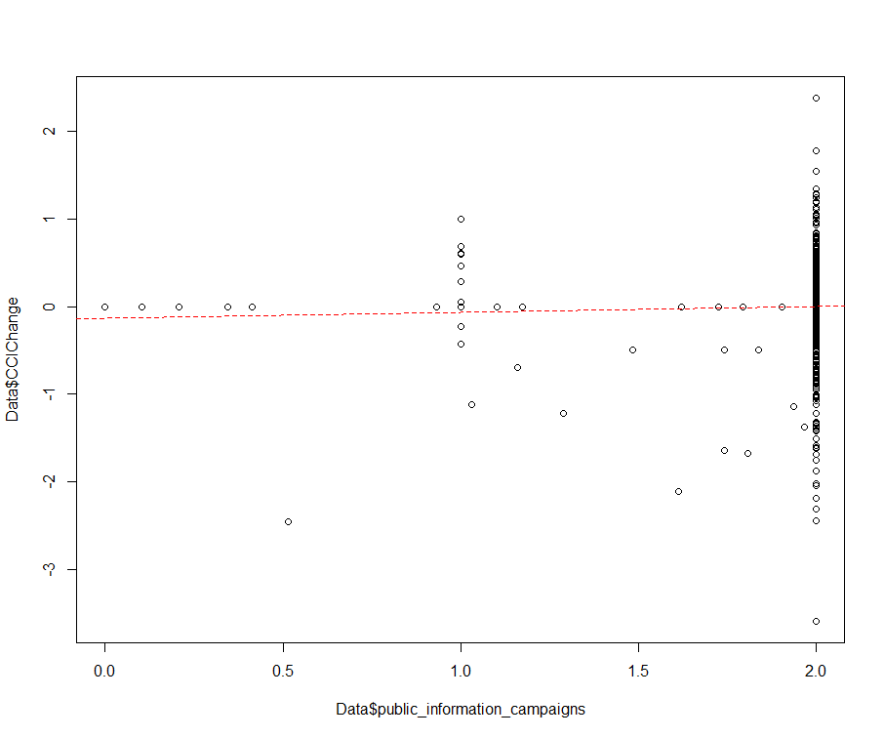
Public Information Campaign
Effect of public information campaign
  When the policy’s stringency is strong, CCI is low.
  If the policy’s stringency is strong, CCI change become positive but the change is small.
Seems less effective to the economy.

Slide 31
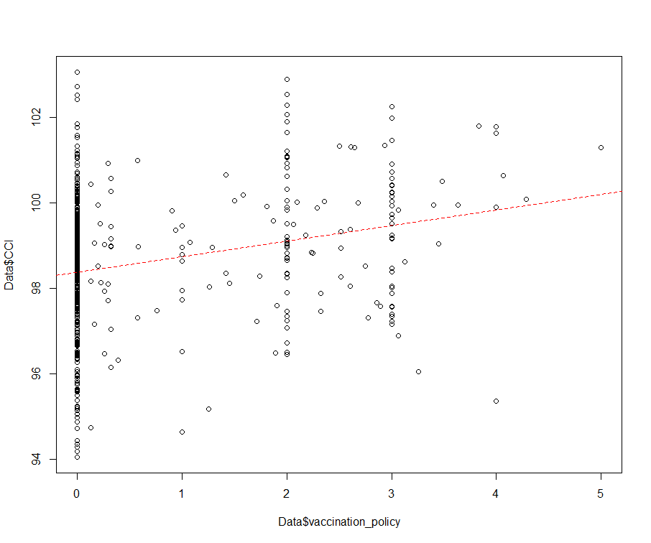
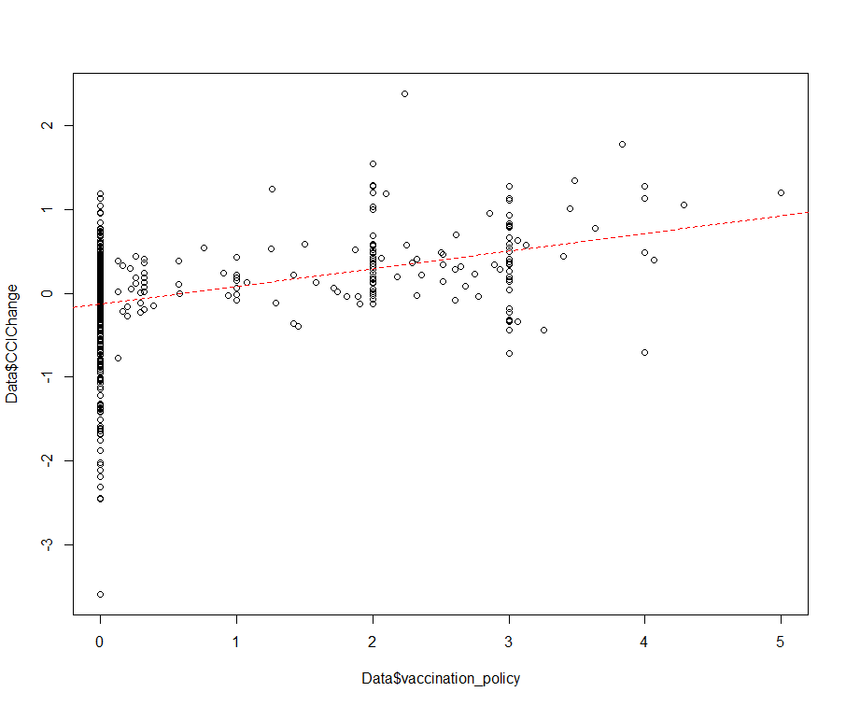
Vaccination
Effect of vaccination policy
  When the policy’s stringency is strong, CCI is high.
  If the policy’s stringency is strong, CCI change become drastically positive.
Seems very effective to the economy.

Slide 32
Policy Group Comparison
Prevent spread - Vacciantion, Testing, Contact Tracing, Public information campaign,
  Multiple R-squared: 0.2152, Adjusted R-squared: 0.2095(for CCI)
Restrict Contact - Facial Coverings, Cancel Public Events, School Closure, Workplace Closure, Stay at Home, Restriction of Internal Movements, Close Public Transport
  Multiple R-squared: 0.1778, Adjusted R-squared: 0.1718
Financial Support - Income Support, Debt Relief
  Multiple R-squared: 0.0291, Adjusted R-squared: 0.02734

Slide 33
Conclusion
& Limitation

Slide 34
Conclusion
As time past, people got optimistic
Total cases decrease CCI but the effect is low at first two months
- not enough time to affect economy or mind
Vaccination increase CCI and the effect is high at first two months
- people’s expectation to economy were higher at first
The format of data shown to people is important to CCI
- because CCI shows how people think
CLI has low correlation to COVID-19 data because it has lots of elements

Slide 35
Conclusion
Prevent Spread is the most effective policy group that has positive effect to CCI.
For each policies, Vaccination, Testing, Contact Tracing, facial covering were effective policies for CCI.
School closure and Workplace closure, and Income Support and Debt Relief doesn’t affect to CCI.

Slide 36
Limitation
The causality between policy and cases
-The economy may have changed due to the influence of the policy, but the policy may have been determined according to the change in the economy
Too many variables & Coefficients close to 0
-Does linear regression produce meaningful results?
Bias of selected countries
-Only OECD countries with all policy and corona information were selected

Slide 37
Limitation
The large impact of case/death
-The influence of case/death is so great that it is difficult to observe the economic change for the policy
Influence of external factors
-There are many factors that affect the economy, but we judged only with Corona data. There may be distortions in the interpretation.

Slide 38
THANK YOU
Insert the Subtitle of Your Presentation

