Slide 1
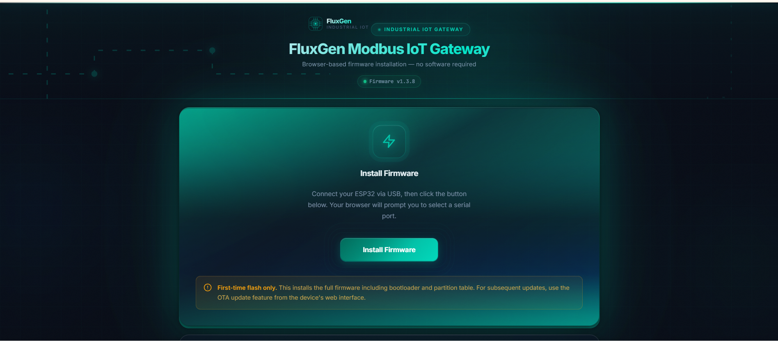
FIRMWARE FLASHER
Initial firmware setup — no software required
A browser-based flasher — any user can install firmware on an ESP32 with a single click.
01
No software required
Runs directly in Chrome or Edge using Web Serial — nothing to install.
02
One-click install
Bootloader, partition table, and firmware — flashed together in one operation.
03
Anyone can deploy
No Arduino IDE, no command line, no developer required.
Any user can flash an ESP32 in under a minute — from a browser, with zero setup.
Notes:
'We also built a web-based firmware flasher to make the initial setup of every device as easy as possible.
Here's how it works. Any user opens this page in Chrome or Edge. They plug in the ESP32 via USB. They click Install Firmware. The browser installs the full firmware — bootloader, partition table, and application — in one shot, directly through the Web Serial API. No Arduino IDE, no command line, no local software of any kind.
Three reasons this matters.
One — no software required. It runs entirely in the browser. There is nothing to install.
Two — it's a one-click install. The full firmware goes on in a single operation.
Three — anyone can deploy a device. You don't need to be a developer. Operations, customer, or new hire — anyone with a browser and a USB cable.
Any user can flash an ESP32 in under a minute, from a browser, with zero setup.'
Timing: 60 seconds.

