Slide 1

PROJECT SHOWCASE
ESP32 IoT Device
Enhancement
SIM Connectivity · SD Card Backup · Web-Based Configuration
From WiFi-dependent to smart hybrid IoT solution
PRESENTED BY
Y Chaithanya Reddy
IoT Platform · Firmware & Cloud · April 2026
Notes:
Open strong — eye contact before first word.
'Good morning. In the next ten minutes, I'll walk you through a project that transformed our ESP32 IoT device — from a WiFi-dependent system into a smart hybrid solution that handles network outages, stores data safely offline, and lets anyone configure it through a web browser.
Three upgrades, one simple story. Let's go through it.'
Pause 2 seconds. Click.

Slide 2




PREVIOUS SYSTEM CHALLENGES
What was breaking before the upgrade
FIELD REALITY
IMPACT
WiFi-only. Code-only.
The cost of the old way.
● Only WiFi connectivity → no cellular fallback available.
● Unstable WiFi at many sites → frequent network downtime.
● Network drops → significant data loss, no recovery.
● Any config change → open Arduino code, edit, recompile.
● Every update → reflash firmware into the ESP32 manually.
Data loss
Technical dependency
Every network outage lost telemetry permanently.
Every change required a developer and recompile.
Slow rollout
Poor user experience
Each site needed code edits + manual reflash.
Non-technical users locked out of configuration.
ESP32 IoT Enhancement · Previous Challenges
Slide 2 of 11
Notes:
'Before this upgrade, the device had two big problems.
ONE — connectivity. It only supported WiFi. At many installation sites, WiFi was unstable or simply unavailable. Whenever the network dropped, data was lost permanently. There was no local buffer, no replay, no recovery.
TWO — configuration. To change any setting — even something small — we had to open the Arduino source code, modify it manually, and reflash the firmware into the ESP32. This was technical, time-consuming, and locked out non-technical users completely.
On the right — the real-world impact. Data loss. Technical dependency. Slow rollout. Poor experience for anyone who was not a developer.
This is the baseline we set out to fix.'
Timing: 75 seconds.

Slide 3

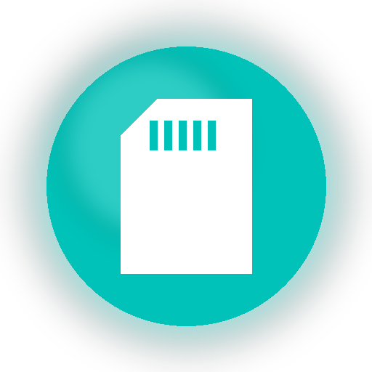


NEW SOLUTION IMPLEMENTED
Four additions that transformed the device
01
02
SIM Module
SD Card Backup
Cellular connectivity — device now uses mobile SIM network directly, reducing WiFi dependency and improving uptime in remote or unstable areas.
Automatic offline storage — when network drops, SD card activates and stores every data ping locally. Zero data loss during outages.
03
04
RTC Module
Web Server
Real-Time Clock — provides accurate date and time continuously, so every stored ping gets an exact timestamp. Reliable historical records.
Browser-based configuration portal — configure device settings from any browser. No Arduino editing, no firmware reflash, no developer needed.
ESP32 IoT Enhancement · Solution Overview
Slide 3 of 11
Notes:
'We solved both problems with four additions.
One — SIM Module. The device can now use a mobile cellular network directly. It no longer depends only on WiFi.
Two — SD Card Backup. Whenever the network goes down, the SD card activates automatically and stores every data ping locally. No more permanent data loss.
Three — RTC Module, which is a real-time clock. It keeps accurate date and time continuously, so every ping stored on the SD card gets a correct timestamp.
Four — a Web Server. We built a browser-based configuration portal. Users can now configure the device from any web browser. No Arduino editing, no firmware reflash, no developer required.
The next four slides go into each one.'
Timing: 60 seconds.

Slide 4
FEATURE 01 · SIM MODULE
Cellular connectivity for unstable WiFi locations
BENEFITS
What the SIM Module delivers.
Mobile SIM network, directly.
Device can now connect through a cellular SIM — no longer dependent on WiFi.
Reduced WiFi dependency.
Even if local WiFi fails, the device stays connected over the mobile network.
Works in remote or unstable areas.
Sites with weak or no WiFi now have a reliable connectivity path.
Fewer transmission failures.
Telemetry reaches the cloud even when the primary network is degraded.
Higher uptime and reliability.
Mobile SIM Network
Overall device availability improves across all deployment conditions.
Cellular (A7670C 4G LTE)
ESP32 IoT Enhancement · SIM Module
Slide 4 of 11
Notes:
'First addition — the SIM Module.
The device can now connect to the internet through a mobile cellular SIM, directly. This removes the single-point-of-failure we had with WiFi-only connectivity.
Five concrete benefits.
One — it uses the mobile network directly, just like a smartphone.
Two — it reduces dependency on WiFi. Even if local WiFi fails, the device stays connected.
Three — it works in remote or unstable areas where WiFi either doesn't exist or isn't reliable.
Four — it minimizes transmission failures. Our telemetry reaches the cloud under a wider range of field conditions.
Five — overall uptime and reliability goes up. Significantly.'
Timing: 70 seconds.

Slide 5
FEATURE 02 · SD CARD BACKUP
Automatic offline storage during network outages
HOW IT WORKS
Zero data loss during outages.
Activates automatically.
When the internet or network goes down, SD backup kicks in without any manual step.
Stores every data ping locally.
Every reading is written to the SD card with its timestamp, safely preserved.
Prevents data loss during outages.
No matter how long the network is down, nothing is dropped.
Chronological replay on recovery.
When the network returns, cached data is sent to the cloud in the correct order.
Local Offline Storage
OFFLINE FLOW
Network drop → SD backup activates → Every ping stored locally → Network back → Chronological replay to cloud
FAT32 · Chronological replay
ESP32 IoT Enhancement · SD Card Backup
Slide 5 of 11
Notes:
'Second addition — SD Card Backup.
Whenever the internet or network connection goes down, the SD card backup activates automatically. There's no manual step, no user intervention — the device detects the outage and switches to local storage.
Every data ping gets stored locally on the SD card with its timestamp.
When the network comes back, the device replays all the cached data to the cloud in chronological order — so the server sees the readings in the exact sequence they were captured.
The bottom bar shows the flow — network drop, SD activates, store locally, network recovers, replay. No data is lost, no matter how long the outage lasts.'
Timing: 70 seconds.

Slide 6
FEATURE 03 · RTC MODULE
Real-Time Clock for accurate timestamps
PURPOSE
Every ping gets the right time.
RTC = Real-Time Clock Module.
Dedicated hardware that tracks the current date and time continuously.
Accurate time, even offline.
The RTC keeps correct time even when the device is disconnected from the network.
Every stored ping gets an exact timestamp.
When SD backup is active, each reading is tagged with the precise time of capture.
Correct historical records.
Server-side logs, reports, and compliance data reflect actual capture time — not arrival time.
Traceability across outages.
DS3231 RTC
You can always tell when each reading was taken, regardless of when it reached the cloud.
Accurate time, even offline
ESP32 IoT Enhancement · RTC Module
Slide 6 of 11
Notes:
'Third addition — the RTC Module.
RTC stands for Real-Time Clock. It's a dedicated piece of hardware that tracks the current date and time continuously — independent of the network and independent of whether the device has power to the main processor.
Why does this matter? Because when the SD card is buffering data during a network outage, we need to know exactly when each reading was captured — not when it eventually reaches the cloud.
The RTC makes sure every ping stored on the SD card gets an exact, accurate timestamp. This means our historical records, compliance reports, and analytics all reflect the real time of capture.
It also means we have full traceability across any outage — we can always tell exactly when each reading happened.'
Timing: 65 seconds.

Slide 7
FEATURE 04 · WEB SERVER
Browser-based configuration for easy deployment
BEFORE · AFTER
How configuration changed.
BEFORE
AFTER
× Open Arduino IDE
✓ Open browser
× Edit source code manually
✓ Navigate to device portal
× Recompile firmware
✓ Change settings in UI
× Reflash the ESP32
✓ Click save
× Requires a developer
✓ Anyone can do it
× Slow, technical, error-prone
✓ Fast, user-friendly
Web Configuration Portal
Browser-based · No code, no reflash
ESP32 IoT Enhancement · Web Server
Slide 7 of 11
Notes:
'Fourth addition — the Web Server.
Before this, changing any configuration on the device meant opening the Arduino IDE, editing the source code, recompiling, and reflashing the firmware. You needed a developer, a laptop with the build environment, and time.
We built a browser-based configuration portal. Now anyone — technical or not — can open a browser, connect to the device, change settings in a clean UI, and click save. That's it.
On the right you can see the before-and-after. Before took six technical steps. After takes four simple clicks, and anyone can do it.
This is the change that makes the device genuinely deployable at scale — because rolling out a hundred sites no longer bottlenecks on developer availability.'
Timing: 70 seconds.

Slide 8
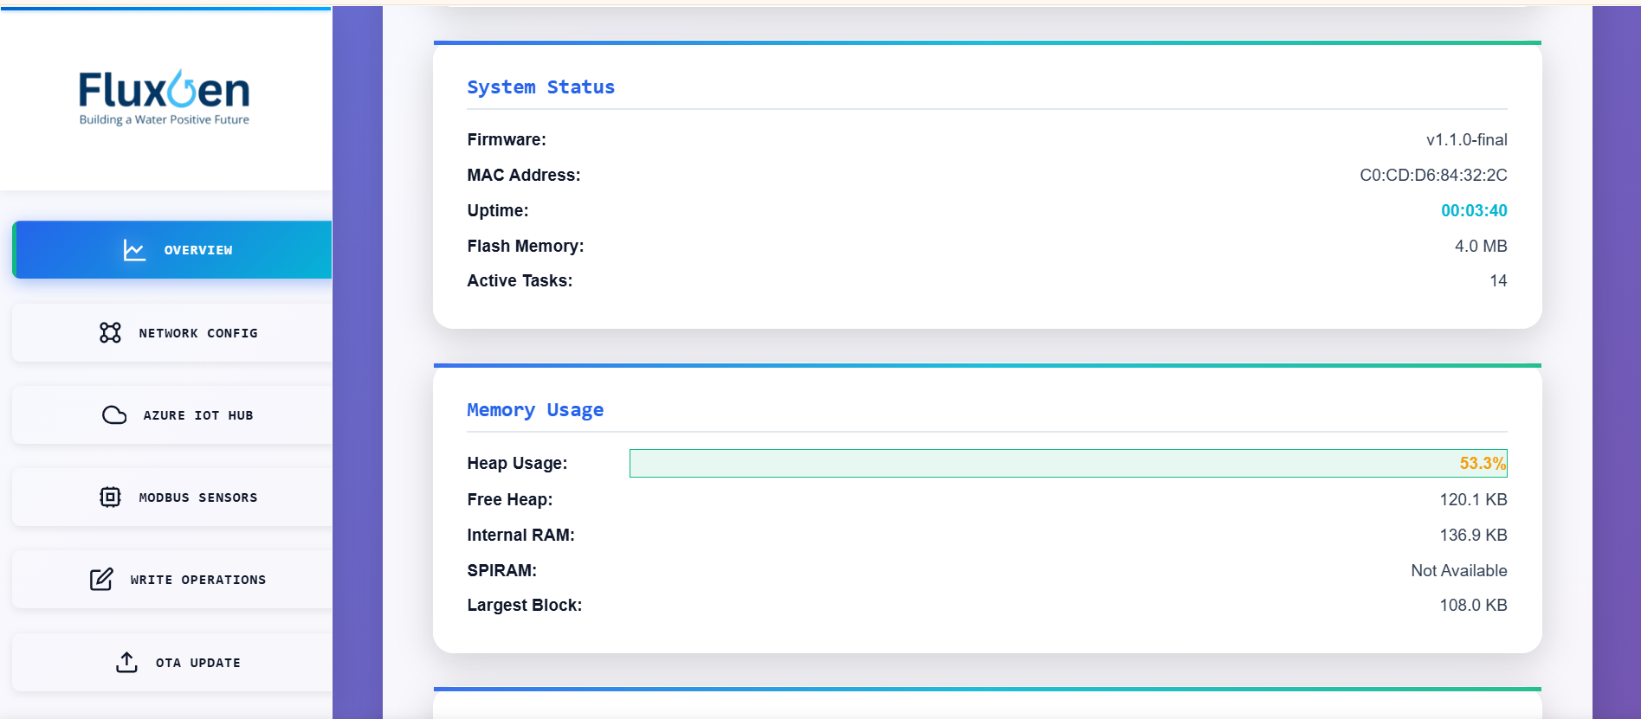
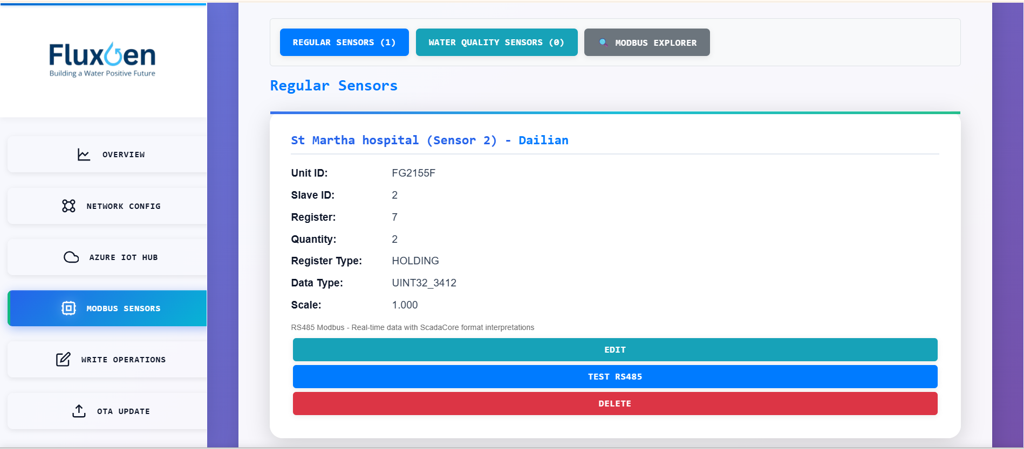
FEATURE 04 · WEB PORTAL LIVE VIEW
Modern, browser-based configuration interface
01 · Dashboard
02 · Sensor Management
Real-time system status — firmware version, MAC address, uptime, heap usage, active tasks.
Add, edit, test and delete Modbus sensors from the browser — no code, no reflash.
PORTAL SECTIONS
Overview · Network Config · Azure IoT Hub · Modbus Sensors · Write Operations · OTA Update
ESP32 IoT Enhancement · Web Portal
Slide 8 of 11
Notes:
Show the actual product. Let the screenshots speak.
'This is what the portal actually looks like — running live on the device.
On the left — the Dashboard. Real-time system status. Firmware version, MAC address, uptime, heap usage, active tasks. Operations teams can check device health at a glance without needing a terminal or a developer.
On the right — Sensor Management. We can add a new Modbus sensor, configure its unit ID, slave ID, register, data type, byte order, scale factor — all from the browser. Then test the connection with a single click. Edit or delete at any time.
The bar at the bottom shows the six portal sections — Overview, Network Config, Azure IoT Hub, Modbus Sensors, Write Operations, OTA Update. Every device setting is reachable from here.
This portal is what replaced the Arduino-IDE-and-reflash workflow.'
Timing: 75 seconds. Let the room look at the screenshots — don't rush.

Slide 9
OVERALL BUSINESS IMPACT
How the transformation helps the business
Six outcomes — direct results of the four additions above.
Major reduction
in data loss.
Improved connectivity
reliability.
Easier field deployment.
SD backup + SIM failover keep data flowing through outages.
Dual network removes the single-point-of-failure from WiFi.
Plug-and-play commissioning via the browser — no laptops, no code.
Reduced technical
dependency.
Faster customer
support.
Better user experience.
Non-technical users can configure, monitor, and adjust settings.
Configuration changes happen remotely, without site visits.
Simple UI and reliable behavior across all network conditions.
ESP32 IoT Enhancement · Business Impact
Slide 9 of 11
Notes:
'Adding those four features gave us six direct business outcomes.
One — major reduction in data loss. The SD backup and SIM failover together mean data keeps flowing even when networks fail.
Two — improved connectivity reliability. Dual network takes WiFi out of being a single point of failure.
Three — easier field deployment. Commissioning a new site is now a browser-and-settings operation, not a firmware operation.
Four — reduced technical dependency. Non-technical users can configure, monitor, and adjust the device.
Five — faster customer support. Configuration changes happen remotely, no site visits needed.
Six — better user experience across the board. Simpler UI, more reliable behavior.'
Timing: 75 seconds.

Slide 10
IN-HOUSE VS EXTERNAL
Aquagen vs Teltonika — feature-by-feature comparison
Feature parity on core capabilities — with ownership, direct Azure integration, and no vendor subscription.
IN-HOUSE · BUILT BY US
EXTERNAL · WE BUY
Aquagen
Teltonika
FluxGen in-house IoT gateway
External procurement · RUT956 / TRB246 series
Platform
ESP32-WROOM-32 · Custom hardware
Platform
RUT956 / TRB246 · vendor-built router
Connectivity
WiFi + 4G LTE (A7670C cellular)
Connectivity
WiFi + 4G LTE · Dual-SIM failover
Industrial bus
RS485 Modbus RTU · 10 sensors per unit
Industrial bus
RS232 + RS485 · digital I/O + relay
Offline storage
SD Card · automatic + chronological replay
Offline storage
microSD (requires configuration)
Timestamps
DS3231 RTC · accurate even offline
Timestamps
System clock · NTP-synced
Cloud integration
Azure IoT Hub · MQTT/TLS direct
Cloud integration
Via MQTT broker or Teltonika RMS
Remote management
Azure Device Twin · built-in · no subscription
Remote management
Teltonika RMS · paid subscription
Configuration
Custom web portal · branded UI
Configuration
RutOS web UI · vendor interface
OTA updates
Signed firmware · dual-slot rollback
OTA updates
Vendor-supplied firmware updates
Customization
Full source control · any change possible
Customization
Limited to RutOS parameters
ESP32 IoT Enhancement · In-House vs External
Slide 10 of 11
We match them on core features — and own the stack, the roadmap, and the cloud integration.
Vendor dependency
None · built in-house at FluxGen
Vendor dependency
Teltonika (Lithuania-based vendor)
Notes:
'Let me put this in context. Teltonika is what we currently buy externally for industrial IoT deployments — specifically their RUT956 and TRB246 series. Good products. Widely used.
On the left — Aquagen, our in-house build. On the right — Teltonika, what we buy.
Look at the feature rows. On connectivity — both do WiFi plus 4G LTE. On industrial bus — both do RS485 Modbus. On offline storage — both support SD-card caching, though on Teltonika it requires specific configuration. On cloud — Teltonika integrates via their RMS subscription service or an MQTT broker; Aquagen connects directly to Azure IoT Hub.
The real differences are at the bottom. Customization — Aquagen is fully in-house, so we can change anything. Teltonika is locked to what RutOS supports. Vendor dependency — Aquagen has none, Teltonika ties us to a Lithuania-based vendor and their subscription model.
The bottom line — we match them on core features, but we own the stack, the roadmap, and the cloud integration.'
Timing: 70 seconds. This slide is where the business case for 'in-house' lands.

Slide 11

FINAL SUMMARY
From Data Loss
to Smart Reliability.
A Complete IoT Upgrade.
The device transformed from a WiFi-dependent system into a smart hybrid IoT solution.
Dual network capability · Offline data backup · Accurate timestamp logging · Easy web-based control
Thank you
Y Chaithanya Reddy · FluxGen · IoT Platform
Notes:
Don't read the slide. Deliver from memory, quietly, with weight.
'To summarize —
This project took a WiFi-dependent ESP32 device and transformed it into a smart hybrid IoT solution.
Four additions made the difference — SIM module for cellular connectivity, SD card for offline backup, RTC for accurate timestamps, and a web server for easy configuration.
The result — major reduction in data loss, improved reliability, easier deployment, and a much better user experience.
From data loss to smart reliability. A complete IoT upgrade.
Thank you.'
Then stop talking. Pause. Let silence work. Five seconds minimum.

