Slide 1
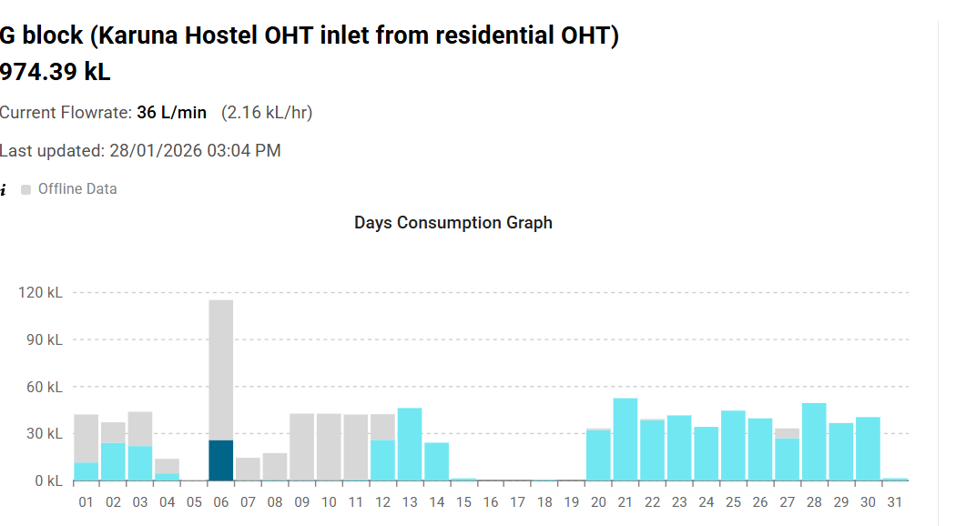
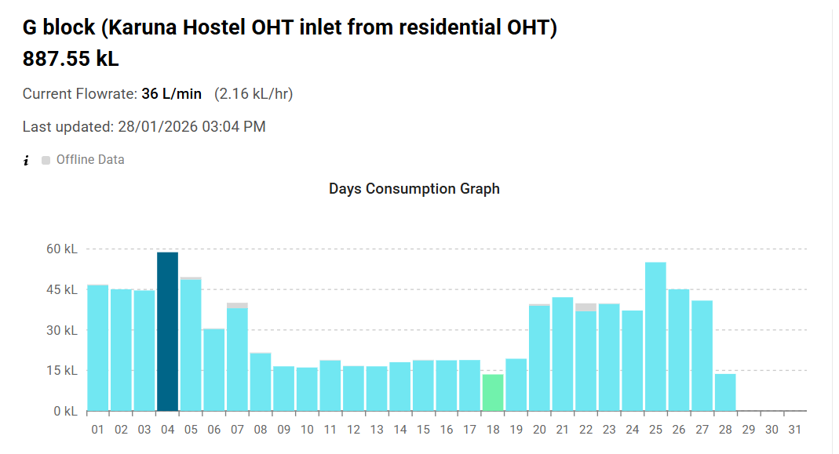
FIELD RESULTS
Real-world impact at Karuna Hostel — G Block
Before and after device deployment — 20 December 2025
DECEMBER 2025 · DEVICE DEPLOYED 19 DEC
JANUARY 2026 · FIRST FULL MONTH
Total: 974.39 kL · transition month
Total: 887.55 kL · first full month
Offline data gaps and accumulated spikes before deployment. Clean consistent readings from 20 Dec onward — the new device in action.
consecutive days of continuous data capture. No offline gaps, no accumulation spikes, no missing data.
One device, deployed once — complete site visibility for every day that followed.
Notes:
Bring the room into the data. Speak slowly — this slide is evidence.
'These are real consumption readings from G Block, Karuna Hostel — a site where we deployed the new device on 19 December 2025.
On the left — December 2025. Look at the pattern. Days 1 through 19 show a mix of grey and teal bars. Grey means offline data — readings that couldn't reach the cloud when they happened. The big spike on day 6 is an accumulation — data that piled up during an outage. From day 15 through 19, there's almost nothing visible — those are days where the old device lost data entirely. Then something changes on 20 December. Clean, consistent teal bars from that point onward. That's the new device in action.
On the right — January 2026. The first full month with the new device. Twenty-eight consecutive days of continuous data capture. No offline gaps. No accumulation spikes. No missing data.
One device, deployed once, on one day. Complete site visibility every day that followed.'
Timing: 75 seconds. Point to the transition around day 19-20 on the Dec chart — let the audience see it.

