Slide 1
Analyses and prediction on loan defaults
Beverly Yang
05MAR23
Notes:
My analyses and modeling on this loan defaults
Submission:
● A presentation deck/slides (up to 10min’s presentation) with your ﬁndings and results for both sections. Treat it as if you are sharing and presenting the results to 4
coworkers or leadership team at a company. It could be in any format (ptt, pdf, keynote, or google slides). We will only grade on the overall ﬂow and ﬁndings of the deck, so you don’t need to spend a lot of time beautifying your slides.

Slide 2
Contents
Summary and Goal
Exploratory Data Analysis (EDA)
Feature Selection and Engineering
Machine Learning Modeling
Model Performance
Model Selection
Improvements
Notes:
overall process flow

Slide 3
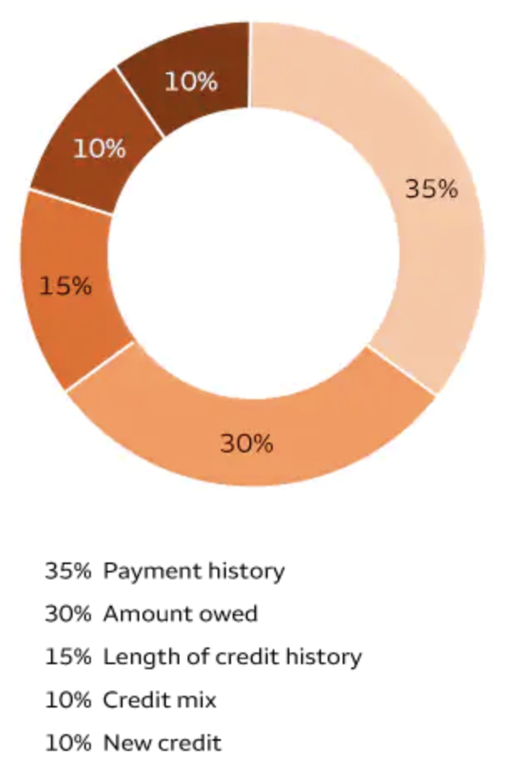
Summary and Goal
Better assess the risk of potential borrowers
Assumption:
Revolving credit features more important than installment features
Derogatory and delinquency remarks are considered
Select model based on highest ROCAUC score
Most of categorical features removed
Saga-lasso logistic regression model is the best at detecting loan default
Notes:
Helping business to increase revenue by predicting correctly and reduce risk of lose money by lending to default customers.
Binary classification.
Factors contribute to loan default
SME knowledge:
Installment loans (student loans, mortgages and car loans) show that you can pay back borrowed money consistently over time. Meanwhile, credit cards (revolving debt) show that you can take out varying amounts of money every month and manage your personal cash flow to pay it back.
get optimum number of PC for best model performance

Slide 4

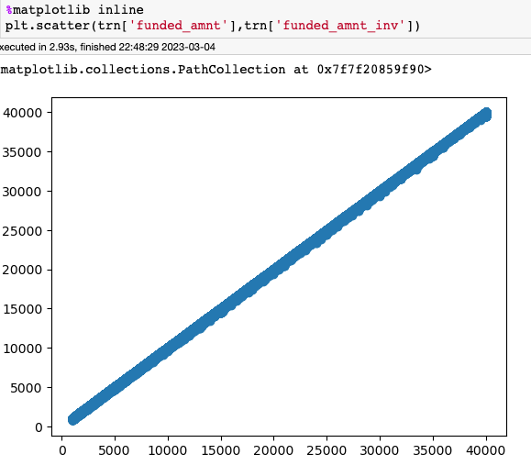
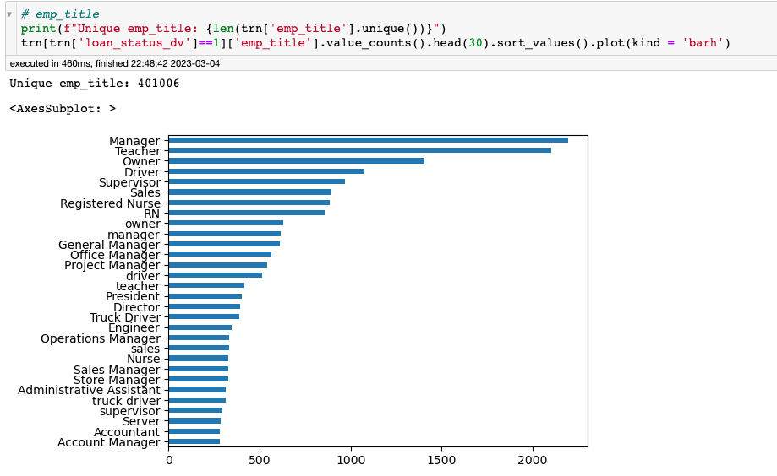
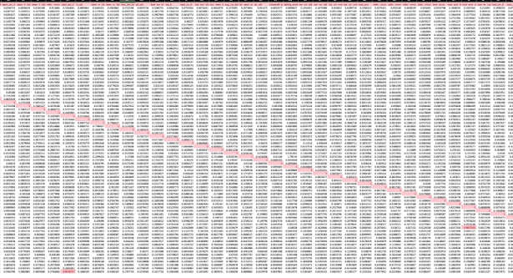
Exploratory Data Analysis
Data Cleaning and Preprocessing
Charged off event rate is: 7.31%
Numeric: Pearson’s correlation
Categorical: Chi-square, and Cramer V score
Most numerical data skew to the right
Notes:
Data cleaning and preprocessing. 1,827,125. 1.8 million. Dataset imbalanced
80% time EDA
Iteration

Slide 5
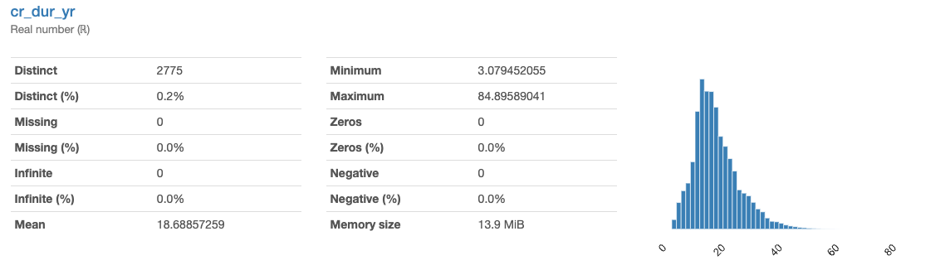
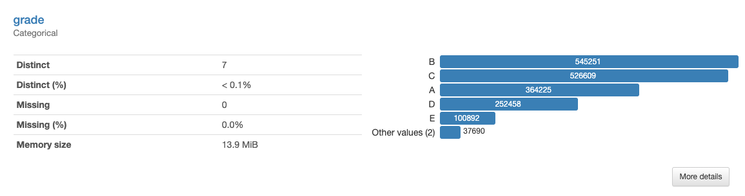
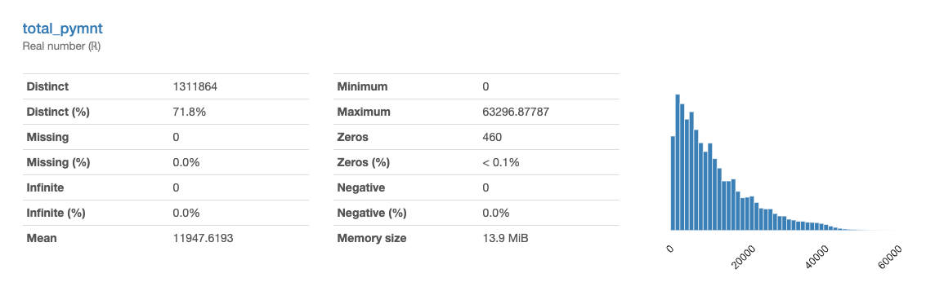
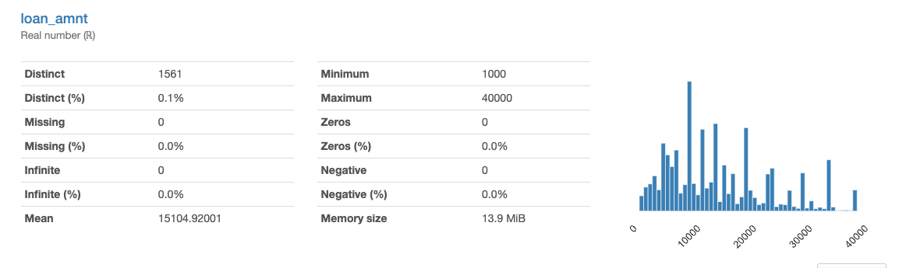
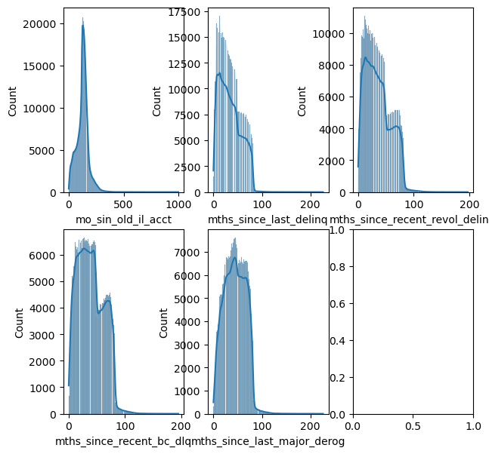
Notes:
Feature engineered – payment history get rid categorical variables

Slide 6

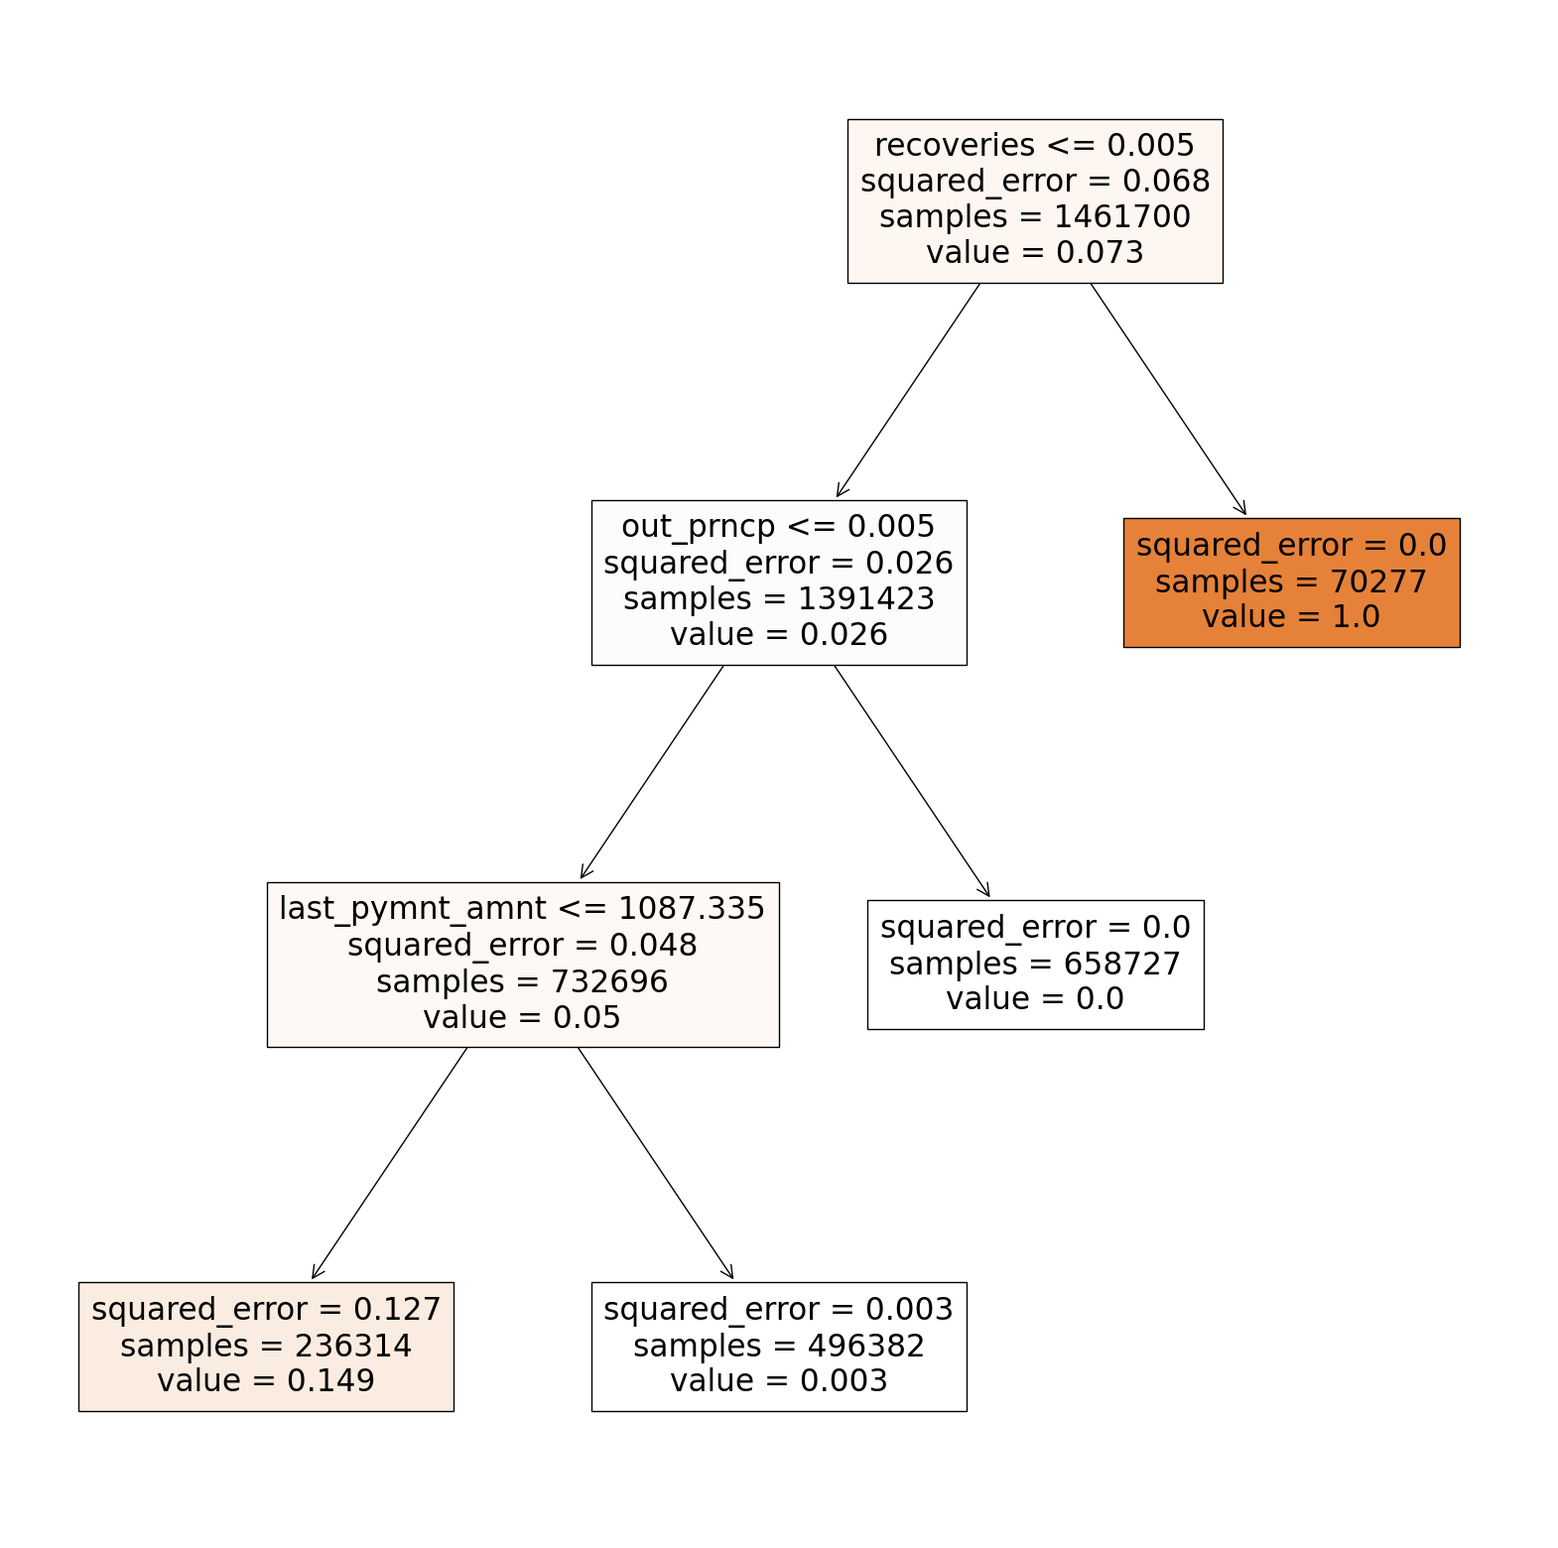
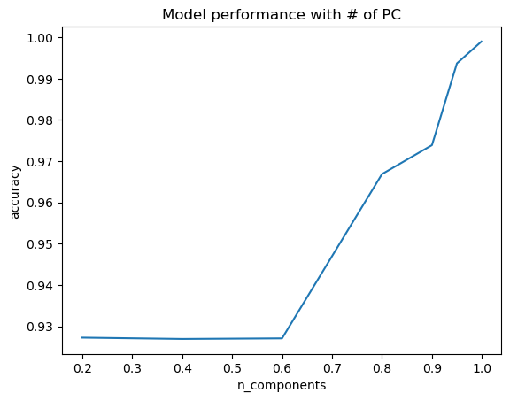
Feature Selection and Engineering
Impute numeric values: dti, inq
Create credit history feature
44 features are used for training
Feature importance:
Baseline logistic regression model
PC performance
Decision Tree Regressor
Notes:
80% time EDA
Impute based on means
Baseline regression model use only numeri values and values without NA, get a sense of important features
High: Gini index values: recoveries, out_prncp_lastpymnt
Regression tree variables not found in test dataset.
tst['collection_recovery_fee'].unique()
tst['out_prncp_inv'].unique()
tst['recoveries'].isna().sum()
tst['out_prncp'].isna().sum()

Slide 7
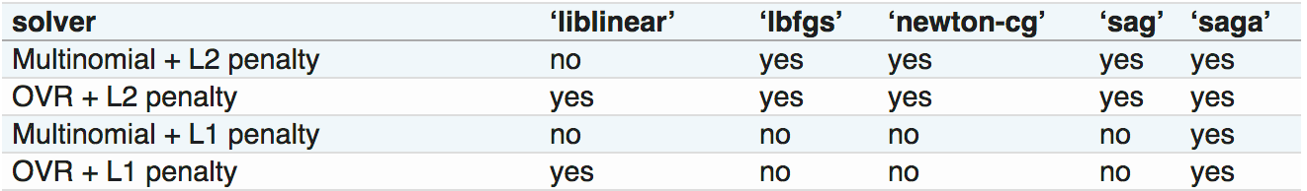
Machine Learning Modeling
Simple logistic regression modeling
Helper functions for one-hot encoding, scoring, plotting ROCAUC
Prepare features and target
Split training dataset into training and validation set. Use all test data for prediction
Normalization
Fit various logistic models
Predict use trained model
Source
Notes:
Normalized: void the vanishing gradient problem (arises when a large input space is mapped to a small one, causing the derivatives to disappear)

Slide 8
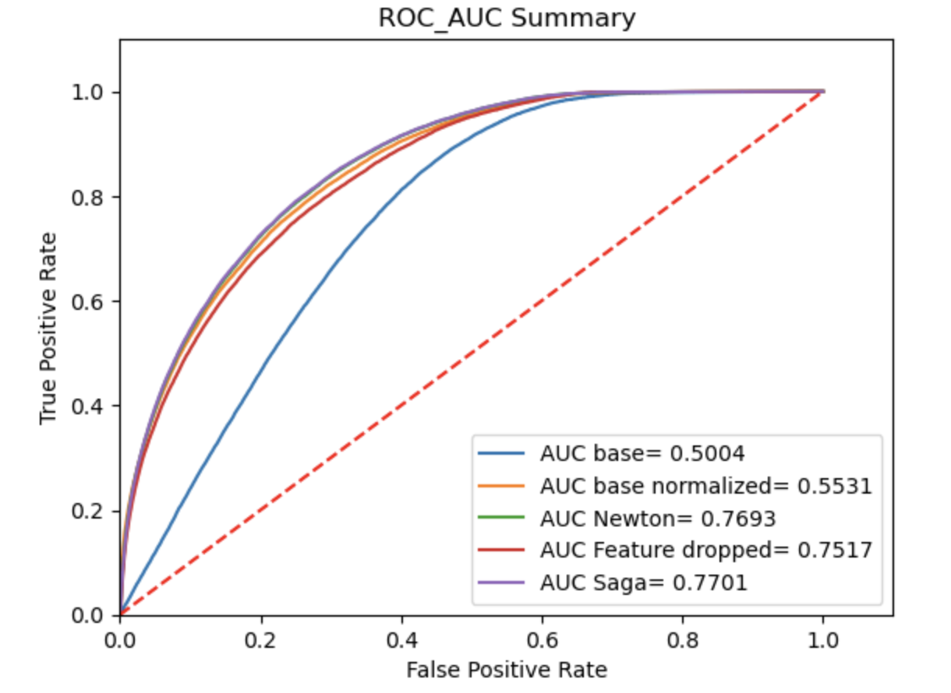
Model Performance using training set
Most accurate and precise:
base normalized
93% accuracy
70% Precision
Best recall:
newton-Cholesky: 83%
Notes:
Recall is a metric that quantifies the number of correct positive predictions made out of all positive predictions that could have been made.
Precision is a metric that measures the accuracy of positive predictions.

Slide 9
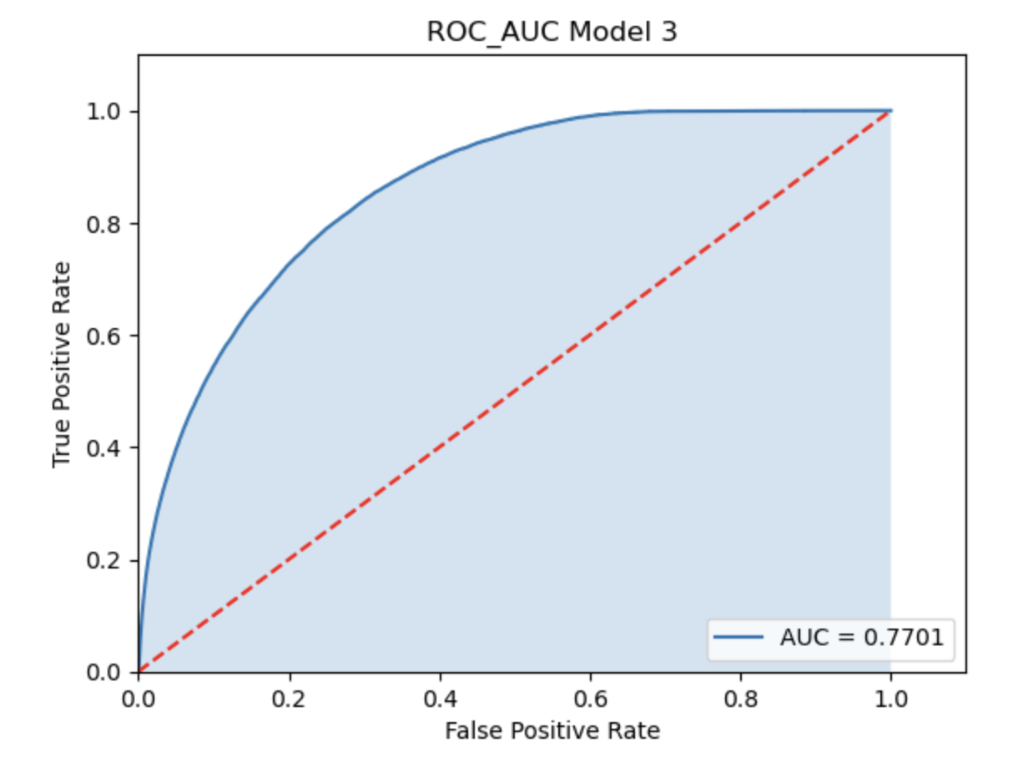
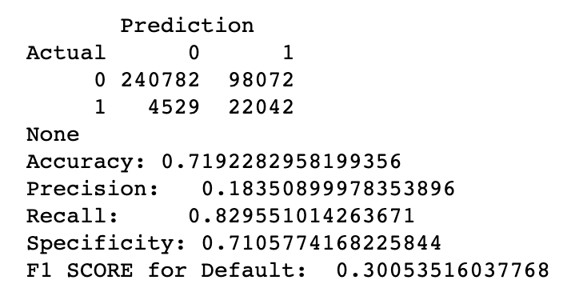
Model Selection
Saga for detection
42.9% default predicted in test
Low Precision & High Recall
Notes:
Good detection capability, but chances of false positives high.
High Precision & High Recall: Good & Balanced Model
High Precision & Low Recall: Not good in detection, but accurate when it does
Low Precision & High Recall: Good detection capability, but chances of false positives high

Slide 10
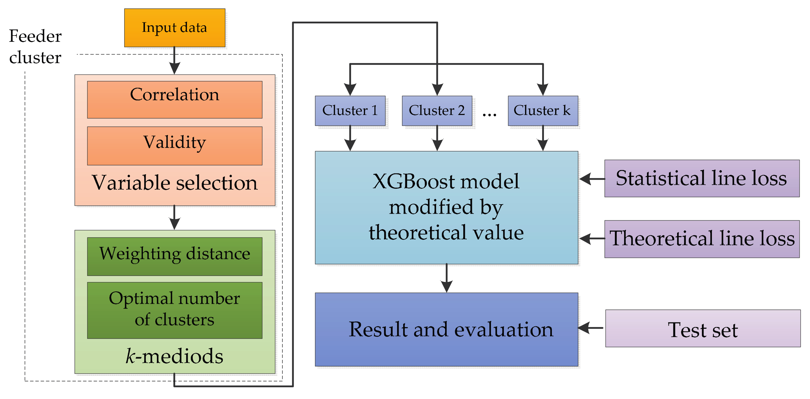
Improvements
Under-sampling
EDA:
Text mining and refining emp_title columns
Remove all rows with NaNs
Investigate geographic implications
Feature Engineering
Assign class weight
Advanced imputations
Narrow down more features (GridSearch)
XGBoost Tree
Business understanding
Source
Notes:
Different strategies can be employed
Under-sampling balances the dataset by reducing the size of the abundant class(number of accounts), when quantity of data is sufficient.
KNN imputations
Cross-validation finding the optimal parameter values from a given set of parameters in a grid.
Simple modeling
XGBoost: sophistic. combines results from multiple models
Good to synergize cross peers

Slide 11
Thank you!

