Slide 1
Database security
Access control in the EAC tariff database
Reader and editor permissions, access tests and rollback verification
Mubarak Dawood
202510537
Nabeel Suliman Ahmed Idris
202513707
Mohamed Ali MohamedTahir Ali
202513467
Maysara Dafaallh
202512952
Moaz Mohammed yacoub
202510648
Almonzer Abdullah
202512093
Asim Mohamed adam
202511198
Mustafa Omer Mustafa
202510734
NYALA 00
01
Notes:
Suggested speaking script
This presentation explains how we control access to the EAC trade tariff database in PostgreSQL. We use two roles, a reader and an editor. First, we explain their permissions. Then we show actual results from pgAdmin for both allowed and denied operations.
Key term
A role represents a set of database privileges. Our administrative session uses SET LOCAL ROLE to test each role inside a transaction.
Transition
We begin by removing general access and granting the permissions required for each task.

Slide 2
How we configure access
REVOKE removes general privileges
PUBLIC includes every PostgreSQL role. We revoke its privileges on the eac schema, tables and sequences before assigning project permissions.
GRANT gives each role the access it needs
Both roles receive schema USAGE. We then grant permissions on specific views or tables. Creating tables requires the separate CREATE privilege.
NYALA 00
02
Notes:
Suggested speaking script
We use REVOKE to remove general privileges from PUBLIC on the eac schema, its tables and its sequences. PUBLIC includes every PostgreSQL role. We then use GRANT to give our project roles specific permissions.
Explanation
Schema USAGE allows a role to access objects for which it has the necessary privileges. Creating tables requires the separate CREATE privilege. Our design follows least privilege by granting access according to each role's task.
Transition
The reader and editor therefore receive different privileges.

Slide 3
Reader and editor roles
Reader
Editor
The reader can SELECT from two reporting views. These views provide tariff details and active tariff records.
The editor can SELECT, INSERT and UPDATE the six tables. It can also read the views and use ID sequences.
Both roles use NOLOGIN. Our administrative test session switches roles with SET LOCAL ROLE. Neither role receives DELETE privilege.
NYALA 00
03
Notes:
Suggested speaking script
The reader role can SELECT from v_tariff_details and v_active_tariffs. A view is a stored query that presents data from the database. The editor can SELECT, INSERT and UPDATE the six project tables. It can also read the views and use sequences for automatically generated identifiers. We grant DELETE to neither project role.
Discussion point
Both roles use NOLOGIN. We test them by switching roles within an administrative session using SET LOCAL ROLE. We are demonstrating authorization within that session.

Slide 4
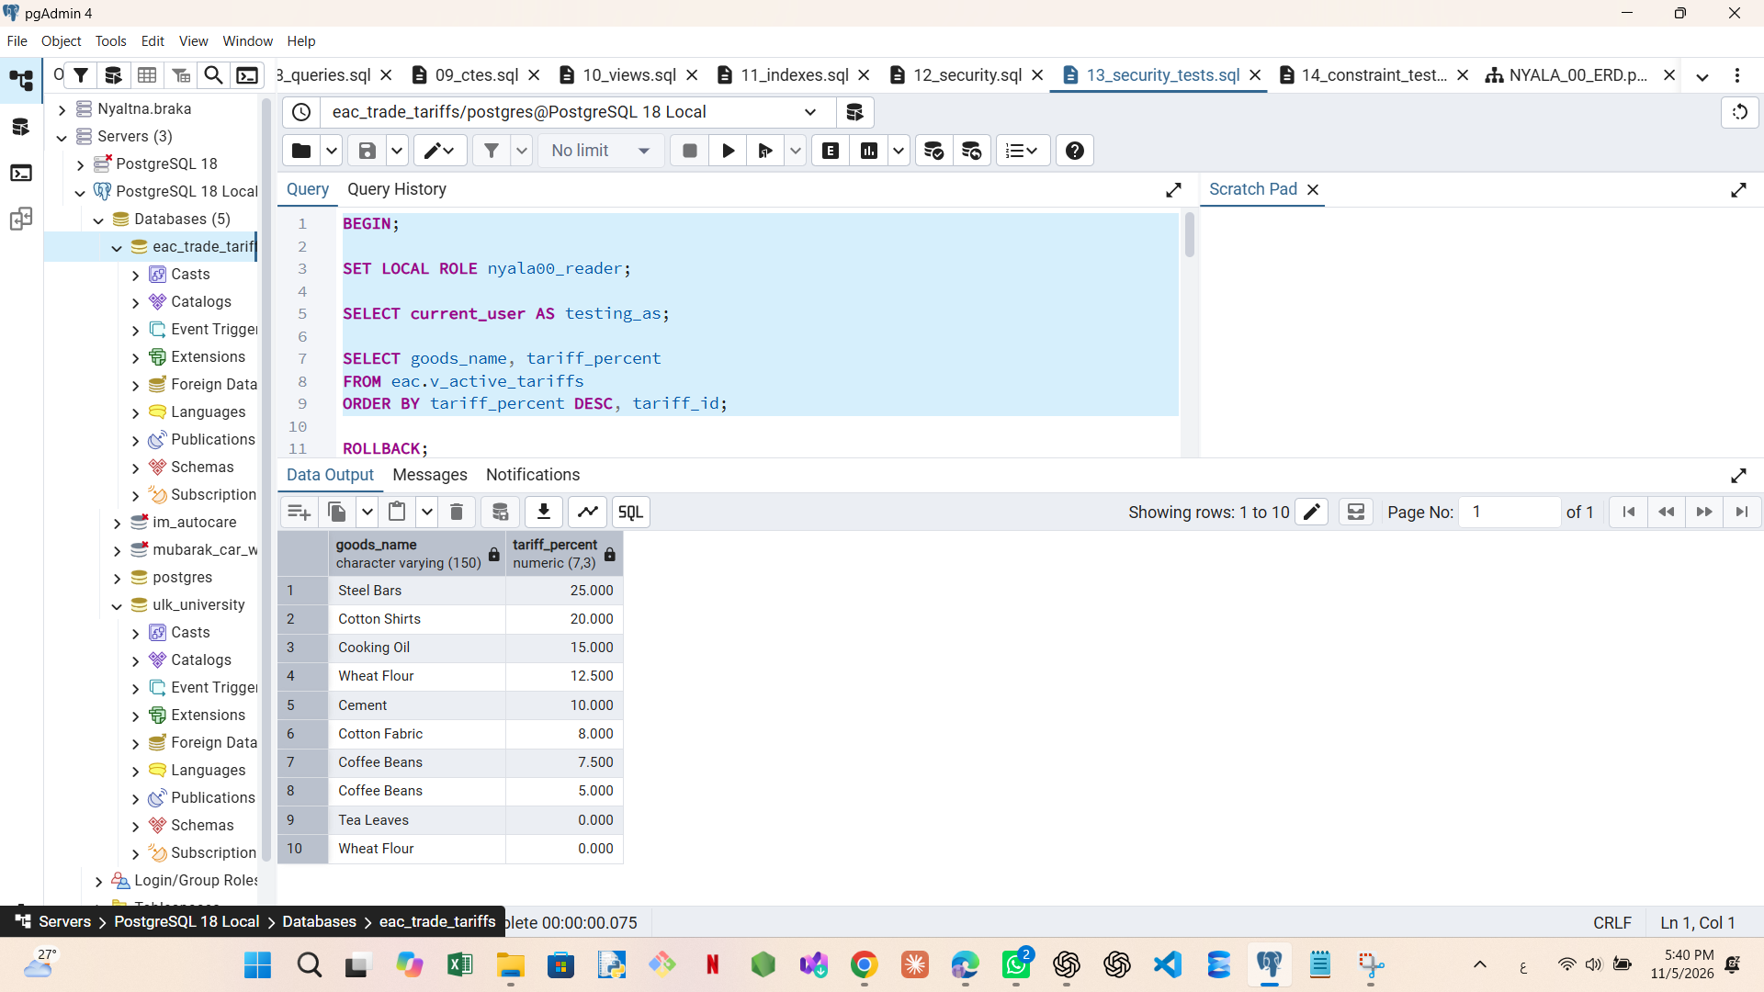
Reader test
Reading the approved view
What we tested
We switched to nyala00_reader and queried v_active_tariffs. The view returned ten records on the test date.
What it shows
The reader can retrieve data through the reporting view. Active rows depend on CURRENT_DATE.
NYALA 00
04
Notes:
Suggested speaking script
We start a transaction with BEGIN and switch to nyala00_reader. We query v_active_tariffs and receive ten rows. This confirms that the reader can access the approved reporting view.
Point to the image
Show the goods names and tariff percentages. The screenshot records ten active tariff rows on the test date. The view uses CURRENT_DATE, so its results may change over time.
Transition
Next, we test whether the reader can access the underlying tariff table directly.

Slide 5
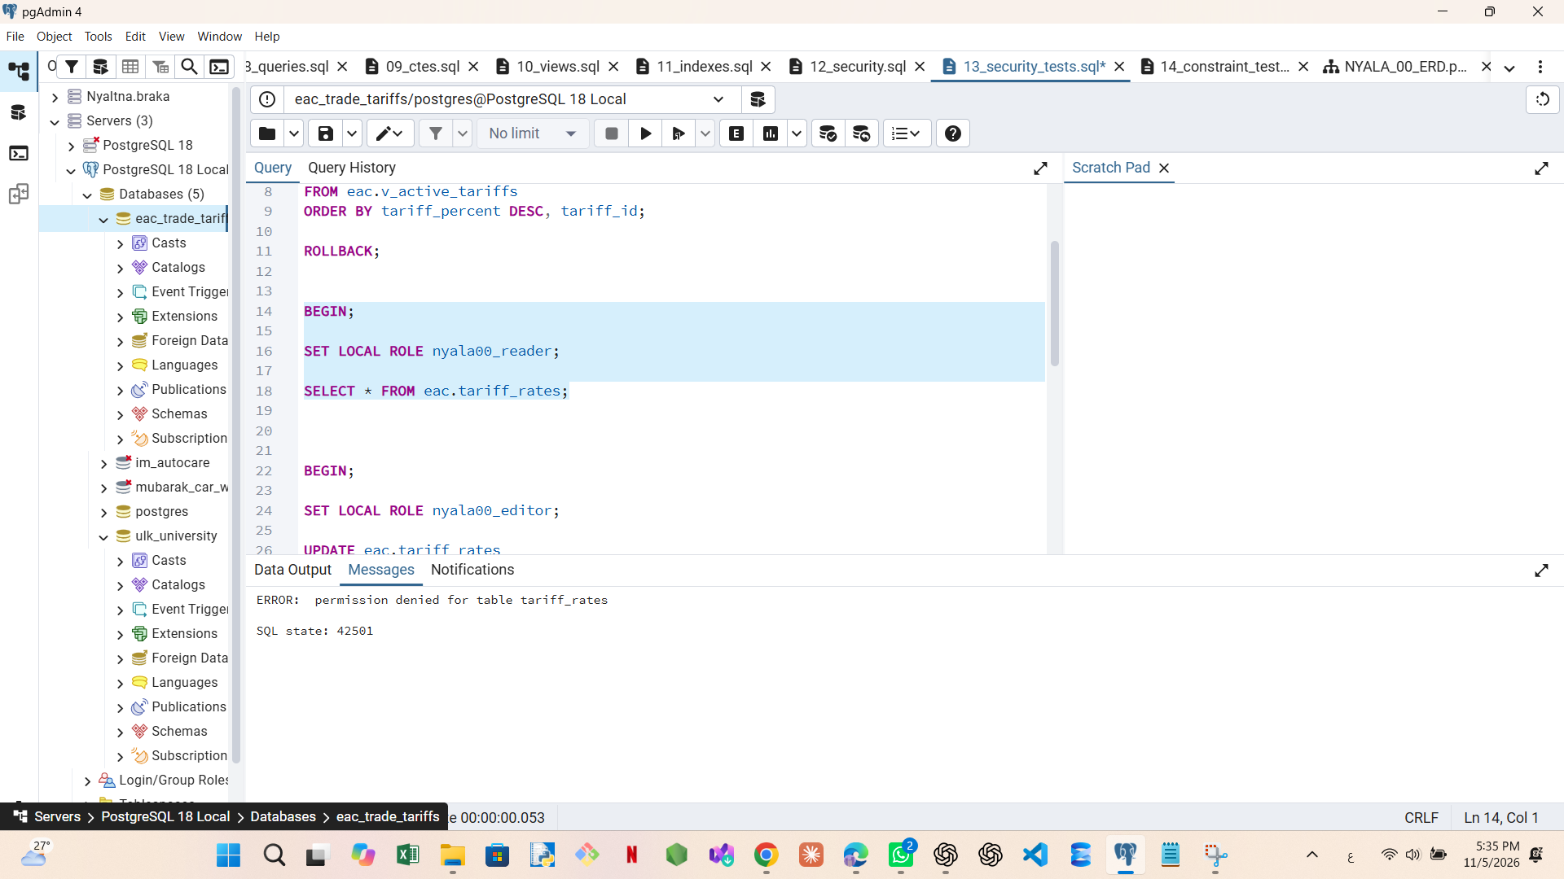
Reader test
Direct table access
The reader attempted SELECT directly on eac.tariff_rates. PostgreSQL rejected the request because the reader has no SELECT privilege on that table.
SQLSTATE 42501 means insufficient privilege.
NYALA 00
05
Notes:
Suggested speaking script
Using the reader role, we attempt SELECT directly on eac.tariff_rates. PostgreSQL rejects the statement with permission denied and SQLSTATE 42501. This code means insufficient privilege. The rejection is the expected result because we granted the reader access to the reporting views.
Point to the image
Identify the table name and the SQLSTATE in the error message.
Transaction handling
After recording the expected error, we execute ROLLBACK separately to end the failed transaction before continuing.

Slide 6
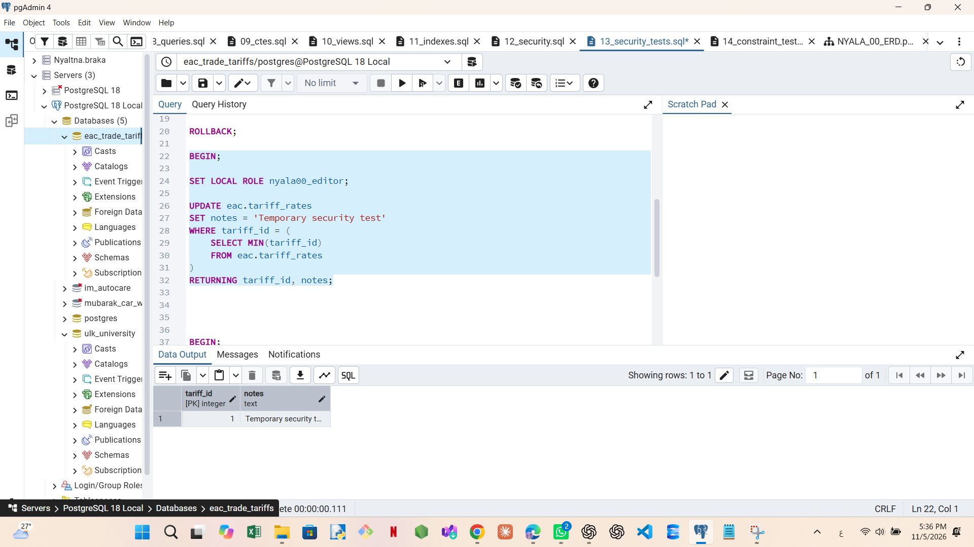
Editor test
Updating a tariff
We used UPDATE as nyala00_editor to change the notes field of one tariff record. RETURNING displayed tariff_id 1 with the temporary note.
The returned row confirms that UPDATE is allowed. We then used ROLLBACK to undo the temporary change.
NYALA 00
06
Notes:
Suggested speaking script
We switch to nyala00_editor and test UPDATE. We temporarily change the notes field of one tariff record to Temporary security test. The RETURNING clause displays the affected record. The screenshot shows tariff_id 1 and the temporary note, confirming that the editor can update the record.
Discussion point
The update runs inside a test transaction. After capturing the result, we use ROLLBACK to undo the temporary change.
Transition
We then check whether the editor has permission to delete tariff records.

Slide 7
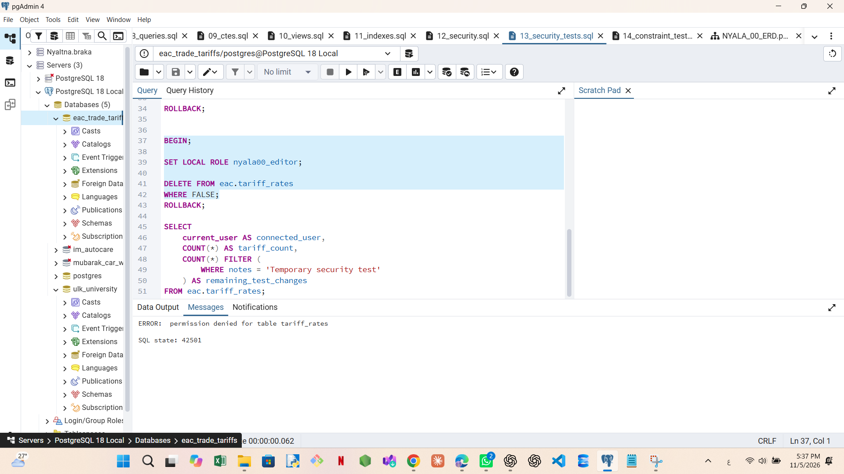
Editor test
Attempting a delete
The editor attempted DELETE with WHERE FALSE, which matches no rows. PostgreSQL still checked the DELETE privilege and rejected the request.
SQLSTATE 42501 confirms that DELETE is denied.
NYALA 00
07
Notes:
Suggested speaking script
We attempt DELETE as the editor role. The WHERE FALSE condition matches no rows. PostgreSQL still checks DELETE permission and rejects the statement with SQLSTATE 42501. This confirms that the editor lacks DELETE privilege on tariff_rates.
Point to the image
Show the permission denied message and the table name.
Transaction handling
We execute ROLLBACK separately after capturing the error, then continue to the final data check.

Slide 8
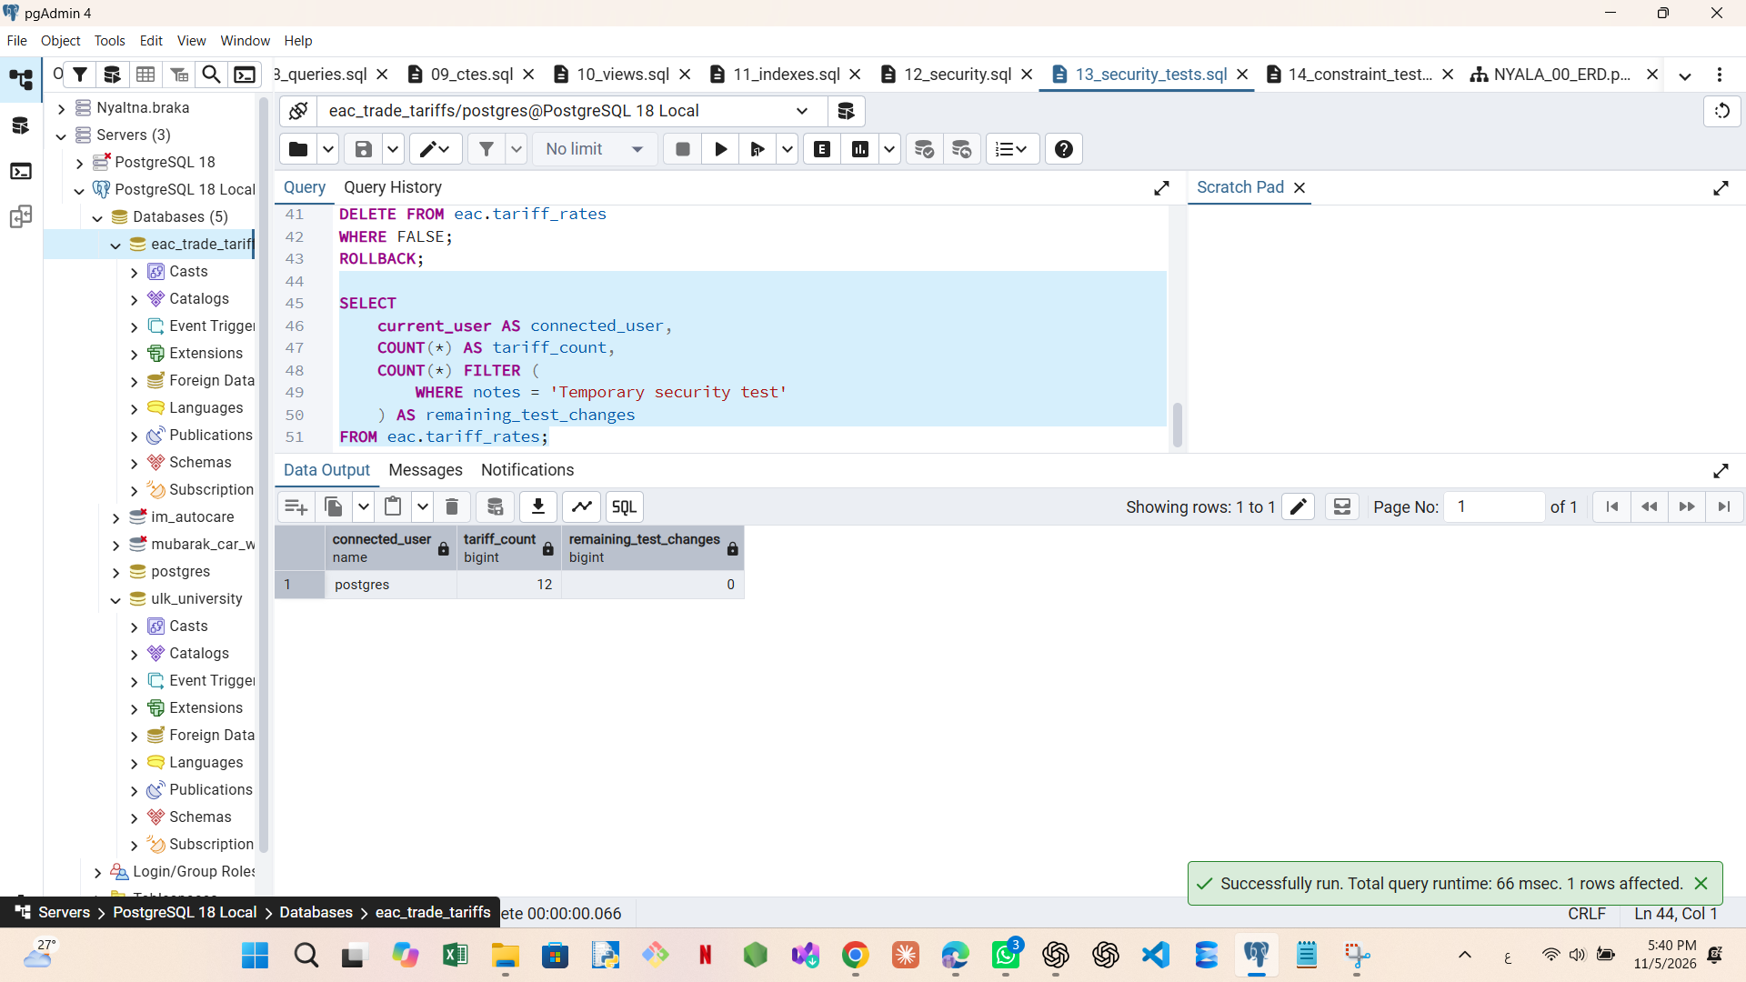
Rollback and the final check
ROLLBACK ends each test transaction and reverses its temporary row changes. It also restores the previous role after SET LOCAL ROLE.
The final query shows 12 tariff records and zero remaining temporary edits. The session is back under postgres.
NYALA 00
08
Notes:
Suggested speaking script
After rolling back the test transactions, we inspect the tariff table. The final result shows the current user as postgres, twelve tariff records and zero remaining temporary edits. This confirms that the temporary note change was removed.
Closing explanation
The tests demonstrate reader access to the view, editor access for an update, denial of direct table access for the reader and denial of DELETE for the editor. Each test transaction ends with a rollback.
Possible discussion question
These tests demonstrate role privileges through SET LOCAL ROLE. Independent login and password tests would require dedicated login accounts and sessions.

