Slide 1
SQL DATABASE PROJECT
Rwanda Mobile Money Transactions
Designing, populating and querying a PostgreSQL database for wallets, transfers and agents

Slide 2
Group_ members
Names Roll_numbers
Jesse Binja 202512173
Giscard Bahati 202520363
Sylvan Madula 202520770
Nathan Poma 202520534
John Prosper 202520487
Inioluwa Edwards 202511270
Shem M, Yarway 202412174

Slide 3
Project overview
Scenario
What we built
Tools
A mobile money service in Rwanda: customers hold RWF wallets, send transfers to each other, and deposit or withdraw cash through agents.
A 6-table relational schema, 20 sample records per table, 45 numbered SQL tasks, 4 indexes and database health checks.
PostgreSQL, SQL scripts organised in /sql and /sample_data, shared through the central GitHub repository.

Slide 4
Database design: six related tables
agents
customers
wallets
agent_id (PK)
first_name, last_name
phone_number (UNIQUE)
locations
registration_date
customer_id (PK)
first_name, last_name
phone_number (UNIQUE)
national_id (UNIQUE)
registration_date
wallet_id (PK)
customer_id (FK, UNIQUE)
balance
currency
status
transfers
transaction_history
agent_transactions
transfer_id (PK)
sender_wallet_id (FK)
receiver_wallet_id (FK)
amount, transaction_fee
transfer_date, status
history_id (PK)
wallet_id (FK)
transaction_type, amount
previous_balance, new_balance
transaction_date
agent_transaction_id (PK)
agent_id (FK), wallet_id (FK)
transaction_type
amount
transaction_date

Slide 5
Data integrity built into the schema
Primary key on every table; foreign keys tie wallets to customers and all activity to wallets and agents
UNIQUE phone numbers and national IDs; one wallet per customer
CHECK rules: balance >= 0, amount > 0, fee >= 0, sender and receiver must differ
Controlled statuses: wallets Active / Suspended / Closed, transfers Successful / Failed / Pending, agents Deposit / Withdrawal
NUMERIC(15,2) for money, DEFAULT RWF currency and CURRENT_TIMESTAMP dates
Execution order
1. 01_create_tables (drops, then creates)
2. Sample data: agents, customers, wallets, transfers, history, agent transactions
3. 02_basic_sql_queries
4. 03_indexing

Slide 6
Key results from the queries
301,000
18,812.5
3,010
RWF moved by 16 successful transfers (Task 11)
RWF average successful transfer (Task 12)
RWF in fees on successful transfers (Task 23)
174,000 / 97,000
2,260,000
40,000
RWF total across all 20 wallets (Task 17)
RWF largest transfer, sent by David Nkurunziza (Tasks 13, 21)
RWF agent deposits vs withdrawals (Tasks 26-27)
Also found: 4 customers never completed a successful transfer; Kigali has the most agents (5 of 20).

Slide 7
Sample data at a glance
20
records in each of the 6 tables
16 / 3 / 1
transfers Successful / Failed / Pending
19 / 1
wallets Active / Suspended
1-10 Oct 2026
period covered by transfers

Slide 8
45 SQL tasks from basic to advanced
Basic | Tasks 1-10
Intermediate | Tasks 11-20
Advanced | Tasks 21-32
SELECT, WHERE, ORDER BY and INNER JOIN to list agents, customers, wallets and filter transfers by status
SUM, AVG, MIN, MAX, COUNT, GROUP BY and LIMIT for totals, averages and top-5 rankings
Multi-table joins, NOT EXISTS, HAVING, DATE_TRUNC and sender/receiver self-joins
Task 21: customer who sent the highest total
SELECT c.first_name, c.last_name, SUM(t.amount) AS total_sent
FROM customers c
JOIN wallets w ON c.customer_id = w.customer_id
JOIN transfers t ON w.wallet_id = t.sender_wallet_id
WHERE t.status = 'Successful'
GROUP BY c.customer_id, c.first_name, c.last_name
ORDER BY total_sent DESC LIMIT 1;

Slide 9
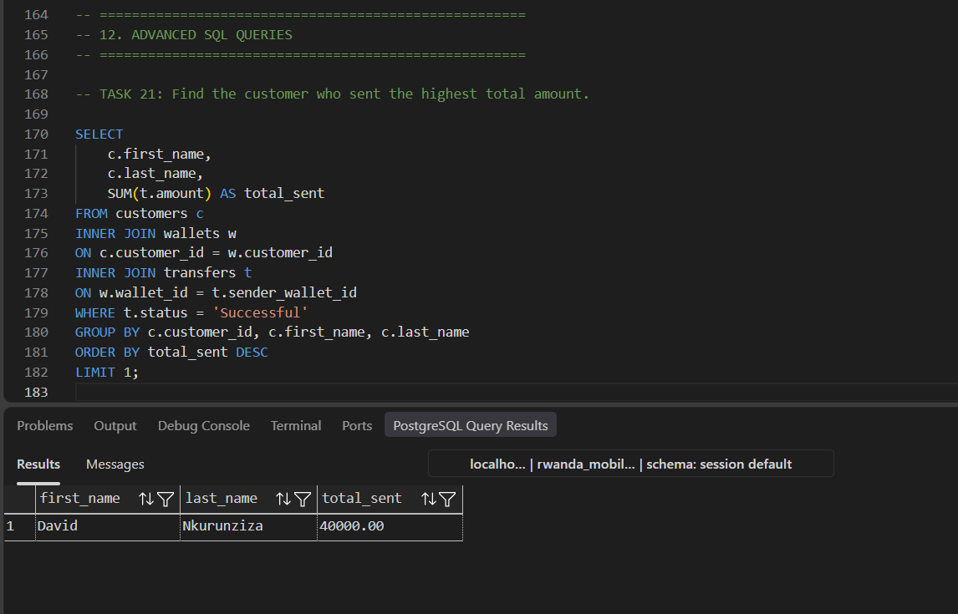

Slide 10
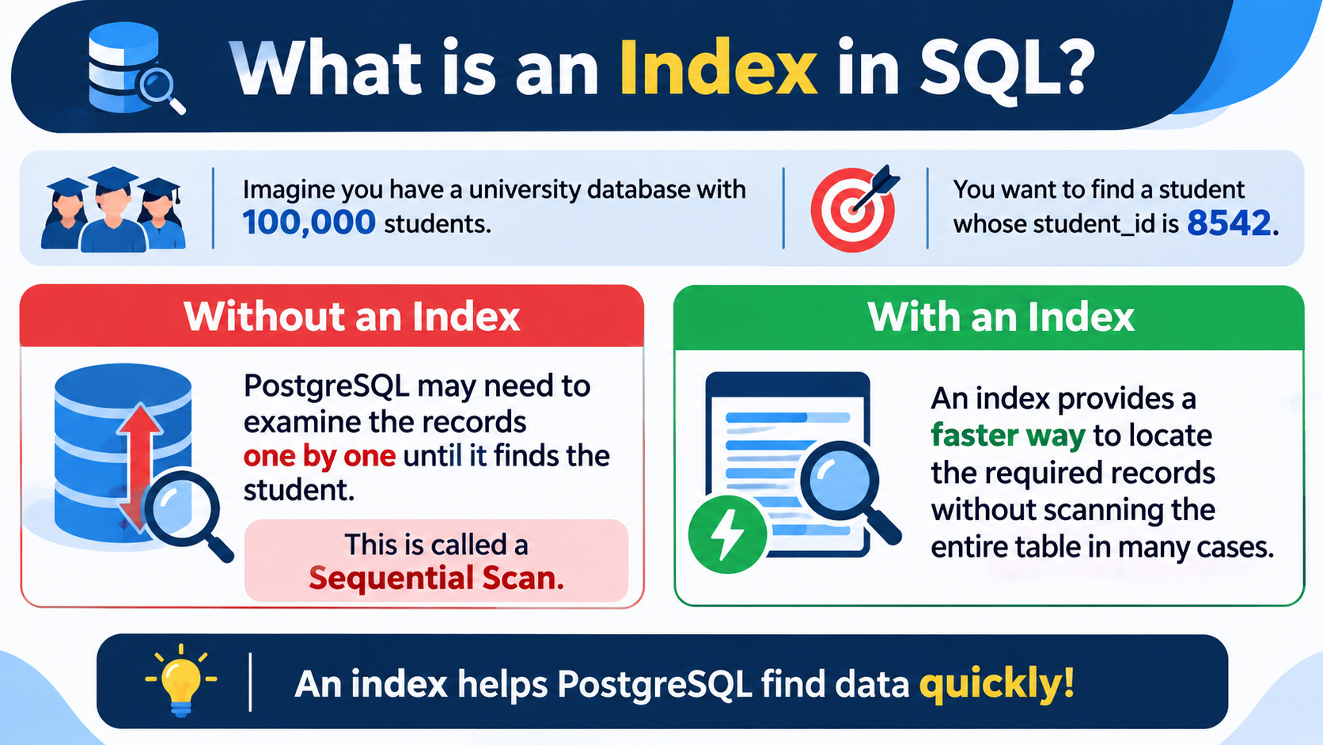

Slide 11


Slide 12
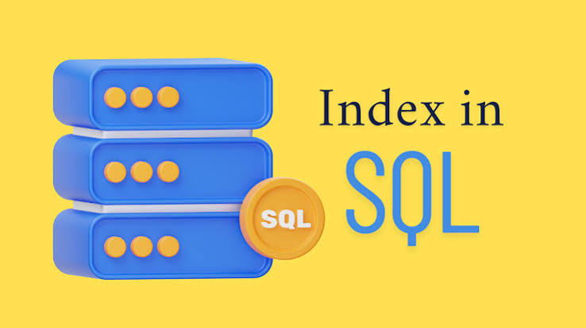
SQL
DEFINITION
An index is a database object that stores an organized structure of values from one or more table columns, together with references to the corresponding rows.
MAIN PURPOSE :
Its primary purpose is to improve data retrieval performance.

Slide 13
Indexing, updates and database checks
Indexes (Tasks 33-37)
Updates and ALTER (38-45)
Health checks
idx_customer_phone
idx_wallet_balance
idx_transfer_date
idx_transfer_status
EXPLAIN ANALYZE to measure query performance
Update a wallet balance
Change an agent location
Suspend a wallet
ADD COLUMN email to customers
Customer transaction history and suspended-wallet report
Record count per table using UNION ALL
pg_indexes lists every index in the public schema
Counts and totals cross-checked against the sample data

Slide 14
What we delivered
A normalized 6-table schema with keys and constraints that protect the data
Consistent sample data covering customers, wallets, transfers and agents
45 queries from simple filters to multi-table analytics, plus indexing and checks
All scripts and documentation versioned in the central GitHub repository
Thank you. Questions?

