Slide 1

Shri Vishnu Engineering College for Women::Bhimavaram (Autonomous) Department of Computer Science and Engineering
BLOCK CHAIN BASED SUPPLY CHAIN MANAGEMENT SYSTEM
IV B.Tech II Sem Project presentation
By
P.Sanjana (20B01A05F6)
R.Sanjana (20B01A05F7)
U.Jahnavi (20B01A05H2)
V.Sylvia Anand (20B01A05I4)
Y.MahaLakshmi (20B01A05J2)
Under the guidance of
Mr. M. V. V Rama Rao
(Assistant Professor)
REVIEW NO: 4
Date: 28-02-2024
Department of Computer Science and Engineering Slide No:1
2023-2024

Slide 2
INTRODUCTION
Supply chain management (SCM) is the process of managing the flow of goods and services to and from a business, including every step involved in turning raw materials and components into final products and getting them to the ultimate customer.
Integration, operations, purchasing, and distribution are the four elements of the supply chain that work together to establish a path to competition that is both cost-effective and competitive.
We mainly focus on customers and sellers where the product details will be displayed i.e. when it is manufactured.
Department of Computer Science and Engineering Slide No:2
2023-2024

Slide 3
OBJECTIVES
Cost Reduction: Streamlining processes to minimize expenses across the supply chain, including procurement, production, transportation, and inventory management.
Improved Efficiency: Enhancing productivity by optimizing operations, reducing waste, and maximizing the use of resources at every stage of the supply chain.
Enhanced Customer Service: Ensuring products are available when and where customers want them, leading to increased satisfaction and loyalty.
Better Collaboration: Fostering stronger relationships and cooperation among suppliers, manufacturers, distributors, and retailers to improve communication and overall performance.
Department of Computer Science and Engineering Slide No:3
2023-2024

Slide 4

Detailed Explanation of Objectives:
Enhanced Transparency:
All participants in the network can access the blockchain and verify the transactions recorded on it. This transparency increases trust among participants as they can independently validate the data and ensure its accuracy.
Smart contracts:
Smart contracts enhance trust in data transactions by eliminating the need for intermediaries and providing transparency in the execution of contracts.
2023-2024 Department of Computer Science and Engineering Slide No: 4

Slide 5
Decentralisation:
Blockchain Eliminates the need for a central authority. This decentralized structure enhances trust as it removes the dependence on a single point of control and minimizes the risk of data manipulation or unauthorized access.
Immutability:
Blockchain's inherent nature as a distributed ledger makes it difficult to remove or modify data once it is recorded.
2023-2024 Department of Computer Science and Engineering Slide No: 5

Slide 6
Problems in Existing System:
Data Security
Lack of transparency
Inaccurate data
Complex Documentation
Counterfeit products
Slow settlements
2023-2024 Department of Computer Science and Engineering Slide No: 6

Slide 7
Problem Statement Identification:
In order to improve efficiency and security, we are incorporating blockchain technology into standard supply chain management.
Blockchain increases the transparency of every transaction by guaranteeing immutable transactions and providing security.
Our project is creating a blockchain website that incorporates Ethereum technology. With the help of the Ethereum network protocol, users may design and execute smart contracts across a decentralized network.
Ethereum does away with the requirement for a middleman to manage peer-to-peer transactions.
2023-2024 Department of Computer Science and Engineering Slide No: 7

Slide 8
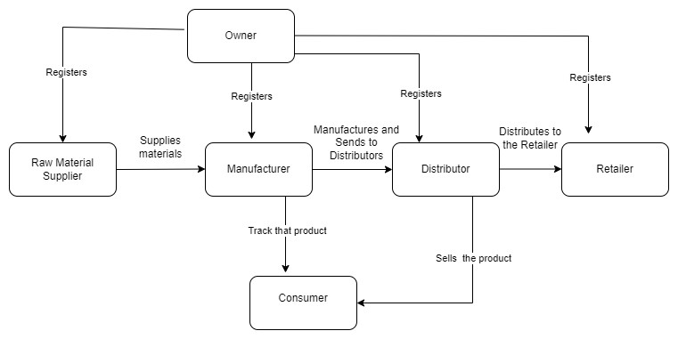
DESIGN
Architectural Design:
Department of Computer Science and Engineering Slide No:8
2023-2024

Slide 9
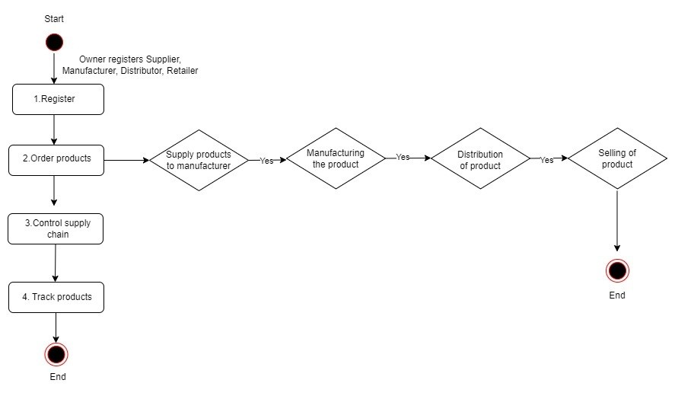
DESIGN
Activity Diagram:
Department of Computer Science and Engineering Slide No:9
2023-2024

Slide 10
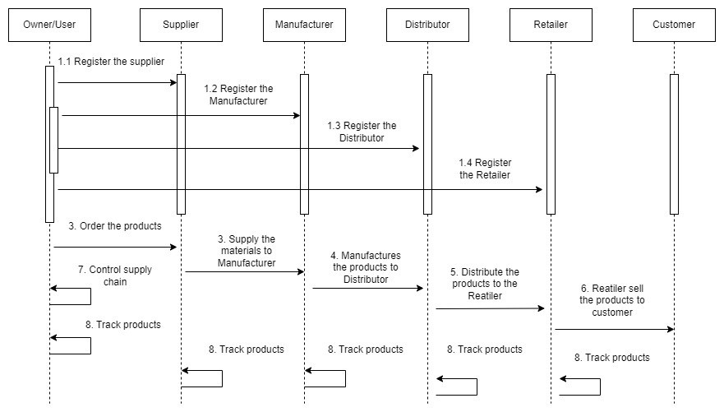
DESIGN
Sequence Diagram:
Department of Computer Science and Engineering Slide No:10
2023-2024

Slide 11
FUNCTIONALITIES
Module 1 :
Owner Module :
In this module, the owner will register himself monitor and modifies
the details of the products.
Registers the Retailers, manufacturers, raw material suppliers, distributors.
Owner can only order the product so that it can be made ready by all the performers except him. Owner can also track the product.
Department of Computer Science and Engineering Slide No:11
2023-2024

Slide 12
FUNCTIONALITIES
Module 2 :
Raw material supplier Module:
The raw material supplier can be added by the owner.
Then, when the owner added him he can supply the materials needed for the product using the id and can track the products too.
Department of Computer Science and Engineering Slide No:12
2023-2024

Slide 13
FUNCTIONALITIES
Module 3 :
Manufacturer Module :
The Manufacturer can be added by the owner.
Then when the owner added him he can get the materials needed for the product from the raw material suppliers using the id and he manufactures it and he can track the products too.
Department of Computer Science and Engineering Slide No:13
2023-2024

Slide 14
FUNCTIONALITIES
Module 4 :
Distributor Module:
The Distributor can be added by the owner.
Then when the owner added him he can get the product which is manufactured by the manufacturer using the id and he distributes it to the retailer for selling the products and he can track the products too.
Department of Computer Science and Engineering Slide No:14
2023-2024

Slide 15
FUNCTIONALITIES
Module 5 :
Retailer Module:
The retailer can be added by the owner.
Then when the owner added him he can get the product which is distributed by the distributor using the id and he sells that product to the customers.
Department of Computer Science and Engineering Slide No:15
2023-2024

Slide 16
Problem Statement Identification:
In order to improve efficiency and security, we are incorporating blockchain technology into standard supply chain management.
Blockchain increases the transparency of every transaction by guaranteeing immutable transactions and providing security.
Our project is creating a blockchain website that incorporates Ethereum technology. With the help of the Ethereum network protocol, users may design and execute smart contracts across a decentralized network.
Ethereum does away with the requirement for a middleman to manage peer-to-peer transactions.
2023-2024 Department of Computer Science and Engineering Slide No: 16

Slide 17
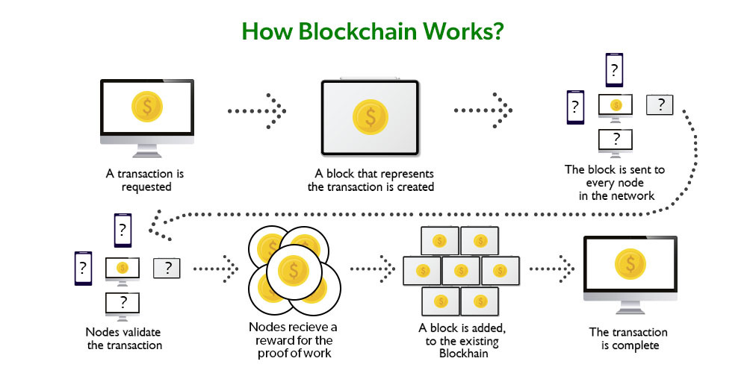
Blockchain Architecture :
2023-2024 Department of Computer Science and Engineering Slide No:17

Slide 18
TECHNICAL SKILLS FOR SYSTEM DEVELOPMENT
Ganache:
Ganache provides a simplified blockchain setup that allows developers to create a personal Ethereum blockchain, offering various features beneficial for the development process:
Local Blockchain
Customizable Blockchain Configuration
Preloaded Accounts
Built-in User Interface
Integration with Development Tools
Department of Computer Science and Engineering Slide No:18
2023-2024

Slide 19
TECHNICAL SKILLS FOR SYSTEM DEVELOPMENT
Metamask:
MetaMask is a popular cryptocurrency wallet and gateway to the decentralized webMetaMask is designed to simplify interaction with the Ethereum blockchain and decentralized applications (dApps) while providing users with control over their digital assets and online identities.
Browser Extension
User-Friendly Interface
Decentralized Application (dApp) Access
Security Features
Department of Computer Science and Engineering Slide No:19
2023-2024

Slide 20
TECHNICAL SKILLS FOR SYSTEM DEVELOPMENT
Solidity:
Solidity is a high-level programming language primarily used for developing smart contracts on blockchain platforms, notably Ethereum
Solidity is an object-oriented language, making it easier for developers to organize and manage code by using features like inheritance, libraries, and user-defined data structures.
Solidity syntax is similar to JavaScript and C++, making it more accessible for developers familiar with these languages.
Department of Computer Science and Engineering Slide No:20
2023-2024

Slide 21
DESIGN COMPARISONS
Blockchain implementation in supply chain management is possible in several ways. When implementing blockchain in supply chain management, there are numerous programming languages and technologies to select from.
For decentralized application:
Web3.0
Ethereum
For transactions:
Hardhat
Ganache
Department of Computer Science and Engineering Slide No:21
2023-2024

Slide 22
DESIGN COMPARISONS
Web3.0:
Web3.0, the next evolutionary phase of the internet, represents a paradigm shift towards a decentralized and user-centric digital landscape.
User Empowerment
Improved Privacy
Global Accessibility
Interoperability
Department of Computer Science and Engineering Slide No:22
2023-2024

Slide 23
DESIGN COMPARISONS
Ethereum:
Ethereum is a decentralized blockchain platform that enables the creation and execution of smart contracts, self-executing agreements with coded terms.
Decentralization
Smart Contracts
Immutable Ledger
Standards and Protocols
Interoperability
Department of Computer Science and Engineering Slide No:23
2023-2024

Slide 24
DESIGN COMPARISONS
Hardhat:
Hardhat is a development environment and task runner for Ethereum that is designed to streamline and enhance the smart contract development process.
Task Automation
Built-in Testing Environment
Network Support
Gas Reporting
Department of Computer Science and Engineering Slide No:24
2023-2024

Slide 25
SYSTEM DESIGN IMPROVEMENTS
Ganache:
Here's how the use of Ganache can enhance system design:
Rapid Prototyping and Development
Controlled Testing Environment
Improved Collaboration and Testing
Enhanced Security and Code Quality
Learning and Educational Purposes
Department of Computer Science and Engineering Slide No:25
2023-2024

Slide 26
IMPLEMENTATION
Major Modules:
Registration – Here all the actors involved in the supply chain register themselves : Assignroles.js
Ordering products – Here the consumers order their required products : Addproduct.js
Control supply chain – Here the supply chain process is controlled and each actor updates the details about the product delivery : supply.js
Tracking products – Here the products can be tracked with the help of a tracking ID. It shows the whole history of the project : Track.js
Department of Computer Science and Engineering Slide No:26
2023-2024

Slide 27
IMPLEMENTATION
Major Modules:
Registration – Here all the actors involved in the supply chain register themselves : Assignroles.js
Ordering products – Here the consumers order their required products : Addmed.js
Control supply chain – Here the supply chain process is controlled and each actor updates the details about the product delivery : supply.js
Tracking products – Here the products can be tracked with the help of a tracking ID. It shows the whole history of the project : Track.js
Department of Computer Science and Engineering Slide No:27
2023-2024

Slide 28
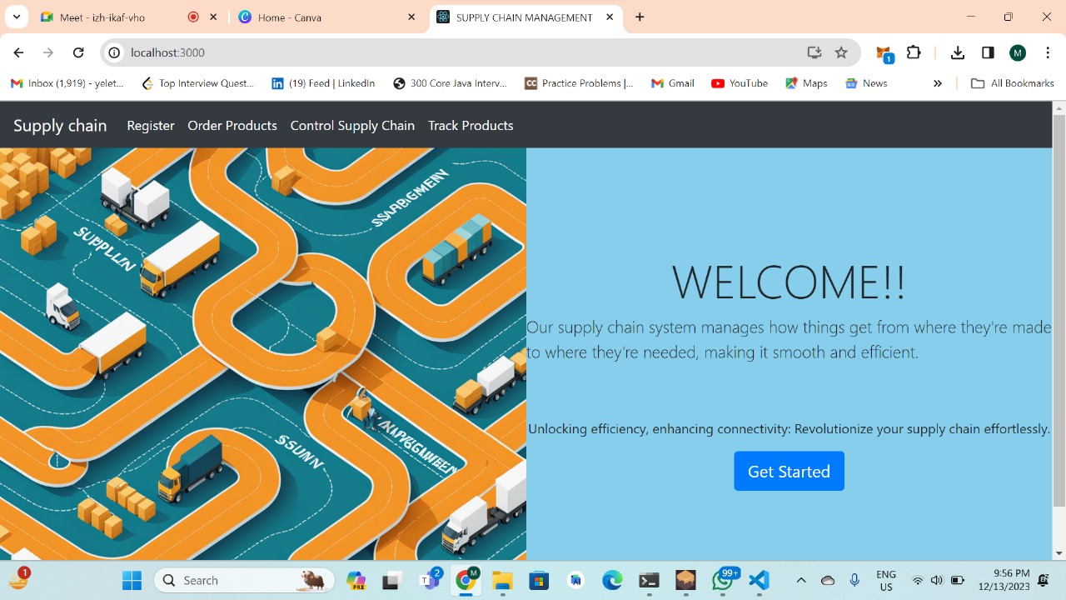
PRELIMINARY RESULTS
Department of Computer Science and Engineering Slide No:28
2023-2024

Slide 29
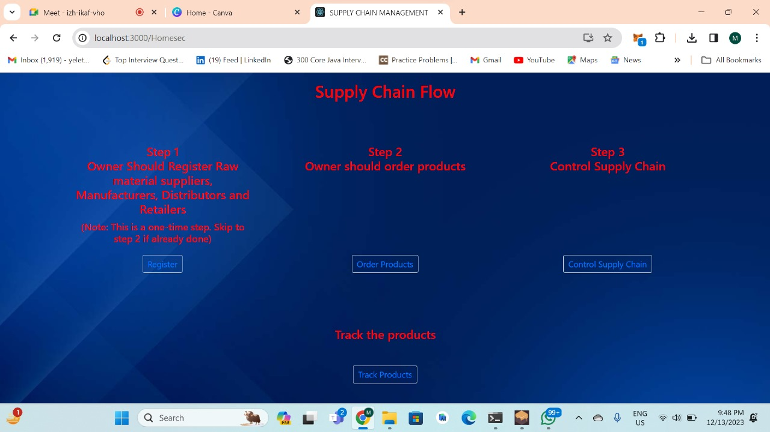
PRELIMINARY RESULTS
Department of Computer Science and Engineering Slide No:29
2023-2024

Slide 30
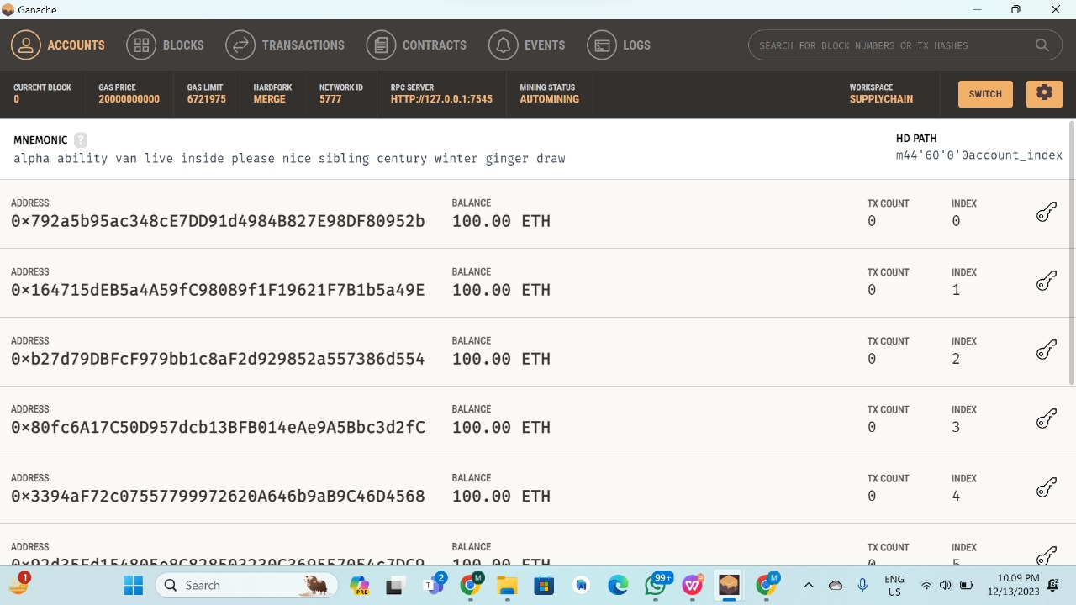
PRELIMINARY RESULTS
Department of Computer Science and Engineering Slide No:30
2023-2024

Slide 31
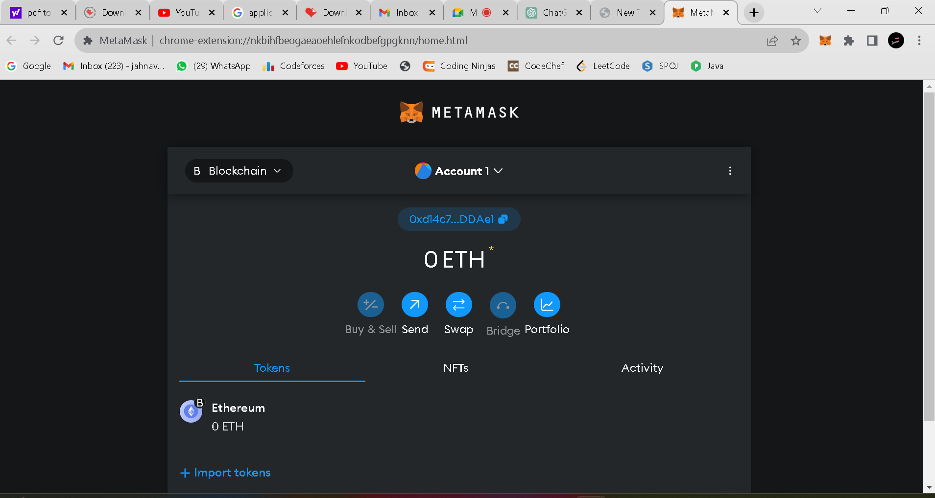
PRELIMINARY RESULTS
Department of Computer Science and Engineering Slide No:31
2023-2024

Slide 32
Literature Survey:
Shuchih Ernest Chang - When Blockchain Meets Supply Chain: A Systematic Literature Review on Current Development and Potential Applications
Source: https://www.researchgate.net/publication/340214661_When_Blockchain_Meets_Supply_Chain_A_Systematic_Literature_Review_on_Current_Development_and_Potential_Applications
Observation: This is the survey where there is analysis of the extent of supply chain management in the block chain technology to a rather diverse focus on industrial applications, managerial implications, and social impact.
2023-2024 Department of Computer Science and Engineering Slide No:32

Slide 33
2.Amulya Gurtu - Potential of blockchain technology in supply chain management
Source: https://www.researchgate.net /publication/337167325_Pote ntial_of_blockchain_technolo gy_in_supply_chain_manage ment_a_literature_review_A mulya_Gurtu
Observation:This paper mainly deals with the imperative role of blockchain technology that has created a discourse in the world of innovation and technology. This paper helped us to further our understanding of blockchain technology. Blockchain technology will provide transparency to consumers. This paper presents the first review of blockchain technology and delves into its value in SCM.
2023-2024 Department of Computer Science and Engineering Slide No: 33

Slide 34
ATTAINMENT OF OBJECTIVES
Enhanced Transparency
Smart contracts
Decentralization
Immutability
Efficient payments
Peer to Peer communication
Department of Computer Science and Engineering Slide No:34
2023-2024

Slide 35
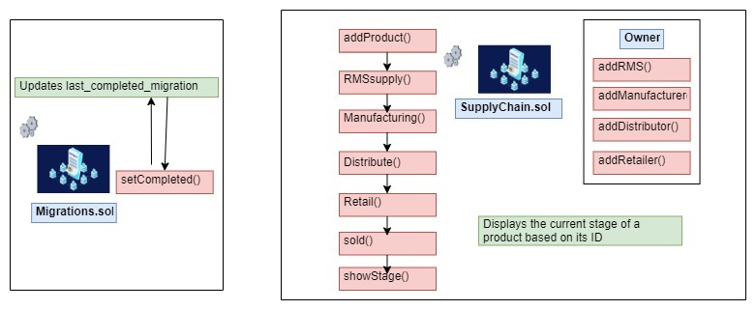
ATTAINMENT OF OBJECTIVES
Smart Contracts:
Blockchain facilitates smart contracts, self-executing agreements with predefined rules, ensuring transaction trust and automation.
Department of Computer Science and Engineering Slide No:35
2023-2024

Slide 36
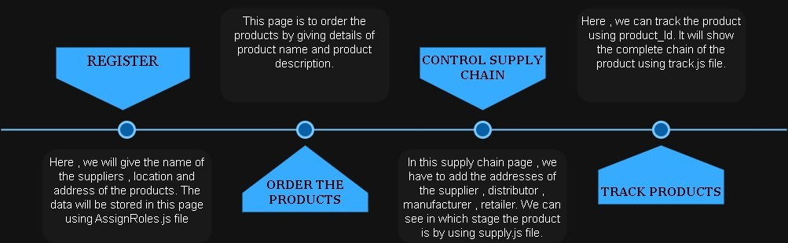
ATTAINMENT OF OBJECTIVES
Immutability :
Blockchain ensures immutability by cryptographically linking and securing blocks, preventing unauthorized changes to historical data.
Department of Computer Science and Engineering Slide No:36
2023-2024

Slide 37
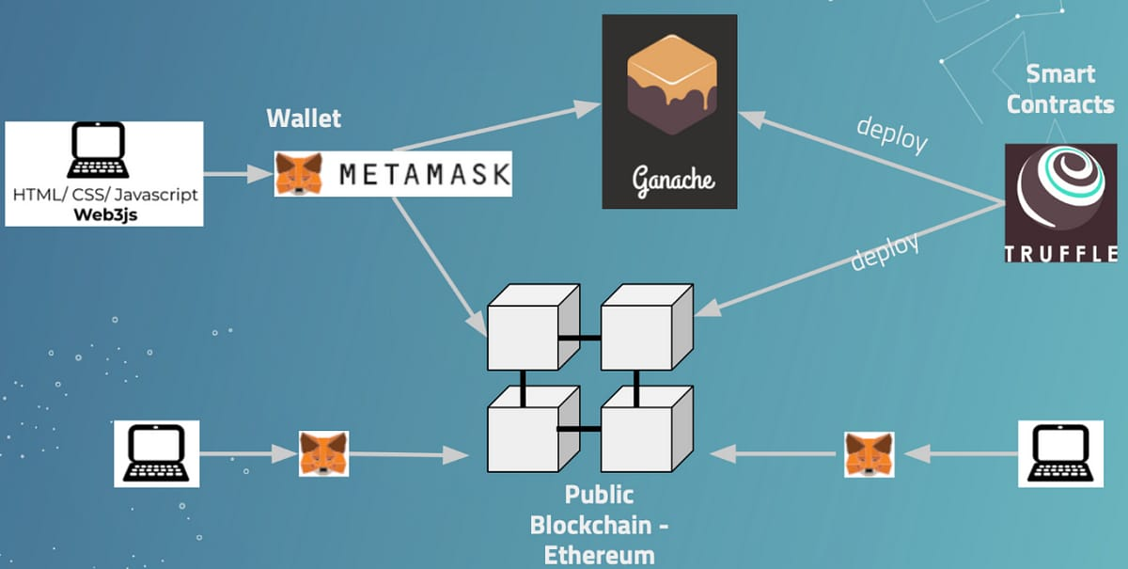
ATTAINMENT OF OBJECTIVES
Efficient payments :
Blockchain enables efficient payments by providing a decentralized, secure, and transparent platform for fast and cost-effective transactions.
Department of Computer Science and Engineering Slide No:37
2023-2024

Slide 38
ATTAINMENT OF OBJECTIVES
Peer to Peer communication:
Blockchain facilitates peer-to-peer communication by eliminating the need for intermediaries, enabling direct and secure transactions between participants.
Department of Computer Science and Engineering Slide No: 38
2023-2024

Slide 39
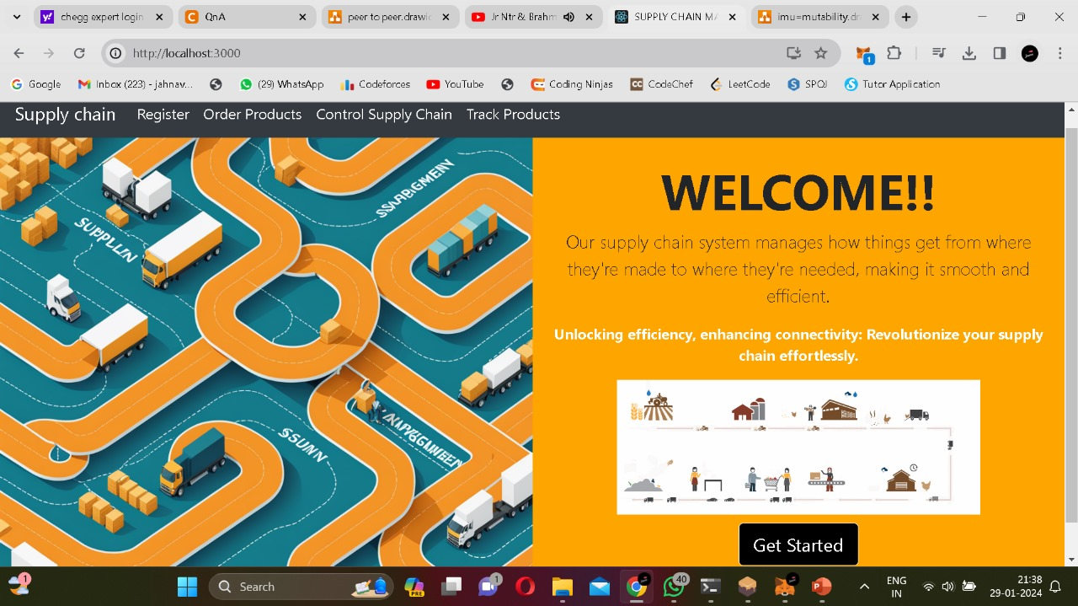
RESULTS
Department of Computer Science and Engineering Slide No:39
2023-2024

Slide 40
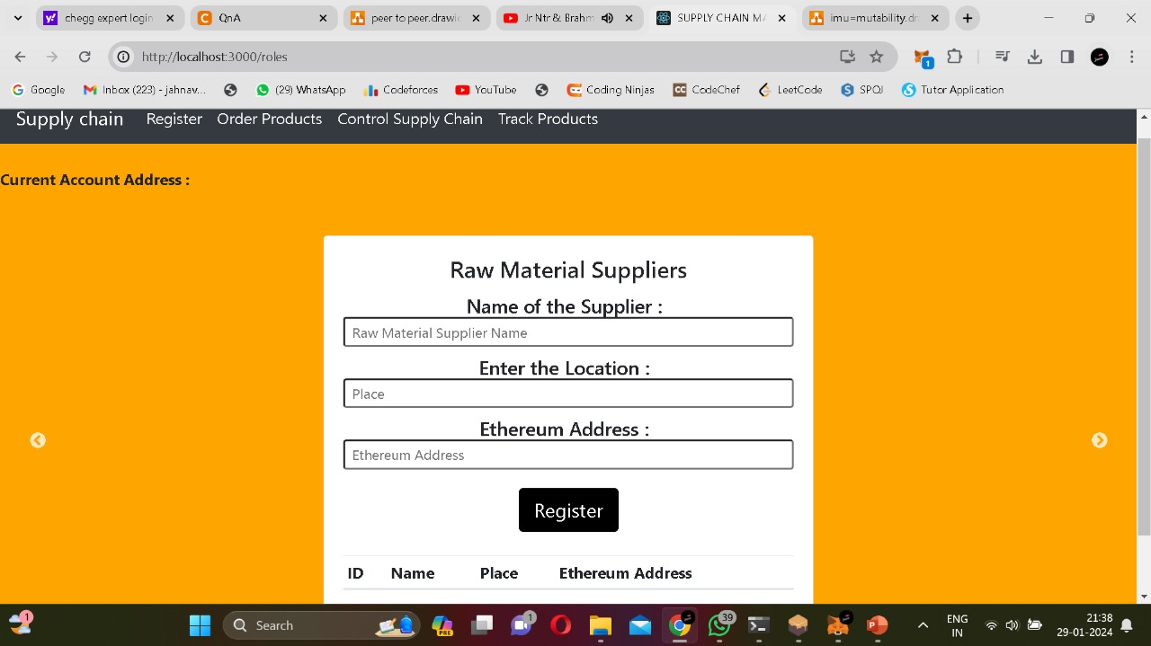
RESULTS
Department of Computer Science and Engineering Slide No:40
2023-2024

Slide 41
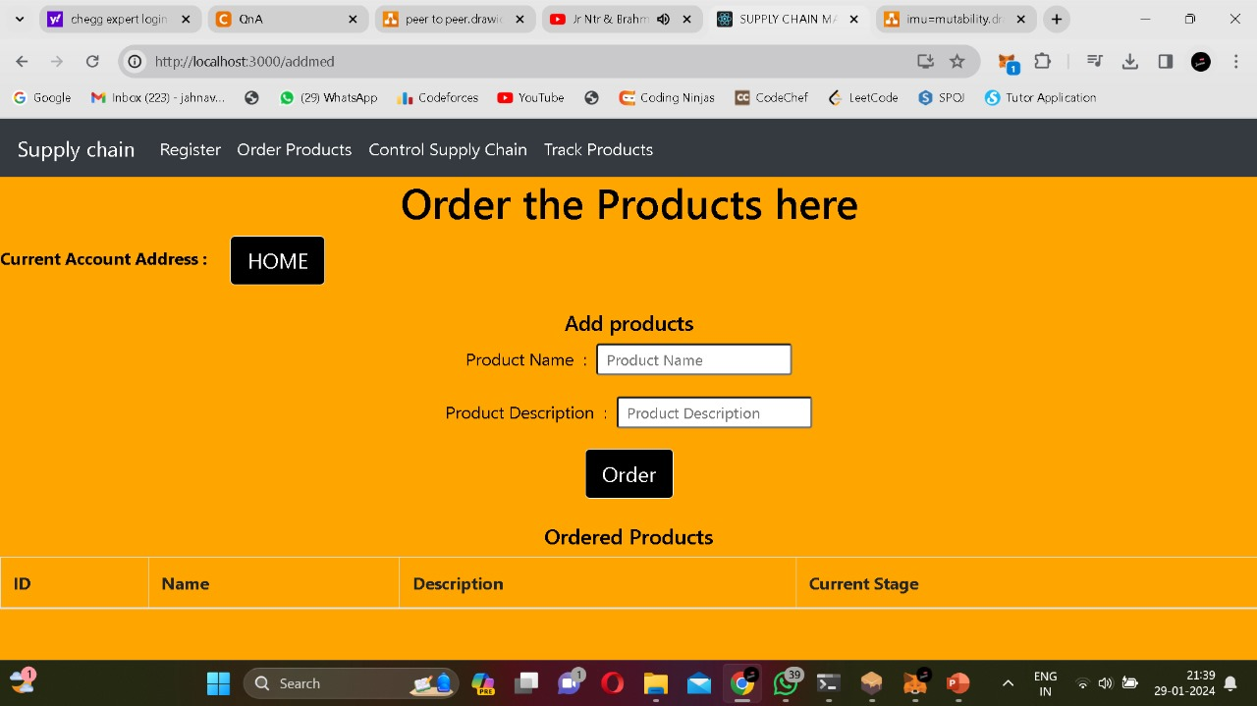
RESULTS
Department of Computer Science and Engineering Slide No: 41
2023-2024

Slide 42
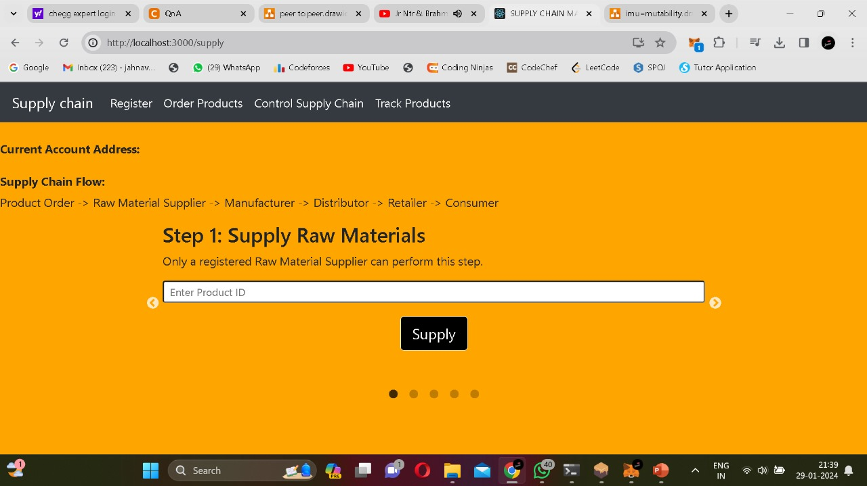
RESULTS
Department of Computer Science and Engineering Slide No:42
2023-2024

Slide 43
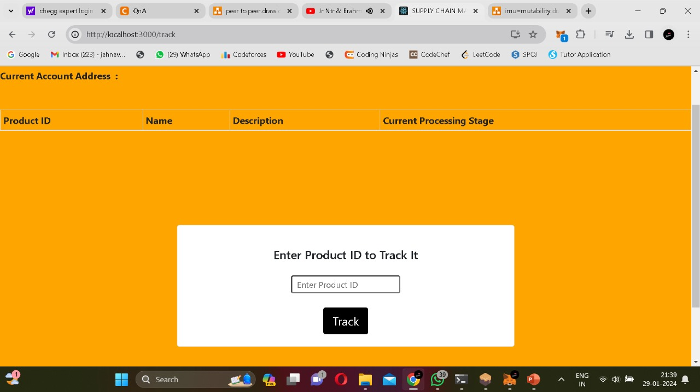
RESULTS
Department of Computer Science and Engineering Slide No:43
2023-2024

Slide 44
TEAM WORK AND COMMUNICATION
Teamwork and communication are crucial for the successful completion of any project.
Teamwork ensures tasks are efficiently distributed and completed. Effective communication within the team ensures everyone understands their roles and responsibilities.
A cohesive team with open communication can brainstorm and solve problems effectively. Different perspectives and ideas contribute to finding innovative solutions.
Department of Computer Science and Engineering Slide No: 44
2023-2024

Slide 45
THANK YOU
Department of Computer Science and Engineering Slide No:45
2023-2024

