Slide 1

Plastic Wood Composite (PWC) Materials: A Sustainable Alternative
This presentation explores the potential of Plastic Wood Composite (PWC) materials as a sustainable alternative to traditional wood products. PWCs are a blend of wood fibers and recycled plastics, offering a promising solution for reducing plastic waste and providing a more sustainable approach to construction materials.

Slide 2
Abstract
Plastic Wood Composite (PWC) materials, a blend of wood fibers and recycled plastics, offer a sustainable alternative to traditional wood products. This research aims to assess the mechanical properties and environmental stability of PWC materials, exploring their potential in construction and outdoor applications.
The methodology involves systematic fabrication and testing of PWC samples with varying proportions of wood fibers and plastics. The research will investigate the tensile strength, flexural strength, water absorption, and UV resistance of these composites. The results are expected to demonstrate the durability and sustainability of PWC materials, providing a compelling alternative to traditional wood and plastic products.

Slide 3

Critical Review of Literature
2013-2023
A comprehensive review of the past decade's literature on Plastic Wood Composite materials, focusing on advancements in material science, manufacturing processes, and applications. The review highlights key findings, trends, and emerging research areas within the field.

Slide 4

Objectives
1
Evaluate Mechanical Properties
Assess the tensile strength, flexural strength, impact resistance, and overall durability of PWC materials to determine their suitability as a replacement for traditional wood.
2
Examine Environmental Stability
Investigate the resistance of PWCs to water absorption, UV degradation, and varying weather conditions to assess their long-term performance and suitability for outdoor applications.
3
Optimize Composition
Explore different ratios of wood fibers to recycled plastics to identify the optimal blend that maximizes the mechanical and environmental performance of the composites.
4
Comparative Testing
Conduct comparative testing to evaluate the performance of PWCs against conventional wood and plastic materials in terms of durability, maintenance requirements, and environmental impact.

Slide 5
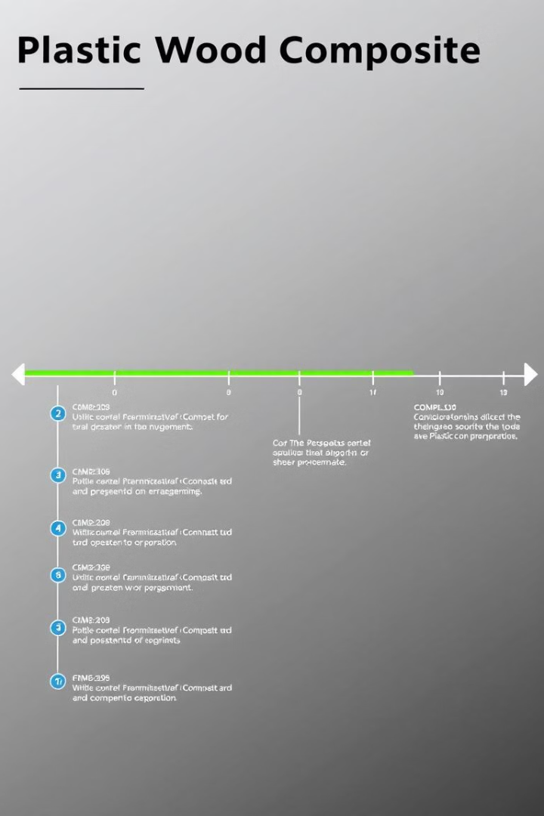
Work Plan
1
Completed: Literature Review, Material Selection, Sample Fabrication, Initial Mechanical Testing.
2
Ongoing: Environmental Stability Testing, Optimization of Composition, Comparative Testing.
3
Future Work: Data Analysis, Report Writing, Presentation of Findings.

Slide 6
Results & Discussion
Preliminary results indicate promising mechanical properties of PWC materials, with enhanced tensile strength and flexural strength compared to traditional wood.
Further testing is underway to assess the impact resistance and environmental stability of PWCs, including their resistance to water absorption and UV degradation. These results will be discussed in detail, highlighting the potential of PWCs for various applications.

Slide 7

Conclusions
The research findings underscore the potential of Plastic Wood Composite materials as a durable and sustainable alternative to traditional wood products. PWCs demonstrate promising mechanical properties and environmental stability, making them suitable for various applications, particularly in construction and outdoor settings. The research contributes to a more sustainable approach in material usage, addressing the growing need for eco-friendly construction solutions.

