Slide 1

PANIMALAR ENGINEERING COLLEGE CHENNAI,600123
DEPARTMENT OF COMPUTER SCIENCE AND ENGINEERING
IV CSE “F”– 2nd PROJECT REVIEW SCHEDULE ON 29.03.2021
TITLE : Enhanced Blockchain Technology for secure online transactions using Hashing Algorithm
TEAM MEMBERS:
YESHWANTH R(211417104310)
VALLARASU R(211417104290)
UNDER THE GUIDENCE OF:
Mr. A.N.SASIKUMAR

Slide 2
Abstract
Blockchain is arguably one of the most significant and disruptive technologies that came into existence since the inception of the Internet.
It's the core technology behind Bitcoin and other crypto-currencies that drew a lot of attention in the last few years.
As its core, a blockchain is a distributed database that allows direct transactions between two parties without the need of a central authority.
This simple yet powerful concept has great implications for various institutions such as banks, governments and marketplaces, just to name a few.
Any business or organization that relies on a centralized database as a core competitive advantage can potentially be disrupted by block chain technology.

Slide 4
Objectives
The Main Objective of the project is creating Distributed Transcations using Blockchain Technology.

Slide 5
Introduction
A Blockchain is a vastly distributed, global, open, shared ledger or database that run on millions of devices, recording all transactions happening between any two parties.
It does this efficiently and in a verifiable manner, essentially acting as a secure storage for not just information, but anything of value.
In simple terms, a Blockchain is a decentralized network for value exchange much which acted as a decentralized network for information exchange.
The blockchain is considered to be a foundational technology that no single organization owns or controls.

Slide 6
Problem statement
Intermediaries today are largely centralized systems This means that they are immensely vulnerable to attacks and failures.
Centralized systems, by design, have a single point of failure.
This presents tremendous opportunities for malicious players to stage large scale attacks.

Slide 7
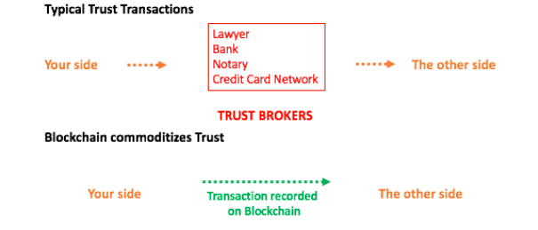
BlockChain Transcations

Slide 8
Proposed system
To solve the double-spending problem, Satoshi proposed a public ledger, i.e., Bitcoin’s blockchain to keep track of all transactions in the network.
Distributed: The ledger is replicated across a number of computers, rather than being stored on a central server. Any computer with an internet connection can download a full copy of the blockchain.
Cryptographic: Cryptography is used to make sure that the sender owns the bitcoin that she's trying to send, and to decide how the transactions are added to the blockchain.

Slide 9
Immutable: The blockchain can be changed in append only fashion. In other words, transactions can only be added to the blockchain but cannot be deleted or modified.
Uses Proof of Work (PoW): A special type of participants in the network called miners compete on searching for the solution to a cryptographic puzzle that will allow them to add a block of transactions to Bitcoin’s blockchain.
This process is called Proof of Work and it allows the system to be secure (more on this later).

Slide 10
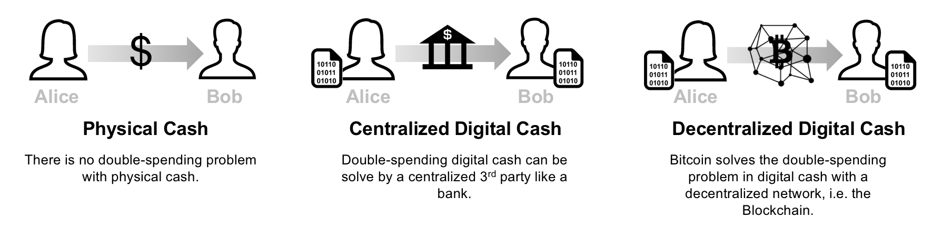

Slide 11
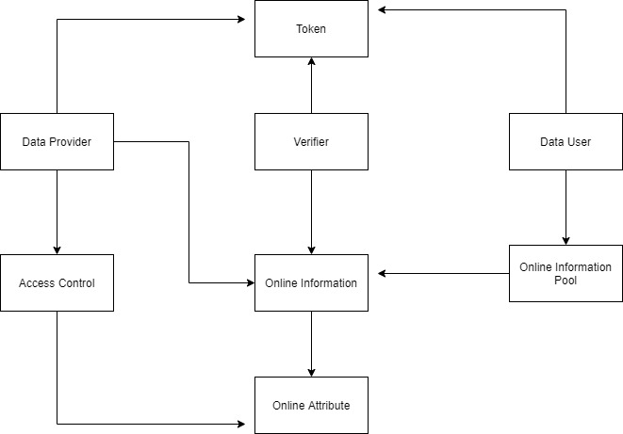
SYSTEM ARCHITECTURE

Slide 12
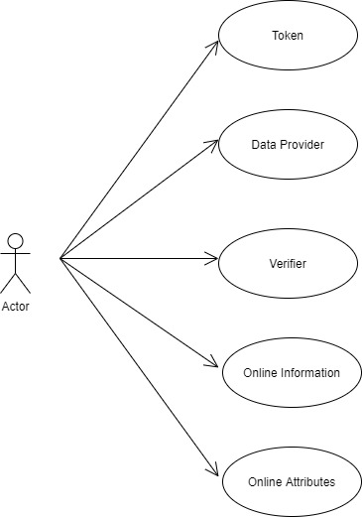
USECASE DIAGRAM

Slide 13
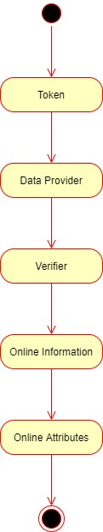
ACTIVITY DIAGRAM

Slide 14
Process
Step 1 (one-time effort): Create a bitcoin wallet. For a person to send or receive bitcoins, she needs to create a bitcoin wallet.
A bitcoin wallet stores 2 pieces of information: A private key and a public key.
The private key is a secret number that allows the owner to send bitcoin to another user, or spend bitcoins on services that accept them as payment method.
The public key is a number that is needed to receive bitcoins.

Slide 15
Step 2: Create a bitcoin transaction. If Alice wants to send 1 BTC to Bob, Alice needs to connect to her bitcoin wallet using her private key, and create a transaction that contains the amount of bitcoins she wants to send and the address where she wants to send them (in this case Bob’s public address).
Step 3: Broadcast the transaction to Bitcoin’s network.
Once Alice creates the bitcoin transaction, she needs to broadcast this transaction to the entire Bitcoin’s network
The public key is also referred to as bitcoin address (not entirely true, but for simplicity we will assume that the public key and the bitcoin address are the same).

Slide 16
Note that the wallet doesn’t store the bitcoins themselves. Information about bitcoins balances are stored on the Bitcoin’s blockchain.
Step 4: Confirm the transaction. A miner listening to Bitcoin’s network authenticates the transaction using Alice's public key, confirms that Alice has enough bitcoins in her wallet (in this case at least 1 BTC), and adds a new record to Bitcoin’s Blockchain containing the details of the transaction.
Step 5: Broadcast the blockchain change to all miners.
Once the transaction is confirmed, the miner should broadcast the blockchain change to all miners to make sure that their copies of the blockchain are all in sync.

Slide 17
Attributes
transactions: List of transactions that will be added to the next block.
chain: The actual blockchain which is an array of blocks.
nodes: A set containing node urls. The blockchain uses these nodes to retrieve blockchain data from other nodes and updates its blockchain if they're not in sync.
node_id: A random string to identify the blockchain node.
The Blockchain class also implements the following methods:
register_node(node_url): Adds a new blockchain node to the list of nodes.

Slide 18
verify_transaction_signature(sender_address, signature, transaction): Checks that the provided signature corresponds to transaction signed by the public key (sender_address).
valid_chain(chain): checks if a bockchain is valid.
resolve_conflicts(): Resolves conflicts between blockchain's nodes by replacing a chain with the longest one in the network.
submit_transaction(sender_address, recipient_address, value, signature): Adds a transaction to list of transactions if the signature verified.
create_block(nonce, previous_hash): Adds a block of transactions to the blockchain.

Slide 19
hash(block): Create a SHA-256 hash of a block.
proof_of_work(): Proof of work algorithm. Looks for a nonce that satisfies the mining condition.
valid_proof(transactions, last_hash, nonce, difficulty=MINING_DIFFICULTY): Checks if a hash value satisfies the mining conditions. This function is used within the proof_of_work function.

Slide 20
Hash Algorithm
In This Project, we compared the MD5 ash algorithm with ShA256 hash algorithm for transaction and we are going to find the performance of these two hash function.
This application generates two encoding cryptographic keys for viewing the private post and public posts.
The key is generated by using the cryptographic algorithm.
The user post undergoes hash encryption using the md5 algorithm and sha256 algorithm hashing functions.
This project shows about blockchain which is a linked list of transaction which contains data and hash pointer to the previous block in the block chain.

Slide 21
Hash function is used to map data in blocks. The values returned by hash function are called hash values, hash codes, etc.
Block chain is a growing list of records called blocks which are linked using cryptography.
Each block contains a cryptographic hash of the previous blocks and also transaction data.
This technology can be implemented anywhere in health care, medicine, insurance, etc Here we are implementing this technology in our daily life activity which is in social now for high-security transaction of post between users.

Slide 22
Advantages
Freedom of Payment – Bitcoin transactions can be done at anytime from anywhere in the world.
Users needn’t be concerned about bank holidays.
No Transaction fee – Currently, there is no transaction fee for bitcoins.
This gives Bitcoins an advantage over credit cards.
Another major advantage of Bitcoin transactions is that it allows merchants to easily convert Bitcoins to fiat currency and get it deposited in their bank accounts.

Slide 23
These services are offered at a much higher fee with credit cards.
Low Risk for merchants - Bitcoins prevent merchants from losses caused because of fraudulent transactions.
Merchants can safely sell their products in new markets where other modes of payment aren’t available, thus expanding their reach to larger markets.
Secure and transparent- Unlike other payment methods, sellers cannot add unnoticed charges in Bitcoin transactions.
Since Bitcoin is built on a secure medium like Blockchain, users can protect their money with encryption and backup.

Slide 24
REQUIREMENTS
HARDWARE REQUIREMENTS
Processor - Intel Pentium
RAM - 4 GB
Hard Disk - 500 GB
Monitor – SVGA
SOFTWARE REQUIREMENTS
Python 3.7.
HTML
CSS

Slide 25
Conclusion
Crypto currencies such as Bitcoin, on the other hand, although popular, may take some time to be adopted as a primary medium of exchange, replacing fiat currencies.
We have already seen how Bitcoin standard is seen in comparison to the Gold standard, without some of the disadvantages of the latter.
To become the future currency of the world, it needs to get the nod of governments and policy makers.
It also needs to make itself technologically much safer to vulnerable attacks.

Slide 26
These are as much a problem of public perception as they are about the economic soundness.
In the truly exciting times ahead, we only have to wait and watch how Bitcoins and Blockchain play out and where they live up to their potential and promises.

Slide 27
References
Tapscott, A., Tapscott, D. Harvard Business Review. (2017). The Impact of the Blockchain Goes Beyond Financial Services. [online] Available at: https://hbr.org/2016/05/the-impact-of-the-blockchain-goesbeyond-financial
services ii Continuations by Albert Wenger. (2017). Bitcoin: Clarifying the Foundational Innovation of the Blockchain. [online] Available at: http://continuations.com/post/105272022635/bitcoin-clarifying foundational-innovation-of iii YouTube. (2017).
How Does Credit Card Processing Work? - Principis Capital. [online] Available at: https://www.youtube.com/watch?v=nRzTaWZ6ebs
Rajiv, R. Bitcoin, Blockchain, and Spotify’s Mediachain acquisition, [online], https://www.linkedin.com/pulse/bitcoin-blockchain-spotifys-mediachain-acquisition-rohan-rajiv v Tepper, F. (2017).

Slide 28
Tepper, F. (2017). The reward for mining Bitcoin was just cut in half. [online] TechCrunch. Available at: https://techcrunch.com/2016/07/09/the-reward-for-mining-Bitcoin-was-just-cut-in-half/ x YouTube. (2017).
How Bitcoin Works Under the Hood. [online] Available at: https://www.youtube.com/watch?v=Lx9zgZCMqXE xi YouTube. (2017).
How Bitcoin Works Under the Hood. [online] Available at: https://www.youtube.com/watch?v=Lx9zgZCMqXE. xii Bitcoin.org. (2017). FAQ - Bitcoin. [online] Available at: https://bitcoin.org/en/faq
[6] P. A. G. Xue Zhang and Hauke Fuehres, Predicting Stock Market Indicators through Twitter I Hope it is not as Bad as I Fear, Procedia – Social and behavioral Sciences, vol. 26, pp. 55–62, (2011).

Slide 29
[7] J. Bollen, H. Mao and X. Zeng, Twitter Mood Predicts the Stock Market, Journal of Computational Science, vol. 2, no. 1, pp. 1–8, (2011). [Online]. Available:http://www.sciencedirect.com/science/article/pii/S187775031100007X
K. Mizumoto, H. Yanagimoto and M. Yoshioka, Sentiment Analysis of Stock Market News with Semi-Supervised Learning, In 2012 IEEE/ACIS 11th International Conference on Computer and Information Science (ICIS), pp. 325–328, May (2012).
[9] M. Z. F. Werner Antweiler, Is all that Talk Just Noise? the Information Content of Internet Stock Message Boards, The Journal of Finance, vol. 59, no. 3, pp. 1259–1294, (2004). [Online]. Available: http://www.jstor.org/stable/3694736.

Slide 30
[10] R. Ahuja, H. Rastogi, A. Choudhuri and B. Garg, Stock Market Forecast Using Sentiment Analysis, In 2015 2nd International Conference on Computing for Sustainable Global Development (INDIACom), pp. 1008–1010, March (2015).
[11] N. Lin, J. Yuan, W. Xu, L. Wei and X. Wang, How web News Media Impact Futures Market Price Linkage?, In 2013 Sixth International Conference on Business Intelligence and Financial Engineering (BIFE), pp. 562–566, November (2013).

Slide 31
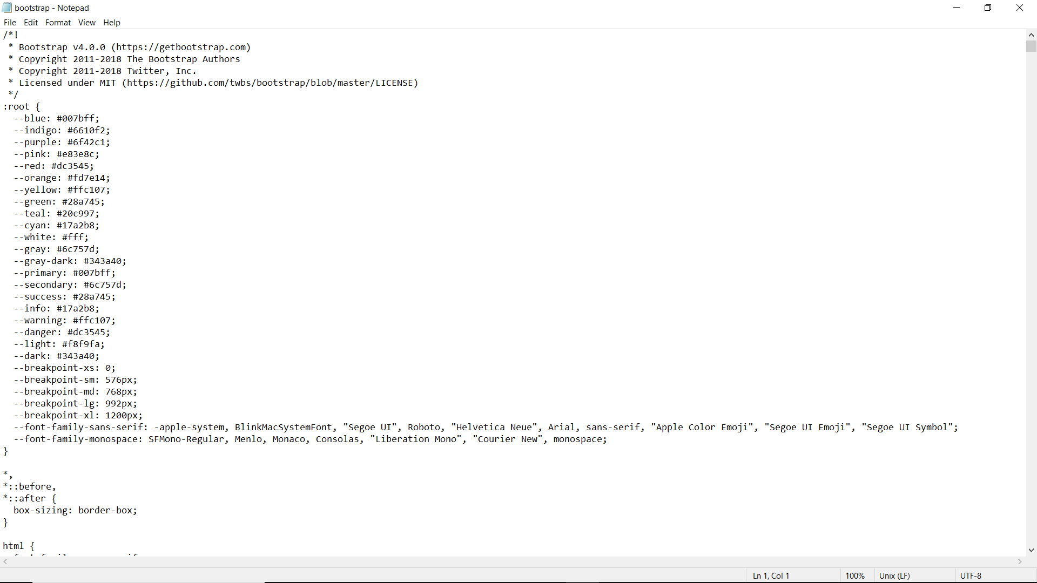
SCREENSHOTS HTML AND CSS FILES

Slide 32
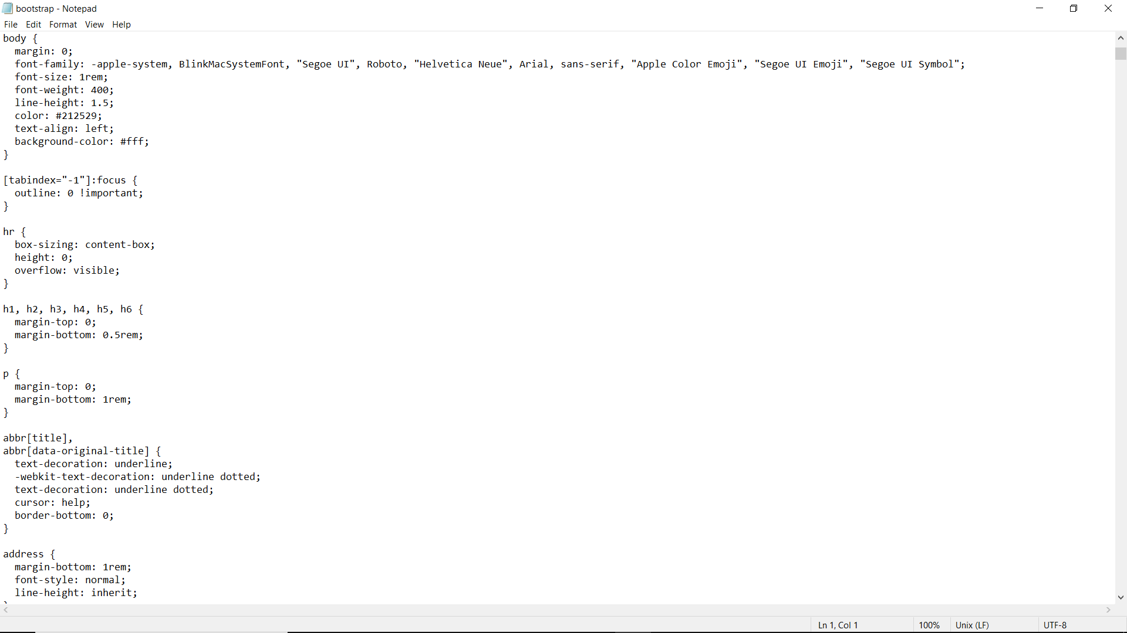

Slide 33
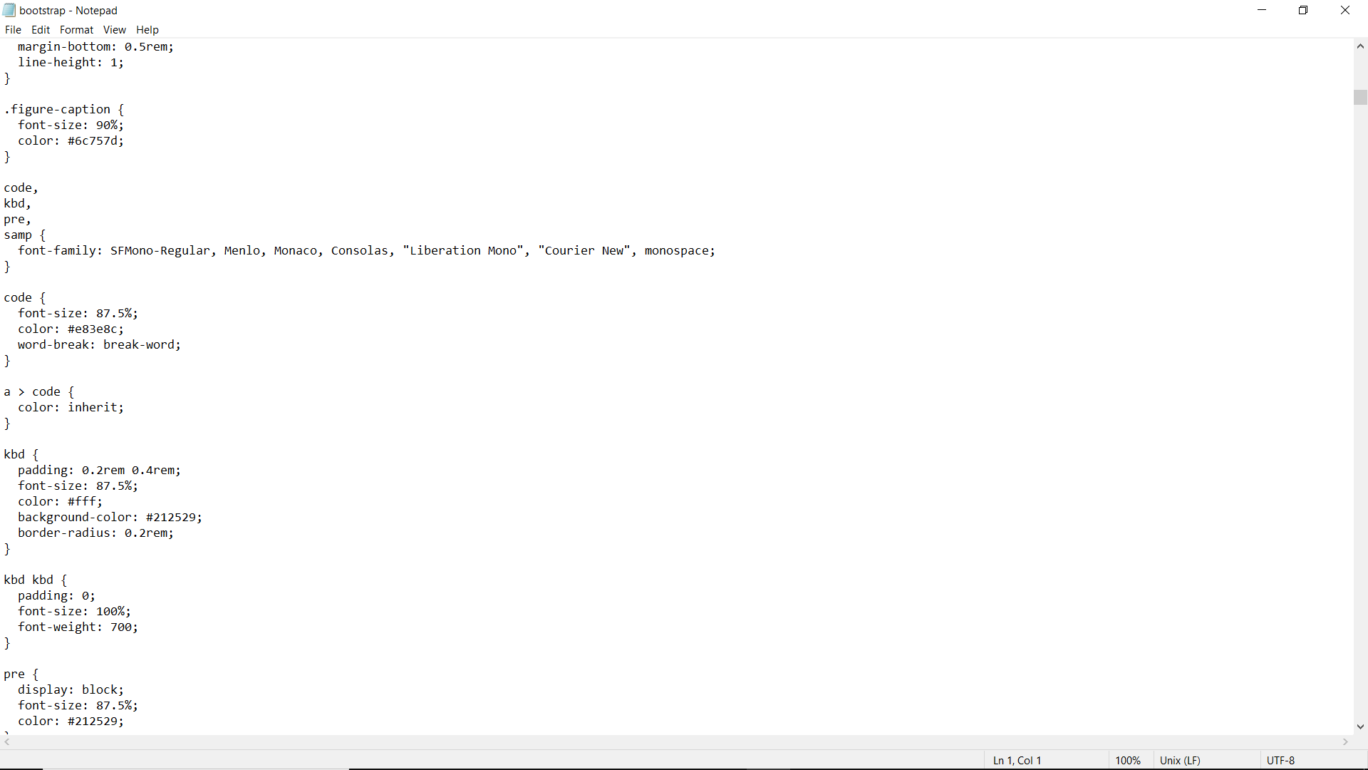
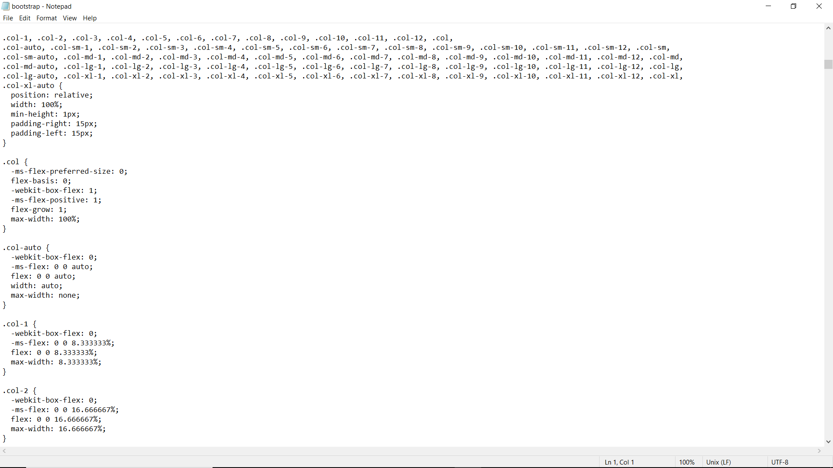

Slide 34
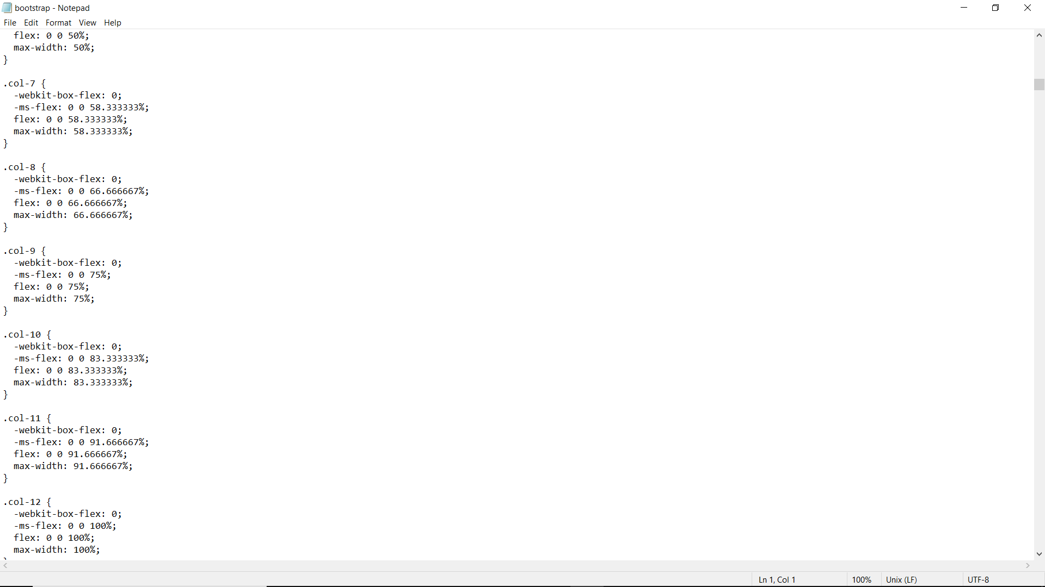
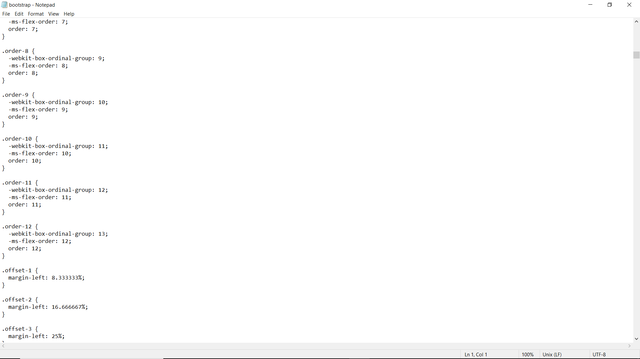

Slide 35
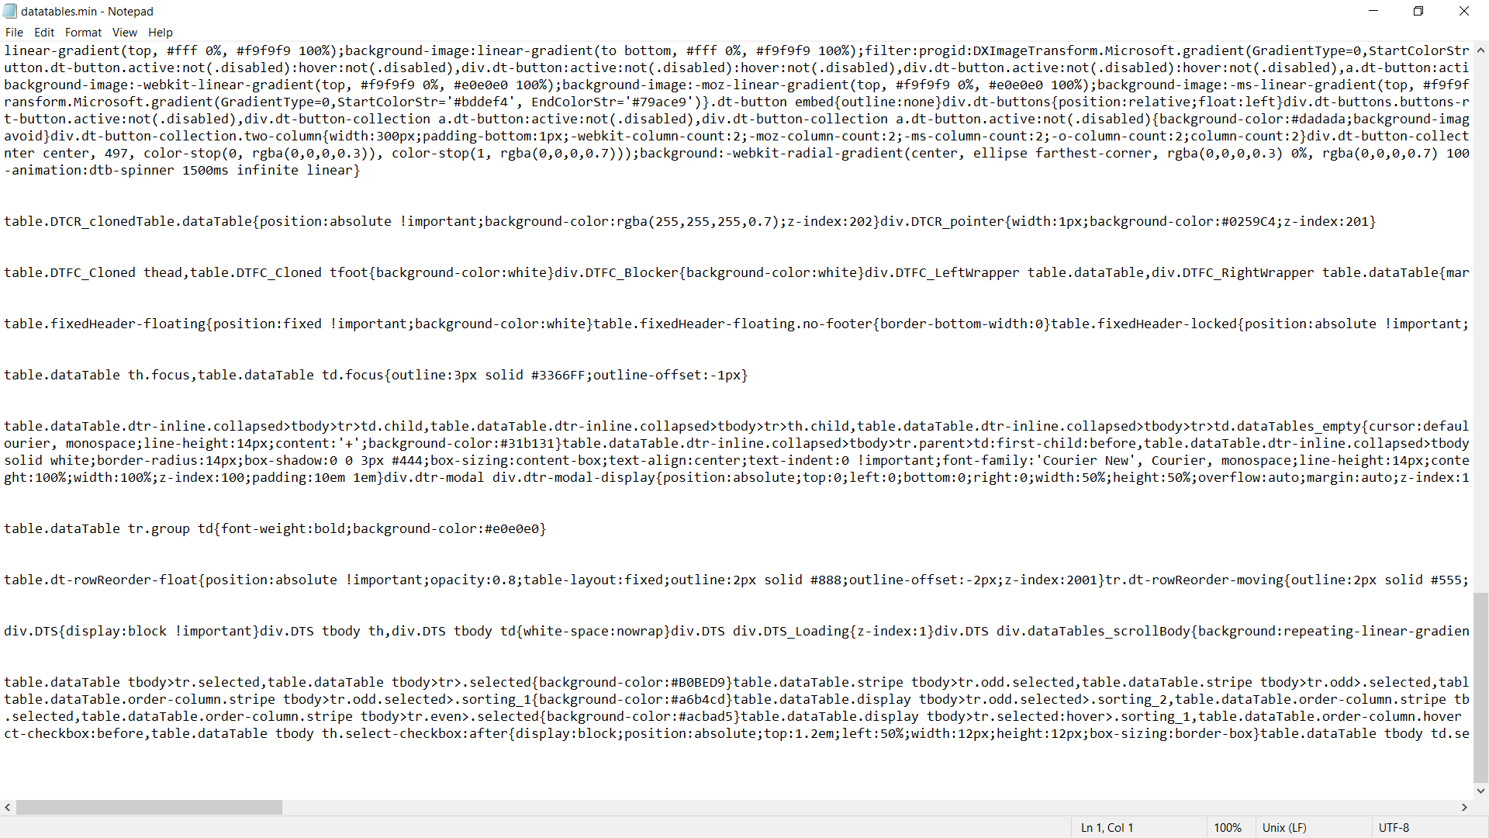
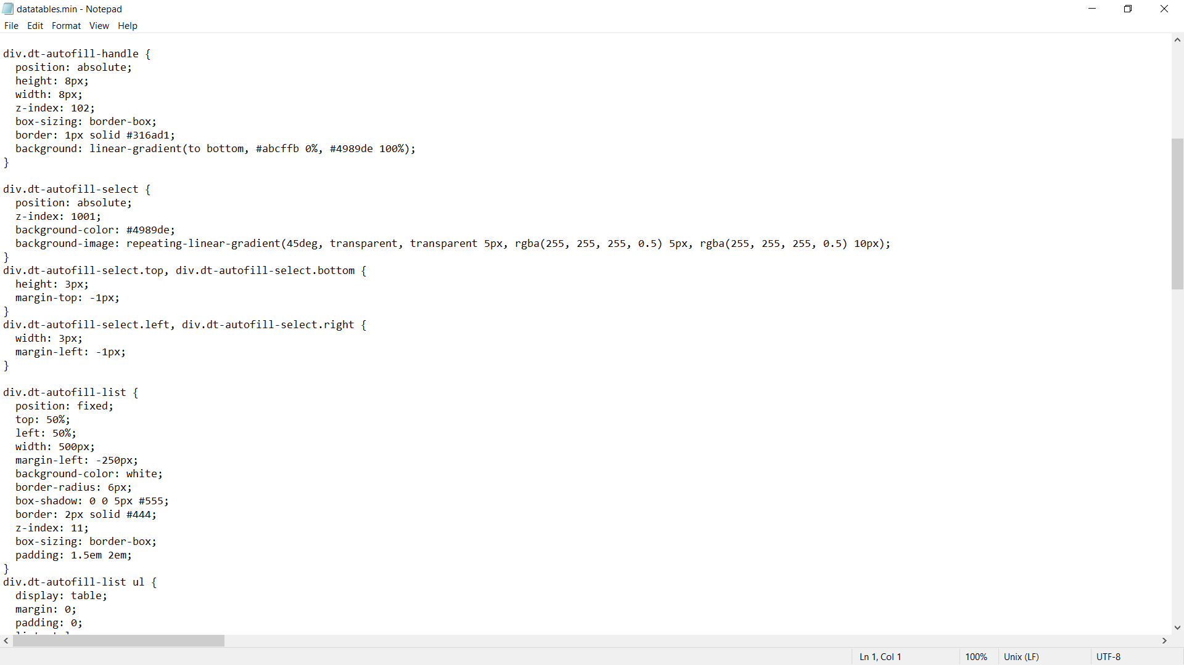

Slide 36
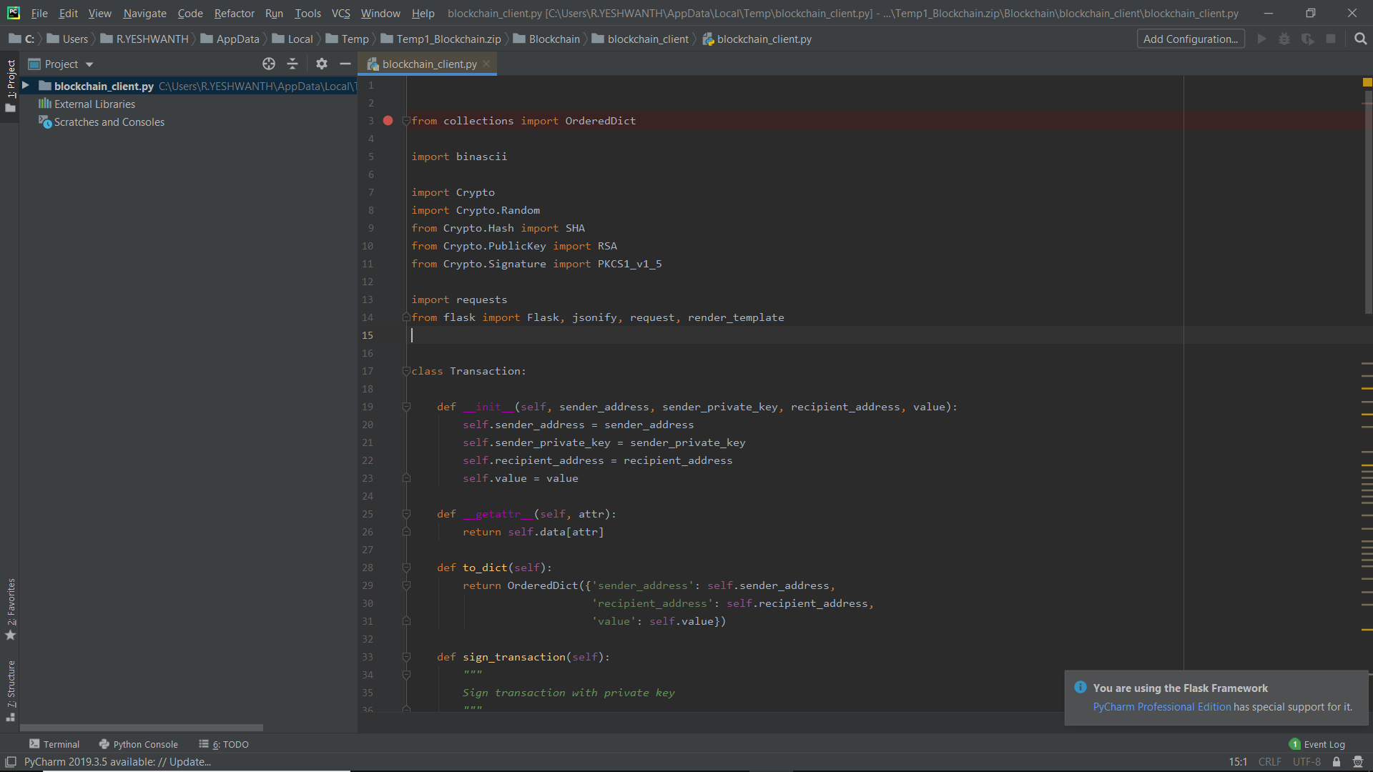
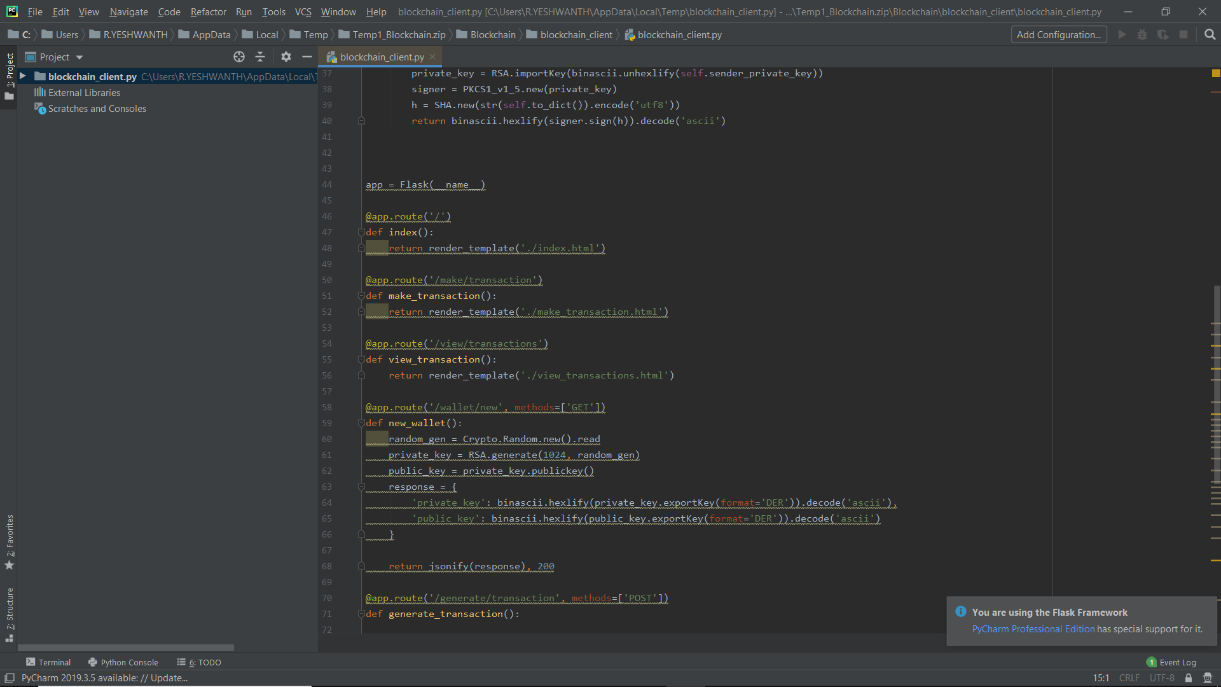
PYTHON FILES

Slide 37
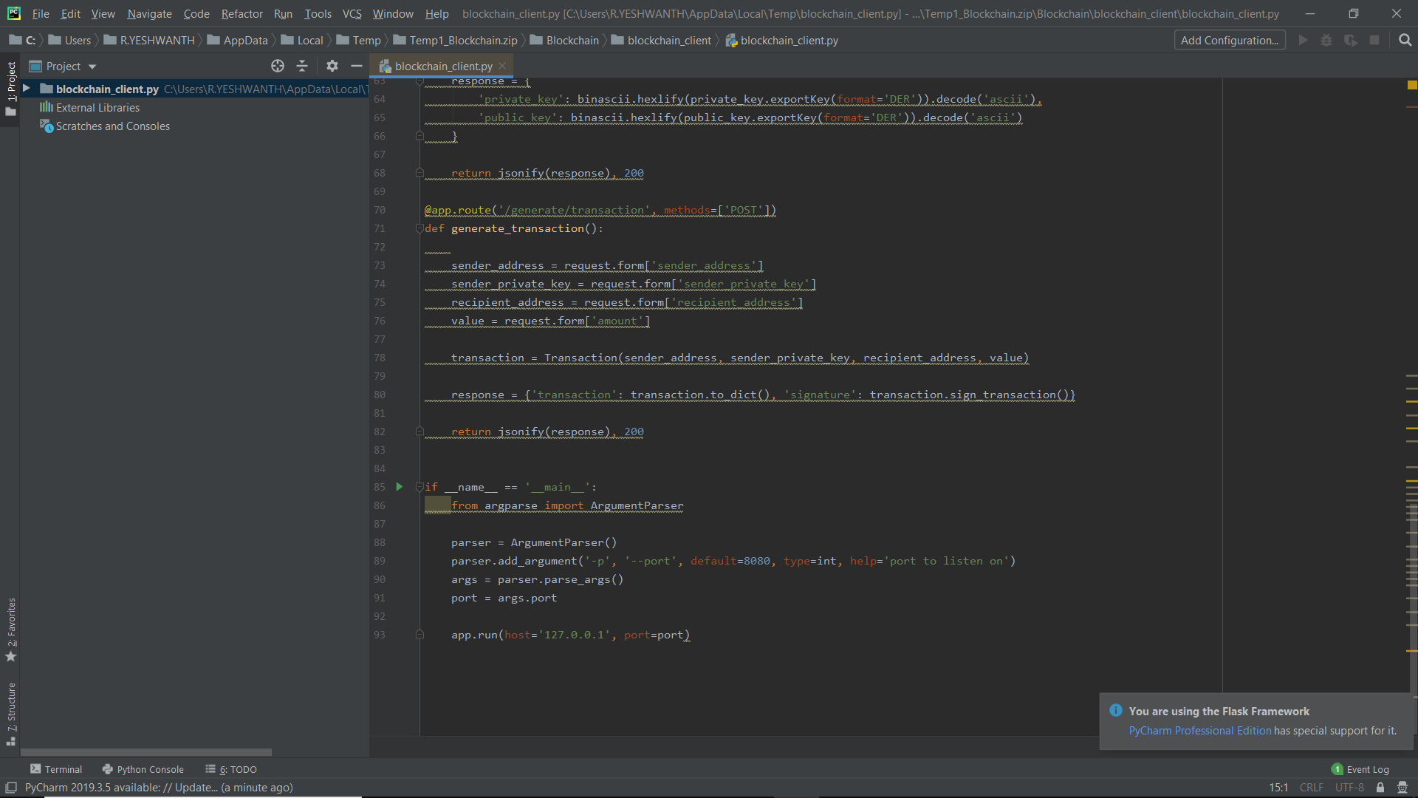
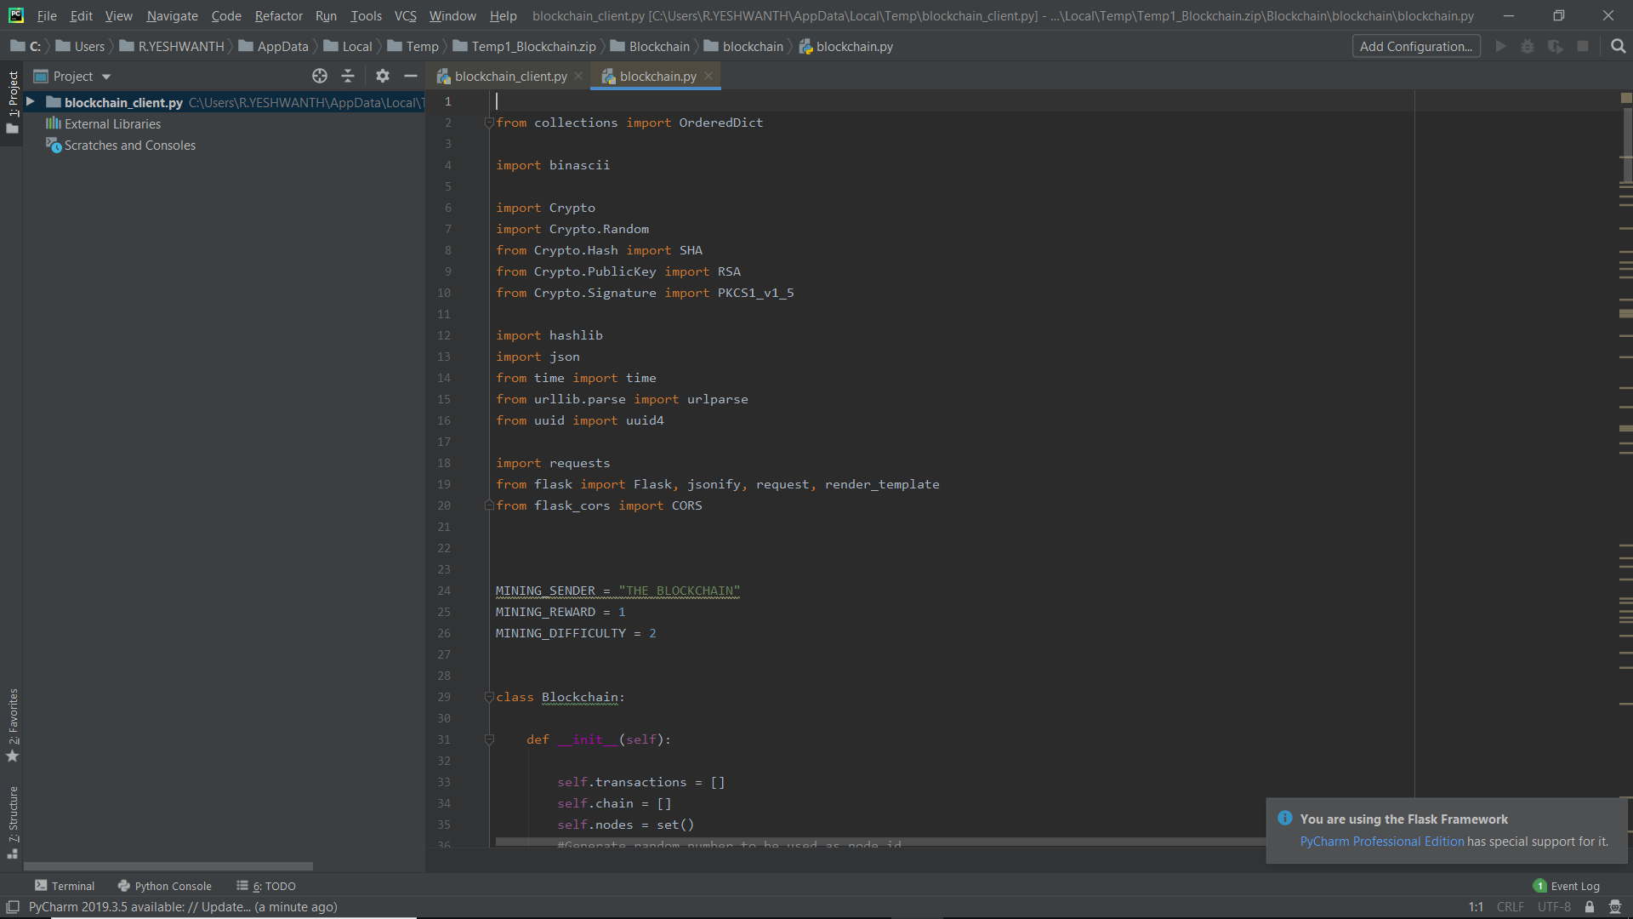

Slide 38
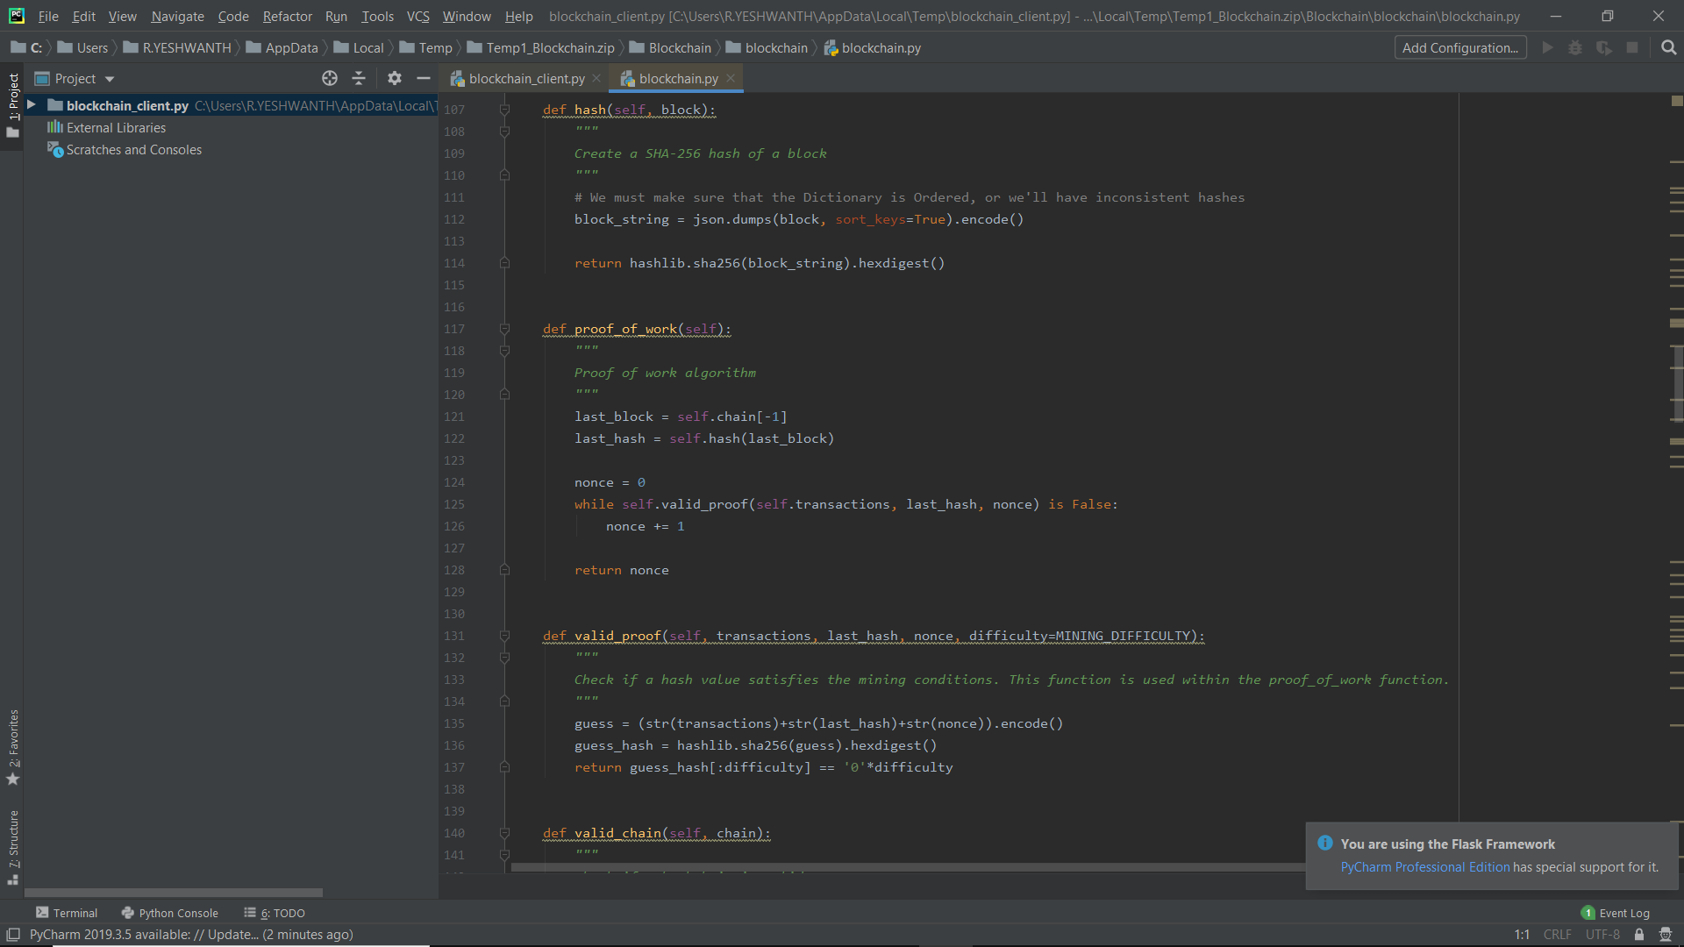
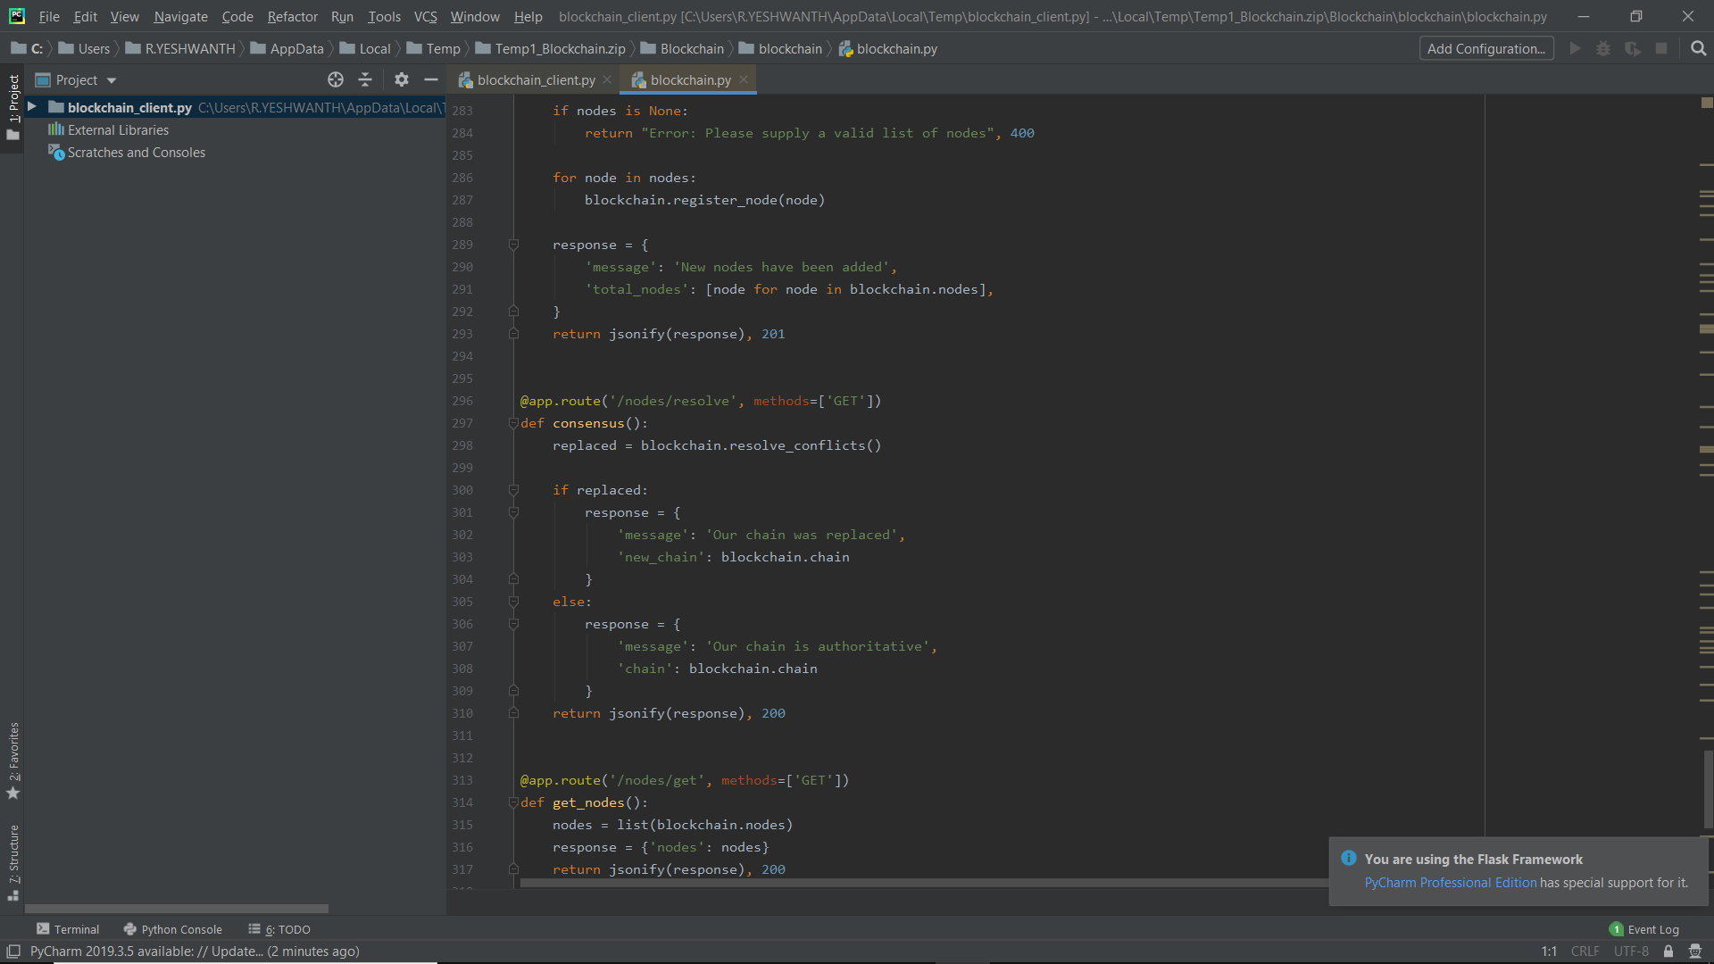

Slide 39
ACKNOWLEDGEMENT
We express our deep gratitude to our respected secretary and Correspondent Dr.P.CHINNADURAI,M.A.,Ph.D. For his kind words ad enthus iastic motivation, which inspired us a lot in completing this project.
We would like to extend our heartfelt and sincere thanks to our Directors Tmt.C.VIJAYARAJESWARI, Dr.C.SAKTHIKUMAR,M.E,Ph.D. And Tmt. SARANYASREE SAKTHIKUMAR,B.E.,M.B.A. For providing us with the necessary facilities for completion of this project.
We also express our gratutude to our principle Dr.K.MANI,M.E.,Ph.D. For this timely concern and encouragement provided to us throughout the course.
We thank the HOD of CSE Department, Dr.S.MURUGAVALLI,M.E.,Ph.D. For the support extended throughout the project.
We would to thank my Project Guide, Mr.A.N.SASIKUMAR, and all the faculty members of the Departmen of CSE for their advice and suggestions for the successful completion of the project.
YESHWANTH R.
VALLARASU R.

