Slide 1
Welcome to Ddos for criminal enterprises
There are a couple of files that we will be using for this class. They can be found here:
https://github.com/git-oaktree/bsidesdc
Smbserver running on IP
Jump Drive – Ask one of the instructors.

Slide 2

You have the Shell…
?
Now where’s the

Slide 3
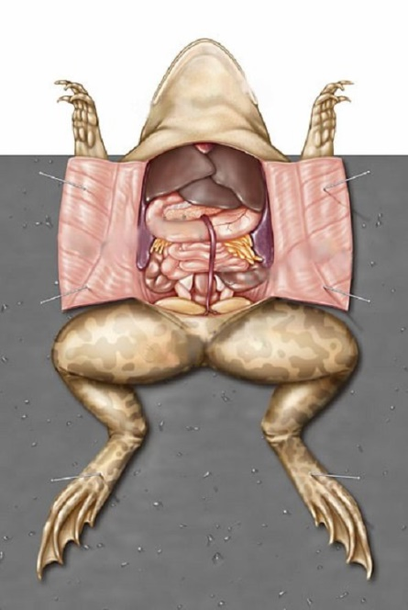
About This Class
We are going to discuss how to go from 0-PWNed by dissecting our tool (script)
I know nothing
Getting the basics
PWNed

Slide 4
More on the Class
Some code & concept for script comes from Metasploit Minute video.
http://mubix.github.io/blog/2015/01/12/powershell-popups-plus-capture/
Reference attack environment
Code can be found at:
git-oaktree
goo.gl/nzLTbA

Slide 5
Our Goal…
Introduce you to PowerShell with plenty of demos/labs to understand the logic behind our reference script and how to go from 0 – code (pwn).
We assume you know nothing.
Other classes start w/ the precursor that you have the basics.

Slide 6
Our Goal
Show what PowerShell can do (Red & Blue Team) without importing modules.
Excite you… Hopefully, to learn more about PowerShell and provide references to resources we have found valuable.
Give you a program and the skills to build off it… go make it better.

Slide 7

On the Shoulder of Giants
Windows PowerShell 2.0 for Beginners Training & Overview
https://www.youtube.com/watch?v=3vJvkANKVWA
Ben0xA
https://www.youtube.com/watch?v=893NGtZlod8 - Gray Hat PowerShell
https://www.youtube.com/watch?v=4X_uBL2YpmA - Practical PowerShell programming for Practical Programmers

Slide 8
On the Shoulder of Giants
Jared Atkinson @jaredcatkinson
PowerForensics
Matt Graber/ @mattifestation
Partial list:
Powersploit
Exploitmonday.com → blog
Will Shroeder/ @harmJoy
Partial list of projects:
Bloodhound
powerview
https://www.youtube.com/watch?v=cXWtu-qalSs
Carlos Perez @darkoperator

Slide 9
On the Shoulder of Giants
Lee Holmes @lee_holmes
Jessica Payne @jepayneMSFT
Sean Metcalf / @pyrotek3
https://adsecurity.org/?p=2843
@enigma0x3
Casey Smith @subtee
Chris Cambell @obscuresec
https://www.youtube.com/watch?v=j9HMjaI9qgk

Slide 10
About Us
Raymond/@Securemaryland
Certs I got them – but who cares.
20+ years in infosec – man I am old
This is all mine and not my employers, well kind of. (see name below)
I have no clue what I am doing…. Just wanted to see if you were reading this ☺
Octavio/@oaktree__
Work in IT but hopefully that is relevant without this bullet point.
This is all mine and not my employers, well kind of. (see name above)
Very tall
Avid reader of handyman magazine

Slide 11
What is PowerShell?
IRONIC
“Windows PowerShell is a shell developed by Microsoft for purposes of task automation and configuration management. This powerful shell is based on the .NET framework and it includes a command-line shell and a scripting language.”

Slide 12
What is PowerShell?
command-line shell
and
a scripting language

Slide 13
WMF
Window Management Framework – is the core that provides PowerShell
The Windows Management Framework Core package provides updated management functionality for IT Professionals. This package includes the following components: Windows PowerShell 2.0 and Windows Remote Management (WinRM) 2.0.

Slide 14
History
PowerShell runs on pretty much any Windows system to include Windows XP
Installed by default on everything Windows 7 and later
PowerShell v2 is the most common as it was installed on most systems (e.g. Win 7)
The latest current version is PowerShell v5
With each new release comes added functionality and add logging/security controls.

Slide 15
Extending PowerShell
The base PowerShell console can be extended to include modules (collection of cmdlets and code). Modules allow easier access to:
Active Directory
Exchange
Does it vary?

Slide 16
Today
The latest current version is PowerShell v5
With each new release comes added functionality and add logging/security controls.
Not just for Windows anymore…. WHAT?
Windows has made versions for Linux, MAC OSX, Docker
Notes:
How will this increase the Red/Blue team usefulness for these different environments.

Slide 17
PowerShell > Security
Possible uses: Administration of the system, troubleshooting
Office 365
Management of remote systems
Desired State configuration
Active Directory
Azure automation
This list goes on and on and on and on…
Notes:
https://blogs.technet.microsoft.com/ashleymcglone/2016/06/29/whos-afraid-of-powershell-security/

Slide 18
Terminology
Some basic terms:
Parameter – data that can be passed to a command. May be mandatory. “qualifier”
Variable - Storage container for data (strings, int, etc.)
Function – a grouping of similarly functioning code
| “pipe” – the ability to pass one command/component to another.
> “redirect” – redirects the output of a command to a file.
Alias – duplicate name for same function

Slide 19
PowerShell Interface
PowerShell comes with two primary interfaces:
Console – allows for the direct interaction with commands/scripts
ISE- The Integrated Scripting Environment (ISE) provides more of a graphical interface and allows you to build scripts before running them
The ISE is not installed by default on Server versions.

Slide 20
Built in Variables
PowerShell comes with some “automatic” built-in variables.
$Profile –full path of PS profile
$PSHome – full path of PS installation directory
$PSModule path
$PWD – full path of current directory
$_ - Contains the current object in pipeline object (we will cover this one a lot)

Slide 21
Create your own variables
Creating your own variable is easy
$ (show me the money)
VariableName - anything you want
= assigning the cmdlet (anything) to the variable
Remove-Variable – incase you didn’t really want it.
More on variables later…

Slide 22
Labs
We will give you a few minutes to start the first 2 labs and then we will demo them in class.
LAB 0 – Getting Started… had to start somewhere.
Launching PowerShell
LAB 1 – Some commands.

Slide 23
PowerShell Lies
Isn’t convenient that PowerShell allows us to run common commands like cd and dir?
It is… but PowerShell lies.
Instead of calling the command itself PowerShell aliases the commands to PowerShell cmdlets.

Slide 24
Broke it
Because the commands are really aliases to cmdlets they can break.
Let’s look at the dir command.

Slide 25
Did you say Cmdlets?
Predefined “commands” in PowerShell are called cmdlets
Cmdlets follow a verb-noun naming convention
Each command can be passed “qualifiers” and further parameters to narrow down what you are looking for
cmdlets available on a machine vary based on role of system, and version of PowerShell installs
$PSVersionTable.PSVersion

Slide 26
How are Cmdlets Written?
“Cmdlets are instances of the .NET framework classes; they are not stand alone executables”
Two primary classes used:
Cmdlet base class
Pscmdlet base class – for more complex cmdlets
Programmers can write their own.

Slide 27
The 1st Cmdlet
Get-Command
VERB
Noun

Slide 28
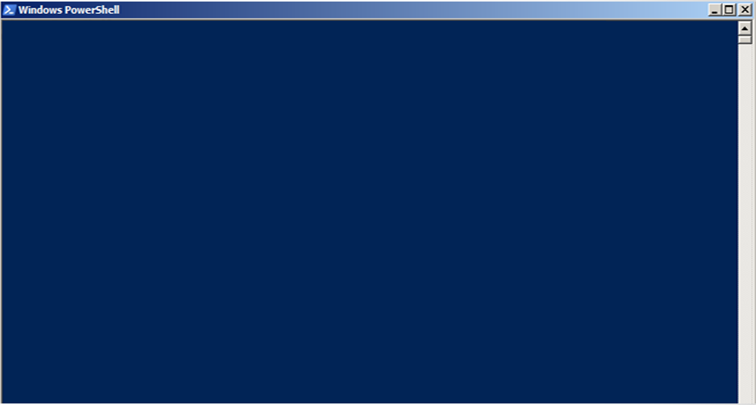
Windows PowerShell
Copyright (C) 2015 Microsoft Corporation. All rights reserved.
PS C:\> Get-command
CommandType Name Version ----------- ---- ------- -
Alias Add-ProvisionedAppxPackage 3.0
Alias Add-VMToCluster 2.0.0.0
Alias Add-WindowsFeature 2.0.0.0
.
.
.
Notes:
Remember the Verb/Noun naming convention?

Slide 29
Labs
Using Get-Command find some help.
LAB 2 That help was helpful.

Slide 30
How do I get help?
Lab 2 Walkthrough:
Get-help is a cmdlet…..
Category types include:
Cmdlets
Aliases
Help_files
Providers

Slide 31
What is a help file?
Help file explains a concept such as:
how to write a for loop, remoting, regex
Great reference when you do not have internet access
To view available help files:
Get-help about*
Get-help –category helpfile

Slide 32
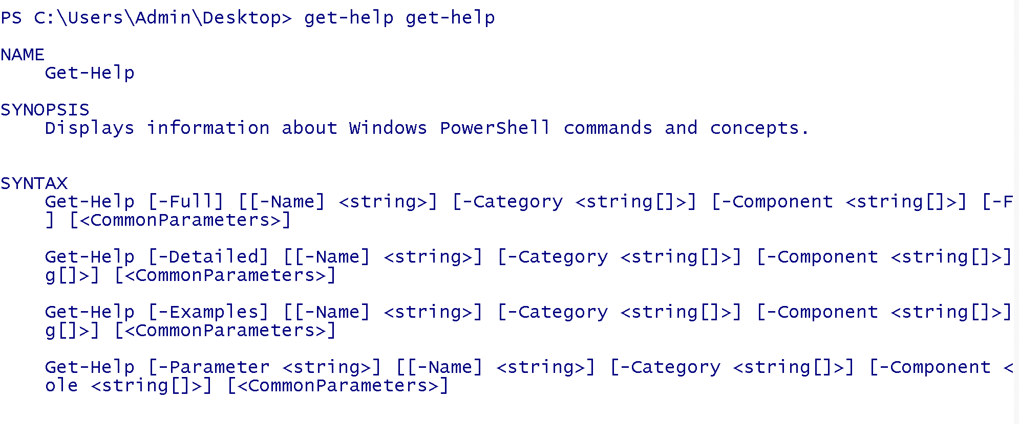
Get-help Get-Help
Notes:
Question when we called get-help get-help, which line of options do we have?

Slide 33
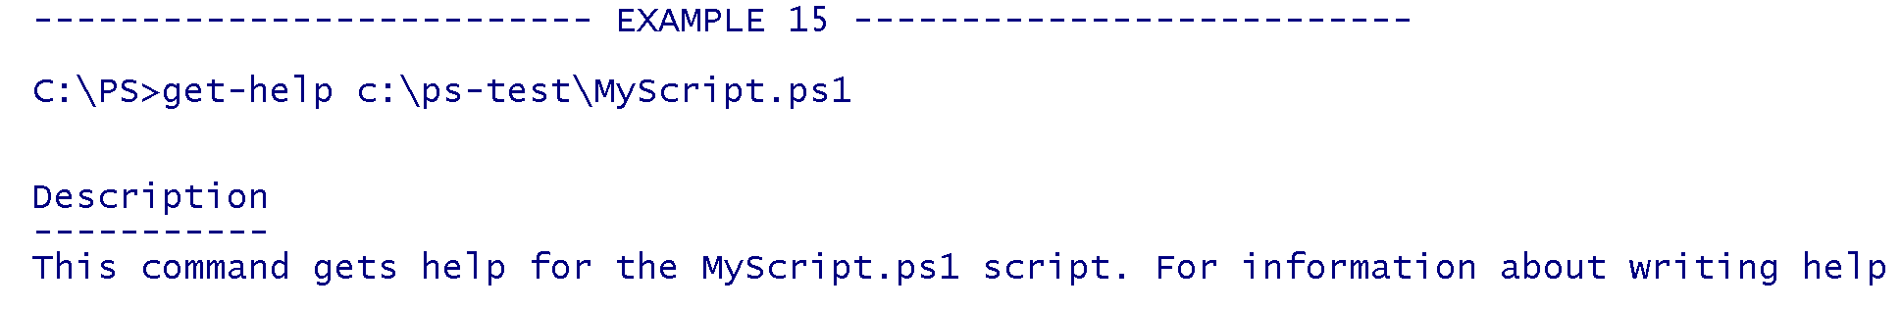
Get-help get-help -examples
Notes:
Provides examples for the cmdlet.

Slide 34
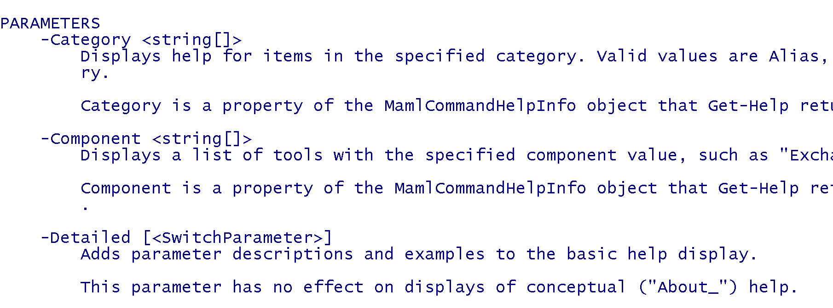
Get-help Get-help -Detailed
Notes:
Provides examples of the cmdlet but also adds parameter descriptions and examples to the basic help display.

Slide 35
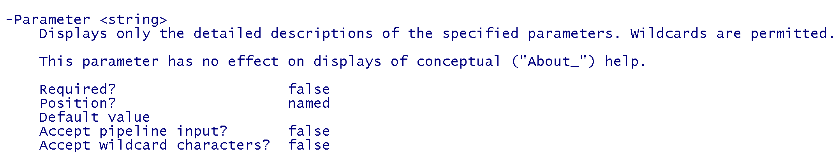
Get-help get-help -Full
Notes:
Displays the entire help file for a cmdlet, including parameter descriptions and attributes, examples, input and output object types, and additional notes

Slide 36
Parameters
“Qualifiers”/Arguments that can be past to the cmdlet to further define what/how it is run. Command line customization.
Named – specifically defined parameters (e.g. online)
Positional – first non-named parameter is assigned to first positional parameter. Args array.

Slide 37
Parameter breakout

Slide 38
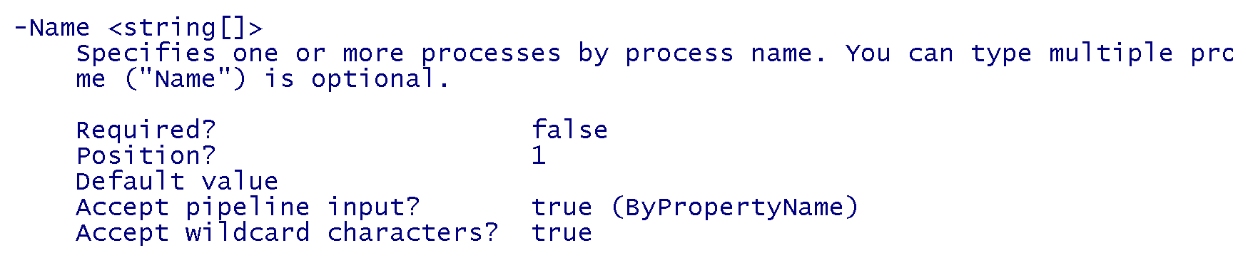
Parameter breakout
Notes:
In this slide we see that the –Name parameter for the get-process cmdlet can be populated just based on location.

Slide 39
Parameter Input
Notes:
The <string> next to parameter dictates what type of input this qualifier accepts.

Slide 40
Parameters cont.
Almost all cmdlets have/accept parameters.
Optional (most) vs. Required
Required parameters will be marked by required=true.
Required Parameters throw errors when omitted.

Slide 41
Parameter breakout

Slide 42
Parameters Syntax.
-ParamName ParamValue
Passing more than one
Space between each
Splat format;
$myargs = @{ path = $env:windir }
Get-childitem $myargs

Slide 43
Let’s Get Started
In order to run the tool we first need to download it.
How to download our tool in PowerShell
Use invoke-webrequest commandlet (damn verb/noun again)
Down load file by passing URL and saved file destination.

Slide 44
Downloading…
Powershell 3+
invoke-webrequest –uri “http://link -outfile “c:\path\to\file”
Powershell 2
(new-object net.webclient).downloadfile(“URL”,”$fullpathofDestination”

Slide 45

Now forget what you saw in the previous slide.

Slide 46

Let’s Get Started
Windows PowerShell
Copyright (C) 2015 Microsoft Corporation. All rights reserved.
PS C:\> invoke-webrequest –uri https://goo.gl/HvprVA -outfile class.ps1

Slide 47
Script Params
Class Activity – looking at the script we just downloaded what parameters are required?
Look only at the invoke-gimmeyourpassword function.

Slide 48
Stretch
<break>

Slide 49
Objects
Some cmdlets contain multiple attributes/properties – these are defined by Objects
Sample – get-service.

Slide 50
Windows PowerShell
Copyright (C) 2015 Microsoft Corporation. All rights reserved.
PS C:\> get-service
Status Name DisplayName
------ ---- -----------
Running AdobeARMservice Adobe Acrobat
Stopped AdobeFlashPlaye... Adobe Flash Player
Stopped AJRouter AllJoyn Router Servic
Stopped ALG Application Layer
...
Notes:
Get-service
Get-service |get-member
In this example we are issuing the get-service commandlet that list all the services by:
Status
Name
Displayname
Remember the Verb/Noun naming convention?

Slide 51
More on Objects
When you type get-service the object returned is an array.
LAB 3 Playing w/ Objects

Slide 52
Get-Member
The get-member cmdlet lists ALL available objects and their properties.
Prints all available properties associated w/ cmdlets
Useful in customizing queries

Slide 53
Pipes
Piping allows you to pass/chain commands together. Technically it allows to perform further actions.
Linux example: ls –al |more
PowerShell: get-service|get-member

Slide 54
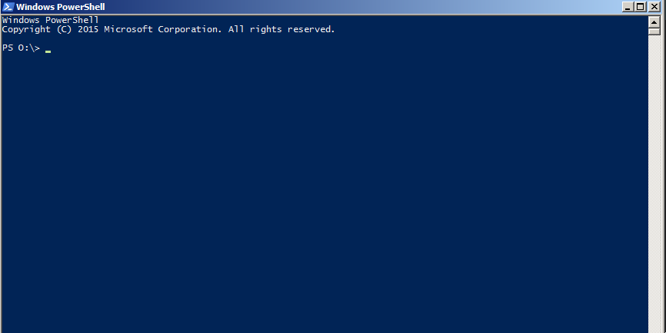
Windows PowerShell
Copyright (C) 2015 Microsoft Corporation. All rights reserved.
PS C:\> get-service | get-member
TypeName: System.ServiceProcess.ServiceController
Name MemberType Definition
---- ---------- ----------
Name AliasProperty Name = ServiceName
RequiredServices AliasProperty RequiredServices = ServicesDependedOn
Disposed Event System.EventHandler Disposed(System.Object, System.EventArgs)
.
.
.
StartType Property System.ServiceProcess.ServiceStartMode StartType {get;}
Notes:
Get-service
Get-service |get-member
We now pass a “qualifier” to get more information. The get-member commandlet returns all the “properties” that are related to get-service. We will see how to use these soon.

Slide 55
Pipe Example Details
Get-Member returns the members, properties and methods for objects. It can get it 2 ways:
Parameter – InputObject
Pipe – via Pipe command

Slide 56
Pipe Example Details
The get-service cmdlet pulls information(objects) for all services and passes it to get-member.

Slide 57
Filtering
Allows us to manipulate the output/data returned to our specific needs.
Good to run get-member first so we know what to look for

Slide 58
Common Filters
Sort-object – returns a list sorted on your input
Select-object – allows us to select cmdlet objects we are interested in
Where-object – allows for pattern matching
ForEach-object –performs action on each object

Slide 59
Windows PowerShell
Copyright (C) 2015 Microsoft Corporation. All rights reserved.
PS C:\> get-service | select-object Name, Status, Starttype
Name Status StartType
---- ------ ---------
AdobeARMservice Running Automatic
AdobeFlashPlayerUpdateSvc Stopped Manual
AJRouter Stopped Manual
ALG Stopped Manual
AppHostSvc Running Automatic
AppIDSvc Stopped Manual
Appinfo Running Manual
Apple Mobile Device Service Running Automatic
AppMgmt Stopped Manual
AppReadiness Stopped Manual
Notes:
Get-service
Get-service |get-member
We now pass a “qualifier” to select-object which allows us to tell get-service what we are interested in pulling. In this case it is:
Name
Status
Starttype

Slide 60
Select-Object Details
Allows us to select (duh) which objects we are interested in. We can pull from pretty much anything that comes back from get-member (properties)

Slide 61
Windows PowerShell
Copyright (C) 2015 Microsoft Corporation. All rights reserved.
PS C:\> get-service | select-object Name, Status, Starttype |where-object {$_.status –eq “running”}
Name Status StartType
---- ------ ---------
AdobeARMservice Running Automatic
AppHostSvc Running Automatic
Appinfo Running Manual
Apple Mobile Device Service Running Automatic
atashost Running Automatic
AudioEndpointBuilder Running Automatic
Audiosrv Running Automatic
BBUpdate Running Manual
BFE Running Automatic
Notes:
Get-service
Get-service |get-member
We now have a long “qualifier” but in essence it is the same – we are filtering/refining what we want returned. In this case we want all services that are in a ‘running’ state.
Note the $_. this tells PowerShell of all the “properties” from get-member I am interested in the one name status.

Slide 62
Where-object
Where-object {$_.status –eq “running”}
{ - indicates that the a code snippet applied to an object
$_ - default variable indicating the current instance of the object being evaluated
-eq – conditional operator in this case equals
“running” – condition check.

Slide 63
Labs
Filters & Pipes
LAB 4 Try on your own.

Slide 64
Coding practices
If
If this then that (IFTT)
Function
Separate code piece that can be called
While
While I sleep nothing gets done
For
While x is less then 10, do something.
Foreach
Foreach child = school debt

Slide 65
Background of the Tool
Scenario:
Have access to a system, and want to obtain a user’s credentials
When a user saves a file to particular network share we want to prompt the user with a password prompt
Credentials obtained are sent to a Metasploit web listener.
Idea came from a Metasploit minute video by Rob Fuller (Mubix)

Slide 66
Demo of tool
<break>

Slide 67
Code review
Demos demos demos

Slide 68
Where else can we look?
Providers shows various kinds of data storage as a disk drive.
Powershell supports the ability to browse the registry, certificate store, and
Get-psprovider will list available what PS has access to

Slide 69
Sample
Windows PowerShell
Copyright (C) 2015 Microsoft Corporation. All rights reserved.
PS C:\> get-psprovider |select Name,capabilities,Drives
Name Capabilities Drives
---- ------------ ------
Registry ShouldProcess, Transactions {HKLM, HKCU}
Alias ShouldProcess {Alias}
Environment ShouldProcess {Env}
FileSystem Filter, ShouldProcess, Creds. {C, F, D}
Function ShouldProcess {Function}
Variable ShouldProcess {Variable}
Notes:
Get-Psprovider allows us to view what is available to us – in this case gives me places to search for files.

Slide 70
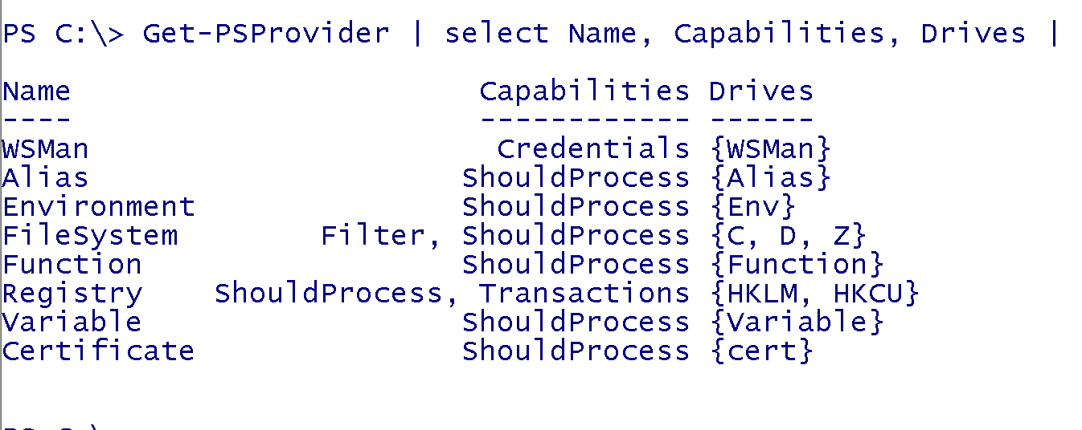
Sample

Slide 71
Sample

Slide 72
Navigating providers
Cmdlets with the noun item, or items are usually used for this purpose.
The noun items is used to retrieve a folder
Eg, get-childitem
The noun itemproperty returns data on a single object/file.

Slide 73
Where to monitor?
GOAL: When a user saves a file to particular network share we want to prompt the user with a password prompt.
DECISION: Where/what do we monitor?
We can ask the user (person running script not the victim)
We can look at the registry
We can “hard code” it
We can look at drive letters….. And on and on and on…

Slide 74
Navigating the registry
The HKEY_Local_Machine (HKLM) & HKEY_Current_User (HKCU) registry keys can be browsed directly through PowerShell.
To navigate into these keys use the set-location or its alias ;)
Use get-item to query registry keys
Use get-itemproperty to read the contents of a value.

Slide 75
Registry example
Set-location ”HKCU:\software\microsoft\Internet Explorer”
Get-item –path ”HKCU:\software\microsoft\Internet Explorer”
Get-itemproperty –path ”HKCU:\software\microsoft\Internet Explorer” –name “Download Directory”

Slide 76
Lets review the registry code from Invoke-Gimme
GOAL: Grab a file path form the most recently used list (e.g. recent files)

Slide 77

Registry Demo cont.
Let’s look at the code.

Slide 78
Lab 5
Time to mess around with the registry… you may need admin.
BE CAREFUL.
LAB 5 Registry

Slide 79

IF Statement Closer Look
If statements are used to determine an action based on the result of statement.
If statement is $TRUE everything in { …} gets executed
Switch statement could be used in lieu of several if’s

Slide 80
If statement continuation
Let’s look at the code.
Notes:
Notice the two parentheses after the if statement, and the –AND parameter linking the two
Statement 1:
If (test-path HKLM:\SOFTWARE\Microsoft\Office\15.0) { write-host “path exist” }
Powershell will check to see if the above registry key exist. If the result is $True, the code within the braces {} is evaluated.
Statement 2:
if ((test-path HKLM:\Software\Microsoft\Office\14.0) –AND (test-path “HKCU:\software\Microsoft\Office\14.0\Word\File MRU”)) {write-host ’these two parameters both exist’}
Powershell is checking to see if two paths exist. If both paths exist then the If statement will evaluate as $True and the write-host statement will be executed.
In lieu of many ”If” statements, you should consider using a switch statement.

Slide 81

Break
Please make sure you have download and save WMIExplorer onto your systems before we begin the next section.

Slide 82
WMI
WMI – Windows Management Instrumentation
We can look at WMI as a collection of objects that provide access to different parts of the operating system
WMI can be used both locally or remotely to obtain information or start process.

Slide 83
More WMI
WMI is organized into namespaces. Think of a namespace as sort of like a folder that ties to a specific product or technology.
WMI is divided into a series of classes. A class represents a management component that WMI knows how to query.

Slide 84
WMI Sample
Windows PowerShell
Copyright (C) 2015 Microsoft Corporation. All rights reserved.
PS C:\> get-wmiobject win32_service |select –first 1
ExitCode : 0
Name : AdobeARMservice
ProcessId : 2664
StartMode : Auto
State : Running
Status : OK
Notes:
Get-wmiobject win32_service | select –first 1

Slide 85
Brief explanation of CIM
First, you have to remember that CIM = WMI = CIM. CIM is an open standard from the Distributed Management Task Force (DMTF), with the latest version introduced in January 2016. CIM provides a common definition of management information for systems, networks, applications, and services, and it allows for vendor extensions. WMI is the Microsoft implementation of CIM for the Windows platform.

Slide 86
Some notes about CIM
The new “CIM cmdlets,” such as Get-CimInstance and Invoke-CimMethod—These are more or less equivalent to the old “WMI cmdlets,” although they communicate over WS-MAN (implemented by the Windows Remote Management service)instead of using RPCs. This is Microsoft’s way forward, and running Get-Command -noun CIM* reveals that Microsoft offers a lot more functionality through these commands.

Slide 87
Three Queries same result
Goal is to locate and identify the win32_service class
WMIExplorer- Great for helping to construct a query for use with Powershell.
Get-wmiobject –namespace root\CIMV2 –class win32_service
$query_service = “select * from win32_service”
Get-wmiobject –query $query_service

Slide 88
So why is example three over complicated?
Example 3
($query_service = “select * from win32_service”)
Example three uses a language referred to as WQL which is SQL for WMI
In order to configure the event monitoring with WMI, you must know how to use WQL to setup the

Slide 89
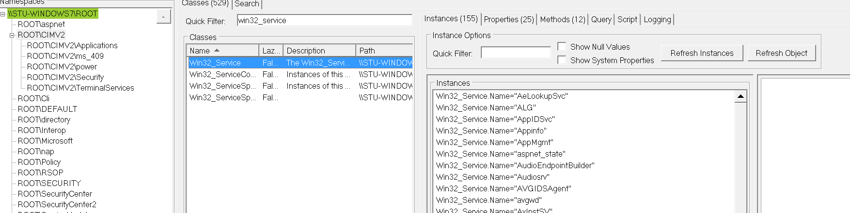
WMI Explorer
Screenshot below path:
Connect to localhost
Root\CIMv2
Win32_service

Slide 90
LAB
Lab <Insert lab number here>
6 if you couldn’t count.
Antivirus query or local group administration

Slide 91
String manipulation
What if we have to manipulate input/output, take only a portion, escape characters, et. Al.? Strings to the rescue.
Upper/Lower
Split/Join
Replace/Remove

Slide 92
Create a variable
$a = ‘The quick brown fox’
[string]$a=‘The quick brown fox’
The options available to us can be seen by running get-member against a string.
$a | get-member –membertype method

Slide 93
Manipulating text
$a.split() & $a.split(’q’)
$a.ToUpper()
THE QUICK BROWN FOX
$a.replace(’Fox’,’Lion’)
the quick brown fox
What is $a equal to after running the above commands?

Slide 94
String Lab
Lab 7 Similar to our sample

Slide 95
WMI Subscriber
Explain concept behind event driven wmi
What are the three components:
Query
Action
Name

Slide 96
Writing a query
Query is written using WQL
Backslashes must be commented out. So if we want to capture at path C:\windows, we must use C:\\windows
The query is comprised of the class to query and then any other components.

Slide 97
Action and ID
Action is what we want to occur after the query is met.
Command(s) are surrounded by hashes (eg, { } )
The ID is the name that will uniquely identify this subscriber.

Slide 98
WMI Subscribers
Temporary
Runs as long as the PowerShell window is open.
Permanent ---- W00T!!!!!!
Run as system
Great way to maintain persistence as it survives a reboot
or use it as a HID

Slide 99
WMI events
Classes of interest:
__instanceCreationEvent
__instanceDeletionEvent
__InstanceModificationEvent
registryKeyChangeEvent
RegistryTreeChangeEvent
RegistryValueChangeEvent
Permanent ---- W00T!!!!!!
Run as system
Great way to maintain persistence or use it as a HID

Slide 100
Temporary event subscriber
$Query ="Select * from RegistryTreeChangeEvent where Hive='HKEY_LOCAL_MACHINE' AND RootPath='Software\\”
$Action = { $Global:Data = $Event ; Write-Host 'Something happened!' -ForegroundColor Green -BackgroundColor Black }
Register-WmiEvent -SourceIdentifier "test" -Query $query -Action $action

Slide 101
DEMO
Lets analyze our code!
Open wmi explorer and
cim_datafile class. It is located under root/cimv2
What Properties can we filter on.
Lets do work!

Slide 102
Our code
$query =("Select * from _instanceCreationEvent within 10 where targetinstance isa 'cim_datafile' and targetInstance.drive='$pathToMonitorDriveLetter')
*Consolidated filter

Slide 103
WMI subscriber code
Register-WmiEvent -Query $query -SourceIdentifier "MonitorFiles3" -Debug -Action {
$Global:MyEVT=$event $modFilename=$event.SourceEventArgs.newevent.TargetInstance.filename
$modExtension=$event.SourceEventAgs.newevent.TargetInstance.extension...

Slide 104
Lab
8

Slide 105
Combining .NET and Powershell
.net framework consist of code that other developers can utilize to obtain repeatable and consistent output.
.Net classes are used when we must provide additional functionality to powershell.

Slide 106
Calling .net libraries
Words, hand gestures and stuff –two demos in one
Demo : [Microsoft.VisualBasic.Interaction]::MsgBox("Unable to reach $modDriveLetter Drive. File $modFileNameExtension was not saved", 'okonly,SystemModal,Information', "Error saving file")
Calling VB.interaction library

Slide 107
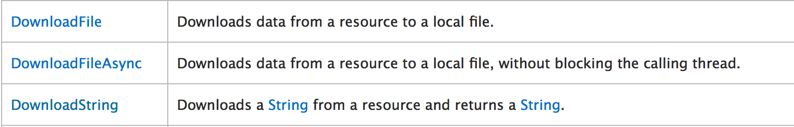
Example 1
Goal is to download a file using the system.net.webclient class
We must first determine if this class is appropriate for our task.
Can check MSDN:
https://msdn.microsoft.com/en-us/library/system.net.webclient(v=vs.110).aspx
Assign a variable within Powershell and then run get-member
$classdemo=(new-object system.net.webclient)

Slide 108
Example 2
We are going to use the Downloadfile method.
$classdemo.downloadfile(<URL>,<full path of destination>

Slide 109
Examples in our script
[Microsoft.VisualBasic.Interaction]::MsgBox()
Purpose: Present the first error box to the user
[Environment]::UserDomainName
Purpose: Populate Domain name into credentials box
[Environment]::UserName
Purpse: Poplute username into credentials box

Slide 110
FIN
About Damn Time already….

Slide 111
Where to go from here?
We built this script to highlight some PowerShell basics and how they could be used pretty simply to attack a system. It’s up to you to improve on this and make it better… don’t worry I will take credit ☺
Demo tool is “red” team focused – how can you use what you learn for “blue” team? Monitoring a directory may be a good thing?
Make this into a module that can run on it’s own or as a module for other PS tools
Improve where it looks to monitor
Why choose one when you can have them all
Validate the creds you get
Multiple pop-ups, back-end validation
Got real creds? Good then get the data
Build your own that has nothing to do with this – hopefully we inspired you and given you the basics to get started.

Slide 112
Further PowerShell Goodness
https://www.youtube.com/watch?v=3vJvkANKVWA
https://www.youtube.com/watch?v=893NGtZlod8 - Gray Hat Powershell
https://www.youtube.com/watch?v=4X_uBL2YpmA - Practical Powershell programming for Practical Programmers
https://dl.mandiant.com/EE/library/MIRcon2014/MIRcon_2014_IR_Track_Investigating_Powershell_Attacks.pdf
https://www.youtube.com/watch?v=cXWtu-qalSs
https://adsecurity.org/?p=2843
https://www.youtube.com/watch?v=j9HMjaI9qgk

