Slide 1

Problem Statement and Team Details
Problem Statement: Stock markets are confusing for beginners. Apps like Groww or Zerodha show stock prices but do not explain what action to take. Students and small investors often rely on friends, random YouTube videos, or trial-and-error, leading to poor decisions.
Team Name: Coffee & Code
Team Leader Name: M. Vikas
Institute Name: KL University
Team Leader Email ID: vikasmacharla2207@gmail.com

Slide 2
Problem and Solution
Problem:
Beginners lack clear, actionable stock advice.
Existing apps show numbers, not decisions.
Solution:
Build a Stock Consultant Agent that:
Accepts a user’s portfolio as input
Uses live/updated stock data
Suggests Buy / Sell / Hold / Diversify in plain English
Tracks usage and integrates billing (Flexprice)
Uses Pathway for updated stock data and live updates

Slide 3
Methodology & Implementation
Input Portfolio: User enters list of holdings.
Data Fetching: Stock data retrieved via Pathway (mock/live API).
Analysis Engine: Rule-based/AI logic generates advice.
Advice Generation: Output simple English suggestions.
Usage Tracking: Count portfolios analyzed and advice generated.
Billing Integration: Flexprice charges per advice and per portfolio.
UI/Reports: Dashboard showing advice, usage, and billing history.

Slide 4
Technology Used
Frontend: React (UI for portfolio input and advice display)
Backend: FastAPI (Python) for portfolio analysis & billing API
Database: PostgreSQL / JSON storage for usage & billing
Data Source: Pathway (CSV or API for stock data)
Integration: Flexprice billing system

Slide 5
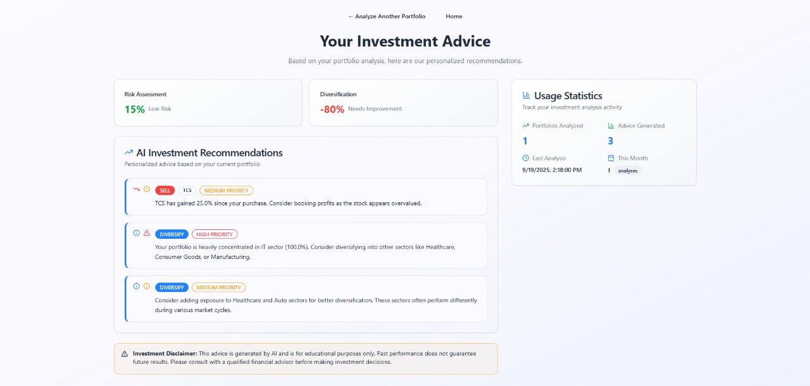
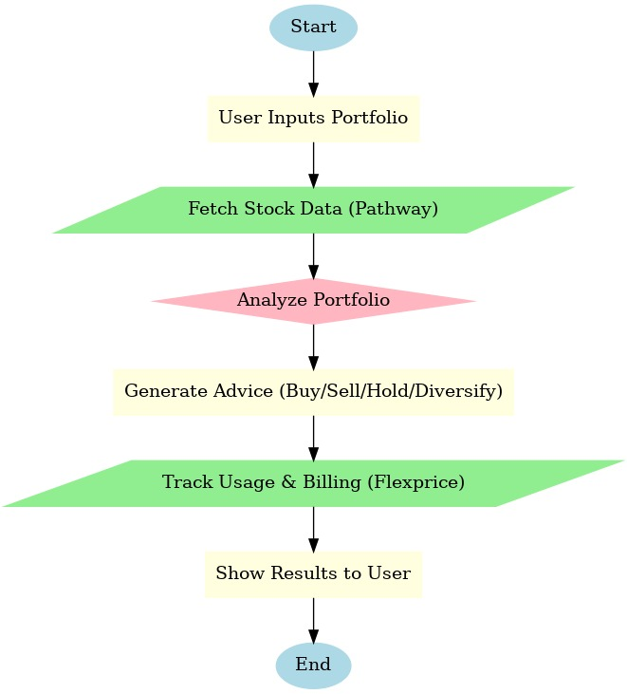
Flowchart & Supporting Images
Supporting Images
Flowchart

Slide 6
Feasibility and Market Use
Feasibility and Market Use Points
The proposed Stock Consultant Agent is highly feasible and meets a clear market need. It addresses the significant gap in accessible, simplified financial advice for new and small-scale investors.
Feasibility Analysis
Simple UI: A basic web form for portfolio input is a standard, low-complexity development task.
Rule-Based Logic: A rules-based engine for providing advice is straightforward to implement.
Data Integration: Using Pathway for a data pipeline ensures that the agent can efficiently process and use updated stock prices.
Billing Integration: The use of a metered billing service like Flexprice simplifies the entire billing process, allowing for a transparent, usage-based pricing model.
Market Use Points
Target Audience: It directly serves students and beginner investors who are often ignored by traditional financial services due to high costs.
Clear, Actionable Advice: The agent's core value is its ability to simplify complex financial data into plain English
Affordable and Transparent: The pay-per-use model is a powerful selling point.
Financial Literacy: By explaining the why behind its advice (e.g., "Your portfolio lacks IT stocks"), the agent serves as an educational tool, helping users learn key concepts like diversification and risk management.

Slide 7
Conclusion
The Stock Market Consultant Agent bridges the gap between raw market data and actionable advice.
It empowers beginners with clear guidance, integrates billing for sustainability, and leverages Pathway for live stock updates.
This makes investing simpler, smarter, and more accessible.

