Slide 1
Email Spam Classification
GONG Yanming
HE Jingrao
ZHOU Ruoyu
ZHOU Yifan
Group 12
13th Apr 2023

Slide 2
01
Background
OUTLINE
02
Data Source
03
Data Preprocessing
04
Classification Model
05
Result Analysis
06
Conclusion

Slide 3
#01
Background

Slide 4

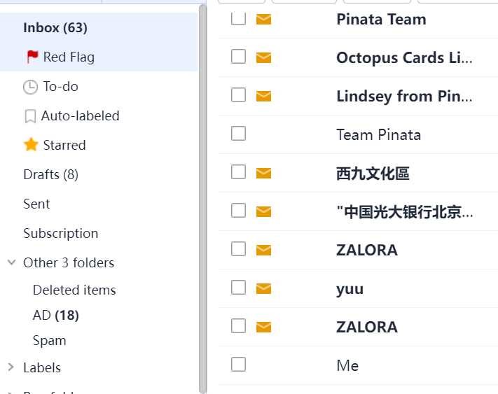
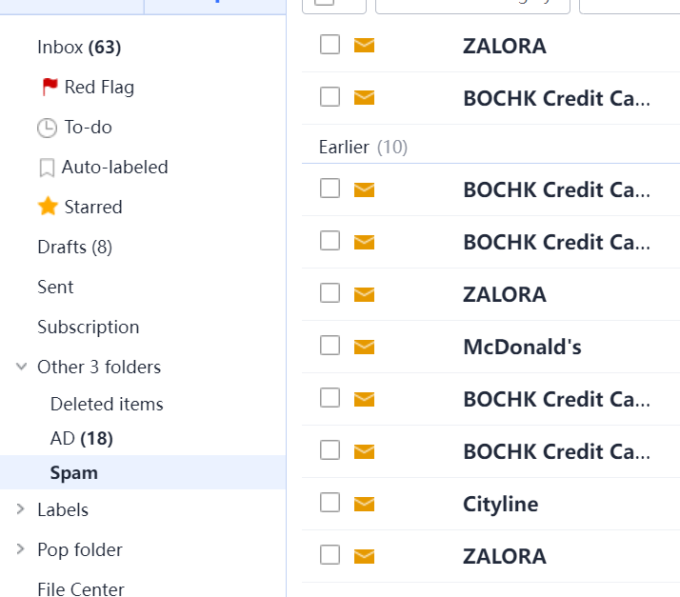
01 Background
Inbox
Spam

Slide 5
#02
Data Source

Slide 6
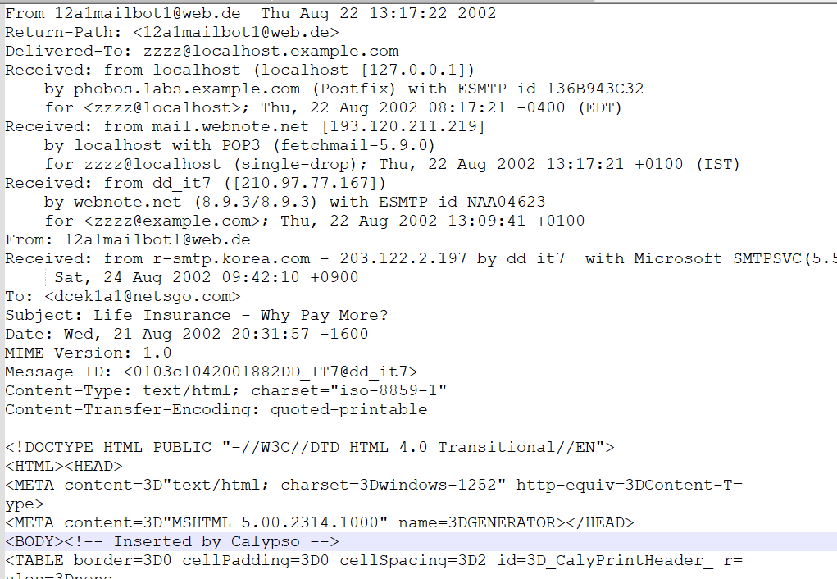
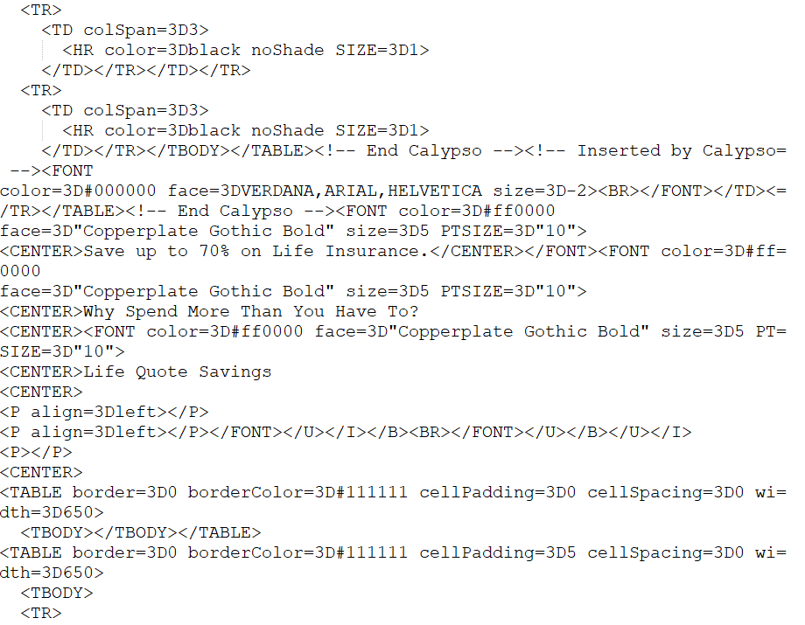
02 Data Source
3302 email files, including 501 original spam files and 2801 original non-spam emails
The example of non-spam emails
The example of spam emails

Slide 7
#03
Data Preprocessing

Slide 8
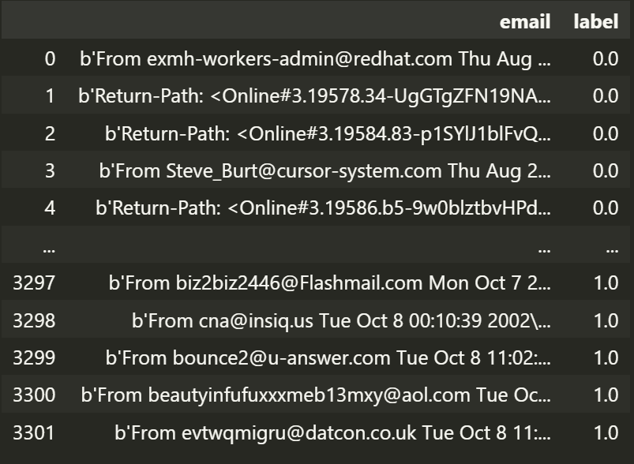
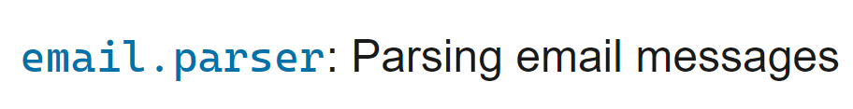
03 Data Preprocessing
Parse emails
Use Email.Parser Package
Read MIME format
Extract the content of emails
Label
Label: spam(1) and ham(0)

Slide 9
03 Data Preprocessing
Remove Punctuation, Numbers, etc.
Change punctuation into blanks
Change \n/numbers into blanks
Convert all words to lowercase
Remove Stopwords
Remove some stopwords
Such as he, she, and it
afford domain everyone new domain name final avail gener public discount price regist one excit new biz info domain name well origin

Slide 10
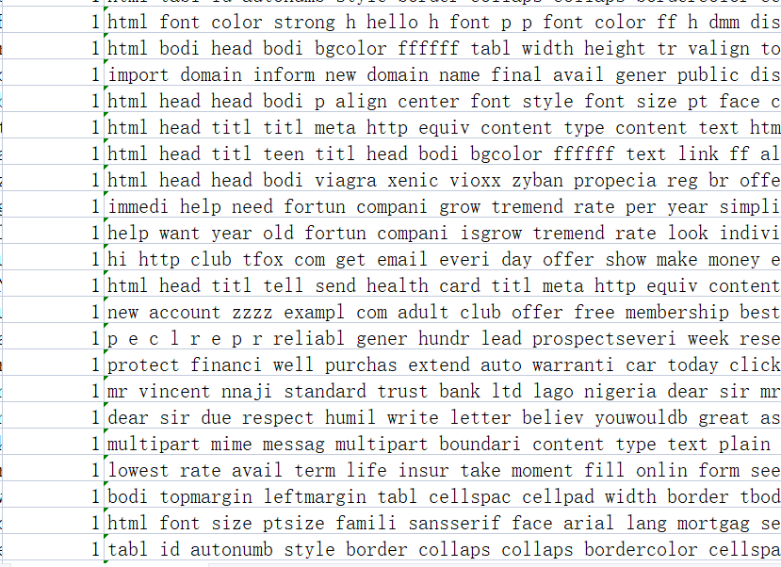
03 Data Preprocessing
Stemming
Use the stemmer from nltk
Extract the stem of each word
Such as eating=>eat
Remove empty lines
3063 pieces of effective data
label
Email content
Part of the Data Set

Slide 11
#04
Classification Model

Slide 12
04 Classification Model
Four classical classification models
SVM
KNN
Decision Tree
Random Forest
Advanced classification model
Bert-Based Model

Slide 13

04 Bert-Based Model
Encoder
Encoded vectors
Decoder
Input Embedding
Fully Connection Layer
Bidirectional Encoder
Representations from Transformers
Loss function
(Binary Cross Entropy Loss)
Email content
Prediction

Slide 14
04 Bert-Based Model
Encoder: Flair(based on BERT)
Solve the problem that the length of each sentence is not the same
Encodes a sequence of text into vectors
Decoder: Bi-LSTM
Find the relationship between sentences and sentences

Slide 15
#05
Result Analysis

Slide 16
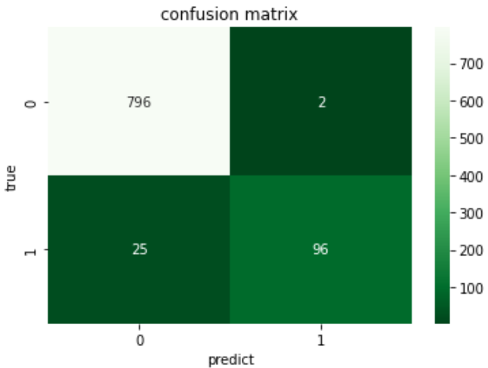
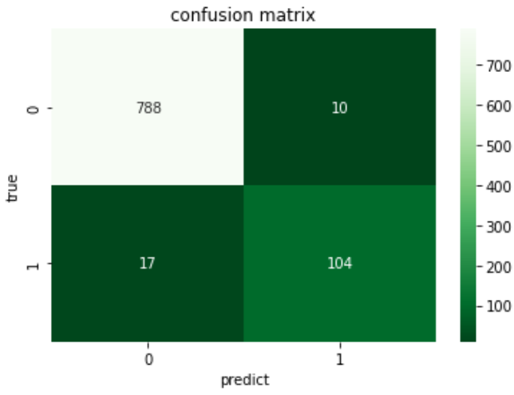
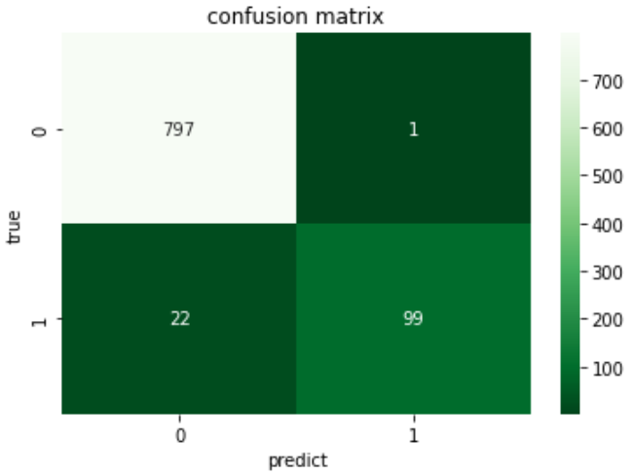
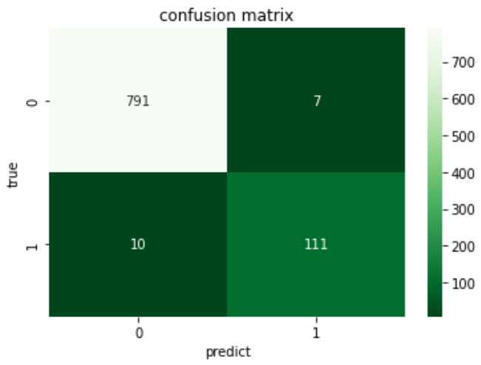
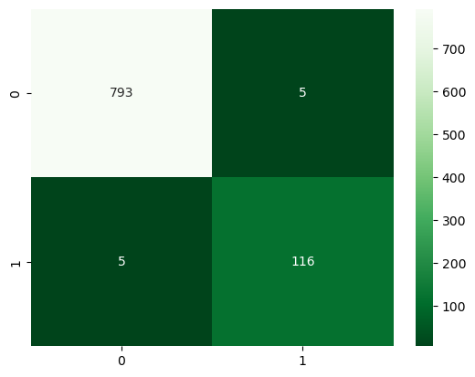
05 Result Analysis：Classic Classification Model
KNN
Decision Tree
Random Forest
SVM
Bert-Based Model

Slide 17
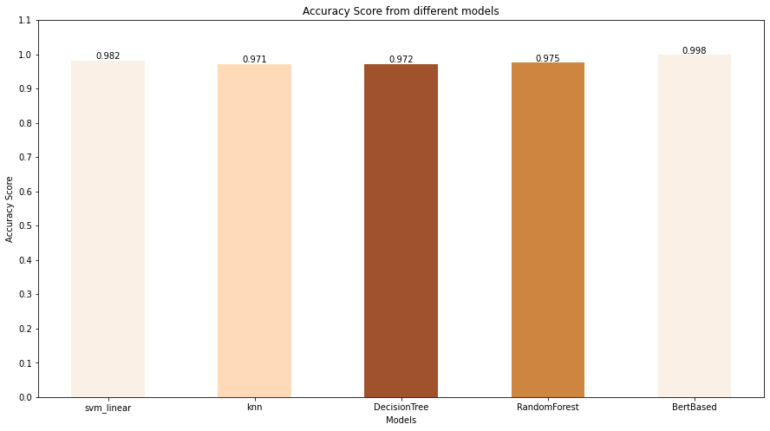
05 Result Analysis
Accuracy Score

Slide 18
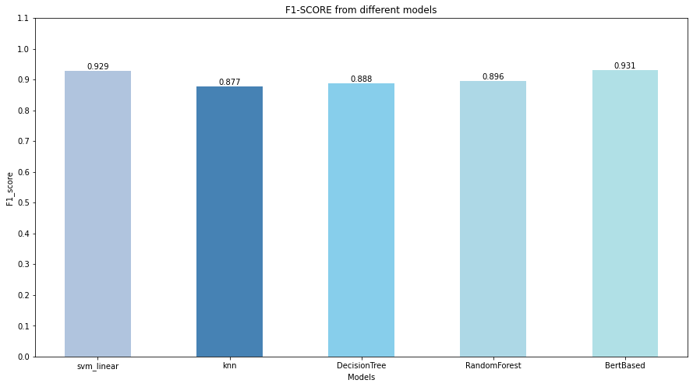
05 Result Analysis
F1 Score

Slide 19
05 Result Analysis: Classic Classification Model
Performance: SVM > Random Forest > Decision Tree > KNN
KNN algorithm is less effective when dealing with data imbalanced data sets
Decision trees and random forests are prone to overfitting
SVM is better to classify spam emails

Slide 20
05 Result Analysis：Bert-based Model
Best Performance
Flair(Bert-based)
Process the context information, avoiding the limitations of the traditional bag of words model
Bi-LSTM
Capture contextual information
Better handling of long text

Slide 21
#06
Conclusion

Slide 22
06 Conclusion
Classic Classification Model
Only pay attention to the classification of the sentence itself
Bert-based Model
Focus on relationships between contexts
Better suited for long texts

