Slide 1


KNN for Facial Expression Detection
Prof. Adriana TAPUS
adriana.tapus@ensta-paris.fr
Heng Zhang
heng.zhang@ensta-paris.fr
Zhegong SHANGGUAN
zhegong.shangguan@ensta-paris.fr
4th of October, 2021

Slide 2


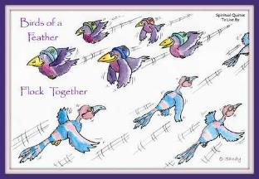
1. Introduction
What is KNN?
“Bird of a feather flock together”
Those who have similar characters or interests tend to form groups.
KNN (K Nearest Neighbors):
K means K training examples in feature space; Nearest Neighbors means these k training examples are nearest to the new input among all examples.
Proposed by Thomas Cover;
Belongs to supervised learning;
Is instance-based learning, no need for training;
Used for classification and regression.

Slide 3





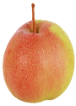
2. KNN for Classification
Fruit Classification
Weight
Watermelon
Apple
KNN Step:
1. Load all samples in the feature space;
2. Fix K (here K=5) as the number of the nearest neighbors;
3. Calculate the Euclidean distances (you can also try other distance) between target example and all the labeled examples (Watermelon, Apple and Pear);
4. Sorted samples based on distance (from smallest to biggest);
5. Pick the nearest K samples and record their labels. (3 pears and 2 apples in this example);
6. Select the label with largest number as the final result (3>2, recognition is “pear”).
Note: if you use KNN for regression, just return the mean of the K labels.
Distances
k=5
Target example
Feature Space
Pear
Size
Euclidean distance:
is Pear!!!

Slide 4
3. Task - Facial Expression Classification
Facial Expression Classification
Task: Classify the emotion given a static face image with KNN.
Emotion categories: 0=Angry, 1=Disgust, 2=Fear, 3=Happy, 4=Sad, 5=Surprise, 6=Neutral.
Dataset: FER-2013. The database contains over 30000 pixel grayscale images of faces, each size is 48×48.
Notice: To get a good result, you should use the feature extraction technology of image processing, for example, Local Binary Patterns (LBP). LSP library can be found in scikit-image. And you can use the KNN library of scikit-learn directly.
Submit: Report and related code (jupyter notebook format code is recommended). You can use github to submit the link.

Slide 5

3. Task - Facial Expression Classification
Pipeline of Processing
Feature extraction
KNN Classifier
Emotion ?
Image Size: 48*48
image type: Grayscale
Extracting feature by LBP method
Using “scikit-image” library
Using “scikit-learn” library
Link of LBP

Slide 6
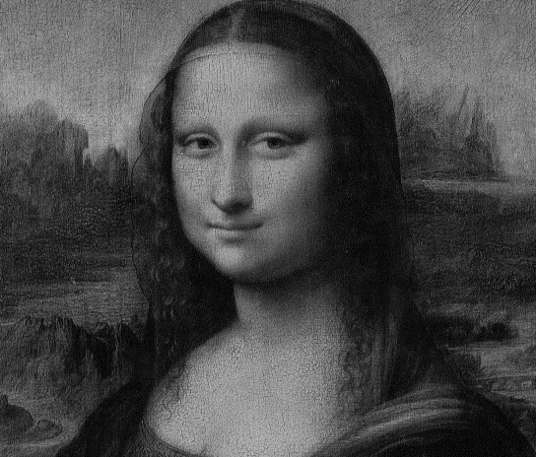
3. Task - Facial Expression Classification
LBP Process
LBP is a simple yet very efficient texture operator which labels the pixels of an image by thresholding the neighborhood of each pixel and considers the result as a binary number.
Block 1
Block 16
……
…
256
256
Divide into 16 blocks
LBP histogram of each block
Concatenated Histogram
(Facial features)

Slide 7

3. Task - Facial Expression Classification
LBP Process
pixel value 0~255
20
30
90
0
0
1
80
50
45
1
0
Block 6
76
66
32
1
1
0
one pixel and its 8 neighbors
Pattern (0,0,1,1,0,1,1,0)
(if pixel >50, binary=1,
else binary=0)
Original image
Binary (0, 0, 1, 1, 0, 1, 1, 0)₁₀
= 2² +2³ + 2⁵ + 2⁶
= 108
8 neighbors
2⁸ =256 possible arrangements
Histograms range [0, 255]
108
256

Slide 8

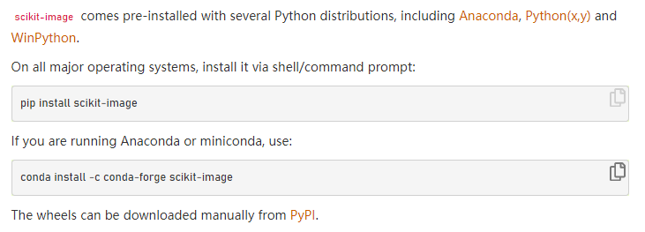
3. Task - Facial Expression Classification
scikit-image is a collection of algorithms for image processing.
More details about installation→ https://scikit-image.org/docs/stable/install.html
scikit-image→ LBP
link

Slide 9
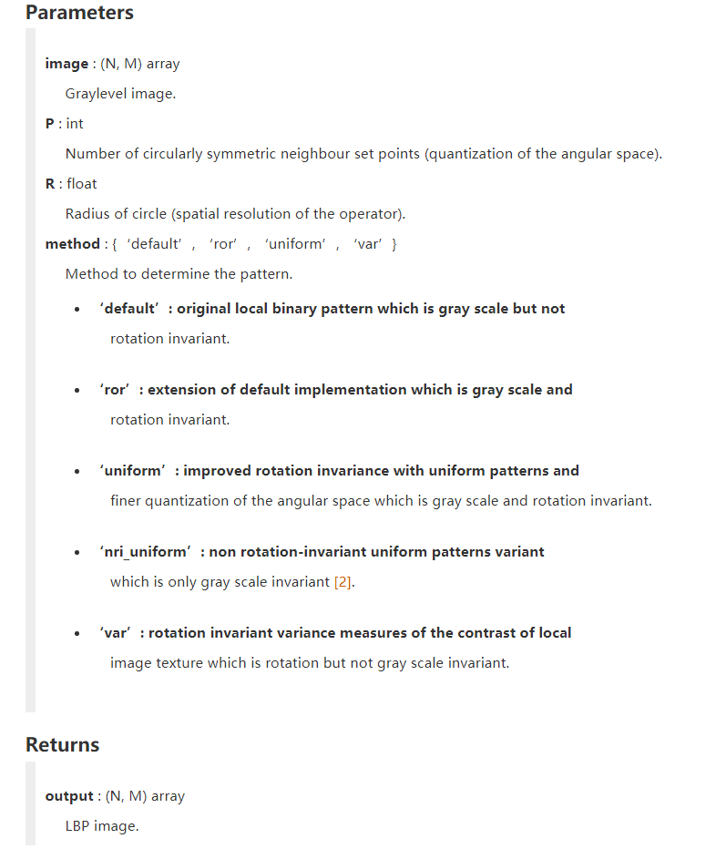
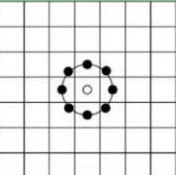
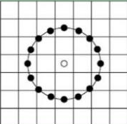
3. Task - Facial Expression Classification
P = R*8
R=1, P=8
R=2, P=16

Slide 10

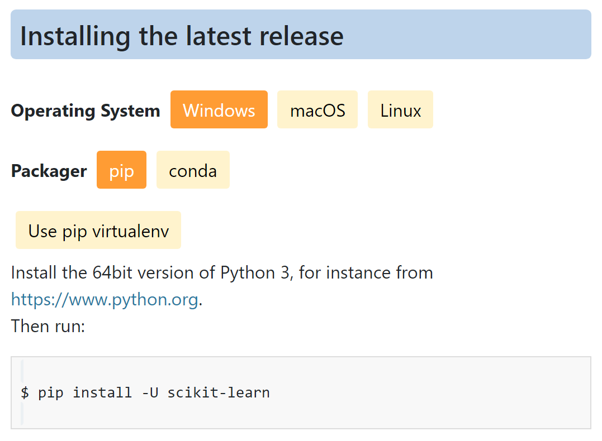
3. Task - Facial Expression Classification
Scikit-learn: a free software machine learning library for the Python.
More details about installation→ https://scikit-learn.org/stable/install.html
scikit-learn→ KNN
link

Slide 11
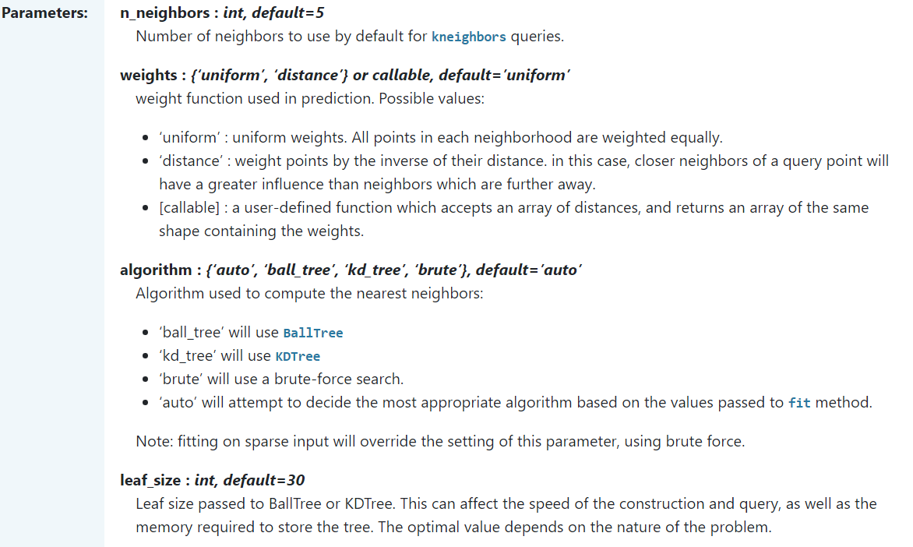
3. Task - Facial Expression Classification

Slide 12
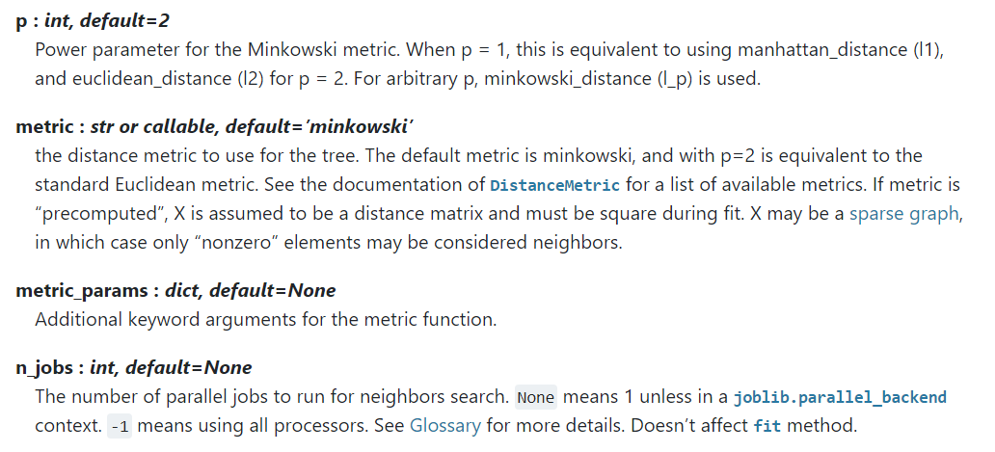

3. Task - Facial Expression Classification
Euclidean distance

Slide 13

Thanks！

