Slide 1
ALL
Major-Course
PUBLIC=
ALL-MC
CROSS MAJOR
MAJOR COMPULSORY
MAJOR ELECTIVE

Slide 2
Input: major_id major_type
MAJOR ID | COURSE ID | TYPE 1-COMPULSORY 2-ELECTIVE
1 | C1 | 1
1 | C2 | 2
2 | C3 | 1
2 | C4 | 2

Slide 3
Section对应entry
合并section
Course 1 1 1 1
Section 1 1 1 2
Class 1 2 3 4
一 荔 一
找到一个section最多有多少class，记为max
维护大小为max的类似队列的东西来存之前的状态

Slide 4
section1 CS101
section2 CS102
section3 CS101
COFLICT:CS101,CS102,CS101

Slide 5
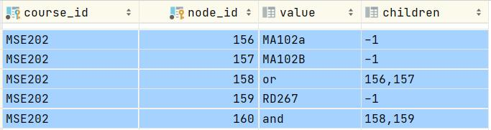
MSE202的先修课是RD267 and (MA102a or MA102B)

Slide 6
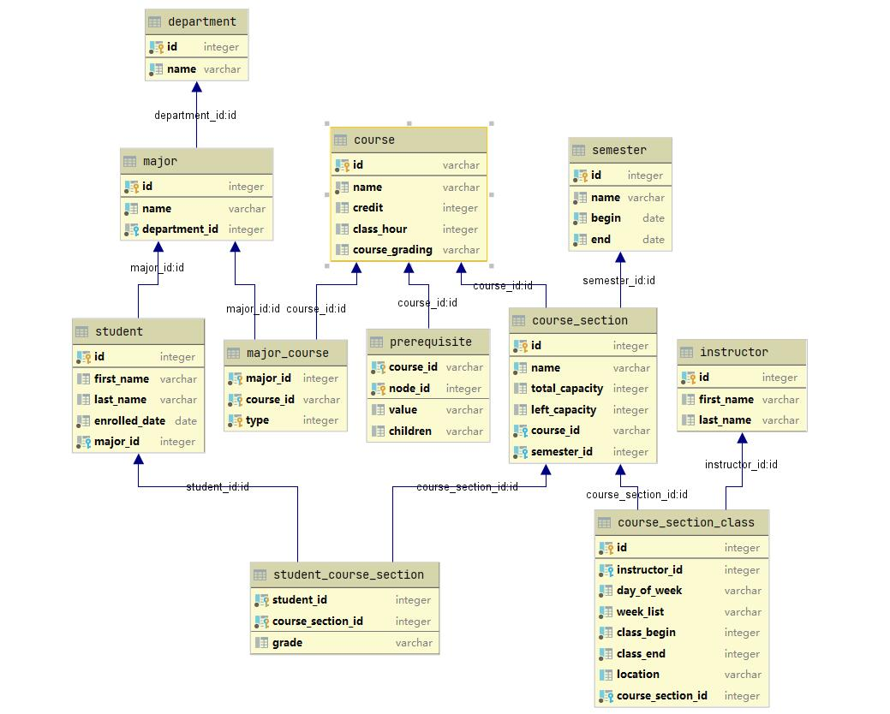

Slide 7
