Slide 1
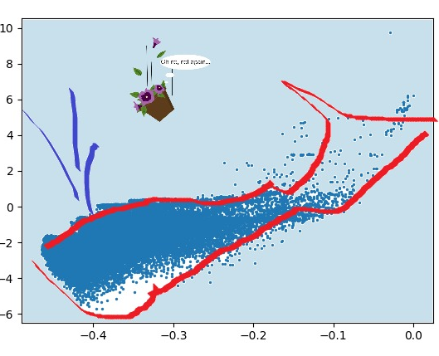
devices-gone-rogue ARMIS challenge OR It’s easy to kill an isolated whale
The whale and The Petunias

Slide 2
OUTLINE
Feature exploration
Feature engineering and selection
Model(s)
Explainability

Slide 3
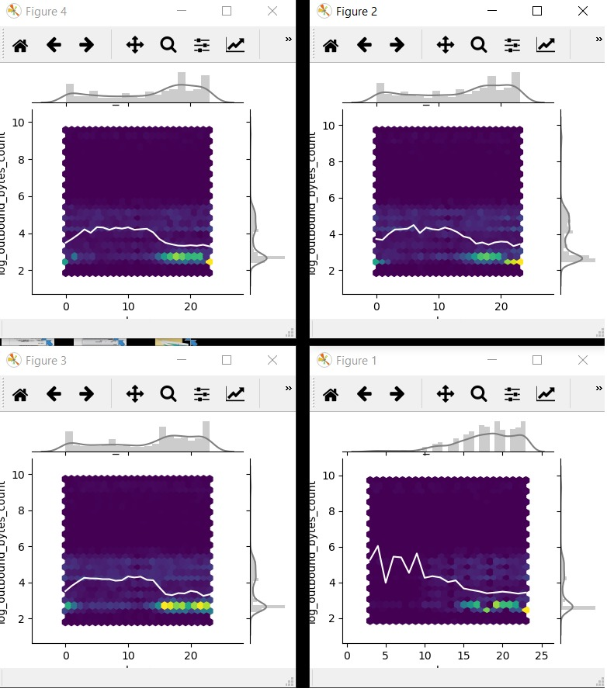
Feature exploration
Differences between networks?
Between days?...

Slide 4
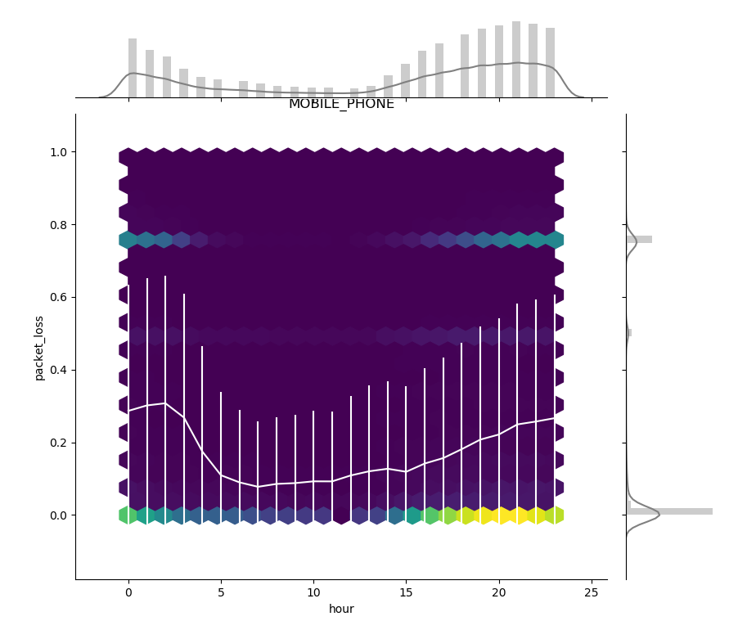
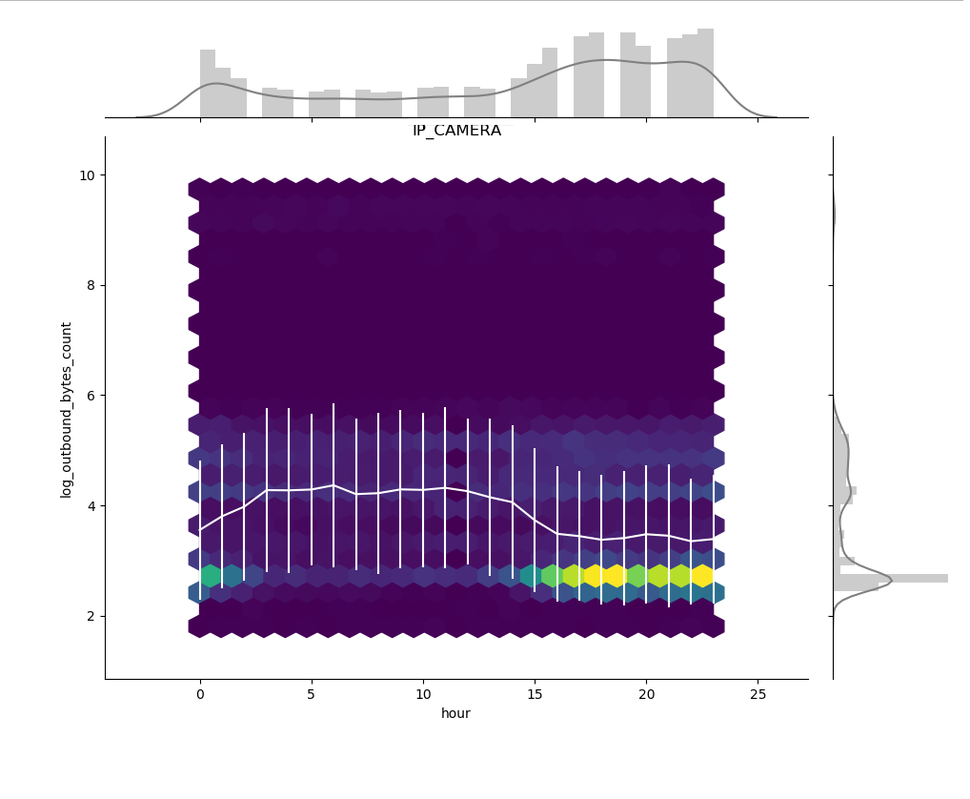
Feature exploration
Devices behave similarly across networks and days, but some have daily cycles
-> We subtract the hour-dependent baseline

Slide 5
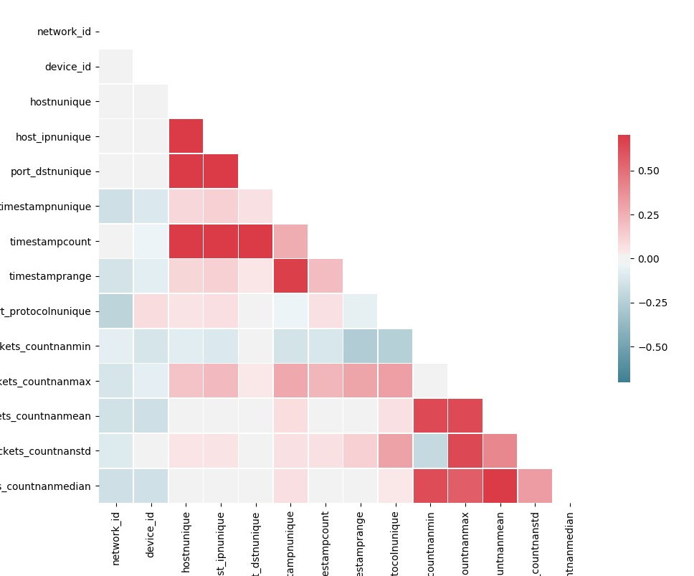
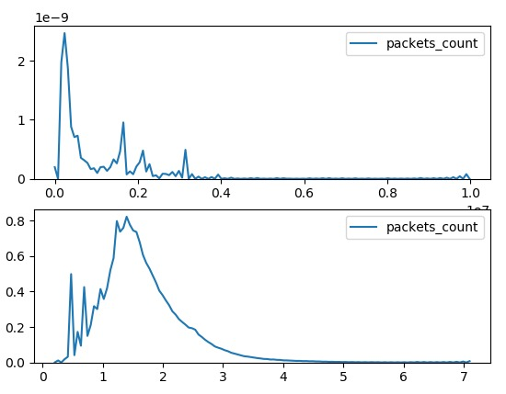
Feature engineering and selection
Aggregation of data across sessions for each device
Residual features per timestamp
Multivariate anomalies (ratios between features etc.)
Remove/combine highly correlated features
Log transformation?

Slide 6
Model
Isolation Forest
Outbound information features (packets/bytes)
When the device was active (timestamp counts, window of activity, etc.)
Communication with other devices (Ips etc.)
Protocols and ports that device communicates with
Other attempts
DBScan, KNN…
AutoEncoder DNN (with training data based on IF results)

Slide 7
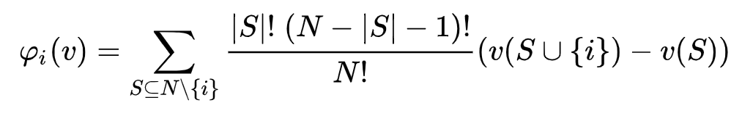
Explaining the results
SHAP values:
Compute theoretical value by brute force (2^{N_model_features} runs of the model):
(can be used for explanation and/or feature selection)
Or…

Slide 8

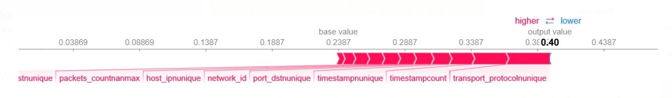
Explaining the results
…estimate it using the shap library
Non-anomalous mobile phone…

Slide 9

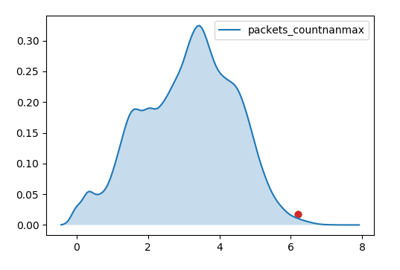
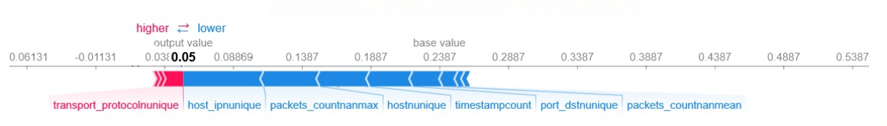
Explaining the results
Anomalous PC…

