Slide 1

SCHOOL OF COMPUTER SCIENCE & INFORMATION TECHNOLOGY
Name of the student:- YASH GUPTA Faculty Mentor:- NEHA SHARMA MAM Industry Mentor:- VIMAL DAGA SIR Name of the company:- REDHAT PUNE, (APAC) Date of Internship:- 02nd August, 2021– 01st October, 2021
Title:- Develop own MLOps Platform - Applying Machine Learning / Deep Learning techniques to Business Operations Using DevOps

Slide 2

$ whoami
Student of B.TECH 3rd Year
Studying CS&IT
Qualified RH294, DO180 in single attempt.
Interned as Multi-Hybrid Cloud Engineer at LW Informatics, Jaipur(Rajasthan)
Interned as MLOps Engineer at Redhat Pune, India(APAC)

Slide 3
Job Description
I interned as MLOps Engineer.
My duty is to integrate ML with DevOps in Fully-Automated way.(Also, known as End-to-End ML).
I worked both in the role of ML Developer as well as Operation's engineer.

Slide 4
What we have in Agenda

Slide 5
How it all Started…
Problem Statement
Pre-Covid vs Post-Covid
Idea of MLOps
Key Skills Earned
Learning Outcome
Notes:
Here, I will explain what we are going to discuss as project presentation. Why companies start thinking other than just ML?

Slide 6
1
SCENARIO OF INDUSTRY

Slide 7
Timeline:-
2000s
2010
Before Pandemic Industry is struggling with CI/CD of ML Models in Production.
But as COVID-19 Pandemic came it impacted very badly…..
2015
2019
2020
2021
Notes:
Pre-Covid vs Post-Covid

Slide 8
90%
“
Machine Learning Models Never Gets To PRODUCTION.
“
Notes:
Before Covid-19 around 90% are never implemented. Means Never gets Deployed in Real World. The percentage of AI models created but never put into production in large enterprises has been estimated to be as much as 90% or more.

Slide 9
“
With massive investments in data science teams, platforms, and infrastructure, the number of AI projects is dramatically increasing — along with the number of missed opportunities. Unfortunately, most projects are not showing the value that business leaders expect and are introducing new risks that need to be managed.
" Problem Statement ...
“
Notes:
Before Covid-19 around 90% are never implemented. Means Never gets Deployed in Real World. The percentage of AI models created but never put into production in large enterprises has been estimated to be as much as 90% or more.

Slide 10
SOLUTION is ….
Notes:
DataScience that Industry Needs MLOps - Enterprise AI
With massive investments in data science teams, platforms, and infrastructure, the number of AI projects is dramatically increasing — along with the number of missed opportunities. Unfortunately, most projects are not showing the value that business leaders expect and are introducing new risks that need to be managed. Solution to the above problem statement is MLOps. MLOps delivers the capabilities that Data Science & IT Ops teams need to work together to deploy, monitor & manage machine learning models in production and to govern their use in production environments.

Slide 11
ML + DevOps
Notes:
DataScience that Industry Needs MLOps - Enterprise AI
With massive investments in data science teams, platforms, and infrastructure, the number of AI projects is dramatically increasing — along with the number of missed opportunities. Unfortunately, most projects are not showing the value that business leaders expect and are introducing new risks that need to be managed. Solution to the above problem statement is MLOps. MLOps delivers the capabilities that Data Science & IT Ops teams need to work together to deploy, monitor & manage machine learning models in production and to govern their use in production environments.

Slide 12
2
WHAT IS “MLOPS”?
Notes:
To clearly understand the idea behind MLops? First I like to tell how this terms is created?

Slide 13
‘
DevOps is a set of practices that combines software development and IT operations. It was introduced in market to remove the SILOS between the Developer & Operation guy. It consists of a Standard DevOps Cycle i.e.
PLAN.
CODE </>
BUILD
TEST
RELEASE
DEPLOY
OPERATE
MONITOR
WHAT DO WE MEAN BY “DevOps”
‘
Notes:
What do we mean by DevOps?
How it was introduced in market?
DevOps lifecycle.

Slide 14
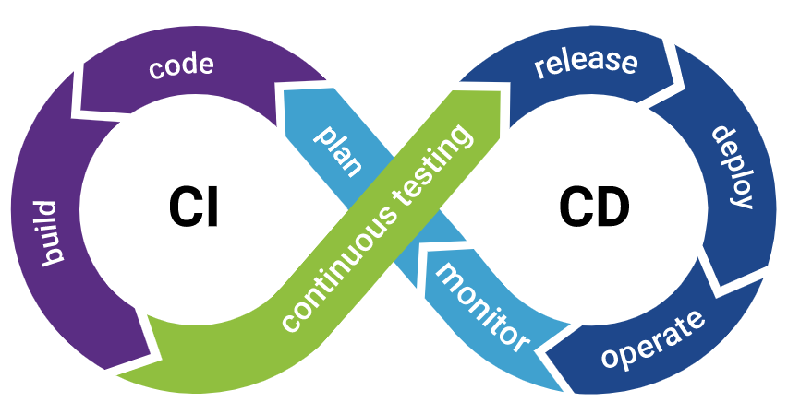
‘
Role of “CI+CD”
‘
Notes:
What do we mean by DevOps?
How it was introduced in market?
DevOps lifecycle.

Slide 15
‘
“
WHAT DO WE MEAN BY
Machine Learning?
Machine learning is a branch of artificial intelligence (AI) and computer science which focuses on the use of data and algorithms to imitate the way that humans learn, gradually improving its accuracy.
“
‘
Notes:
What is core behind ML?

Slide 16
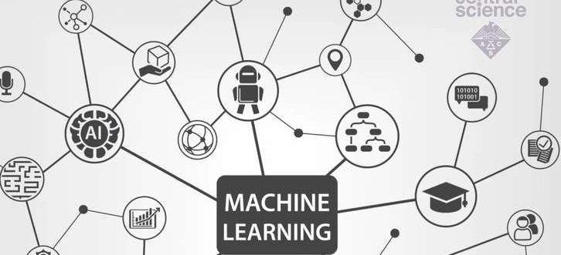
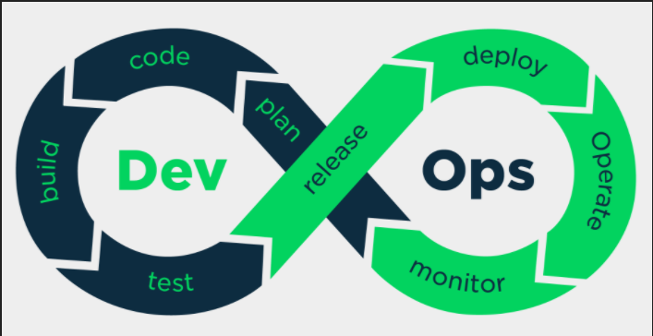
‘
Combining Machine Learning
+ DevOps >>> MLOps
“
+
“

Slide 17
3
HOW TO PERFORM MLOps?

Slide 18
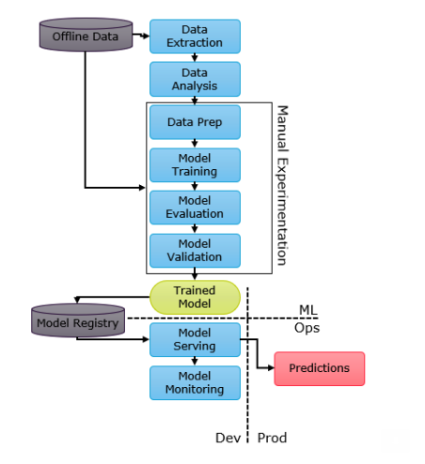
‘
Level 0: NO Automation
‘
Notes:
In 9 Jan 2020, RBI done some amendment to the PML rules launching concept of a) digital KYC b) Equivalent e-document
In India, Electronic Know Your Customer or Electronic Know your Client or eKYC is a process, wherein the customer's identity and address are verified electronically through Aadhaar authentication. Aadhaar is India's national biometric eID scheme.
facial biometrics

Slide 19
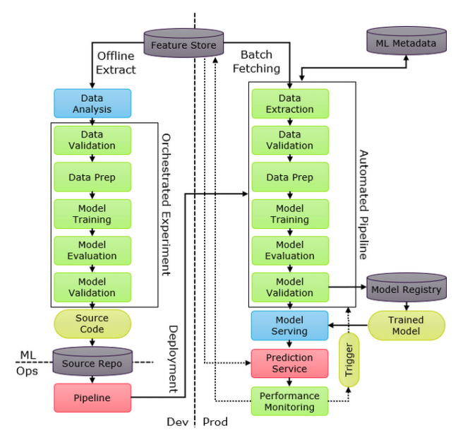
‘
Level 1: MLOps
‘
Notes:
This is High Level Automation The first new item here is a feature store. This is a database specifically for ML features. We do a variety of operations when training models such as scaling, feature engineering, encoding and mathematical transformations. Many of these features are not useful for typical analysis so a feature store allows us to store this and access it more easily.
On the left side, we have orchestrated experiments. This is the concept of automation many operations in the Data Science work flow.
The red square in the bottom left is the creation of a pipeline. This is another automation. When we deploy as pipeline, we are deploying the model and the transformations required to generate predictions from the model.
Many validation steps can also be automated.
We also allow continuous monitoring and retraining by collecting new data and storing it in the feature store.

Slide 20
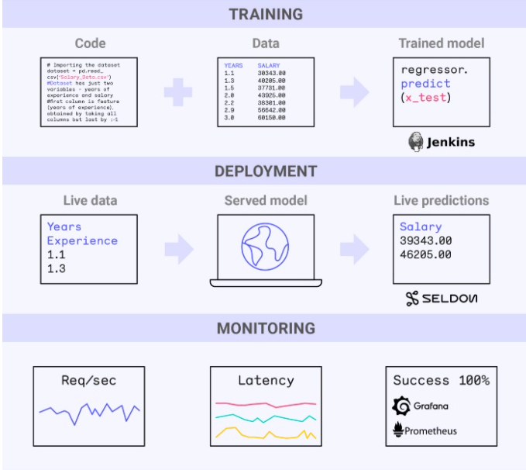
‘
MLOps Lifecycle
‘
Notes:
This is High Level Automation The first new item here is a feature store. This is a database specifically for ML features. We do a variety of operations when training models such as scaling, feature engineering, encoding and mathematical transformations. Many of these features are not useful for typical analysis so a feature store allows us to store this and access it more easily.
On the left side, we have orchestrated experiments. This is the concept of automation many operations in the Data Science work flow.
The red square in the bottom left is the creation of a pipeline. This is another automation. When we deploy as pipeline, we are deploying the model and the transformations required to generate predictions from the model.
Many validation steps can also be automated.
We also allow continuous monitoring and retraining by collecting new data and storing it in the feature store.

Slide 21
4
IMPLEMENTATION OF MLOps

Slide 22
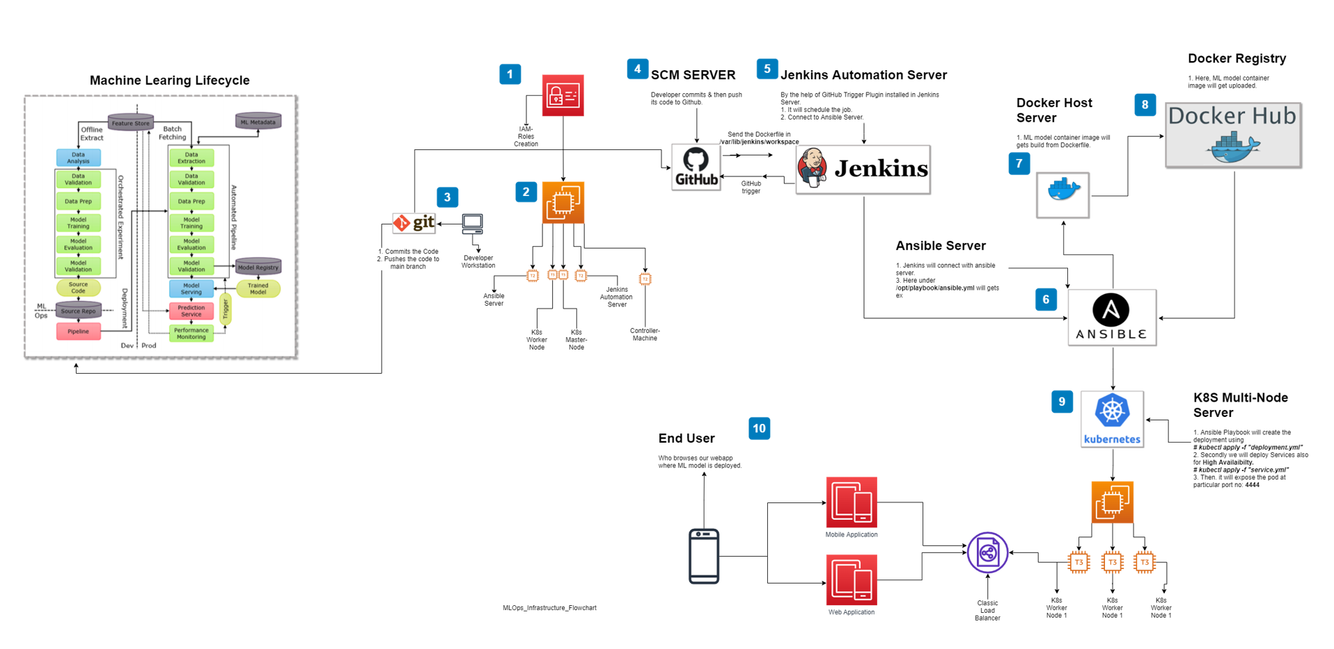

Slide 23

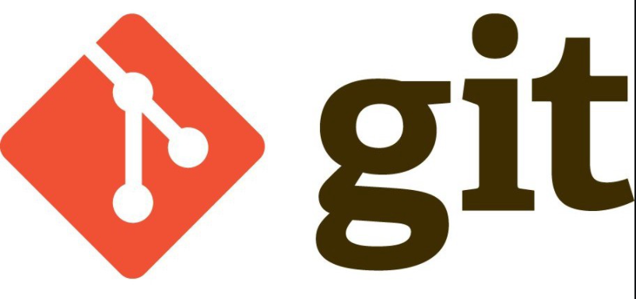
‘
ML Developer-Side
Tools we used are
For Source Code </>
Management
Git
GitHub as SCM-Server
‘

Slide 24
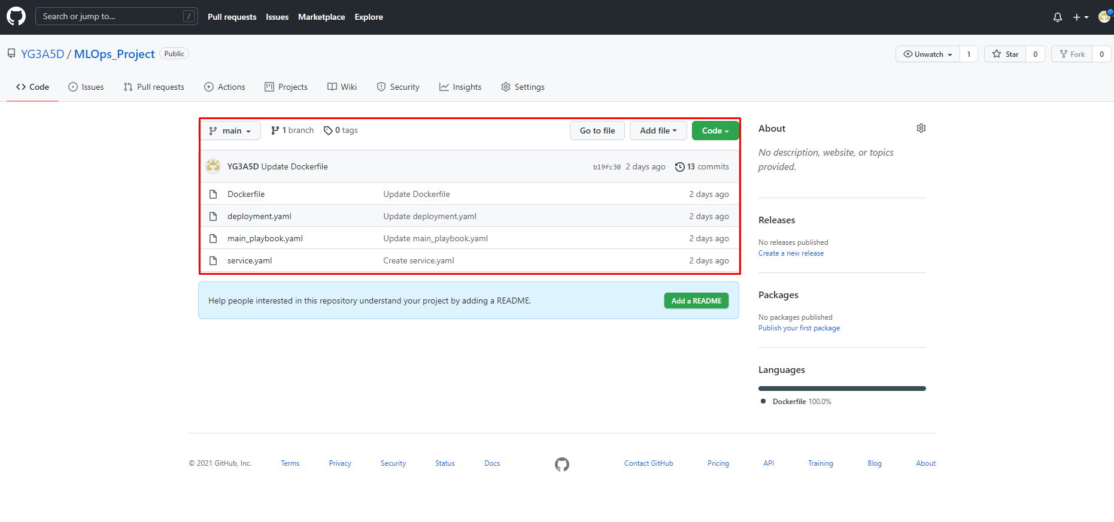

Slide 25

‘
Tool we used is
For Continuous Integration + Deployment
Jenkins Automation Server
‘

Slide 26
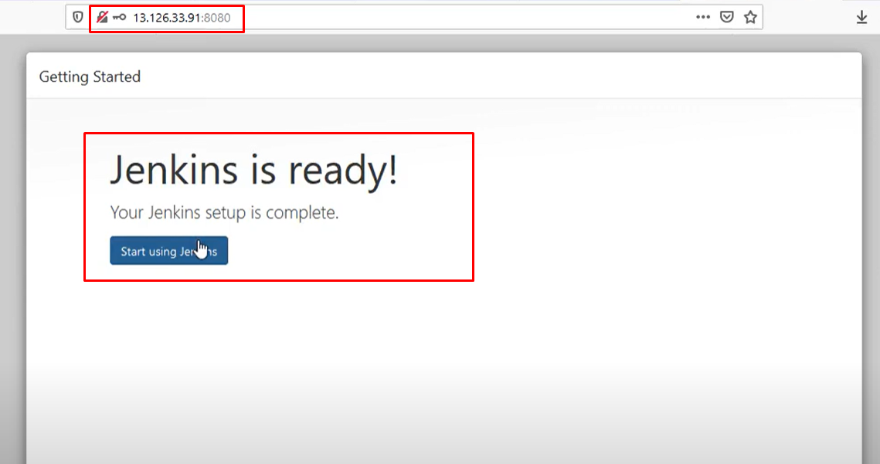

Slide 27
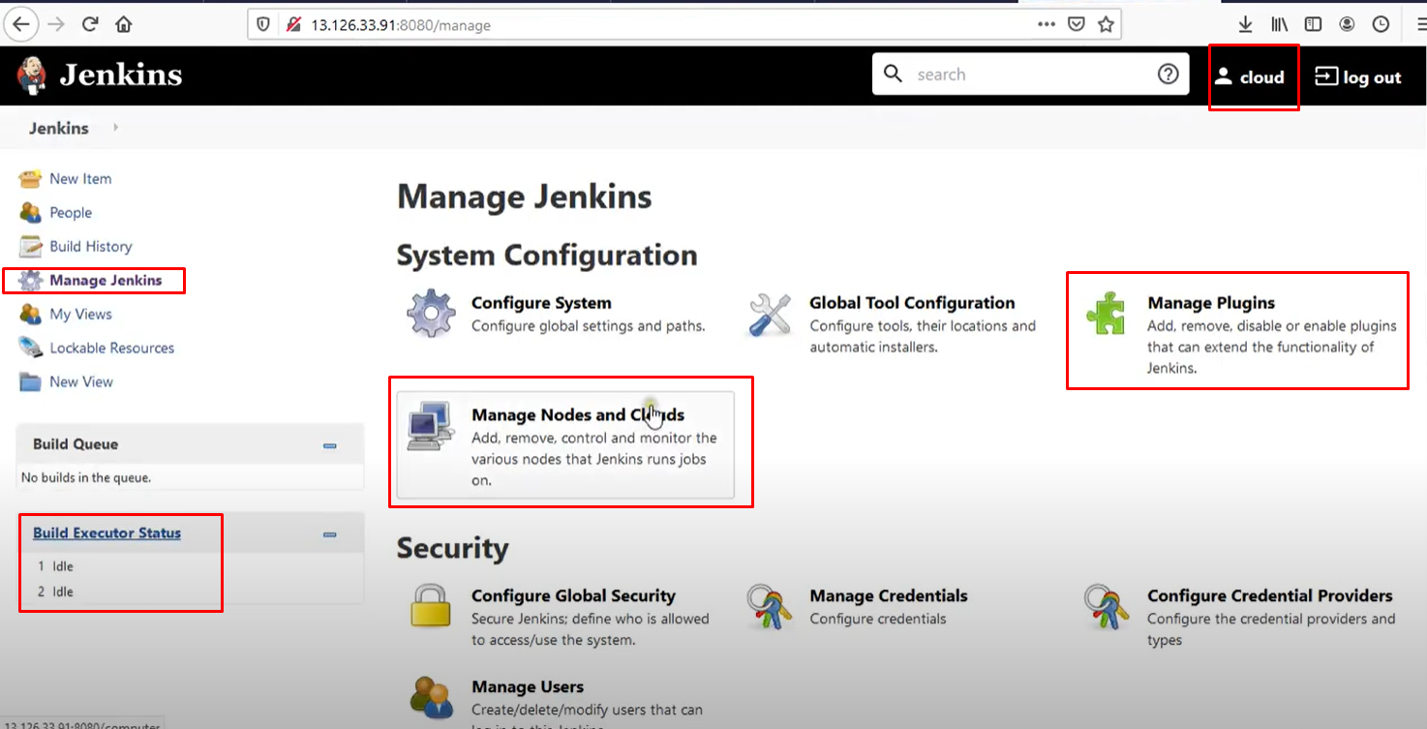

Slide 28
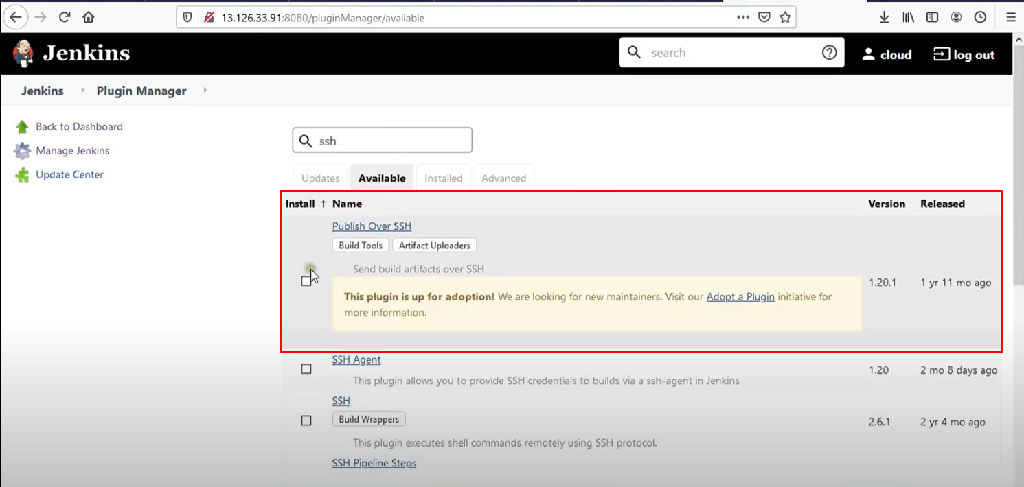

Slide 29
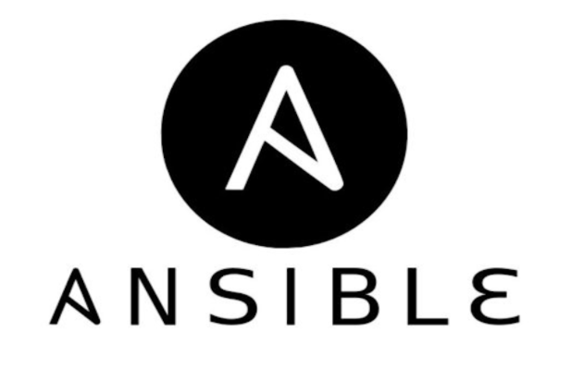
‘
Tool we used is
For Configuration Management
Ansible Server
‘

Slide 30
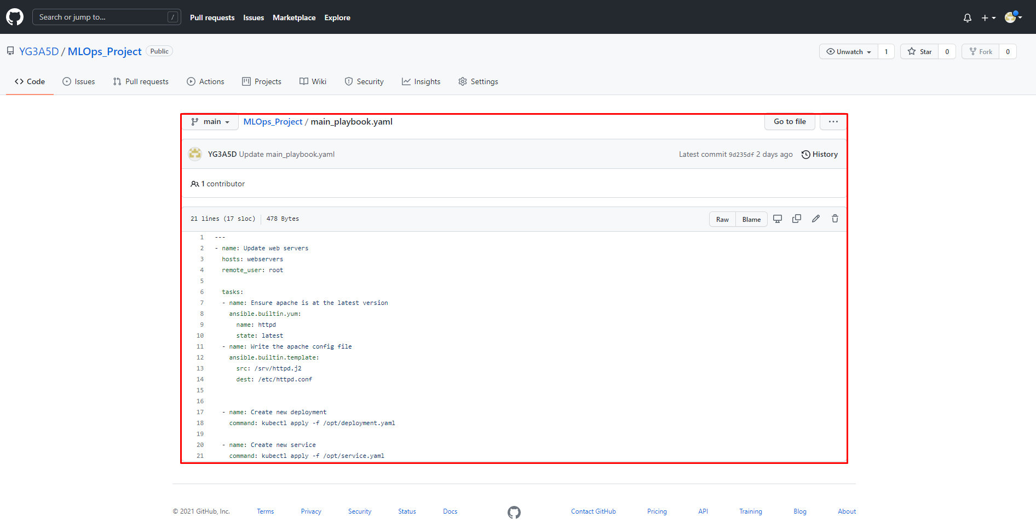

Slide 31


‘
Tools we used are
Docker
Docker Registry: DockerHub
For Containerization
‘

Slide 32
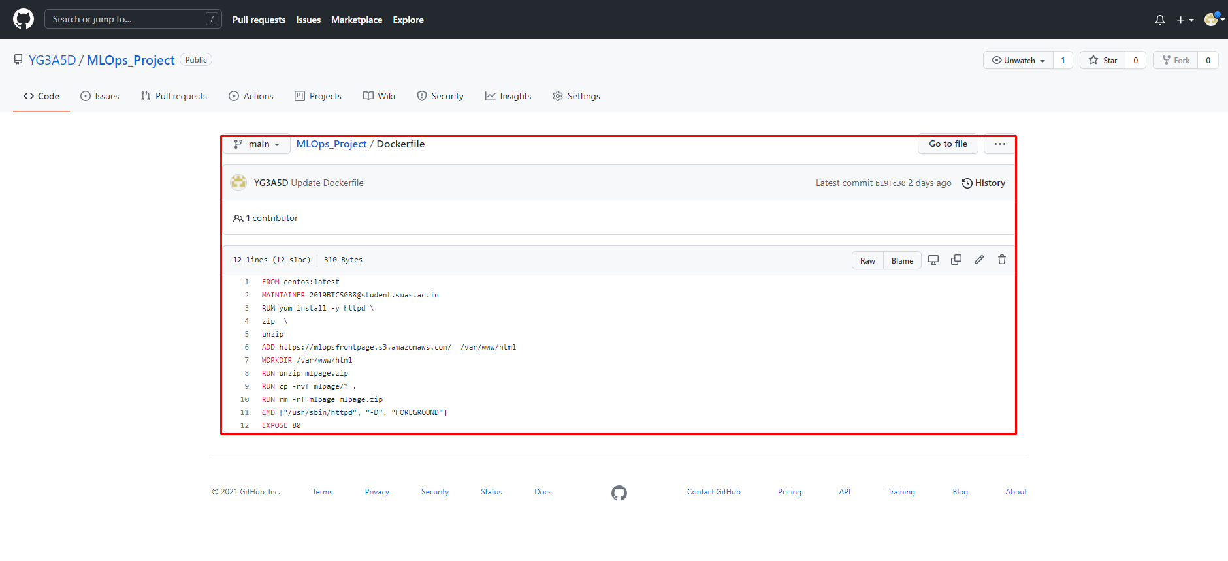

Slide 33
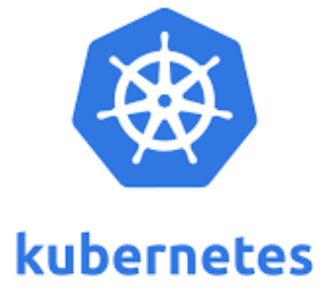
‘
Tools we used are
Kubernetes using KOPS
For Orchestration Management
‘

Slide 34
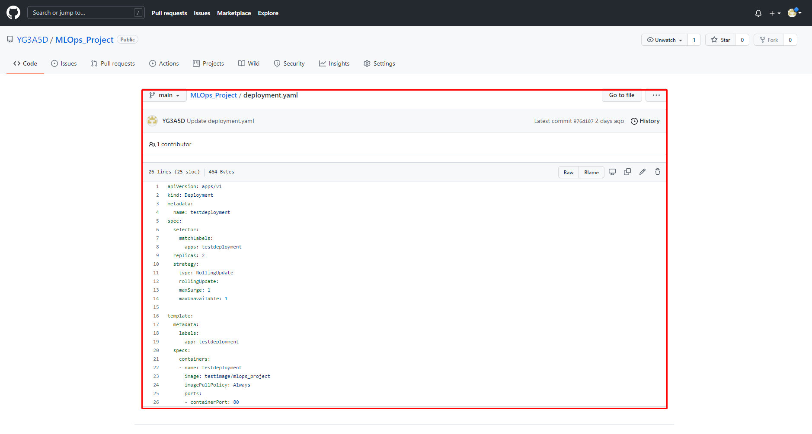

Slide 35
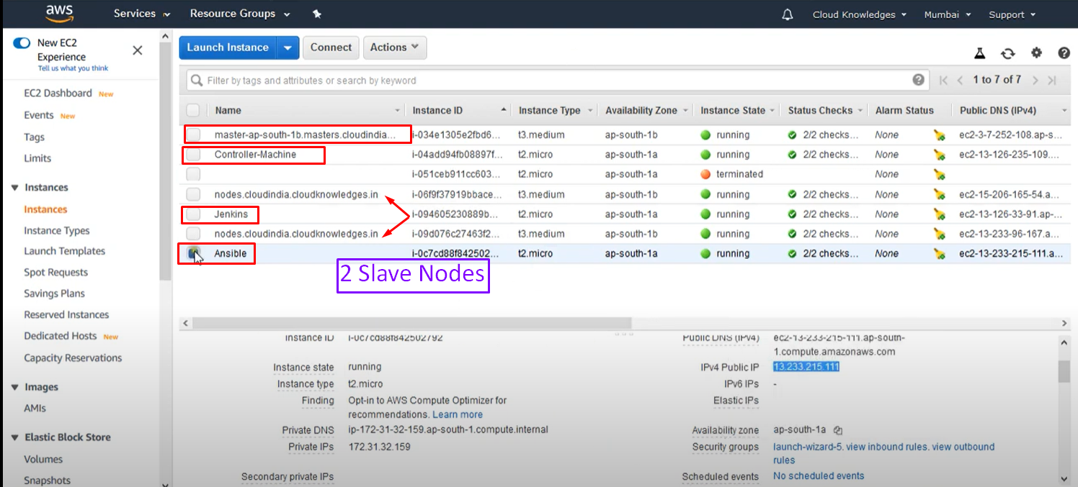

Slide 36
5
KEY SKILLS EARNED

Slide 37
1. DevOps Approach
DevOps CI/CD pipeline to build and deploy a project
Git, Jenkins, Docker, Kubernetes (integration of all these)
Integration of CI/CD with ML/DL
Deploy ML/DL model over Kubernetes
KEY SKIILS Earned ...
2. ML Stack ​
Linear Regression
Logistic Regression
K Nearest Neighbor algorithm
K-Means classifier
Random Forest classifier
Neural Networks (Deep Learning)
Feature Extraction
Feed forward neural networks (FNN)
Convolutional neural networks (CNN)
Recurrent Neural networks (RNN)
Generative Adversal Neural Networks (GAN)

Slide 38
6
FUTURE SCOPE FOR MY PROJECT

Slide 39
Implementing Concept of DevSecOps
Easy Intersectionality with least coupling.
Easy Multifunctionality 
Best Cost Optimization of different cloud providers.
Implementing different strategies for High Scalability & High Availability.
NEED TO INTEGRATE SECURITY LENS IN PIPELINE DevSecOps

Slide 40

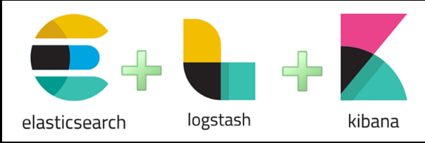

Tools we can use
ELK STACK
Prometheus
Grafana
NEED TO INTEGRATE
MONITORING
{METRICS}

Slide 41
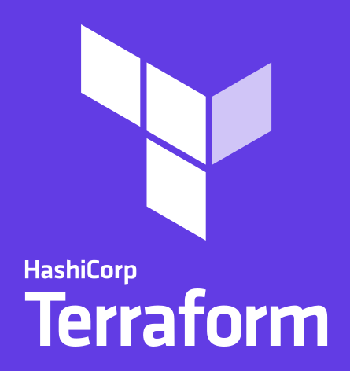
Infrastructure as Code
Tool we can use
Hashicorp Terraform
NEED TO INTEGRATE IAC….

Slide 42
7
SPECIAL ACHIVEMENTS ...

Slide 43
Qualified in following GLOBAL REDHAT certifications:-
RH294: The Red Hat Enterprise Linux Automation with Ansible (RH294) is designed for Linux system administrators and developers who need to automate provisioning, configuration, application deployment, and orchestration. This course is based on Red Hat® Enterprise Linux® 8.4 and Red Hat Ansible Automation Platform 1.2
EX180: The Red Hat Certified Specialist in Containers and Kubernetes exam (EX180) tests your skills and knowledge of the fundamentals of containers and OpenShift, including the ability to find, customize, run, and manage containerized services in both stand-alone environments, and environments with both Kubernetes and OpenShift.
Special
Achievement
During Internship.

Slide 44
Thank you...

