Slide 1
Parabanking products and services

Slide 2
ATM
The automated teller machine (ATM) is an automatic banking machine (ABM) that allows the customer to complete basic transactions without any help from bank representatives.
It is an electronic device that is used by only bank customers to process account transactions. The users access their accounts through a special type of plastic card that is encoded with user information on a magnetic strip. The strip contains an identification code that is transmitted to the bank’s central computer by modem. The users insert the card into ATMs to access the account and process their account transactions. The automated teller machine was invented by john Shepherd-Barron in the year of 1960.

Slide 3
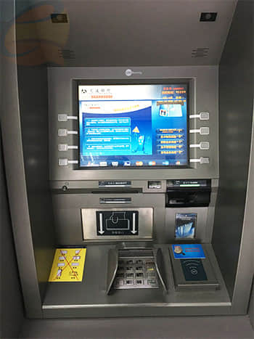
ATM Advantages
The ATM provides 24 hours service
The ATM provides privacy in banking communications
The ATMs reduce the workload banks staff
The ATM may give customer new currency notes
The ATMs are convenient for banks customers
The ATM is very beneficial for travelers
The ATM provides services without any error

Slide 4
Features of Automated Teller Machine:
Transfer funds between linked bank accounts
Receive account balance
Prints recent transactions list
Change your pin
Deposit your cash
Prepaid mobile recharge
Bill payments
Cash withdrawal
Perform a range of features in your foreign language.

Slide 5
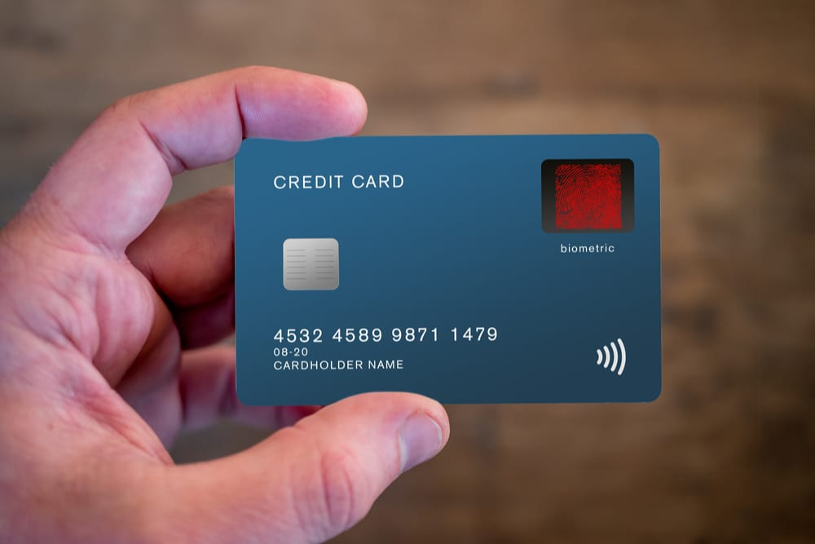
Credit Card
A credit card is a payment card issued to users as a system of payment. It allows the cardholder to pay for goods and services based on the holder's promise to pay for them. The issuer of the card creates a revolving account and grants a line of credit to the consumer (or the user) from which the user can borrow money for payment to a merchant or as a cash advance to the user.

Slide 6
Advantages of credit card
A credit card is safer than carrying cash.
You can make online purchases.
Credit cards offer flexibility.
Credit cards work in any currency.
Fast Payment.
Easy Access.
Fewer Trips to the Bank.
Automatic Currency Conversion.
If you report the loss before the thief makes any transactions, you owe nothing for any transactions made after that.
If you report the loss within two business days after you discover it, you owe a maximum of $50 for transactions made by the thief.
Cash Back. Travel RewardsPoints

Slide 7
Disadvantages of Credit card
Interest payments
The most obvious problem with credit cards is that if you carry a balance, you have to pay interest – a lot of interest. A survey of credit card interest rates by CreditCards.com shows that the average interest rate on credit cards in the U.S. is 15%. And that’s just the overall average – for users with bad credit, the typical interest rate is a whopping 22.73%.
2. Other Fees
Interest payments aren’t the only cost of doing business with a credit card company. Credit cards also hit you with fees for just about everything you can think of, including the following:
Annual Fees
Balance Transfer Fees.
Cash Advance Fees.
Foreign Transaction Fees.
Late Payment Fees
Over-Limit Fees

Slide 8
Debit card
A debit card is a payment card that deducts money directly from a consumer’s checking account to pay for a purchase. Debit cards eliminate the need to carry cash or physical checks to make purchases directly from your savings. In addition, debit cards, also called “check cards,” offer the convenience of credit cards and many of the same consumer protections when issued by major payment processors such as Visa or Mastercard.
Unlike credit cards, debit cards do not allow the user to go into debt, except perhaps for small negative balances that might be incurred if the account holder has signed up for overdraft protection. Debit cards usually have daily purchase limits, meaning it may not be possible to make an especially large purchase with a debit card.

Slide 9
Advantages of debit card
Debit card can be easily obtained: When you open a savings or current account, most banks issue a free debit card. Make sure that you fill in the necessary documentation to receive your debit card.
Very convenient to use: One of the advantages of a debit card is that it can be swiped for transactions as well as withdrawal of cash from ATMs.
Debit card can be easily obtained: When you open a savings or current account, most banks issue a free debit card. Make sure that you fill in the necessary documentation to receive your debit card.
Very convenient to use: One of the advantages of a debit card is that it can be swiped for transactions as well as withdrawal of cash from ATMs.
Earn rewards: Offers are not restricted to credit cards alone. Using your debit card too can help you gain rewards and cashback india offers. Several online and retail outlets offer cashback offers for every purchase made on the debit card. The points can be redeemed at any time to either purchase products from an online catalogue of the bank or to earn shopping vouchers from various brands.

Slide 10
Disadvantages
No credit allowed: A debit card is linked to your bank account. There is no possibility of making any transaction on credit. All transactions and withdrawals are limited to the balance available in your account.
Difficult to dispute fraudulent use: It is easier to fraudulently use your debit card. In case someone steals the details of your card, especially the PIN and CVV, the chances of a fraudulent transaction are very high. It is difficult to dispute such transactions with the bank.
Additional fees on ATM withdrawals: Every bank offers you a limited number of free ATM transactions and other non-financial transactions per month at the branches of other banks. Once you exceed the limit of free withdrawals/ non-financial transactions, fees are levied.

Slide 11

Gift card
A gift card is a prepaid debit card that contains a specific amount of money available for use for a variety of purchases.There are generally two types of gift cards: open loop and closed loop cards. Both types can typically be used online and in person.
Many gift cards will have a minimum and maximum initial loading amount. A common minimum is $10, and a common maximum is $500. In some situations, they can be used to pay for a portion of a purchase with cash, debit or credit used to balance the expense.

Slide 12
Smart card
A chip card is a standard-size plastic debit or credit card which contains an embedded microchip as well as a traditional magnetic stripe. The chip encrypts information to increase data security when making transactions at stores, terminals, or automated teller machines (ATMs). Chip cards also are known as smart cards, chip-and-PIN cards, chip-and-signature cards, and the Europay, MasterCard, Visa (EMV) card.
Benefits of Chip Cards
Chip card technology provides an additional layer of security when used at a chip-enabled terminal because they're more difficult to skim. This encryption security is in addition to the fraud prevention monitoring already offered by card providers. In most cases, purchases have coverage for fraudulent usage. This coverage limits customer liability in the event of theft. Embedded chips help merchants avoid card-present fraud, but other lines of protection must come from other methods to prevent card-not-present-fraud.

Slide 13
Mobile Banking Services
Mobile banking is a facility which enables customers to initiate and/or perform banking tasks on their mobile phones. This is provided by most of the banks in India and abroad. Customers can use mobile banking to view their account balance, make instant fund transfers and pay bills, etc.
Mobile banking is useful to customers in the following ways:
Access to Account Information
Information is power. And thus, knowing your exact bank balance is important. This helps you in better management of your funds. And thus, this is the primary mobile banking service provided by any bank. You can check the following:
View account balance (balance enquiry)
Transaction history
e-statement of account
Loan statements
Card statements
e-Passbooks

Slide 14
Transactions
Making payments and transferring money from one account to another is the most basic banking activity. Therefore it only makes sense that these are the most used and in-demand mobile banking services. You can transfer funds to anyone by adding them as beneficiaries or simply via Unified Payments Interface or UPI.
Bank to bank transfers
Transfer of funds to self
Payments to third parties (rent payments, bill payment, etc.)
Giving standing instructions for periodic payments
Payments via NEFT/IMPS/RETG/UPI/MMID
Investments
Opening fixed deposit/recurring deposits
Mutual fund investments
Portfolio management services (e.g. SBI Capital Securities)

Slide 15
Other Services
Apart from the account summary, bill payments, fund transfers and investments, there are other services that a customer requires for smooth banking experience. Also, there may be times when you have some grievances and due to lack of time, are not able to address. For such extra services, you can always resort to your bank’s mobile banking and find solutions to your complaints or queries. These services include:
ATM locators
Branch locators
Lodging complaint/ tracking applications
Ordering new cheque book
Cancelling/stopping an issued cheque

Slide 16
Telebanking or Phone Banking: Get details via a phone call(bank rep on one side and you on the other) after getting authenticaed with series of security questions like PAN No or Date of Birth. Secure untill you make a call. Vishing (pishing over voice call) /Pishing makes telebanking vunerable where someone calls or emails you to ask your bank details.This is the least secure method owing to its first generation origin.
Internet banking: Currently the biggest platform for digital banking /payment transactions is through the internet. Almost all banks provide most services directly over the internet. This makes your device a phone or a computer connected to the internet your access point to all banking facilities like deposits/withrawal, payment to others, checking balance etc. Now mobile wallets are being flushed out in the internet market making. However not all people are connected to the internet.(only 13 percent of world population uses internet)
Mobile banking or Sms or Ussd based payments: This concept is suddenly gaining momentum in other to cover customers not habitable to the internet either due to lack of access or because of scepticism over the security of it, internet being the biggest realm of cyber attacks currently. SMS or Ussd codes(codes often you send to know your phone balance or data left over) which do not require internet are used.USSD have a crude interface so while SmS or mobile apps using your phone's SmS service will provide you with a better interface. However security is a challenge as airwaves use crude encryption or sometimes use plain text to exchange connection packets. Internet and Mobile banking have potential to be the next big payment methods as more people get access to the internet(with google's loons, facebook's free internet, government's free wifi zones) and the encryption levels are improved.

Slide 17
Ancillary Services
DRAFTS->
The term bank draft refers to a negotiable instrument that can be used as payment just like a check. Unlike a check, though, a bank draft is guaranteed by the issuing bank. The total amount of the draft is drawn from the requesting payer's account—their bank account balance decreases by the money withdrawn from the account—and is usually held in a general ledger account until the draft is cashed by the payee. Bank drafts provide the payee with a secure form of payment.
Features of drafts->
It is drawn by one branch to another branch.
The bank of the two branches will be same is payable on demand.
It is payable on demand.
The amount specified is written on it.
The name of specified person is also written on it.
It bearer signature of the issuing authority.
Branch code number is also written on it.
It bears no stamp

Slide 18
Travellers cheque
A traveller's cheque^{[a]} is a medium of exchange that can be used in place of hard currency. They can be denominated in one of a number of major world currencies and are preprinted, fixed-amount cheques designed to allow the person signing it to make an unconditional payment to someone else as a result of having paid the issuer for that privilege.
They are generally used by people on vacation in foreign countries instead of cash, as many businesses used to accept traveller's cheques as currency.
The advantage of traveler's cheques is if you lose them you can get your money back. But we should make sure that we follow the instructions about keeping a separate note of the cheque numbers and the receipt so you know which cheques have been lost.

Slide 19
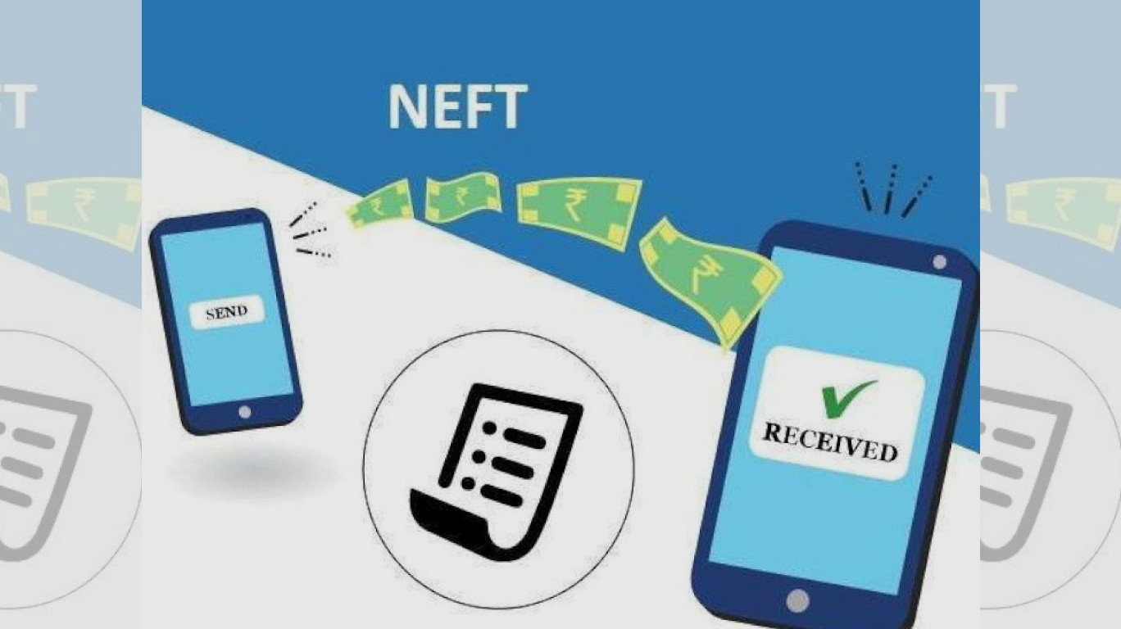
Electronic Fund Transfer
NEFT-> The acronym “NEFT” stands for National Electronic Funds Transfer.
National Electronic Fund Transfer (NEFT) is a nation-wide payments system that allows the transfer of funds from one bank’s account to another. With an increased focus on online banking, NEFT has become one of the most popular ways of transferring funds. Since it can electronically transfer funds from any bank branch to any individual, it has eliminated the need to visit a bank branch for transfer of funds.
RBI has regularised that NEFT transactions will be available 24*7 on all days of the year, including holidays.

Slide 20
RTGS
The term real-time gross settlement (RTGS) refers to a funds transfer system that allows for the instantaneous transfer of money and/or securities. RGTS is the continuous process of settling payments on an individual order basis without netting debits with credits across the books of a central bank
Real-time gross settlement is the continuous process of settling interbank payments on an individual order basis across the books of a central bank.
This system's process is opposed to netting debits with credits at the end of the day.
Real-time gross settlement is generally employed for large-value interbank funds transfers.
RTGS systems are increasingly used by central banks worldwide and can help minimize the risks related to high-value payment settlements among financial institutions.

Slide 21
IMPS
Immediate Payment Service is an instant payment inter-bank electronic funds transfer system in IndiaIMPS provides robust & real time fund transfer which offers an instant, 24X7, interbank electronic fund transfer service that could be accessed on multiple channels like Mobile, Internet, ATM, SMS. IMPS is an emphatic service which allow transferring of funds instantly within banks across India which is not only safe but also economical
Objectives of IMPS
To enable bank customers to use mobile instruments as a channel for accessing their banks accounts and remit funds
Making payment simpler just with the mobile number of the beneficiary
To sub-serve the goal of Reserve Bank of India (RBI) in electronification of retail payments
To facilitate mobile payment systems already introduced in India with the Reserve Bank of India Mobile Payment Guidelines 2008 to be inter-operable across banks and mobile operators in a safe and secured manner
To build the foundation for a full range of mobile based Banking services.

Slide 22
UPI
A Unified Payment Interface (UPI) is a single window mobile payment system launched by the National Payments Corporation of India (NPCI). The system is designed to provide a simple, secure and convenient “single interface” to enable sending and receiving of money using smartphones through a "single identifier" which can be a virtual address like an email ID, mobile number or Aadhaar number (like the Social Security Number). It eliminates the need to enter bank details or other sensitive information each time a customer initiates a transaction.
Automatic bill payments are routine payments made from a banking, brokerage or mutual fund account to vendors. Automatic payments can be made from a checking account or credit card. They are usually set up with the company receiving the payment, though it’s also possible to schedule automatic payments through a checking account’s online bill pay service. Automatic bill payments occur over an electronic payment system, such as the Automated Clearing House

Slide 23
Dividend
The term dividend refers to that part of profits of a company which is distributed by the company among its shareholders. The investors basically have two desires:
a) high percentage of dividends
b) increase in their investment.
These two factors influence the dividend policies.
it refers to the divisible profits of a company distributed or divided among its shareholders in proportion to their share holdings.

Slide 24
Agency Services of bank
1. Collection of Cheques, Dividends, Interests etc.: Collecting cheques, drafts, bill of exchange, dividends, interests etc. on behalf of its customers and credit the amount in their account is one of the most important agency services rendered by the banks.
2. Payment of Subscription, Rent, Insurance Premium etc.: Banks undertake the payment of subscriptions, rent, insurance premium etc. on behalf of the customers and debit the account with the amount.
3. Conduct of Stock Exchange Transactions: Banks purchase and sell various securities such as shares, debentures, bonds etc. of joint stock companies both private and Government on behalf of their customers.

Slide 25
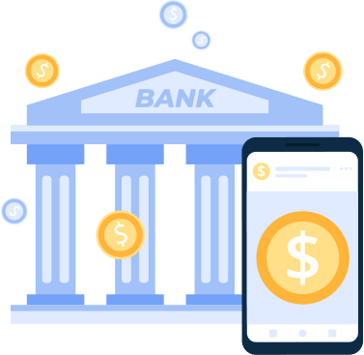
4. Acting as Executor, Trustees, Attorneys etc.: Banks act as executors of will, trustees, attorneys and administrators. As an executor it preserves the “Wills” of the customers and executes them after their death. As a trustee, it takes care of the funds of the customers. As an attorney, it signs transfer forms and documents on behalf of the customer.
5. Preparation of Income Tax Returns: Banks prepare income tax returns for their customers through their tax service departments.
6. Conducting Foreign Exchange Transactions: Commercial banks purchase and sell foreign exchange for their customers.

Slide 26
Locker services and its procedure
A bank locker is used for depositing valuables like gold, jewelry and important documents . It can be hired by individuals, firms, trusts, companies etc. Locker comes in different sizes like small, medium, large and extra-large.
Rent of each locker differs on the basis of size. For example, in SBI it ranges from Rs.1500 per year (small locker rural branch) to Rs 8000 annually (extra-large locker in urban branch). For accessing the locker there are two keys – one key is with the bank while the other key is with the customer. A locker can’t be accessed without using both keys simultaneously.

Slide 27
While choosing a locker, keep in mind the location and ease of transaction. A neighbourhood branch in which one already has an account would be the best option.
1) Application-> The person looking to hire a locker needs to fill up a simple application form and complete the KYC formalities with the bank.
2) Agreement-> The hirer must sign a locker agreement, known as ‘memorandum of letting’, agreeing to abide by the bank’
3) Collateral-> Most banks insist on some kind of collateral. Hence, they typically provide lockers only to their exist.
4) Rent->A nominal rent is charged for hiring the locker. It depends on the size of the locker and branch location (both intra-city and inter-city). It is charged annually and is payable in advance.
*Lockers cannot be allotted to minors in their names or jointly with others.*

Slide 28
Cash Management
CMS is the process of optimizing receivable and payables ensuring predictability in the cash flows of CMS clients. In a geographically large country like India having a complex financial clearing system, corporate find it increasingly challenging to process collections & payments across dispersed business locations. Cash Management thus means getting funds in time, quick transfers, quick realization of local and outstation instruments, easy disbursements, accounts reconciliation, controlled processes and customized MIS.
NEED FOR CMS->
Geographical spread of the country
Complex clearing system
Delays in cash realizations
Uncertainty in cash flows
Increased borrowing and associated costs
Difficulty in collecting data / MIS on the funds collected

Slide 29
Third party services
A mutual fund is a type of financial vehicle made up of a pool of money collected from many investors to invest in securities like stocks, bonds, money market instruments, and other assets. Mutual funds are operated by professional money managers, who allocate the fund's assets and attempt to produce capital gains or income for the fund's investors. A mutual fund's portfolio is structured and maintained to match the investment objectives stated in its prospectus.
Mutual funds

Slide 30
How mutual funds work?
Investors typically earn a return from a mutual fund in three ways:
Income is earned from dividends on stocks and interest on bonds held in the fund's portfolio. A fund pays out nearly all of the income it receives over the year to fund owners in the form of a distribution. Funds often give investors a choice either to receive a check for distributions or to reinvest the earnings and get more shares.
If the fund sells securities that have increased in price, the fund has a capital gain. Most funds also pass on these gains to investors in a distribution.
If fund holdings increase in price but are not sold by the fund manager, the fund's shares increase in price. You can then sell your mutual fund shares for a profit in the market.

Slide 31
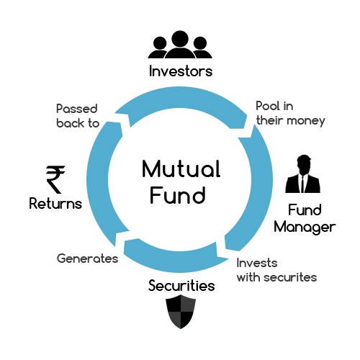
Types of mutual funds:
Equity funds
Fixed- Income funds
Index funds
Balanced funds
Money market funds
Income funds
International / global funds
Speciality funds
Exchange traded funds

Slide 32
insurance
Insurance is a contract, represented by a policy, in which an individual or entity receives financial protection or reimbursement against losses from an insurance company. The company pools clients' risks to make payments more affordable for the insured.
Insurance policies are used to hedge against the risk of financial losses, both big and small, that may result from damage to the insured or her property, or from liability for damage or injury caused to a third party.
How Insurance Works
There is a multitude of different types of insurance policies available, and virtually any individual or business can find an insurance company willing to insure them—for a price. The most common types of personal insurance policies are auto, health, homeowners, and life. Most individuals in the United States have at least one of these types of insurance, and car insurance is required by law.

Slide 33
Trading account
A trading account can be any investment account containing securities, cash or other holdings. Most commonly, trading account refers to a day trader’s primary account. These investors tend to buy and sell assets frequently, often within the same trading session, and their accounts are subject to special regulation as a result. The assets held in a trading account are separated from others that may be part of a long-term buy and hold strategy.
A trading account can hold securities, cash and other investment vehicles just like any other brokerage account. The term can describe a wide range of accounts, including tax-deferred retirement accounts. In general, however, a trading account is distinguished from other investment accounts by the level of activity, purpose of that activity and the risk it involves. The activity in a trading account typically constitutes day trading. The Financial Industry Regulatory Authority (FINRA) defines a day trade as the purchase and sale of a security within the same day in a margin account.

Slide 34
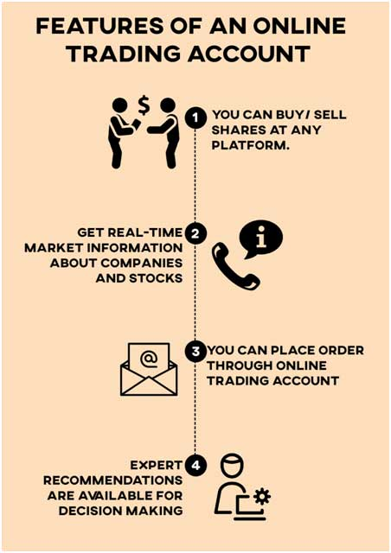
What are the advantages of a Trading Account?
One-point Access
Notifications and customisation
Flexibility
Seamless Transactions
Reliable Information

Slide 35
Demat account
Demat Account is an account that is used to hold shares and securities in electronic format. The full form of Demat account is a dematerialised account. The purpose of opening a Demat account is to hold shares that have been bought or dematerialised (converted from physical to electronic shares), thus making share trading easy for the users during online trading.
A Demat Account or Dematerialised Account provides the facility of holding shares and securities in an electronic format. During online trading, shares are bought and held in a Demat Account, thus, facilitating easy trade for the users. A Demat Account holds all the investments an individual makes in shares, government securities, exchange-traded funds, bonds and mutual funds in one place.

Slide 36
Benefits of opening a Demat Account:
Invest Easily & Earn Better
Gain access to the award-winning Angel Broking App - Trade, learn, and stay updated on the go. The app gives you latest news, research reports, and real-time updates on your fingertips. It also offers Portfolio Health Check to help you maintain an ace portfolio
Get a better chance of earning higher returns with ARQ
Fastest account opening process - Start trading in 1 hour
Highly secure & speedy financial transactions

Slide 37
Documentation required for demat account:
A Demat account is similar to any other bank account, except that it is used to hold securities and other financial instruments. As the procedure to open demat account online is almost the same across different firms and institutions, the list of mandatory documents required to register the account is also the same. The different types of documents required for opening a Demat account are:
Proof of Identity (POI) (Eg.: Driving license)
Proof of Address (POA) (Eg.: Passport)
Proof of Income (For trading in derivatives such as F&O) (Eg.: Copy of ITR Acknowledgement)
Proof of Bank Account (Eg.: Cancelled cheque)
PAN Card
1 to 3 passport size photographs

