Slide 1

Decentralized E-Voting System Using Public Blockchain
B.TECH CSIT VIII SEM
(Group No. 24)
Supervised by – Dr. Indrajeet Kumar
Yash Gupta (088)
Rishabh Verma (063)
Goutam Choudhary (032)

Slide 2

Content
Problem Statement and Objectives
Introduction
Literature Review (With table)
Proposed Methodology - Algo, Framework
Gantt Chart
Expected Outcomes
Future Scope
Contribution by each member
References

Slide 3
Problem Statement
Economical Problem
Estimates of all public transports
Vehicle Cost, Diesel/Petrol Cost, Manpower Cost{all Public servants + Private servants}, food cost, residence cost{men + women} = Total upfront cost
Embedded Cost = Cost_of(EVMs{Rs. 17,000 per unit} , VVPATs Machines), Handling all documents{cost of papers}.
Managerial Problem
Managing of workforce (for managing 900 million people => 1,035,918 polling stations)
Managing of EVMs {3.96 million} & VVPATs {1.74 million}
Managing huge no. of polling stations {1,035,918}
Managing of Security forces (CRPFs, CISFs, State Police & other departments)

Slide 4
Problem Statement(Cont.)
Simple Statistics of EVMs

Slide 5
Objectives
Telematic Voting is Secure & has Legal validity.
Invalidity of Decision
Illegal Activities
Electronic Voting reduces the effort of preparing a Poll.
Huge Census demands huge resources.
Online Voting optimizes the voter experience.
Vote from Anywhere, Anyplace, Any Device(min. Internet connection)
Digital Voting saves the environment, which results in health.
Saves huge cost of batteries used in EVMs.
Huge Savings in finance.(Shown in earlier slide)

Slide 6
Introduction
100% De-Centralized: Our E-Voting System is & completely open, yet it ensures that voters are protected.
100% Anonymity: Anybody may count the votes with blockchain electronic voting, but no one knows who voted to whom.
Method we provides maximum security properties such as
Integrity,
Security,
Privacy,
Fairness,
Verifiability,
Mobility.

Slide 7
Literature Review (With table)
S.No. | Authors | Paper Title | Journal | Conclusion | Methodology Used
1 | K. Dhinakaran, P. M. Britto Hrudaya Raj, and D. Vinod | A Secure Electronic Voting System Using Blockchain Technology | Information Management and Machine Intelligence. Lecture Notes in Networks and Systems, vol 166. Springer. (2023) doi: 10.1007/978-981-15-9689-6_34 | In this paper, we concluded that 1. Electoral Voting System is the best way to cast your vote by saving huge resources; 2. We can ensure that the voting process is more secure. 3. For reliability & zero fault tolerance of the system, as the Nodes grew, the time for the system was also raised in simulation to make it work. 4. Recording the voting result using hash values makes the system more secure. | They proposed a blockchain structure in which a Node consists of: 1. Voter_ID {4 bytes} 2. Timestamp {4 bytes} 3. Signature {32 bytes} 4. Hash of previous block data {20 bytes} 5. Data Structure used: Merkel Tree {20 bytes} 6. With respect to System Design the system continued sequence even if {(initial node) lower (next node)}: counter time++ 7. Then dimensions needed for the Recording Process ∝ Number Nodes.
2 | A. M. Al-madani, A. T. Gaikwad, V. Mahale and Z. A. T. Ahmed, | De-Centralized E-voting system based on Smart Contract by using Blockchain Technology | International Conference on Smart Innovations in Design, Environment, Management, Planning and Computing. (2022) doi: 10.1109/ICSIDEMPC49020.2020.9299581. | In this paper, 1. Developed a Voting Application in a Decentralized Method with a Smart Contract based on Ethereum Blockchain technology as a network & decentralized database all in one for storage voter accounts, votes and candidate details. 2. Voter's Point of View: 1 VOTE == 1 PERSON == 0% DUPLICACY 3. Problems with Centralized Voting System (CVS) a. To overcome limitations b. Security Issues using Blockchain technology. | They proposed 4-Tier Architecture Design: - Level 1: Authentication Web Page 1. Created a webpage which contains Authentication {using Aadhar Card} Level 2: Authentication with DB 2. Used Mongo DB as Government Identity Verification Service. Level 3: Smart Contract Creation 3. Created Smart Contract includes {District, List Candidates} Level 4: POA Network Deployment 4. Deploy a POA Network. It has 3 sub-modules: - a. Government {Boot Node, Node1, Node2} b. Origin {Boot Node, Node1, Node2} c. HR {Boot Node, Node1, Node2}
3 | F. Þ. Hjálmarsson, G. K. Hreiðarsson, M. Hamdaqa and G. Hjálmtýsson, | Blockchain-Based E-Voting System | IEEE 11th International Conference on Cloud Computing. (2021) pp. 983-986, doi: 10.1109/CLOUD.2018.00151. | In this paper, 1. We analysed the Traditional Voting System. 2. Benefits of Implementing a blockchain-based E-Voting system using various blockchain-based tools 3. Found using a Case study of the Manual Voting Process. 4. Also studied about comparison between the traditional voting system in use and the electronic voting system based on the blockchain. | They created 3-Tier Architecture Design: - A. Level 1: End User (HOME PAGE), Cast a Vote B. Level 2: Candidate Management, Voter Management, Result, View Ledgers C. Level 3: Logout

Slide 8
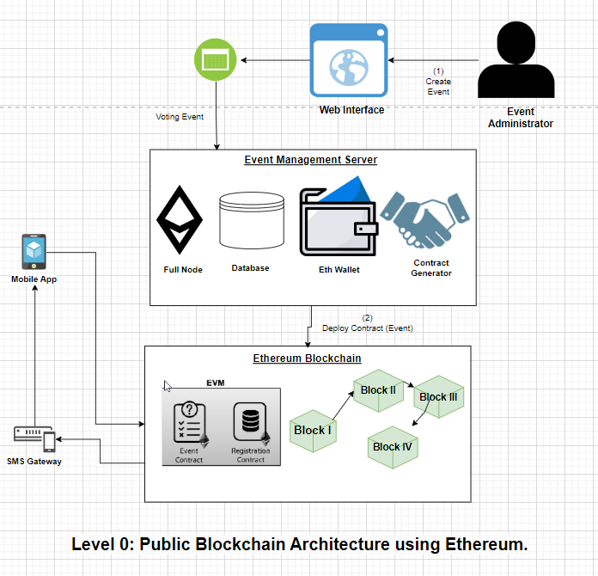
Proposed Methodology - Algo, Framework
Algorithmic Steps :
Step-1: Voter needs to enter his/her credentials in order to vote.
Step-2: All data is then encrypted and stored as a transaction.
Step-3: This transaction is then broadcasted to every node in network, which in turn is then verified.
Step-4: Network approves transaction, it is stored in a block and added to chain.
Step-5: Block is added into chain, it stays there forever and can't be updated.
Step-6: Users can now see results and also trace back transaction if they want.
Framework :
GitHub (as SCM)
NPM, NodeJS
Ethereum.js
Hardhat Suite

Slide 9
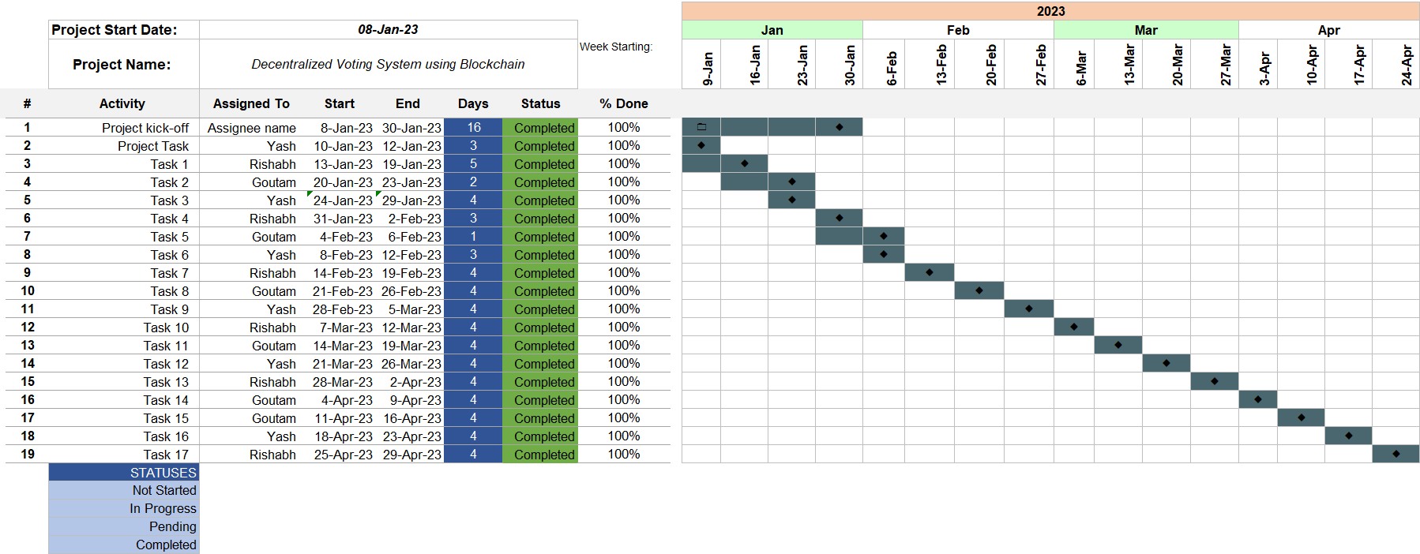
Timeline Chart

Slide 10
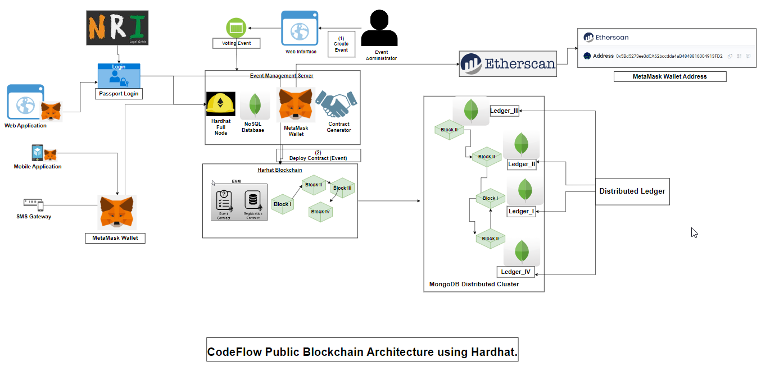
Architecture

Slide 11
Expected Outcomes
All Tier-I & Tier-II cities can easily vote using this application.
Application can be used from any device(Android 5.x+, WebGUI)
Improves Voter Engagement
Using SHA512 bits encryption as CA.
Providing access to NRIs.
Centralized Web Portal for event management.
Create Event
Voting Event
Deploy Smart Contract in .sol

Slide 12
Project Demo
Project Demo Video.mp4

Slide 13
Research Paper
Research_Paper.pdf

Slide 14
Future Scope
Security Trust Enhancement
In Voting Protocol
Using Best Practices for Creating Smart Contracts
Regression of Auditing Test must be performed
Integrating 5G-SMS services
Privacy of Data Transmission
Data Confidentiality & Neutrality
Dishonest Behaviors from the Organizer and Inspectors

Slide 15
Challenges
Security Analysis
Voter’s Privacy
Ballot Manipulation & Forgery
Network Attack
Ballot Collision
Authentication Issues
Scalability Issue: Layer I issues
Low Authentication Efficiency
Storage Overload: Bitcoin's block size is limited to 1 MB, but this small amount of data is enough to store over 2000 transactions.

Slide 16
Contribution by each Team Member
Yash Gupta (088) Contributing as – Team Leader – Back End Tech Stack {Hardhat Suite, MongoDB}
Rishabh Verma (063) Contributing in – Front End Tech Stack {React JS, HTML, CSS}
Goutam Choudhary (032) Contributing in – Documentation

Slide 17
References
Dhinakaran, K., Britto Hrudaya Raj, P.M., Vinod, D. (2023). A Secure Electronic Voting System Using Blockchain Technology. In: Goyal, D., Gupta, A.K., Piuri, V., Ganzha, M., Paprzycki, M. (eds) Proceedings of the Second International Conference on Information Management and Machine Intelligence. Lecture Notes in Networks and Systems, vol 166. Springer, Singapore. https://doi.org/10.1007/978-981-15-9689-6_34
Lahane, Anita & Patel, Junaid & Pathan, Talif & Potdar, Prathmesh. (2022). Blockchain technology based e-voting system. ITM Web of Conferences. 32. 03001. 10.1051/itmconf/20223203001.
A. M. Al-madani, A. T. Gaikwad, V. Mahale and Z. A. T. Ahmed, "Decentralized E-voting system based on Smart Contract by using Blockchain Technology," 2021 International Conference on Smart Innovations in Design, Environment, Management, Planning and Computing (ICSIDEMPC), Aurangabad, India, 2021, pp. 176-180, doi: 10.1109/ICSIDEMPC49020.2021.9299581

Slide 18
Thanking You

