Slide 1
Benchmark Dataset Generator for
MLaaS Ecosystems
A Benchmark Dataset for Machine Learning as a Service (MLaaS)
Generating heterogeneous ML service benchmarks for selection and composition research
Joshua Boland · MATH3004 Industrial Project
BSc Data Science · Supervisors: A/Prof Sajib Mistry & Deepak Kanneganti
MSC Benchmark · MATH3004 · ICSOC 2026
Notes:
This project explores how we can generate realistic benchmark datasets for machine learning services
Traditional service-computing research has datasets like QWS and WS-DREAM but an equivalent datasets for ML are limited
We focus on generating heterogeneous ML service providers with measureable runtime and QoS attributes/behaviours.
To understand why this this matters – we need to first look at how ML services are changing modern applications…

Slide 2
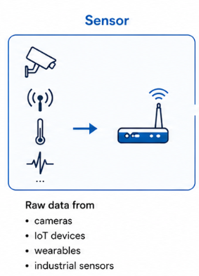
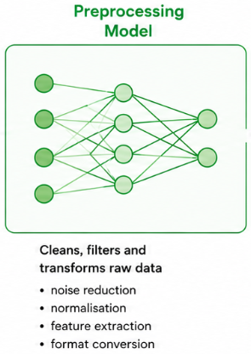
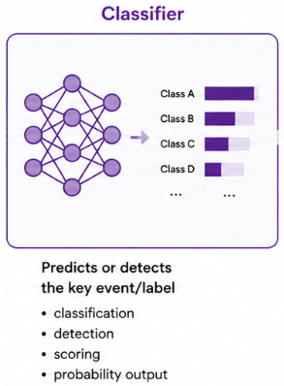
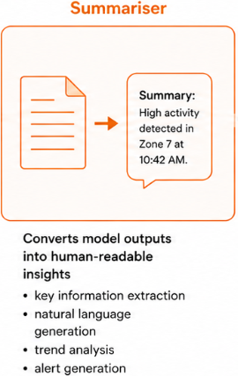
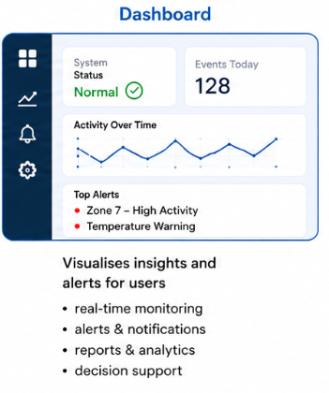
Motivation
MLaaS, and Service Composition
MLaaS lets organisations use cloud ML without owning full infrastructure (SageMaker, Azure ML, Hugging Face).
Modern systems rarely rely on a single model anymore. Complex applications often need multiple ML services - preprocessing, classification, summarisation in one pipeline.
Once systems become pipelines of ML services, we need ways to compare and combine them.
Providers expose limited model and QoS detail. Research lacks public benchmarks with requirements and composition solutions—unlike QWS and WS-DREAM for web services.
Notes:
MLaaS is cloud ML – users can incorporate ML without the expense of owning the resources (data and hardware) needed to train, host and implement ML. MLaaS can provide end users with ready to use or easy to setup models.
This is more important considering we are moving into an age where 1 type of model is rarely enough. Complex applications that deal with different types of data and/or move through multiple stages need multiple models for each stage it goes through.
Selecting a service for you application may already be hard enough. Once systems become a pipeline of services, selecting the right services becomes a difficult as cominations explode,. You may need a system to meet some behavioural requirements and thus you need to select a comination of services that both meet the requirements and works well together
For web-services we had datasets like WS_Dream were you could evaluate services and pipelines on one place to meet some requirements. The problem is that these datasets were never designed for ML behaviour

Slide 3
Research gap
Why web-service datasets are not enough
Dataset | MLaaS | Functional | Rich QoS | Internal | XAI | Composition
QWS | ✗ | ✗ | ◐ | ✗ | ✗ | ✗
WS-DREAM | ✗ | ✗ | ◐ | ✗ | ✗ | ✗
MLSDG (ours) | ✓ | ✓ | ✓ | ✓ | ✓ | ✓
Why MLaaS is fundamentally harder than web services
Traditional web services | MLaaS services
Same output | Outputs vary depending on data
Easy to compare between providers | Different models behave very differently
Composition is connecting services | Composition must balance quality and performance
Relatively predictable behaviour | Behaviour changes with training data and configuration
Limited internal complexity | Model type and training choices strongly affect results
Simple QoS (latency, uptime) | Complex QoS (accuracy, explainability, reliability)
Joshua Boland
Notes:
Why do existing datasets fail. These datasets were built before ML became popular and don’t capture ML behaviour.
Why is it harder?
Web services are predictable, have simple QoS that you can compare; you input, knowing what output you're going to get. Connecting is just givning one output to another
ML is probalistic, similar services may behave very differently depending on training and configuration, connecting services require not just compatible behaviours but quality and performance
This project aimed to build a framework capable of generating realistic ML service ecosystems.

Slide 4
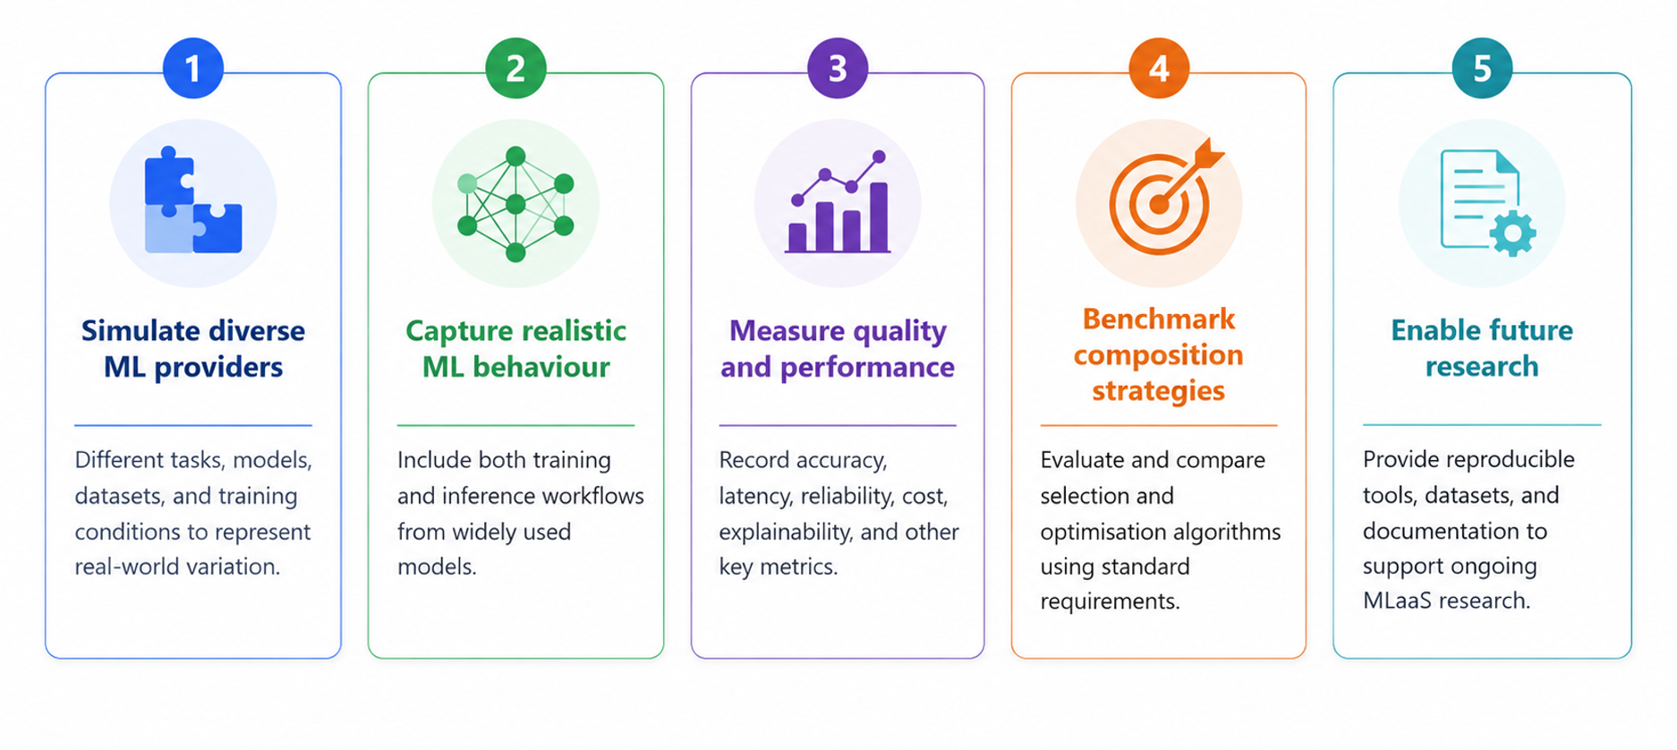
Project objectives
Building a realistic benchmark ecosystem for MLaaS research
Joshua Boland
Notes:
This project is a generator framework – not just a dataset and experiments.
1. we want to capture different task like image recognition, text generation, clustering ect. With each task I also wanted to vary training conditions like data splits, model archetectures to represent the real world variation.
2. We used both training and training fine tuning approaches. We executed real, popular ML models and workflows rather than just generating synthetic data.
3. then record any metric we can, accuracy, latency, reliability, cost, explainability – which is how predictable the model is (will get into it), resource usage ect.
4 enable future research with the framework.
The goal was not to find the best model it was to simulate realistic ML services to create a benchmark where people can test ML research..
The result is an ecosystem of thousands of heterogeneous ML service records.

Slide 5
MLaaS Dataset at a Glance
25,900
20,000
12
MLaaS services
composition requirements
task families
Enables large optimisation spaces
Creates realistic composition
Complexity supports benchmark reproducibility
10,000 sequential + 10,000 collaborative composition scenarios
Composition algorithms need standardised evaluation scenarios
Diverse task types to evaluate a wide range of services
Sequential composition
Collaborative composition
Workflow: output of service i → input of service i+1
Each stage depends on the prior. Failure propagates, Latency accumulates.
medical image → text caption → clinical summary
Multiple services merged into one unified capability
HAR — walk/run service + sitting service
Models compatibility across functional and QoS dimensions
Largest known MLaaS composition dataset — inference and fine-tuned services
Joshua Boland
Notes:
Here is the scale of the benchmark ecosystem, but the important point is not just the size — it is the diversity of ML service behaviour captured.”
“Each service can be thought of as a simulated MLaaS provider, with its own task, model, dataset, configuration, and measured performance.” “The 25,900 services create a large pool of possible ML providers. This is what makes later selection or composition problems realistic.”
“The 20,000 requirements and sequential/collaborative scenarios are more specific to the paper’s evaluation layer. For my project, I treat these as downstream applications of the generated service dataset.”
“Sequential composition is like a pipeline, where one service feeds into the next. Collaborative composition is where multiple services contribute together to form one broader capability.”
“The key takeaway is that the dataset generator provides the foundation: once realistic services exist, they can support composition, recommendation, orchestration, and QoS prediction research.

Slide 6
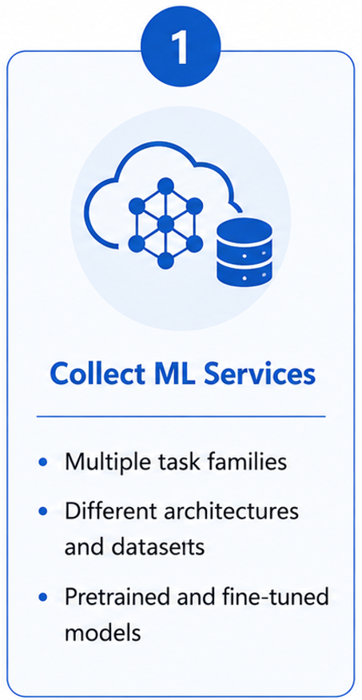
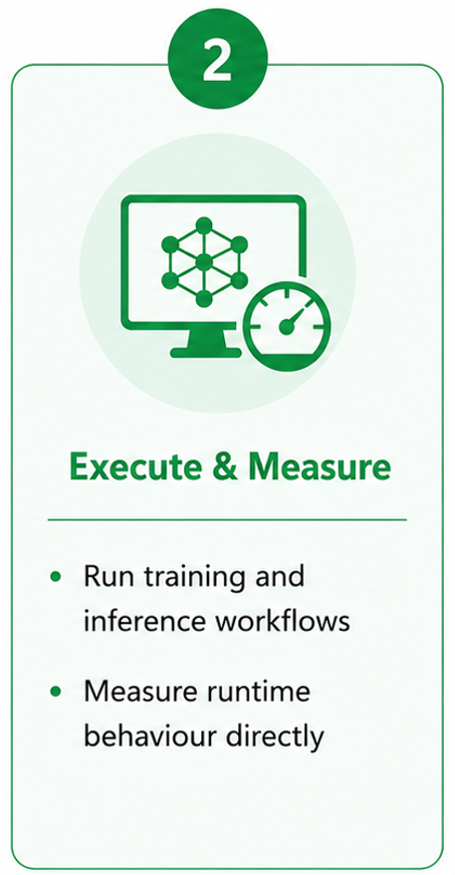
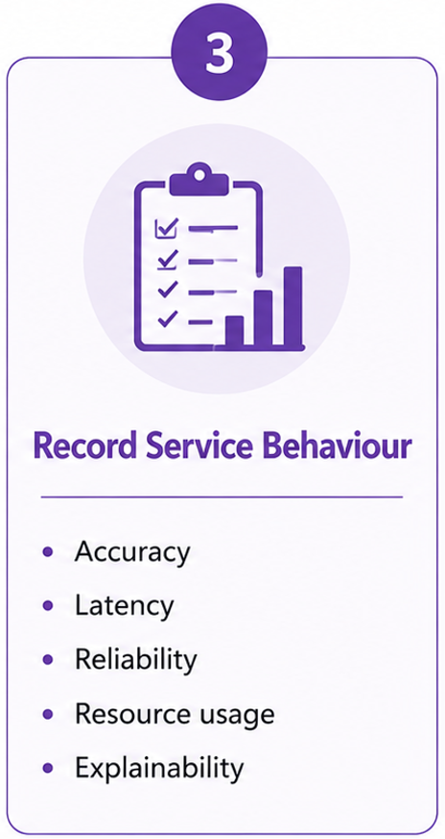
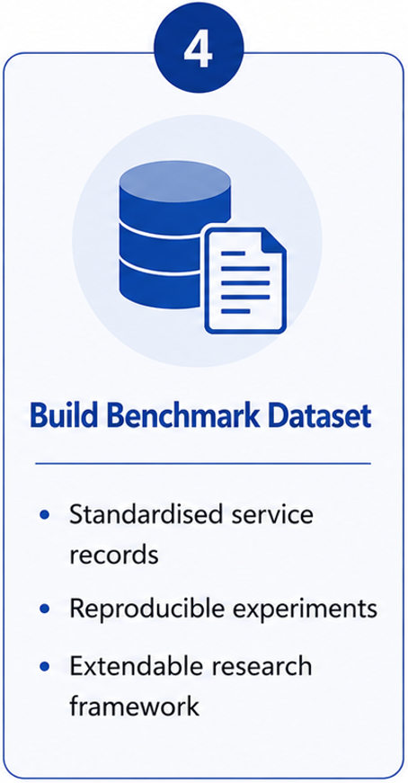
MLaaS collection workflow
Collect ML services → Execute and Measure → Record Service Behaviour → Build dataset
The generated services can later support composition, recommendation, orchestration, and QoS research
Joshua Boland
Notes:
“This slide shows how the dataset is built, moving from raw ML services through to benchmark-ready service records.”
“The first stage is collecting or defining ML services across different providers, tasks, models, and datasets.”
“The most important step is execution and measurement. The framework does not just invent service values — it runs models and captures behaviour from training or inference.”
“Attributes such as accuracy, latency, reliability, resource usage, and explainability are extracted from the service run.”
“The requirement and optimisation stages are mainly the paper’s composition layer. In this presentation, I’m treating them as what the generated dataset can support after the core service records exist.”
“The key point is that the generator turns model executions into structured MLaaS service records that can be reused for benchmarking and future research.”

Slide 7
What each MLaaS service records
Over 120 attributes are recorded within the dataset. Here are some key ones:
Functional Attributes
Data & Models | Accuracy | Latency
Dataset size, distribution, model configuration | Measures prediction quality | Measures response speed
Behavioural Attributes
Reliability | Resource Usage | Explainability
Consistency under load | Compute time and cost | Sensitivity and trustworthiness
Also captured: tail latency, cost efficiency, popularity, modality, training regime and more
Joshua Boland
Notes:
“Once a service is executed, the framework records both ML behaviour and runtime behaviour.”
“Traditional web-service datasets mainly capture metrics like latency and uptime, but ML services introduce additional behavioural dimensions.”
“Functional attributes include the model configuration, dataset characteristics, prediction accuracy, and latency.” “Behavioural attributes include reliability, resource usage, and explainability — all of which affect how practical a service is in real-world systems.”
“The key idea is that the dataset captures realistic ML service behaviour rather than just simple service metadata.”
“One of the most challenging attributes to define consistently across different ML tasks was explainability, which leads into the next slide.”

Slide 8
Explainability as a QoS metric
Traditional service QoS
ML services add interpretability
Latency · reliability · cost · throughput — well defined for web and cloud services (QWS, WS-DREAM).
Users must trust predictions — especially healthcare (clinical decisions) and finance (risk, compliance).
Challenge: define explainability consistently across 12 task families — text, vision, and tabular each need different XAI tooling.
Why not a unified SHAP / Grad-CAM / LIME pipeline?
Engineering decision: perturbation-based proxy
Methods are task-specific (tokens vs pixels vs feature columns)
Heavy models × thousands of services → high cost
These methods are hard to scale on regular hardware
Perturb inputs on benchmark eval samples
Measure output stability (confidence, prediction, quality)
Stable behaviour → higher explainability_score
Joshua Boland
Notes:
“Traditional service datasets mainly measure latency, reliability, and throughput, which are well-defined for web and cloud services.”
“ML services introduce an additional challenge: users must also trust and interpret model predictions.”
“The difficulty is that explainability is highly task-specific. Text, vision, and tabular models all require different XAI methods.”
“Methods like SHAP, LIME, and Grad-CAM work well individually, but they become difficult to apply consistently across thousands of heterogeneous services.”
“Applying full XAI pipelines at benchmark scale would also introduce major computational cost and slow down dataset generation.” “Instead, the framework uses a perturbation-based proxy approach. Inputs are perturbed and the stability of model predictions is measured.”
“The goal was not perfect interpretability, but a scalable and consistent explainability signal across heterogeneous ML services.”

Slide 9
Simulating realistic ML providers
Generating heterogeneous ML service behaviour from real model execution
Heterogeneity pipeline
1 · Task & model diversity
2 · Service variation
3 · Runtime execution
Base models
NLP, vision, tabular task families
Multiple architectures & providers
Benchmark datasets per task
Hyperparameters: LR, batch, epochs, optimiser
IID vs non-IID splits & training skew
Fine-tuned vs inference-only regimes
Execute real train / inference workflows
Measure actual runtime — not synthetic metadata
CPU / GPU resource tracking
▼
Different datasets
▼
Training conditions
4 · Behavioural measurement
5 · Dataset generation
▼
Prediction quality under benchmark eval
Latency, reliability, resource usage
Explainability via perturbation sensitivity
Standardised comparable service records
Reproducible manifest-driven experiments
Catalogue for composition research
Runtime behaviours
▼
ML service records
The goal was not to find the best ML model — the goal was to simulate many realistic ML providers with diverse behaviours.
Joshua Boland
Notes:
“This slide shows how the framework generates realistic heterogeneous ML providers from real model execution.”
“The process begins with base models, then introduces variation through different datasets, training conditions, and runtime behaviours.”
“Task and model diversity is important because NLP, vision, and tabular systems all behave differently under execution.”
“The most important stage is service variation, where providers are differentiated through hyperparameters, dataset splits, optimisation strategies, and training regimes.”
“This allows the framework to simulate providers with very different trade-offs in accuracy, latency, reliability, and compute cost.”
“The framework then executes real train and inference workflows rather than generating synthetic QoS values.”
“Runtime behaviour such as latency, resource usage, and reliability emerges naturally from execution.”
“These behavioural measurements are stored as standardised ML service records within the benchmark dataset.”
“The key idea is that the framework is not trying to find the single best ML model — it is trying to simulate many realistic ML providers with diverse behaviours.”

Slide 10
Implementation Architecture
From configuration to dataset
1. Registry
2. Manifest generation
3. Service execution
4. Metrics collection
5. Benchmark dataset
Curated tasks, models, and datasets
Hugging Face and generic providers
NLP, vision, tabular, detection, segmentation, …
hf-manifest builds many service rows
Vary hyperparameters, datasets, IID / non-IID splits
Training regimes & knob variants at scale
run-manifest: validate → train / inference
Loads splits, builds model, runs benchmark eval
CPU / GPU execution · grouped HF · multi-worker
Behaviour: accuracy, F1, task metrics, metric_score
QoS: latency, reliability, resource, cost
Explainability score (perturbation stage)
SQLite services.db — normalised schema
One manifest row → one service record
Ready for composition & algorithm evaluation
One manifest row = one simulated ML provider
This framework generates heterogeneous, realistic ML service providers and captures their behaviour for reproducible benchmarking.
Joshua Boland
Notes:
“The process begins with a registry of models, datasets, and task families across different ML domains.”
“The most important stage is manifest generation, where provider configurations are created programmatically at scale.”
“Each manifest row represents one simulated ML provider with its own datasets, hyperparameters, split strategy, and training regime.”
“The framework then executes real train and inference workflows attributes such as latency, resource usage, reliability, and evaluation metrics.come from actual execution”
“These measurements are collected and stored as within the SQL dataset.”
“The result is a reproducible framework capable of generating large-scale heterogeneous ML service ecosystems for benchmarking and future orchestration research.

Slide 11
Why task diversity matters
Different ML tasks produce different runtime, QoS, and explainability behaviour
Web-service benchmarks cannot assume one QoS profile. ML tasks differ in compute, latency, memory, and trust signals — richer ML-specific measurement is required.
NLP
Vision
Segmentation
Variable sequence lengths → latency spread
Token-level vs sentence-level workloads
Different explainability (perturbation on text units)
High compute & GPU cost per sample
Batch size strongly affects throughput
Spatial explainability differs from text
Large memory & VRAM footprint
Longer runtimes than classification
Pixel-level outputs → distinct QoS trade-offs
Classification
Regression / tabular
Often faster inference per sample
Accuracy-sensitive provider ranking
Reliability varies with class imbalance / skew
Lower compute than deep vision/NLP
Feature-space behaviour, not sequences
Different error metrics (RMSE, MAE) & cost profiles
The goal was to generate realistic variation in ML service behaviour.
Generator spans 12 MSC task families (NLP, vision, tabular, detection, generation, …) via hf-manifest — scale supports diversity, not a model inventory.
Notes:
why task diversity is important when benchmarking ML services.”
“Traditional web-service benchmarks often assume providers behave similarly aside from small QoS differences.”
“ML services are fundamentally different because different task families naturally produce different runtime and behavioural characteristics.”
“For example, NLP workloads have variable sequence lengths and different explainability behaviour compared to computer vision.”
“Vision and segmentation models are often much more computationally expensive and memory intensive.”
“Classification workloads may be relatively lightweight, while regression and tabular models behave very differently again.”
“This means a single QoS profile cannot realistically represent all ML services.” “The framework therefore spans many task families to intentionally generate heterogeneous provider behaviour.”
“The goal was not simply model diversity — the goal was realistic behavioural diversity across ML providers.”

Slide 12
Downstream Research on the Services
Composition & benchmarking layer
Extending the dataset to composition research
Benchmarking ML service behaviour
Service records
 | Traditional service datasets | MLaaS dataset generator
QoS depth | Limited QoS | Rich behavioural metrics
Behaviour | Static / advertised | Measured runtime variability
ML awareness | Minimal | Accuracy + explainability + resources
Provider space | Small, homogeneous | Realistic heterogeneous providers
↓
Requirements
Requirements: accuracy needs, latency limits, cost constraints
Applications: recommendation, service selection, benchmark evaluation
↓
Applications
The dataset enables:
Fair comparison across provider configurations
Reproducible evaluation from manifest → execution → records
Realistic optimisation problems (not toy QoS tables)
Once realistic ML service records exist, they can support higher-level research like composition and orchestration.
Joshua Boland
Notes:
how the generated service records can support downstream MLaaS research.”
“The core contribution of the project is the benchmark dataset generator itself. Composition and orchestration research are downstream applications built on top of these records.”
“Once realistic ML providers exist, requirements such as latency limits, accuracy thresholds, and cost constraints can be applied.” “This then enables applications like recommendation, orchestration, service selection, and benchmark evaluation.”
“One of the key differences compared to traditional service datasets is that behaviour is measured directly from runtime execution rather than relying on static advertised QoS values.”
“The generated dataset captures richer behavioural metrics including accuracy, explainability, runtime variability, and resource usage.”
“This creates a more realistic provider ecosystem and more meaningful optimisation and benchmarking problems.”
“The key idea is that realistic ML service records provide the foundation for future orchestration and composition research.”

Slide 13
Key Contributions and Limitations
A reproducible framework for generating heterogeneous ML service ecosystems.
Enabling
Fair benchmarking across diverse provider configurations
Reproducible evaluation
QoS analysis from measured train/inference behaviour
ML service orchestration and selection research
Future composition research on top of the service catalogue
Reflection and future work
Explainability
Runtime cost
No universal XAI metric across all ML task families — perturbation proxy is a deliberate trade-off.
Large-scale evaluation is computationally expensive; sample caps and time budgets are required in practice.
Real-world realism
Ecosystem evolution
Public Hugging Face and open models may not fully reflect commercial MLaaS provider behaviour.
Benchmark catalogues must evolve as models, tasks, and provider offerings change over time.
Joshua Boland
Notes:
“The key contribution of the project is a reproducible framework for generating heterogeneous ML service ecosystems.”
“The framework enables fair benchmarking across diverse provider configurations through standardised runtime execution and behavioural measurement.”
“Because providers are generated programmatically through manifests, experiments become reproducible and scalable.”
“One important contribution is that QoS behaviour is measured directly from train and inference execution rather than relying on static advertised service values.”
“Once realistic service records exist, they can also support higher-level research areas such as orchestration, recommendation, and composition.” “The project also highlights several important limitations and future challenges.”
“Explainability remains difficult to standardise across different ML task families, so the perturbation proxy is a deliberate engineering trade-off.”
“Large-scale evaluation is computationally expensive, which means practical runtime budgets are still required.”
“Public Hugging Face and open-source models may also not fully represent commercial MLaaS ecosystems.”
“Finally, ML ecosystems evolve rapidly, so benchmark catalogues must continue evolving alongside new models and providers.”
“Overall, the framework prioritises scalable and reproducible benchmarking over perfect real-world representation.”

Slide 14
Summary
Problem
Method
No public MLaaS benchmark with ML-specific QoS, requirements, and composition solutions
Execute diverse ML providers and capture runtime behaviour
Solution
Output
A configurable ML service dataset generator
Standardised benchmark-ready service records
25,900 services
Impact
Reproducible MLaaS benchmarking and future orchestration research
Questions?
Joshua Boland

