Slide 1

UDHNA CITIZEN COMMERCE COLLEGE & S.P.B. COLLEGE OF BUSINESS ADMINISTRATION OF SMT. DIWALIBEN HARJIBHAI GONDLIA COLLEGE OF BCA & IT
BACHELOR OF COMPUTER APPLICATION

Slide 2
G-CAMPUS COLLEGE MANAGEMENT SYSTEM
Submitted by:
Ayush A. Varma
Ramashanker M. Pandey
Kishore A. Sunchu
Guided by:
Prof. Ronak Shah

Slide 3

Index
Project profile
Introduction
Objective / Goal / Aim
Technology / Environment
Manual / Current / Existing System Study
Major Component / Flow
Minimum hardware / Software configuration
Drawbacks / Limitations
Software Analysis
Flow chart
DFD / UML
Data Dictionary
ER Diagram
Result snapshots
Reference

Slide 4
01 Project Profile

Slide 5

01 Project Profile
1.1 Introduction
Welcome to our College Management System!
Our College Management System is a comprehensive platform designed to streamline various administrative and academic processes within educational institutions. With the use of modern technologies such as ReactJS for the frontend, NodeJS for the backend, and MySQL for the database, our system offers an intuitive interface and robust functionality.
Profile Tittle: G-Campus
Projection Duration: 3 Months
Team Member: Ayush Varma, Ramashankar Pandey, Kishore Sunchu
Project Status: Completed

Slide 6

01 Project Profile
1.2 Objectives / Goals
Objectives/Goals of Our College Management System:
- Streamline administrative Tasks
- Improve academic management
- Promote data integrity and Security
- Enable Data-Driven Decision making
- Support Scalability

Slide 7
01 Project Profile
1.3 Technology / Environment
Frontend Development:
ReactJs
HTML/CSS
Tailwind CSS
Backend Development:
NodeJS
ExpressJS
Database:
MySQL
Development Tools:
Visual Studio Code
Git and GitHub
Command line interface(CLI) Tools

Slide 8
02
System Study
Manual / Current / Existing System Study

Slide 9

2.1 Major Components /Flow
A college management system typically consists of several major components designed to streamline various administrative, academic, and operational tasks within an educational institution.
Student Information System (SIS)
Administrative Management Module
Course Management System (CMS)
Library Management System
Examination Management System
Attendance Management System
Human Resource Management System (HRMS)
Communication and Collaboration Tools
Security and Access Control

Slide 10

2.2 Hardware / Software configuration
2.2.1 Hardware configuration (Sever side):
Processor: Intel Xeon or equivalent multicore processor
RAM: Minimum 8 GB (16 GB or more recommended for better performance)
Storage: Minimum 500 GB HDD or SSD (SSD recommended for faster data access)
Operating System: Linux (e.g., Ubuntu Server, CentOS) or Windows Server
Database Management System: MySQL, PostgreSQL, or Oracle Database

Slide 11

2.2 Hardware / Software configuration
2.2.2 Hardware configuration (Client side):
Processor: Intel Core i3 or equivalent
RAM: Minimum 4 GB (8 GB or more recommended for better performance)
Storage: Minimum 128 GB HDD or SSD
Operating System: Windows 10 or newer, macOS, or Linux

Slide 12
2.2 Hardware / Software configuration
2.2.3 Software configuration:
Web Server: Apache HTTP Server or Nginx
Programming Languages: PHP, Python, JavaScript
Frameworks: Laravel (for PHP), Django (for Python)
Database Management System: MySQL, PostgreSQL
Version Control: Git for managing source code

Slide 13
2.3 Drawbacks /Limitations
Initial Cost and Implementation Time
Complexity and Customization
Integration Challenges
Data Security Risks
Dependence on Technology
User Resistance and Training Needs
Scalability and Flexibility
Maintenance and Upkeep
User Experience and Usability

Slide 14
03
Software Analysis

Slide 15
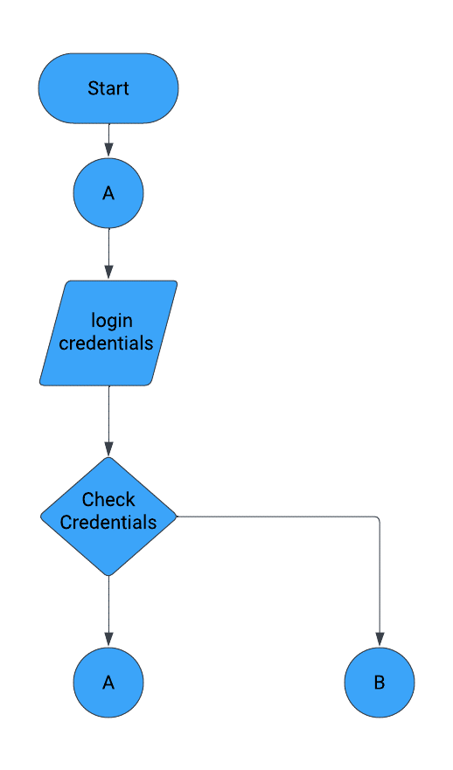
Software Analysis
3.1 Flow Chart:
- Admin Flow

Slide 16
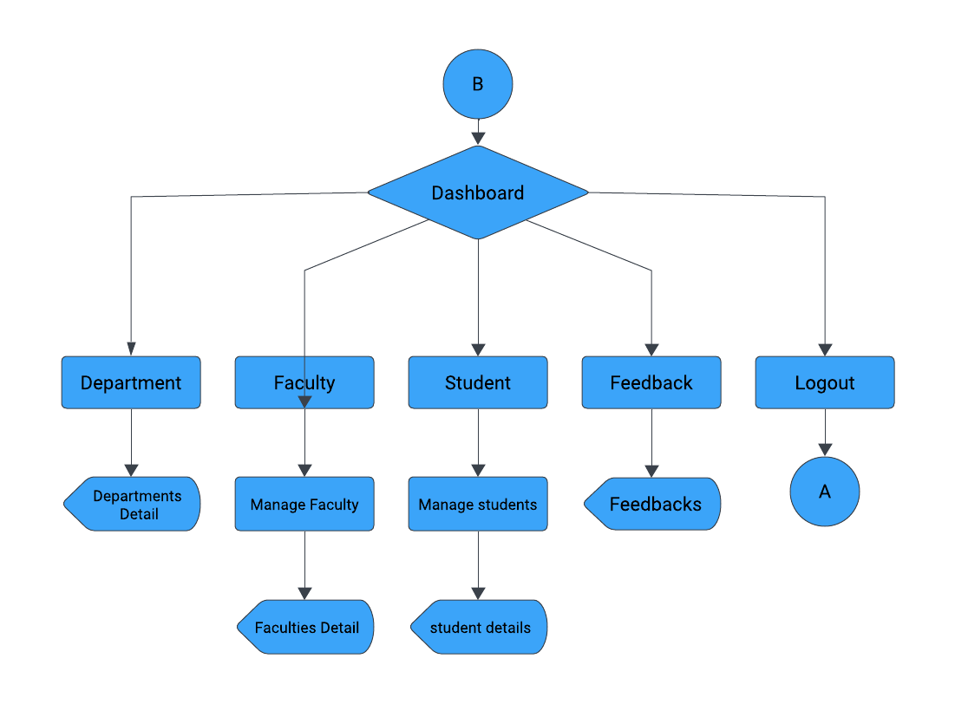
Software Analysis
3.1 Flow Chart:
- Admin Flow

Slide 17
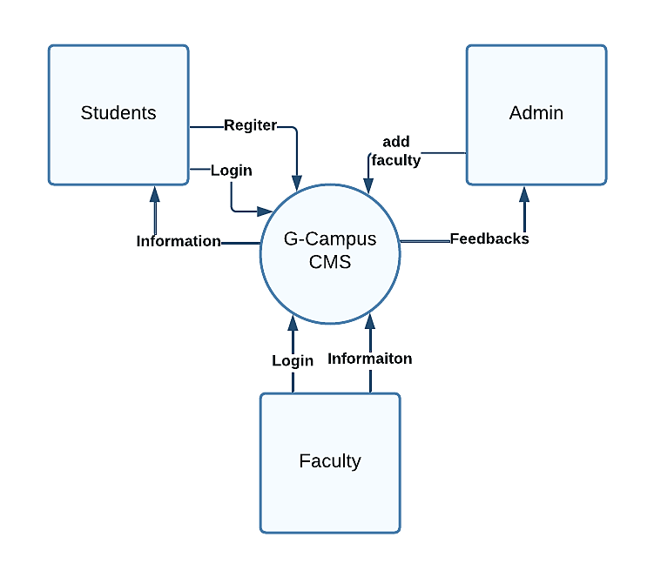
Software Analysis
3.2 DFD / UML
- 0 LEVEL

Slide 18
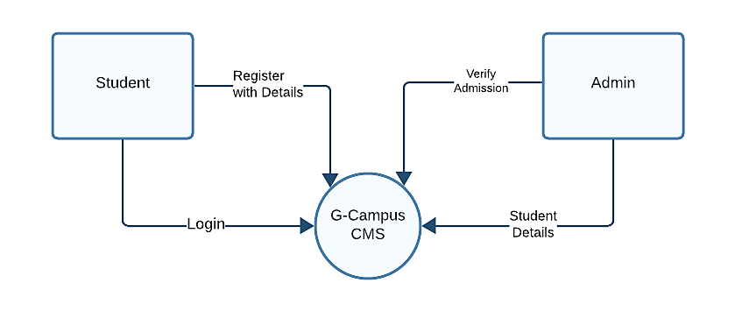
3.2 DFD / UML
Software Analysis
- 1 LEVEL DFD

Slide 19
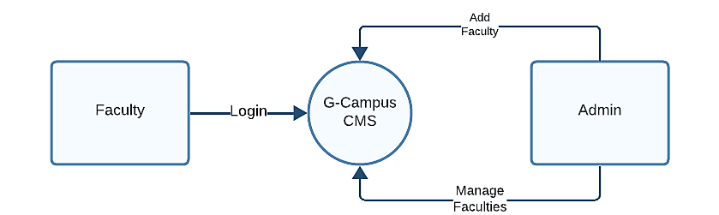
3.2 DFD / UML
3.2 DFD / UML
- 1 LEVEL DFD

Slide 20
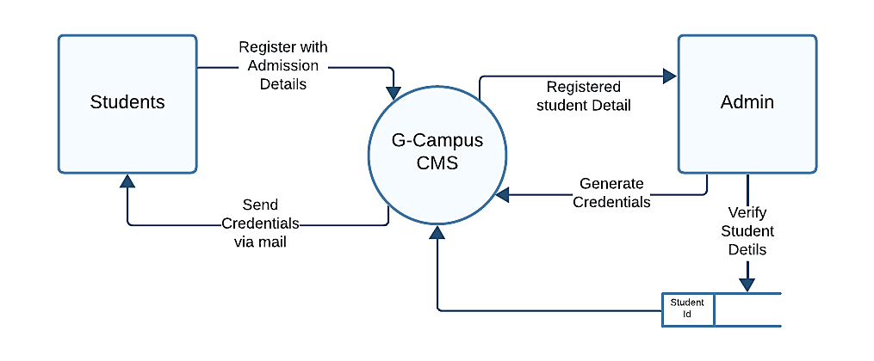
3.2 DFD / UML
- 2 LEVEL DFD

Slide 21
3.3 Data Dictionary
- Department Table:
SR No. | Column Name | Datatype | Description
1 | DeptId | Integer | Unique id for departments
2 | DeptName | Varchar | Name of the department
3 | Medium | Varchar | Medium of the department
4 | HeadofDept | Integer | Head of department’s unique id

Slide 22
3.3 Data Dictionary
- Classes Table:
SR No. | Column Name | Datatype | Description
1. | Classid | Integer | Unique id for class
2. | ClassName | Varchar | Name of the class
3. | DeptId | Integer | Unique id of the department
4. | FacultyId | Integer | Unique id of the faculty
5. | Fees | Integer | Fees of the class

Slide 23
3.3 Data Dictionary
- Faculty Table:
SR No. | Column Name | Datatype | Description
1. | FacultyId | Integer | Unique id of faculty
2. | FName | Varchar | First name of the faculty
3. | LName | Varchar | Last name of the faculty
4. | Gender | Varchar | Gender of the faculty
5. | Qualification | Varchar | Qualification of the faculty
6. | ClassId | Integer | Unique id of the class
7. | Experience | Varchar | Working experience of the faculty
8. | Status | Varchar | Status of the faculty: active/inactive

Slide 24
3.3 Data Dictionary
- Feedback Table:
SR No. | Column Name | Datatype | Description
1. | SR No. | Integer | Serial number of the feedback
2. | Full Name | Varchar | Full name of user
3. | Email | Varchar | Email address of user
4. | Phone | Varchar | Phone number of the user
5. | Message | Varchar | Actual message of the feedback
6. | Time stamp | DateTime | Date and Time of the feedback
7. | Status | Varchar | Status of the faculty: active/inactive

Slide 25
3.3 Data Dictionary
- Student Table:
SR NO. | COLUMN NAME | DATATYPE | DESCRIPTION
1. | Sid | Integer | Unique id of the student
2. | Fname | Varchar | First name of the student
3. | Mname | Varchar | Middle name of the student
4. | Lname | Varchar | Last name of the student
5. | DOB | Date | Date of birth of the student
6. | Gender | Varchar | Gender of the student
7. | Blood | Varchar | Blood group of the student
8. | Address | Varchar | Address of the student

Slide 26
3.3 Data Dictionary
- Student Table:
SR NO. | COLUMN NAME | DATATYPE | DESCRIPTION
9. | City | Varchar | City of the Student
10. | State | Varchar | State of the student
11. | Phone | Varchar | Phone number of the student
12. | Email | Varchar | Email Address of the student
13. | Tenth school | Varchar | Name of Tenth School
14. | Tenth Passing Year | Varchar | Passing year of tenth school
15. | Tenth Percentage | Varchar | Percentage of tenth school

Slide 27
3.3 Data Dictionary
- Student Table:
SR NO. | COLUMN NAME | DATATYPE | DESCRIPTION
16. | Twelfthschool | Varchar | Name of Twelfth School
17. | Twelfthpassingyear | Varchar | Passing year of Twelfth school
18. | Twelfthpercentage | Varchar | Percentage of Twelfth school
19. | Deptid | Integer | Unique id of the department-
20. | Classid | Integer | Unique id of the department-
21. | Password | Varchar | Student password for login purpose
22. | Profile | Varchar | Name of the profile picture
23. | Status | Varchar | Status of student
24. | Verified | Varchar | Student verification status

Slide 28
3.3 Data Dictionary
- Student Table:
SR NO. | COLUMN NAME | DATATYPE | DESCRIPTION
16. | Twelfthschool | Varchar | Name of Twelfth School
17. | Twelfthpassingyear | Varchar | Passing year of Twelfth school
18. | Twelfthpercentage | Varchar | Percentage of Twelfth school
19. | Deptid | Integer | Unique id of the department-
20. | Classid | Integer | Unique id of the department-
21. | Password | Varchar | Student password for login purpose
22. | Profile | Varchar | Name of the profile picture
23. | Status | Varchar | Status of student
24. | Verified | Varchar | Student verification status

Slide 29
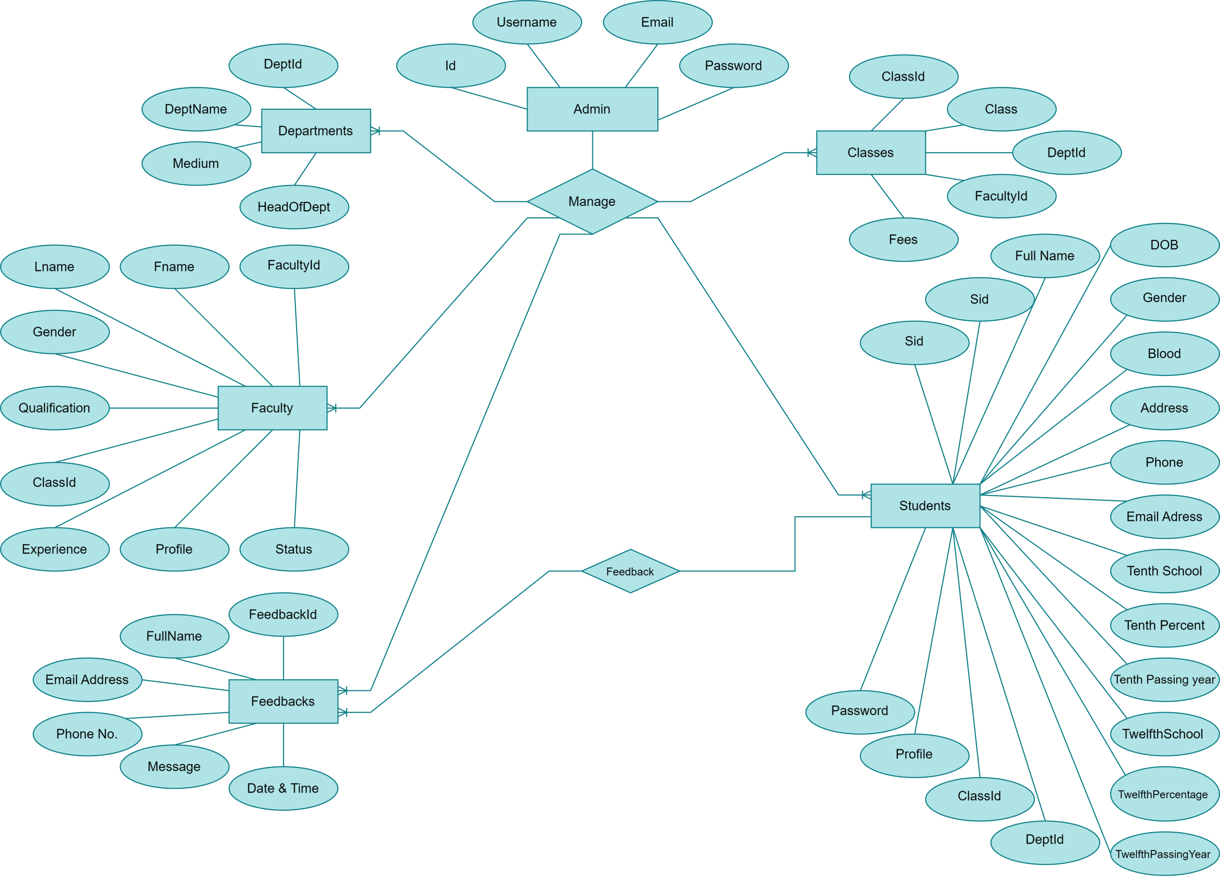
3.4 Entity Relational Diagram

Slide 30
04
Result Snapshots

Slide 31

04 Result Snapshots
Home Page -1

Slide 32

04 Result Snapshots
Home Page -2

Slide 33
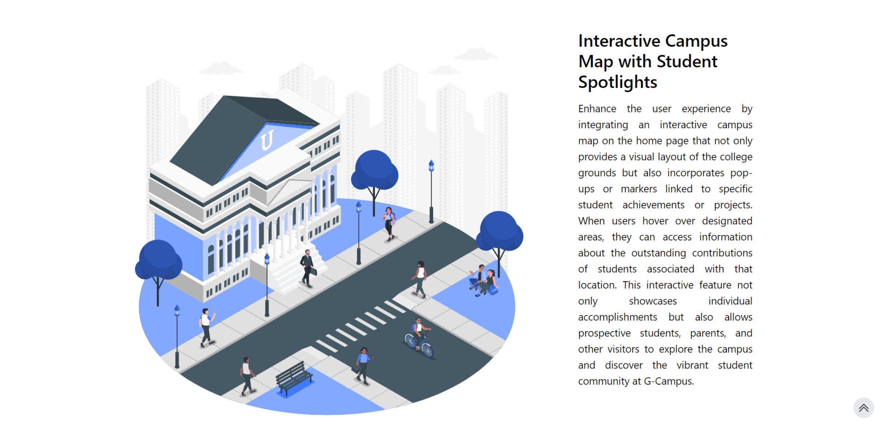
04 Result Snapshots
Home Page -3

Slide 34

04 Result Snapshots
Course Page:

Slide 35
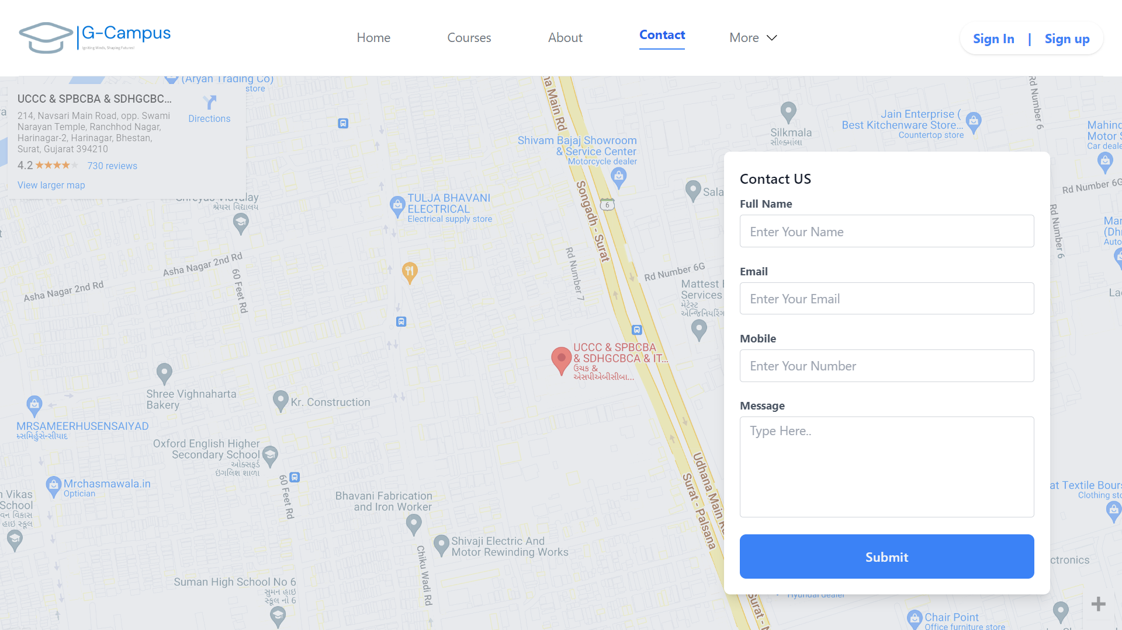
04 Result Snapshots
Contact US

Slide 36
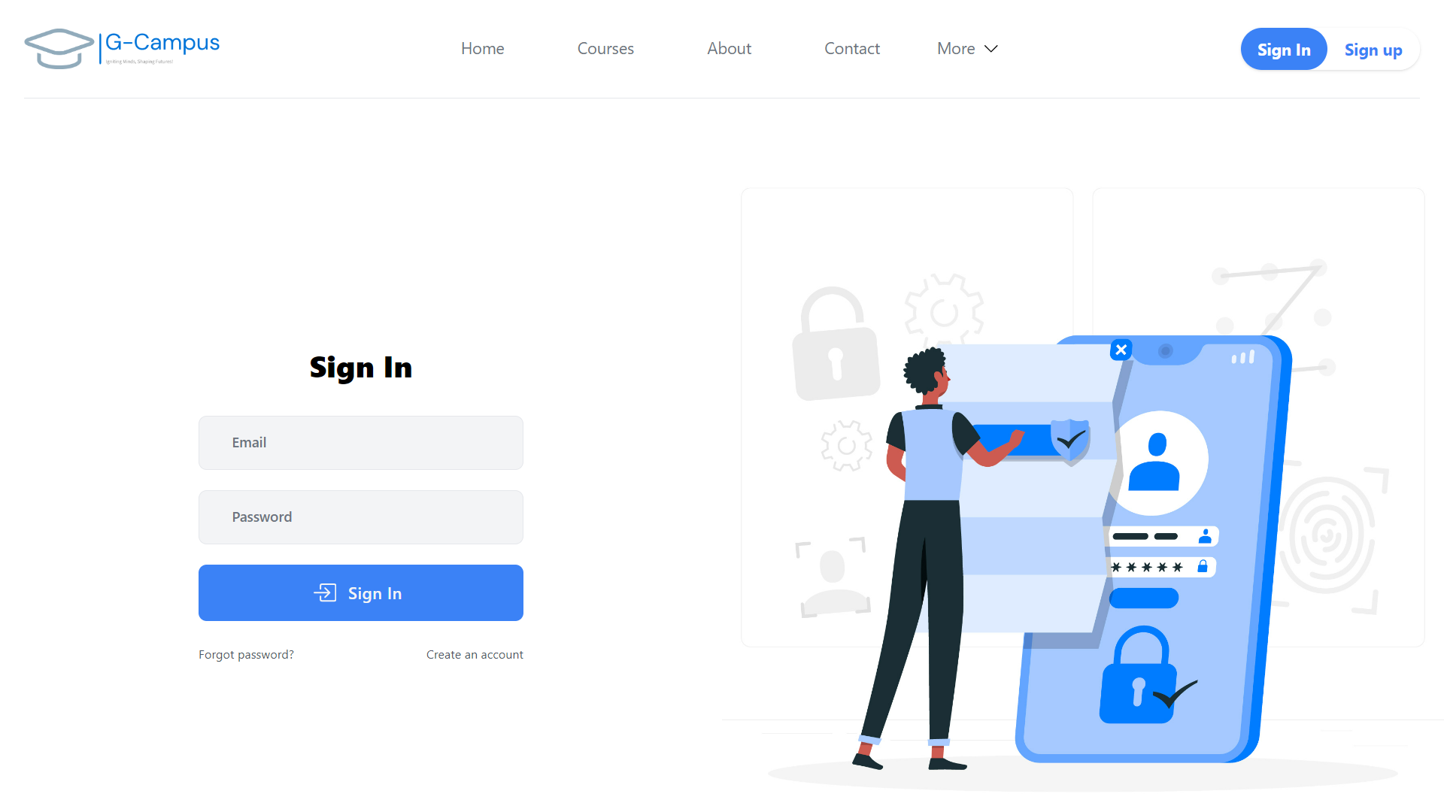
04 Result Snapshots
Sign In:

Slide 37
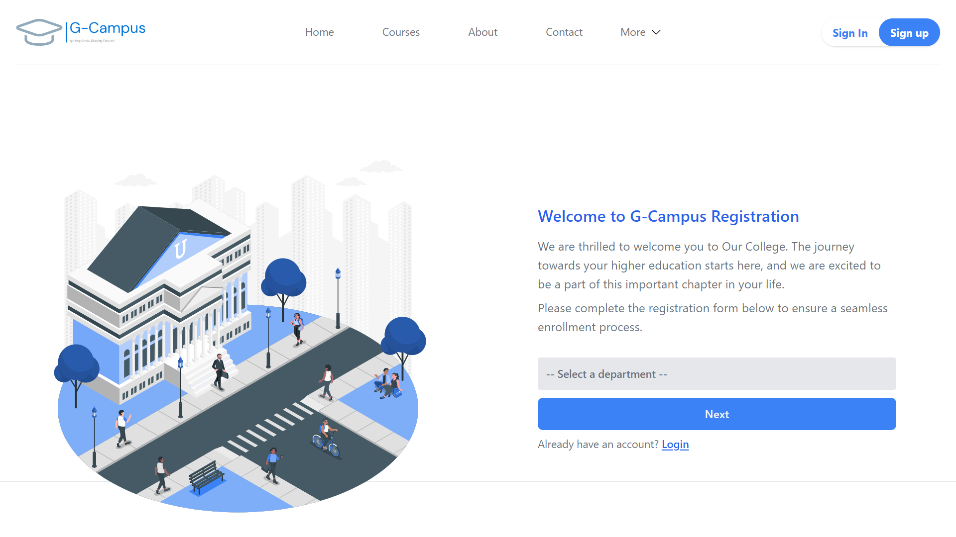
04 Result Snapshots
Sign up:

Slide 38
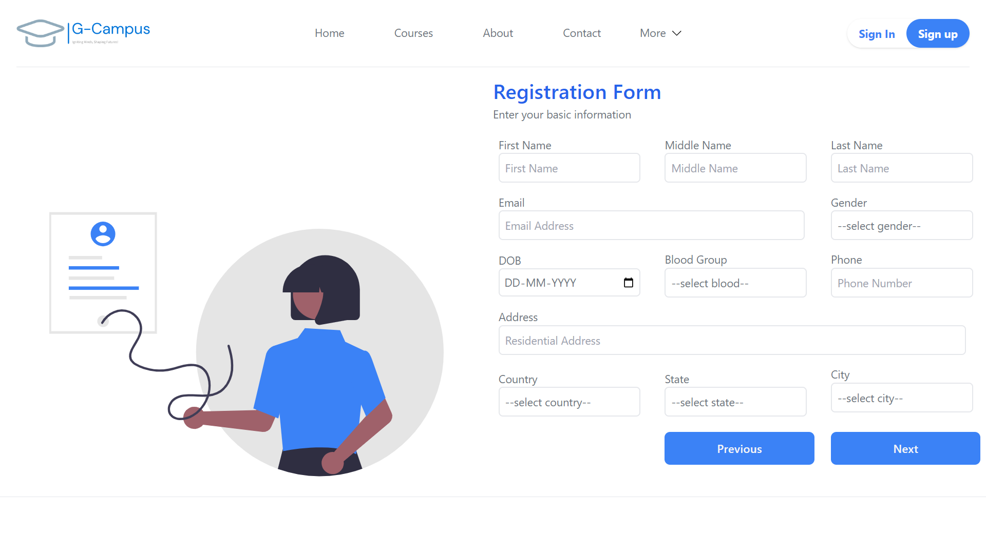
04 Result Snapshots
Sign up:

Slide 39
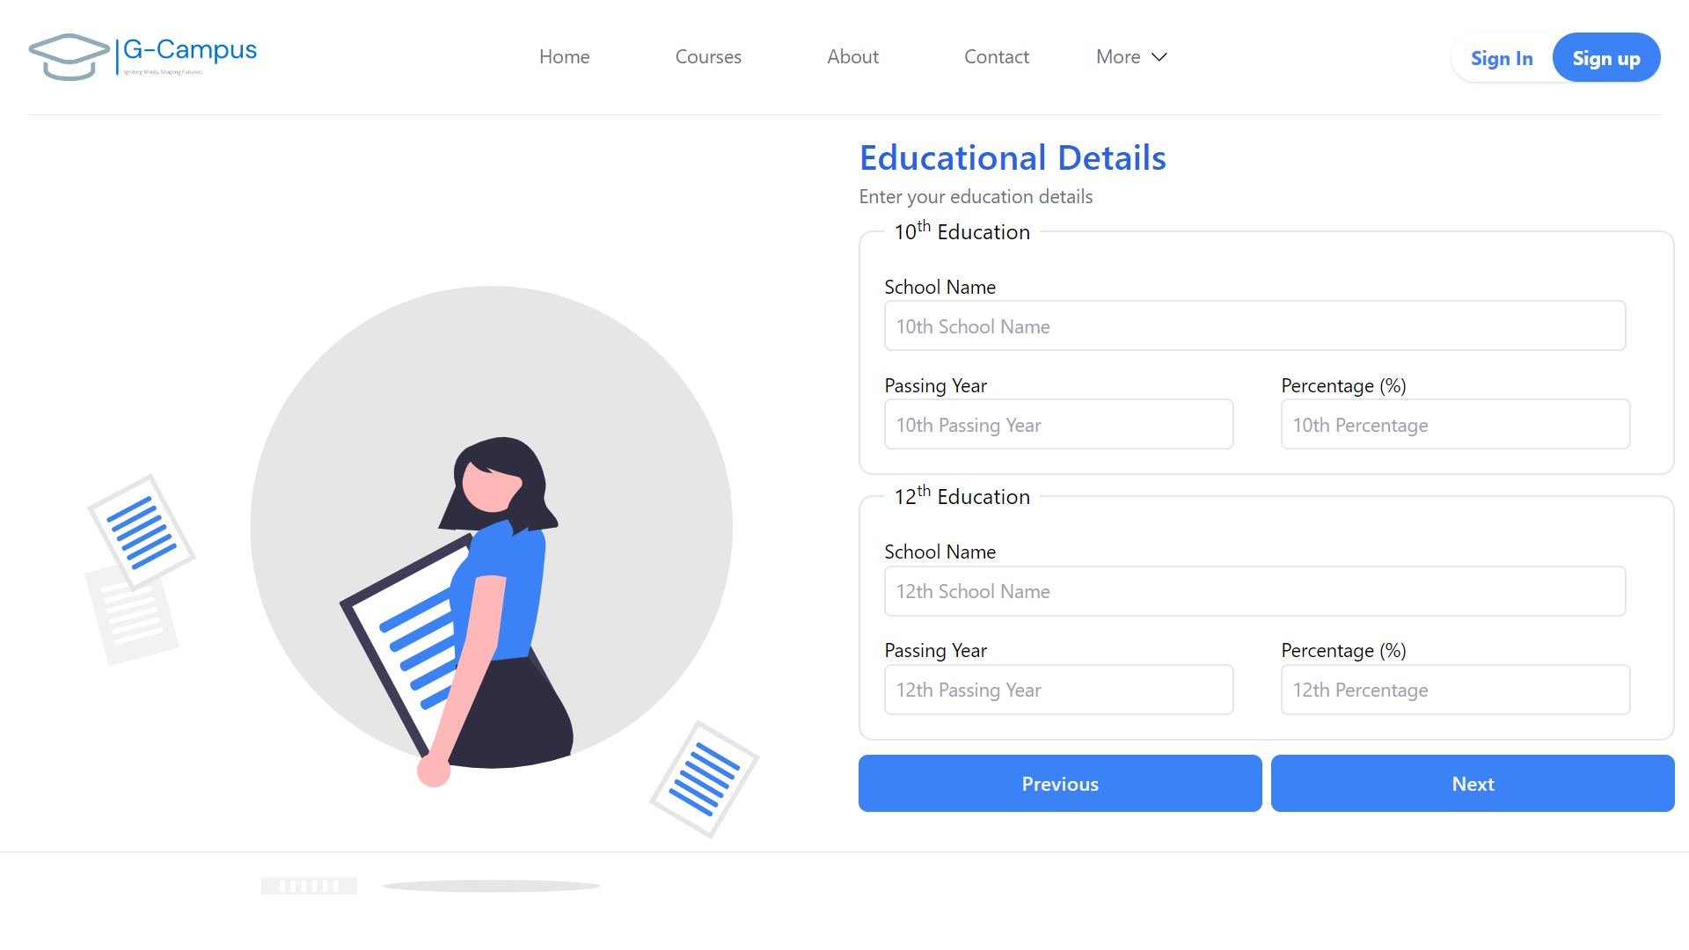
04 Result Snapshots
Sign up:

Slide 40
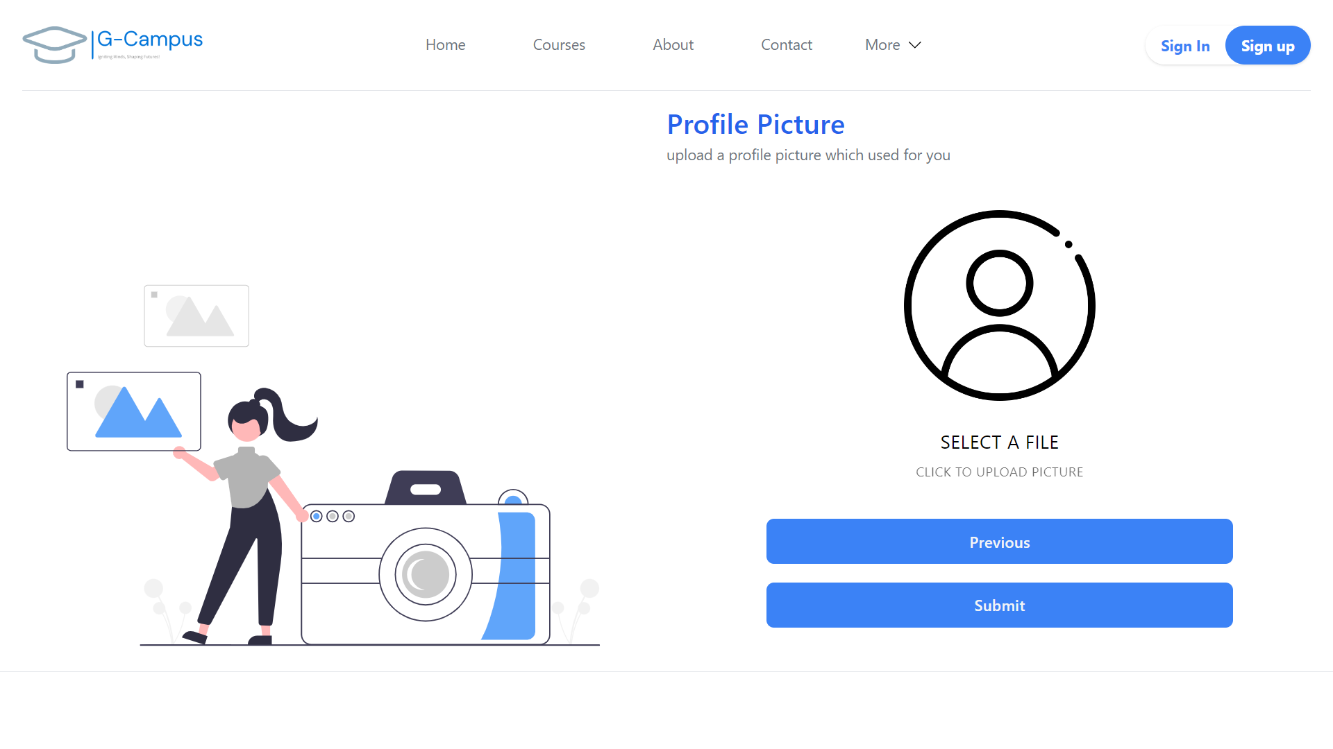
04 Result Snapshots
Sign up:

Slide 41
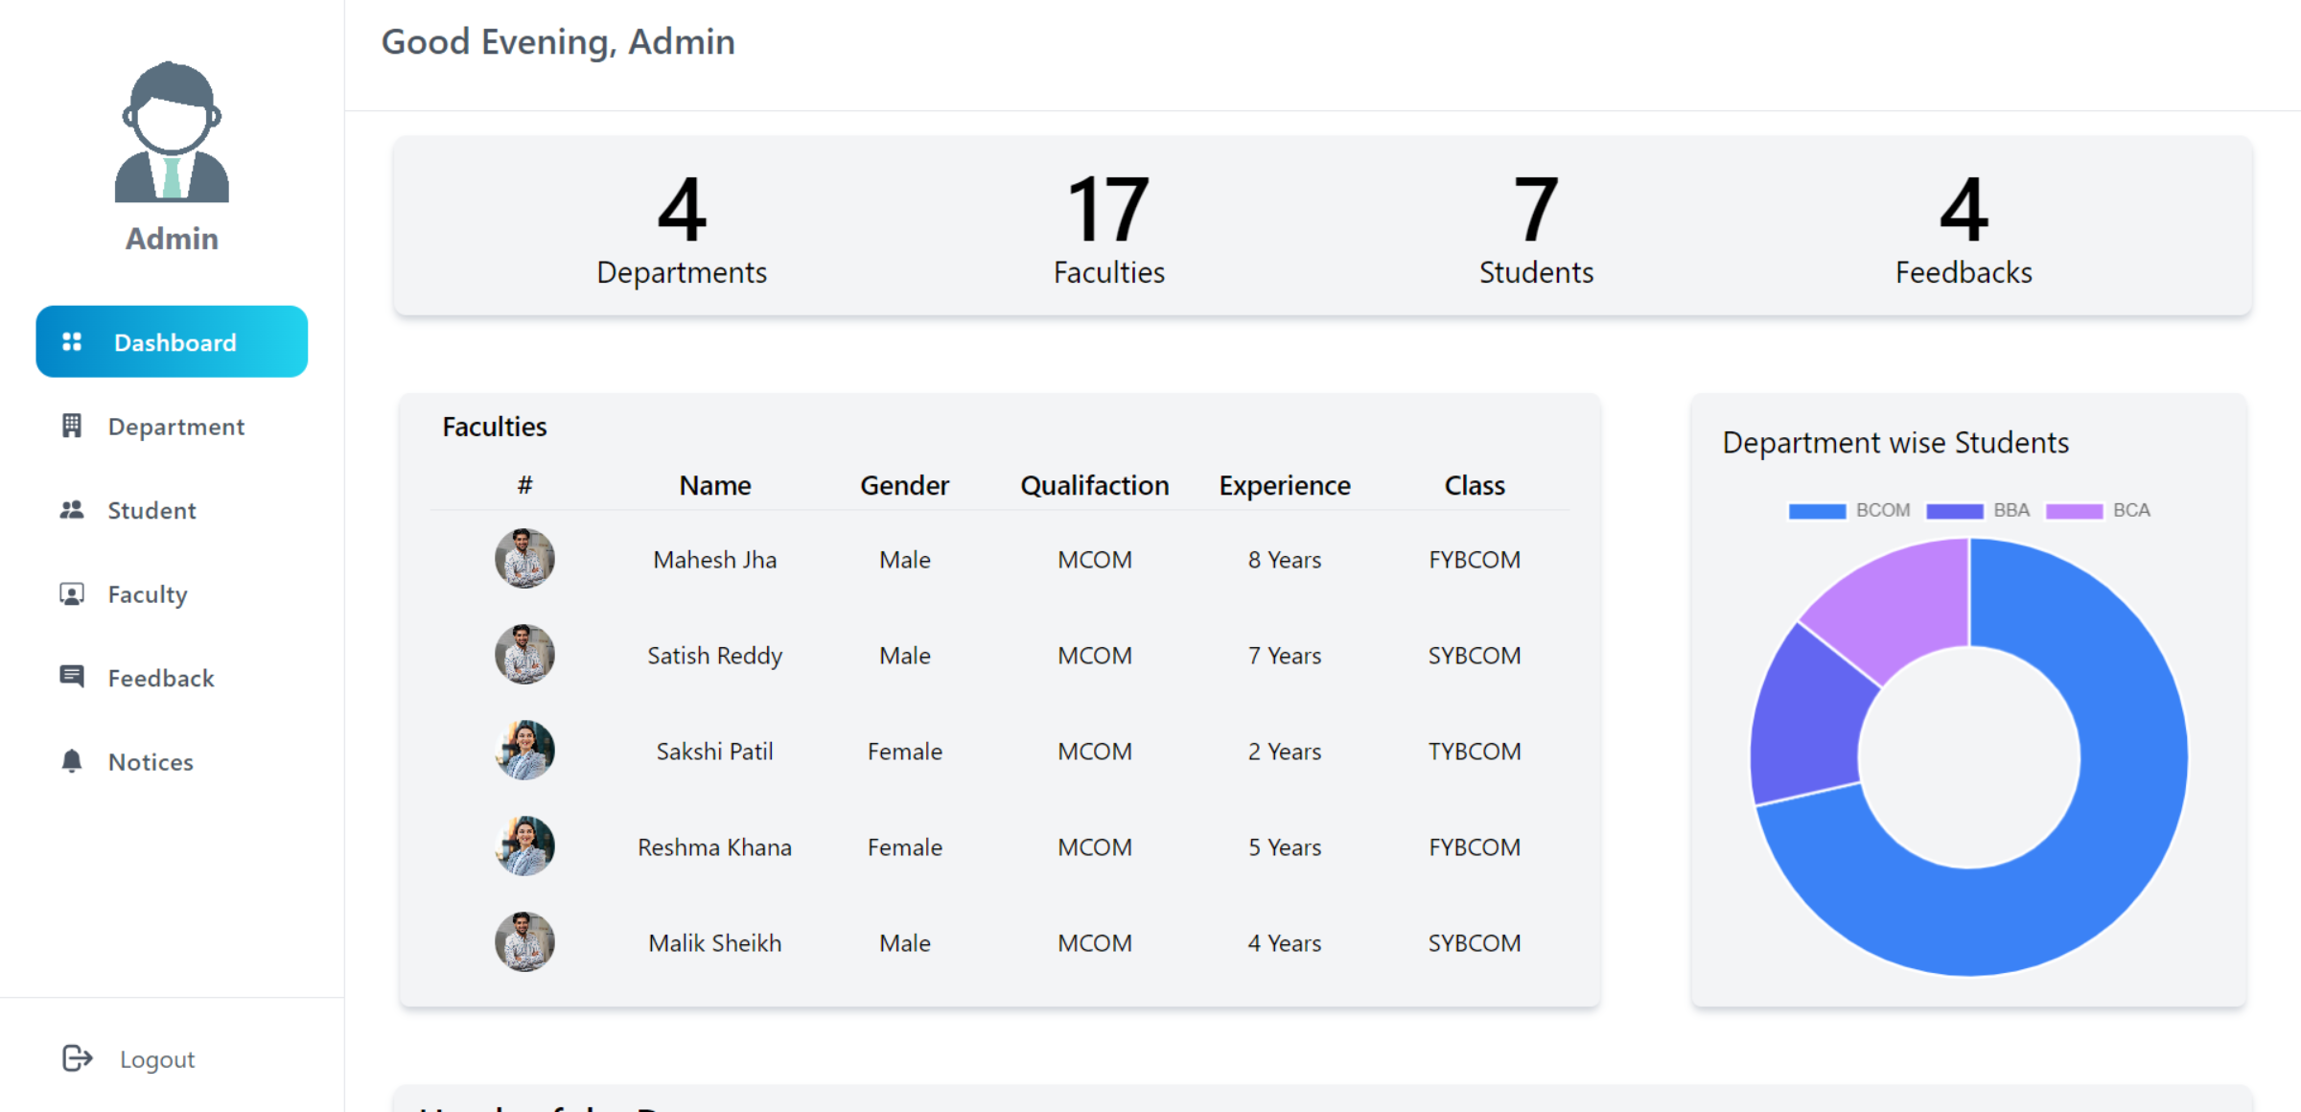
04 Result Snapshots
ADMIN DASHBORAD (Main Page) :

Slide 42
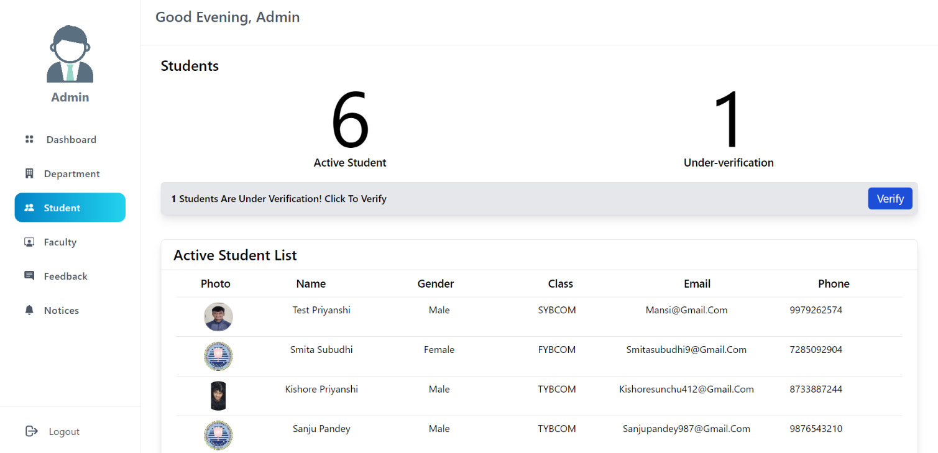
04 Result Snapshots
ADMIN DASHBORAD (Student Page) :

Slide 43
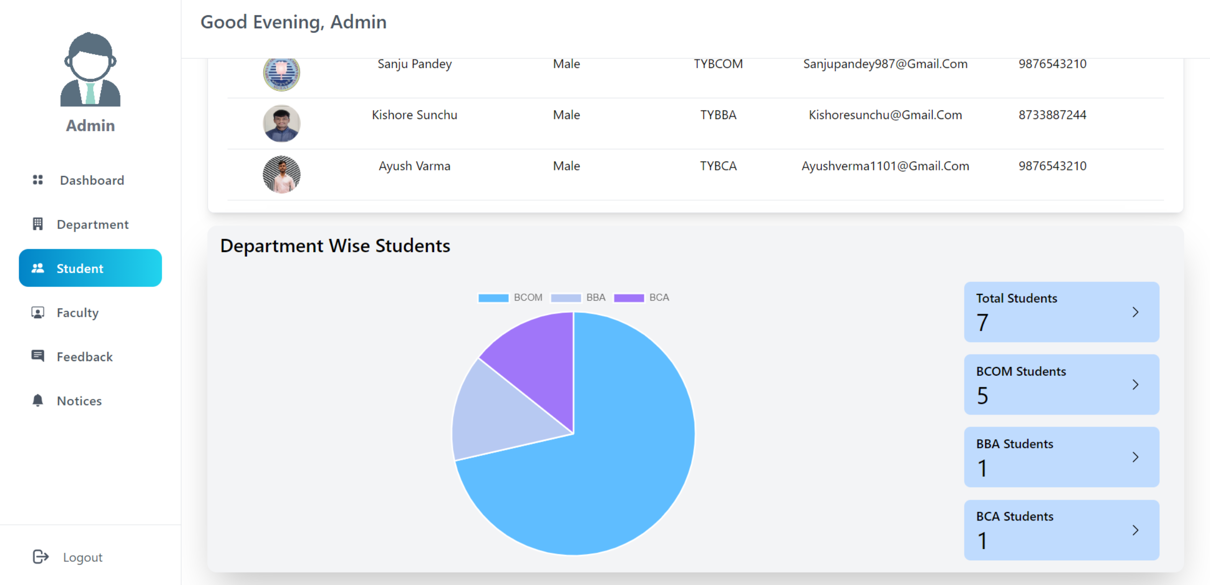
04 Result Snapshots
ADMIN DASHBORAD (Student Page) :

Slide 44
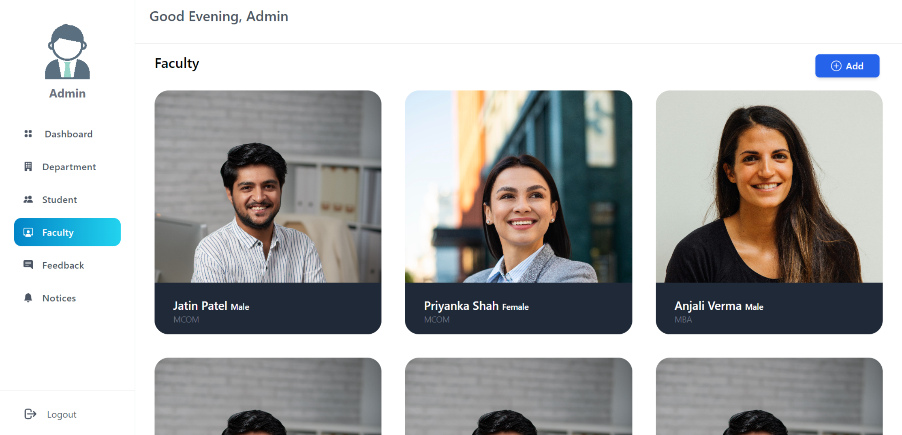
04 Result Snapshots
ADMIN DASHBORAD (Faculty Page) :

Slide 45
Reference
- REACTJS: https://react.dev/
- NODEJS: https://nodejs.org/en/
- MYSQL: https://www.mysql.com/
- EXPRESSJS: https://expressjs.com/
- NPMJS: https://www.npmjs.com/
- AXIOS: https://axios-http.com/docs/intro/
- REACT-ROUTER-DOM: https://reactrouter.com/en/main/
- REACT-COUNTUP: https://www.npmjs.com/package/react-countup/
- CHARTJS: https://www.chartjs.org/
- REACT-CHARTJS-2: https://react-chartjs-2.js.org/
- STACKOVERFLOW: https://stackoverflow.com/

Slide 46

Thank You

