Slide 1
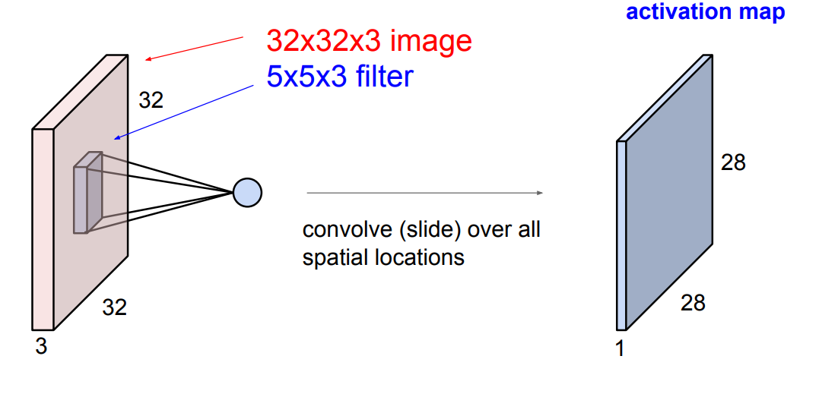
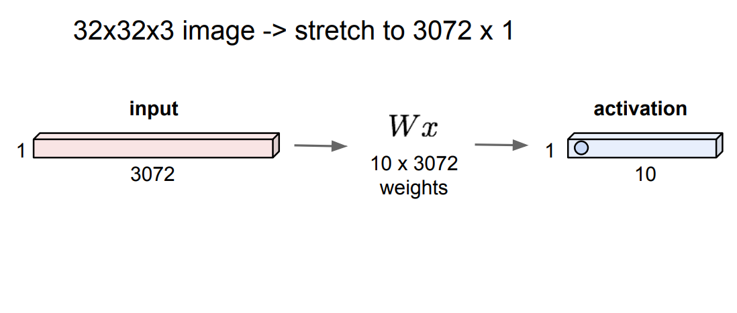
Fully-connected Layer
Convolutional Layer

Slide 2
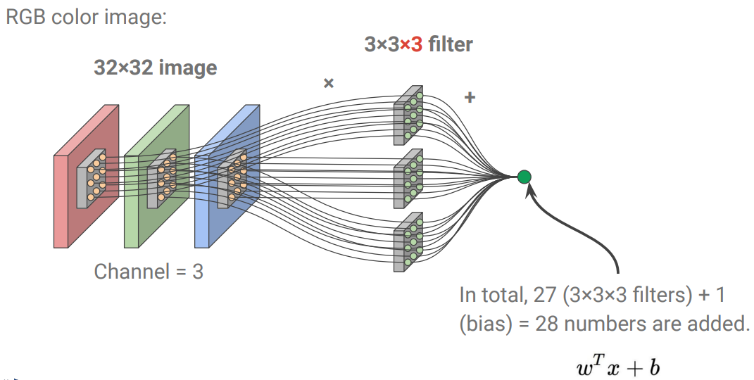
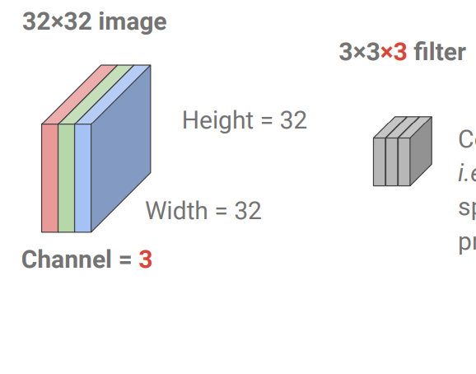

Slide 3
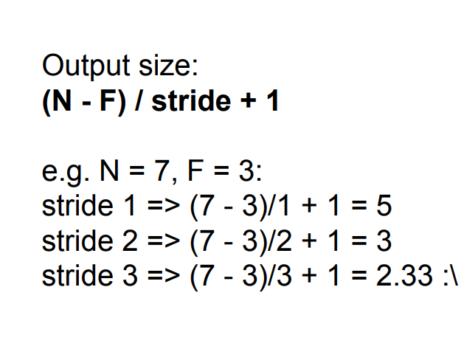
stride
F
N
N
F
N
N

Slide 4
stride(3)
padding(1)
0 | 0 | 0 | 0 | 0 | 0 | 0 | 0 | 0
0 |  |  |  |  |  |  |  | 0
0 |  |  |  |  |  |  |  | 0
0 |  |  |  |  |  |  |  | 0
0 |  |  |  |  |  |  |  | 0
0 |  |  |  |  |  |  |  | 0
0 |  |  |  |  |  |  |  | 0
0 |  |  |  |  |  |  |  | 0
0 | 0 | 0 | 0 | 0 | 0 | 0 | 0 | 0
Output size:
F
(N-F+2P)/stride + 1
Preserve size spatially(stride 1):
F
-F+2P=-1
P=(F-1)/2
F=3 -> P=1
F=5 -> P=2
F=7 -> P=3
N
Number of parameters:
N
K(F²C+1)
*C: Channel

