Slide 1

Sri Venkateswara College of Engineering and Technology
(Autonomous)
R.V.S Nagar, Chittoor – 517 127. (A.P)
B.Tech – Computer Science and Engineering (AI & ML)
Academic Year:2025 – 2026
Project Title
Employee performance prediction and productivity Analysis
Submitted By:
Under the Guidance of
Mr.K.Anjaneyulu M. Tech
Assistant Professor
Department of CSE (AI & ML)
Student Name | Register Number
Y.Ganesh | 22781A33E5
Y.Sindhu | 23785A3318
P.Praveen | 22781A3394
V.Viswa | 22781A33E4
N.Siddu | 23781A3393

Slide 2
ABSTRACT
Employee performance evaluation plays a crucial role in organizational growth and productivity. Traditional performance assessment methods are often manual, subjective, and time-consuming, leading to biased and inaccurate decisions. This project, Employee Performance Prediction and Productivity Analysis, proposes a machine learning–based system to predict employee performance using work-related attributes such as attendance, working hours, experience, productivity metrics, and feedback.
The system collects and preprocesses employee data, applies feature engineering techniques, and trains classification models to categorize employees into different performance levels such as high, average, and low. Machine learning algorithms like Logistic Regression, Random Forest, and XG boost are used to achieve accurate and reliable predictions. The trained model is integrated with a user-friendly interface to display performance insights and prediction results.

Slide 3
AGENDA
Introduction
Problem Statement
Existing System
Proposed System
System Architecture
Methodology
Implementation
Conclusion

Slide 4
INTRODUCTION
Employee Performance Prediction and Productivity Analysis is a machine learning–based system designed to evaluate and predict employee performance using work-related data. The project aims to assist organizations in making data-driven HR decisions by analyzing factors such as attendance, working hours, experience, productivity metrics, and feedback. By automating performance evaluation, the system reduces human bias and improves organizational efficiency.

Slide 5
2. PROBLEM STATEMENT
Traditional employee performance evaluation methods are often manual, subjective, and time-consuming. These approaches may lead to biased decisions, delayed feedback, and inaccurate performance assessments. There is a need for an intelligent system that can analyze employee data efficiently and predict performance levels accurately to support better decision-making.

Slide 6
EXISTING SYSTEM
In the existing system, employee performance is mainly evaluated through manual reviews, supervisor feedback, and periodic appraisals. These methods depend heavily on human judgment, which can be inconsistent and biased. Data is often scattered across multiple sources, making analysis difficult, and predictive insights are not available.

Slide 7
PROPOSED SYSTEM
The proposed system uses machine learning techniques to predict employee performance and analyze productivity. It collects and processes employee-related attributes, applies feature engineering, and trains classification models to categorize employees into performance levels such as high, medium, or low. The system provides accurate, fast, and unbiased performance predictions through an interactive interface.

Slide 8
SYSTEM ARCHITECTURE
The system architecture consists of data collection, data preprocessing, model training, and prediction layers. Employee data is stored in a database, preprocessed using Python libraries, and fed into machine learning models. The trained model is integrated with a user interface (Streamlit/CLI) to display predictions and analytics results to the user.

Slide 9
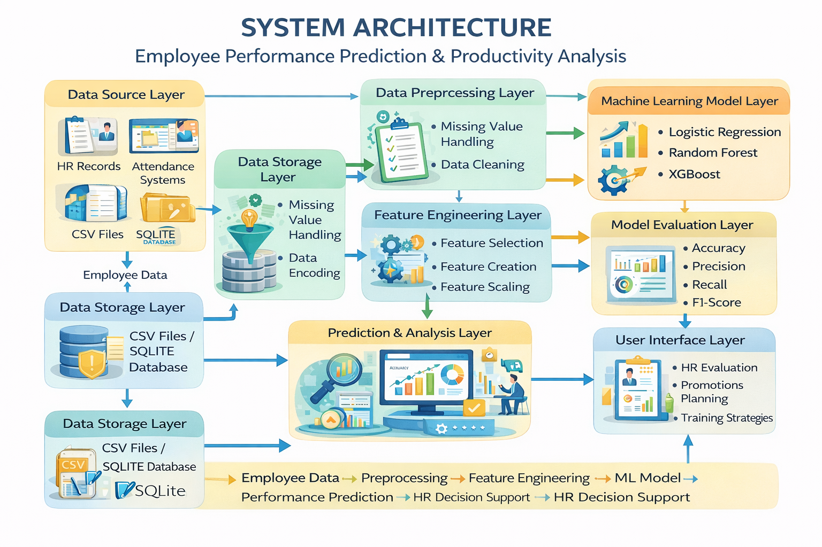

Slide 10
DATA COLLECTION
Employee ID – Unique identifier for each employee
.Attendance – Number of days present or attendance percentage
Working Hours – Average daily or monthly working hours
Experience – Total years of professional experience
Productivity Score – Task completion rate or output efficiency
Feedback Score – Performance feedback ratings from supervisors
Training Hours – Number of training sessions attended
Performance Level (Target Variable) – High, Medium, or Low

Slide 11
METHODOLOGY
The methodology includes data collection, data cleaning, feature engineering, model selection, training, and evaluation. First, raw employee data is collected and preprocessed. Relevant features are selected and scaled. Machine learning classification algorithms are trained on the dataset, evaluated using performance metrics, and the best-performing model is selected for deployment.

Slide 12
IMPLEMENTATION
The implementation of the Employee Performance Prediction and Productivity Analysis system is carried out using Python and machine learning techniques. The system integrates data handling, model training, and performance prediction into a single workflow.

Slide 13
CONCLUSION
The Employee Performance Prediction and Productivity Analysis system provides an effective and intelligent solution for evaluating employee performance using machine learning techniques. By analyzing key attributes such as attendance, working hours, experience, productivity, and feedback, the system accurately classifies employees into different performance levels.
The proposed system overcomes the limitations of traditional manual evaluation methods by reducing human bias, saving time, and improving accuracy. Experimental results show that machine learning models can successfully identify performance patterns and support data-driven HR decision-making.
Overall, this project helps organizations improve workforce productivity, identify high-performing employees, and plan training programs for continuous improvement. The system is scalable, reliable, and can be further enhanced with advanced analytics and real-time data integration in the future.
.

Slide 14
