Slide 1

Moonrise
Christhel, Tianran, Vladimir, Yann, Rosalie

Slide 2
Goal
-Compare biobased and fossil-based insulation for buildings
-Calculate carbon emissions and radiative forcing over time

Slide 3
Achievements
-Load Excel file with exchanges
-Added time distribution to ecoinvent
-Calculate and plot the CO2 emissions over time with a manually created database
-Calculate it with a dynamic characterization method

Slide 4
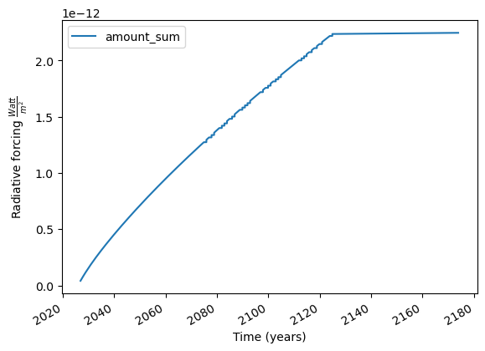
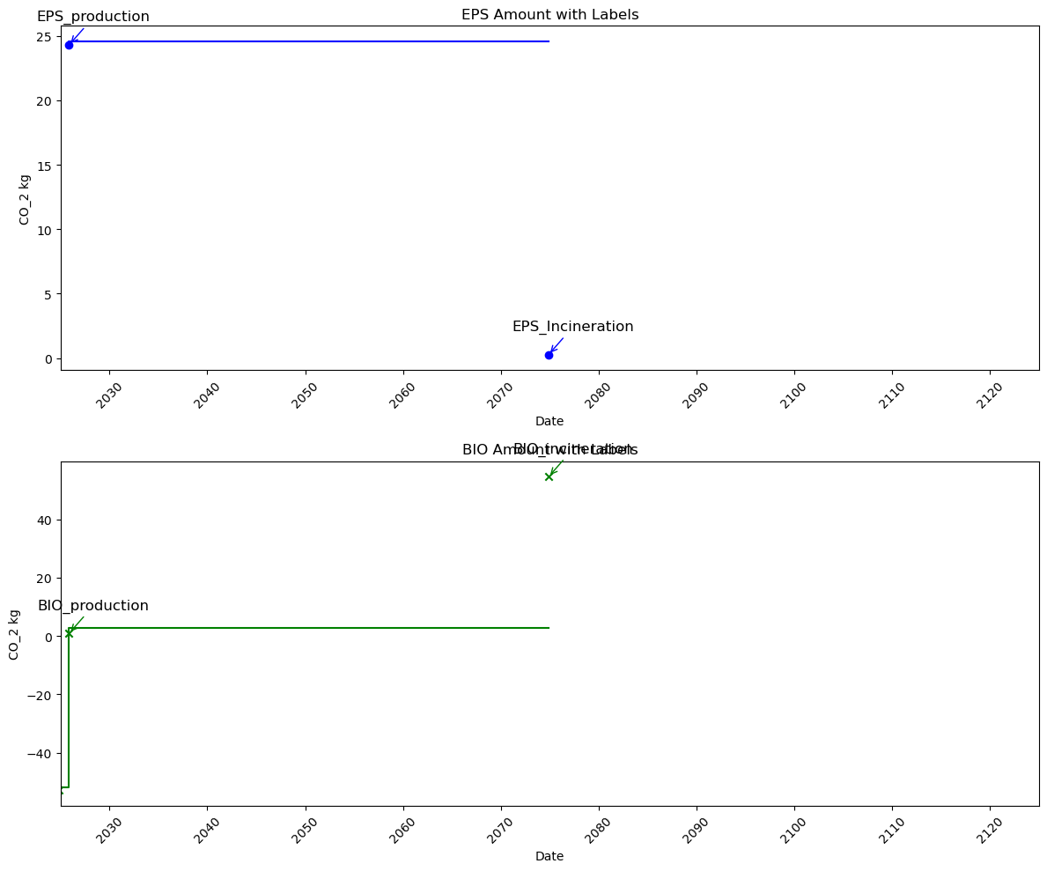
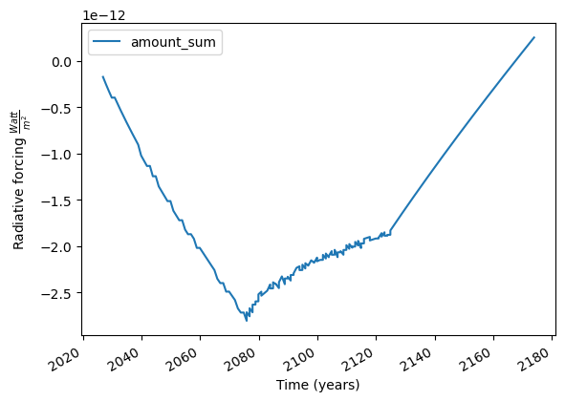

Slide 5
Improvement
-Testing
-Connect ecoinvent with our calculations
-Add more Greenhouse gases

