Slide 1



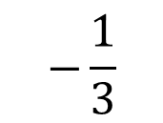
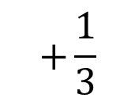
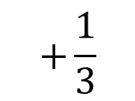
Must Buy!
Average portfolio return: 2.25%
Volatility: 0.48%
$$+\frac{1}{3}$$
$$+\frac{1}{3}$$
$$−\frac{1}{3}$$
Why you should consider: Good returns and low volatility

