Slide 1


제 7회 전자구조계산 여름학교
실습 1: EDISON 홈페이지에서의 양자계산 패키지 설치 (VS Code)
Ph. D. Joonho Park
School of Electrical Engineering
Korea Advanced Institute of Science & Technology (KAIST)
2026. 7. 13. (월)

Slide 2
목차
Edison homepage
계정 만들기
다양한 App 활용
Crystal Viewer, File Browser, Jupyter Notebook, VS Code
VS Code
실행
Panel
Editor, Terminal, …
Job
Submit
확인, …
Linux
Linux 환경
Command, variable, etc
ls
git
Bash, …
수업
Atom install

Slide 3
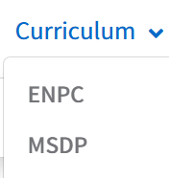
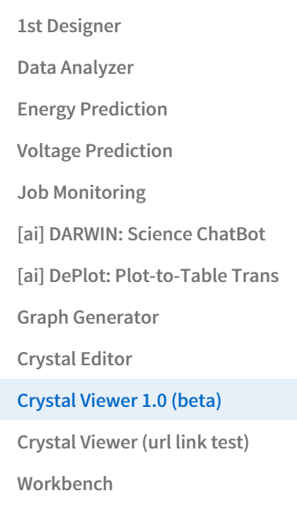
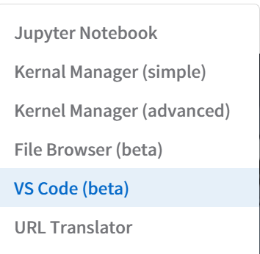
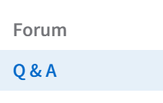
1. Edison homepage
Make an account
Homepage: https://nanornd.edison.re.kr/home
계정 만든 후 5분간 대기

Slide 4
1. Edison homepage
다양한 앱 활용
Crystal Viewer
물질 구조, 전자 밀도 (surface cut/projection), Brillouin Zone
Construction, modification, etc
Jupyter Notebook
Jupyter notebook, terminal 가능 (job submit 안 됨)
File Browser
고용량 파일 전송
VS Code → 여름학교 수업 진행
Job submit 가능 ( sbatch, qsub)

Slide 5
1. Edison homepage
원 본
Edison site 구조
Server
POD containers
EDISON 2.0
(similar to docker)
/Jupyter notebook
/IDE/VS Code
/File Browser
VS Code
POD
Ncpu = 4
Memory = 2G
Ngpu = 1
Home directory
root 접근불가
공용 Storage
/home/userid/.bashrc
persistent space

Slide 6
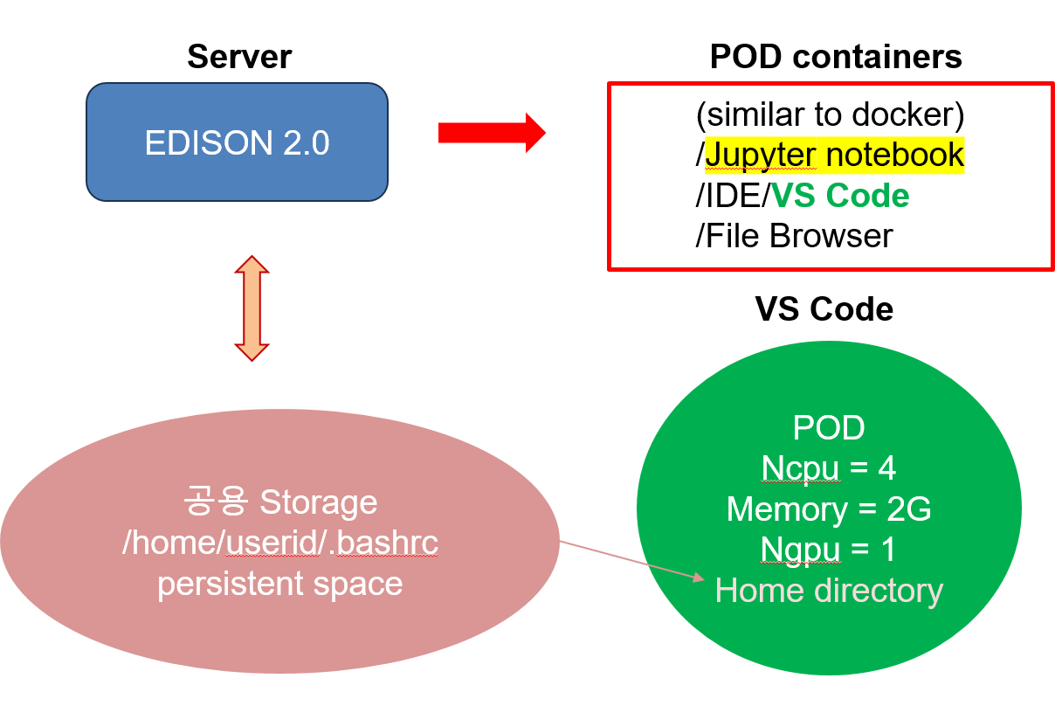
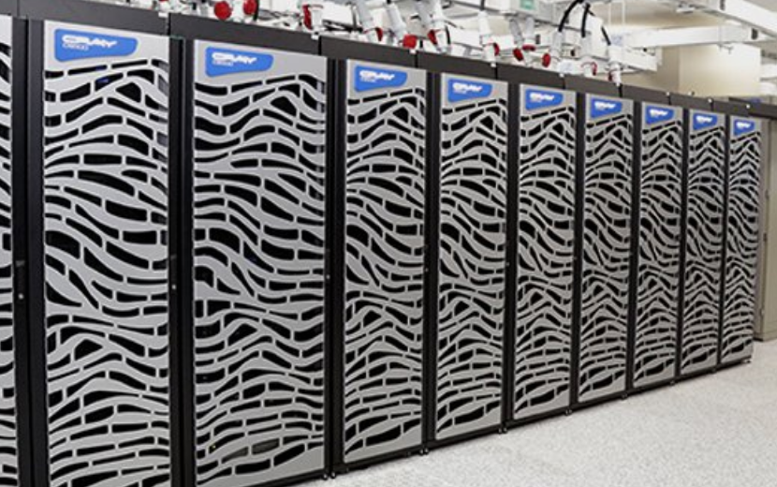
1. Edison homepage
Edison site 구조
Slave node
Job submit
Ncore = 500
system = 50
master = 4/person
나머지 = queue

Slide 7
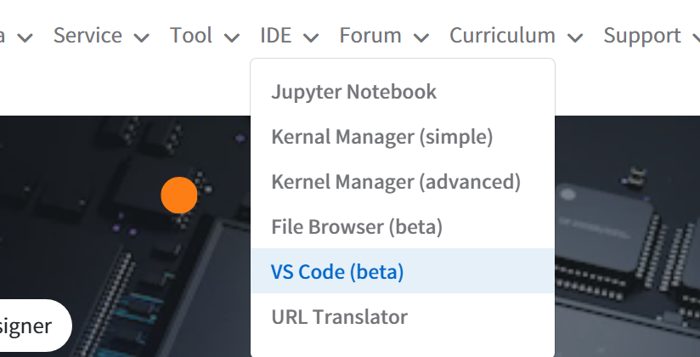
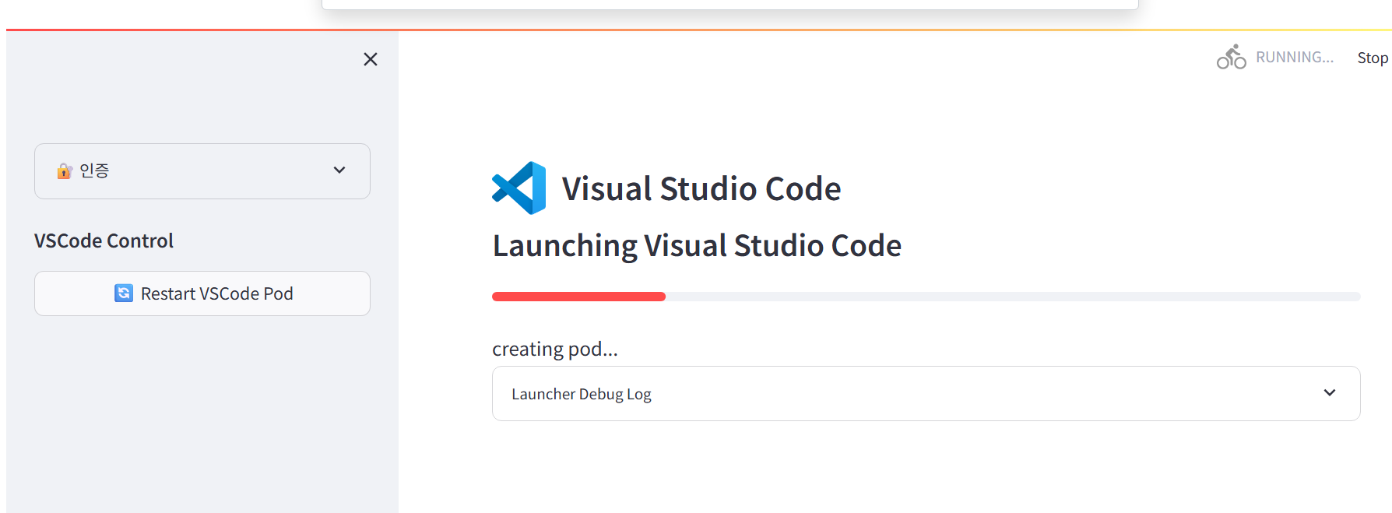
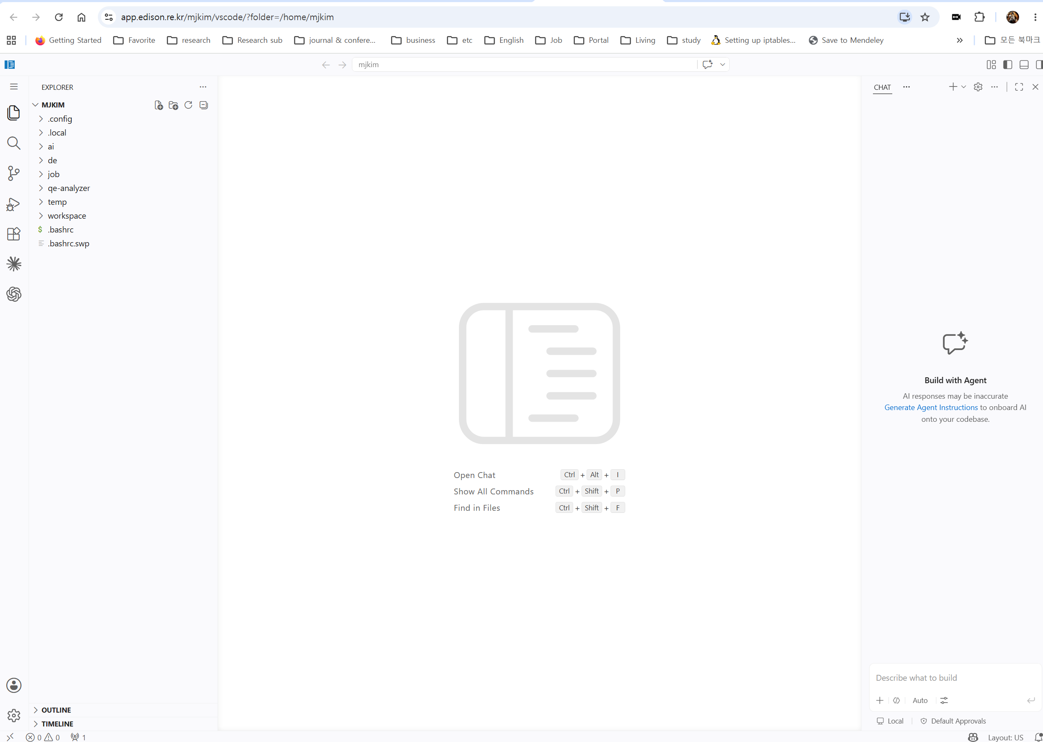
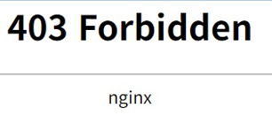
2. VS Code
실행
Waiting until ready: red line to the full
바로 열기 (준비되면 클릭)
Opening warning: “restricted mode is intended …
Check “trust parents folder”
2. Log in
Click VS Code (beta)
VSCode Control
바로열기 click
1. POD restart
VS Code Error

Slide 8

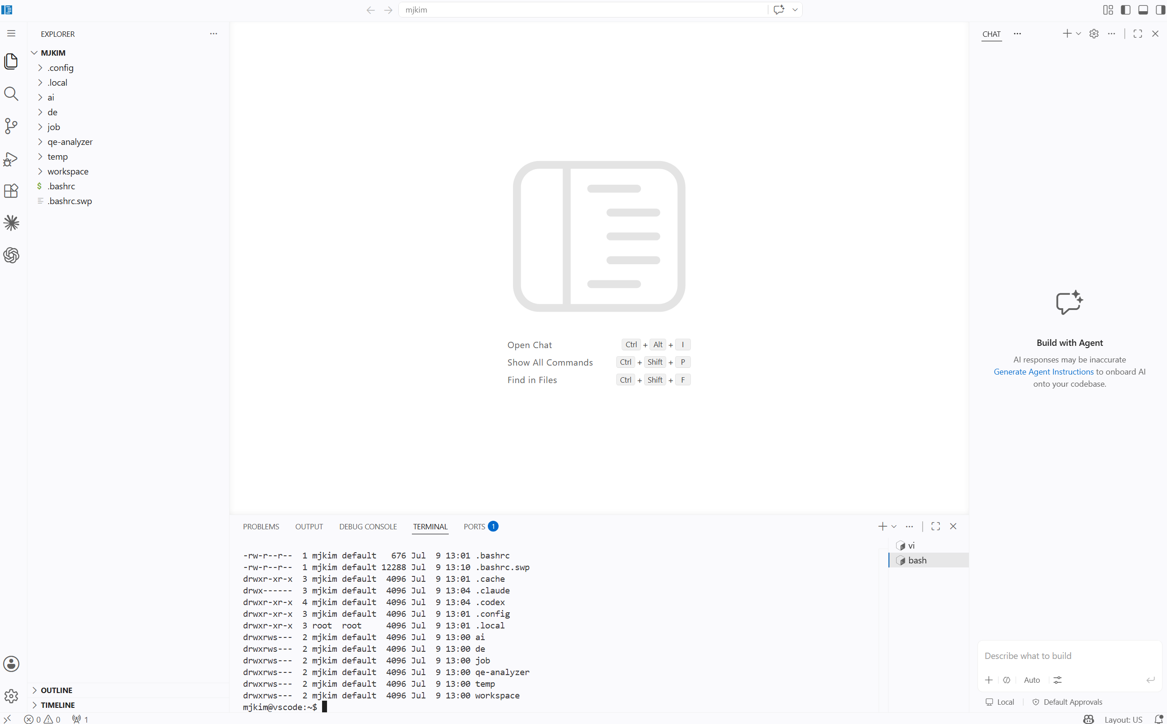
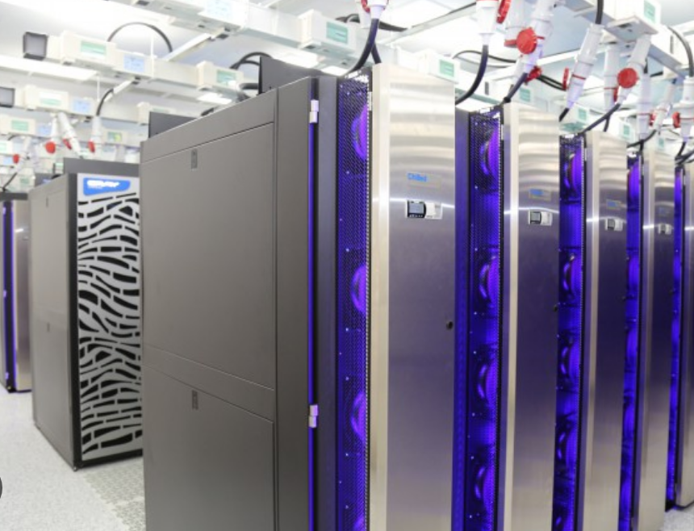
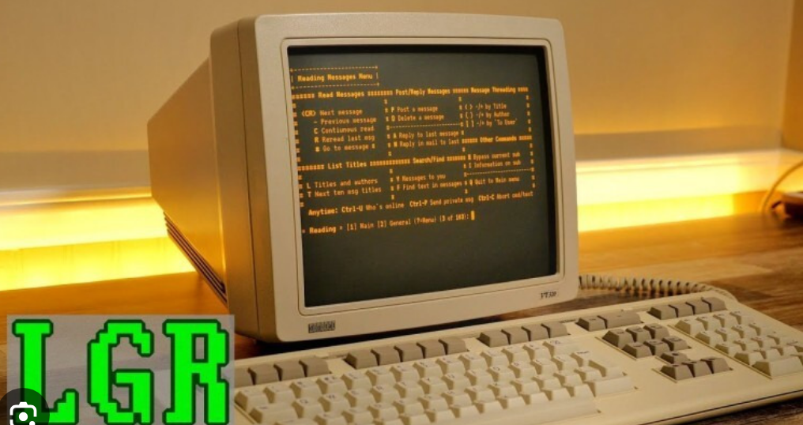
2. VS Code
Panel
Menu (hamburger icon):
Terminal 열기와 화면 분할
편집기
편집기
터미널
PC (ssh client)
MobaXterm
PuTTY

Slide 9
3. Linux
Linux 환경
X-window vs Terminal
terminal: cli (command line interface)
SHELL as operating system
echo $SHELL → /bin/bash
Root vs user
/ # root by root manager
Many other …
/home/userid # User Home
.bashrc # hidden, in case bash
last running script in booting
초기 설정: 터미널 열 때마다
파일 제거 시 재생 안 됨
Basic command
ls # list, 폴더 보기
which ls # find command
echo $var # write
(continued)
Important Env variable & setting
variables
SHELL
bash 이면 .bashrc가 실행됨
PATH
오직 PATH에 잡혀 있는 실행파일만 실행됨
Setting in .bashrc
export PATH=$PATH:new_dir
PYTHONPATH
여기에 잡혀 있는 모든 python modul들은 import 될 수 있음.
cf. 만일 module과 running script가 같은 dir에 있으면 둘 다 잡아줘야 됨.
PS1 # prompt setting
Related command
export var # var 을 광역변수
source script # bash script 실행
source .bashrc

Slide 10
3. Linux
Development tool (command)
git # git 저장소와 연결
git clone repo_address
git pull # inside git repo
conda 설치 (Edison 에서)
conda init # write .bashrc
source .bashrc # conda 실행
cf
conda deactivate
conda activate
sbatch # job을 queue에 넣음
.bashrc 세팅
dir, file 종류 등 색 구별
alias ls='ls --color=auto‘
prompt 색을 바꾸고, dir 표기
export PS1="\[\e[32m\]\u@\h:\[\e[34m\]\w\[\e[0m\] \$ "
Variable setting in bash
Basic command
ls # list, 폴더 보기
-a (all), -l (long) # options
pwd # present working dir
which # find command
echo # write
# no space at both sides of ‘=‘
a=3
b=‘hello’

Slide 11
3. Linux
Basic command
pwd # show present working dir
ls # list, 폴더 보기
-a (all), -l (long) # options
cd # change directory
mkdir # make directory
echo # write
which # find command
rm # remove 파일-glob 이용
-r (recursive) # dir 까지 다 지움
history # 지금까지 명령어 기록
cat, more, less
find
jobs # 현재 실행중인 job
Run job background
ctrl + C In case
Job running foreground
Cannnot recover prompt
Linux special dir name
. # present directory
.. # parent directory
~ # HOME directory
Linux glob symbol
(많은 파일 이름에 matching)
* # 모든 기호에 해당
? # 한 기호에 해당
[ ] # 중 하나에 해당

Slide 12
4. 수업
git
$HOME/ cf. echo $HOME → $home/userid
git clone https://github.com/YHKlab/ESC2026.git
# github.com/yhklab → repo → ESCSchool → copy
$HOME/ESC2026
git pull # 수시로 자료가 update 되면 download
Work directory
cp –r ESCSchool/exe1-atom exe1
cd exe1
Here is work directory for exe1

Slide 13
4. 수업
Python module 설치
현재 설치된 pip을 사용할 경우 홈에도 설치가 안 됨 → error
(conda542) → gcc, gfortran 을 쓸 수 있는 환경 변수
Conda info –envs
Which pip
/opt/miniconda3/bin/pip
pip install wannierberri → can’t write $HOME/.local/lib (permission error)
Install pip in new env
conda create –n myenv # python version, module, etc
$HOME/.conda/envs/myenv
conda activate myenv # still path to /opt/miniconda3
(myenv) conda install pip
(myenv) which pip
$HOME/.conda/envs/myenv/bin/pip
$HOME/.conda/envs/myenv/bin/python
python –version
Use myenv to install modules
pip install wannierberri
python –c “import wannierberri”
pip install pyfftw

Slide 14
4. 수업
Atom
#!/usr/bin/bash
echo "1. Install xml"
wget https://launchpad.net/xmlf90/trunk/1.5/+download/xmlf90-1.5.4.tar.gz
tar xvzf xmlf90-1.5.4.tar.gz
mkdir libs
cd xmlf90-1.5.4
./configure --prefix=$HOME/atom/libs
make -j4
make install
cd ..
echo "2. Install libgrid"
wget https://launchpad.net/libgridxc/trunk/0.7/+download/libgridxc-0.7.6.tgz
tar xvzf libgridxc-0.7.6.tgz
cd libgridxc-0.7.6
mkdir Gfortran
cp extra/fortran.mk Gfortran
cd Gfortran
sh ../src/config.sh # this makes makefile
make
cd ../..
echo "3. atom install"
wget https://siesta-project.org/SIESTA_MATERIAL/Pseudos/Code/atom-4.2.7-100.tgz
tar xvzf atom-4.2.7-100.tgz
cd atom-4.2.7-100
cp ../patch/arch.make .
make

